Slide 1
SNAP CIRCUITS TEACHER MANUAL
Ensure each students’ set has all the necessary parts and working batteries.
Review Snap Circuits prezi and key words
The black numbers show which pieces to put down 1st, 2nd, or 3rd
Have extra batteries, light bulbs, and fans on hand in case any break or stop working.

Slide 2
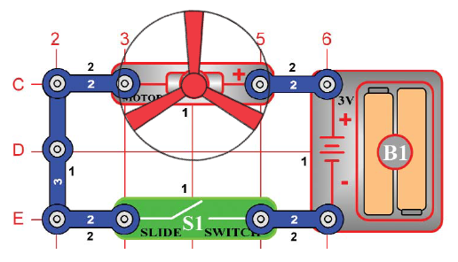
#1 SERIES CIRCUIT with LIGHT
OBJECTIVE: To show how a switch turns an electrical circuit “ON” and “OFF”.
Basic SERIES circuit
Have students trace path of electricity from the battery + terminal through the lamp, through the slide switch (if it is ON), then back into the battery through the – side.
Ask students if electricity would still be flowing if you removed the lightbulb
You don’t have to take it out yet – you wouldn’t see any changes (though electricity would stop flowing).
#2 SERIES CIRCUIT with FAN
OBJECTIVE: To show how electricity can be used to run a Direct Current (DC) motor.
Replace Light with motor and fan. Fan rests on top of motor, does not ‘snap’ in place.
Again, have students trace path of electricity.
When switch is ON, circuit is CLOSED, electricity is flowing. Make sure that the + terminal of motor in next to + terminal of battery.
Fan should not fly off yet.

Slide 3
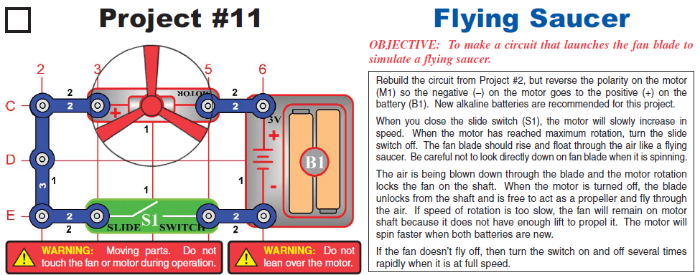
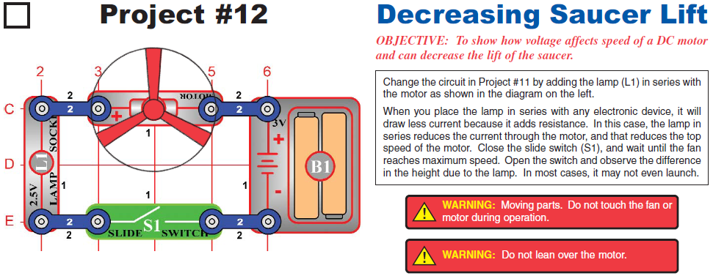
OBJECTIVE: To make a circuit that launches the fan blade into the air to simulate a flying saucer or frisbee.
Rebuild the circuit from Project #2, but reverse motor polarity
Before turning it on, ask the students which direction the fan will spin (same way or opposite, or will it not spin?)
Fan will fly off when the switch is turned OFF after the fan begins going at maximum speed. New batteries might be necessary if the fan does not fly off. Try switching on and off rapidly at max speed.
#3 SERIES CIRCUIT with FAN
#4 SERIES CIRCUIT with LIGHT AND FAN
OBJECTIVE: To show how voltage affects speed of a DC motor and can decrease lift of the fan.
By adding the lightbulb, a significant amount of the CURRENT is used by the lightbulb and in turn the fan does not spin as fast. There is a difference between VOLTAGE and CURRENT, but with younger children simply explaining that the light takes some electricity from the fan is a good start.
Ask the students what will happen if you remove the lightbulb – most will say the fan will spin FASTER – THIS IS WRONG! The circuit becomes open if you remove the light – the electricity has no path to travel in without the lightbulb.

Slide 4
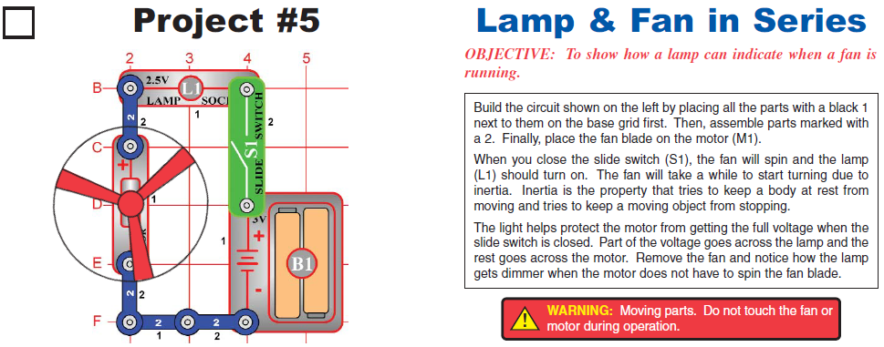
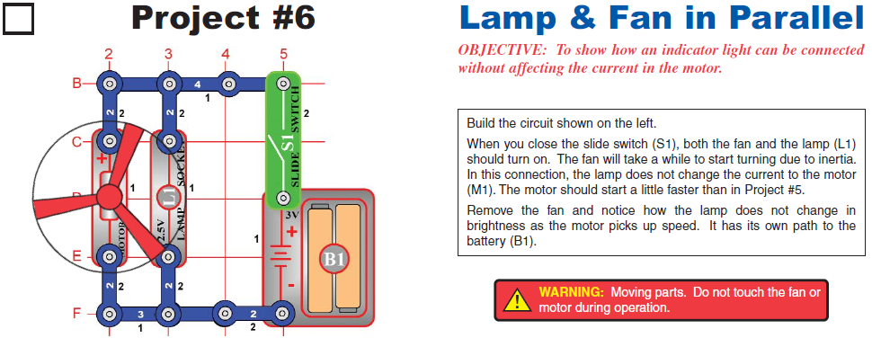
#5 SERIES CIRCUIT with LIGHT AND FAN (Same Parts, Different Arrangement)
OBJECTIVE: To show how a lamp can indicate when a motor is running.
Re-arrangement of the last project, nothing different except for the orientation of the pieces.
BUT – there is a secret message in the students’ packets:
“If you read this, raise your hand and call over a teacher to let them know you’ve been reading the directions. Good work!! Keep it up!”
#6 PARALLEL CIRCUIT with LIGHT AND FAN
OBJECTIVE: To show how an indicator light can be connected without affecting the electrical current to the motor (without decreasing the speed of the motor).
This is the first PARALLEL circuit, meaning the electricity has MORE THAN ONE path to travel in. In this situation, the current through the fan is just the same as it was without the light. The voltage is split between the light and motor + fan, which is why it takes longer to begin to spin.
As students what will happen if you remove the lightbulb.
As students what will happen if you remove the fan from the motor.

Slide 5
#7 PARALLEL CIRCUIT – 2-Speed Fan and Light
OBJECTIVE: To show a parallel circuit with variable (changing) fan speed.
By closing switch S2, the electrical current takes the path of LEAST RESISTANCE – meaning it does not travel through the light any more. This makes the fan spin faster when switch S2 is closed, and slows down when the switch is open and the light is on.
Have students predict and test what will happen if they remove the light bulb and keep switch S2 open (electricity will not flow).
#8 PARALLEL CIRCUIT – Musical Doorbell
OBJECTIVE: To show how a full circuit can be used as a musical doorbell.
Now is when the students begin playing around with making noises and sounds.
You can talk with them about electrical energy becoming sound energy, which is simply vibrations through the air. The electrical energy is used to vibrate plates of metal at specific frequencies, which produces the pitches and sounds you hear.

Slide 6
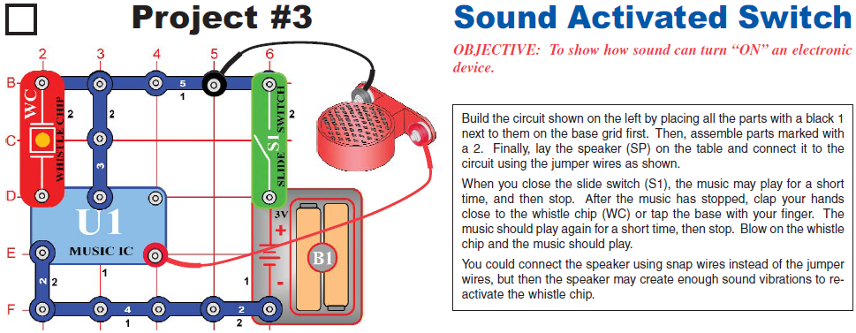
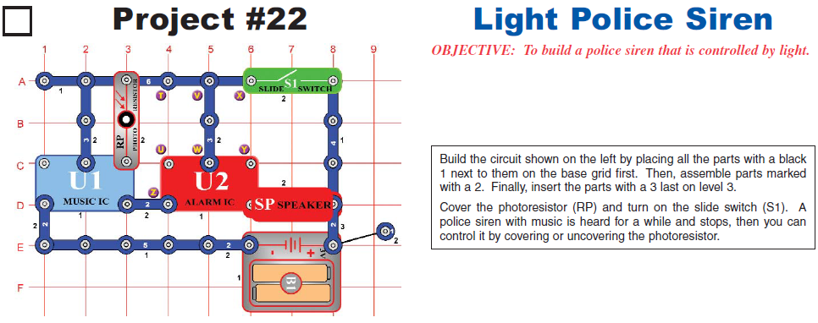
#9 PARALLEL CIRCUIT – Sound Activated Whistle Chip
OBJECTIVE: To show how sound can be turned ON and OFF in an electronic device (circuit).
The whistle chip is meant to be sound activated. If you tap it or clap near it, it should re-activate the circuit for a second.
#10 PARALLEL CIRCUIT – Police Light Siren
OBJECTIVE: To build a police siren activated by light.
The photoresistor is a light-sensitive switch. When you put your finger over the opening, the circuit becomes OPEN an d the flow of electrical current is OFF.

Slide 7
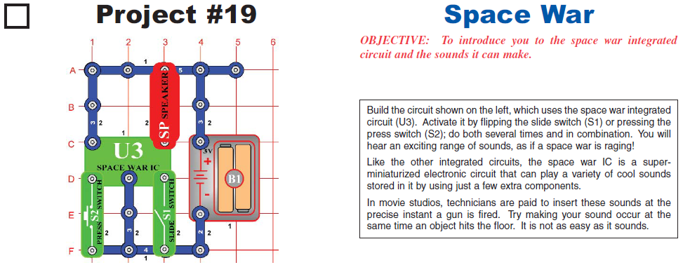
#11 PARALLEL CIRCUIT – Space Wars
OBJECTIVE: To use the space wars circuit to make sounds.
Build the circuit show at left. Close the circuit by flipping the slide switch (S1), or pressing the press switch (S2). Do both several times in combination. You will hear an exciting range of sounds, as if the space war is happening!
The space wars circuit can play a variety of sounds stored inside .
#11.5 Space Wars Light Resistor
OBJECTIVE: To use the space wars circuit to make sounds with a light switch.
Use the circuit you created in Project #11, but replace the slide switch (S1) with the photoresistor (RP). The circuit immediately makes noise. Try turning it off!
If you experiment, you can see the only way to turn it off is to cover the photoresistor (or turn off the lights in the room). Since light is used to turn on the circuit, you might call it a “light switch”.
The photoresister contains material that changes its properties when exposed to light. As it gathers more light, the material becomes better at carrying electrical current. For example, street lights use this technology to know when it is dark out and when the light should be turned on and off.

Slide 8
These are the questions they can answer after the activity:
What is the difference between a series and parallel circuit?
A series circuit has only one path in which the electricity can travel. A parallel circuit has more than one path in which the electricity can travel. In a parallel circuit, if the lightbulb breaks then electricity can continue to flow in the other path. In a series circuit, if one light breaks then the entire circuit stops working.
If you add a light to a circuit, what will that do to the other parts connected to the circuit?
Adding a light will reduce the amount of electricity that flows to the other parts of the circuit, which will make them spin slower in the case of the motor. The light takes up current from the circuit, and acts as a resistor to the flow of electricity.
How does a lightbulb act as a switch in a circuit?
A lightbulb is like a switch because if you remove it, the circuit becomes open and electricity cannot flow though. If the lightbulb is in place, the switch is closed and the circuit has current flowing through it.

