Slide 1
2018 GE Girls Northeastern University

Slide 2
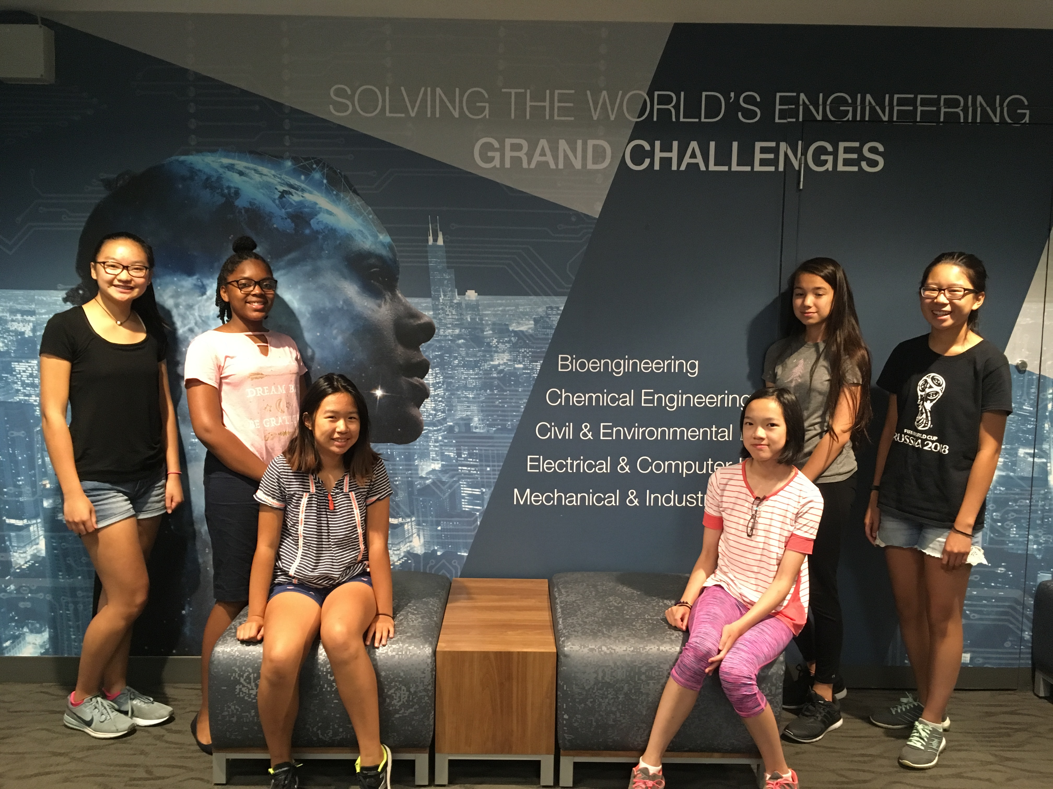
Team
Laylah
Dominique
Amy
Chloe
Ashley
Lia

Slide 3
Key things we learned about Engineering, the Engineering Design Process, and Engineering pathways
Engineering Design Process – Ask, Imagine, Design, Create, Improve
Paper Towers
Different Engineering Pathways – Chemical, Industrial, Aviation, Biomedical, Environmental, Electrical, Healthcare

Slide 4
Key things we learned about aviation and GE’s work in aviation
Most engines are built by GE
All Southwest planes use engines by GE
Physics of planes – thrust, drag, gravity, lift
Turbines are made from nickel
5,000 commercial flights in the US at a time
9,000-10,000 commercial flights worldwide
87,000 flights per day

Slide 5
Key things we learned about Healthcare and GE’s work in healthcare
Cell therapy
More accessibility
Ultrasound
Visit to GE Healthcare
Strawberry DNA
Milk and protein extraction
Machines

Slide 6
Key things we learned about Power/Renewable Energy
Solar panels
Climate change
Snow
Storms
Summers
Wind Turbines
Hydropower
We have 100 years left using our fossil fuels

Slide 7
As a team, what we want to learn more about..
Future career opportunities
Computer programming/AI
The future of cell therapy
The future of renewable energy

