Slide 1
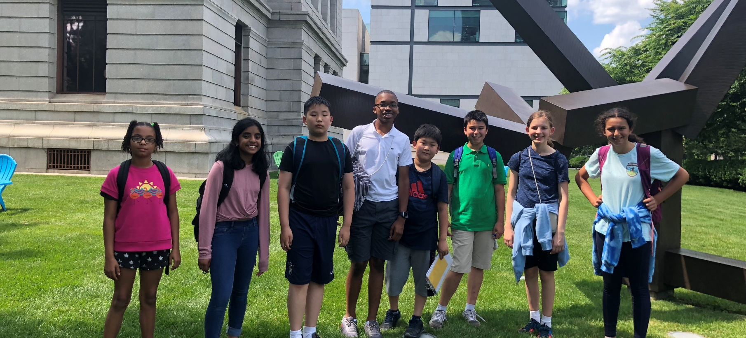
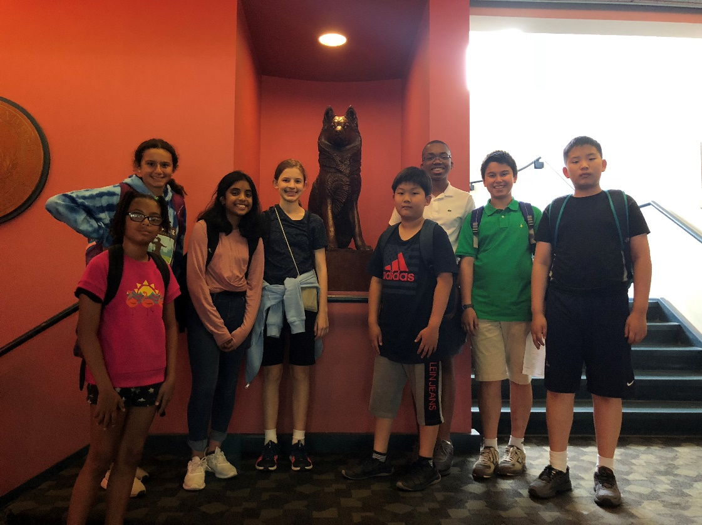
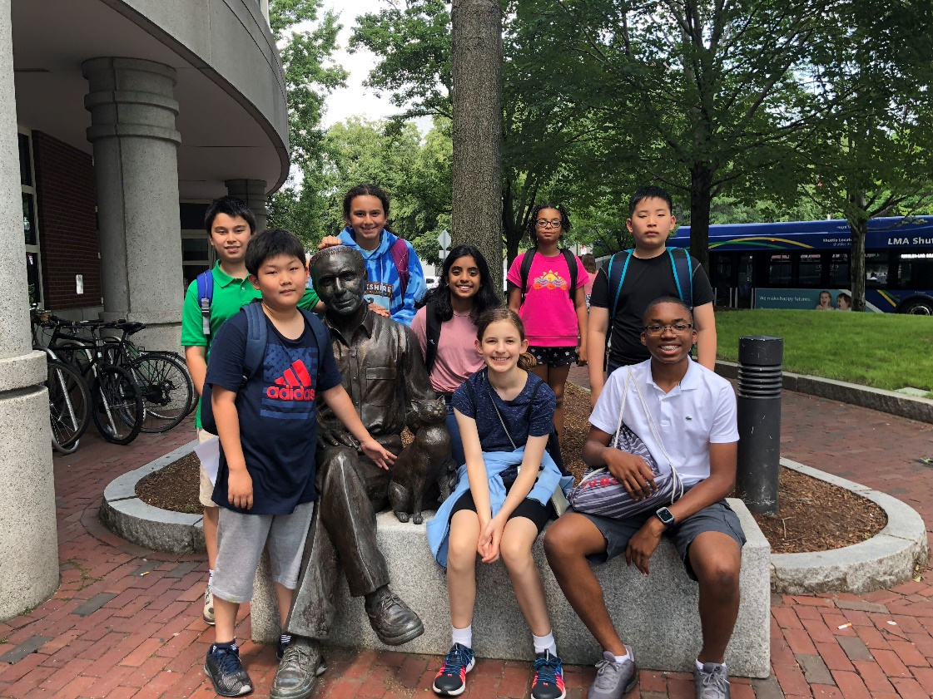
SUPERCALIFRAGISLISTICEXPIALIDOCIOUS
ELISABETH, KEIRA, RIYA, KAILANI, JORDAN, KEVIN, KYLE, JIHWAN

Slide 2
RESILIENCE
Resilience is how fast you can bounce back after being damaged.
What is Urban Resilience / How does resilience relate to cities?
Urban resilience is the ability for a city to recover after a disaster
Notes:
Speaker: Keira

Slide 3
SUSTAINABILITY
Sustainability is being able to maintain a state for a long time period without declining(Continuous resilience)
What is Urban Sustainability / How does sustainability relate to cities?
Urban sustainability is the ability for a city to repeatedly bounce back effectively.
Notes:
Speaker: Elisabeth

Slide 4
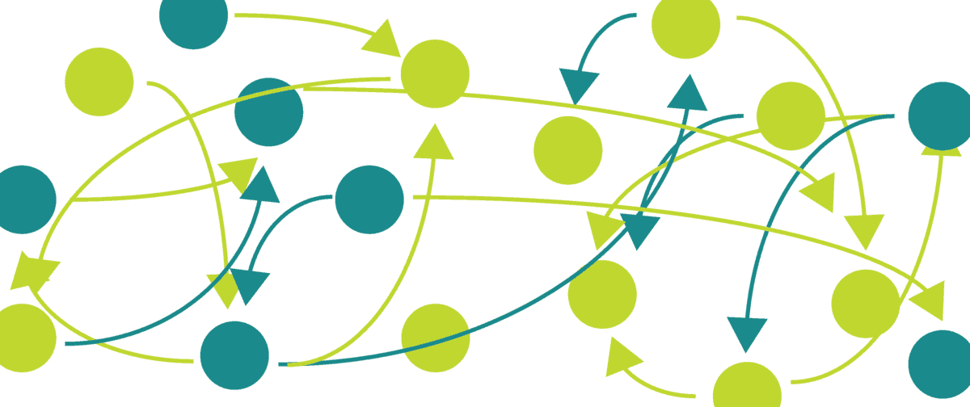
SYSTEM THINKING
Why is systems thinking important to help urban resiliency?
You can think of all aspects that are in your city
They can help you find all possible problems in your city
You can better weigh pros and cons
Source:
https://kindling.xyz/next-systems/donella-meadows-systems-thinking/
Notes:
Speaker: Kyle

Slide 5
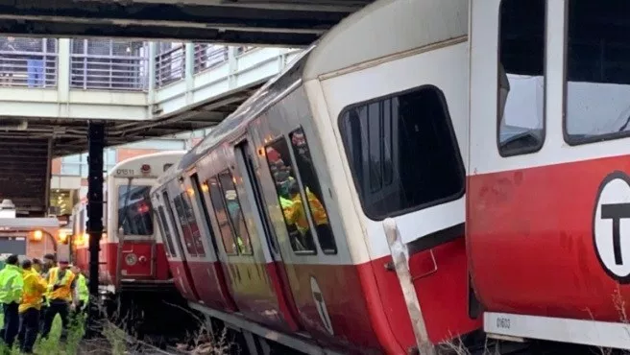
BOSTON & HURRICANES
Source:
https://www.wpri.com/new-england/massachusetts/boston-commuter-trolley-derails-during-morning-commute/
Why is Boston at risk for hurricanes?
There are a lot of pot holes in the highway so this would lead to water getting trapped in them; this will contribute to flooding
Some parts of Boston only has one way in, so if the tunnel/bridge connecting to Boston collapses then there is no way out.
Boston doesn’t have infrastructure “Hurricane ready” so, if there were a hurricane it would be devastating.
Most of Boston’s buildings are old so they are weakened
Boston is on the coast
Notes:
Speaker: Jordan

Slide 6
Effects on Transportation in Boston
How might a hurricane affect transportation in Boston?
Can’t drive, take a bus(you would hydroplane), planes, trains, or boats
Airports and Boston Harbor will be closed
Transportation to hospitals might be limited
Highways and bridges will be affected
Notes:
Speaker: Riya

Slide 7
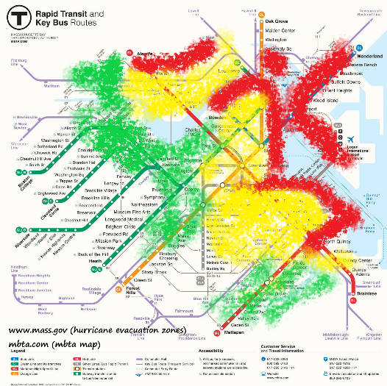
Resiliency/Sustainability of Transportation in Boston
What currently makes Boston a resilient/sustainable city in terms of transportation?
Center of MBTA is the highest part of Boston (population…)
Transportation that can go out of Boston
More rails of MBTA to go to safer towns and cities
Logan airport is one of the largest airports
There are a lot of ways to get out of Boston (MBTA and Uber, Lyft)
MBTA more safe, trains don't go over the speed limit.
Make houses more stable for hurricanes
Sources:
www.mass.gov
Mbta.com
Notes:
Speakers: Kailani & Jihwan

Slide 8
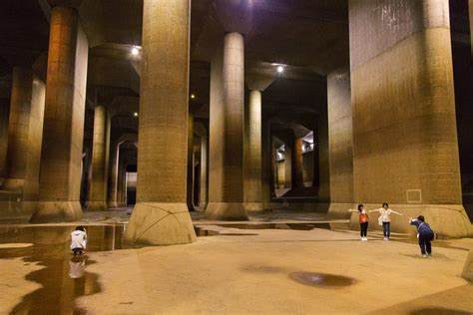
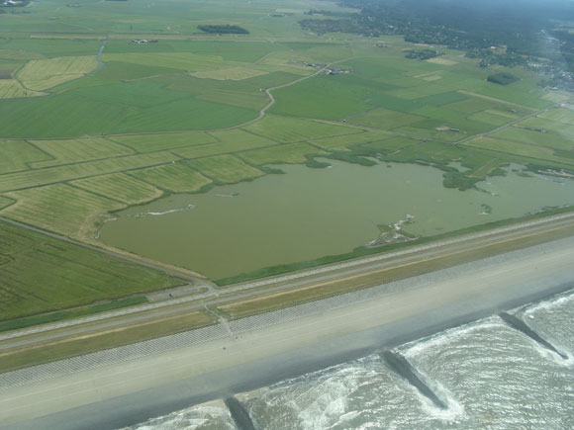
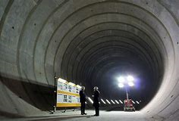
Resiliency/Sustainability Improvements
sloped highways so that rain would not pool on the highways
levees to stop the water
use parks or public spaces as emergency reservoirs
tunnels and cisterns to divert flood waters
stronger building materials and stricter building codes
How might resiliency/sustainability in Boston be improved in regards to TRANSPORTATION?
Sources:
https://www.nytimes.com/2017/10/06/climate/tokyo-floods.html?emc=edit_th_20171007&nl=todaysheadlines&nlid=67172636&_r=0
https://www.bing.com/images/search?view=detailV2&id=8CA99CB66DF6439A1B4E36FDDBB8D8556514875A&thid=OIP.1SypQ-s4pdXQ8noLnlBFHwHaFj&mediaurl=https%3A%2F%2Fwww.wired.com%2Fwp-content%2Fuploads%2Farchive%2Fimages%2Farticle%2Fmagazine%2F1701%2Fff_dutch_delta_levees_f.jpg&exph=435&expw=580&q=netherlands+levees&selectedindex=6&ajaxhist=0&vt=0&eim=1,2,6
https://www.bing.com/images/search?q=tokyo+typhoon+tunnels&form=HDRSC2&first=1&cw=1129&ch=946
Notes:
Speakers: Kevin & Elisabeth

Slide 9
NUSSP - Takeaways
Notes:
Speakers: Everyone

Slide 10
Jordan Macarty
Jihwan Lee
Riya Methratta
Kailani Deeran
Sources:
https://www.mpo-mag.com/contents/view_top30/2017-07-26/3-ge-healthcare-836277
http://www.mwra.com/03sewer/html/sewdi_access.htm
https://www.pinterest.com/pin/329044316503804637/
https://www.vectorstock.com/royalty-free-vectors/meeting-engineer-operator-vectors

Slide 11
Kyle Denny
Kevin Wang
Keira Finn
Elisabeth van Reijendam
Sources:
https://waterworksmuseum.org/about
https://www.cityofwestsacramento.org/Home/Components/News/News/1171/
https://www.bwsc.org
https://www.nrdc.org/issues/stop-overfishing-and-restore-fisheries

Slide 12
Thank you!

