Slide 1
Summarization Using Artificial Intelligence
Amina Naidjate, YSP Student, Al-Noor Academy
Alejandro Gardinier, YSP Student, Arlington High School
Zijia Lu, Ph.D. Student, Northeastern University
Yuhan Shen, Ph.D. Student, Northeastern University
Dr. Ehsan Elhamifar, Electrical and Computer Engineering, Northeastern University
Notes:
Good Morning everyone, my name is Amina I go to ANA
And my name is Alex I go to Arlington High
And together, under the mentorship of Zijia Lu and Yuhan Shen, PHD students, we worked in Professor Ehsan Elhamifar’s lab on Summarization Using Artificial Intelligence

Slide 2
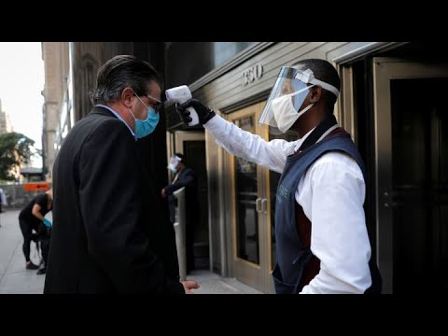
Notes:
Show the first 45 seconds of the video

Slide 3
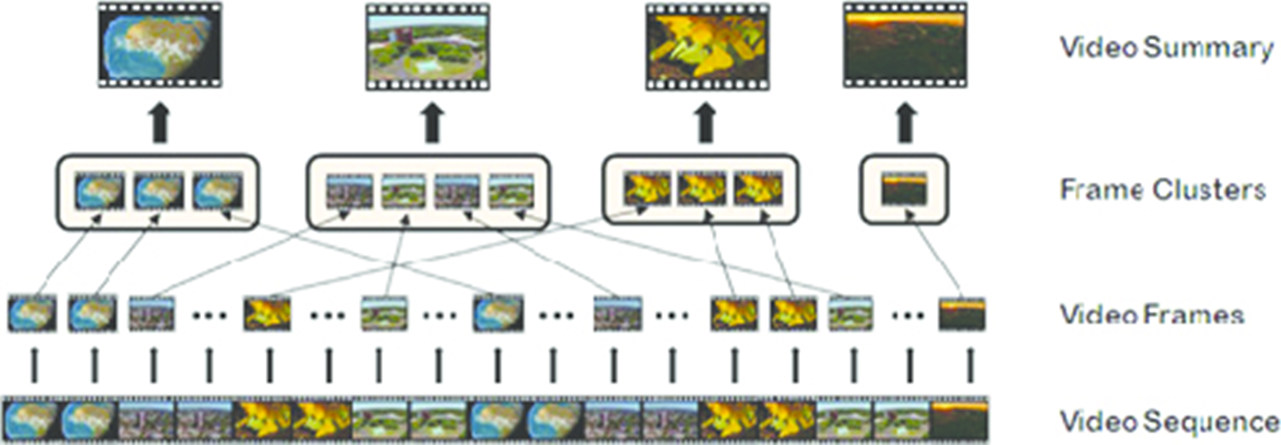
Introduction
Humans have the ability to summarize large amounts of abstract data
How can computers be programmed to automatically select the frames most representative of a video through deep learning?
What combinations of features like PCA and K-means will provide the highest accuracy and efficiency?
Figure 1. A visual outline of the video summarization process. The video is broken into frames which are grouped into scenes based on pixel similarity, and one frame per cluster is chosen to represent the scene.
Notes:
Purpose is to explore automatic methods based on artificial intelligence to summarize large collections of data in visual media

Slide 4
Experimental Methods
K-means Algorithm, RGB Feature, PCA Component, & Resnet-50

Slide 5
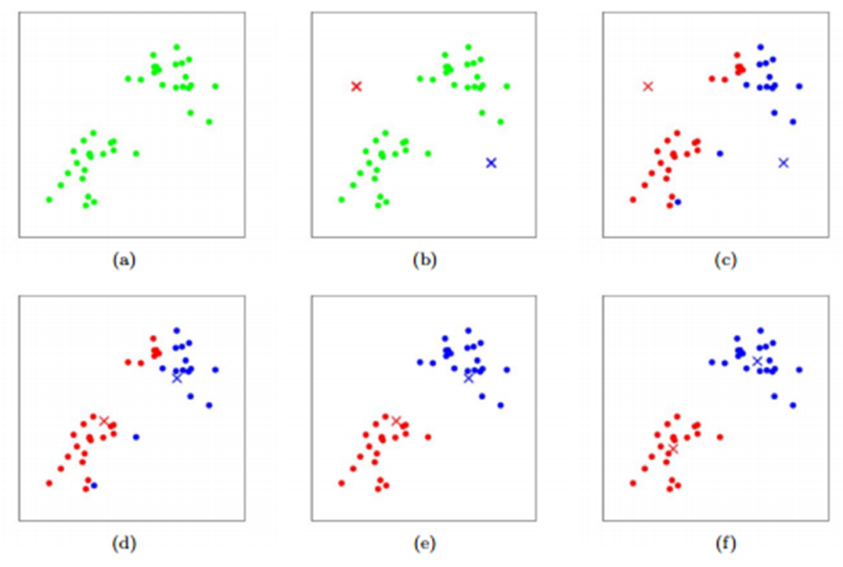
K-Means Clustering
K-means is a centroid-based algorithm that can classify data points into clusters based on similarity
Number of Ks is chosen, centroids are plotted
Determines which centroid each point is closest to, calculates average, and moves centroid to average
Figure 2. K-means algorithm. Data values are shown as dots, and cluster centroids are crosses. (c-f) shows the running of two iterations of the algorithm.
Notes:
The process is repeated until the variance between the points and the cluster center is minimal

Slide 6
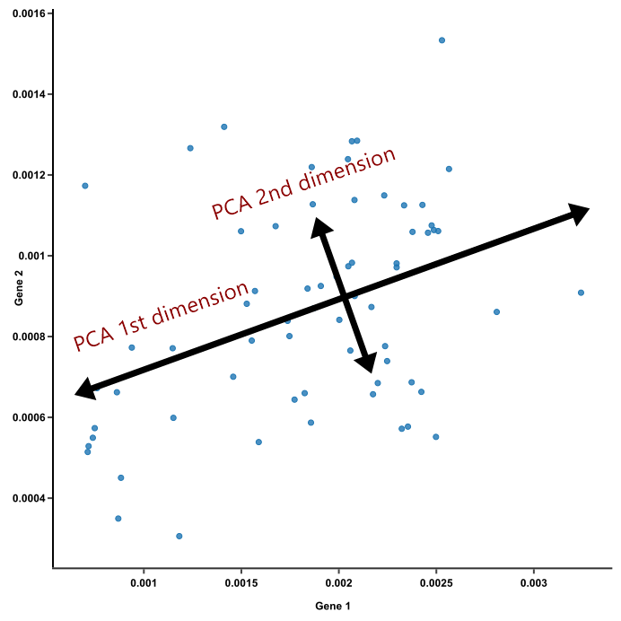
RGB & PCA Component
RGB
Computers use red, green, and blue to make every color
Each pixel in each frame was assigned a R, G, and B value → compared to other frames’ RGB values
Frames with similar values = same cluster
PCA Component
PCA is a dimensional reduction tool to improve the efficiency of code and limit redundant dimensions
Experimented with limiting the PCA Component to 128 dimensions (PCA-128) and 32 dimensions (PCA-32)

Slide 7
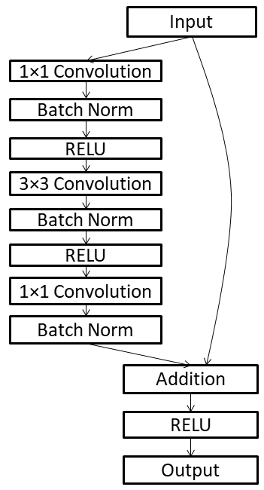
ResNet-50
ResNet-50 is a deep neural network in a subclass of convolutional neural networks used for image recognition
Consists of 50 layers and solves complex operations that increases the recognition and classification accuracy of images
Both color and object-oriented reading
Notes:
, short for Residual Network-50,
PCA builds solely off of the RGB method, ResNet-50 also uses an object, not just color, oriented approach
Illustration of a typical residual block of ResNet (50 layers), where each layer consists of Convolutional (conv), Rectified Linear Unit (RELU) and Batch Normalization (Batch Norm) layers.

Slide 8
Results

Slide 9
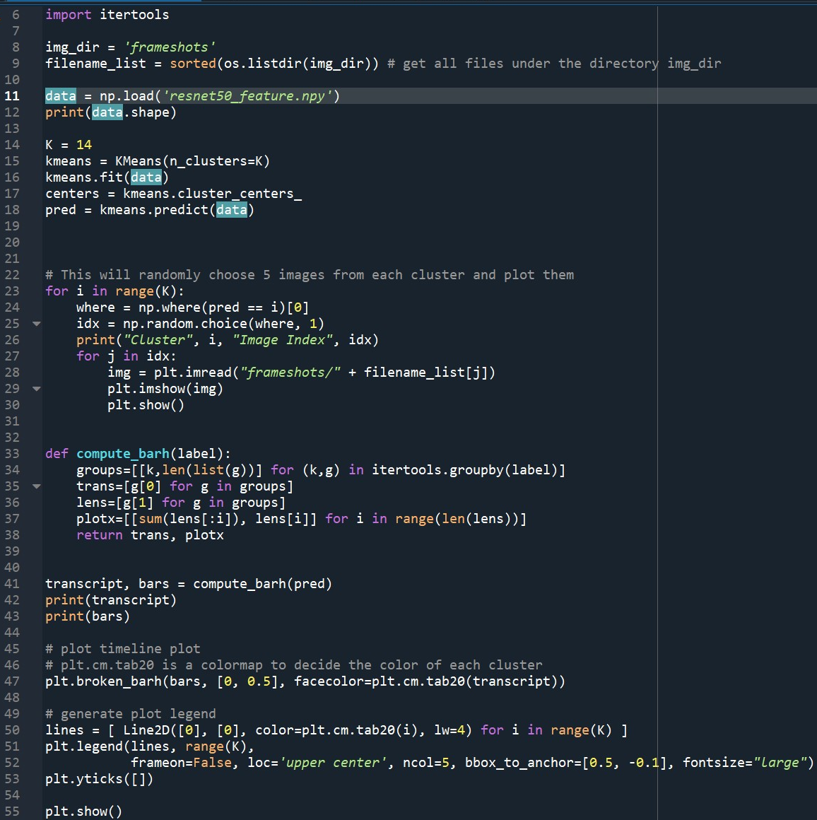
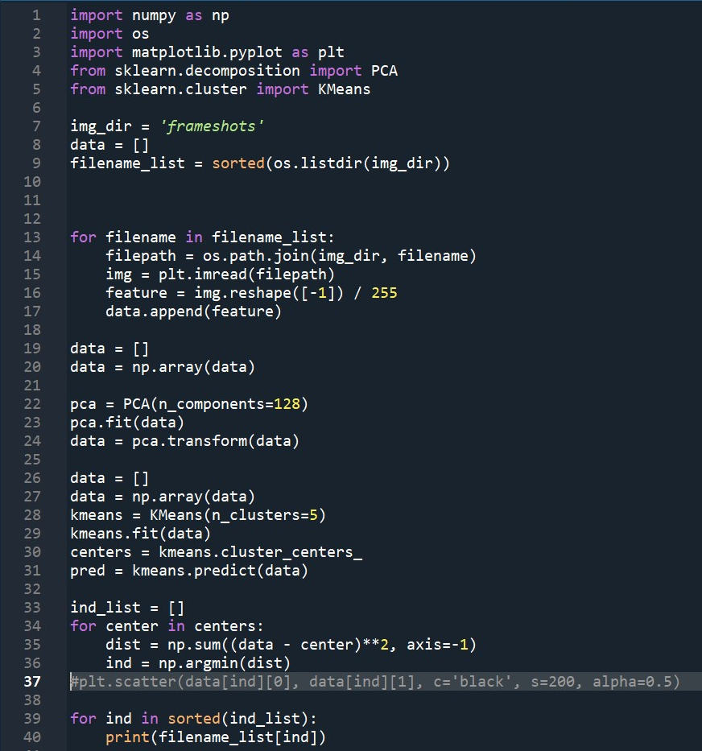
Figure 3. Fragments of Python code used. On the left is the ResNet-50 code, and on the right in the PCA-128 code. Python extensions such as Numpy, Matplotlib, SciKit, and itertools were used.

Slide 10
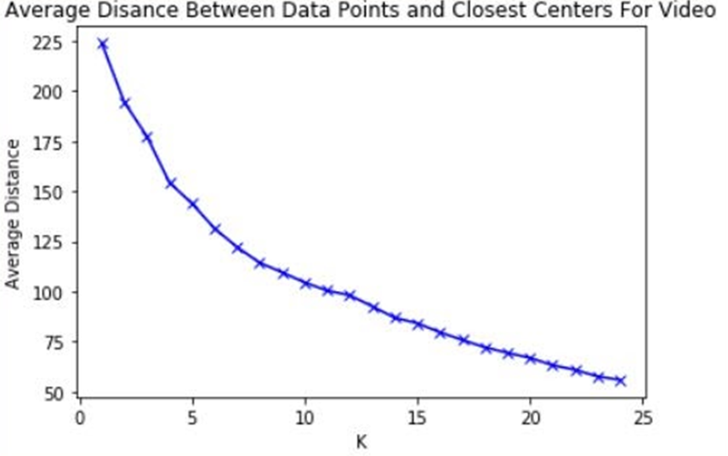
K-means Accuracy Curve
Figure 4. K-Means accuracy curve. As K increases, the average distance decreases, but once the graphs hits the “elbow point”, the average distance lost for each cluster added minimizes. It’s inefficient for the computer to compute new clusters for minimal gain, so the optimal K is at the elbow point.
Notes:
While it intuitively seems like the highest K will yield the best result, that is not the case. As K increases, the average distance decreases (variance), but once the graphs hits the “elbow point”, or the point where the slope drastically flattens, the average distance lost for each cluster added minimizes. It becomes inefficient for the computer to compute new clusters for minimal gain, so the optimal K is the one found on the elbow point. In this case, it is 14, as there are 14 scenes in the video being summarized.

Slide 11
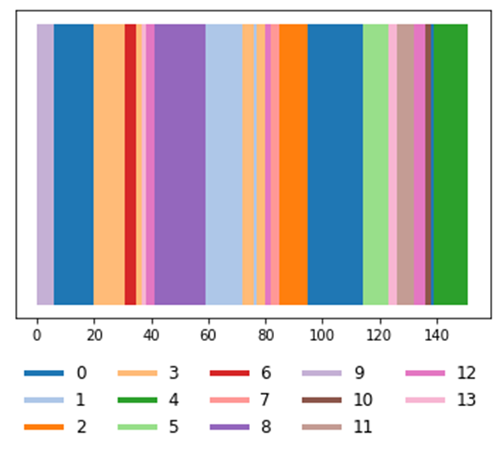
Figure 5. Timeline plot for cluster frequency. On the x-axis are the frame numbers (151 total) and each cluster (14 total) is represented by a bar of color .
Notes:
Clusters are not always comprised of successive frames in the video; frames 5 to 20 and 95 to 115 are grouped into Cluster 0 though they are far apart.
Many times, this is due to inaccuracy on the computer’s part, but in this case, it is correct since US Secretary of Health and Human Services Alex Azar is seen talking in frames belonging to both regions.

Slide 12
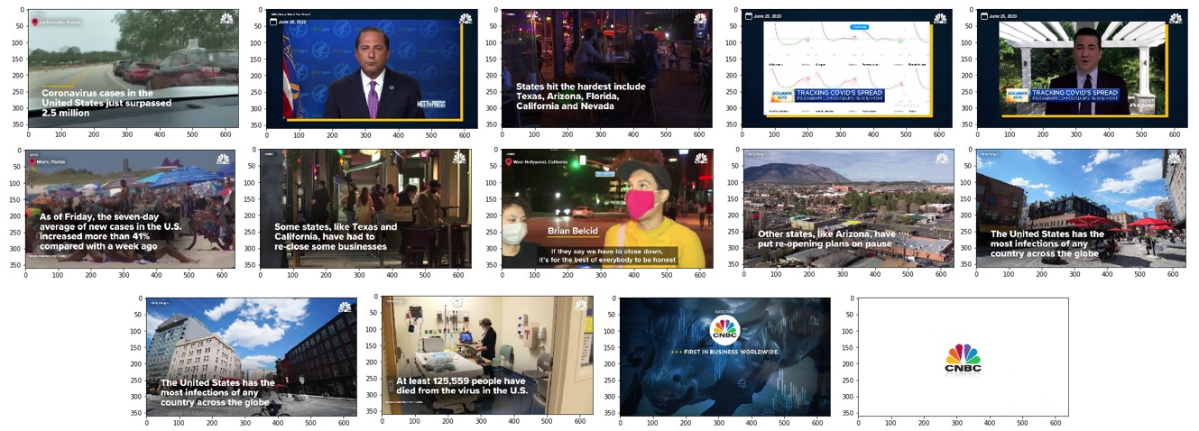
Figure 6. Representative Frames. Above are the 14 frames chosen by the computer as the most representative images of the video in a ResNet-50 test run.
Notes:
While the process was not perfect (images 10 and 11 are from the same cluster and there is a scene left unrepresented), it does give an accurate and helpful depiction of what is mentioned in the video.

Slide 13
Table 1. Accuracy and efficiency of different methods. All four methods have similar accuracies but the RGB feature has the highest. However the RGB feature takes a significantly longer time than the other features to load. The ResNet-50 feature, with a very similar accuracy, was the fastest to determine the representative frames.
Notes:
hough all four methods have such similar accuracies to the point where discrepancies are statistically insignificant, the RGB feature has the highest. But the RGB feature takes a significantly longer time than the other features to load, largely because it goes through all 691,200 of its dimensions compared to just the 32 of PCA-32, 128 of PCA-128, or 2048 of ResNet-50. On the other hand, the ResNet-50 feature, with a very similar accuracy, was the fastest to determine the representative frames, and nearly 84 times quicker than the RGB feature.

Slide 14
Conclusions
Computers can be taught to summarize large amounts of data through algorithms like K-means
The optimal number of Ks (14) is the value found on the “elbow point” of the accuracy curve
All four features had nearly identical accuracies
The higher the number of dimensions considered is, the longer it takes to compute. The feature with the highest performance in relation to its computing time is ResNet-50
While this process is not infallible and much can be improved on, it does serve the purpose of summarization. It’s a practical method that follows human logic and performs relatively quickly
Notes:
machine learning algorithms Though the RGB feature produced the most accurate results, its accuracy was so similar to the others’ that the differences were statistically insignificant

Slide 15
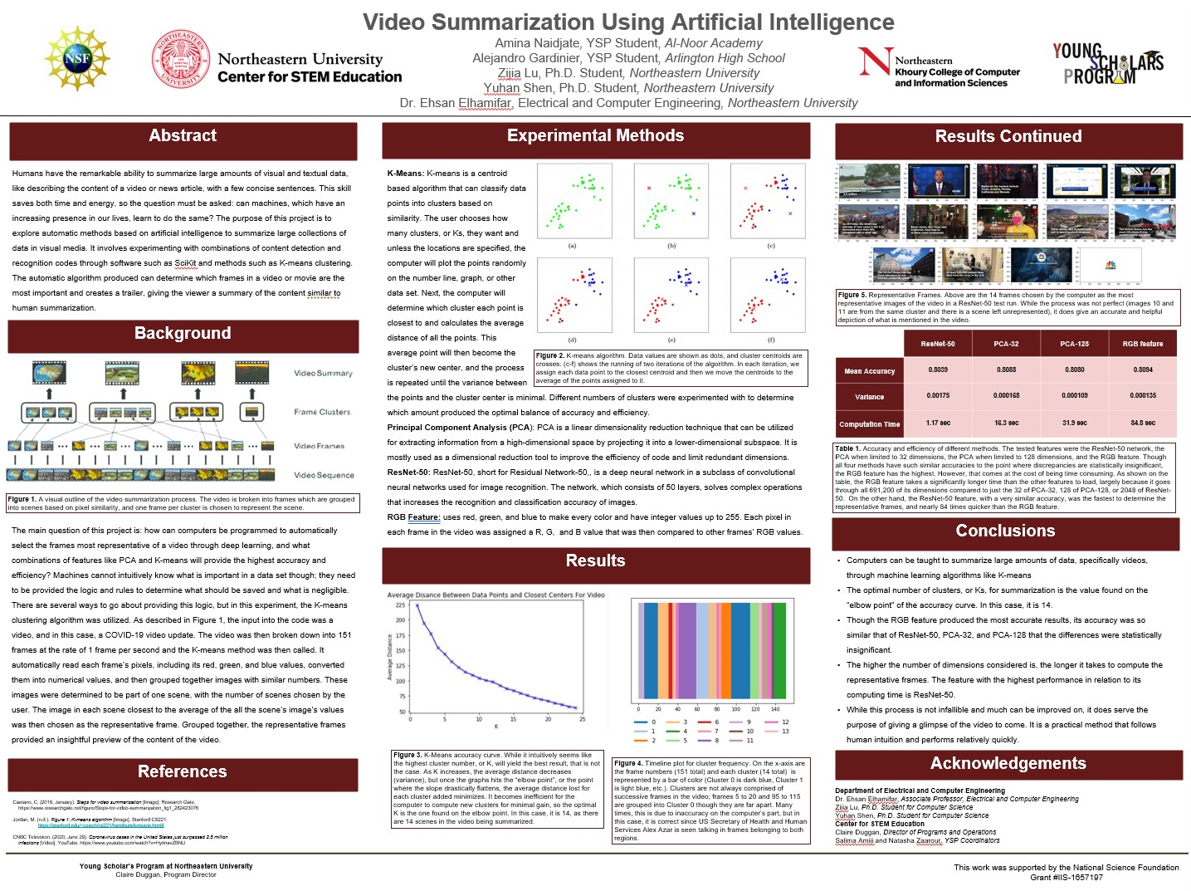

Slide 16
Acknowledgements
Department of Electrical and Computer Engineering
Dr. Ehsan Elhamifar, Associate Professor, Electrical and Computer Engineering
Zijia Lu, Ph.D. Student for Computer Science
Yuhan Shen, Ph.D. Student for Computer Science
Center for STEM Education
Claire Duggan, Director of Programs and Operations
Salima Amiji and Natasha Zaarour, YSP Coordinators
Nicolas Fuchs, Project Implementation Coordinator

Slide 17
References
Caetano, C. (2016, January). Steps for video summarization [Image]. Research Gate.
https://www.researchgate.net/figure/Steps-for-video-summarization_fig1_282423076
Jordan, M. (n.d.). Figure 1: K-means algorithm [Image]. Stanford CS221.
https://stanford.edu/~cpiech/cs221/handouts/kmeans.html#
CNBC Television. (2020, June 29). Coronavirus cases in the United States just surpassed 2.5 million
infections [Video]. YouTube. https://www.youtube.com/watch?v=HyttnavZBNU
Sultana, N. N. (n.d.). Fig2 [Photograph]. ResearchGate. https://www.researchgate.net/figure/
Illustration-of-a-typical-residual-block-of-ResNet-50-layers-where-each-layer-consists_fig1_326372957

