Slide 1
Leveraging Parallel Processing for Advanced Graph Computations
Professor: David Kaeli & Mentor: Kaustubh Shivdikar
Dept. of Electrical and Computer Engineering
Ayman Alabbasi - Computer Science

Slide 2
Leveraging Parallel Processing for Advanced Graph Computations
Who Will This Benefit? | Research Hypothesis | Progression | Research Activities | Goals/Mission Objectives
The current graph neural network would benefit a wide variety of sectors | In essence it’s all about efficiency and production |  | We will be using an inhouse simulator known as NEURASIM | The goal is to accelerate various machine learning workloads
Parallel computing accelerates tasks in finance, healthcare, and scientific research | We re engineer on chip communication to speed up GNN’s |  | This will accelerate exascale graph workloads | While also lowering execution time for a more functional review
Also social network analysis, traffic prediction, and computer vision | Communication is a bottleneck for Graph Neural Networks |  | All while visualizing the data for a more comprehensive assessment | The mission is to democratize Graph Neural Network accelerator development
X
X
X
To do
In progress
Done
Visualization Project
Studying With Data Visualization
Comprehension

Slide 3
Leveraging Parallel Processing for Advanced Graph Computations
What is Python?
01
03
Why Python?
Python, is a versatile programming language used for its simplicity and readability. It enables developers to write clear, concise, and efficient code, making it ideal for various applications.
Python is popular among programmers because of its ease of use, readability, and large community support. Its vast libraries and frameworks make tasks easier to complete, allowing for quick development, data analysis, and machine learning applications.
Python is a popular choice across sectors because it has applications in web development, data analysis, machine learning, automation, scientific computing, artificial intelligence, game development, and scripting.
Python's 'multiprocessing' and 'concurrent.futures' modules facilitate parallelism, enabling users to process data in parallel, reducing execution time for computationally intensive tasks.
02
04
Applications?
Parallel Python

Slide 4
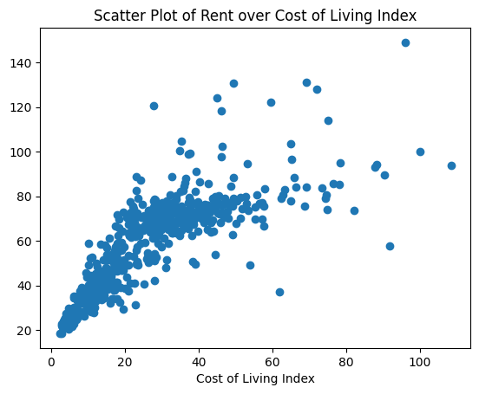
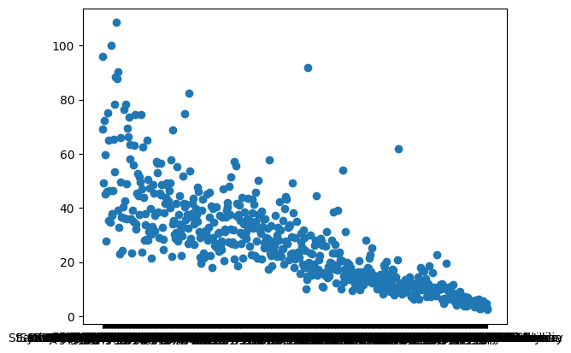
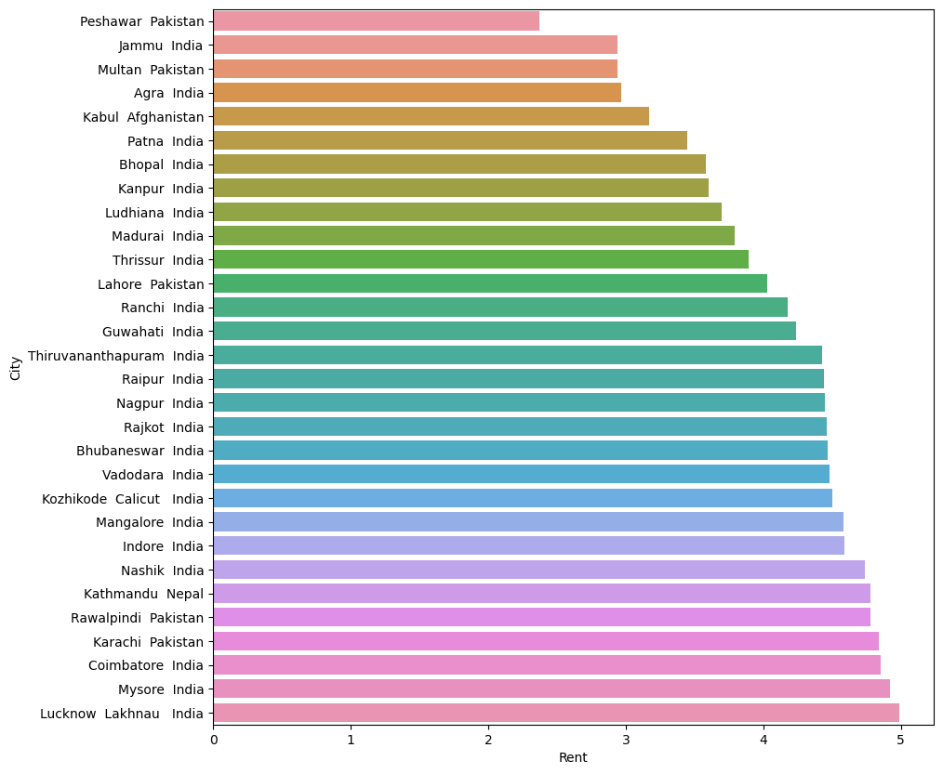
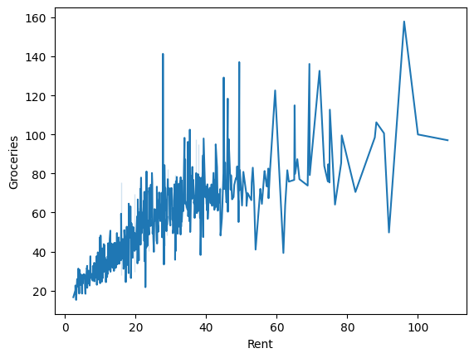
Leveraging Parallel Processing for Advanced Graph Computations
1
2
Visual Studio Code
Cost of Living
VS Code is a great IDE for data visualization due to its extensibility, rich ecosystem, and interactive debugging capabilities.
We utilized the 2022 Cost of Living Index as our dataset to analyze and compare living expenses across different locations.
3
4
Sorting
Data Visualization
We sorted a list of countries based on various indices including Cost of Living, Rent, Groceries, Restaurant Price, and Local Purchasing Power.
What we've learned is how to load a dataset, organize and view your data using Pandas, and several ways to visualize data in Python.

Slide 5
Leveraging Parallel Processing for Advanced Graph Computations
Graph Neural Network
Machine Learning
Machine learning is a branch of artificial intelligence that enables computers to learn and make predictions from data without explicit programming.
The benchmark suite enables comprehensive evaluation of GPU performance in training Graph Neural Networks, aiding optimization and comparison efforts.
Benchmark Suite
Deep Learning
The benchmark suite assesses GPU performance for training Graph Neural Networks, facilitating optimization and comparison endeavors.
Deep learning is a subset of machine learning that uses artificial neural networks to model and solve complex problems, mimicking human brain processes.
Expense Tracker
PyTorch
Implemented a comprehensive expense tracker in Python that efficiently tracked and managed various expense categories including transportation, food, fun, and household. The project aimed to provide users with a user-friendly interface for recording and analyzing their expenses.
PyTorch is a popular open-source machine learning framework that enables efficient computation and dynamic neural network building for researchers and developers.

Slide 6
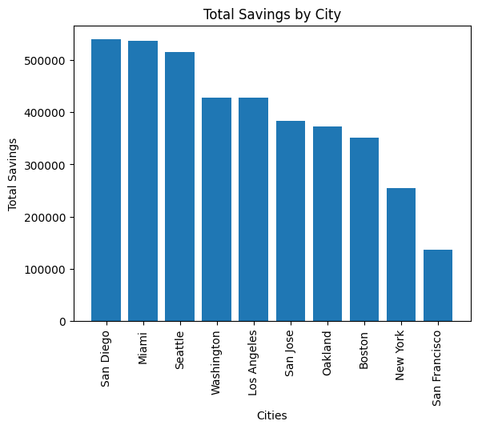
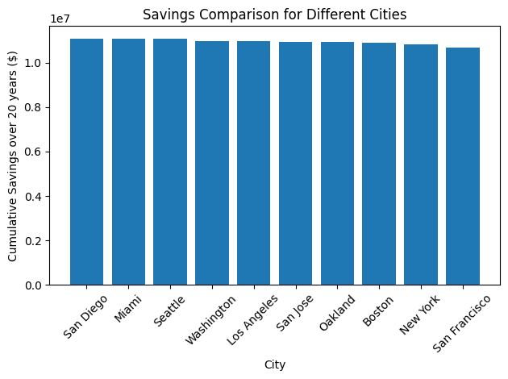
Leveraging Parallel Processing for Advanced Graph Computations
Our Result
AI
Problem
Choose what city gives us the most savings over a 20 year period considering these factors.
* The cities are "San Francisco", "New York", "Boston", "Oakland", "San Jose", "Los Angeles", "Washington", "Seattle", "San Diego", "Miami"
* The rent in each city is respectively [3500, 3000, 2590, 2500, 2450, 2260, 2260, 1890, 1790, 1800]
* Your standard yearly salary is 48,000
* You receive a monthly bonus 3/10 of the city you are living in monthlies rent
* The bonus is only active for the first two years
* Groceries cost 1/100 of the city you are living in monthlies rent
* You are currently at Boston
* To relocate to another city you must pay a $10,000 fee
* All cities except Boston must pay the fee since you are already in Boston
* You are only allowed to move once
* you must live in each city for at least a year
* List each city in order from greatest savings over 20 years to least
* Write a python code that will produce these results and plot them
The Human vs. AI
AI Result
Human

Slide 7
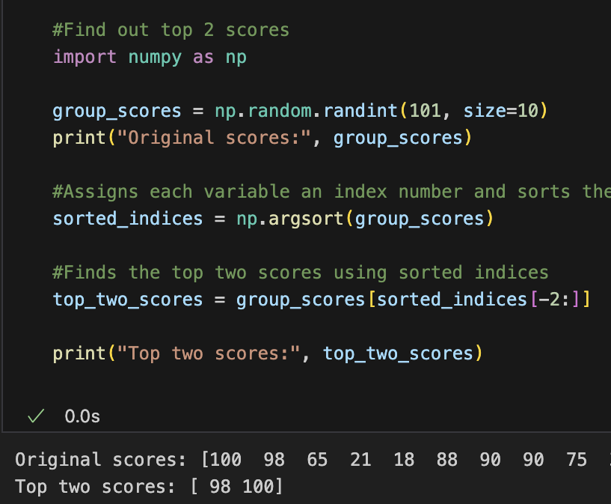
Leveraging Parallel Processing for Advanced Graph Computations
Construction
Top K Algorithm
Explanation
Efficiently find K largest elements in a dataset, reducing time complexity using data structures
We created a group of 10 random integers and using argsort could determine the top 2 scores within the list
01
03
02

Slide 8
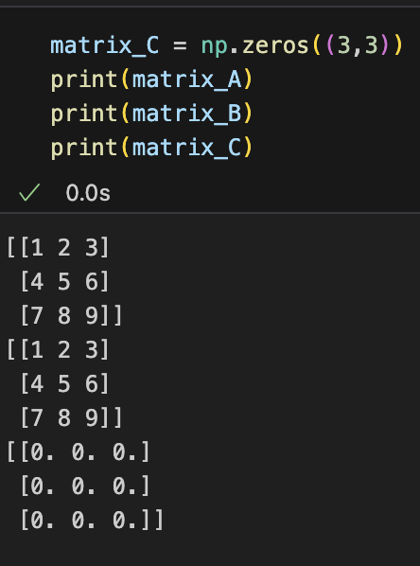
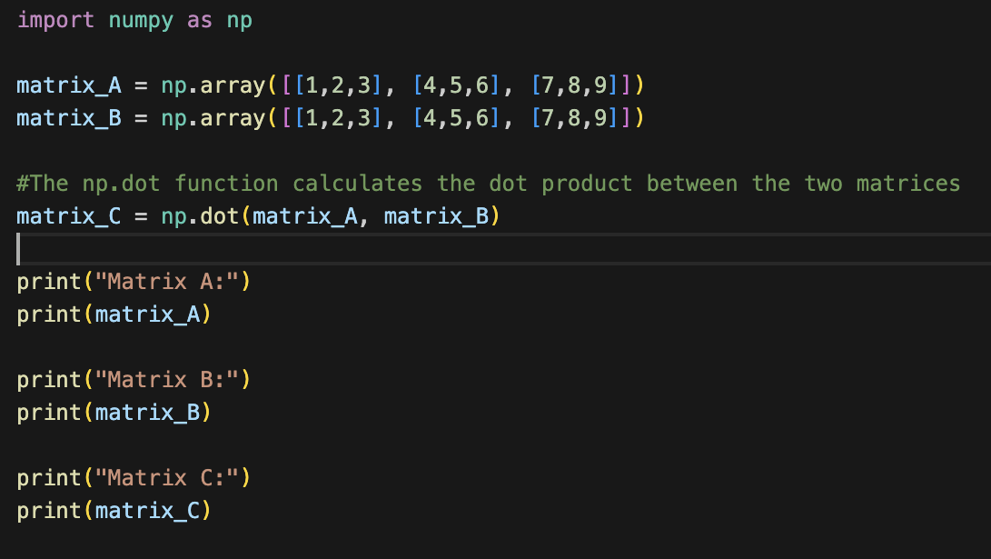
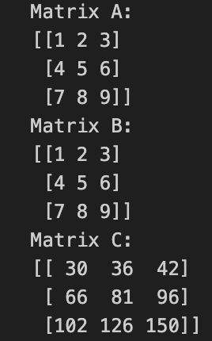
Leveraging Parallel Processing for Advanced Graph Computations
Start
Question
Goal
Execution
End
We created an array for both Matrix A and B with numbers 1-9. Then created Matrix C but only used 0s in the array
How can we multiply Matrix A and Matrix B to solve for Matrix C?
Our goal was to not only solve for Matrix C but do it in a way that it could be scaled
I added the np.dot function which is apart of the numpy library. This takes both matrices, multiples them, then returns the dot product
What we got was Matrix C. We confirmed it two ways. By doing our own calculations and using an online matrix calculator

Slide 9
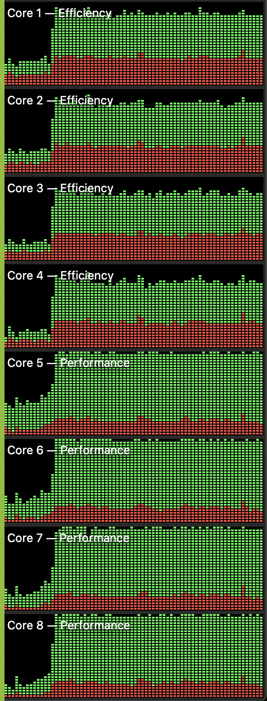
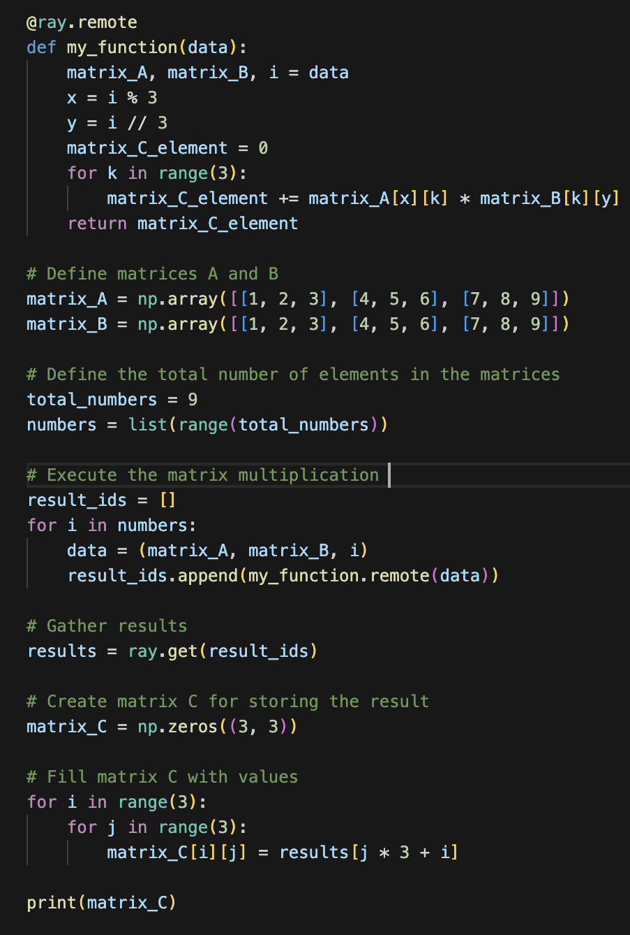
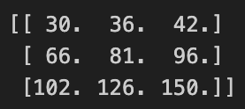
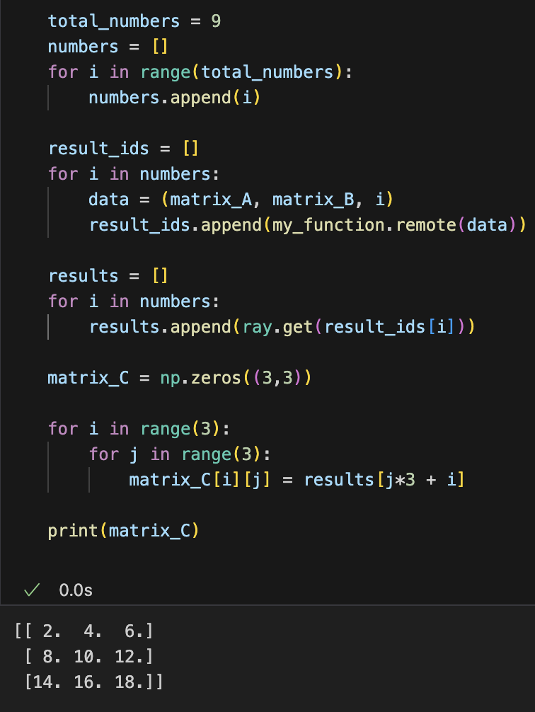
Leveraging Parallel Processing for Advanced Graph Computations
Problem
CPU Usage
Code
Solution
Our assignment was to change the initial code from addition to multiplication while implementing multi threading techniques
In this section, we compared the efficiency and performance of an 8-core laptop executing the code before and after
Both matrices and the total number of elements inside each were defined here. The multiplication is then carried out, the data is gathered, and it is inserted into the newly constructed C matrix
What we got was a perfectly multiplied matrix C using multi threading
Multi Threading
Multithreading is defined as the ability of a processor to execute multiple threads concurrently. In a simple, single-core CPU
Why Multi
Multithreading streamlines the efficient utilization of resources as the threads share the same memory and data space. It also allows the concurrent appearance of multiple tasks and reduces the response time. This improves the performance

Slide 10
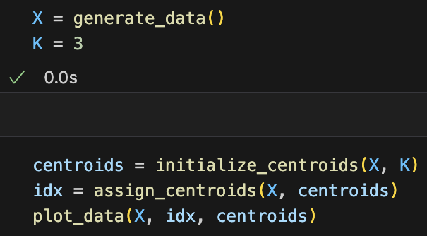
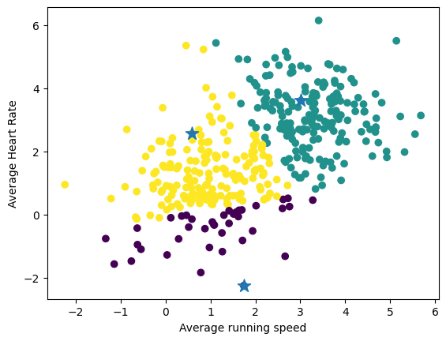
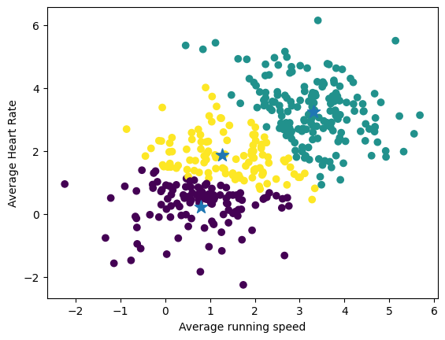
Leveraging Parallel Processing for Advanced Graph Computations
K Means Clustering
Implementation
is a machine learning technique that partitions data into K clusters based on similarity, aiming to minimize variance.
The given code aims to create three clusters. First, three initial centroids are selected from 'X' using the 'initialize_centroids' function. Then, each data point in 'X' is assigned to
the closest centroid. Then, we visually represent the data points using different colors to indicate each cluster, resulting in easy analysis of results.
Lean agile
Benefits
K Means Clustering offers efficient data grouping, aiding pattern discovery, data compression, and simplified decision-making for diverse applications.
Assignment
First Iteration
Sort a set of data points into three clusters according to their level of fitness. While also allocating centroids to each cluster and visualizing the data.
The data points were separated into three distinct clusters, but the centroids are not centered and the groupings are uncoordinated.
Final Iteration
After running it five times, we got the most accurate response. The data points are uniformly distributed among three established clusters. The centroids of each cluster are exactly in the center. Resulting in easy analysis of data.

Slide 11
Leveraging Parallel Processing for Advanced Graph Computations
Kaustubh Shivdikar, PHD Student, Northeastern University
Ayman Alabbasi, REU Participant Student, North Shore Community College
David Kaeli, College Of Engineering, Northeastern University
Abstract
Goal - The goal is to accelerate various machine learning workloads while also lowering execution time for a more functional review
Mission - To democratize Graph Neural Network accelerator development
Hypothesis - In essence it’s all about efficiency and production. We reengineer on chip communication to speed up GNN’s. With heavy emphasis on communication.
Who Will This Benefit?
GNNs assist in protein molecule analysis in Bioinformatics
Also social network analysis, traffic prediction, and computer vision.
GNNs enhance machine learning by modeling complex relationships in data structured as graphs or networks.
Research
K Means Clustering
Cost of Living Index
Goal: to analyze and compare living expenses across different locations
Process: We utilized the 2022 Cost of Living Index as our dataset
Single Threaded Matrix Multiplication
K Means Clustering: is a machine learning technique that partitions data into K clusters based on similarity, aiming to minimize variance.
Assignment: Given a collection of data points categorize them into three clusters based on levels of fitness.
Goal: Our goal was to solve for Matrix C using single threading
Reasoning: To understand efficiency and performance trade-offs in single-threaded implementations
Solution
First Iteration: We divided the data points into 3 distinct clusters,
but the centroids are
not centered and the groups are uncoordinated.
Final Iteration: We obtained the most accurate response after running it five times.The data points are divided evenly across three established clusters. Each clusters centroids are located exactly
in the center.
Multi Threading: the ability of a processor to execute multiple threads concurrently. in a CPU
Multi Threaded Parallel Computing
Why Parallel Computing: accelerates tasks by distributing them across multiple processors, reducing execution time, increasing throughput, solving larger problems, and improving efficiency.
Assignment: change the initial code from addition to
multiplication while implementing multi threading techniques
Solution: multiplied matrix C using MT & PC
Why Multi Threading: MT streamlines the utilization of resources as the threads share the same memory and data space. It also allows the concurrent appearance of multiple tasks and reduces the response time. This improves the performance.
Background
Graph Neural Networks: is a deep learning model for data, capturing dependencies between nodes.
Python: versatile, programming language known for its readability, and libraries for diverse applications.
Parallel Computing: Simultaneous execution of tasks using multiple processors to achieve faster computation and increased efficiency.
Conclusion
Our research demonstrates the potential of using parallel processing and multithreading for complex graph computations. Our approach enhances performance and scalability by leveraging the capabilities of several processors. Advantages such as faster processing, better resource usage, and the capacity to manage complex graph structures, make it a tempting solution for a variety of real-world applications. In the age of big data, embracing parallel computing is critical for realizing the full potential of graph analytics.
NSF REU-Site: Research Experience for Undergraduates site to create "Pathways Opening World Energy Resources" (REU - POWER)
This work was supported by the National Science Foundation Grant ##2150417
Notes:
11

