Slide 1
Whole Energy Homes
Acknowledgements
Emma Casavant
Katherine Bassett
U.S. Department of Energy (DOE)
Office of Energy Efficiency and Renewable Energy (EERE)
Building Technologies Office (BTO)
NSF #2150417: REU-PATHWAYS | P.I.: I. Zeid | Co-P.I.: C. Duggan
DOE, EERE, BTO #DE-EE0009154
August 02, 2023
Zoe Chappell
REU student:
Civil Engineering
Professor Michael Kane
Assistant Professor of CEE

Slide 2
Project Partners
NREL
FSEC Energy Research Center
Packetized Energy (Distribution partner)
ECOBEE (Distribution Partner)
15 Lightyears (additional subject enrollment)

Slide 3
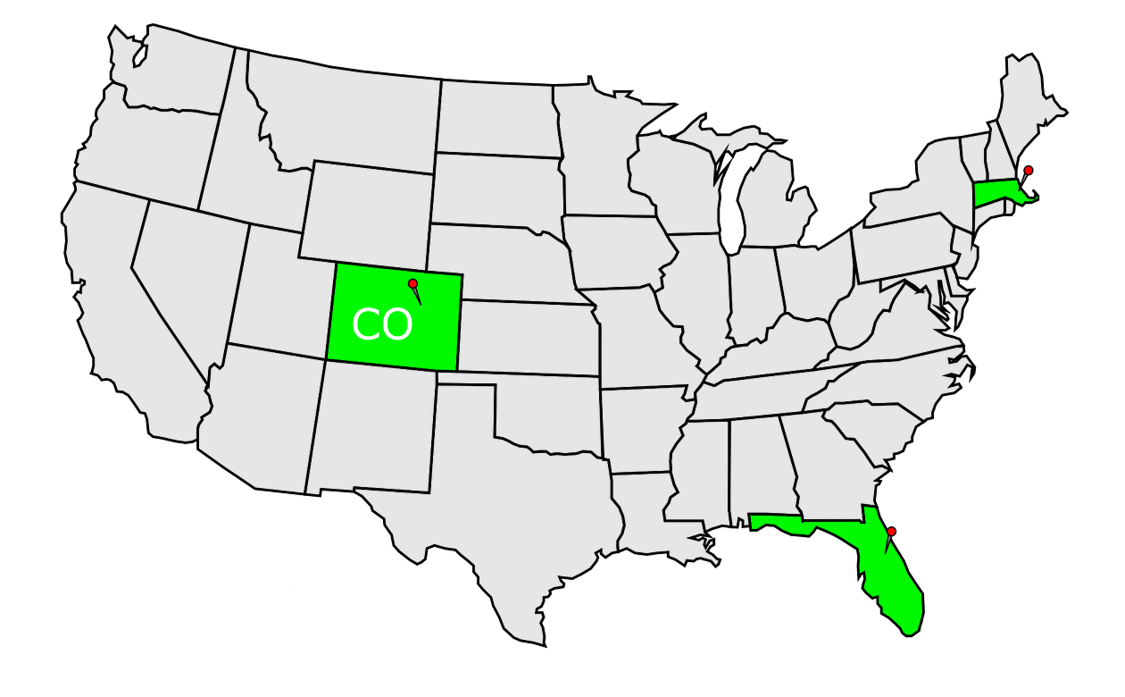
Whole Energy Homes
Two year study to understand how people interact with their thermostats
Create an open data set for use in future studies on climate change and Grid Based Demand Responses
Three states, ten homes per state
MA, CO, FL
Decrease grid demand to allow for more reliance on renewable energy
[4] US. Department of Energy, Grid-interactive Efficient Buildings: Overview

Slide 4
Cleaning, Curation and Communication of Home Metadata
Creating a baseline methodology to enable ease of communication with future researchers
What?
Why?
Familiarization with Entities and home Metadata
Formatting autoCAD home layouts into a 'clean' format
Additional formatting in Inkscape
Creating a basic presentation of metadata to communicate an overview of what data the study contains
Dataset is intended to be open
Too much data to scan without an overview
Home layouts are confusing to look at

Slide 5
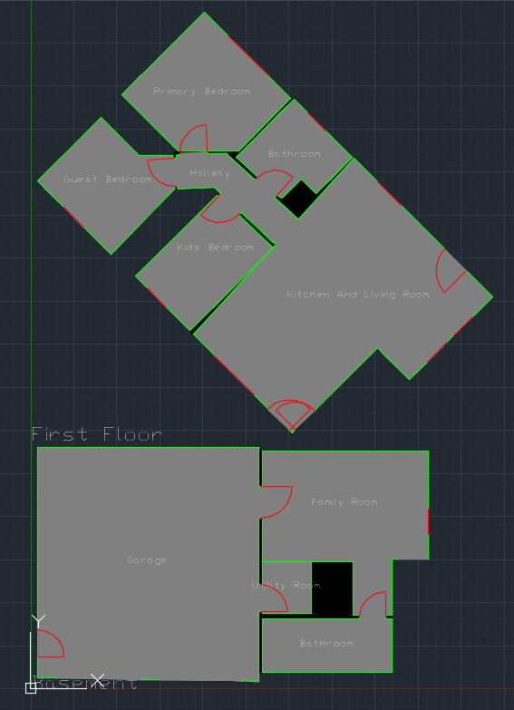
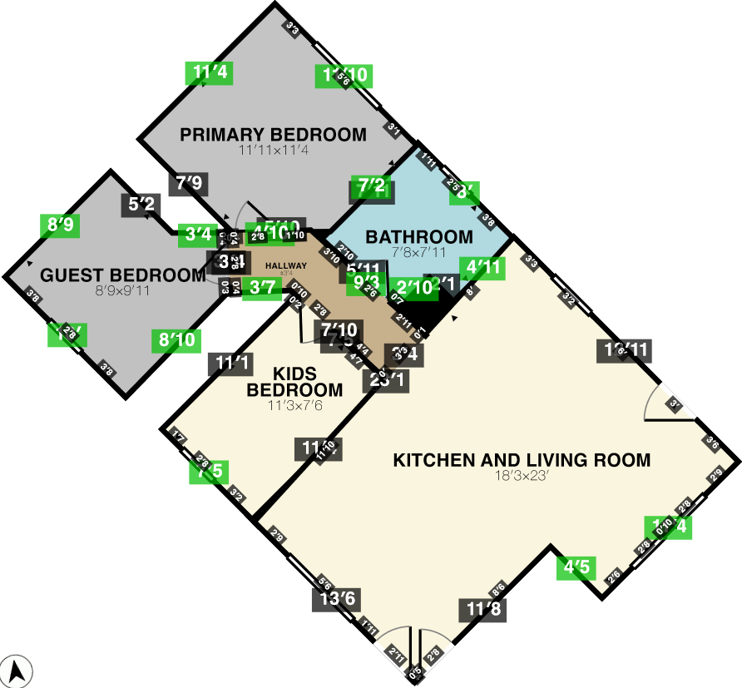
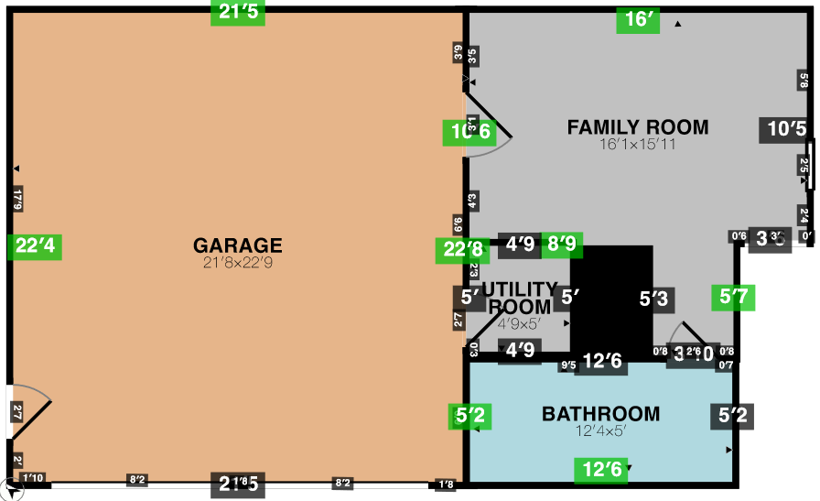
Raw Data

Slide 6
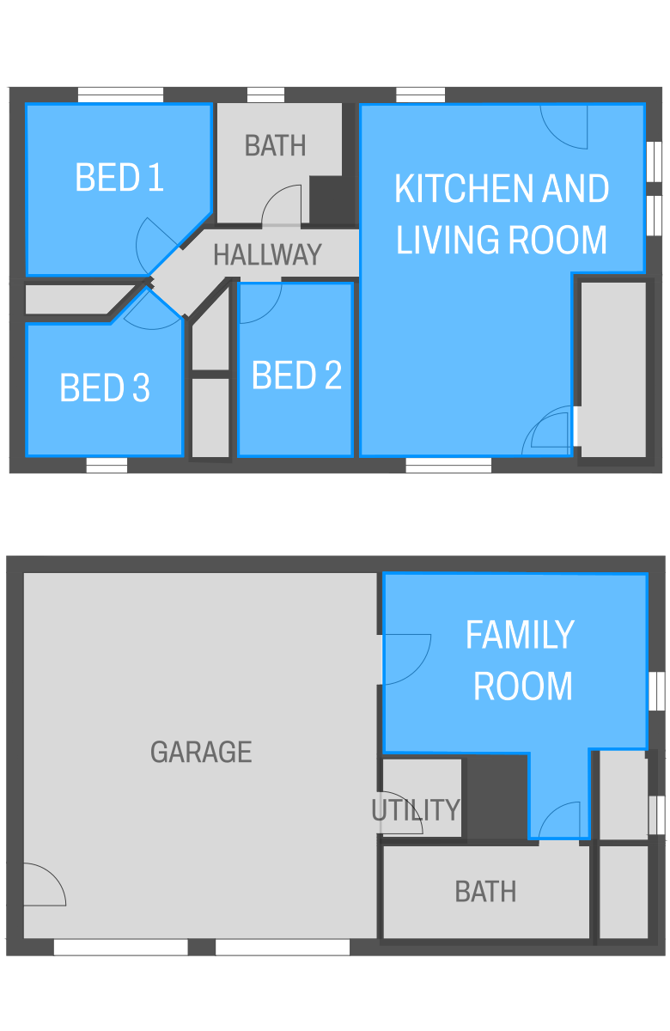
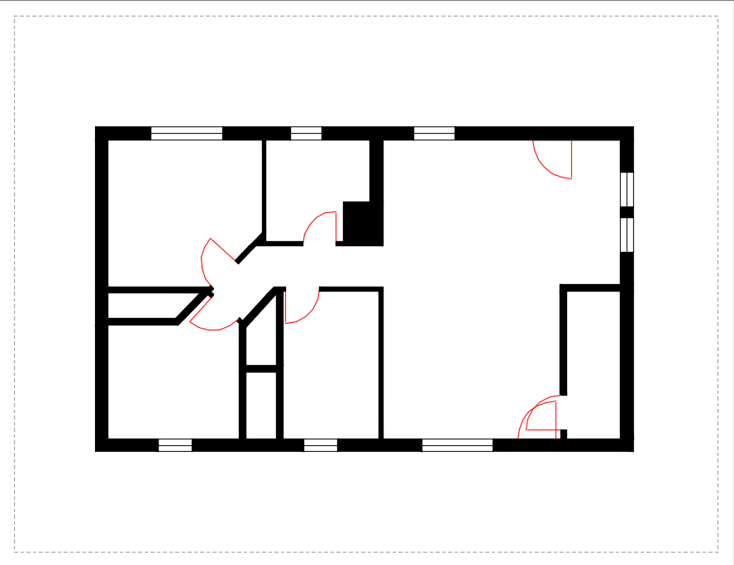
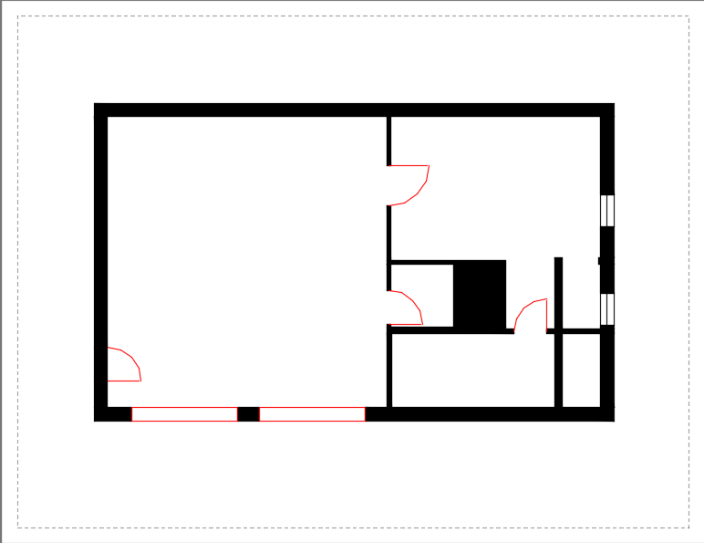
Cleaned Data

Slide 7
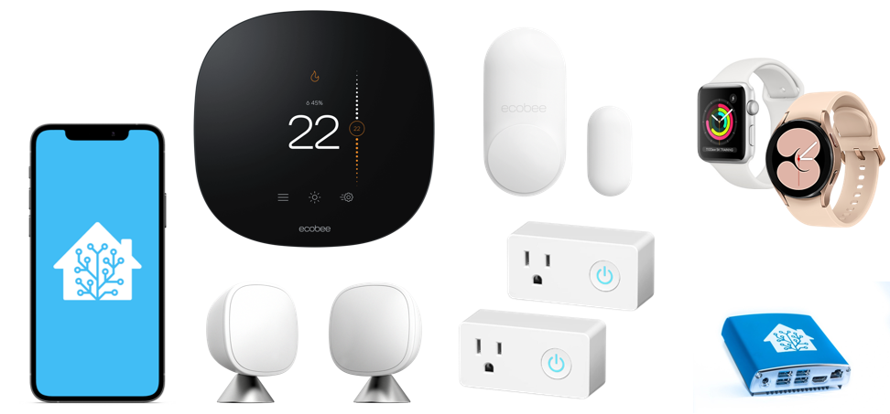
Entities (Week 1)
First week doing Entity Inventory to send Occupational/Temperature and Contact sensors to Florida homes
10 OCC and 10 Contact sensors, and 2 Thermostats sent to each home
ECOBEE
Each entity has multiple sensors

Slide 8
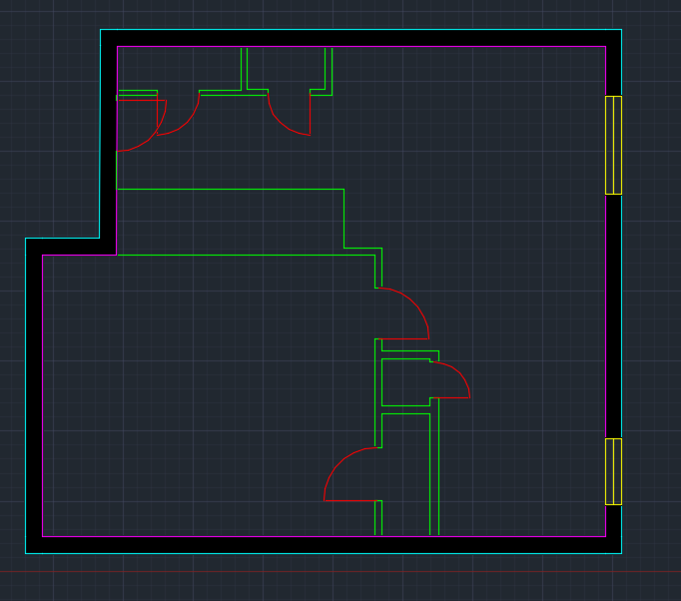
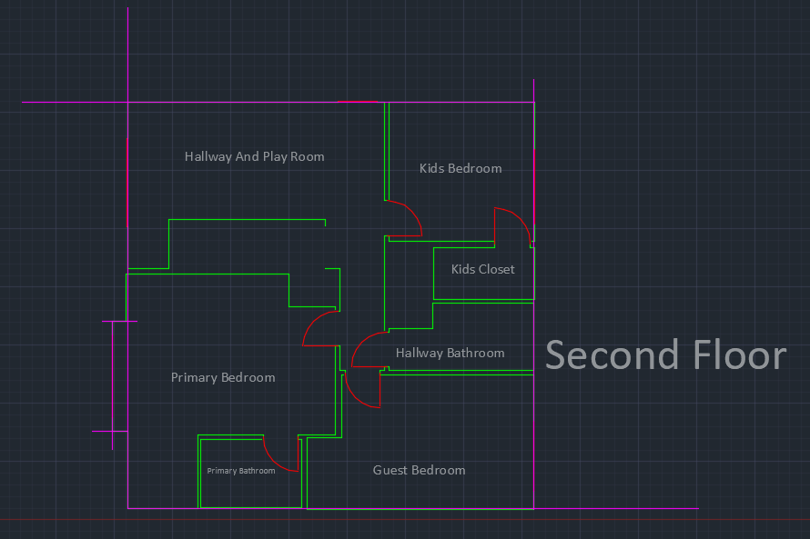
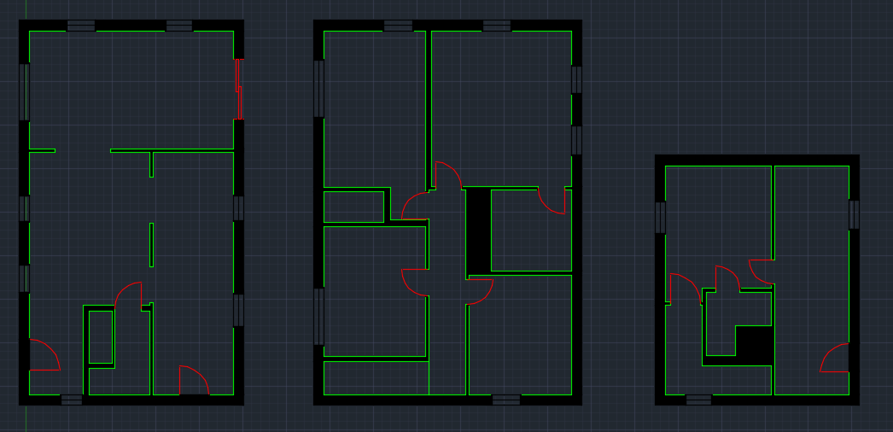
AUTOCAD (Week 2-6)
Overview CAD designs generated in RoomScan LiDAR
Create a plan to clean these layouts using AutoCAD
Add additional elements not originally generated by RoomScan, (which have been added in annotation) to CAD designs
Export layouts for later use
(From the top, house 4 final floorplan, CO house 1, in progress, house 6, in finalized)

Slide 9
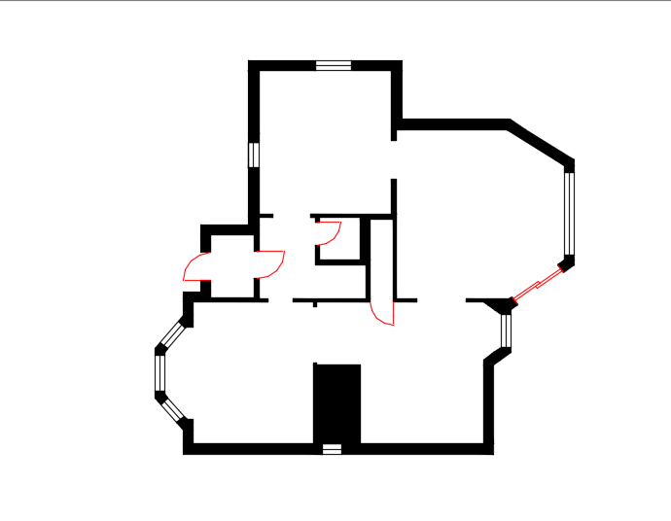
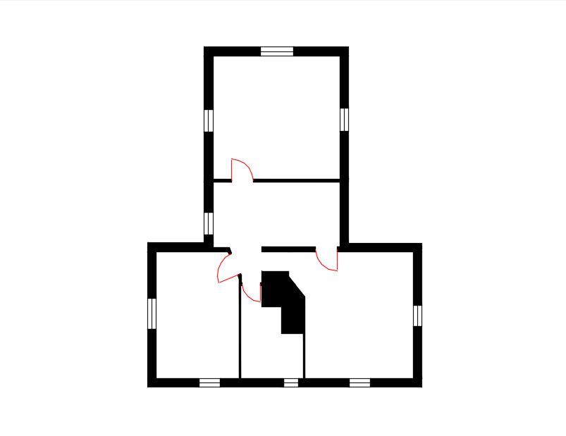
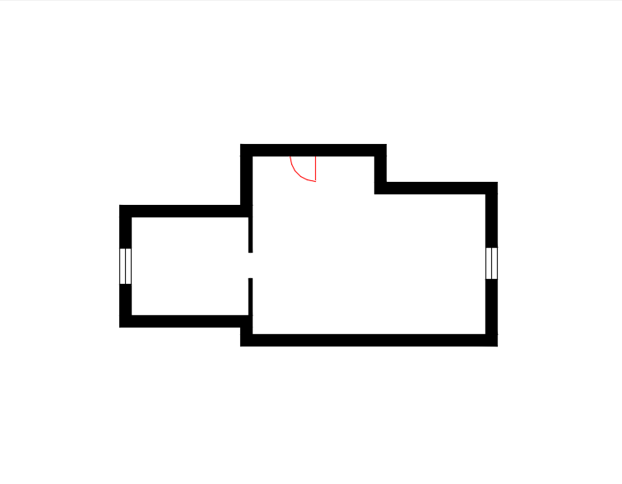
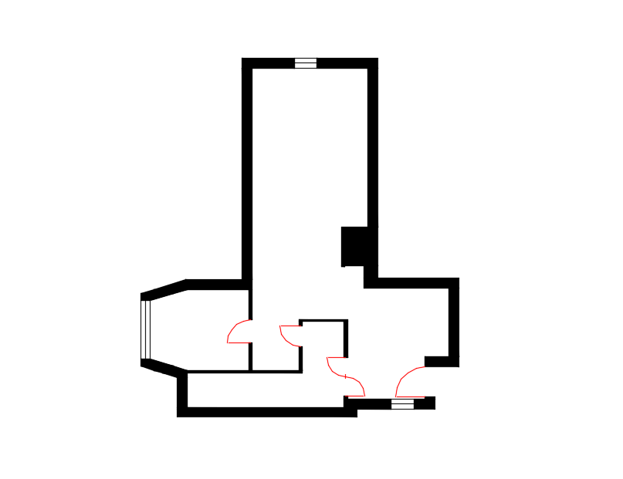
Complete Home Layout MA09

Slide 10
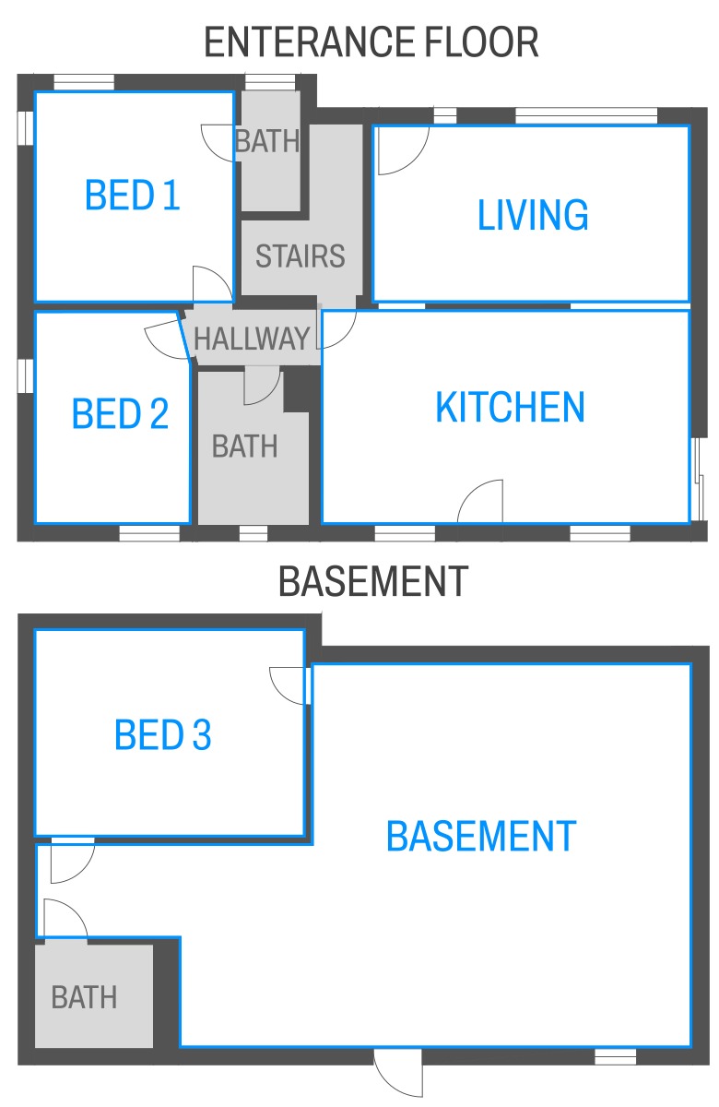
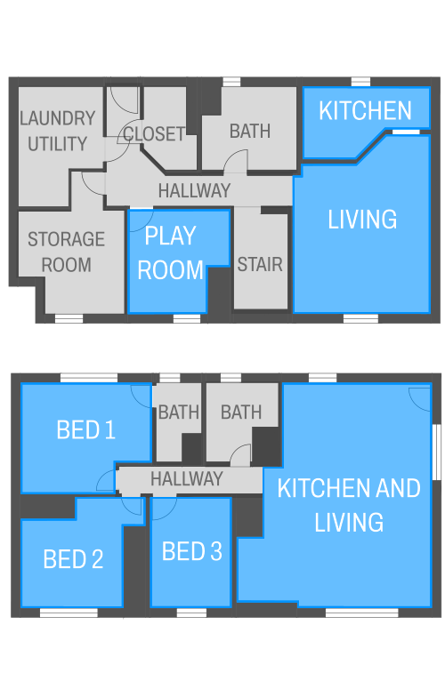
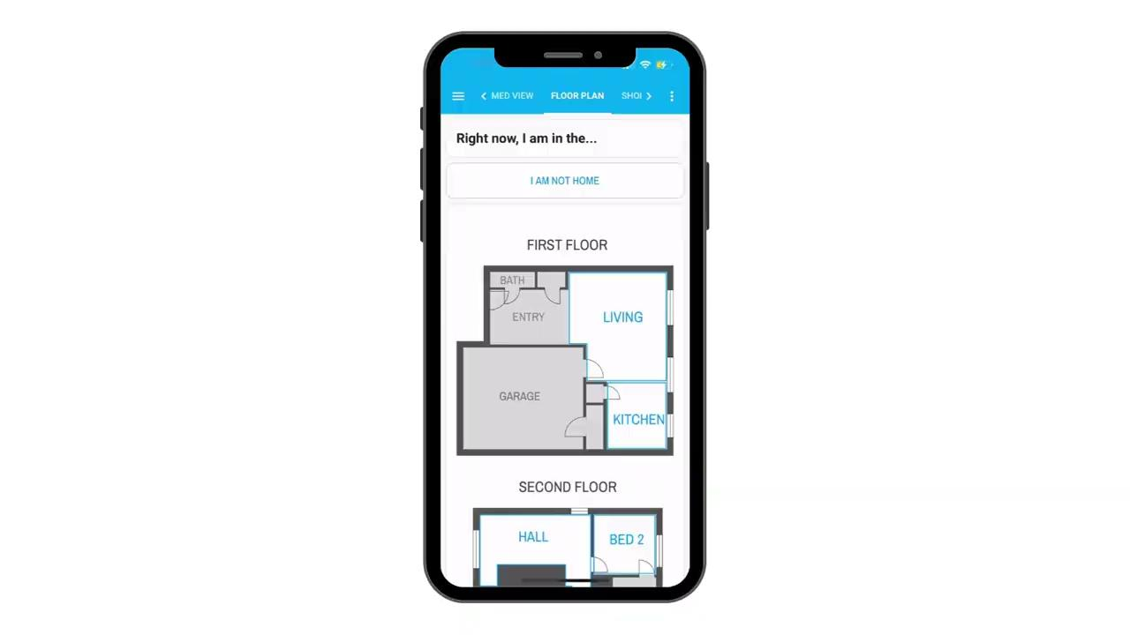
InkScape (Week 4-6)
The Time spent on Inkscape Overlapped with time spent on CAD files
Familiarized self with the opens source vector program
Did designs according to specifications given
From left to right: House X rooms turned 'on', House 5, final design, rooms turned 'off', video of home layout in Homeassist App

Slide 11
Data Analysis and Curation (Week 7-9)
Overviewed Home Metadata, and began to organize it into quick and easy to interpret tables for use in a 'read me' type file
Created Tables to show Number of sensors and Metadata of homes in both MA and CO using excel spreadsheets
Number of Sensors in MA Homes
House | Occupancy | Humidity | Temperature | Contact Sensors | Smart Plugs
MA01 | 5 | 2 | 6 | 5 | 2
MA02 | 8 | 2 | 9 | 5 | 2
MA03 | 9 | 2 | 10 | 7 | 4
MA04 | 4 | 2 | 5 | 5 | 1
MA05 | 8 | 2 | 9 | 4 | 5
MA06 | 7 | 1 | 7 | 6 | 1
MA07 | 6 | 1 | 7 | 4 | 4
MA08 | 11 | 1 | 12 | 3 | 2
MA09 | 11 | 0 | 12 | 6 | 4
MA10 | 14 | 0 | 15 | 13 | 5

Slide 12
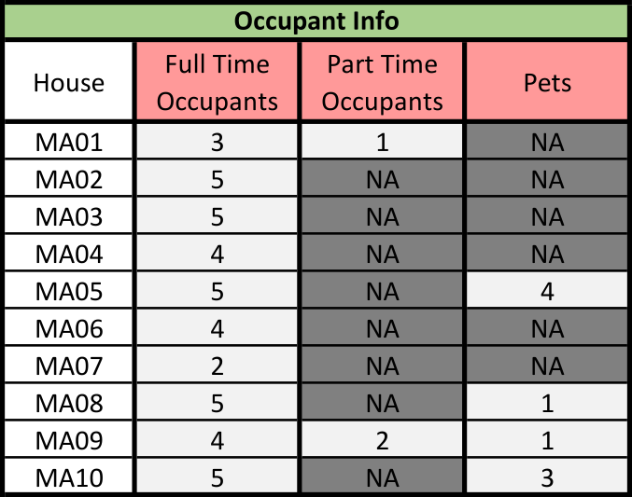
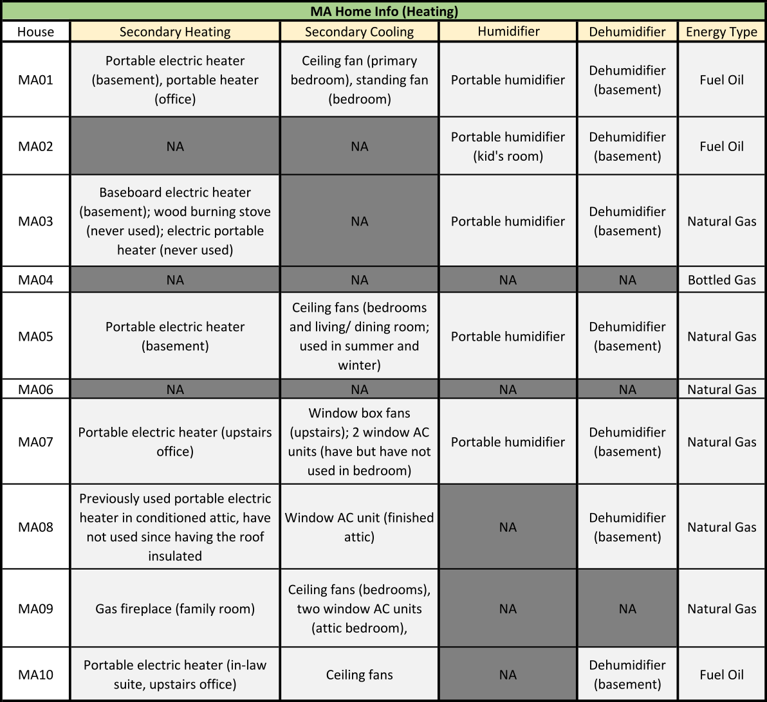
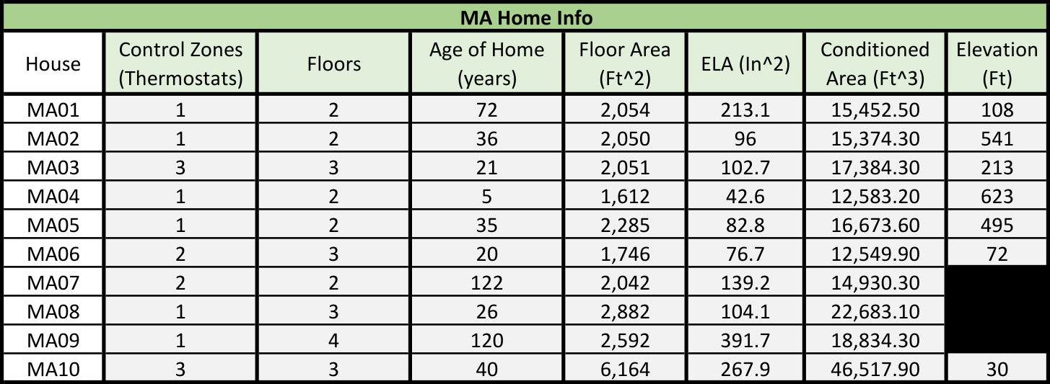

Slide 13
Other Acknowledgements
• Center for STEM Education
• Claire Duggan - Executive Director
• Jennifer Love - Associate Director
• Nicolas Fuchs - Program Manager
• Mary Howley - Administrative
• Lydia Bird - REU Coordinator

Slide 14
