Slide 1
Creating a Magnetic Field Gradient for Engineering of Magneto-functional Materials
Isabela Eliassen
Computer Engineering,
North Shore Community College, Lynn MA
Prof. Laura Lewis
Chemical Engineering, Mechanical Engineering,
Northeastern University, Boston MA
Dr. Xiaoyu (Criss) Zhang
Mechanical Engineering,
Northeastern University, Boston MA
NSF #2150417: REU-PATHWAYS
Notes:
What is Magneteofuctional

Slide 2
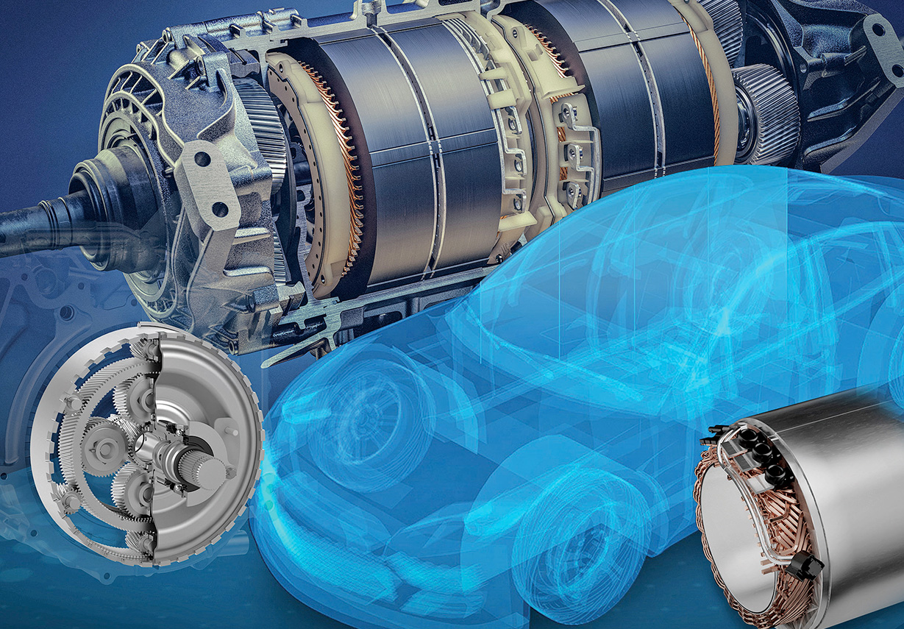
Towards Next-Generation Magnets
Ferromagnetic materials are important for energy conversion
Could potentially benefit the future industry to diversify the supply chain

Slide 3
Objective
Design an experimental apparatus using permanent magnets to deliver a magnetic field gradient (∇B) for engineering of magnetic material
∇B ~ Force
Processing
Property
Structure

Slide 4
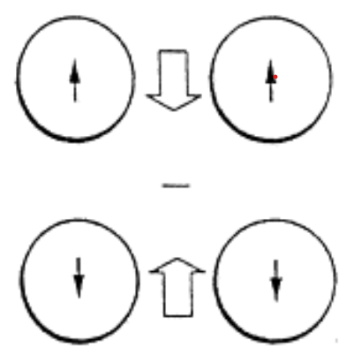
Methodology
1. Chose design
*sample
2. Identify size constraints
3. Simulate a matrix of separations
4. Analyze data
Coey, J. M. D. "Permanent magnet applications." Journal of Magnetism and Magnetic Materials 248.3 (2002): 441-456.

Slide 5
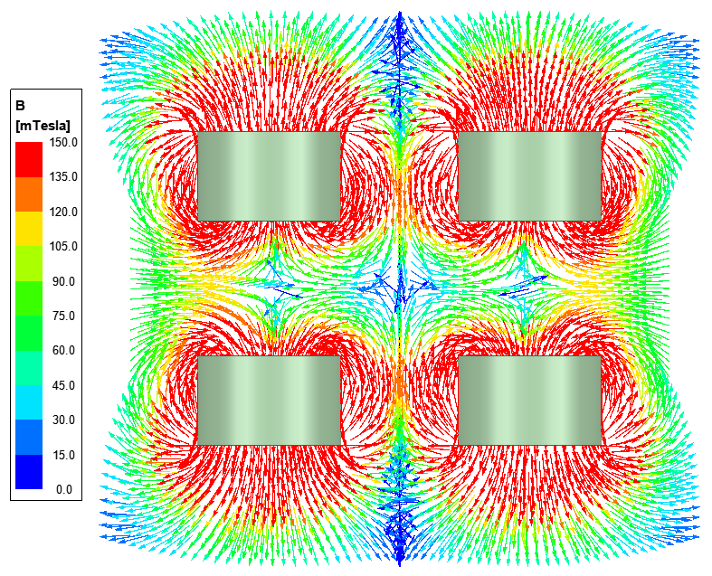
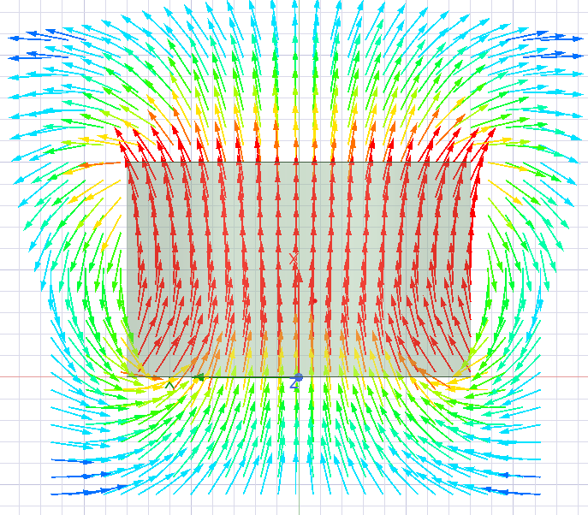
Visualizing magnetic field gradient in design
High
N
S
Low

Slide 6
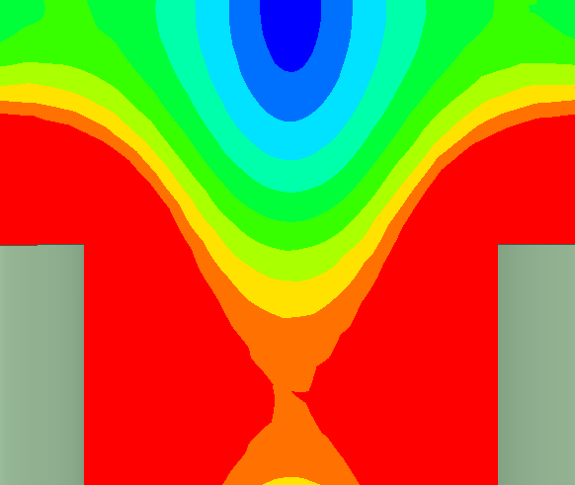
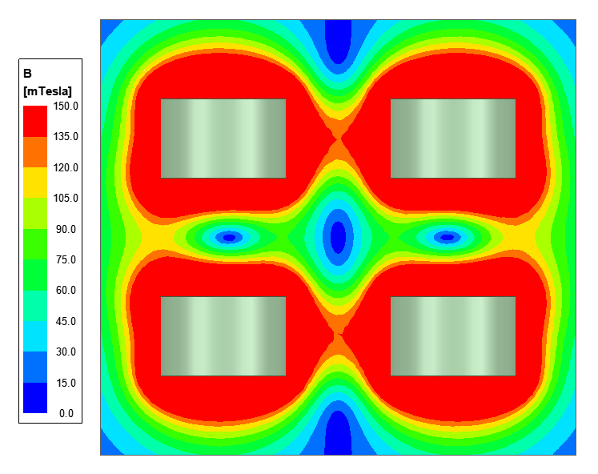
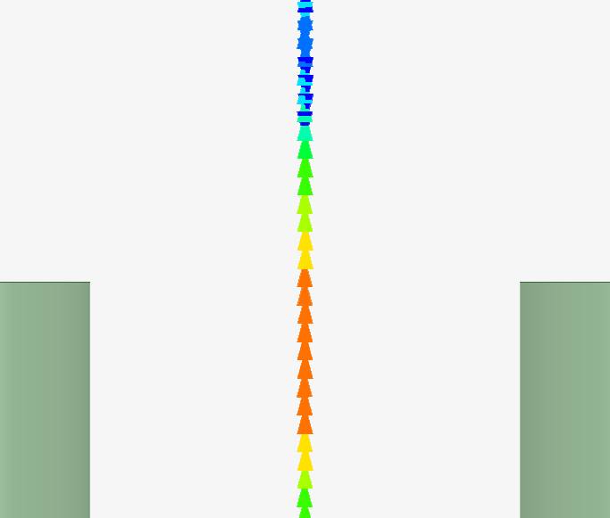
Aligned gradient along center of array

Slide 7
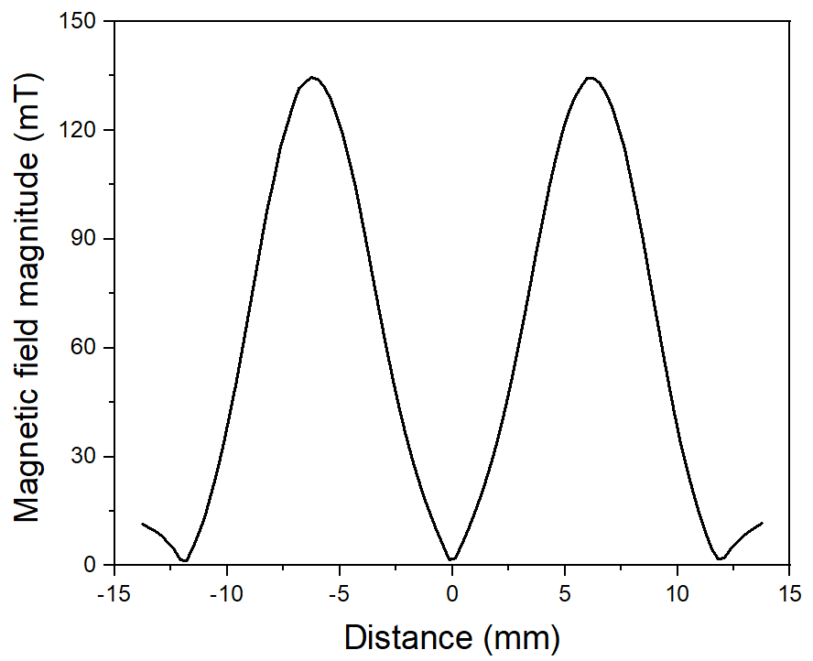
Quantitative view of design
Distance along centerline = Sample length
Slope = Gradient strength
∇B = dB/dX
∇B
Notes:
58 gradient

Slide 8
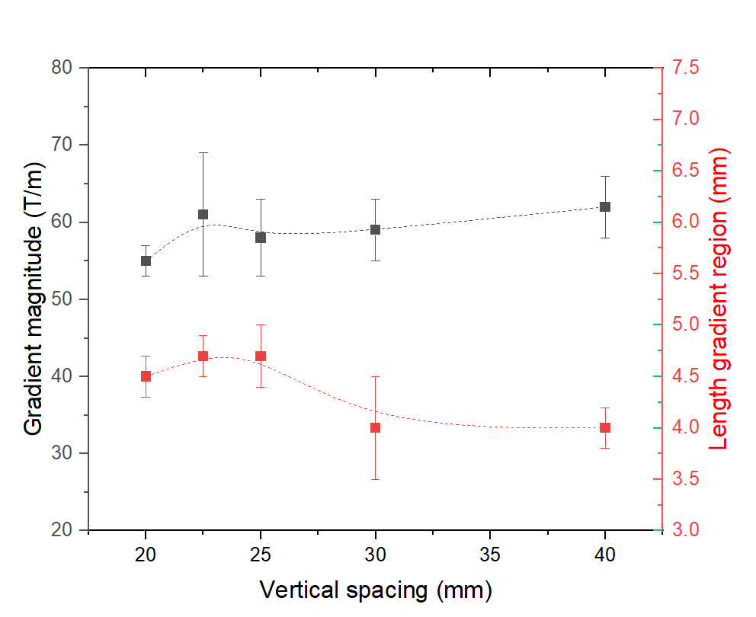
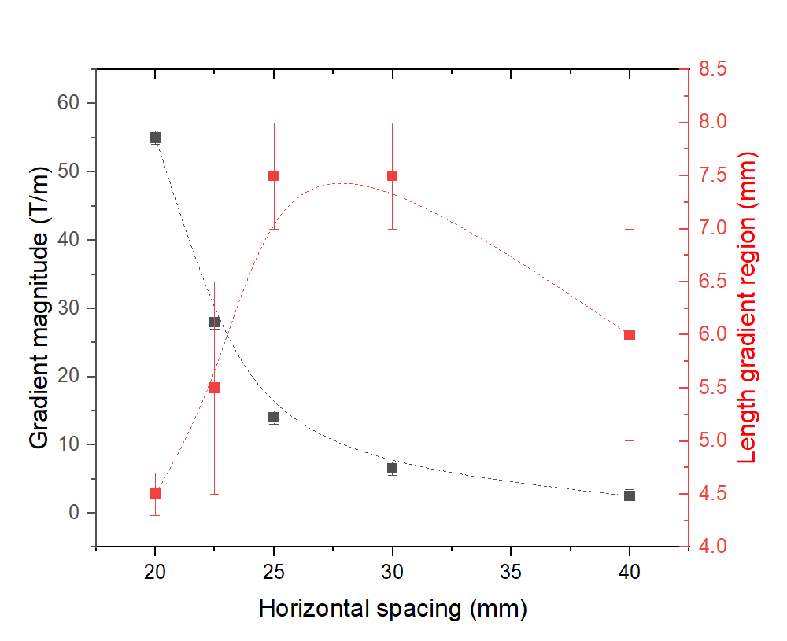
Trends with Relation to Spacing
Changing vertical spacing
Changing horizontal spacing
Magnetic field gradient is more sensitive to changing horizontal spacing

Slide 9
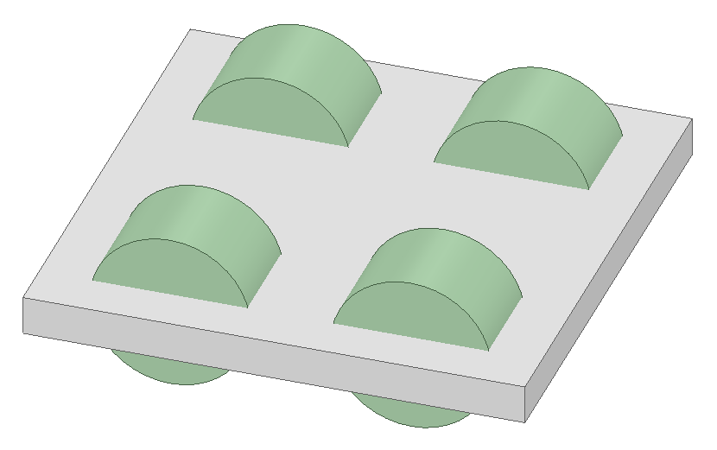
Conclusion:
Future Work:
Changing the horizontal spacing has greatest effect on ∇B
Tailorable by an order of magnitude
Accelerate research with computation
Design concept for apparatus
Use results of model to build magnet apparatus

Slide 10
Acknowledgements:
Nanomagnetism Group:
Prof. Laura Lewis
Dr. Criss Zhang
Dr. Brian Lejeune
Dr. Lars Daniel Hedlund
Marissa Westerbeke
Henri Baldino
Michael Bitetto
REU Facilitators:
Claire Duggan - Executive Director
Jennifer Love - Associate Director
Nicolas Fuchs - Program Manager
Lydia Bird - REU Coordinator
10

Slide 11
11

