Slide 1
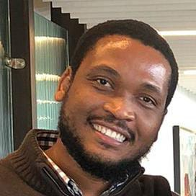
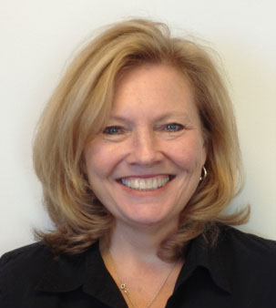
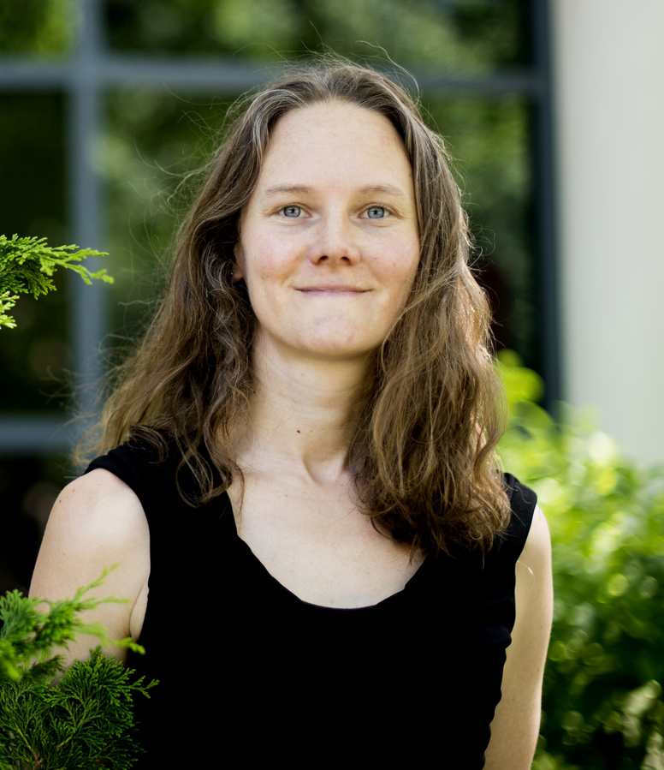
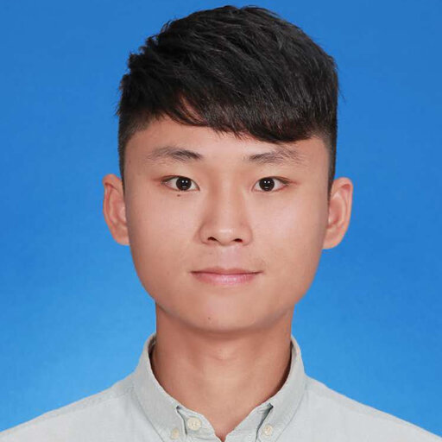
Cross-calibration and visualization of data for a portable air quality monitor
Olivier Kepler Francois
Civil Engineering & Computer Science
Claire Duggan
Executive Director, The Center for STEM Education Northeastern University
Olivier K. Francois
Amy Mueller
Assistant Professor, Civil & Environmental Engineering and Marine & Environmental Sciences
Ruifeng Song
PhD Student, civil &Environmental Engineering, Northeastern University

Slide 2
MOTIVATION
Due to the high expenses associated with instrumentation and the variability of air quality in complex urban settings, the project intends to support various ongoing initiatives by implementing cost-effective sensors. These sensors will play a vital role in achieving critical goals for monitoring urban air quality.

Slide 3
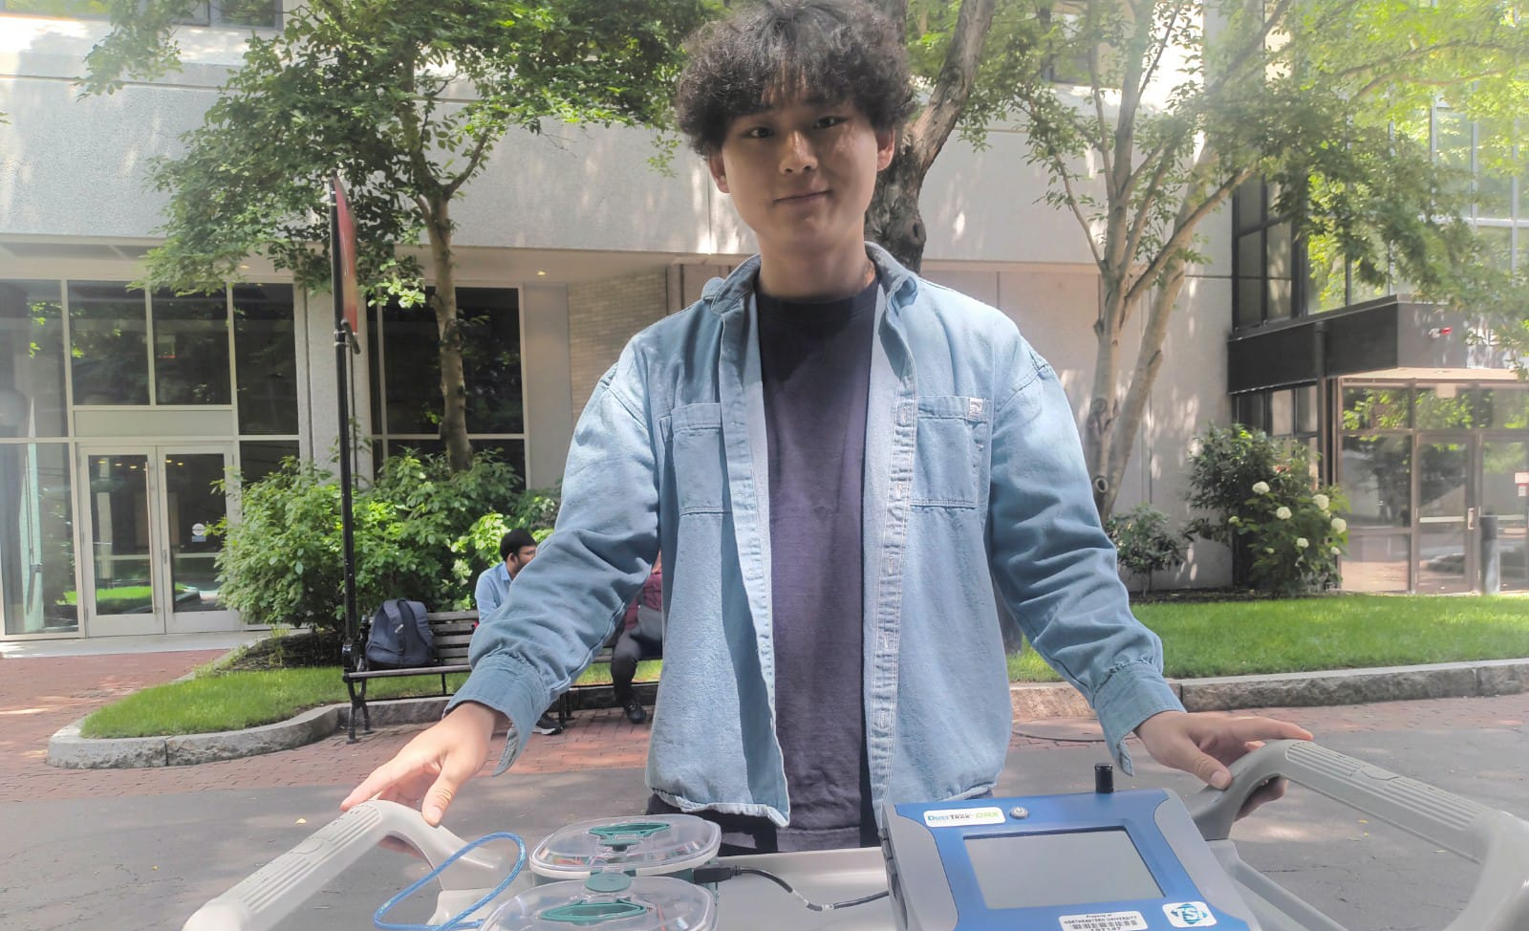
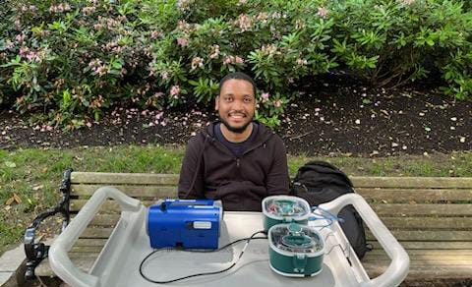
Cross-calibration and visualization of data for a portable air quality monitor
Deploying the portable air quality monitors and the reference instruments in the same place and conducting the comparison experiment in different locations where they have different air pollutant concentrations

Slide 4
Timeline
Read background materials to learn air quality monitoring vocabulary and understand the meaning of data from field sensors.
Understand the software operation for air sensor measurements, including SD card recording and real-time data download.
Conduct comparison experiments between our sensors and other sensors to assess accuracy.
Focus on the final presentation and the preparation of the poster.
Week 1
Week 2
Week 3
Week 4
Week 5
Week 6
Week 7-8
Completed all necessary safety (EHS) training required for work on campus, while concurrently working on understanding how the modules function.
Utilize High-precision instruments to gain insight into their functionality in order to compare them with our own.
Analyze the data collected by sensors and compare them with our data using various comparison methods and graphs.

Slide 5
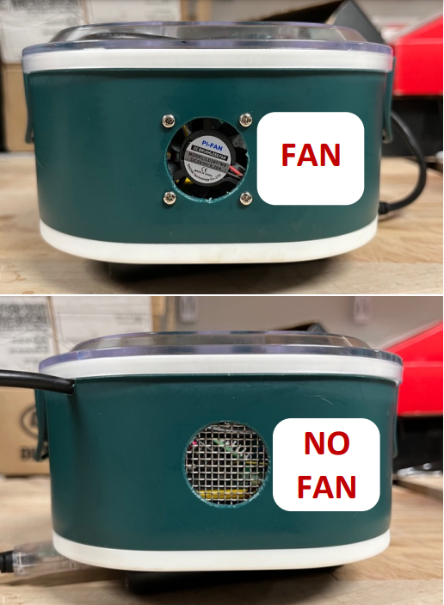
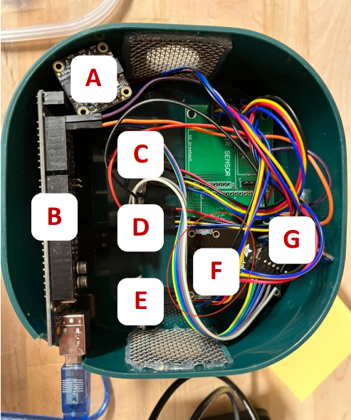
Characteristics
A: GPS
B: Micro Controller
C: TVOC & eCO2 & Ethanol (SGP)
D: TVOC & eCO2 (CCS)
E: Temp & RH
F: PM
G: SD Module
Measurement
Particles matter (PM)
Volatile compounds (VOCs)
Humidity
Temperature
Read background materials to learn air quality monitoring vocabulary and understand the meaning of data from field sensors

Slide 6
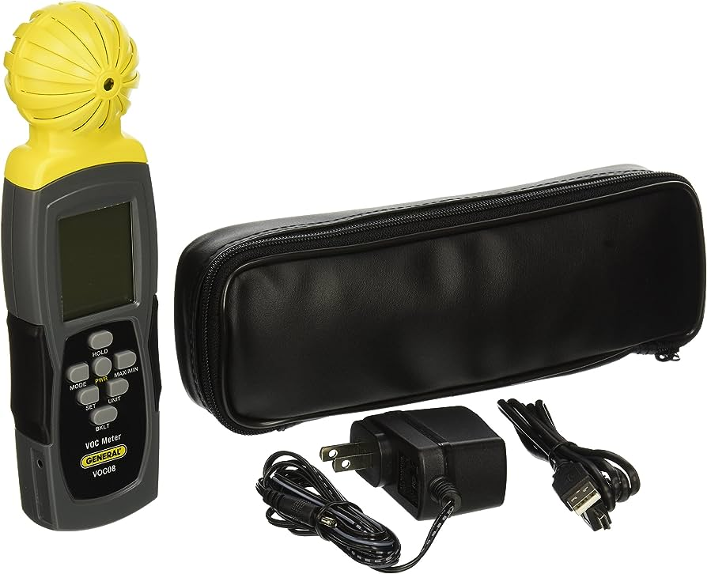
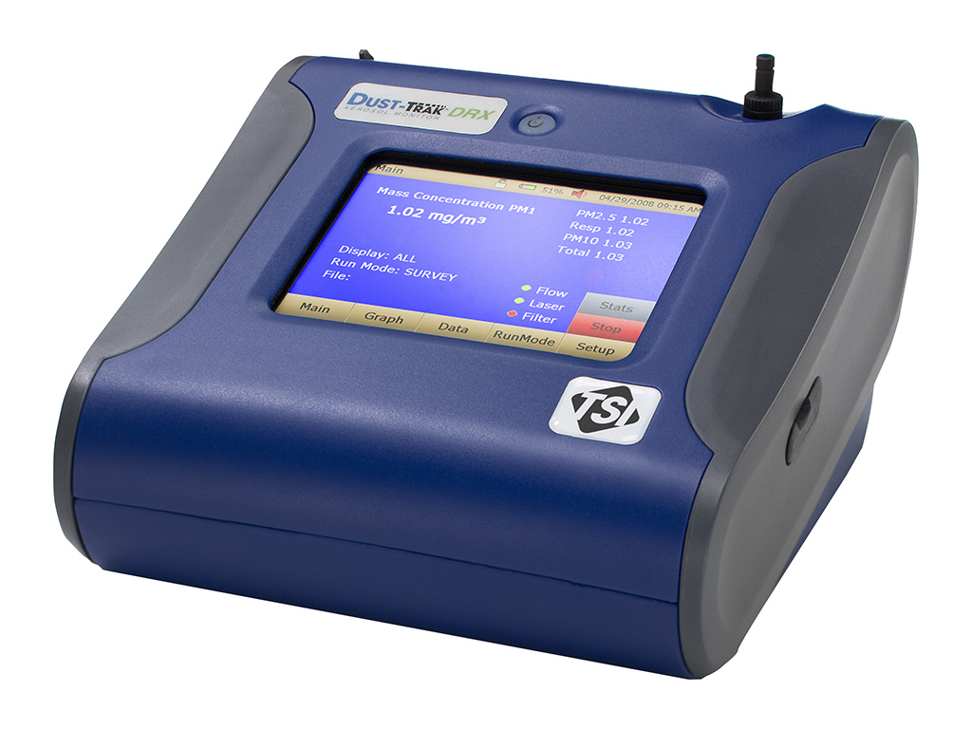
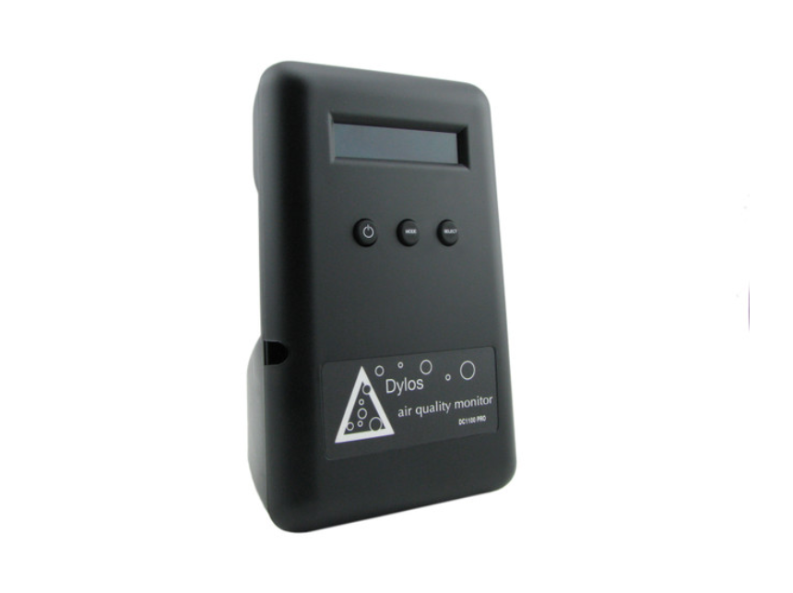
Comparison instruments
Detect VCOs
VOC08, Volatile Organic Compound Emission Detector
Utilize other sensors to gain insight into their functionality in order to compare them with our own.
DustTrak™ DRX Aerosol Monitor
PM1, PM2.5, PM10
VOCs , PM1, PM2.5, PM10
Dylos sensor
PM1, PM2.5, respirable, PM10

Slide 7
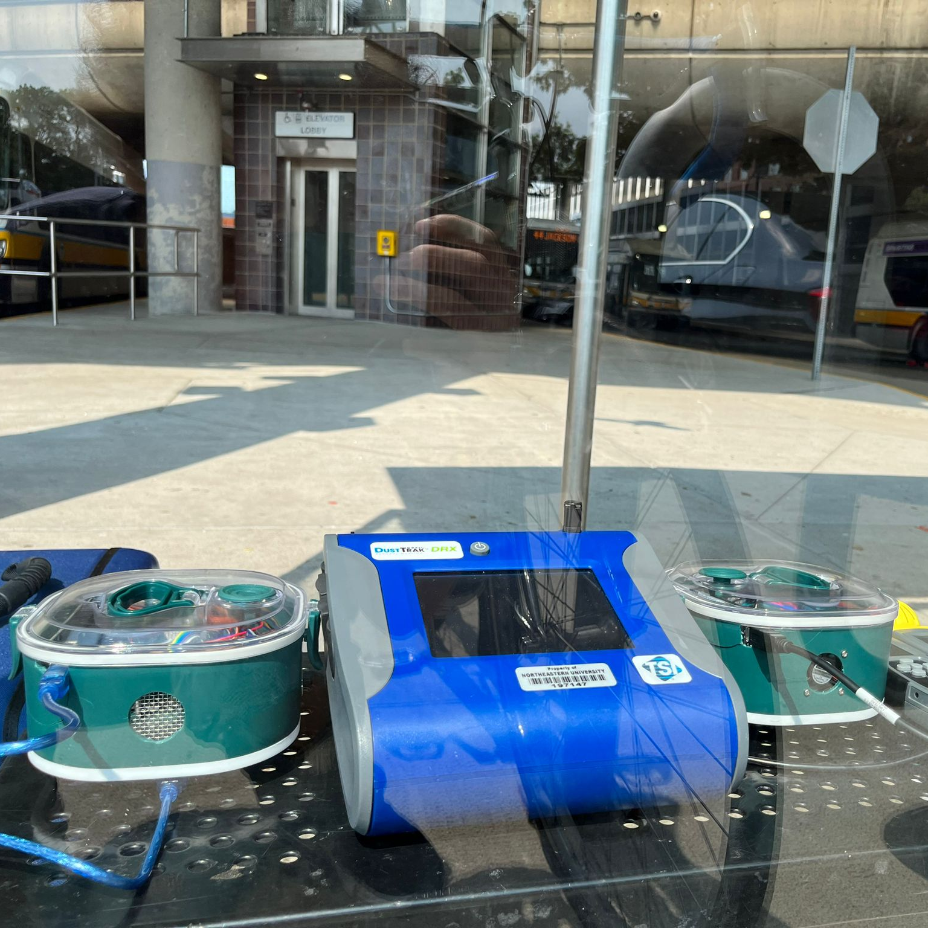
Data Collection
Ruggles Station
We went to different places with varying levels of concentration. We first went to a place with lower concentration and then to a place with a middle level of concentration.
Northeastern Station
Ruggles Station
Northeastern

Slide 8
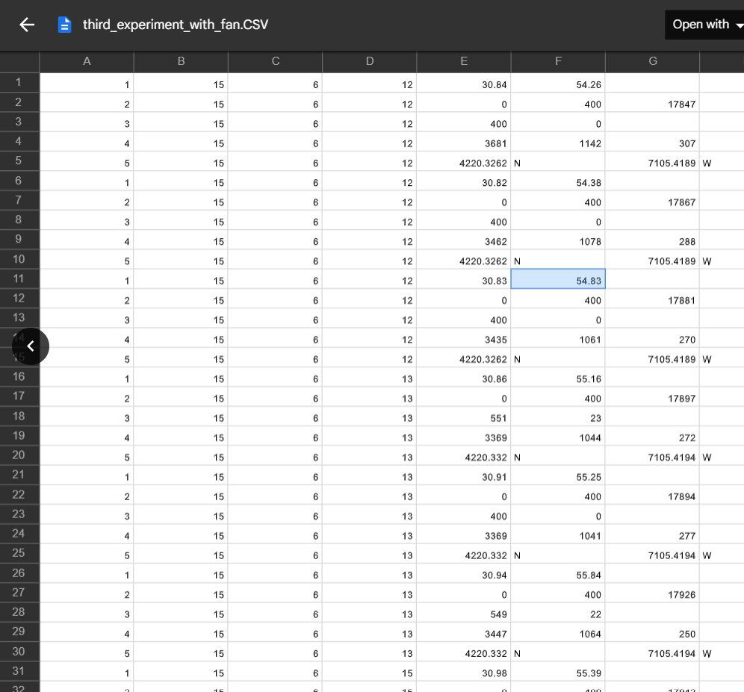
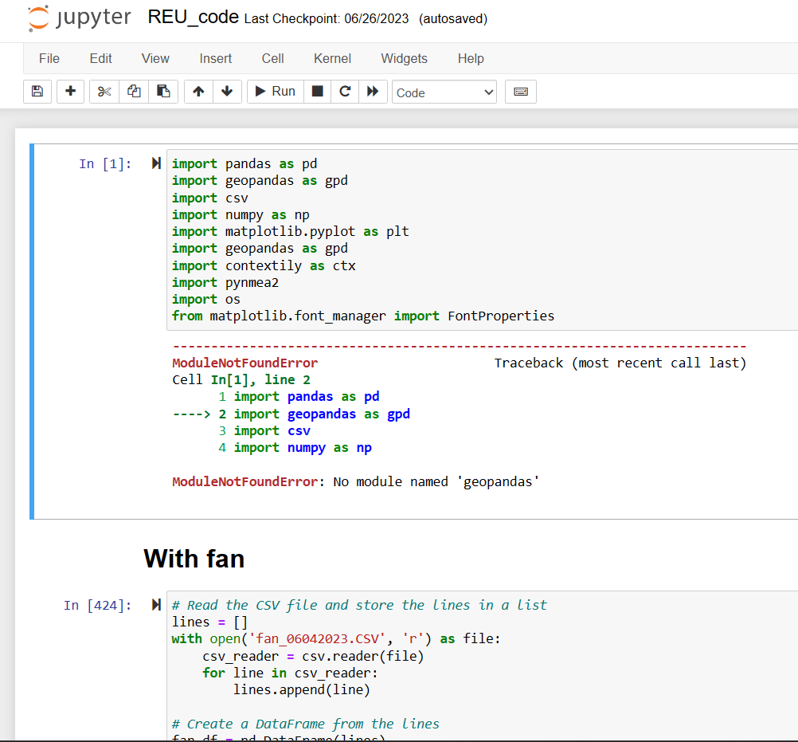
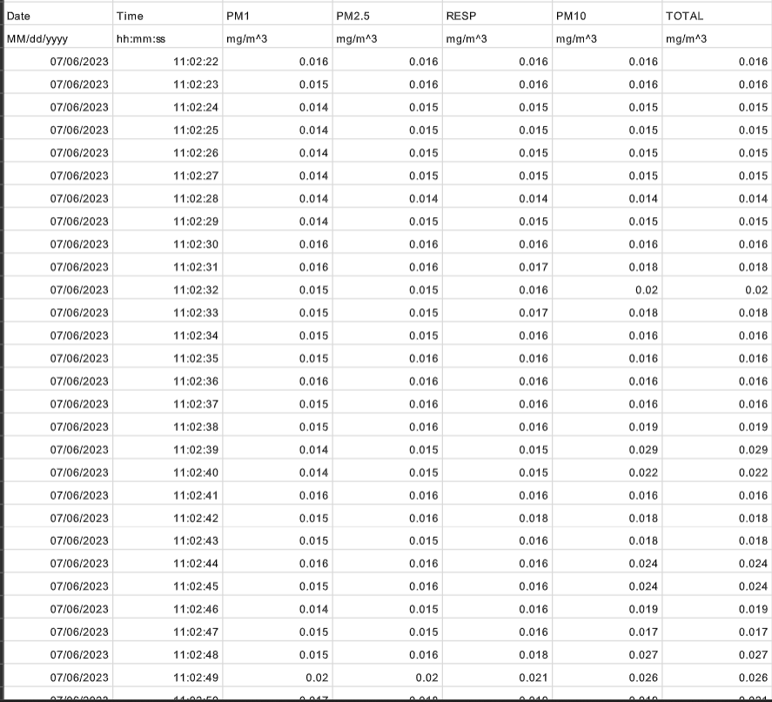
Data analysis procedure
Understand the software operation for air sensor measurements, including SD card recording and real-time data download.

Slide 9
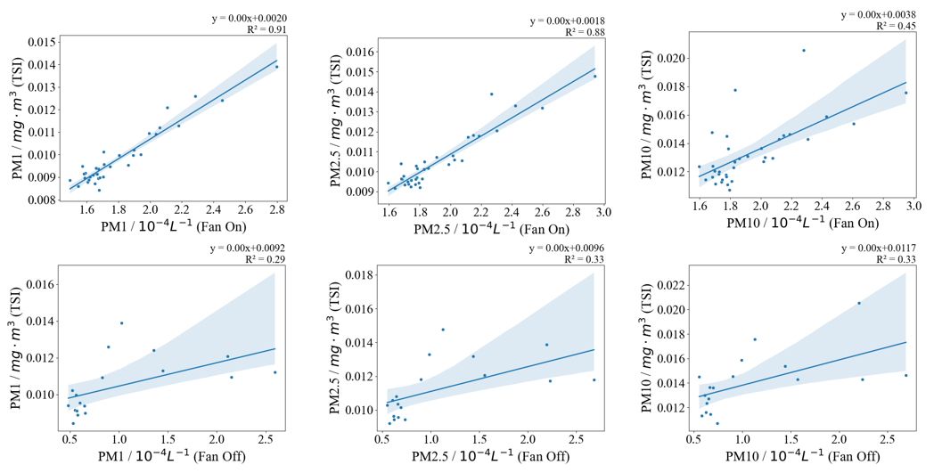
Visualization
FAN-ON
The coefficient of determination, or R², measures how well the data fit the fitted regression line. In this case, the R² value is greater when the fan is on compared to when the fan is off. This suggests that the lunch box with the fan is more accurate than the one without the fan when comparing their performance to the TSI sensor.
FAN-OFF

Slide 10
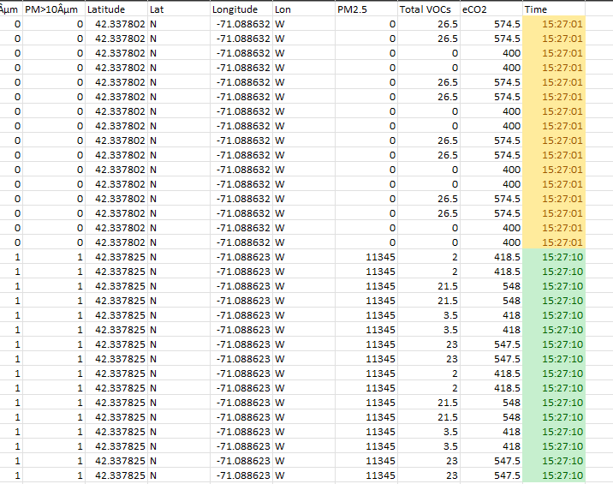
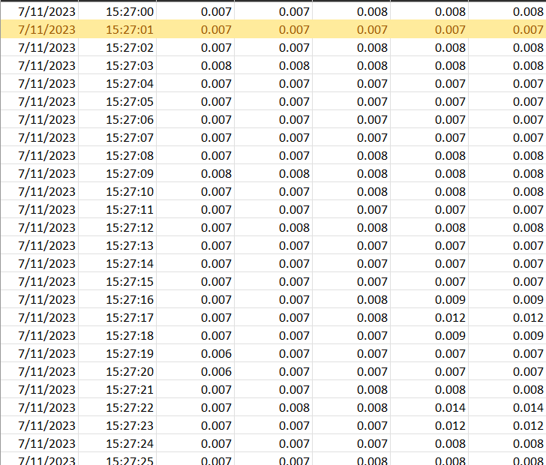
Challenges
Data from the lunch boxes sensors
Data from the DustTrack sensor
Data collection posed difficulties due to some irregularities and missing data.
Analyzing data for comparison using Python also presented challenges that required careful thought and problem solving.
.

Slide 11
Next step
High concentration
Layout
Experiment with VOCs
Since we conduct experiments in spaces with low average concentration, it is necessary to perform similar tests in a location with high concentration
Find a method to alter the layout of the sensor modules and the fan arrangement to enhance accuracy.
As we did the comparison for the PM, we must do the same thing for VOCs.

Slide 12
Idea of conception
Preliminary sketch

Slide 13
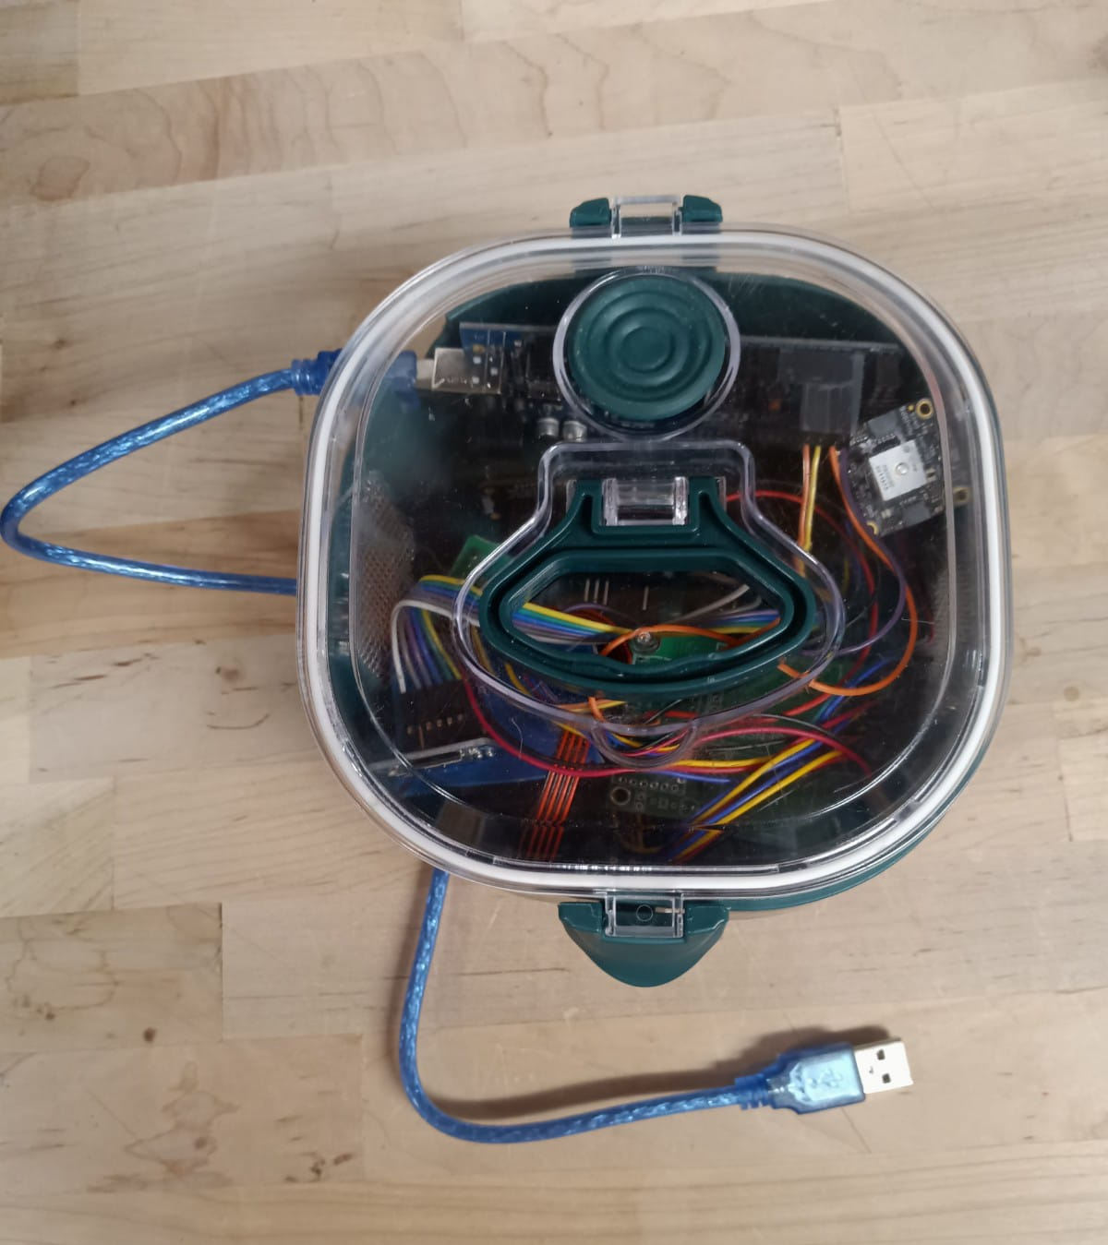
Thank You
Olivier Kepler Francois
olivierkfrancoi1@gmail.com

