Slide 1
Leveraging Parallel{
Shamil_Imakaev
workshop.ipynb
[Processing for]
< Advanced Graph
Computations>
<Faculty Advisor: Professor Kaeli
Student Mentor:Kaustubh Shivdikar>
NSF #2150417: REU-PATHWAYS | P.I.: I. Zeid | Co-P.I.: C. Duggan
Dept. of Electrical and Computer Engineering

Slide 2
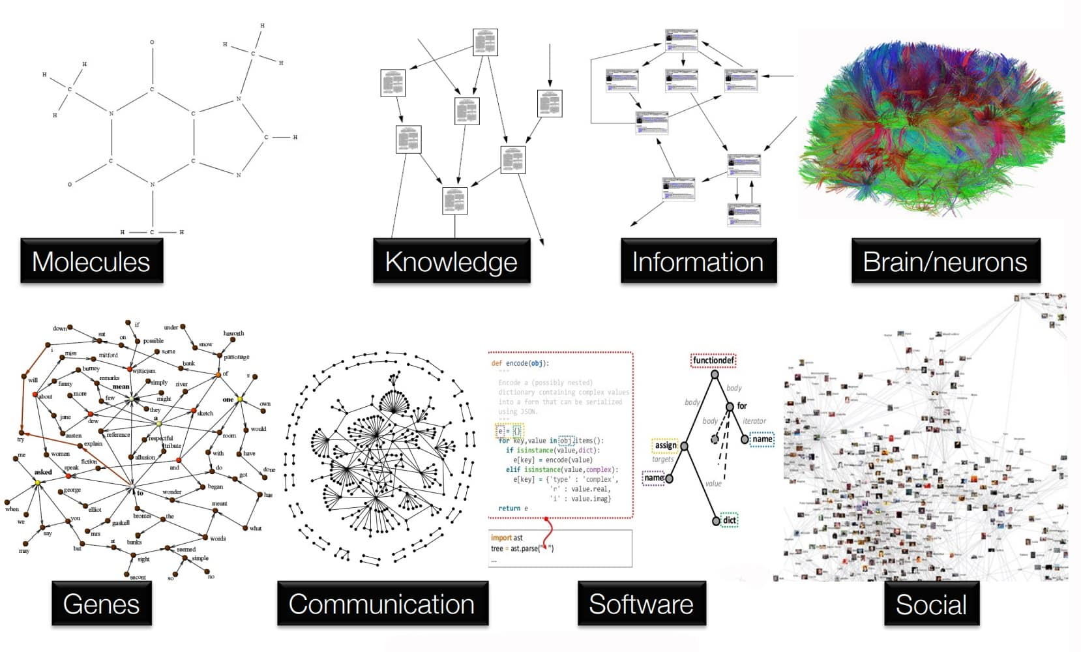
Abstract of Graph Neural Networks(GNNs)
Goal:
•Dive into the core mechanisms of GNNs
•Approach various projects that reflect the idea of GNNs such as efficient organization of data and scalability.
•This research is not just an exploration of GNNs, but an important step towards future innovations in the era of big data and AI.
<Example of what GNNs can be used
for>

Slide 3
Learning Python{Week 1}
Shamil_Imakaev.html
Python is a high-level, interpreted computer language that is known for its readability, large standard library, and wide range of uses in areas like web development, data analysis, artificial intelligence, and scientific computing.
Went through the basics of Python during the first week
Setting up Jupyter Notebook with Python
}
Python

Slide 4
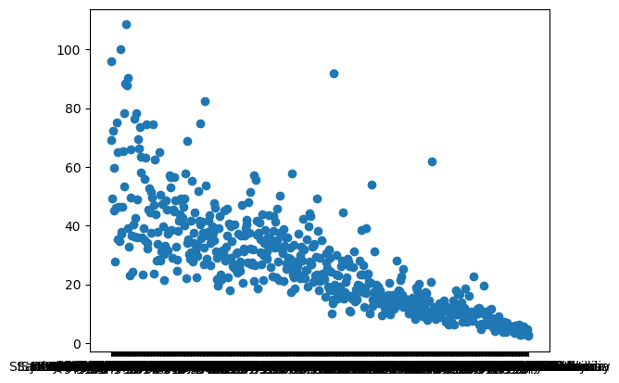
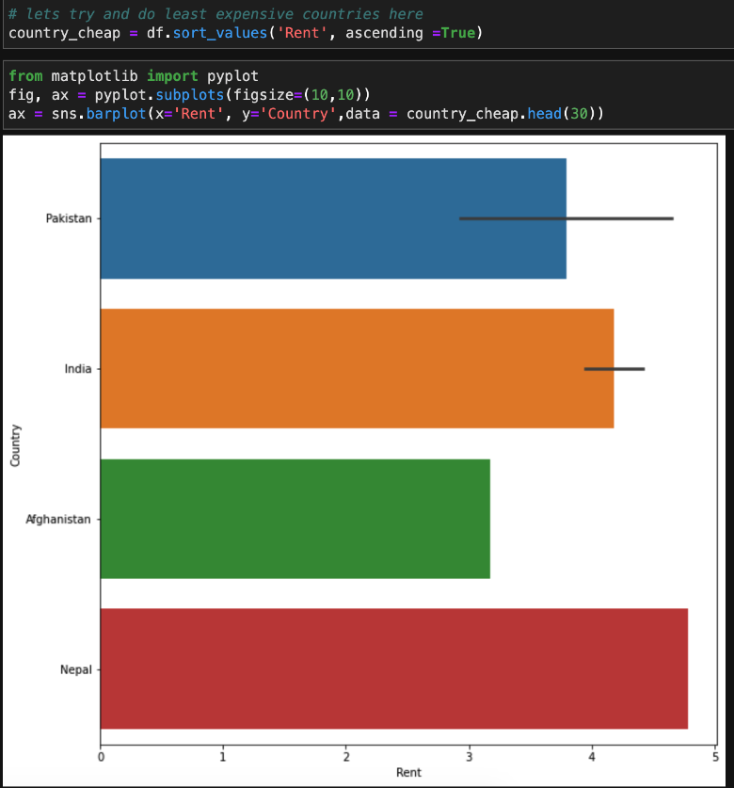
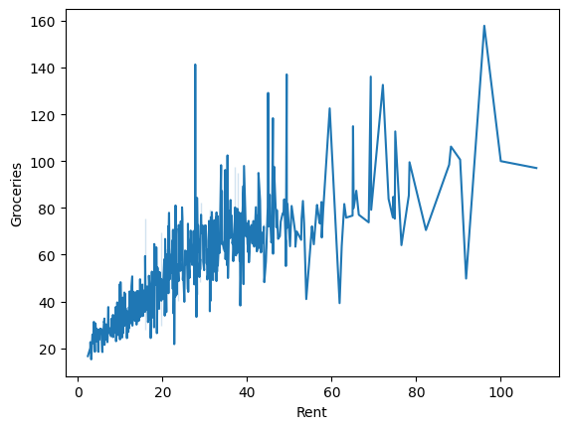
Jupyter Notebook{Week 2}
Shamil_Imakaev.html
Data_Visualization.ipynb
[Introduction to Data Visualization in Python}
We utilized Pandas with Python, which is a is an open source Python package primarily used for data science and machine learning tasks.
[Matplotlib]
Used matplotlib package with our data, which is Matplotlib is a plotting library in Python for creating static, animated, and interactive visualizations in 2D and 3D.
Some visualized Data from Cost Living Index of Cities
Python

Slide 5
Yearly Savings Project{Week 3 and 4}
Solved a problem on our own and entered a prompt in ChatGPT 4 to see the difference of our own work and AI.

Slide 6
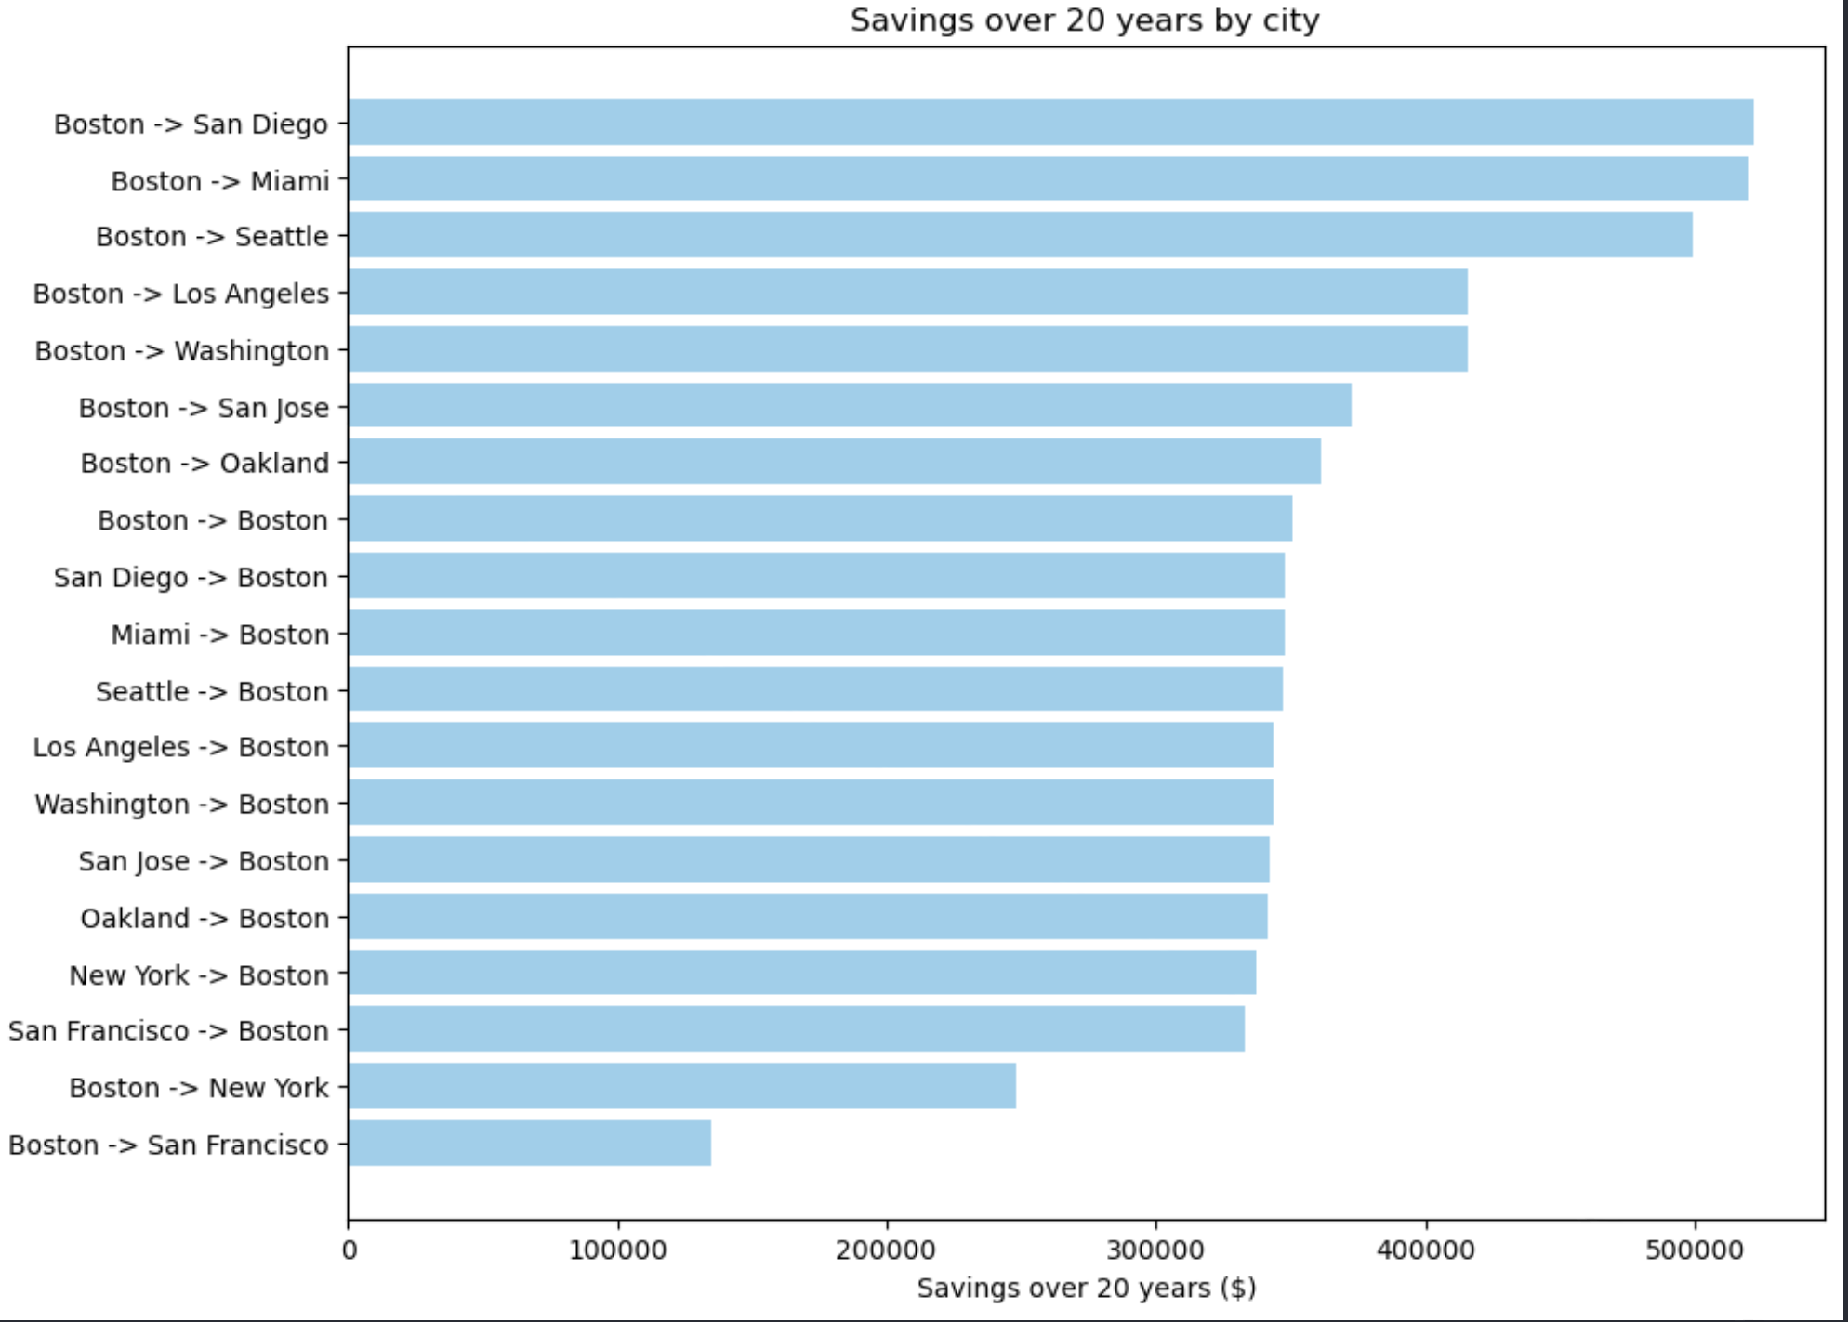
Yearly Savings Project{Week 3 and 4}
Shamil_Imakaev.html
Yearly_Savings.ipynb
The AI not only showed cheapest city to live in, but also cheapest starting -> endpoint.
Python

Slide 7
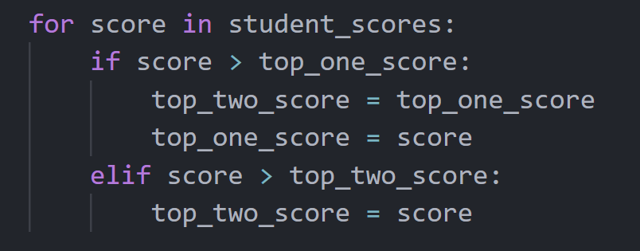
Top K Algorithm{Week 5 & 6}
Shamil_Imakaev.html
Top_K.ipynb
Randomly generated scores
Algorithm project to find top one and two scores
Top-k; type of algorithm that returns the k most important or relevant elements from a set of data. The k elements can be defined by their size, their value, or their ranking.
[55 73 73 45 15 81 13 48 72 98]
Python

Slide 8
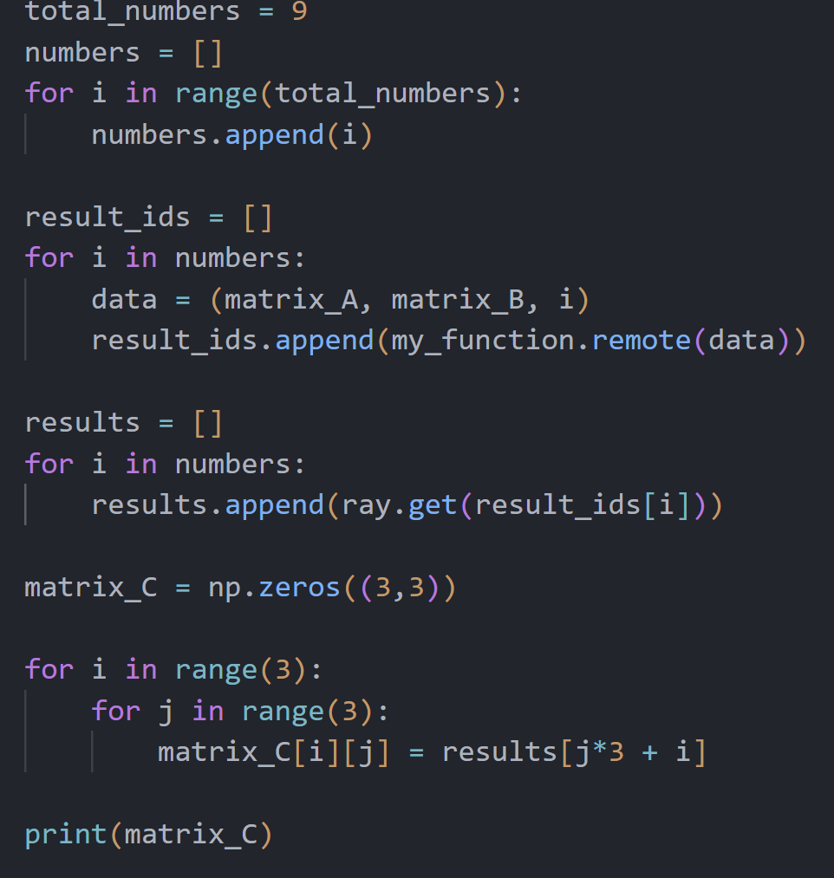
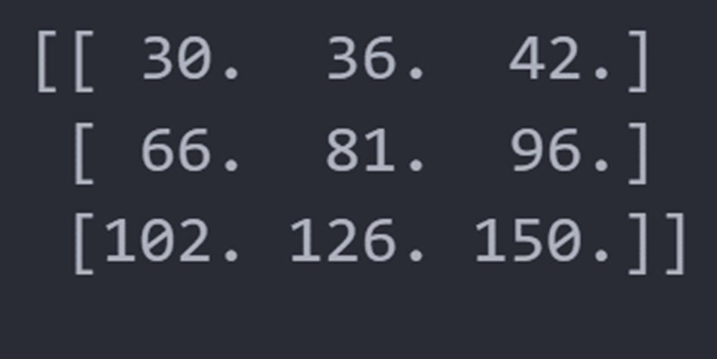
Matrix Multiplication{Week 7 & 8}
Shamil_Imakaev.html
Matrix.ipynb
Had an algorithm to divide the multiplication process of the program, and do each operation simultaneously.
The work is distributed through all the cores in the CPU when the program is run.
Task was to multiply two(A and B) matrices, to get the values into a (3,3) matrix labeled C
Python

Slide 9
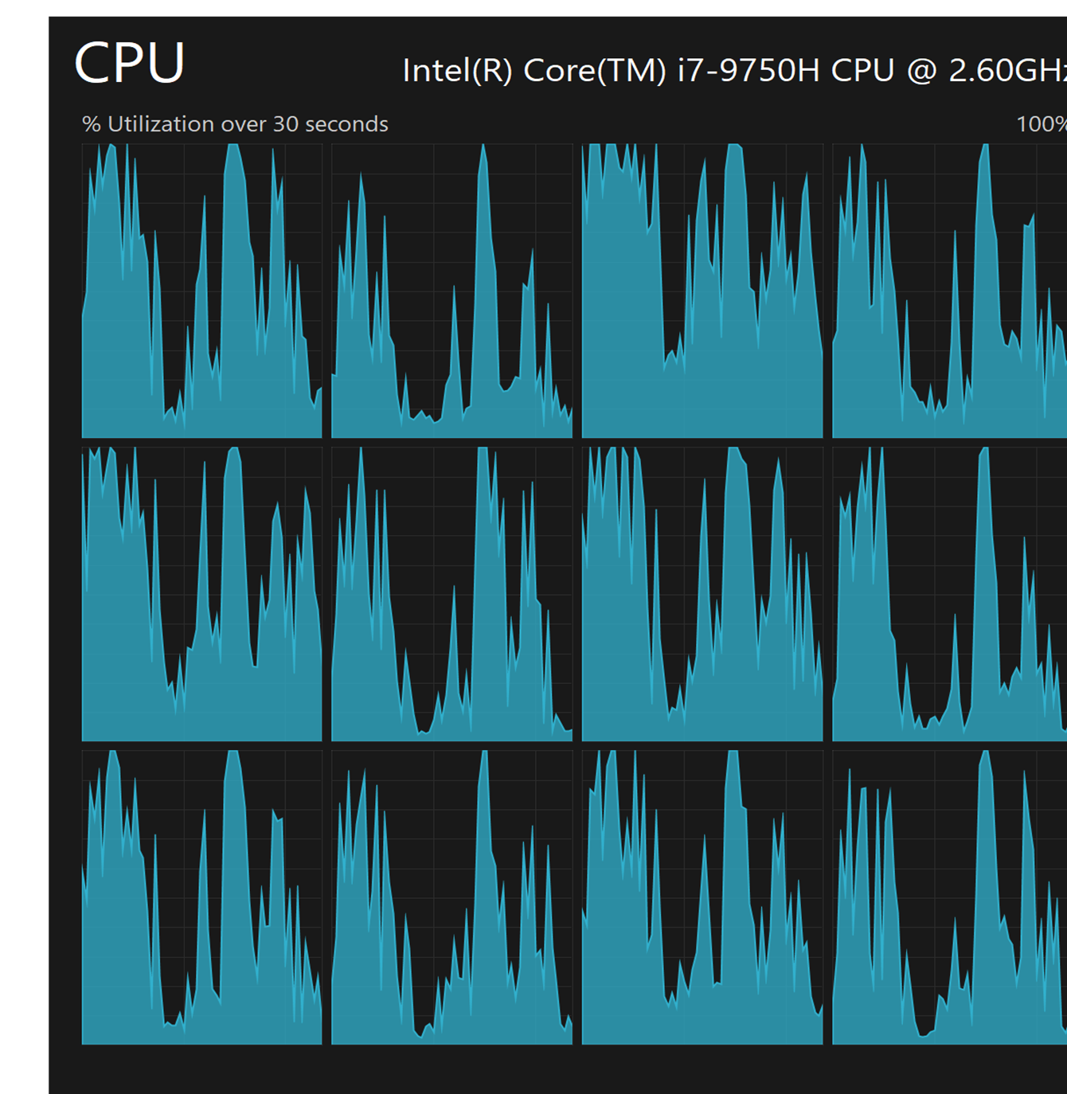
Matrix Multiplication{Week 7 & 8}
Shamil_Imakaev.html
Matrix.ipynb
<When running the code, we can see the CPU using all of its cores to run the multiplication problem simultaneously instead of doing each operation individually
<Multithreading speeds up the computation of matrix multiplication by dividing the problem into smaller tasks that can be executed in parallel
The number of threads that can be used depends on the number of cores available on the CPU
Python

Slide 10
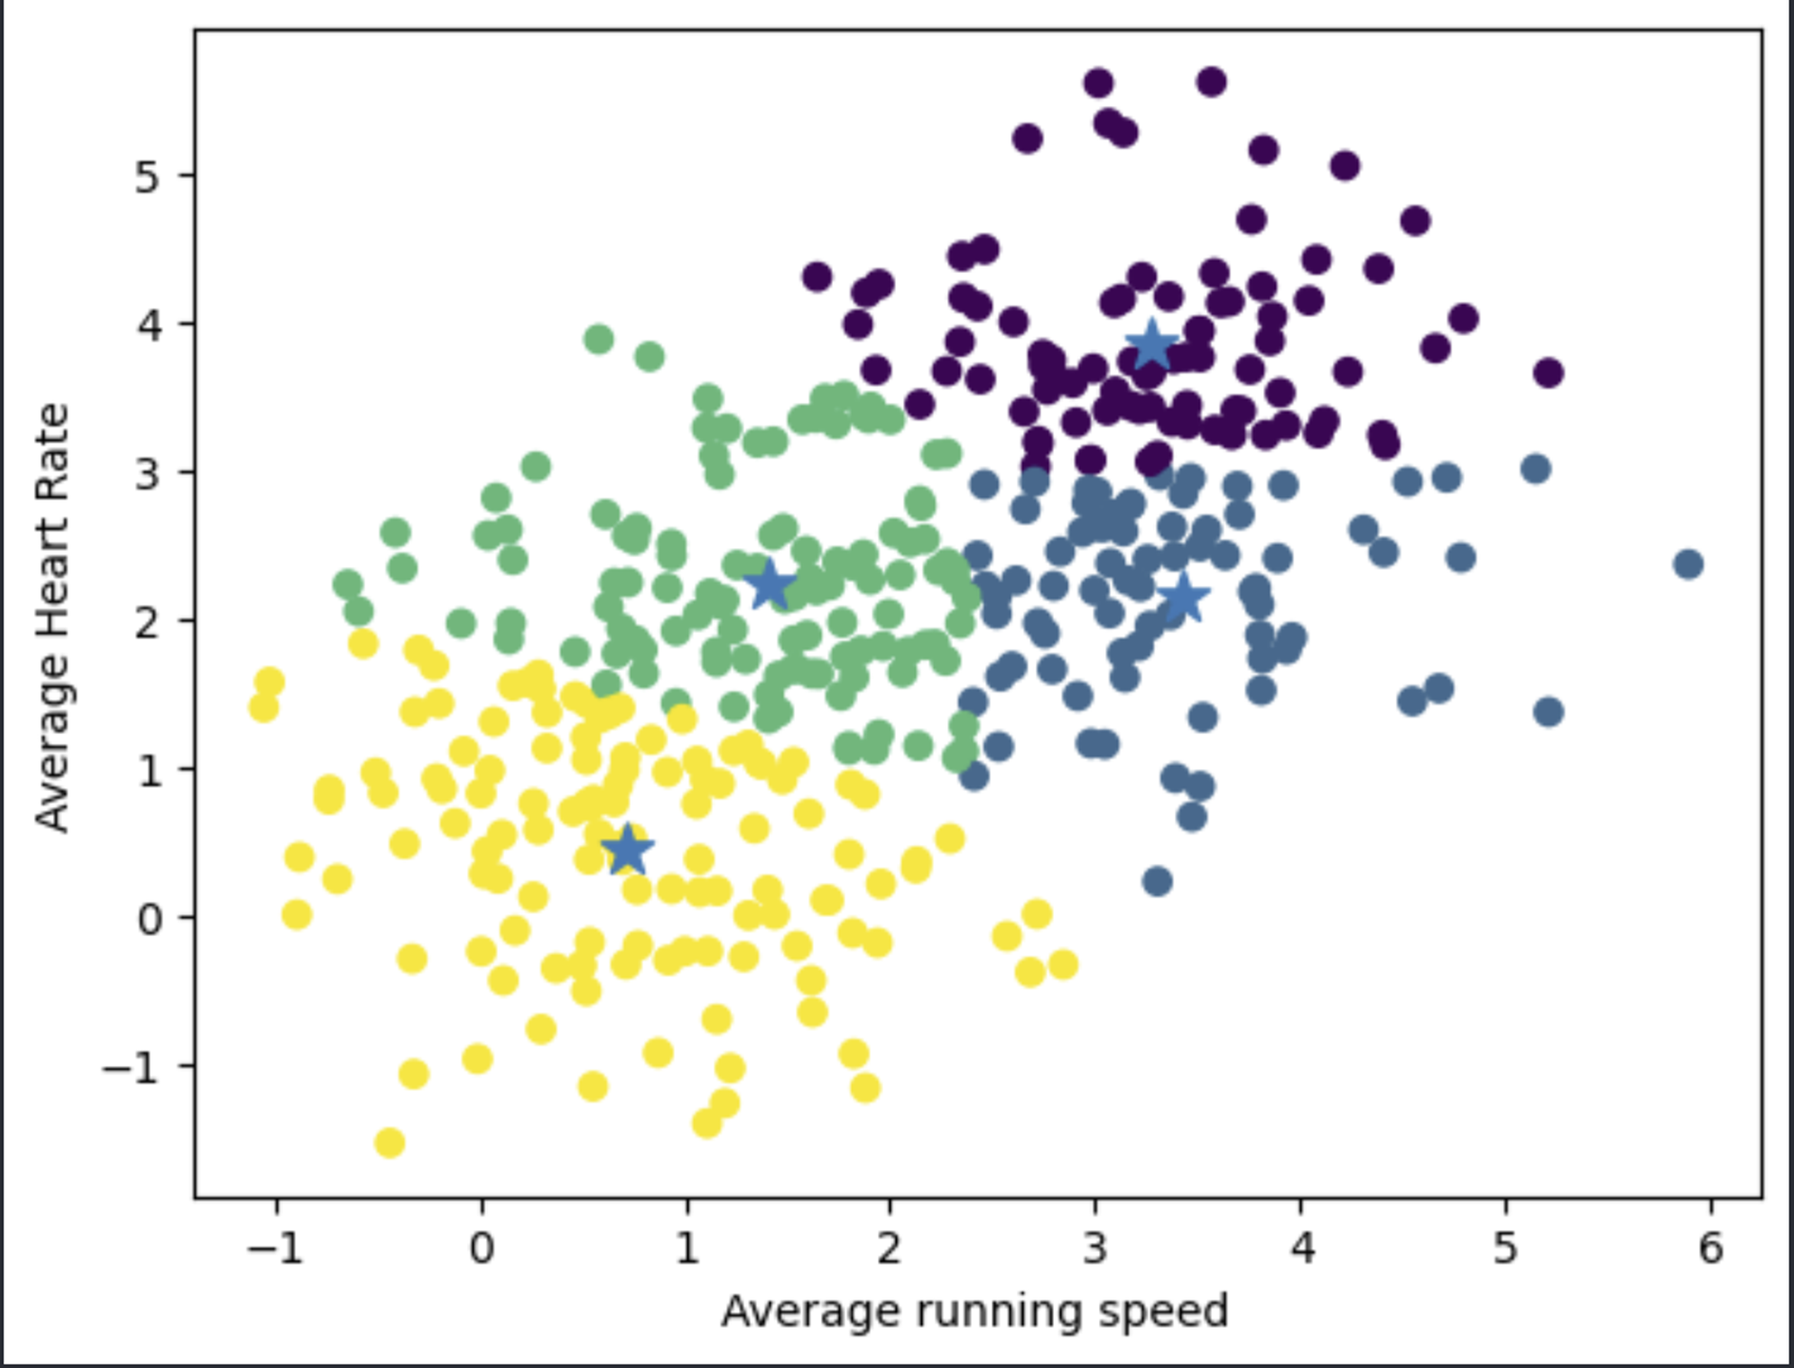
Clustering {Week 9}
Shamil_Imakaev.html
K-Means.ipynb
Grouped a data set into clusters
Multiple centroids on scatter plot to group data into different clusters
•The K-means algorithm groups data points together based on how similar they are
•It does this by first randomly selecting k points, called centroids, to represent each cluster
•Then, it assigns each data point to the cluster with the nearest centroid
•Finally, it updates the centroids to be the average of all the data points in their respective clusters
•This process repeats until the centroids no longer change
Python

Slide 11
Summary
Parallel Computing:
•Important operation in GNNs as they often involve multiple nodes and edges. The application of parallel computing in matrix multiplication shows how GNNs perform operations on different nodes simultaneously
Data Visualization:
•GNNs deal with complex, high-dimensional data. Understanding this data and the results of GNNs can be done through visualization. The skills learned in creating bar graphs and scatter plots can be applied to visualize GNN results.
Multi-threading:
•Crucial for efficient GNN operations. The Matrix Problem gives a better understanding of efficient GNN computation
K-Means Clustering:
•Method that clusters data based on similarity, shows how GNNs group nodes in the network. Understanding K-means clustering helps in comprehending how GNNs can classify nodes or communities in a network.

Slide 12
{Acknowledgements}
• Claire Duggan - Executive Director
• Jennifer Love - Associate Director
• Nicolas Fuchs - Program Manager
• Mary Howley - Administrative
• Lydia Bird - REU Coordinator

