Slide 1
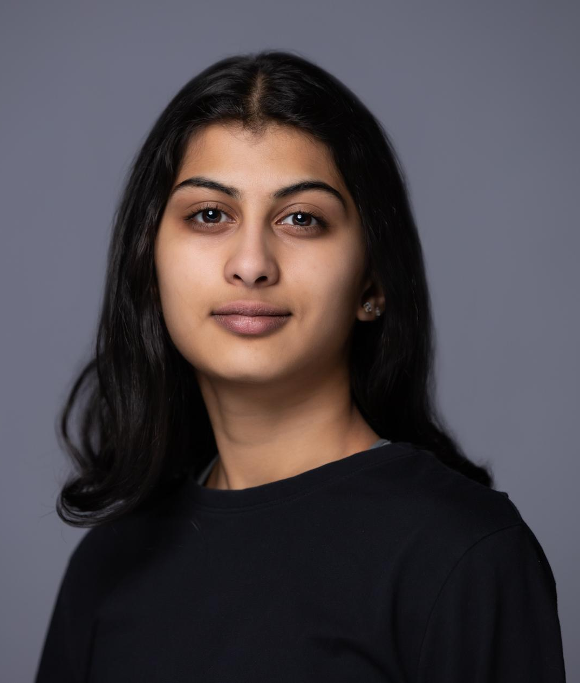
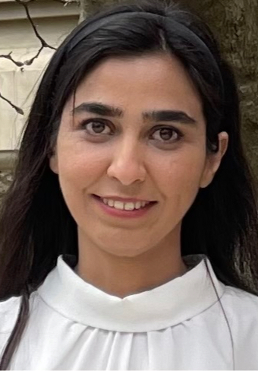
Computer Vision and Its Applications in Infant Health Monitoring
Muskan Kumar Undergraduate Student, Massbay Community College
Professor Sarah Ostadabbas, Electrical and Computer Engineering, Northeastern University
Elaheh Hatami, Post-Doc Research Fellow, Northeastern University
NEU REU Summer Program 2023 - August 2, 2023

Slide 2
Abstract
In the US, around 7% of children have neurodevelopmental delays, but only ⅓ of children under 5 receive recommended screenings.
Delayed screening can negatively impact children at risk for conditions like autism and cerebral palsy, leading to challenges in academics, social interactions, and long-term development.
This research aims to develop a device for developmental screenings and motor abnormality detection in infants, utilizing computer vision and machine learning.
The research is centered around understanding, identifying, and predicting infant behaviors, approximating their behavioral, physical, and psychological conditions.
The data derived from skeleton-based representations will be used to train deep neural networks to detect infant abnormalities automatically.
NEU REU Summer Program 2023 - August 2, 2023
Notes:
Home-based smartphone videos across diverse infant groups.

Slide 3
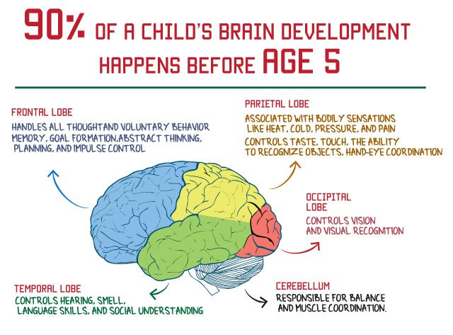
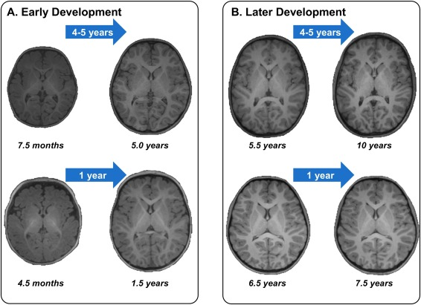
Background: Neurodevelopment
Neurodevelopment refers to the growth and organization of the central nervous system and its functions establish the functional abilities of a child later in life.
Major developmental milestones are reached during the first few years of a child's life.
Developing gross motor skills, language abilities, and problem solving skills—all skills that influence each other.
Turesky, Ted K, et al. “Imaging the Rapidly Developing Brain: Current Challenges for MRI Studies in the First Five Years of Life.” Developmental Cognitive Neuroscience
“Importance of Brain Development in the First Five Years.” Theme Loader
NEU REU Summer Program 2023 - August 2, 2023

Slide 4
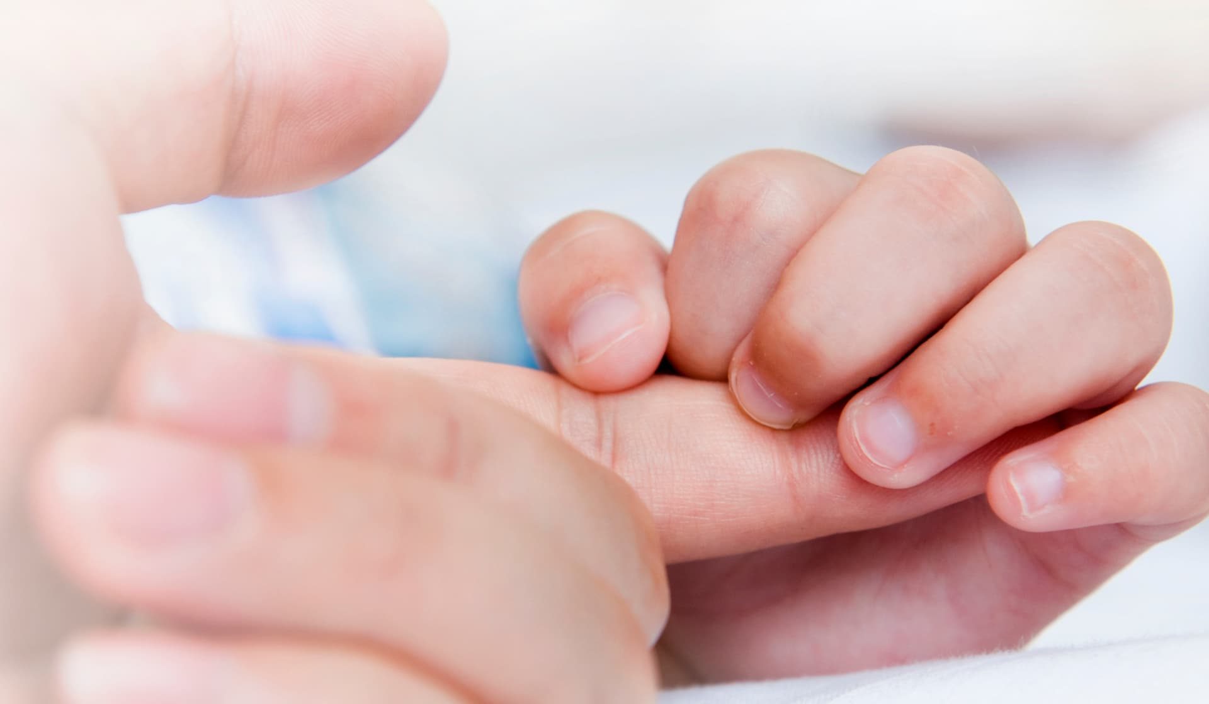
Neurodevelopmental Disorders
Neurodevelopmental delays (NDDs) may happen from early development up to around 5 years old and may last throughout a person's life
Delayed NDD screenings can adversely affect at-risk infants and children, following a lack of timely support , difficulties in social interactions, performance in school, and other aspects of long-term development
NDD Examples
Congenital torticollis
Cerebral Palsy
Autism spectrum disorder
“Screening for Professionals.” Centers for Disease Control and Prevention
NEU REU Summer Program 2023 - August 2, 2023
Brown, Stephanie. “Why Your Newborn Has a Grasping Reflex.” Verywell Family,

Slide 5
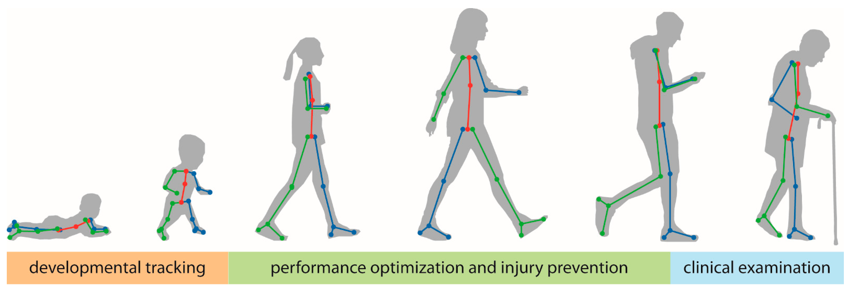
Learning Algorithms: Pose Estimation
Pose estimation is a focus of computer vision that studies quantifying the position and orientation of a person as a visual representation of action
Kinematic Model
Locating key points on a human, such as hands, elbows, and fingers.
Information can be interpreted through pose estimation
An automated AI model to provide low dimensional representation of body states
Kojovic, Nada, et al. “Using 2D Video-Based Pose Estimation for Automated Prediction of Autism Spectrum Disorders in Young Children.” Nature News
Stenum, Jan, et al. “Applications of Pose Estimation in Human Health and Performance across the Lifespan.” MDPI
NEU Research Undergraduate Program 2023 - August 2, 2023

Slide 6
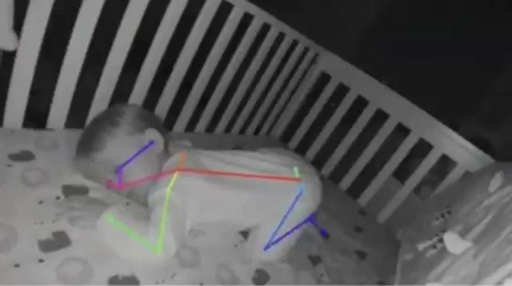
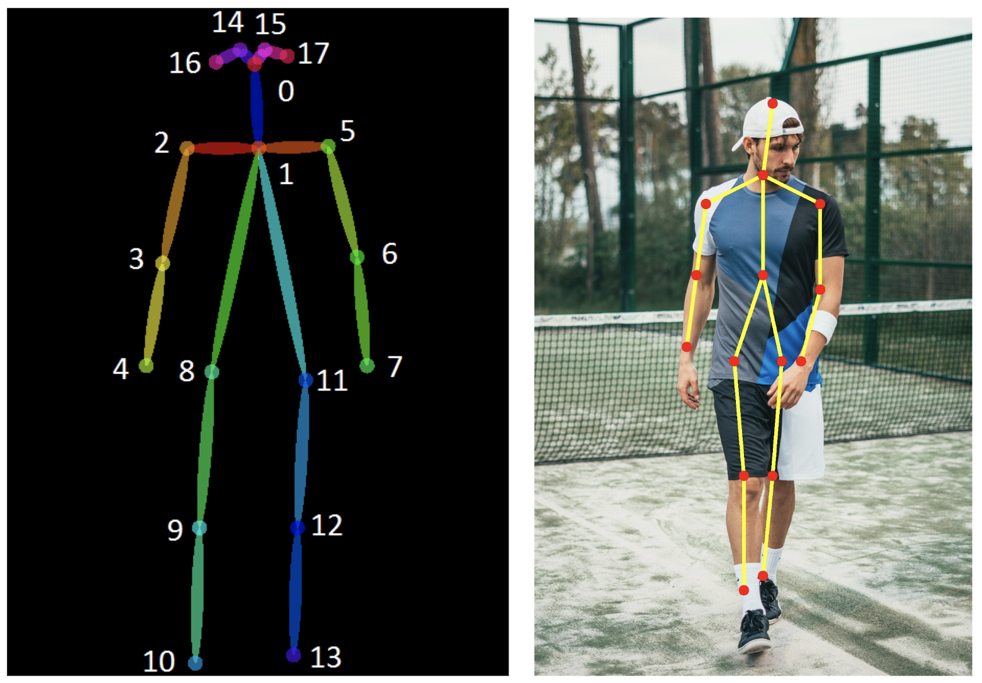
Pose Estimation: Domain Gap Adults vs. Infants
Ostadabbas, Sarah. “Game-Changing Startup by EAI Faculty Member Introduces AI to Baby Monitors.” Institute for Experiential AI
Walia, Mrinal Singh. “A Comprehensive Guide on Human Pose Estimation.” Analytics Vidhya
Infants have a very different muscle to bone ratio
Infant data requires additional privacy preserving components
Adults have longer limbs
Adults have more versatility in their poses
Gap between infant and adult action
Kojovic, Nada, et al. “Using 2D Video-Based Pose Estimation for Automated Prediction of Autism Spectrum Disorders in Young Children.” Nature News,
NEU Research Undergraduate Program 2023 - August 2, 2023

Slide 7
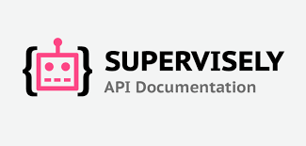
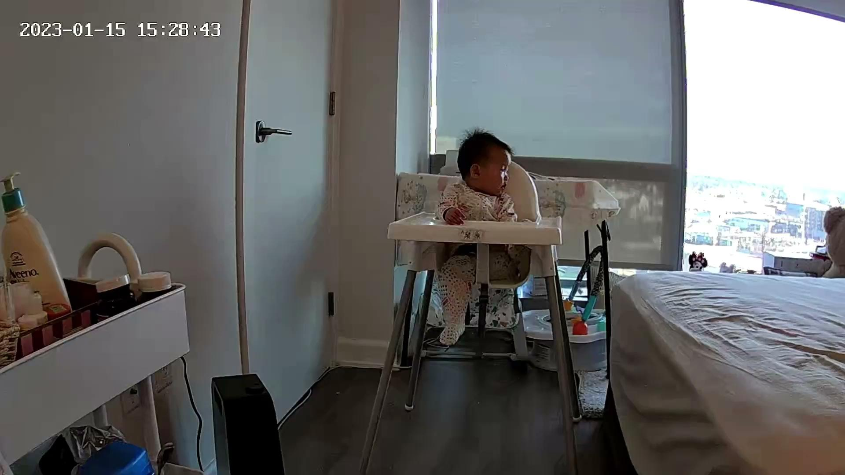
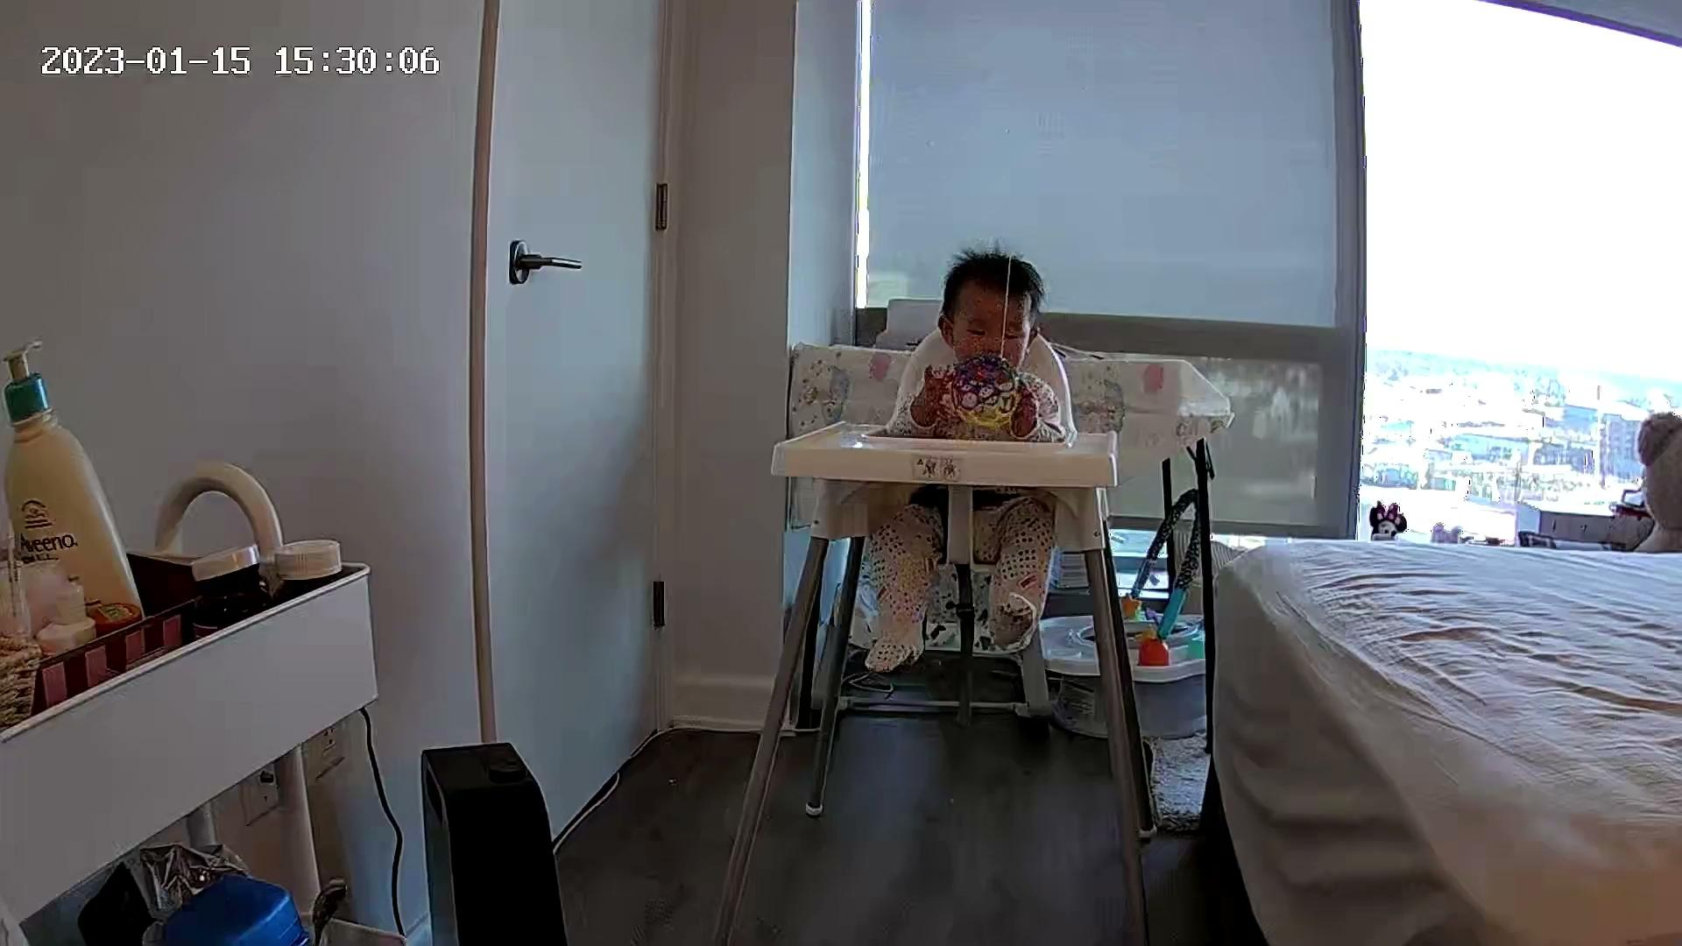
Pipeline
Videos
Annotate
Clips
Analysis
Images
Pose Estimation
NEU Research Undergraduate Program 2023 - August 2, 2023

Slide 8
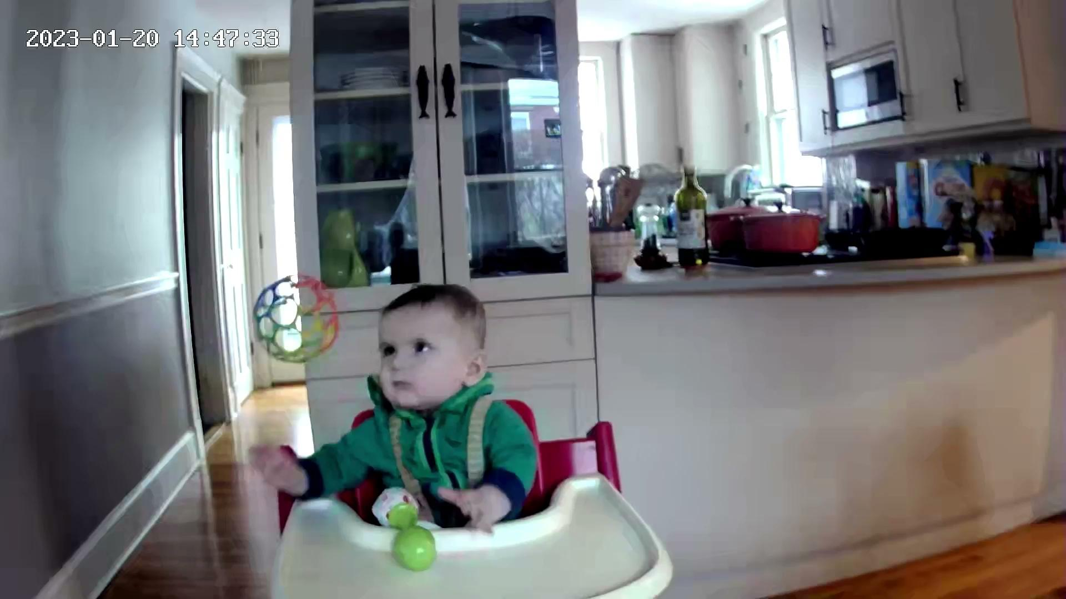
Action Data Collection
3-5 second diverse real infant clips
Infants interacting with their natural environment
Motor Skills and action:
Holding
Grabbing
Reaching
Train & strengthen deep neural network
Ex. Grasping Clip, Infant 3
NEU Research Undergraduate Program 2023 - August 2, 2023

Slide 9
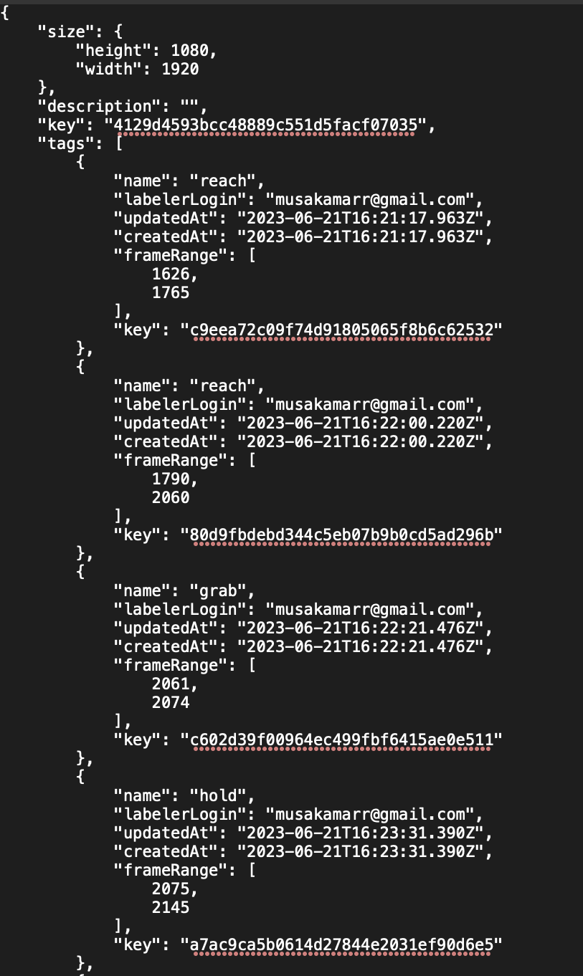
Data Collection: Annotation
Supervisely: annotate raw home videos
Analyzing, verifying and annotating the frame-by- frame action for the different motor functions displayed helps the machine learning models interpret the data
Strengthen the machine learning model
Created a .json file for the keys, classes and frame tags
NEU Research Undergraduate Program 2023 - August 2, 2023

Slide 10
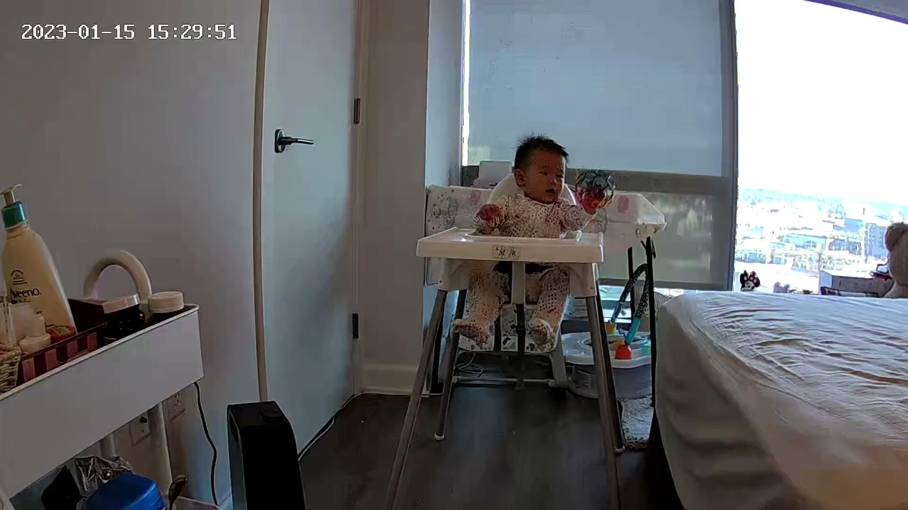
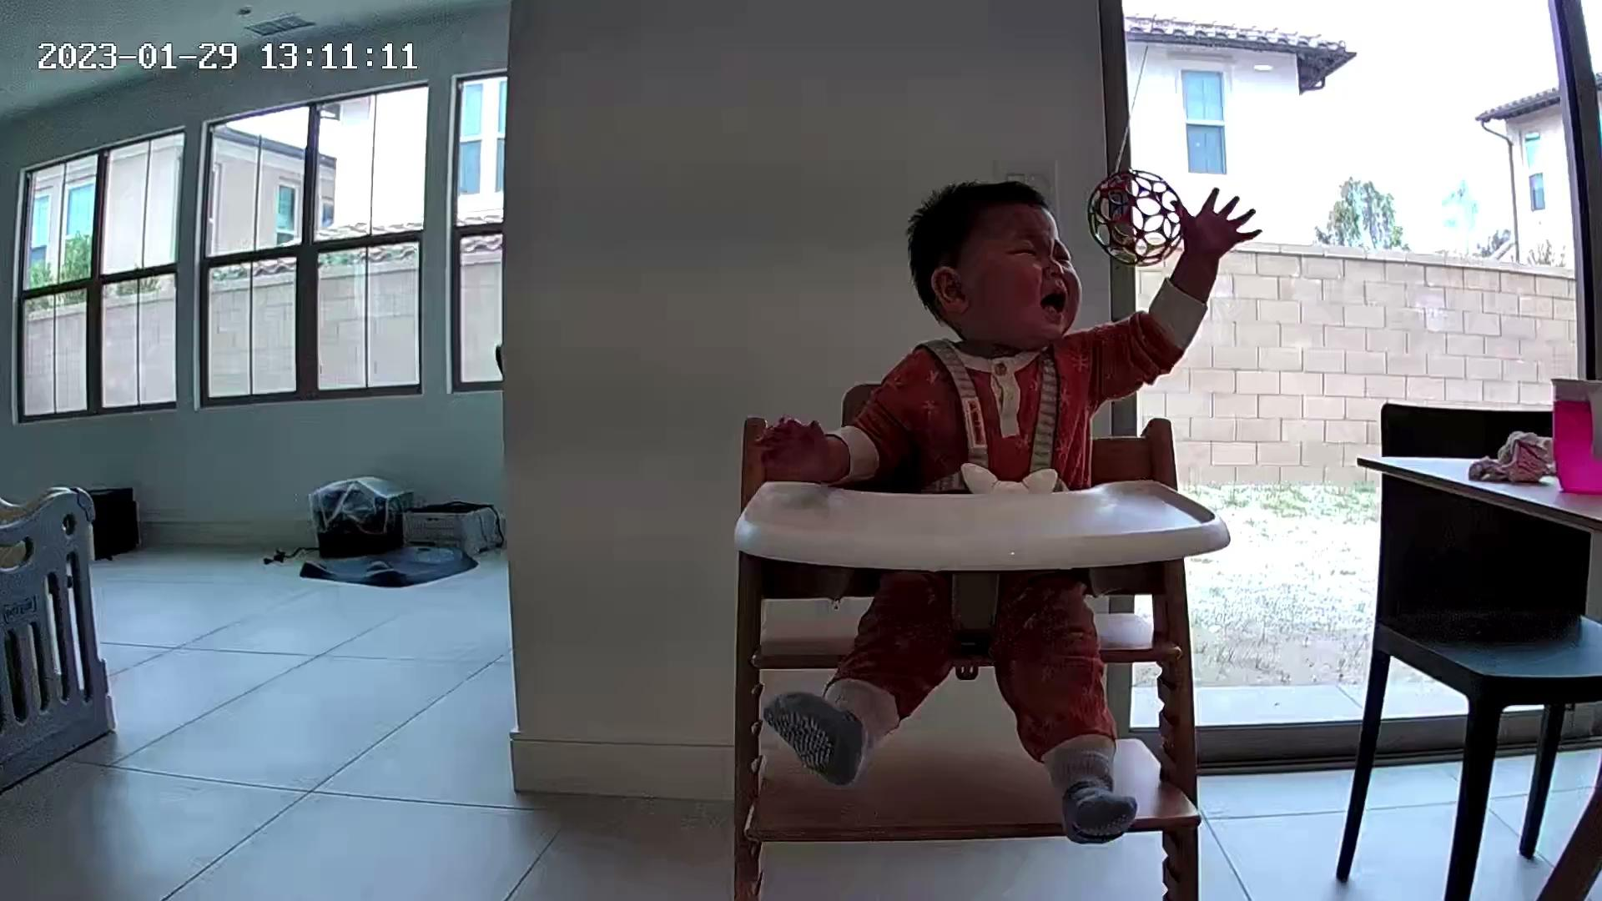
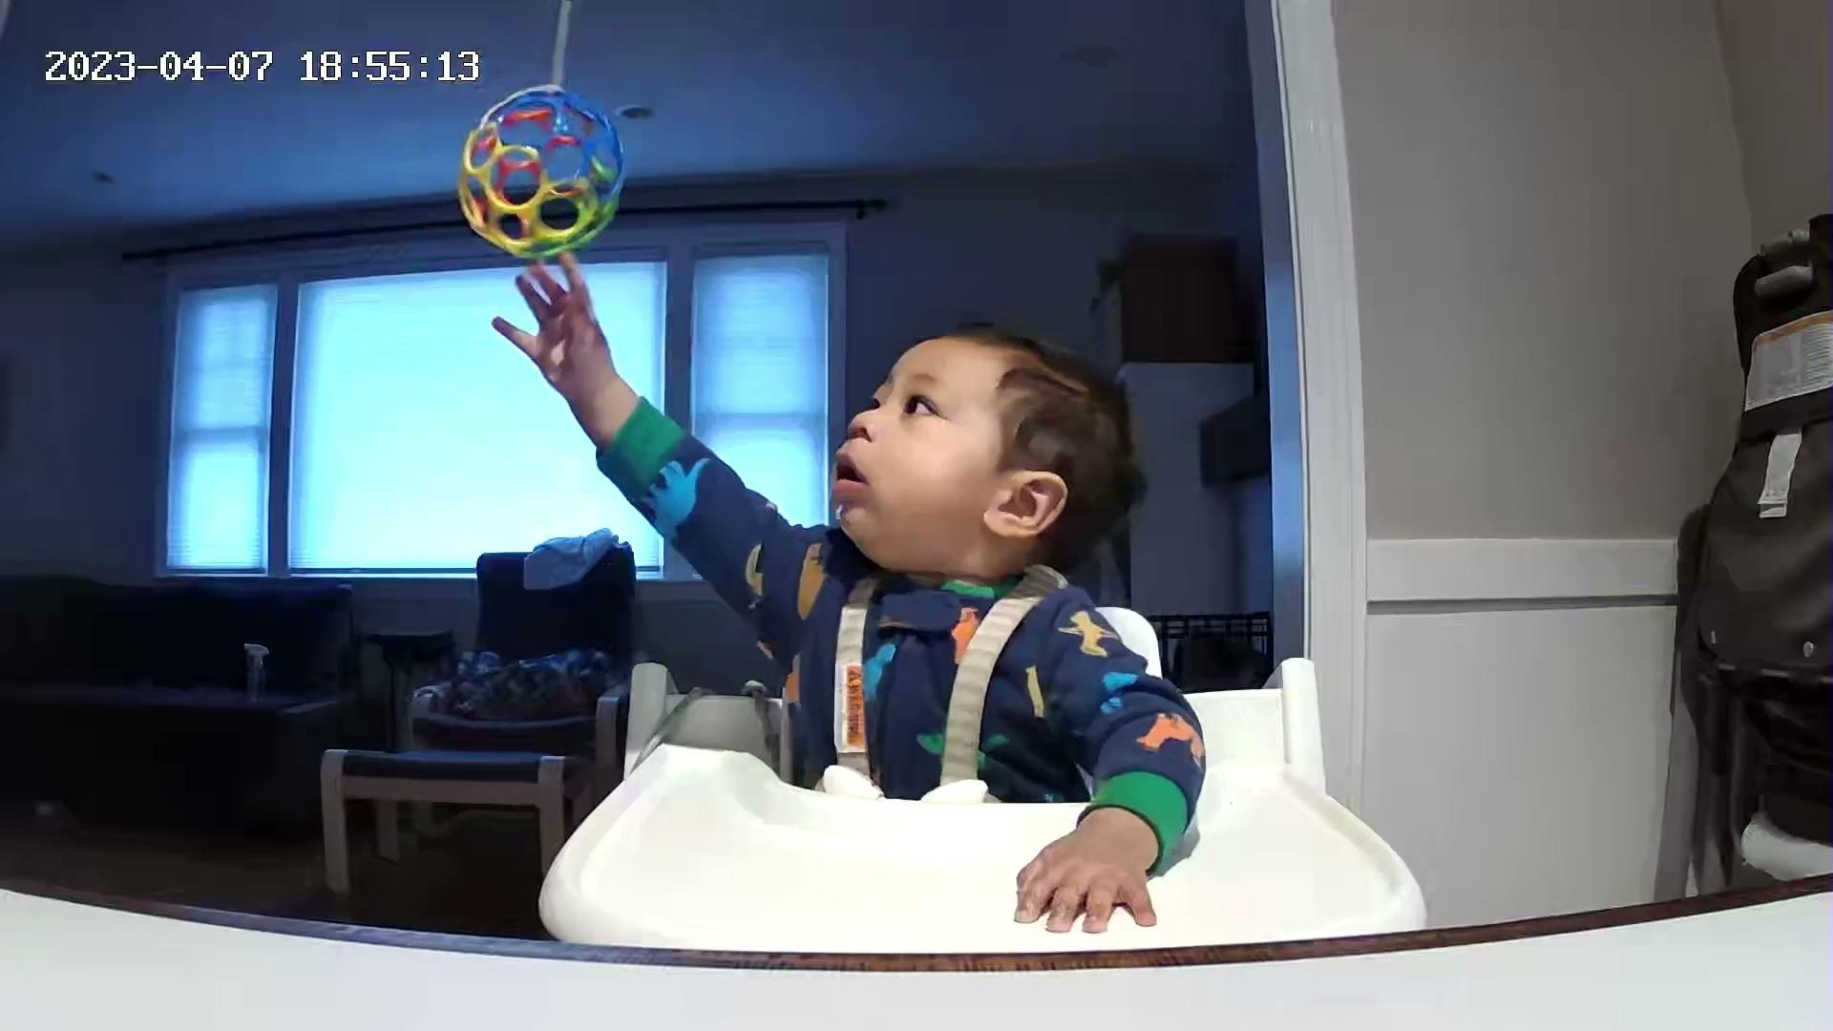
Examples of Actions
Ex.Infant 2, reaching
Ex.Infant 5, holding
Ex.Infant 3, grabbing
NEU Research Undergraduate Program 2023 - August 2, 2023

Slide 11
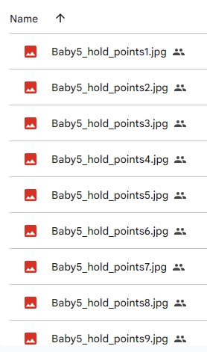
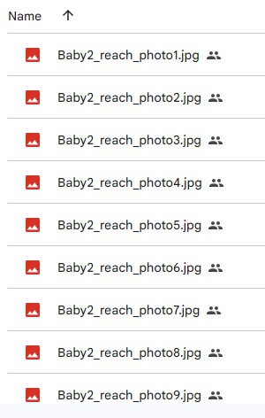
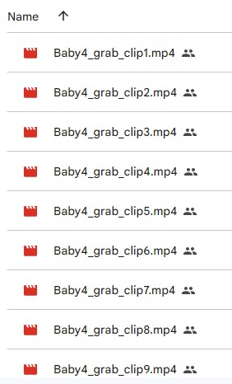
File Identities:Actions
Ex Infant 5
Holding
Ex Infant 5
Grab
Ex Infant 5
Reach
File naming identities for all the data had to be easy to read, find executable by researchers, as well as artificial intelligence models.
NEU Research Undergraduate Program 2023 - August 2, 2023

Slide 12
Observation Collection
Each infant’s movements when performing various atomic actions were highlighted.
Ex.The hand used when interacting with the ball and the ball’s relative position.
Clip Title | Baby | Hand | Ball | Comment
Infant2_reach_clip1 | Infant 2 | Left | Left
Infant2_reach_clip2 | Infant 2 | Left | Left
Infant2_reach_clip3 | Infant 2 | Left | Left
Infant2_reach_clip4 | Infant 2 | Both | Both | Ball was swinging from side to side, baby extended left arm more than right arm
Infant2_reach_clip5 | Infant 2 | Left | Left | Ball was swinging a little and went over baby's head
Infant2_reach_clip6 | Infant 2 | Left | Left | Used left arm at first but raised right arm a little
Infant2reach_clip7 | Infant 2 | Left | Left | Right arm was out to the side at first
Infant2_reach_clip8 | Infant 2 | Both | Left | Right arm went from being up to being to the side
Infant3_reach_clip1 | Infant 3 | Right | Right
Infanty3_reach_clip2 | Infant 3 | Right | Center | Ball was in front of baby's face
Infant3_reach_clip3 | Infant 3 | Right | Center | Ball was in front of baby's face at first, then moved to the left, baby raised left arm
Infant3_reach_clip4 | Infant 3 | Left | Left | Ball was swinging on the left side, baby raised right hand a little
Infant3_reach_clip5 | Infant 3 | Both | Left | Left hand was higher than right hand
Infant3_reach_clip6 | Infant 3 | Both | Left | Ball was swinging a little, left hand higher than right hand
Infant3_reach_clip7 | Infant 3 | Both | Right | Baby was using right hand more, but both arms were up
Infant3_reach_clip8 | Infant 3 | Both | Right | Baby was using right hand more, but both arms were up
NEU Research Undergraduate Program 2023 - August 2, 2023

Slide 13
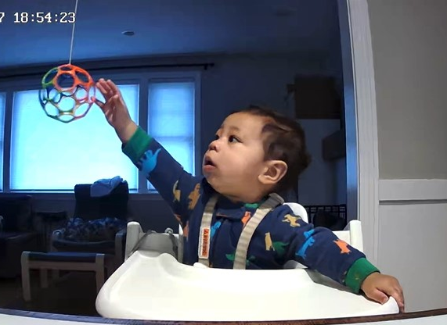
Bar Graphs: Reaching & Hand Used
Observations
Infants tend to use the hand closer to the ball
Bilateral integration
Coordinate both of the sides of the body
Crossing the body midline
Both sides of the brain are working
Ex. Infant 4, reaching left hand
Ex. Infant 5, reaching right hand
NEU Research Undergraduate Program 2023 - August 2, 2023

Slide 14
Bar Graphs: Grabbing & Hand Used
Observations
Infant 1 was distracted
Infant 5 became frustrated and more reactive when the ball was taken away
Ex. Infant 5, grabbing left side left hand
Ex. Infant 4 grabbing right hand right side
NEU Research Undergraduate Program 2023 - August 2, 2023

Slide 15
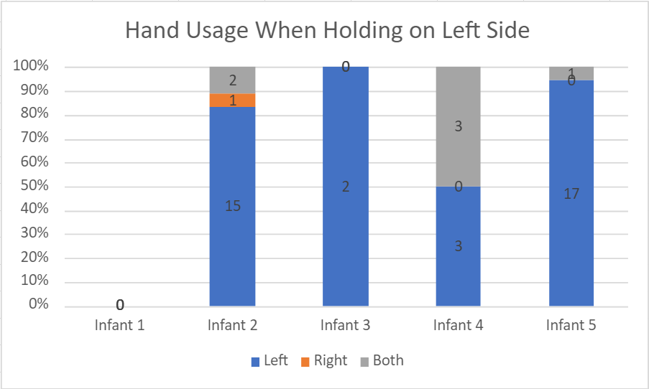
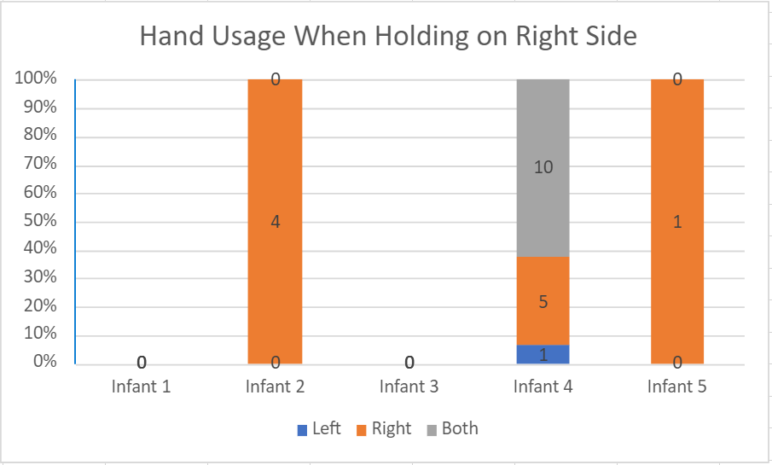
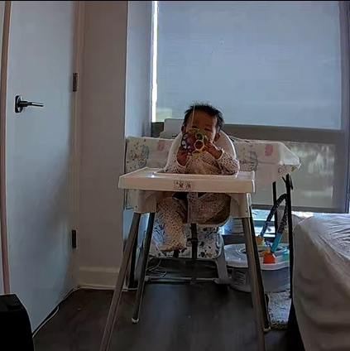
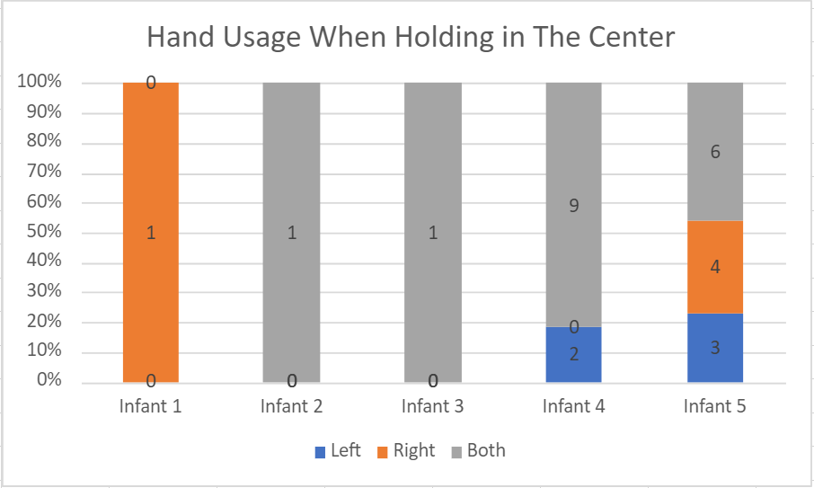
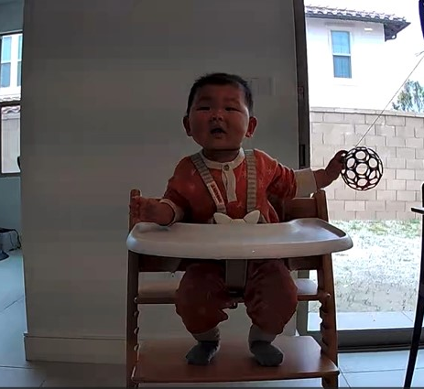
Bar Graphs: Holding & Hand Used
Ex. Infant 5 Holding Center
Ex.Infant 4 Holding Left
NEU Research Undergraduate Program 2023 - August 2, 2023
Ex. Infant 2 Holding Right

Slide 16
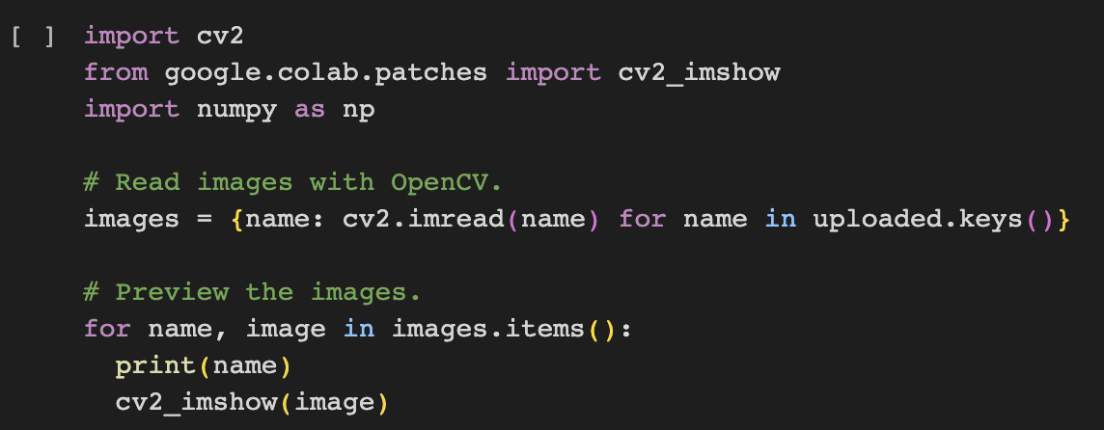
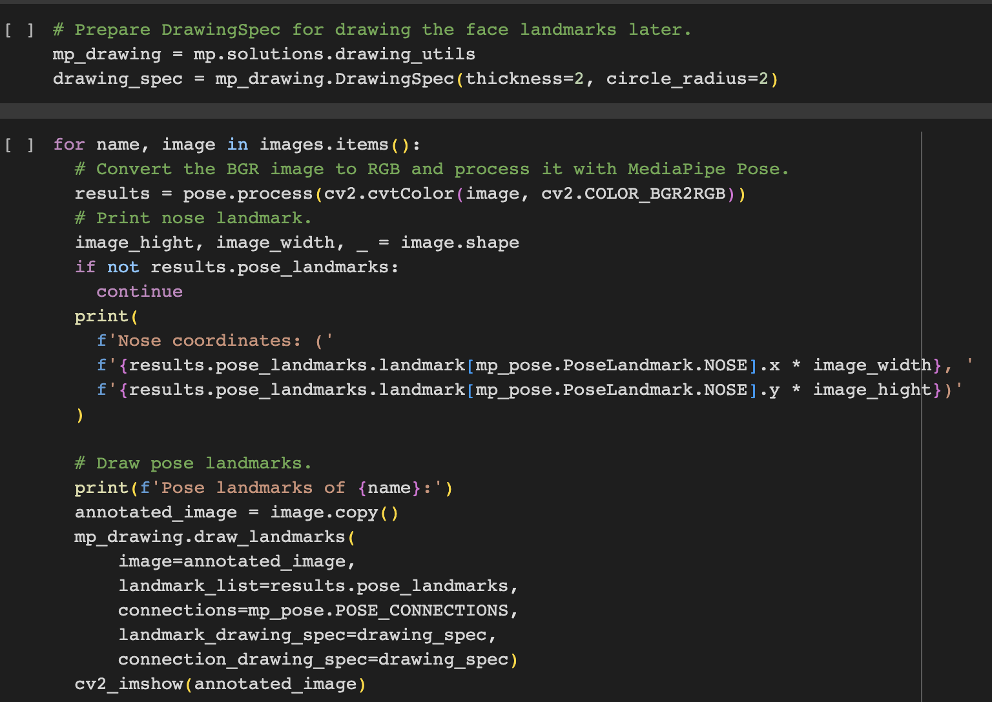
Machine Learning Python Code Pose Model
Public Semi-Automated Code
Install media pipe
Upload image
Import image
Prepare image
Receive pose estimated image
NEU Research Undergraduate Program 2023 - August 2, 2023

Slide 17
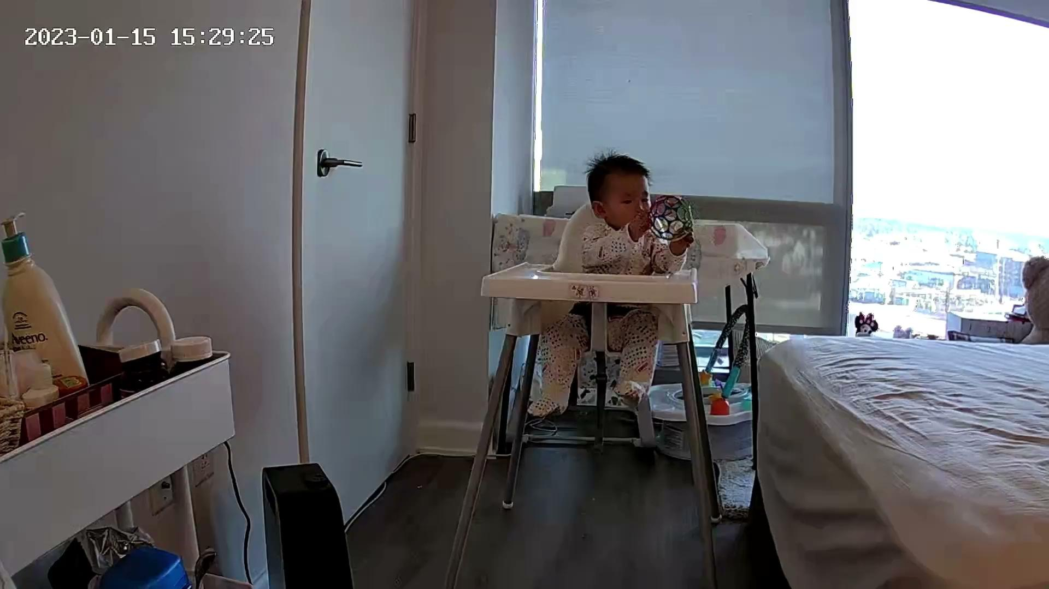
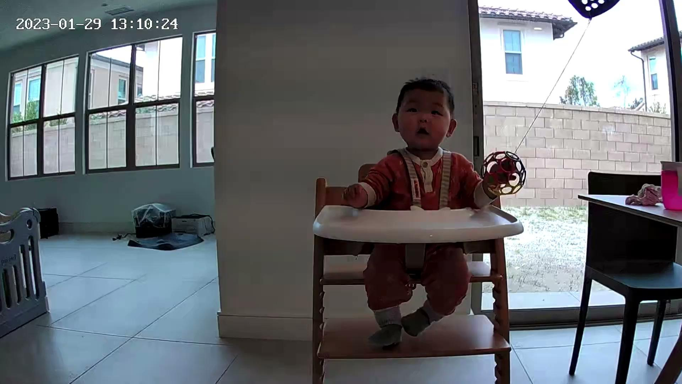
Action Collection: Video Clip Samples
Ex: Grabbing clip, Infant 5
Ex: Holding clip, Infant 2
NEU Research Undergraduate Program 2023 - August 2, 2023

Slide 18
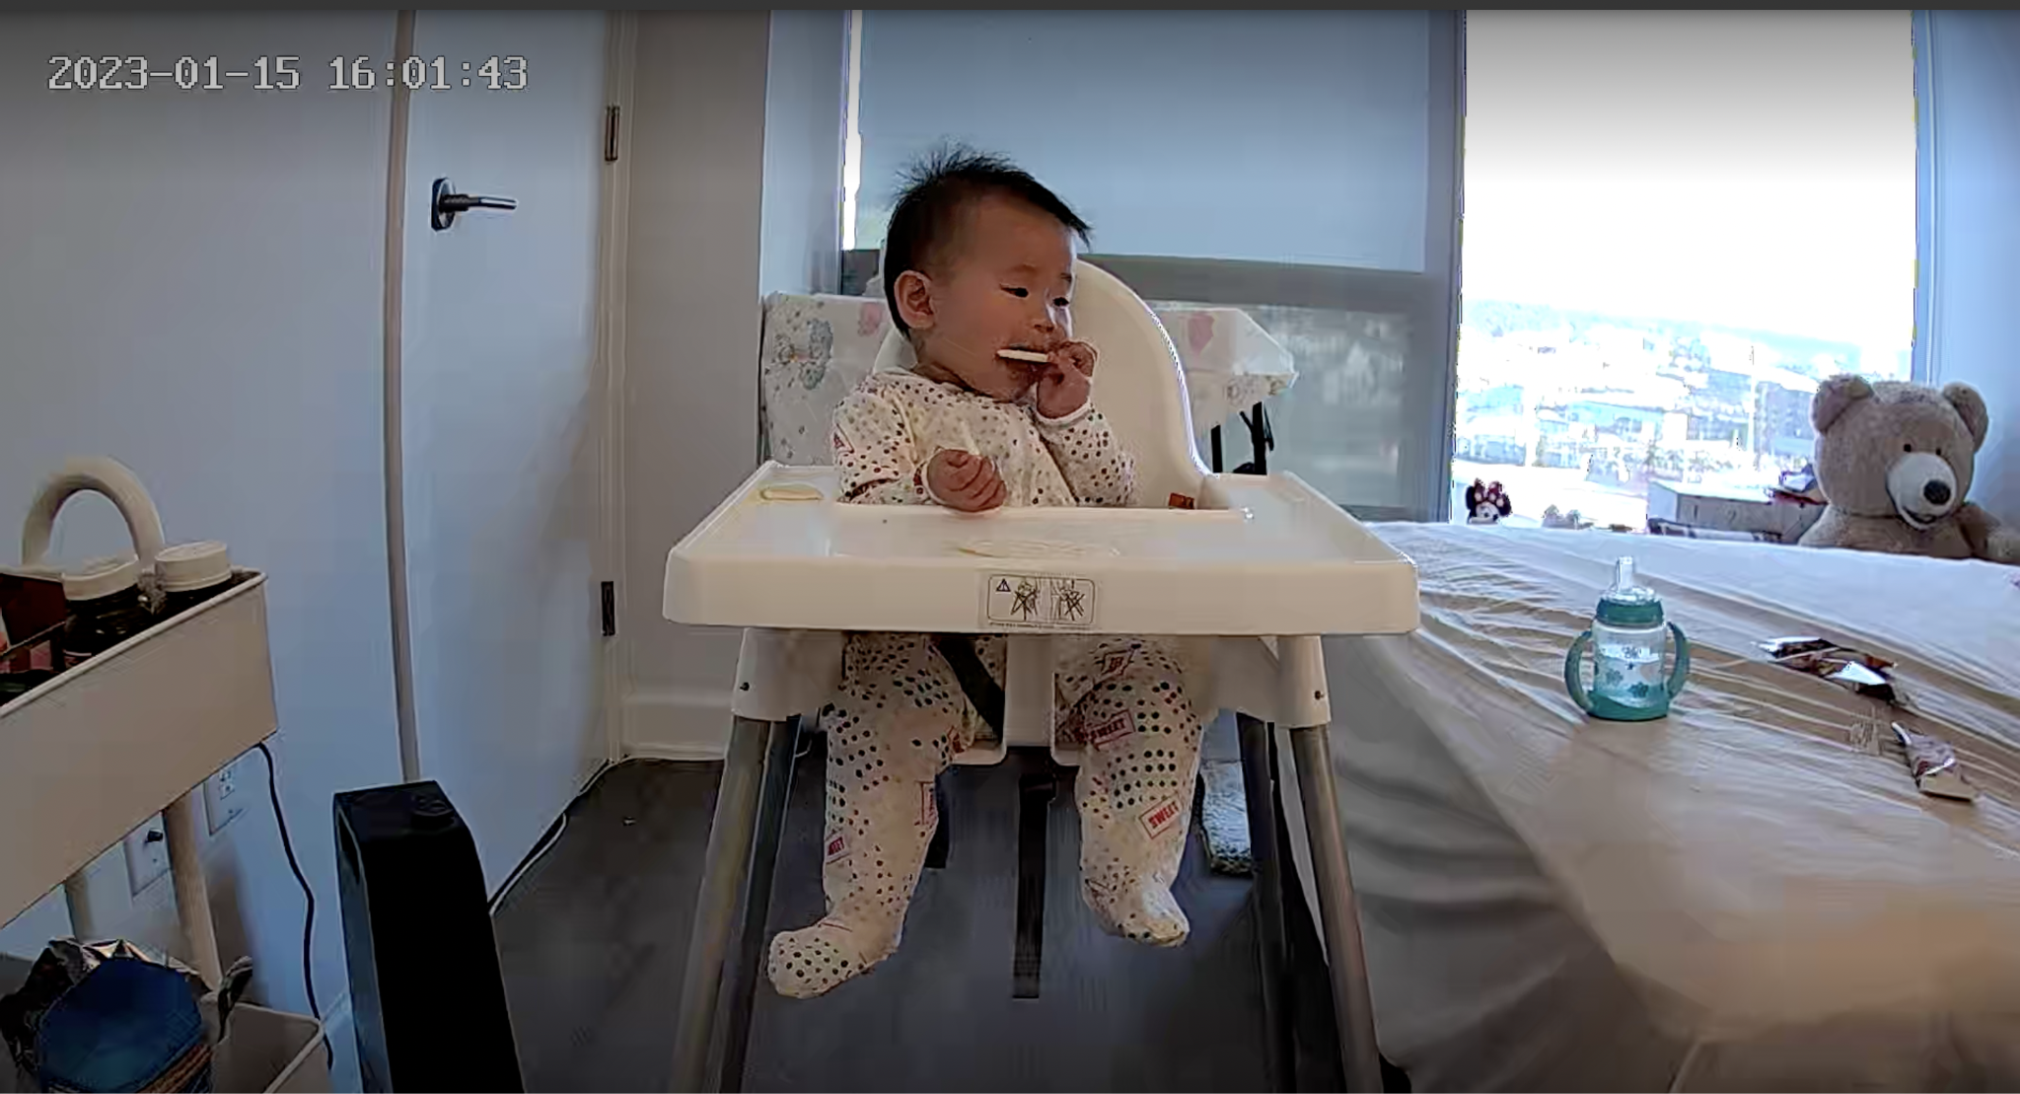
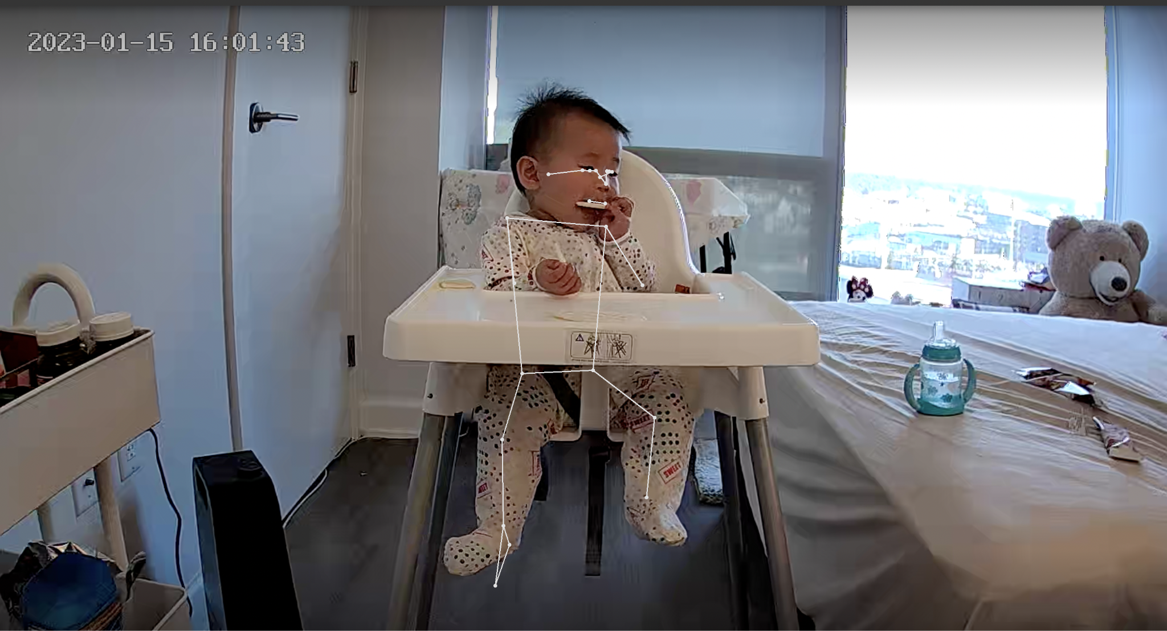
Pose Based Model Computer Vision
Ex. Infant 5, Holding
Ex. Infant 5, Holding
Algorithm Process Interface approximated the joint coordinates and pose onto the images as low-dimensional pose and body landmark representations.
NEU Research Undergraduate Program 2023 - August 2, 2023
Notes:
align to left

Slide 19
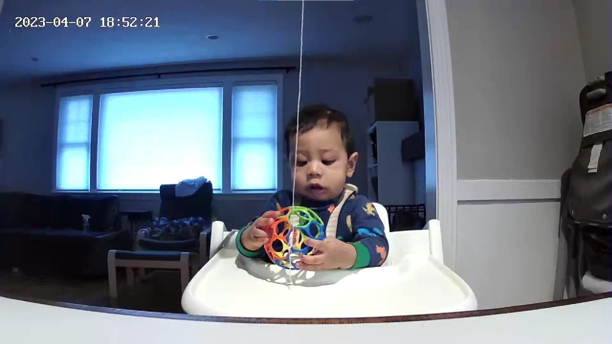
Pose Estimation Results
Ex. Holding Image, Infant 4
Ex. Holding Image, Infant 4
Priorities for Data Collection
Interpretable
Verifiable
Organized
NEU Research Undergraduate Program 2023 - August 2, 2023

Slide 20
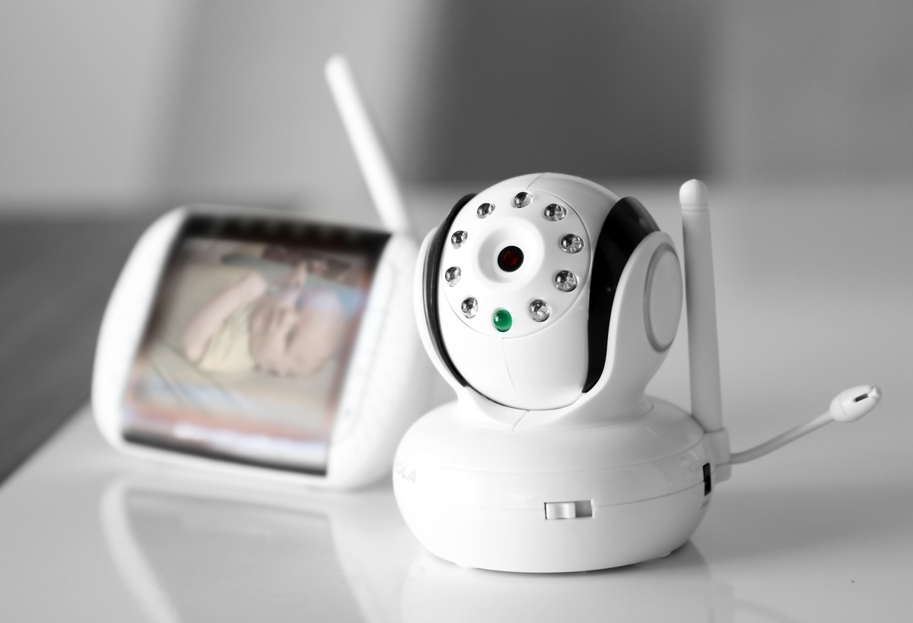
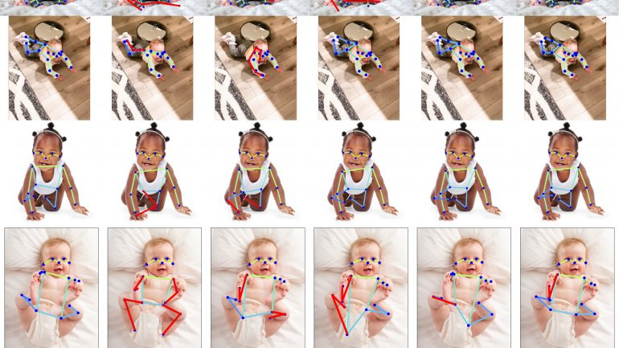
Takeaway
Challenges around infant data collection & labeling
Additional real infant data
Pose estimation model is a strong computer vision based data representation in infant action recognition
Potential application
Ostadabbas, Sarah. “Infant Pose Learning with Small Data.” Augmented Cognition Lab, 9 Oct. 2021,
Ostadabbas, Sarah. “Game-Changing Startup by EAI Faculty Member Introduces AI to Baby Monitors.” Institute for Experiential AI
NEU Research Undergraduate Program 2023 - August 2, 2023
Notes:
The flim and the MediaPipe Pose images that were collected will be interpreted by researchers to supplement artificial intelligence and computer vision algorithms to revolutionize infant monitoring devices.
The main focus of this research was in data analysis, additional real infant data will need to be analyzed for proper machine learning functions.
The ACLab seeks to improve early intervention and support for infants at risk of NDDs, aiming to enhance their overall developmental outcomes and well-being.

Slide 21
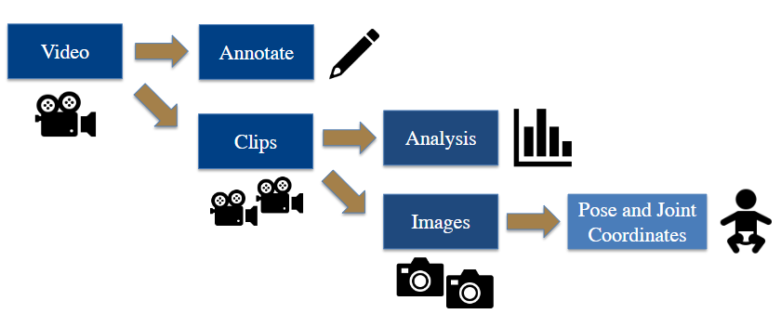
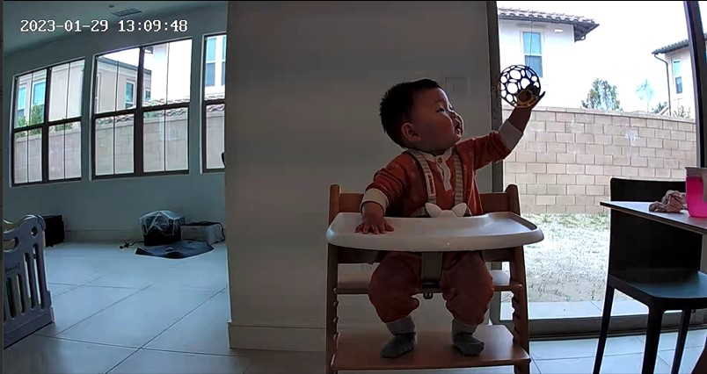
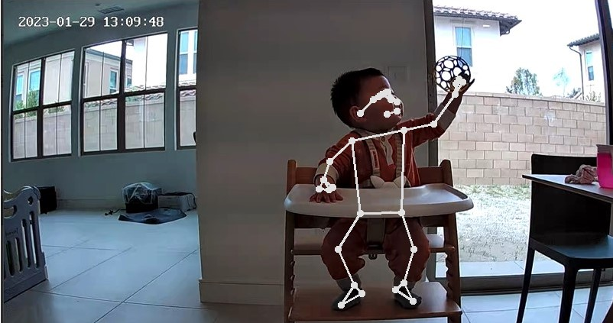
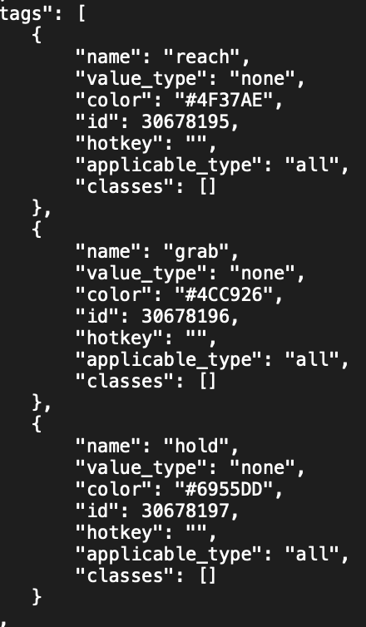
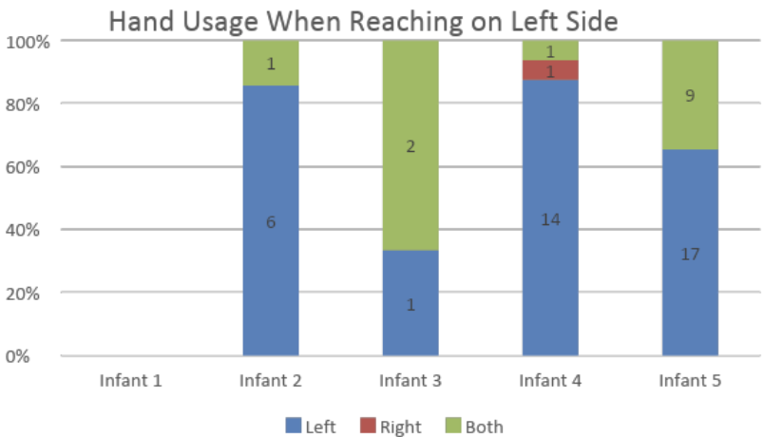
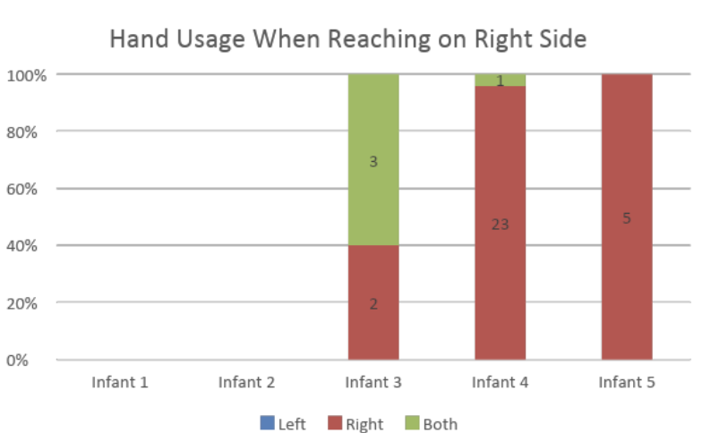
Computer Vision and Its Applications in Infant Health Monitoring
Muskan Kumar, Undergraduate Student, Massbay Community College
Professor Sarah Ostadabbas, Electrical and Computer Engineering, Northeastern University
Elaheh Hatami, Post-Doc Research Fellow, Northeastern University
Abstract
Infant motion analysis is a topic with critical
importance in early childhood development studies
Process of Data Collection
Before:
Results
The research involved collecting and processing data from videos of infants naturally interacting with their environments.
Machine learning models were utilized to understand motor functions, categorizing infants' actions into holding, reaching, and grabbing.
The concept of Pose was used to estimate infant joint coordinates, providing low-dimensional representations.These skeleton-based representations aid in understanding typical infant motor functions.
MediaPipe Pose API
Key body points
Analyzes posture
Categorizes action
After:
Infant motion analysis is a topic with critical
importance in early childhood development studies
Background
Operating System for Computer Vision
Neurodevelopmental conditions affect nearly 7% of children in the US, yet only ⅓ of children under 5 years old receive recommended developmental screenings.
Analyze, verify and annotate the frame-by-frame action for the different motor functions displayed.
Results
Outcomes
Analyzed raw video data
Developed deep learning techniques
Supported the developmental assessment of infants
40+ home videos 211 clips were annotated for infants reaching grasping and holding a ball.
Semi-automated code by Supervisely
Evaluates classes, keys and tags
Sources
“AI-Guided Cloud-Based Baby Monitoring System.” Northeastern.Portals.In, 17 Mar. 2022, northeastern.portals.in-part.com/AMx7Bbw87paO?utm_source=technologies&utm_medium=portal&utm_term=latest.
.Brighton Center for Pediatric Neurodevelopment. (n.d.). What is Neurodevelopment?. Brighton Center for Pediatric Neurodevelopment. https://www.bcpn.org/what-is-neurodevelopment-.html
Brown, Stephanie. “Why Your Newborn Has a Grasping Reflex.” Verywell Family, 19 Sept. 2019, www.verywellfamily.com/get-to-know-your-newborns-grasping-reflex-290100.
“Importance of Brain Development in the First Five Years.” Theme Loader, www.themeloader.com/importance-of-brain-development-in-the-first-five-years.
Kojovic, Nada, et al. “Using 2D Video-Based Pose Estimation for Automated Prediction of Autism Spectrum Disorders in Young Children.” Nature News, 23 July 2021, www.nature.com/articles/s41598-021-94378-z#citeas.
LDV Capital, director. AI-Powered Infant Monitoring to Enable Early Detection of Autism & Other Developmental Disorders. YouTube, YouTube, 6 Apr. 2023, https://www.youtube.com/watch?v=Qk97GTj00fY. Accessed 29 July 2023.
Ostadabbas, Sarah. (2023). An overview of one of our research at the Augmented Cognition Lab at Northeastern University. YouTube. YouTube. Retrieved July 18, 2023, from https://www.youtube.com/watch?v=_1ZlxC4Q65I.
Ostadabbas, Sarah. “Infant Pose Learning with Small Data.” Augmented Cognition Lab, 9 Oct. 2021,https://www. web.northeastern.edu/ostadabbas/2020/10/09/infant-pose-learning-with-small-data/.
“Screening for Professionals.” Centers for Disease Control and Prevention, 22 Feb. 2021, www.cdc.gov/ncbddd/childdevelopment/screening-hcp.html.
. Stenum, Jan, et al. “Applications of Pose Estimation in Human Health and Performance across the Lifespan.” MDPI, 3 Nov. 2021, www.mdpi.com/1424-8220/21/21/7315.
.Papers with Code - Pose Estimation. (n.d.). https://paperswithcode.com/task/pose-estimation
Turesky, Ted K, et al. “Imaging the Rapidly Developing Brain: Current Challenges for MRI Studies in the First Five Years of Life.” Developmental Cognitive Neuroscience, 11 Dec. 2020, www.sciencedirect.com/science/article/pii/S1878929320301432.
United States Environmental Protection Agency. (2019, August). America’s Children and the Environment | Third Edition. United States Environmental Protection Agency. https://www.epa.gov/system/files/documents/2022-04/ace3-neurodevelopmental-updates_0.pdf
Villagomez, A. N., Muñoz, F. M., Peterson, R. L., Colbert, A. M., Gladstone, M., MacDonald, B., Wilson, R., Fairlie, L., Gerner, G. J., Patterson, J., Boghossian, N. S., Burton, V. J., Cortés, M., Katikaneni, L. D., Larson, J. C. G., Angulo, A. S., Joshi, J., Nesin, M., Padula, M. A., … Brighton Collaboration Neurodevelopmental Delay Working Group. (2019, December 10). Neurodevelopmental Delay: Case definition & guidelines for data collection, analysis, and presentation of Immunization Safety Data. Vaccine. https://www.ncbi.nlm.nih.gov/pmc/articles/PMC6899448/
Xiaofei Huang, Lingfei Luan, Elaheh Hatamimajoumerd, Michael Wan, Pooria Daneshvar Kakhaki, Rita Obeid, Sarah Ostadabbas; Proceedings of the IEEE/CVF Conference on Computer Vision and Pattern Recognition (CVPR) Workshops, 2023, pp. 4911-4920
Notes:
Using a modular representation referred to as “pose”, a brief identifiable representation of important information in the act. The state can then be predicted and envisioned from this 2D representation. This delay in screening can have adverse effects on at-risk children, depriving them of timely support and leading to difficulties in academics, social interactions, and overall long-term development. To address this issue, our research project focuses on developing a monitoring device that utilizes computer vision and machine learning techniques to provide developmental screenings and detect motor abnormalities in infants.
Created .json files for keys, classes and tags
3–5 second clips extracted from raw home videos
Infants interacting with their environment
Creates a CNN-LTSM (long short-term memory network)
Labeled objects
Ball
Food
Supplement artificial intelligence and computer vision algorithms to revolutionize infant monitoring devices.
Additional real infant data will need to be analyzed for proper machine learning functions
Improve early intervention and support for infants at risk of neurodevelopmental delays,

Slide 22
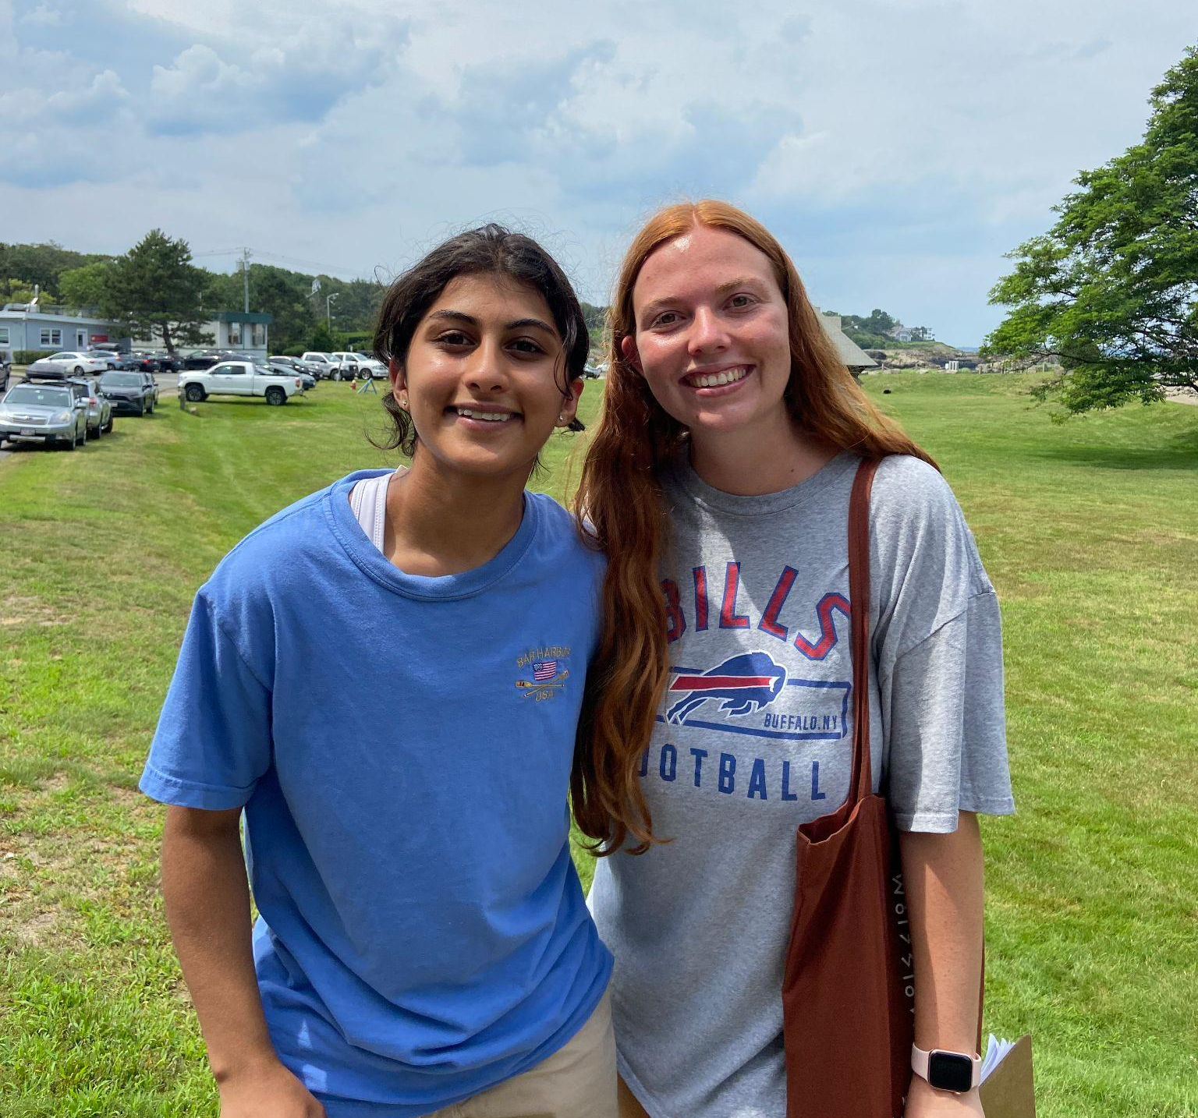
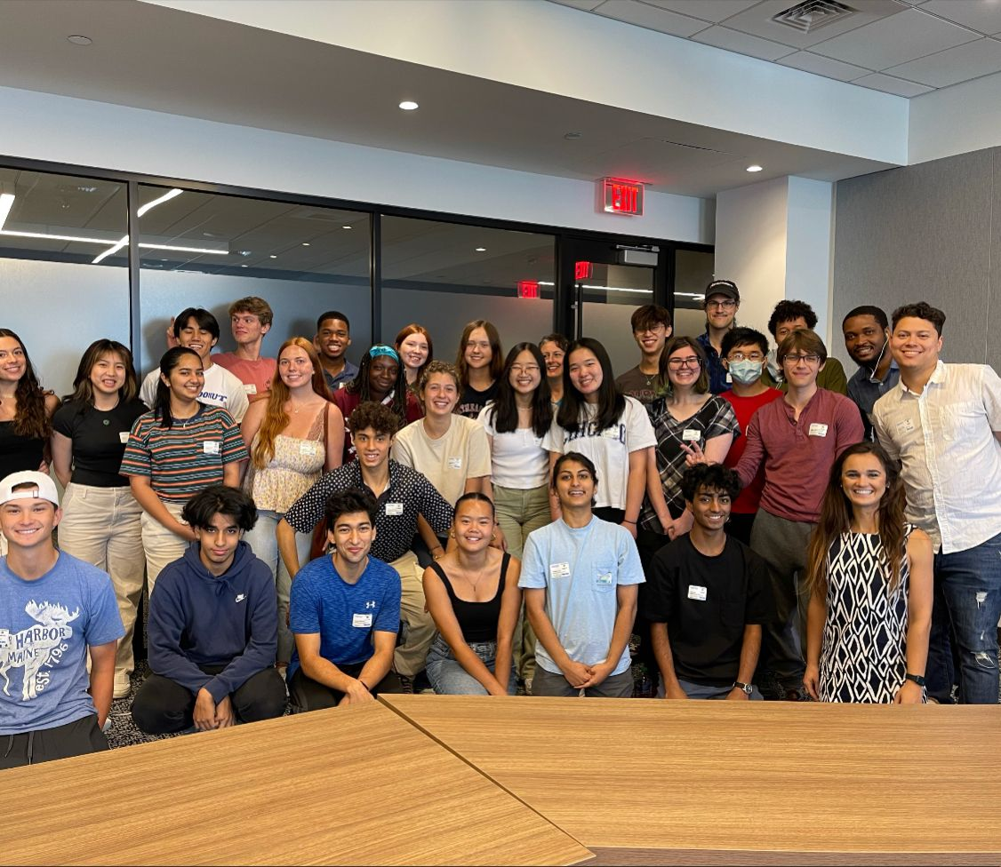
Acknowledgments
Center for STEM Education
Claire Duggan - Executive Director
Jennifer Love - Associate Director
Nicolas Fuchs - Program Manager
Mary Howley - Administrative
Lydia Bird - REU Coordinator
Augmented Cognition Lab
Dr. Sarah Ostadabbas, Electrical and Computer Engineering, Northeastern University
Dr. Elaheh Hatami, Post-Doc Research Fellow, Northeastern University
NEU Research Undergraduate Program 2023 - August 2, 2023

Slide 23
Resources
“AI-Guided Cloud-Based Baby Monitoring System.” Northeastern.Portals.In, 17 Mar. 2022, northeastern.portals.in-part.com/AMx7Bbw87paO?utm_source=technologies&utm_medium=portal&utm_term=latest.
.Brighton Center for Pediatric Neurodevelopment. (n.d.). What is Neurodevelopment?. Brighton Center for Pediatric Neurodevelopment. https://www.bcpn.org/what-is-neurodevelopment-.html
Brown, Stephanie. “Why Your Newborn Has a Grasping Reflex.” Verywell Family, 19 Sept. 2019, www.verywellfamily.com/get-to-know-your-newborns-grasping-reflex-290100.
“Importance of Brain Development in the First Five Years.” Theme Loader, www.themeloader.com/importance-of-brain-development-in-the-first-five-years.
Kojovic, Nada, et al. “Using 2D Video-Based Pose Estimation for Automated Prediction of Autism Spectrum Disorders in Young Children.” Nature News, 23 July 2021, www.nature.com/articles/s41598-021-94378-z#citeas.
LDV Capital, director. AI-Powered Infant Monitoring to Enable Early Detection of Autism & Other Developmental Disorders. YouTube, YouTube, 6 Apr. 2023, https://www.youtube.com/watch?v=Qk97GTj00fY. Accessed 29 July 2023.
Ostadabbas, Sarah. (2023). An overview of one of our research at the Augmented Cognition Lab at Northeastern University. YouTube. YouTube. Retrieved July 18, 2023, from https://www.youtube.com/watch?v=_1ZlxC4Q65I.
Ostadabbas, Sarah. “Game-Changing Startup by EAI Faculty Member Introduces AI to Baby Monitors.” Institute for Experiential AI, 17 May 2023, ai.northeastern.edu/game-changing-startup-by-eai-faculty-member-introduces-ai-to-baby-monitors/.
Ostadabbas, Sarah. “Infant Pose Learning with Small Data.” Augmented Cognition Lab, 9 Oct. 2021,https://www. web.northeastern.edu/ostadabbas/2020/10/09/infant-pose-learning-with-small-data/.
“Screening for Professionals.” Centers for Disease Control and Prevention, 22 Feb. 2021, www.cdc.gov/ncbddd/childdevelopment/screening-hcp.html.
Stenum, Jan, et al. “Applications of Pose Estimation in Human Health and Performance across the Lifespan.” MDPI, 3 Nov. 2021, www.mdpi.com/1424-8220/21/21/7315.
.Papers with Code - Pose Estimation. (n.d.). https://paperswithcode.com/task/pose-estimation
Turesky, Ted K, et al. “Imaging the Rapidly Developing Brain: Current Challenges for MRI Studies in the First Five Years of Life.” Developmental Cognitive Neuroscience, 11 Dec. 2020, www.sciencedirect.com/science/article/pii/S1878929320301432.
United States Environmental Protection Agency. (2019, August). America’s Children and the Environment | Third Edition. United States Environmental Protection Agency. https://www.epa.gov/system/files/documents/2022-04/ace3-neurodevelopmental-updates_0.pdf
Villagomez, A. N., Muñoz, F. M., Peterson, R. L., Colbert, A. M., Gladstone, M., MacDonald, B., Wilson, R., Fairlie, L., Gerner, G. J., Patterson, J., Boghossian, N. S., Burton, V. J., Cortés, M., Katikaneni, L. D., Larson, J. C. G., Angulo, A. S., Joshi, J., Nesin, M., Padula, M. A., … Brighton Collaboration Neurodevelopmental Delay Working Group. (2019, December 10). Neurodevelopmental Delay: Case definition & guidelines for data collection, analysis, and presentation of Immunization Safety Data. Vaccine. https://www.ncbi.nlm.nih.gov/pmc/articles/PMC6899448/
Walia, Mrinal Singh. “A Comprehensive Guide on Human Pose Estimation.” Analytics Vidhya, 10 Feb. 2022, www.analyticsvidhya.com/blog/2022/01/a-comprehensive-guide-on-human-pose-estimation/.
Xiaofei Huang, Lingfei Luan, Elaheh Hatamimajoumerd, Michael Wan, Pooria Daneshvar Kakhaki, Rita Obeid, Sarah Ostadabbas; Proceedings of the IEEE/CVF Conference on Computer Vision and Pattern Recognition (CVPR) Workshops, 2023, pp. 4911-4920
NEU Research Undergraduate Program 2023 - August 2, 2023

Slide 24
Thank You
Questions?
NEU Research Undergraduate Program 2023 - August 2, 2023

