Slide 1
Demographic and Building Information for Residential Load Flexibility data set
Student Photo Here
Student Name Here
Engineering
Faculty Advisor Photo Here
Faculty Advisor: Dr. Michael Kane
Department of Civil and Environmental Engineering
Acknowledgements
Professor Kane
Emma Cassavant, Katherine Basset
Research funding agency: National Science Foundation, Department of Energy
Research Conducted:
Automation for the Built Environment

Slide 2
WHOLE ENERGY HOMES
Grid-Interactive efficient commercial Building
Conducted study analyzing 30 single family detached homes in area states such as Massachusetts, Colorado, and Florida.
Analyze human behavior patterns as their response to thermal comfort changes in their homes.
Represent how grid interactive buildings allow for greater load flexibility and demand response to match the supply of electricity.
Showcase Home Assistant as a tool for users to interact with their thermostats, and to conduct self reported information surveys to locate their occupancy in their home.
Buildings account for >70% of U.S. electricity consumption and power sector CO₂ emissions. Grid Interactive Buildings have the potential to shift the energy throughout the day especially during peak times when the demand of energy is high, that way there is not an excess demand on the grid.
Buildings account for >70% of U.S. electricity consumption and power sector CO₂ emissions. Grid Interactive Buildings have the potential to shift the energy throughout the day especially during peak times when the demand of energy is high, that way there is not an excess demand on the grid.

Slide 3
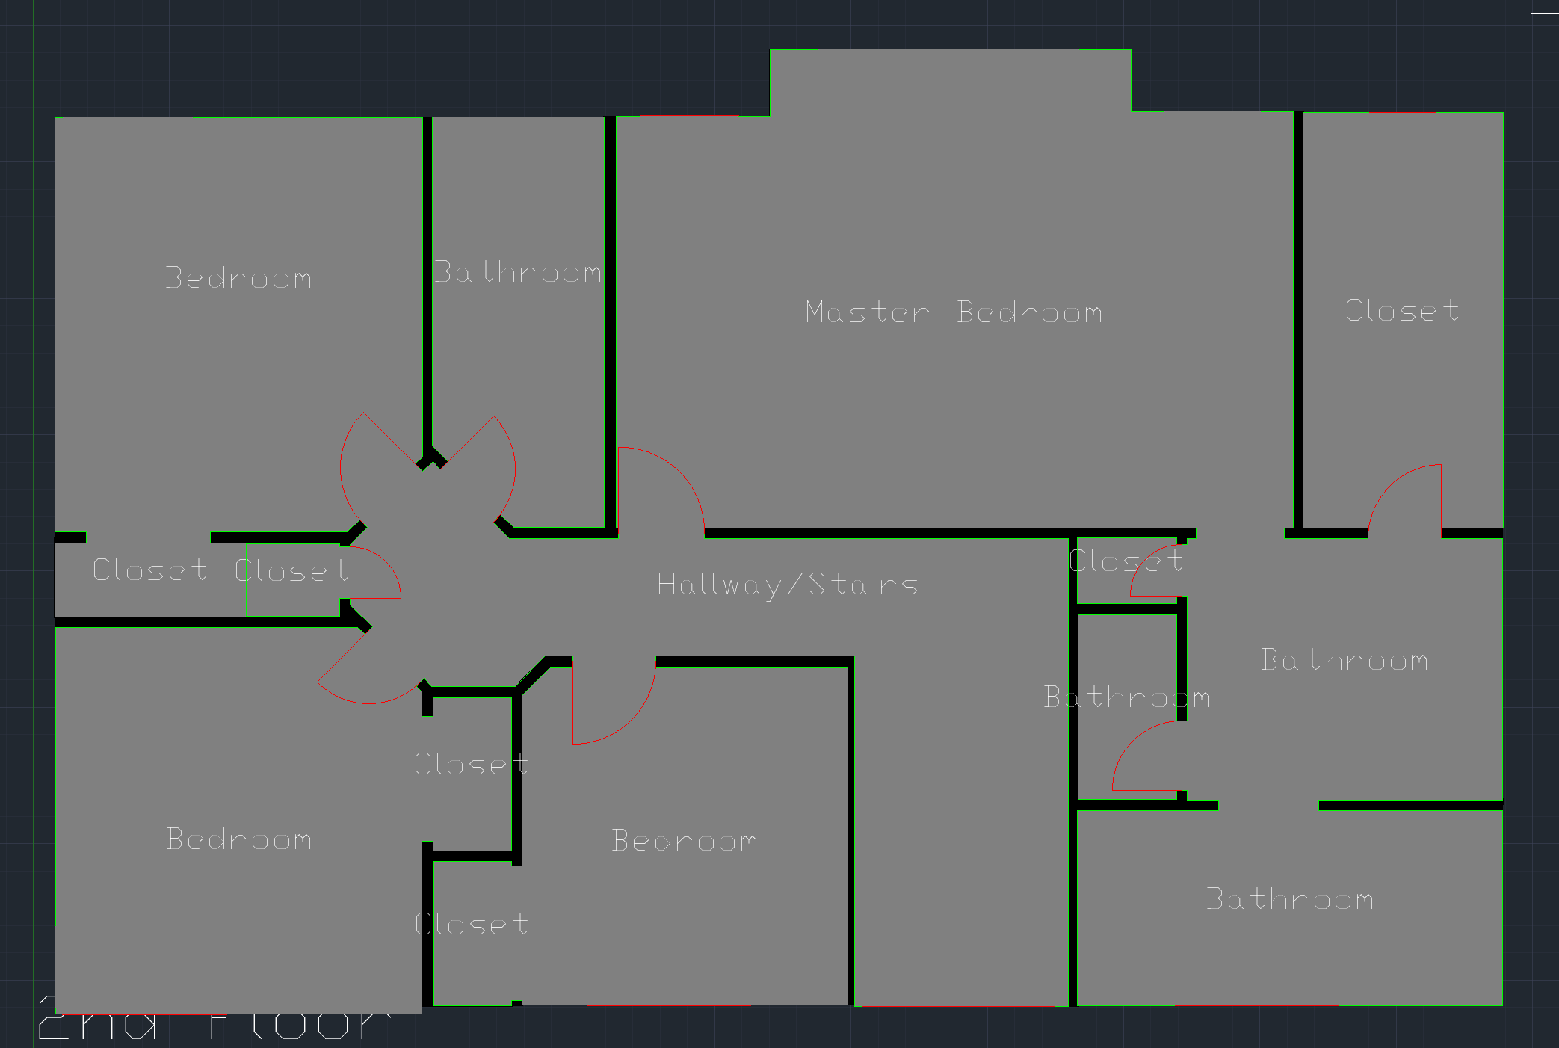
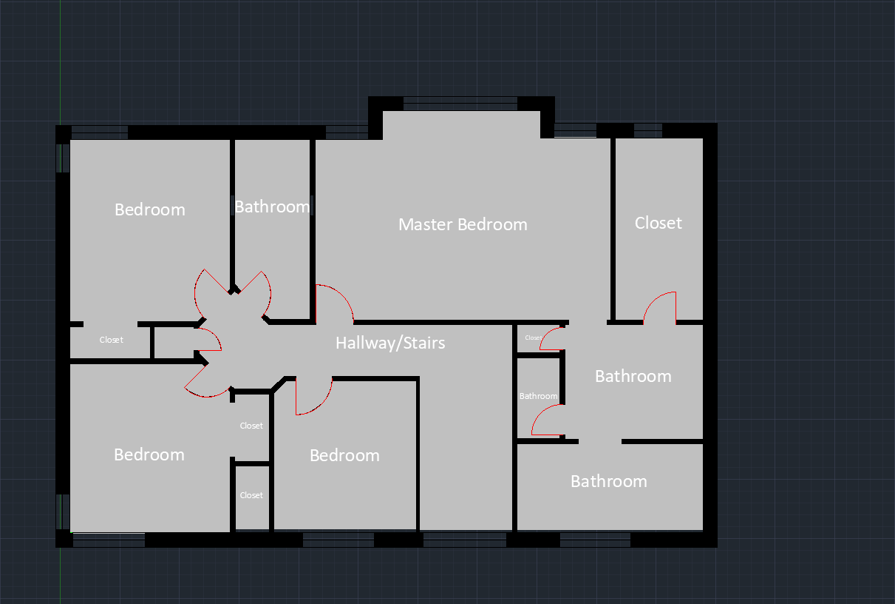
AutoCAD FLOORPLANS
Original Floorplan:
I had to clean up ten given floorplans with AutoCAD for Colorado houses.
Used layering hatching, and room fill techniques to separate the interior and exterior walls, the occupants' spaces and change font sizes and style to have a clear representation of each home.
AutoCAD was useful in modeling an occupant's home and the location and infrastructure layout of the rooms and spaces in a home. This was a very important initial step that later translated to layouts to create the user-interactive surveys.
Cleaned Floorplan:
Layout Floorplan:

Slide 4
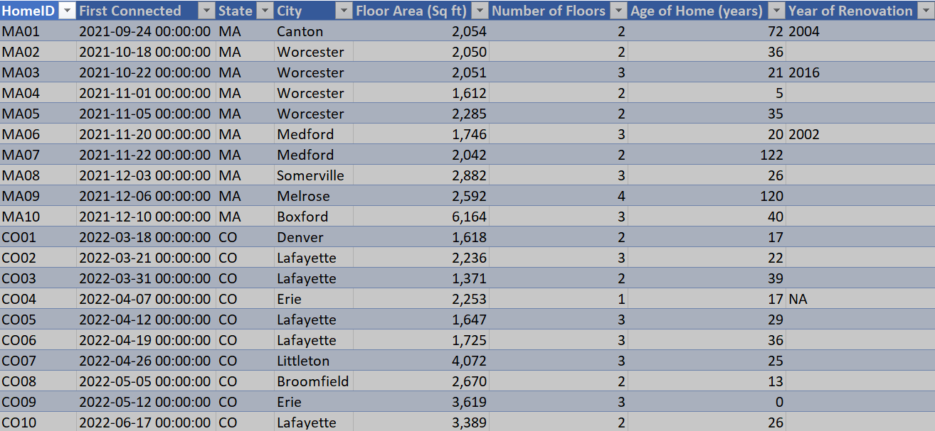
Floor Area descriptions for MA and CO homes

Slide 5
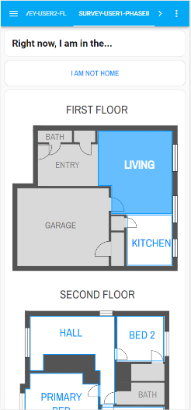
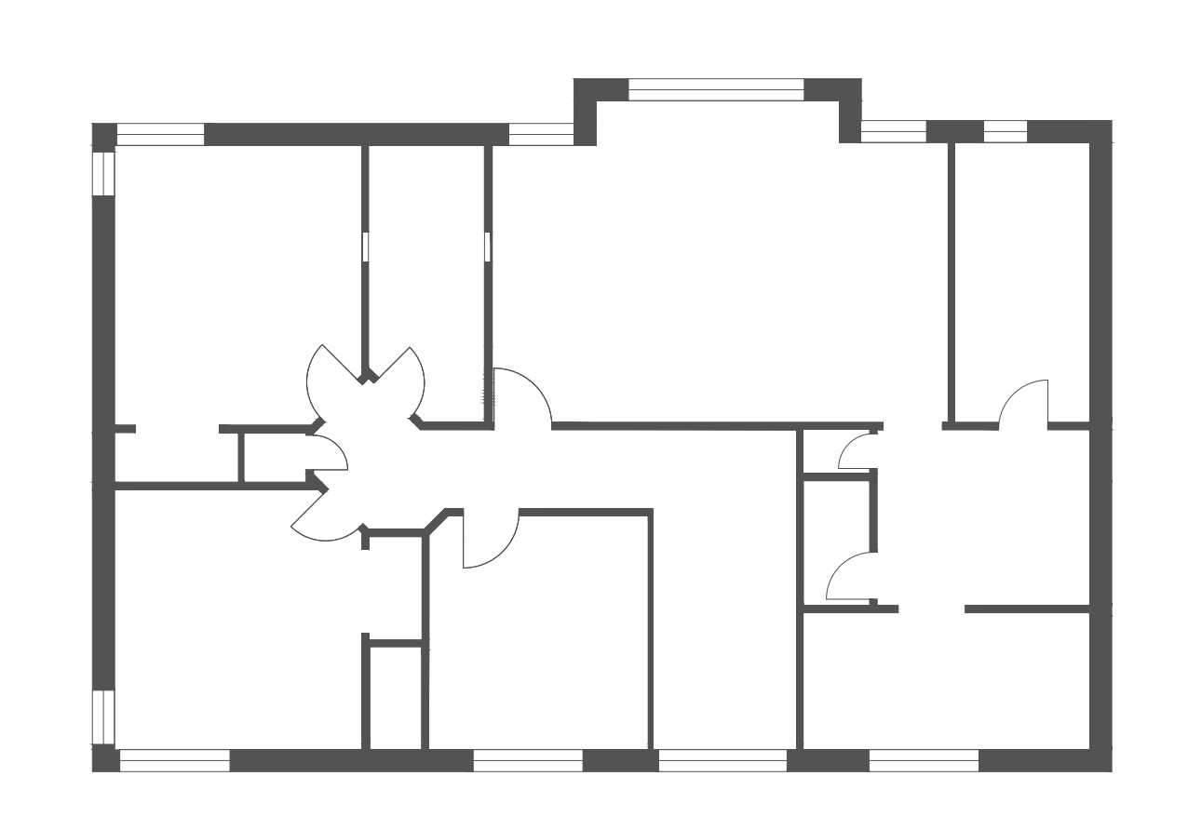
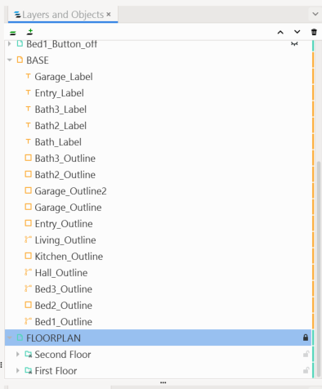
Inkscape layouts
Inkscape pdf demonstration:
Afterwards, exporting the CAD files as a pdf format they were then opened in Inkscape where the layout were enhanced to demonstrate the occupied homes as a click On/Off feature.
Important note: each room highlighted has an ecobee occupancy sensor, rooms that are not highlighted do not have an occupancy sensor and therefore identified as an unoccupied space.
These are all embedded in the survey.
Layers and Objects:
For the click On/OFF feature it was important to create multiple base layers and objects to demonstrate the highlighted room.

Slide 6
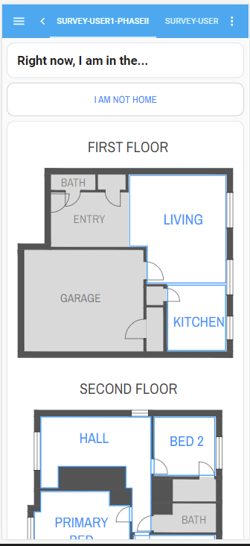
Home Assistant Surveys
Surveys
Home Assistant is a great example of a smart automation system that sends out surveys to users that provide useful information that can show valuable data that asks occupants location in a home, which room they occupy at the time the survey is being sent out, and it asks a very important question regarding their thermal comfort.
After multiple surveys are sent out throughout the course of the study, the researcher can develop behavioral models that demonstrate their thermal comfort, how they might respond to the electric grid.
As well, as see how long it might take for the occupant to adapt to changes in their thermostat as their residential building transitions to be grid-interactive.

Slide 7
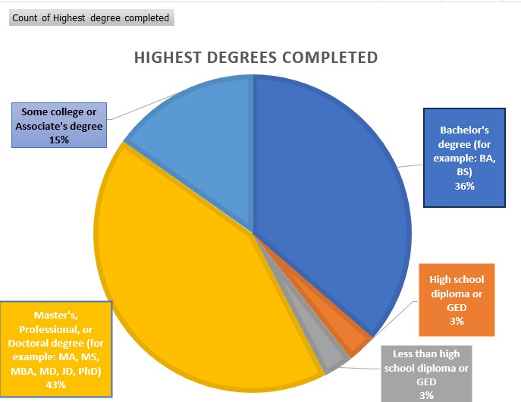
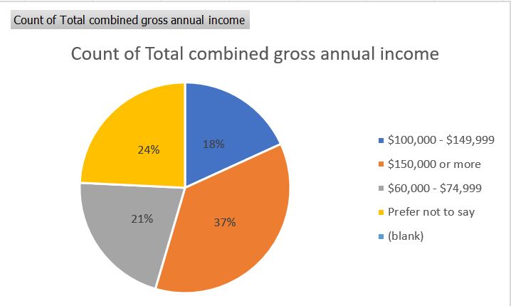
Representing Demographic information of participants
It is valuable to recognize that this data is self reported information, and the data does not represent the entire population due to non-responsive bias which accounted for 28%.
Occupants' self reported their education in the study
Occupants’ self reported their gross annual income

Slide 8
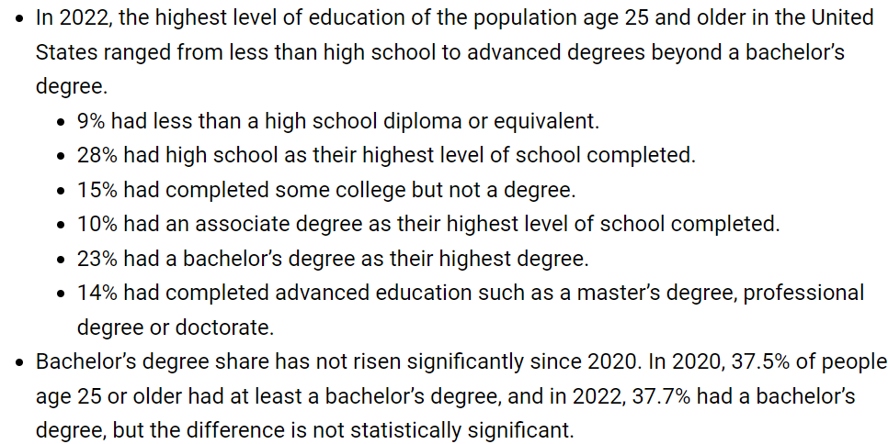
Comparing participant education vs. U.S. Population
Information obtained from U.s. Census
A bachelor’s degree: 23% of the U.S. population had a bachelor’s degree as their highest degree while in the study, 36% of the population obtained bachelor degrees. Also, important to note, 14% of the U.S. population completed advanced education such as master’s degree, professional degree or doctorate, while in the study 43% of the population have an advanced degree.

Slide 9
Social implications
Engineers often need to contextualize their efforts
Engineers are not train to solve poverty, but have the capability to alleviate it
Without contextualizing research may lead to urban inequities due to lack of knowing how efforts may impact surrounding communities or members of the community. The problem falls within the decision making behind the research and who it is intended for.
Leading to consequences of climate gentrification making some areas more valuable than others and could potentially drive certain members of a community out of their homes.
One could argue in the sake of this study that although it is beneficial for the energy grid and single residential homes, this data set has limitations and cannot support analysis on how load flexibility and grid interactive buildings will function in homes occupied in marginalized communities and socio-economic affordable housing complexes.

Slide 10
Future Work
Researchers should consider information overall in the study and take this data set as a foundation for sustainable building infrastructure especially for residential homes in marginalized communities.
As well as consider commercial buildings and how load flexibility would interact in a commercial building.
Also, finding ways this could help develop future research questions.

Slide 11
Struggles I had to overcome
Learning and practicing AutoCAD
Creating layers in AutoCAD
Learning Inkscape and creating layers and objects
Time constraints and organization

