Slide 1
Mechanical Design of Sequential Injection Analysis System for Nitrate Sensing
Jodi Zangari
REU Pathways Program
Mechanical Engineering
Environmental Sensors Lab
Amy Mueller, Ph.D, Ben Eck
NSF#2150417
P.I. I.Zeid
Co-P.I. C.Duggan

Slide 2
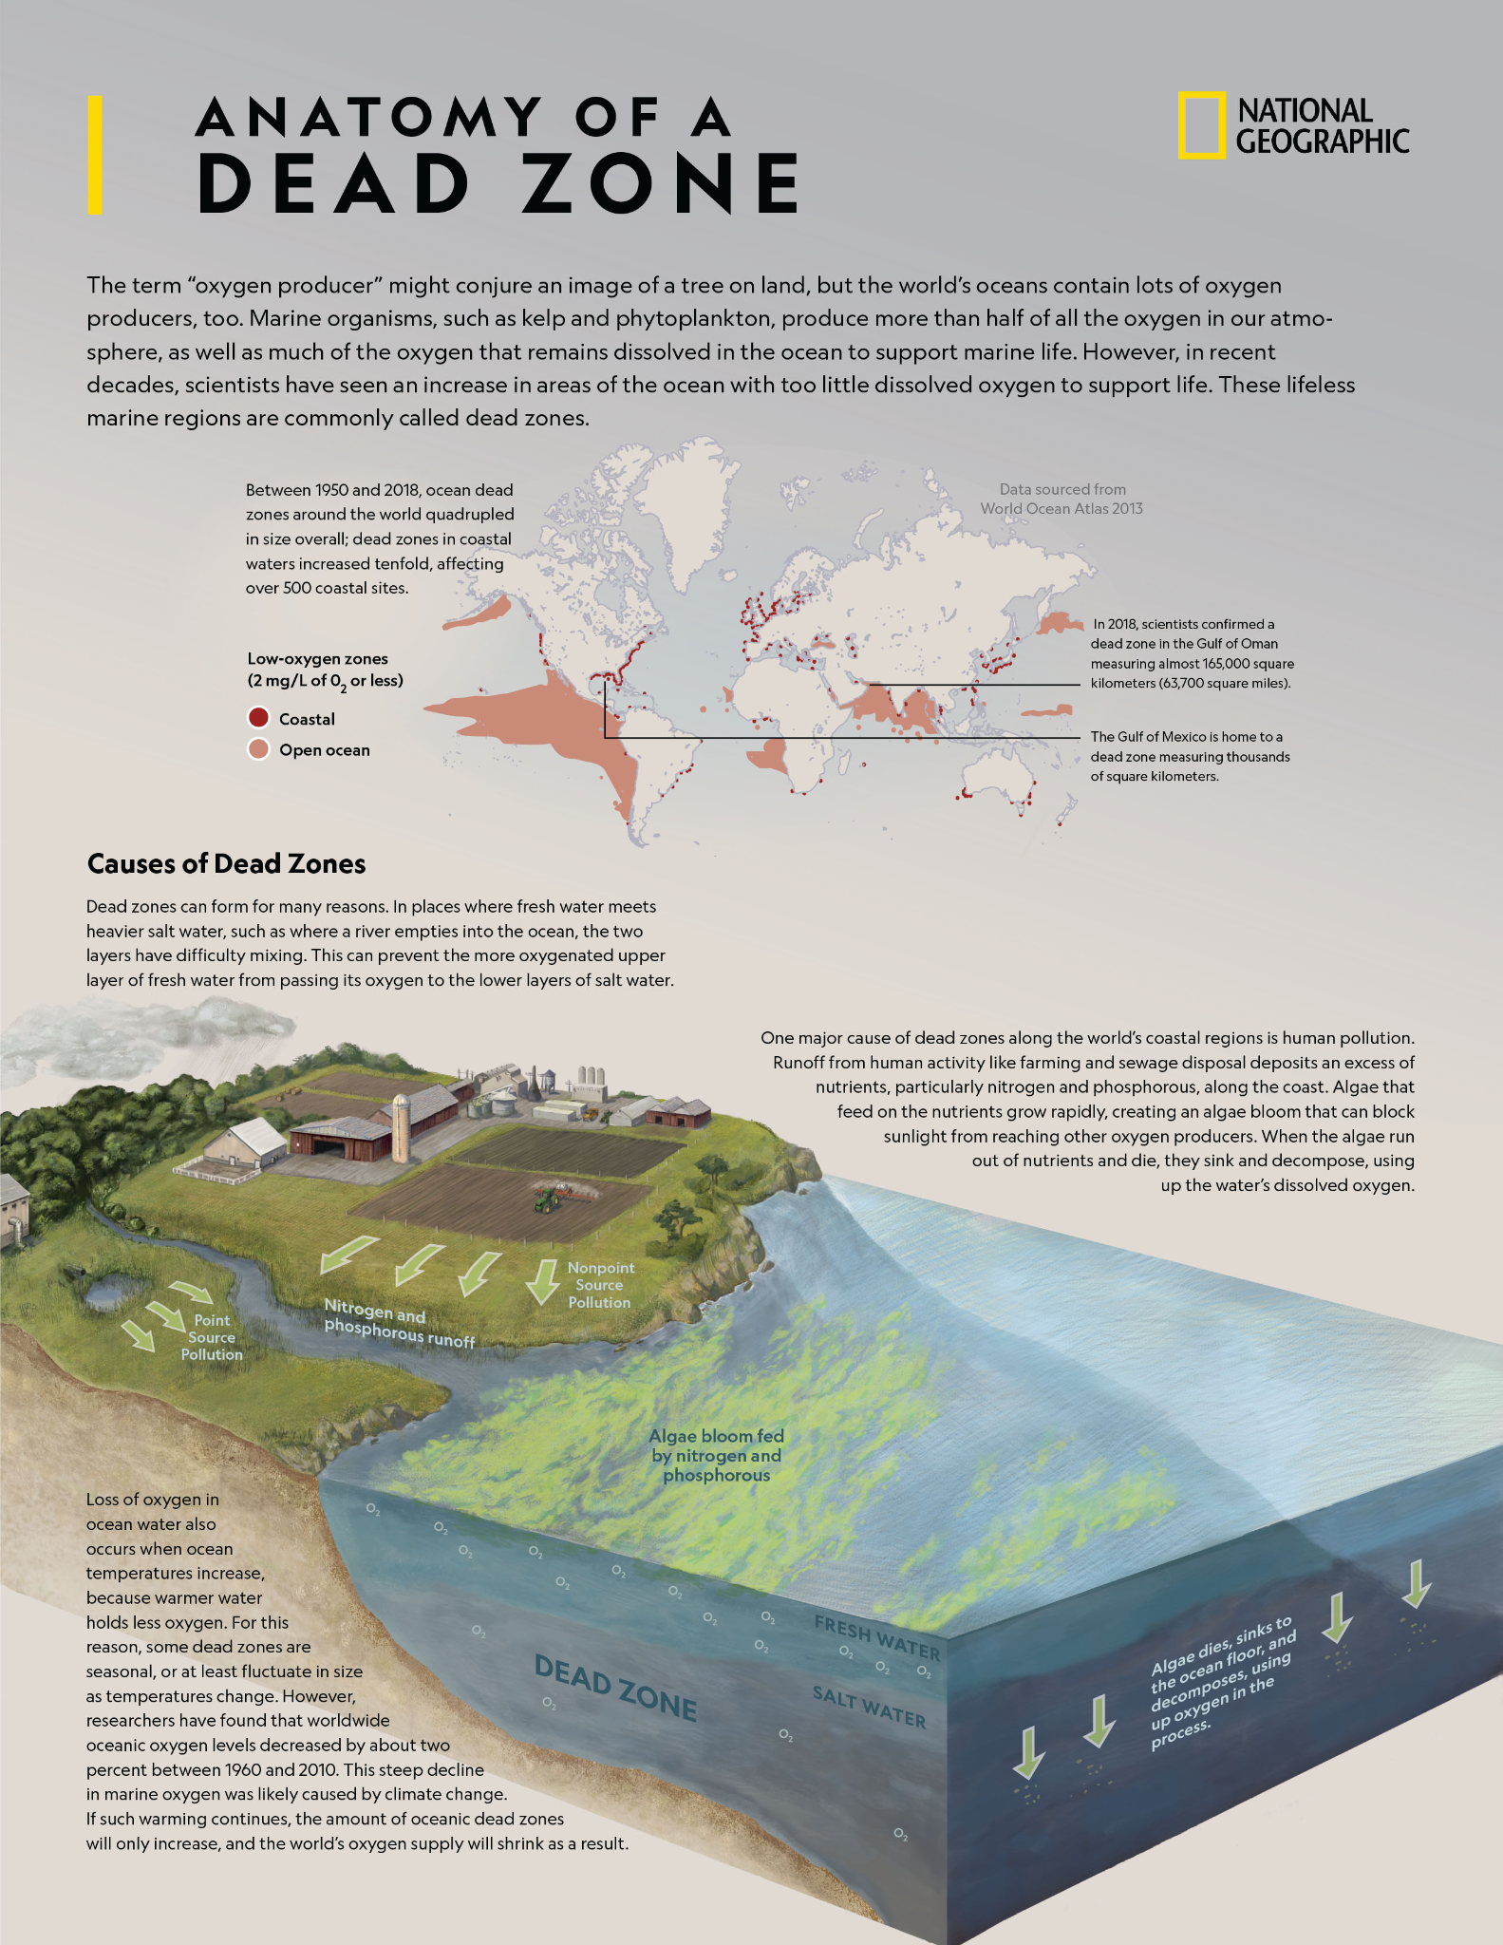
Understanding the problem
Fertilizer Runoff
Expensive Sensors
Sea-Bird Scientific SUNA V2 UV Nitrate Sensor
Nitrate pollution from fertilizer runoff is degrading our oceans and contributing to dead-zones. Dead zones are areas where pollution has severely damaged natural ecosystems.
In order to address the problem we first need to understand the severity of its impact across space and time.
High-cost sensors ($10k++) are making this a challenge for scientists.

Slide 3
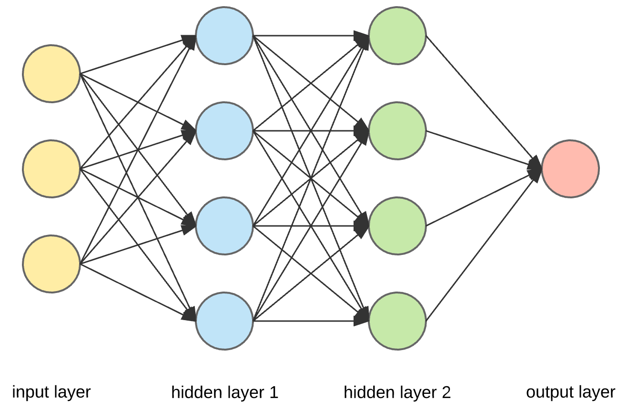
Understanding the problem
ISE Interference
Off the Shelf ISE Arrays
Training Data
Artificial Neural Networks (ANNs)
Ion-selective electrodes (ISEs) are a promising low-cost (~$100s) alternative but they suffer from interferences caused by other ions in seawater.
Correcting this interference is possible by using multiple ISEs, but this requires a significant amount of training data. Collecting this data is a lengthy and time consuming manual task.
http://www.nico2000.net/datasheets/mltsen1l.html
NU-Printed Multimodal Arrays
https://towardsdatascience.com/applied-deep-learning-part-1-artificial-neural-networks-d7834f67a4f6
6.5mm
24mm

Slide 4
Project objective:
Automate lab work of fluid analysis in order to generate large quantities of training data, enabling data-driven approaches to improve the effectiveness of low-cost ISEs.

Slide 5
Developing a sequential injection analysis (SIA) system for fluid analytics
Manual fluid analysis = lengthy lab time
Automated fluid analysis system
Saves manual labor and increases data collection

Slide 6
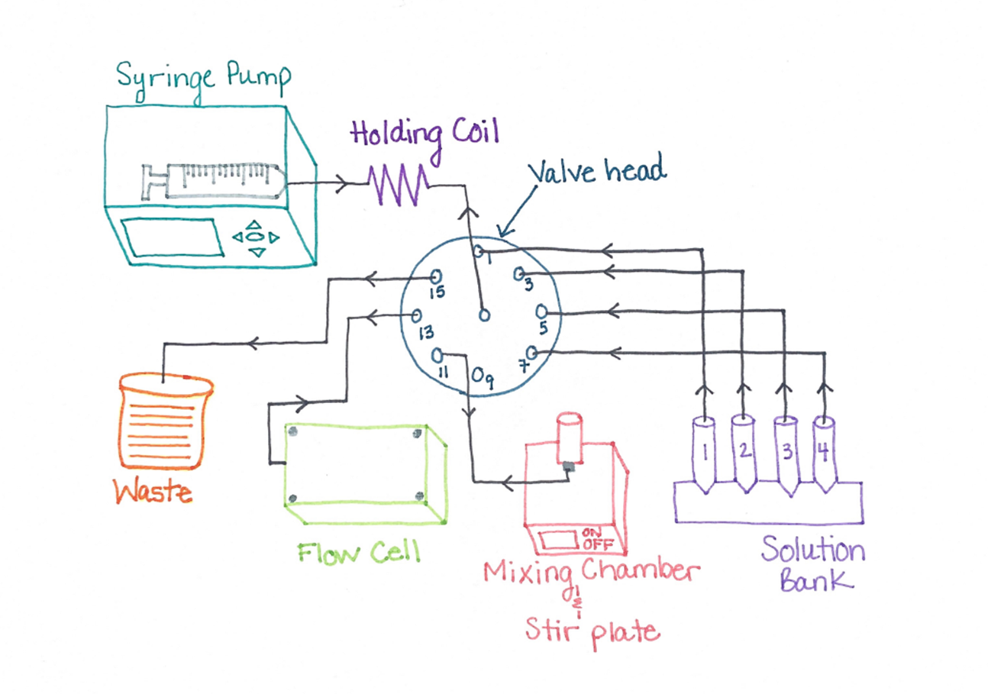
Hardware System Design
System Components:
Bi-directional syringe pump
Multi-position valve head
Mixing chamber and stir plate
Flow cell for analysis
Solution bank
Waste container

Slide 7
Component | Design Intent & System Parameters
Syringe pump | Bi-directional for fluid movement, capacity for 10 ml glass, salt resistant syringe, with adjustable force settings and LabVIEW compatibility.
Valve | Multi-position valve head capable of bi-directional movement, with manual stepper, actuator, and RS-232 compatibility for computer connection. LabVIEW compatibility preferred.
Teflon tubing | 10 meters of 1/16” inner diameter, teflon tubing for holding coil and all outports to ensure fluid capacity of at least 10 ml.
Custom fittings | Zero-dead volume fittings with 1/16” connections for increased accuracy along fluid path.
Mixing chamber | Cast acrylic, chemically inert mixing chamber with 10 ml capacity, conical inner chamfer for proper drainage and fluid inlet/outlet customized at base of design. Special order stainless steel NPT to compression fittings were used to avoid dead volume in fluid path and for corrosion resistant materials.
Materials | Material such as Teflon, Stainless Steel and Cast acrylic were used to minimize chemical interferences and increase resistance to corrosion. Waterproof 3D printing materials used for fluid capacity in flow cell design.
LabVIEW | Compatibility preferred for instrument control of both valve and syringe pump using one interface.

Slide 8
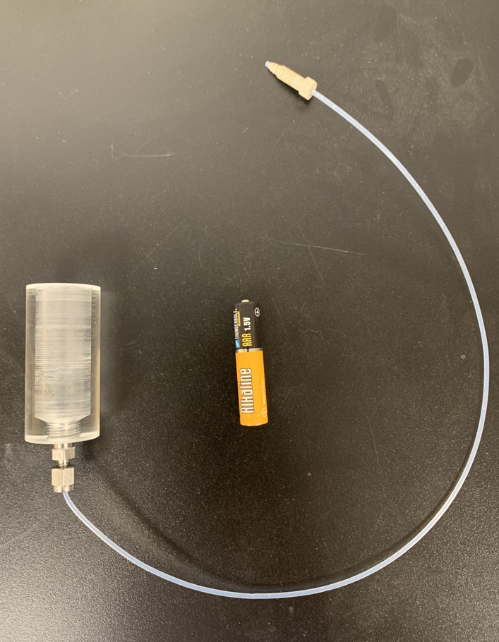
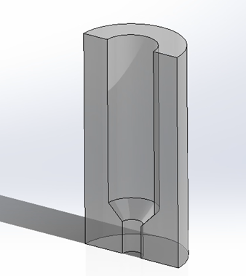
Mixing Chamber
Design Parameters:
Hold 10 ml, 2” height, 1 ½” inner diameter with ¼” walls for thread
Inner chamfer for proper draining
Inlet/outlet port at base
Zero-dead volume fitting
Cast acrylic rod and stainless steel fitting for chemically inert and corrosion resistant system
Prototyping Process:
SolidWorks - draft and design
3D Printing - proof of concept
Machining - final product
SolidWorks design
3D Printed model
Machined final product required use of mill, lathe, and vertical bandsaw.

Slide 9
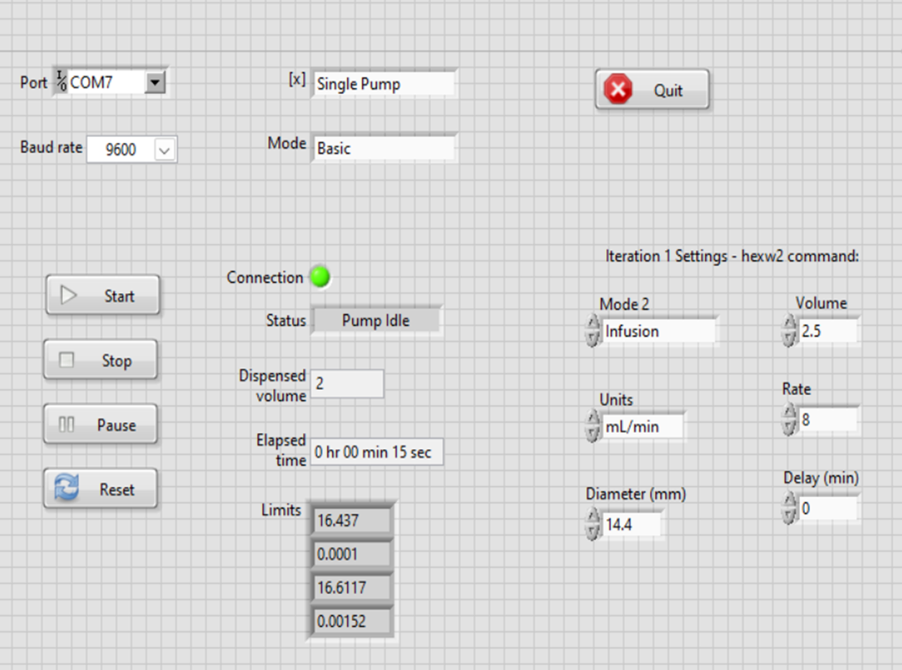
LabVIEW - Flow Control Software Design
LabVIEW:
Third party instrument control of multiple devices from one interface
Controls the pump over USB serial port
Adaptable programming allows for integration into larger, more complex code
Current Program:
Part of the broader software module
Configures fluid settings from the front panel and sends to syringe pump
Input settings include, diameter, volume, rate, delay, units and mode
Continuous pump status checks built in to code
Front Panel: User interface for instrument control of syringe pump.

Slide 10
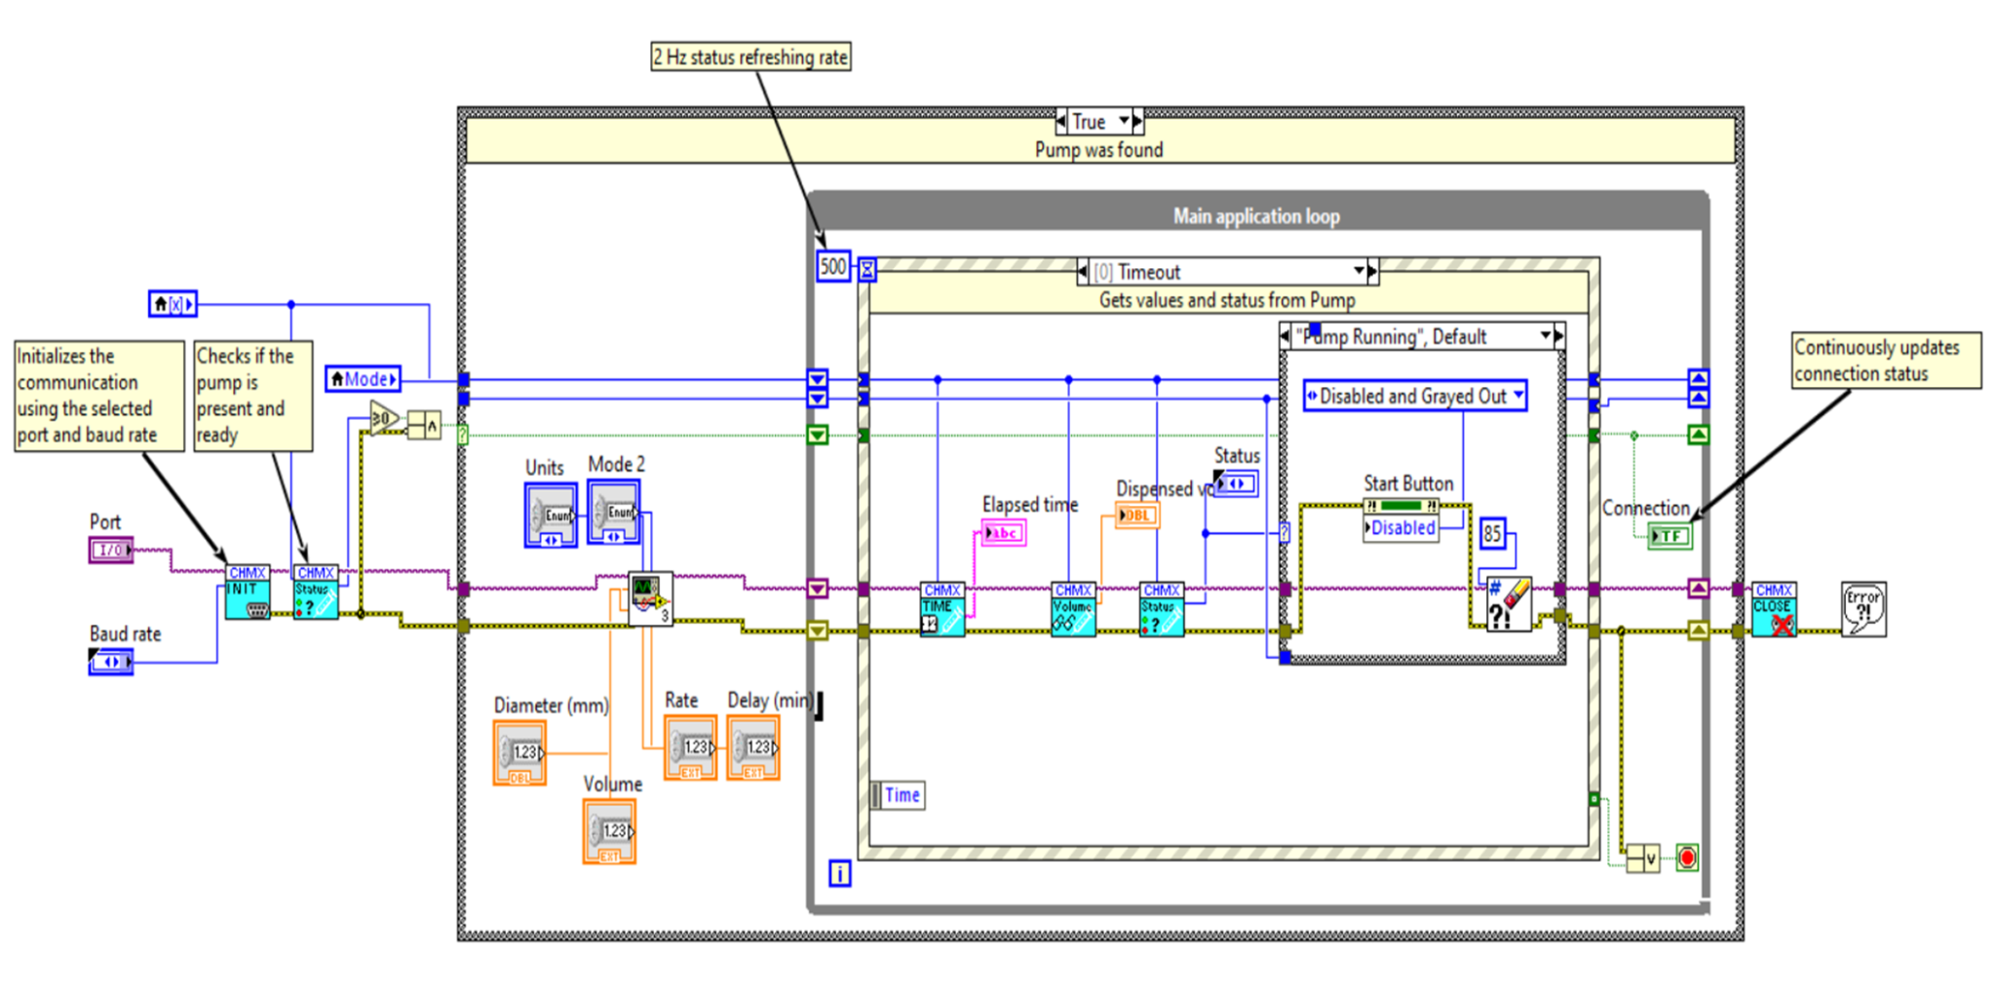
Block Diagram VI For Syringe Pump
Designed for instrument control of Chemyx, Inc. Fusion 200 syringe pump
While loop with sub-VI for system configuration of pump
Main application loop and embedded case structure ensure continuous status updates
Virtual Instrument (VI)

Slide 11
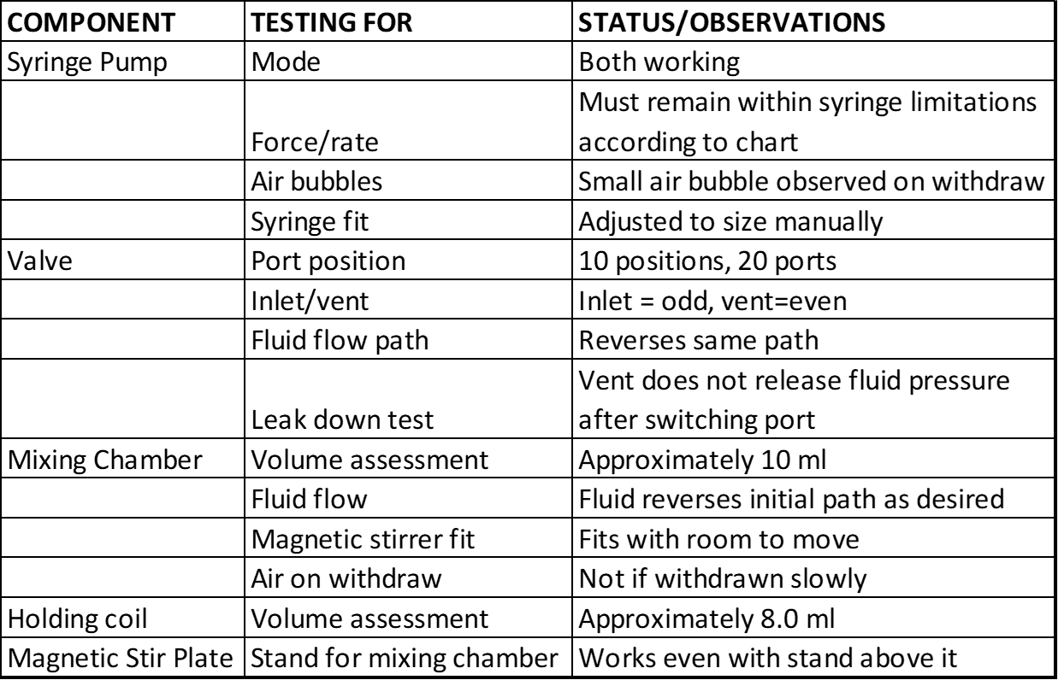
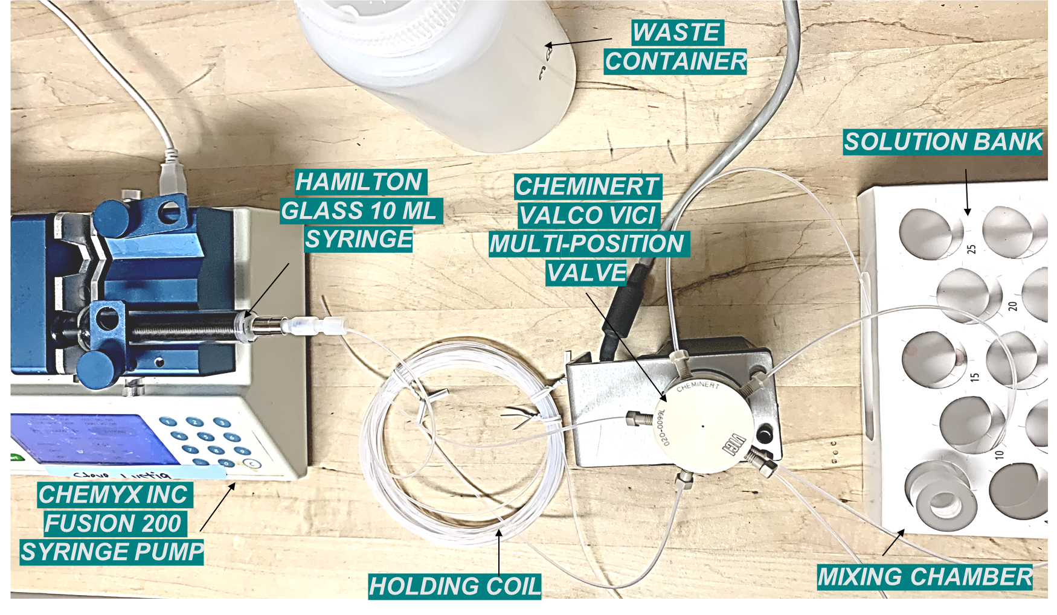
Initial Component and System Testing
Phase 1 - Hardware Testing:
Testing of all system components for functionality and system integration. Fluid volumes and flow paths were also observed and tested.
Table 2. Initial testing observations from individual components and overall system integration and functionality.

Slide 12
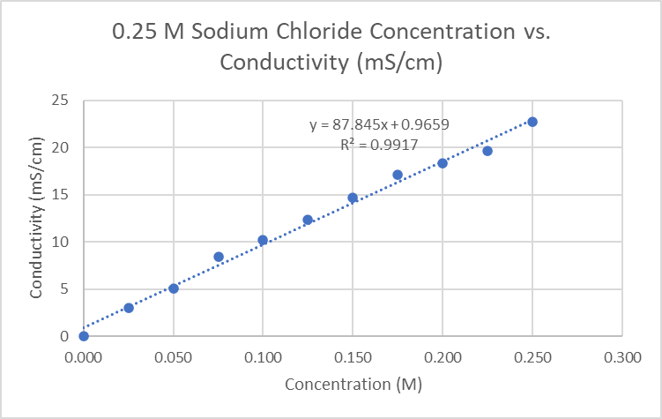
Phase 2: Conductivity Testing
Solution 1 - Milli-Q Water
Findings:
Solution concentration values followed linear fit as expected with R² value = 0.9917
Proved that current mixing procedure is creating accurate concentration levels of intended solutions
Error Implications:
Small air bubbles observed in syringe
Re-calibrate conductivity tester using 4 points of calibration rather than 2
Increasing volume (ml) used for cleaning system between each run
Solution 2 - 0.25 M NaCl

Slide 13
Future Work
Hardware
Complete flow-cell and integrate with current system
Refine integrated system and flow processes for improved accuracy
Software/LabVIEW
Expand current programming to include valve control and make adaptable to arrays of configurations
Fluid testing
Establish protocol for priming the pump and all output lines to avoid air bubbles in the syringe and tubing
Prototype testing
Test overall functionality of fully integrated system when used with larger solution bank

Slide 14
Next Steps
Hardware development
Software design
Prototype testing
Advanced goals
Implement 15 solution array
Implement 30 solution array

Slide 15
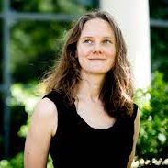
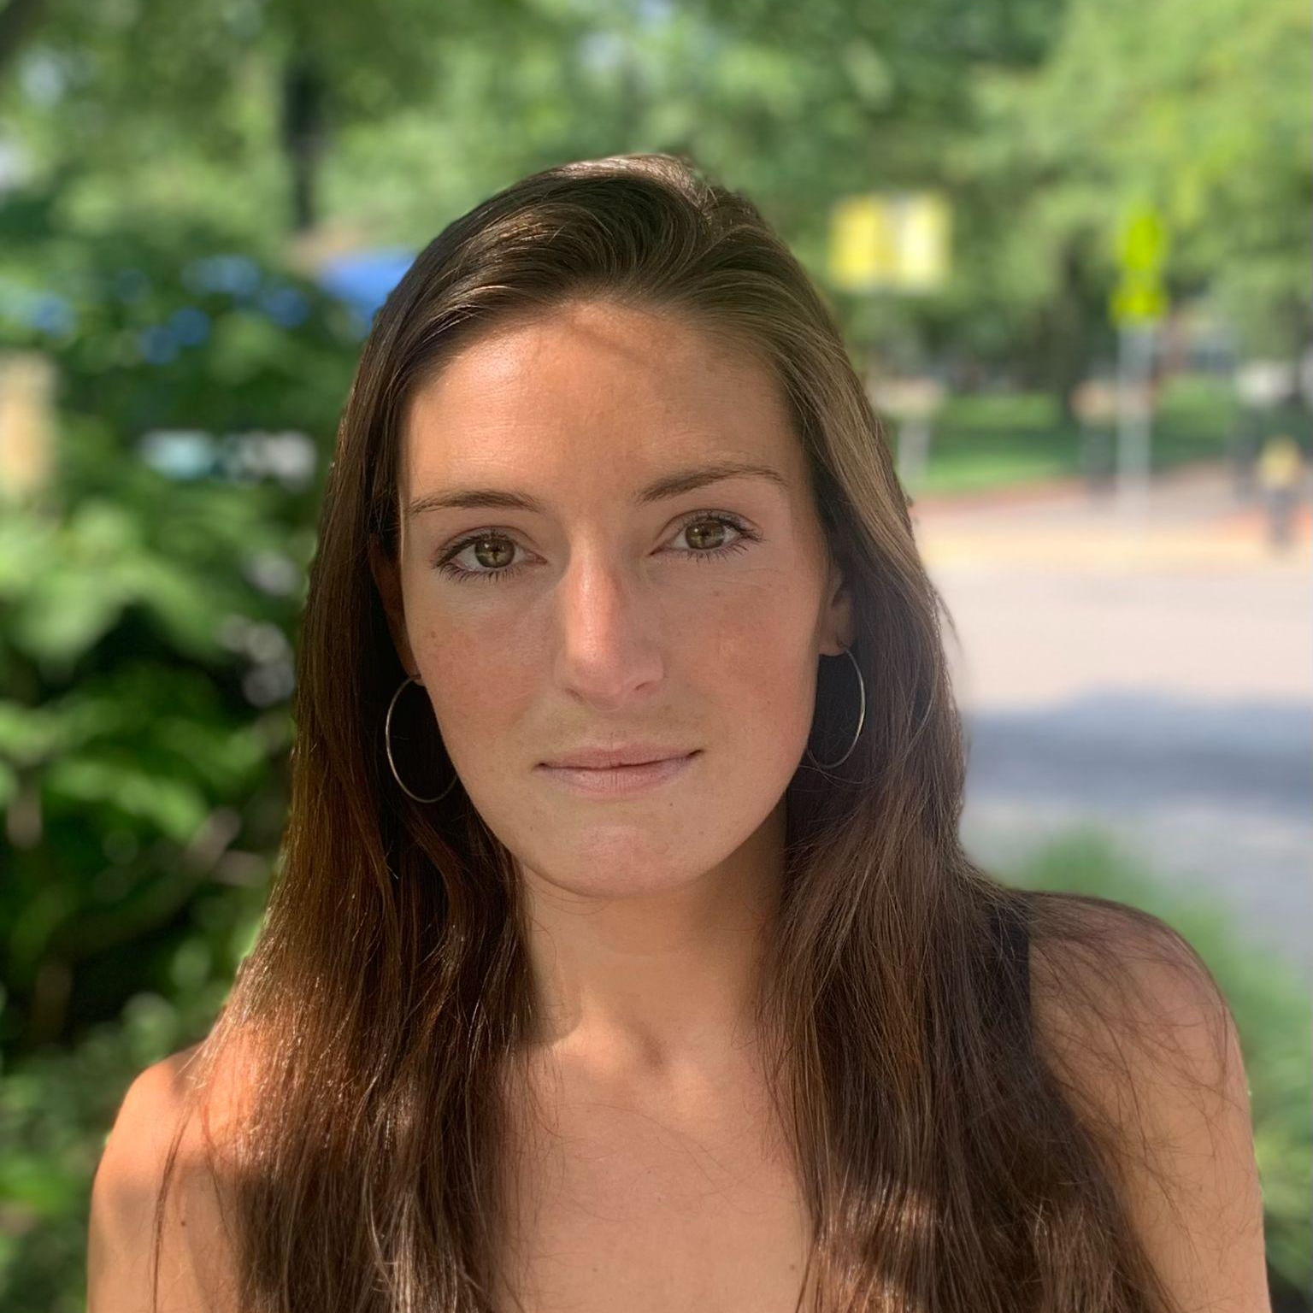
The Team
Amy Mueller, Ph.D
Ben Eck
Jodi Zangari
Principle Investigator
Associate Professor
Doctorate Student
Undergraduate Research Assistant

Slide 16
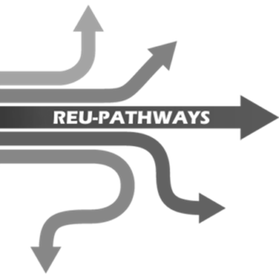
Special Acknowledgements
Center for STEM Education:
Claire Duggan - Executive Director ¹
Jennifer Love - Associate Director ²
Nicolas Fuchs - Program Manager ³
Lydia Bird - REU Coordinator ⁴
Mary Howley - Administrative ⁵
Funding:
1
2
3
4
5

Slide 17
