Slide 1


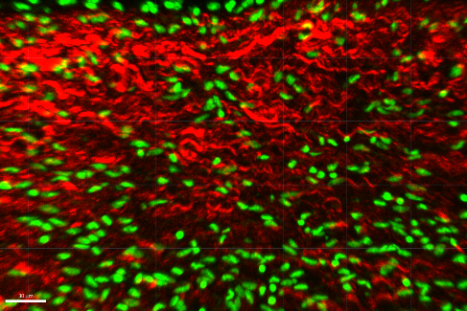




Head/Helmet Contact Force Characterization in Combat Helmet Systems
D'mitra Mukasa, Michael Marchev, Turner Jennings¹, Sinan Müftü¹, Rouzbeh Amini^{1,2}
1 Department of Mechanical and Industrial Engineering, Northeastern University, Boston, MA
2 Department of Bioengineering, Northeastern University, Boston, MA

Slide 2
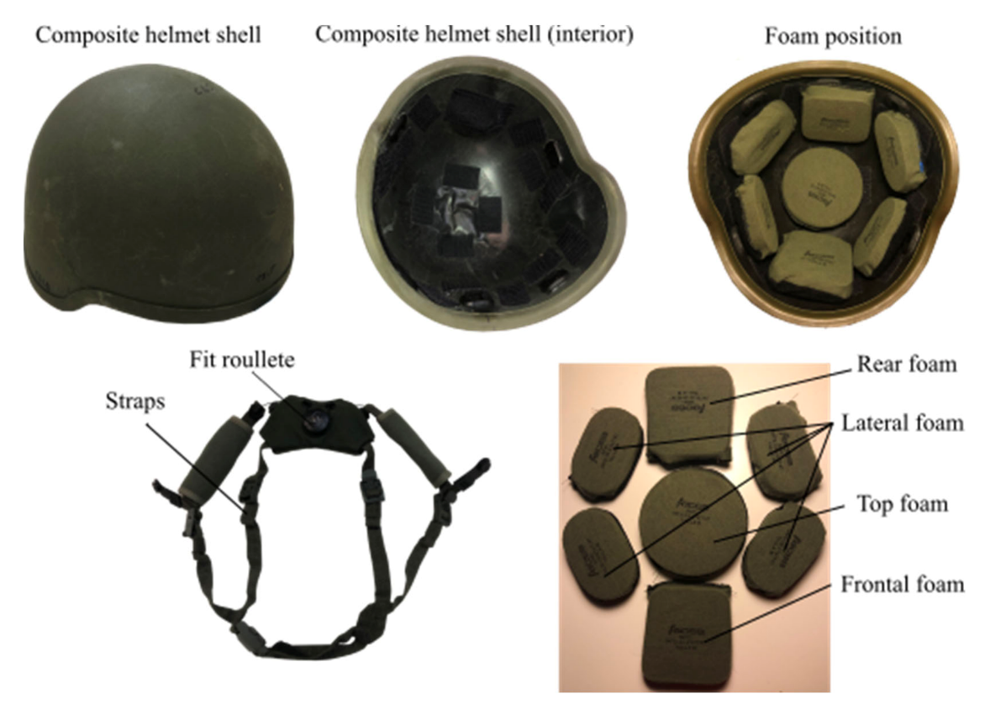
Background - Current Combat Helmet Technology
Head/Helmet Contact Force Characterization in Combat Helmet Systems
NEU Young Scholars Program 2023 - August 3, 2023

Slide 3

Background - Traumatic Brain Injury (TBI)
A TBI is a family of brain dysfunction caused by an outside force, usually a violent blow to the head, in our case; a projectile or explosive shrapnel
Head/Helmet Contact Force Characterization in Combat Helmet Systems
NEU Young Scholars Program 2023 - August 3, 2023
Notes:
Not Classifiable – there are triage criteria which are used to classify TBIs but some combinations do not have a formal classification

Slide 4
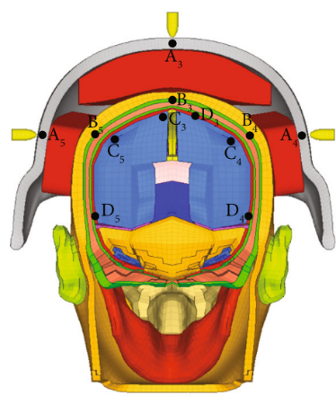
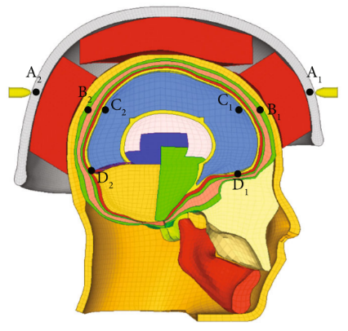
The Problem
Development of higher performance helmet materials relies heavily on numerical simulation.
Current simulations fail to construct a fully representative model.
It is unknown how pre-compression changes behavior of the padding upon impact.
Cai et al., Appl Bion Biomech, 2020
Head/Helmet Contact Force Characterization in Combat Helmet Systems
NEU Young Scholars Program 2023 - August 3, 2023
Notes:
Get a little more specific --> talk about sizing --> we don't know exactly how helmet fit affects forces etc.

Slide 5
Research Aims
Create experimental testing setup to measure contact force between the helmet and head in combat helmets
1.0
Calibrate pressure sensors for combined pressure/bending on helmet pads
1.1
Test the effects of head size, demographics, and chinstrap on helmet contact forces
2.0
Head/Helmet Contact Force Characterization in Combat Helmet Systems
NEU Young Scholars Program 2023 - August 3, 2023

Slide 6
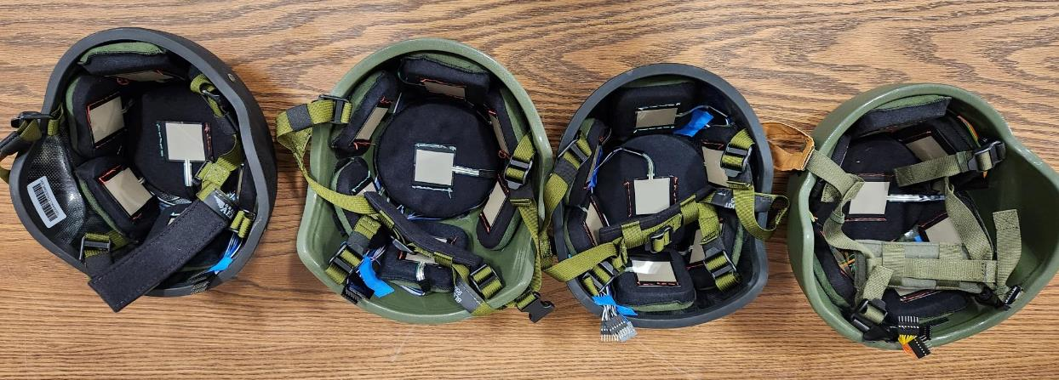
Abstract
Motivation
Previous studies on impact mechanics of combat helmets have failed to consider pre-compression of helmet padding under normal use conditions.
Our Goal:
Obtain experimental data on helmet/head contact forces to determine relationship between head size, helmet size, and pad pre-compression.
Head/Helmet Contact Force Characterization in Combat Helmet Systems
NEU Young Scholars Program 2023 - August 3, 2023
Notes:
sl

Slide 7
Methods
Objective: Estimate pad compression on helmets (S, M, L, XL) by taking readings of contact force on subject heads at rest while wearing helmets
Assemble helmets with pads
Sew pressure sensors on pads and run through Arduino
Calibrate mapping between voltage output and pressure applied through repeated measurements with known forces
Record participants’ age, sex, head length, width, and circumference
Record pressure data with and without chinstrap
Head/Helmet Contact Force Characterization in Combat Helmet Systems
NEU Young Scholars Program 2023 - August 3, 2023

Slide 8
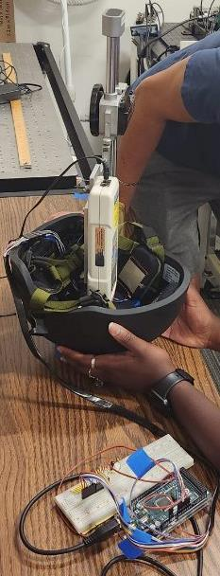
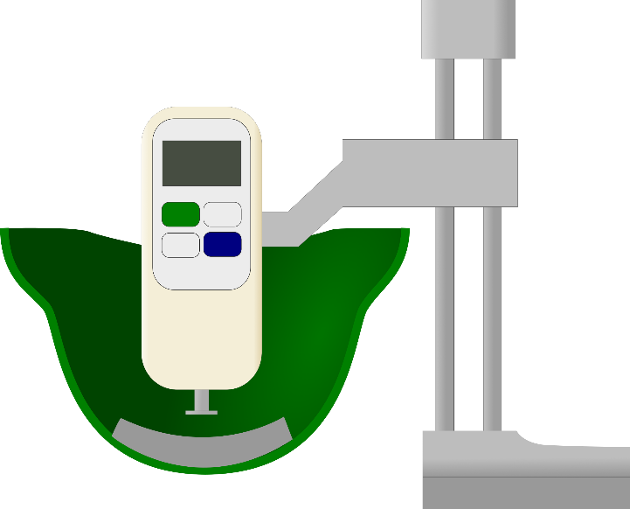
Methods - Calibration
Z-axis stage
Force Gauge
Helmet pads
Helmet shell
Diagram of pressure sensor calibration setup
Calibration setup in use
Head/Helmet Contact Force Characterization in Combat Helmet Systems
NEU Young Scholars Program 2023 - August 3, 2023

Slide 9
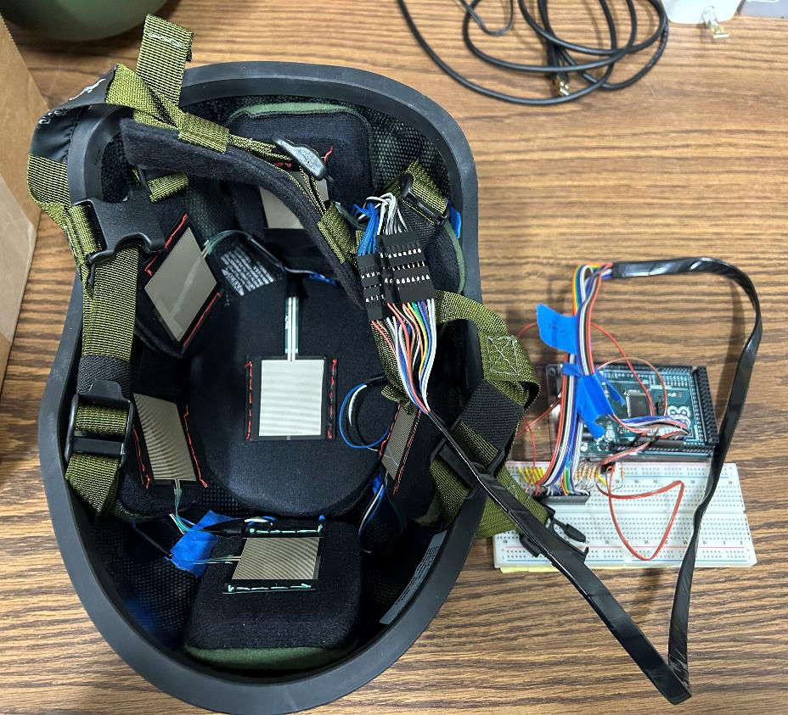
Methods – Assembled Helmet
Data connection
Pressure sensors
Helmet pads
Arduino board
Helmet shell
Helmet measurement setup
Head/Helmet Contact Force Characterization in Combat Helmet Systems
NEU Young Scholars Program 2023 - August 3, 2023

Slide 10
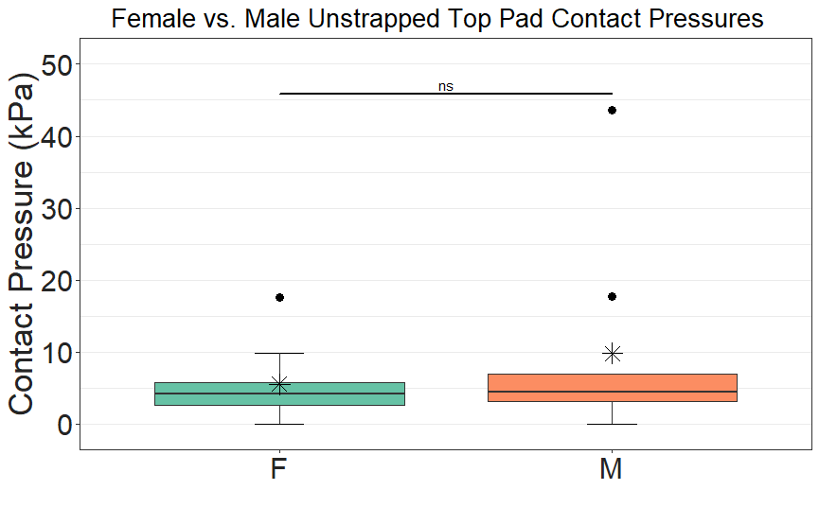
Results - F vs. M Unstrapped
No significant difference between male and female participants when helmet is unstrapped
Head/Helmet Contact Force Characterization in Combat Helmet Systems
NEU Young Scholars Program 2023 - August 3, 2023

Slide 11
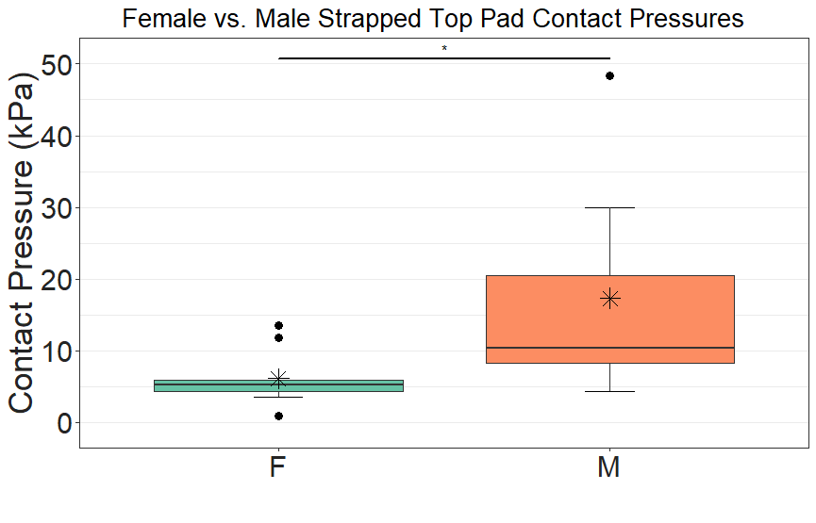
Results - F vs. M Strapped
Contact forces with chinstrap significantly higher on male participants (p<0.05) when chinstrap applied
Head/Helmet Contact Force Characterization in Combat Helmet Systems
NEU Young Scholars Program 2023 - August 3, 2023

Slide 12
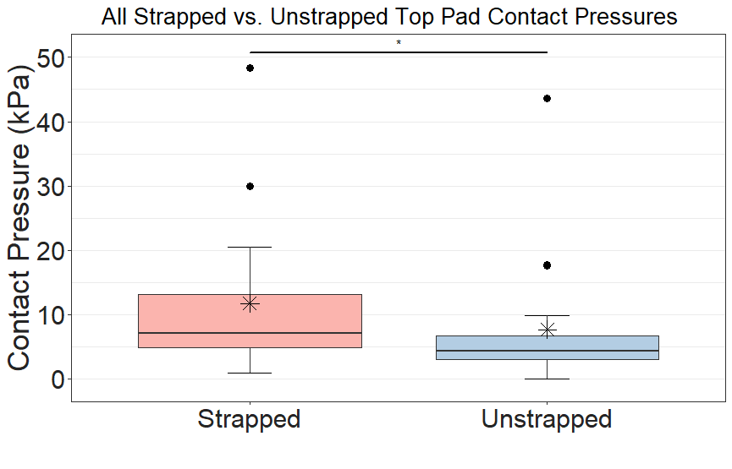
Results - Strapped vs. Unstrapped All
Contact forces with chinstrap are significantly higher than without the chinstrap (p<0.05)
Head/Helmet Contact Force Characterization in Combat Helmet Systems
NEU Young Scholars Program 2023 - August 3, 2023

Slide 13
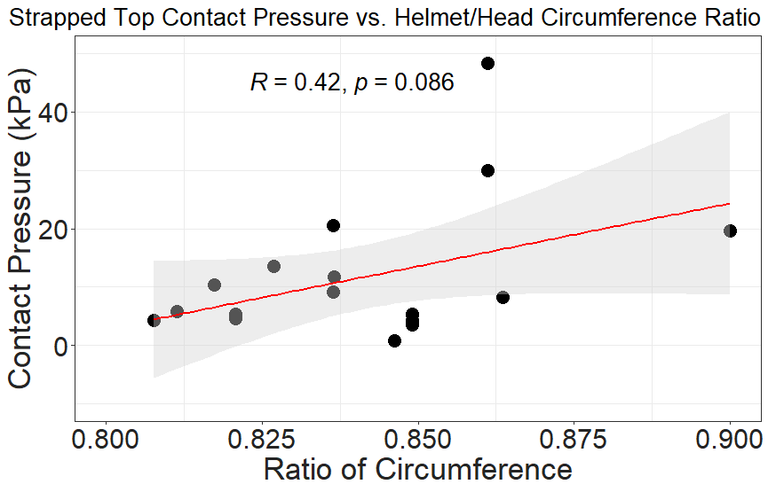
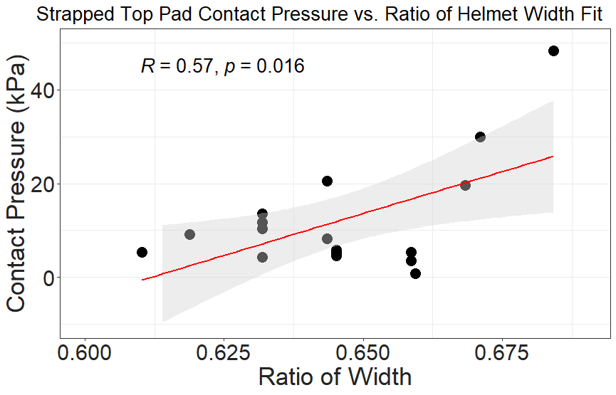
Results – Helmet Fit vs. Contact Pressure
Tighter fit loosely correlated with higher contact force, more data needed
Head/Helmet Contact Force Characterization in Combat Helmet Systems
NEU Young Scholars Program 2023 - August 3, 2023

Slide 14
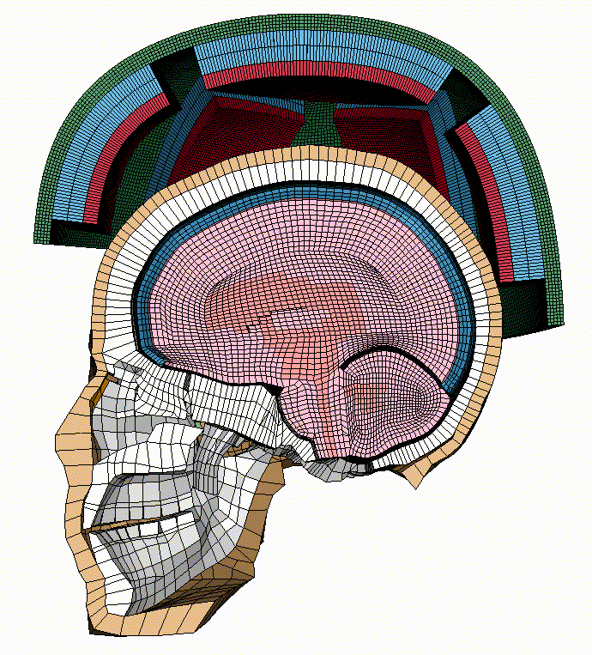
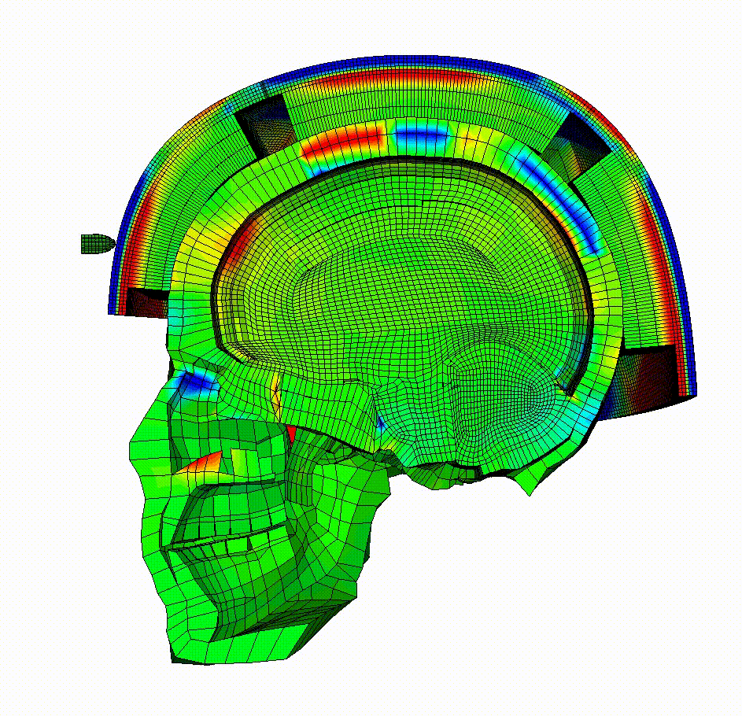
Future Work
Our data will be used to calibrate finite element simulations considering pad pre-compression in the future.
These simulations will be used to design granular materials capable of greater shock absorption.
Head/Helmet Contact Force Characterization in Combat Helmet Systems
NEU Young Scholars Program 2023 - August 3, 2023

Slide 15
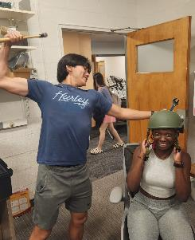



Acknowledgments
Center for STEM Education
Claire Duggan, Executive Director
Jennifer Love, Associate Director
Claire Stipp and Yassine Souabny, YSP Coordinators
Nicolas Fuchs, Program Manager
Mary Howley, Administrative Officer
ARL Soldier Protection Program CA#W911NF2120208.

Slide 16

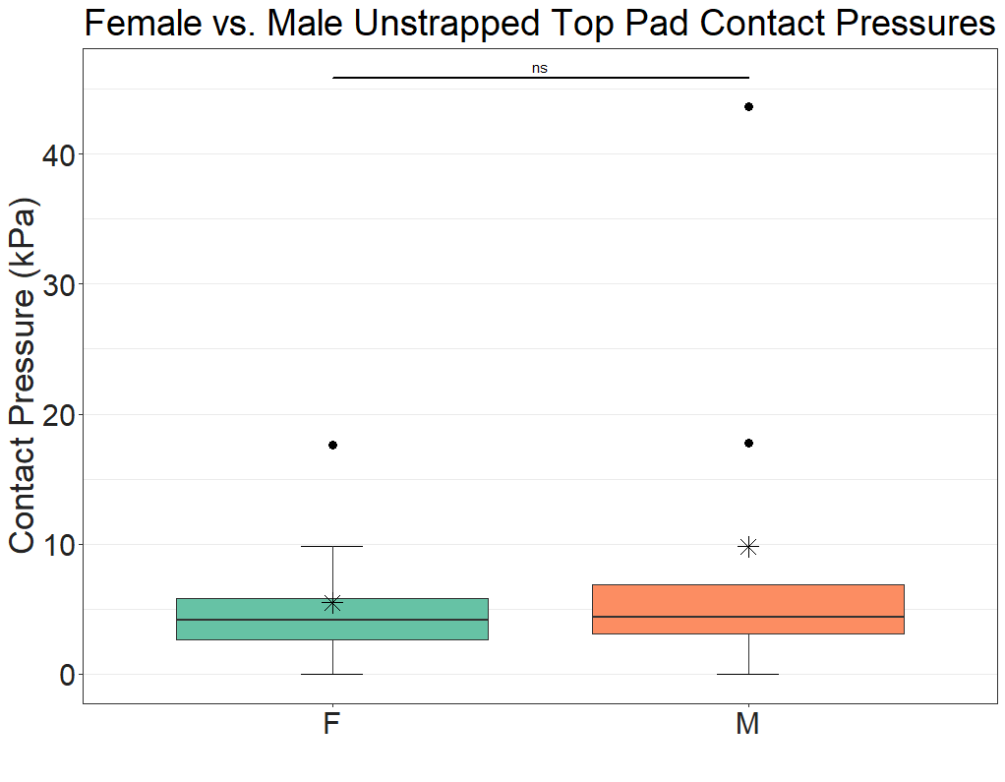
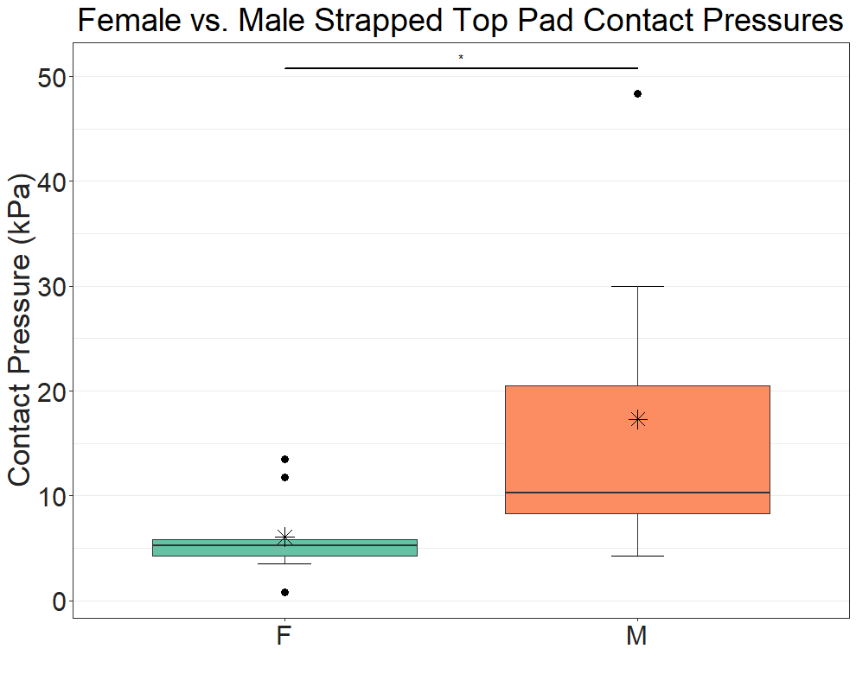
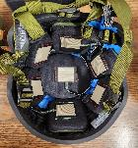

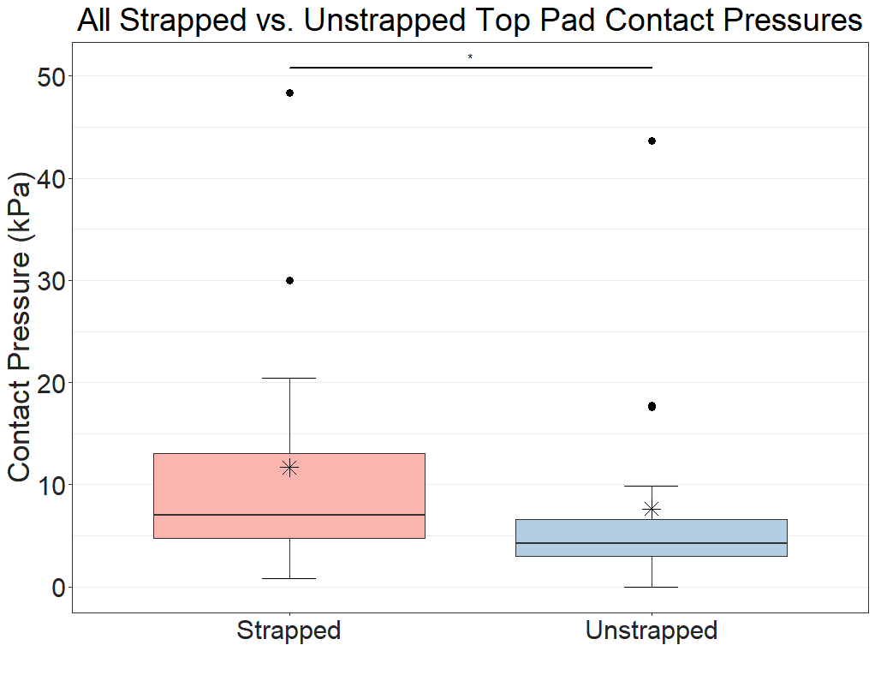
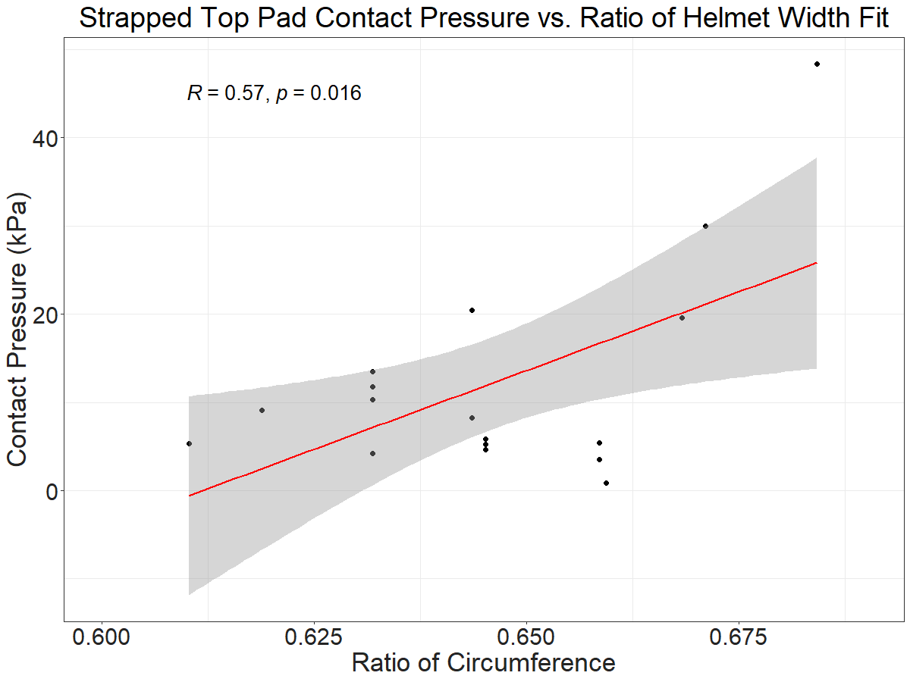
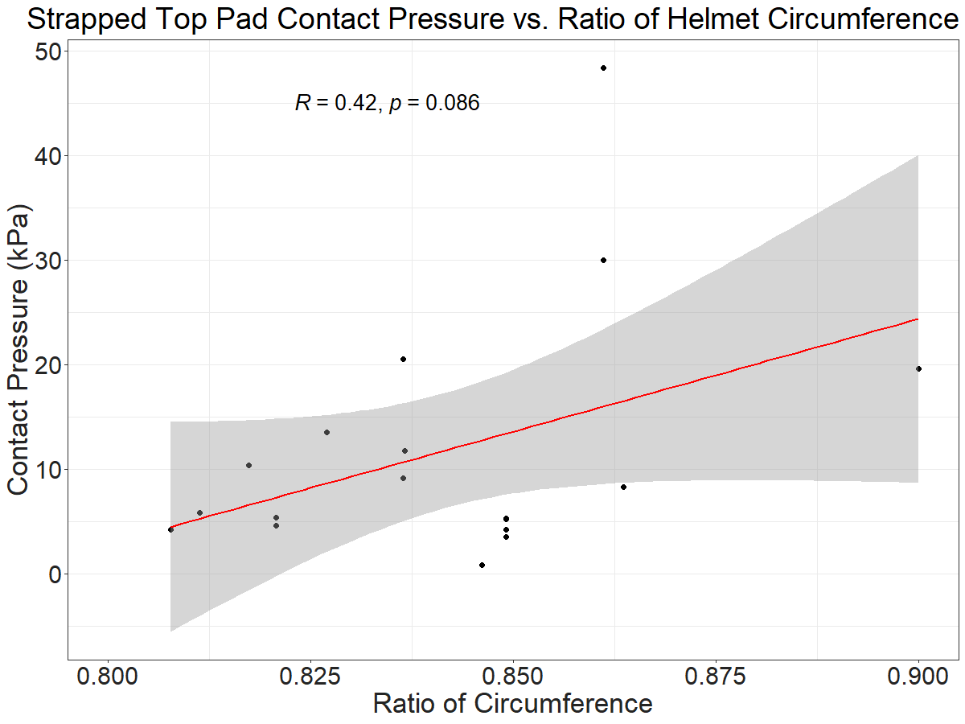



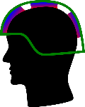
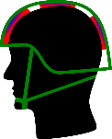
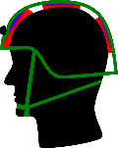
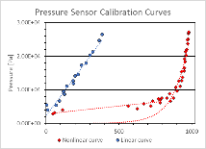






Head/Helmet Contact Force Characterization in Combat Helmet Systems
D'mitra Mukasa¹, Michael Marchev¹, Turner Jennings², Sinan Müftü², Rouzbeh Amini^{2,3}
1 Young Scholars Program, Northeastern University, Boston, MA
2 Department of Mechanical and Industrial Engineering, Northeastern University, Boston, MA
3 Department of Bioengineering, Northeastern University, Boston, MA
Current combat helmets consist of an exterior fiber composite shell with an interior soft foam padding. This foam layer provides additional protection by absorbing shock transferred from helmet shell to skull through compression upon impact. Existing research does not consider pre-compression that occurs while wearing the helmet; the accuracy of these models used to model force propagation is therefore limited. This affects predictions of the risk of impact-induced traumatic brain injuries. Four different size helmets have been instrumented with contact pressure sensors on the interior padding system. We will use these instrumented helmets to measure head-helmet interface contact forces on volunteer users. We hypothesize that interface forces will change depending on whether the user fastens the helmet strap and that male and female volunteers will additionally contrast due to statistical differences in head size. The experiments conducted will be used to calibrate finite element simulations of impacts on a helmeted head to develop higher-performing energy absorbing materials capable of reducing the risk of impact-induced traumatic brain injury.
Obtained S, M, L, XL Advanced Combat Helmets with Oregon Aero pads and assembled as instructed; sewed pressure sensors onto all pads with connection to Arduino
Recorded demographic data (age, gender);measured head length, width, and circumference; documented contact forces with and without chinstrap
Comparison of top pad contact pressure between male and female users not wearing the chinstrap
Comparison of top pad contact pressure between male and female users while wearing the chinstrap
Male contact pressure is not significantly higher than females when the chinstrap is not applied. The pressure difference is statistically significant (p<.05) when the chinstrap is applied. We hypothesize that the difference between male and female pressures could be a result of smaller head and helmet sizes, since all the female participants sampled used either size S or M helmets. We further hypothesize that the increased difference from strapped data could indicate that males fasten the strap more tightly than females. Among all groups, we additionally found significantly higher strapped than unstrapped contact pressures. The sample size of the present study was limited to 18 participants, the results can be further refined by expanding the number of users tested.
Helmet assembled with contact pressure sensors
Diagram of pressure sensors calibration setup
pre-compression is naturally present and brought on by the weight of the helmet, the fit of the head within the pads, and use of the chinstrap
Prior studies on ballistic impact with combat helmets have failed to considered pre-compression of padding [1,2]
A characterization of contact forces has not been previously attempted
(A) (B) (C)
Comparison of top pad contact pressure between user wearing and not wearing the chinstrap
Collect contact pressure data from military personnel
Create new helmet fitting simulations with pad pre-compression data considered
(A)
(B)
Representative diagram of helmet padding layout
Simulated top pad contact pressure difference between (A) 0.5 mm and (B) 1.5 mm padding compression
Plot of top pad contact pressure against the non-dimensionalized ratio of head width to helmet width of users wearing the chinstrap
Plot of top pad contact pressure against the non-dimensionalized ratio of head circumference to helmet circumference of users wearing the chinstrap
We would like to thank Julia Clarin, Fred Sebastian, Ana Vargas, and Sean Harrington. We would also like to thank the NU Center for STEM Education; particularly Claire Duggan, Jennifer Love, Claire Stipp, Yassine Souabny, Nicolas Fuchs, and Mary Howley. Funding for this project was provided by the United States Army Research Lab Soldier Protection Program Cooperative Agreement #W911NF2120208.
There is a weak positive correlation between top pad contact pressure and the relative size of the helmet compared with the head (width and circumference ratio of head/helmet). When calibrating different helmet pads, we saw significant variation in the calibration curves. All helmet pads were assigned either a linear or piecewise non-linear calibration curve. We hypothesize that the difference among pad calibrations may be due to differing curvature of the helmet underneath the padding.
The padding is compressed by the weight of the helmet (A).
The padding is further compressed by buckling the chinstrap (B).
The padding is fully compressed when bullet hits the helmet (C).
[1] Tan, L.B. et al., Int J Impact Engrg, 50, 2012:99-112
[2] Rodríguez-Millán, M. et al., Mat Des, 110, 2016:391-403
Representative calibration curves of pressure sensors mapping voltage output to pressure
This poster contains unpublished confidential information

Slide 17


Additional Lab Summary – Pregnant Valve Mechanics
1.6M
Moderate to severe cases in the US¹
15%
US adults with mild TR¹
Pregnancy increase risk of regurgitation
Tricuspid Regurgitation (TR)
Head/Helmet Contact Force Characterization in Combat Helmet Systems
NEU Young Scholars Program 2023 - August 3, 2023
Notes:
While working in Prof. Rouzbeh Amini's lab, we worked on several projects in addition to our main research with combat helmets. Namely, we worked heavily on Julia Clarin's lab examining the effects of pregnancy on the tricuspid valve
During pregnancy the volume of blood increases and can cause blood regurgitation if the tricuspid valve does not close fully, causing the heart to pump harder than needed

Slide 18
Discussion/Conclusion
Higher contact pressure among males
  Females tested had generally smaller heads and helmets
  Shape difference
Male/Female difference increase with strap application
  Magnification of the same difference
  Males may tension the strap more tightly
Higher contact pressure with tighter fit
  Pads forced to compress further
Sample consisted of 18 inexperienced users and may not be representative.
Head length population distribution
 |  | Percentiles
Sample |  | 1st | 5th | 50th | 95th | 99th
Male | [cm] | 18.3 | 18.8 | 20.0 | 21.1 | 21.7
Female | [cm] | 17.5 | 18.0 | 19.1 | 20.2 | 20.7
Source: DOD Human Factors Engineering
Head/Helmet Contact Force Characterization in Combat Helmet Systems
NEU Young Scholars Program 2023 - August 3, 2023

