Slide 1


2026-09-29
Richard West
Teach a Computer Chemistry, then Watch It React.

Slide 2
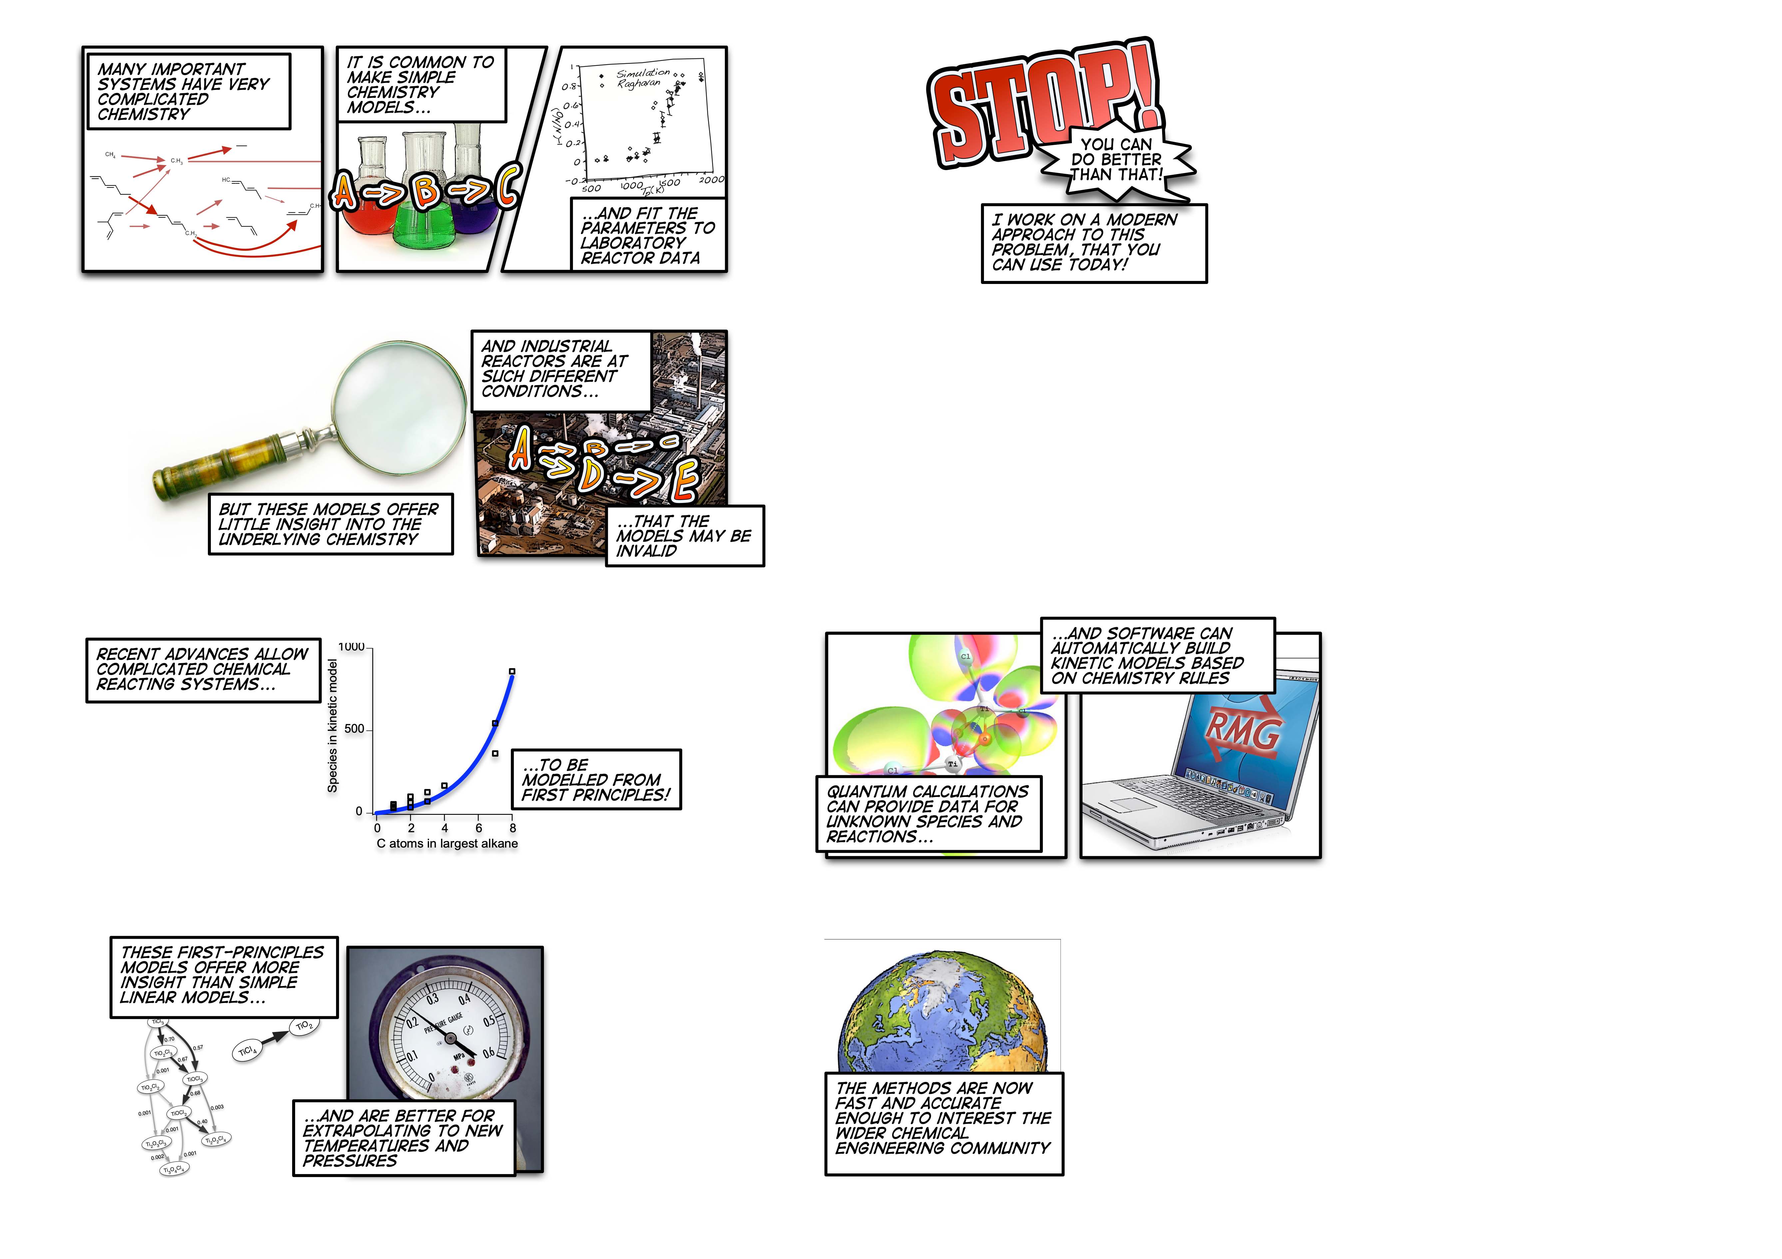

Slide 3
Notes:
o We used to build models to check our understanding;
♣ if we can’t make the model match the experiment then the understanding we built the model on (eg first order wrt O2) needs revising.
o May not be based on correct understanding – even if it fits the curve, it may not be physically meaningful.
o Not reliably predictive for conditions outside range of experiments, due to the complex T,P-depnedence mentioned above.
♣ Very difficult to do experiments at relevant conditions – too hot, high pressure, too fast (TiO2)
o Complex tradeoffs, competing pathways
o Strange temperature and pressure dependencies
♣ At higher temperature, a new dominant pathway may open up and the reaction order may change
♣ At higher pressure, a different pressure-dependent network may activate

Slide 7
Predictive Detailed Kinetic Modeling
thousands
computer
new conditions
chemical reactions

Slide 8
Using computers to predict how things will react.
What?
Why?
Faster than experiments
Hypothetical scenarios
Transferrable skills
Efficient combustion
of new fuels
Environmentally friendly
flame suppressants
Destroying toxic
“forever chemicals”
Catalytic synthesis
of fuels and chemicals
Electrochemical synthesis
of fuels and chemicals

Slide 9
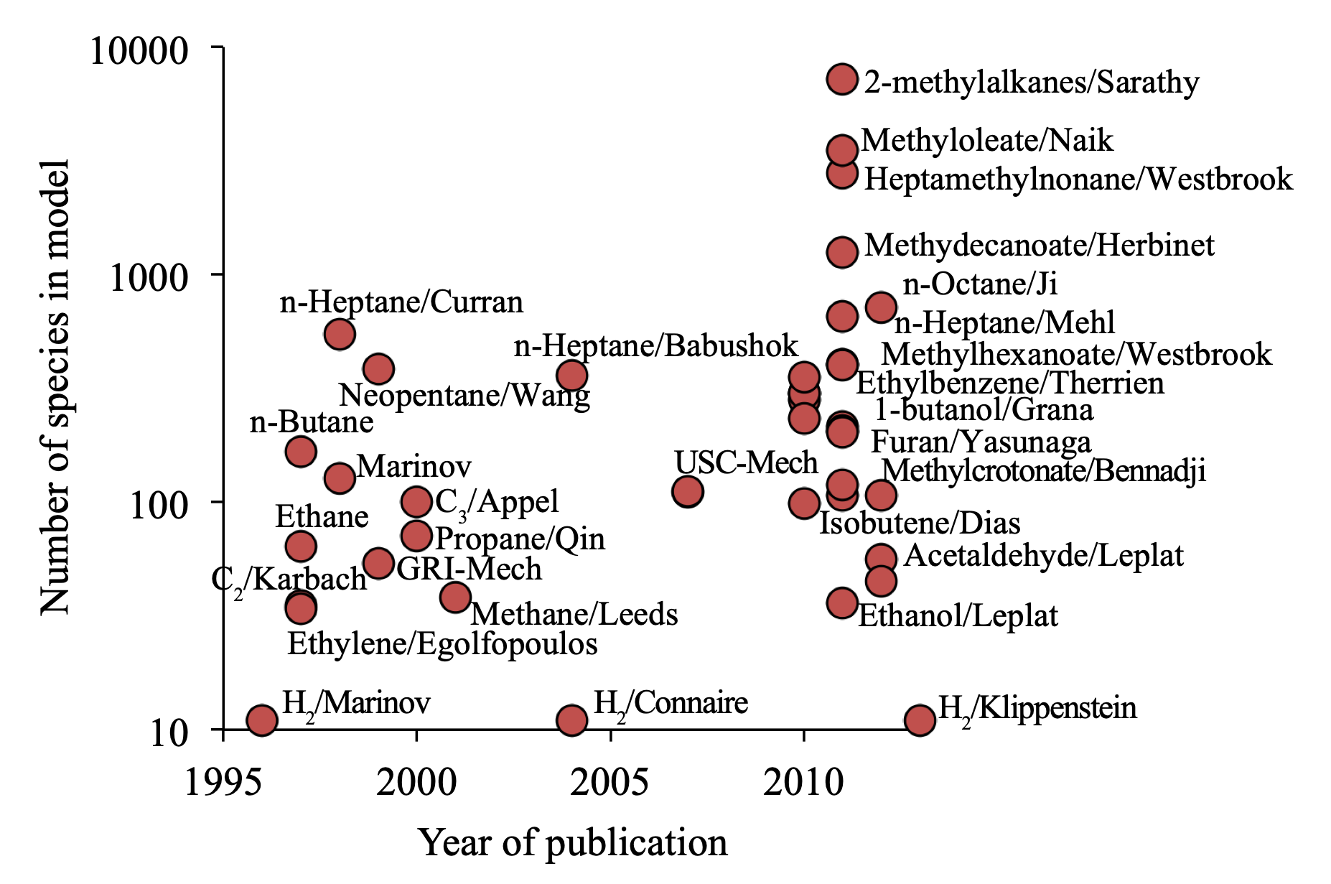
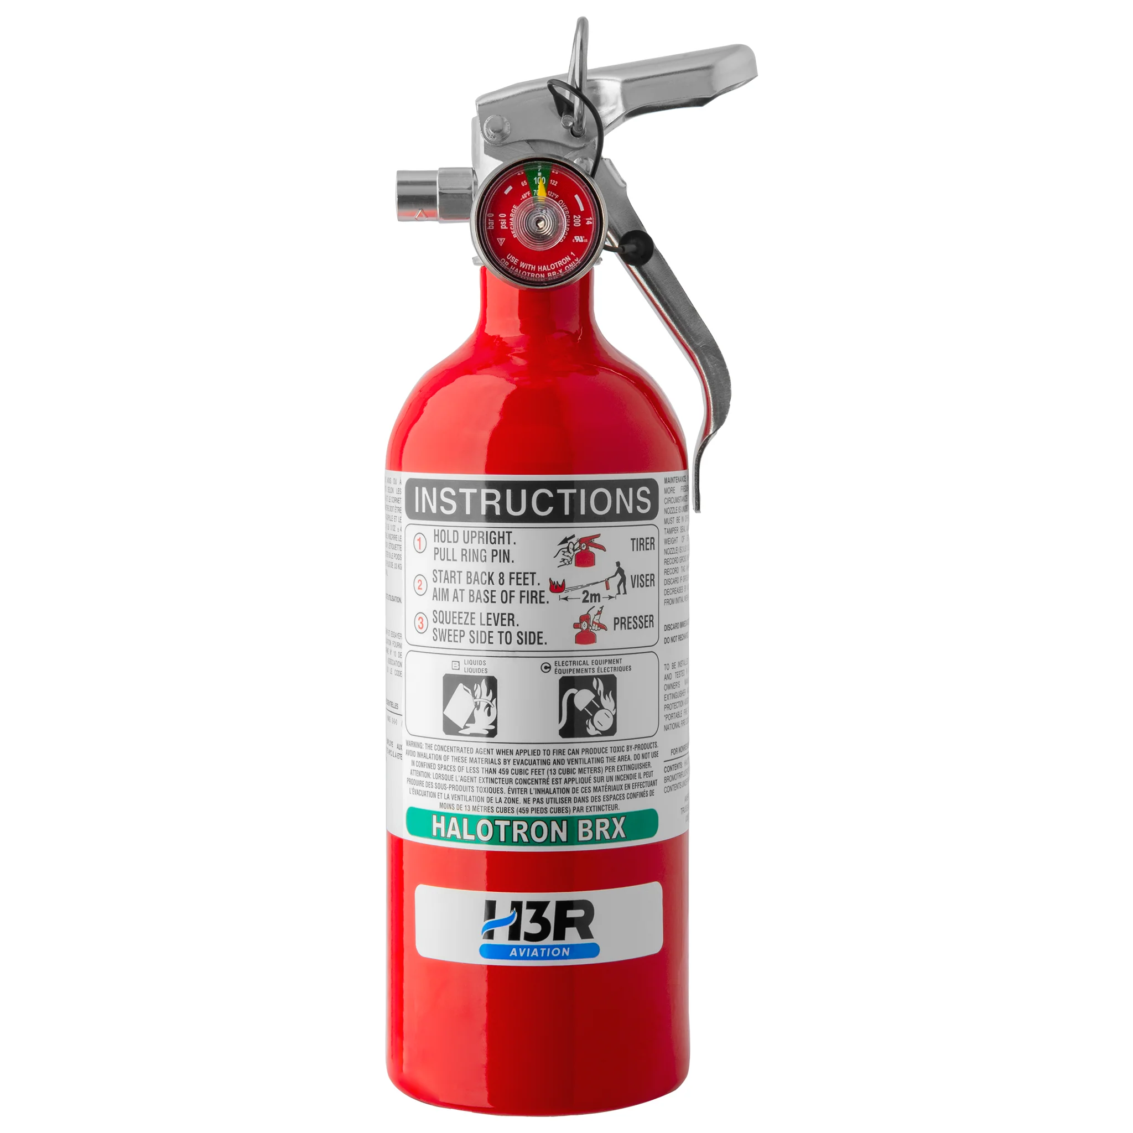
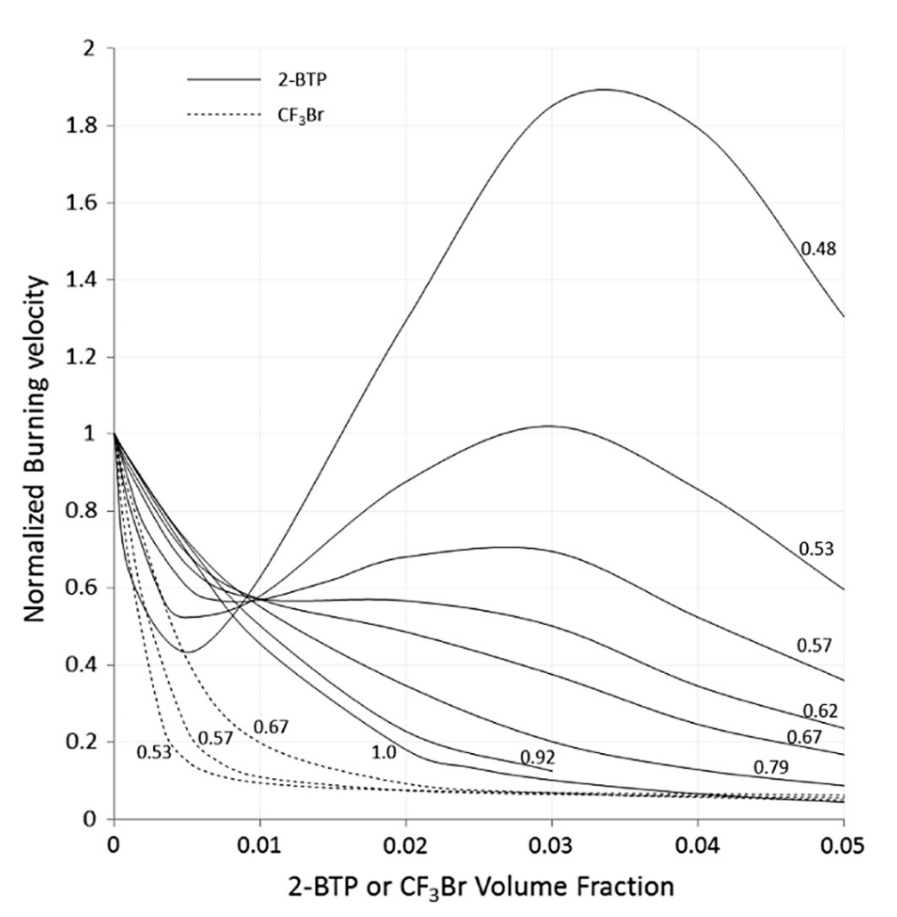
Combustion Chemistry is Complex
CH₂=CBrCF₃
0.48
CF3Br
methane flame speed
0.53
0.57
ɸ=1.00
0.62
ɸ=0.67
0.67
0.53
0.57
0.92
0.79
suppressant fraction
Fuels are hard but routine
Halocarbons are weird!

Slide 10
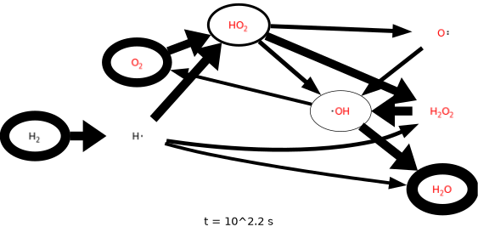
Combustion Chemistry is Complex
CH₂=CBrCF₃
0.48
CF3Br
methane flame speed
0.53
0.57
ɸ=1.00
0.62
ɸ=0.67
0.67
0.53
0.57
0.92
0.79
suppressant fraction
Fuels are hard but routine
Halocarbons are weird!

Slide 11
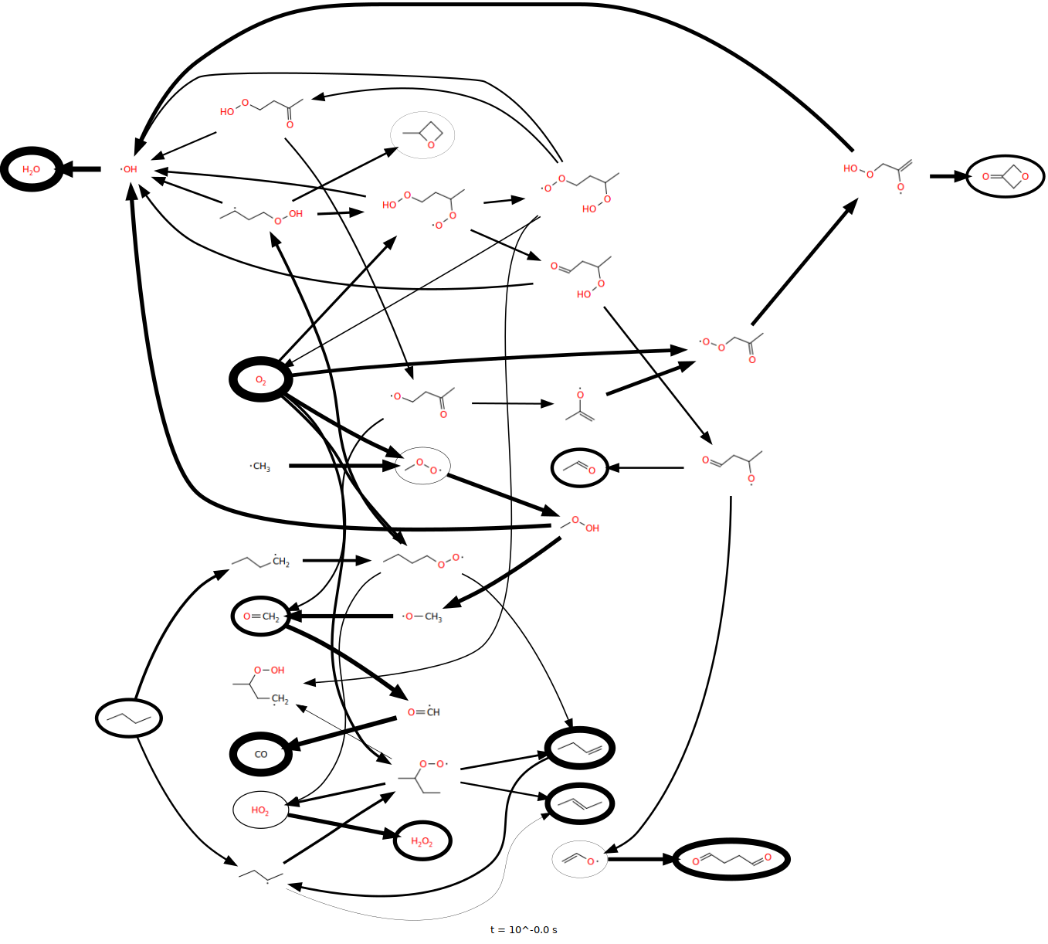
Combustion Chemistry is Complex
CH₂=CBrCF₃
0.48
CF3Br
methane flame speed
0.53
0.57
ɸ=1.00
0.62
ɸ=0.67
0.67
0.53
0.57
0.92
0.79
suppressant fraction
Fuels are hard but routine
Halocarbons are weird!

Slide 12
Combustion Chemistry is Complex
CH₂=CBrCF₃
0.48
CF3Br
methane flame speed
0.53
0.57
ɸ=1.00
0.62
ɸ=0.67
0.67
0.53
0.57
0.92
0.79
suppressant fraction
Fuels are hard but routine
Halocarbons are weird!

Slide 13
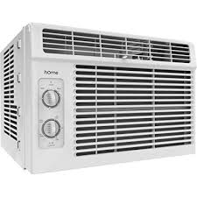

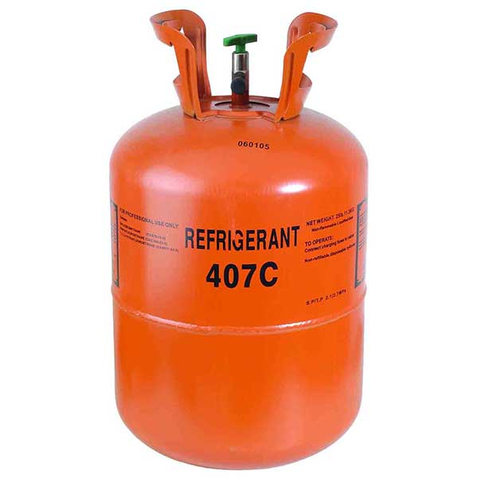
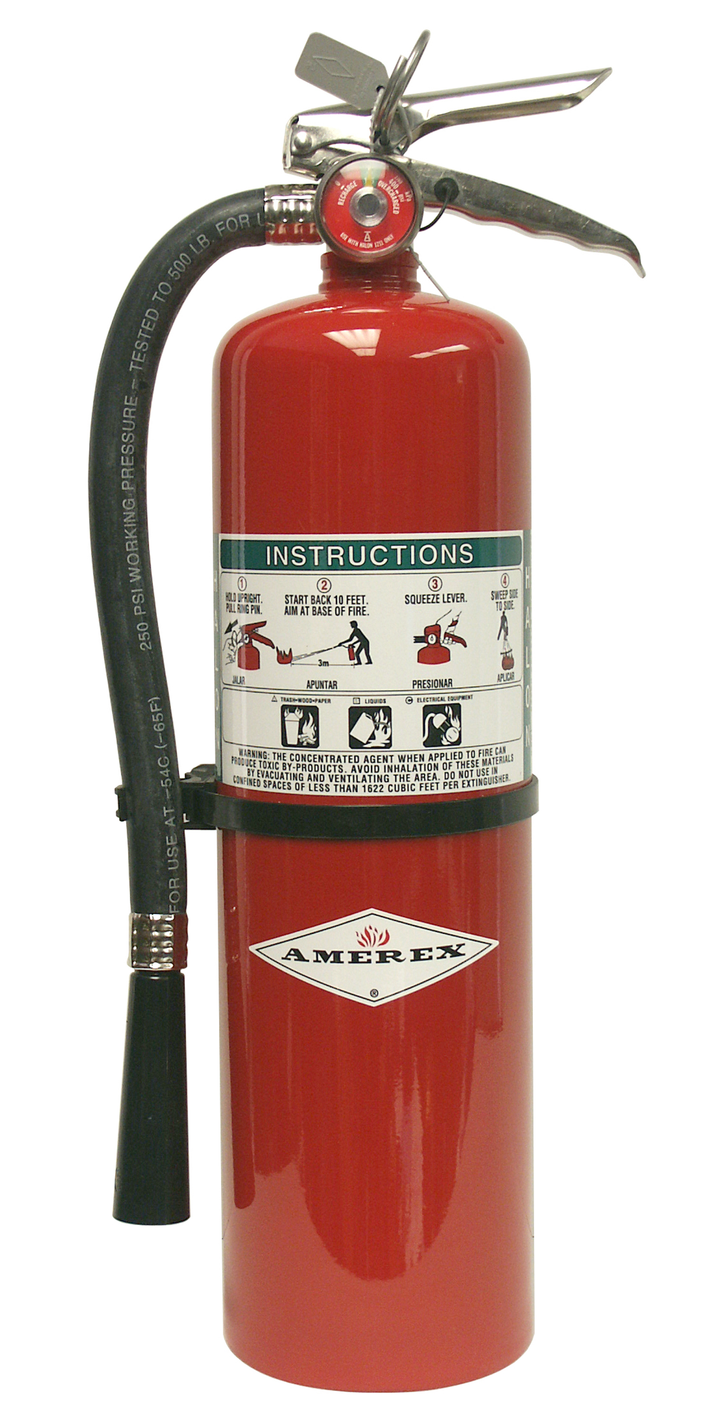
Halogenated Hydrocarbons (HHCs) are commonly used as refrigerants and flame suppressants
CH2F2
C2HF5
F3CCH2F
Halon 1211
CF2ClBr
https://learn.compactappliance.com/freon-alternatives/
http://amerex-fire.com/products/halon-1211-extinguishers/
Notes:
2. First off, what are HHCs used for? HHCs are widely uses as refrigerants and as flame suppressants. For example, Refrigerant 407c which is used in air conditioning systems is primarily a mixture of 3 fluorinated hydrocarbons. CF2ClBr, more commonly known as Halon 1211, is a fire suppressant often used aboard commercial aircrafts

Slide 14
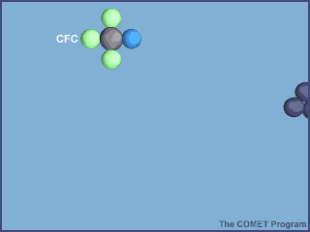
Environmental concerns motivate a new generation of HHC flame suppressants and refrigerants
Compound | Formula | Ozone Depleting Potential [2] | Lifetime (years) | Global Warming Potential [3]
CFC-12 | CCl2F2 | 0.82 | 100 | 10,200
CFC-113 | CCl2FCClF2 | 0.85 | 85 | 5,820
CFC-11 | CCl3F | 1 | 45 | 4,660
HCFC-22 | CHClF2 | 0.04 | 11.9 | 1,760
HFC-134a | CH2FCF3 | 0.000015 | 13.4 | 1,300
Carbon dioxide | CO2 | 0 | 2-20,000^{[4]} | 1
HFO-1234yf | CF3CF=CH2 | 0 | 0.03 | <1
1st Gen
How CFC-11 destroys the ozone layer [1]
2nd Gen
3rd Gen
[1] http://www.theozonehole.com/ozonedestruction.html
[2] EPA. https://www.epa.gov/ozone-layer-protection/ozone-depleting-substances
Notes:
HHC fire suppressants are good at putting out fires, but they are harmful to the environment. The first generation of suppressants, chlorofluorocarbons or CFCs, were potent greenhouse gases and depleted the ozone layer, as shown on the figure in the upper left. A simplified animation of how this happened is shown below.
In the stratosphere, the Carbon-Chlorine bond in CFC dissociates with the absorbance of UV light creating free chlorine radicals. The chlorine radicals abstract an oxygen atom from ozone creating molecular oxygen. The destruction of the ozone layer by CFCs led to the development of a second generation of suppresants, mainly HCFCs and HFCs. Although these suppressants are ozone-friendly, they are strong greenhouse gases with global warming potentials over 1000 times that of carbon dioxide(GWP is defined as the warming potential over a chosen amount of time of 1 kg of a gas relative to 1 kg of CO2, which is given a GWP value of 1). These environmental concerns motivate the need for a new generation of greener and cleaner HHC refrigerant and flame suppressants.
One Dobson Unit is the number of molecules of ozone that would be required to create a layer of pure ozone 0.01 millimeters thick at a temperature of 0 degrees Celsius and a pressure of 1 atmosphere (the air pressure at the surface of the Earth). Expressed another way, a column of air with an ozone concentration of 1 Dobson Unit would contain about 2.69x1016ozone molecules for every square centimeter of area at the base of the column
GWP is defined as the warming potential over a chosen amount of time of 1 kg of a gas relative to 1 kg of CO2, which is given a GWP value of 1.

Slide 15
Environmental concerns motivate a new generation of HHC flame suppressants and refrigerants
Compound | Formula | Ozone Depleting Potential [2] | Lifetime (years) | Global Warming Potential [3]
CFC-12 | CCl2F2 | 0.82 | 100 | 10,200
CFC-113 | CCl2FCClF2 | 0.85 | 85 | 5,820
CFC-11 | CCl3F | 1 | 45 | 4,660
HCFC-22 | CHClF2 | 0.04 | 11.9 | 1,760
HFC-134a | CH2FCF3 | 0.000015 | 13.4 | 1,300
Carbon dioxide | CO2 | 0 | 2-20,000^{[4]} | 1
HFO-1234yf | CF3CF=CH2 | 0 | 0.03 | <1
1st Gen
How CFC-11 destroys the ozone layer [1]
2nd Gen
3rd Gen
[1] http://www.theozonehole.com/ozonedestruction.html
[2] EPA. https://www.epa.gov/ozone-layer-protection/ozone-depleting-substances
Notes:
HHC fire suppressants are good at putting out fires, but they are harmful to the environment. The first generation of suppressants, chlorofluorocarbons or CFCs, were potent greenhouse gases and depleted the ozone layer, as shown on the figure in the upper left. A simplified animation of how this happened is shown below.
In the stratosphere, the Carbon-Chlorine bond in CFC dissociates with the absorbance of UV light creating free chlorine radicals. The chlorine radicals abstract an oxygen atom from ozone creating molecular oxygen. The destruction of the ozone layer by CFCs led to the development of a second generation of suppresants, mainly HCFCs and HFCs. Although these suppressants are ozone-friendly, they are strong greenhouse gases with global warming potentials over 1000 times that of carbon dioxide(GWP is defined as the warming potential over a chosen amount of time of 1 kg of a gas relative to 1 kg of CO2, which is given a GWP value of 1). These environmental concerns motivate the need for a new generation of greener and cleaner HHC refrigerant and flame suppressants.
One Dobson Unit is the number of molecules of ozone that would be required to create a layer of pure ozone 0.01 millimeters thick at a temperature of 0 degrees Celsius and a pressure of 1 atmosphere (the air pressure at the surface of the Earth). Expressed another way, a column of air with an ozone concentration of 1 Dobson Unit would contain about 2.69x1016ozone molecules for every square centimeter of area at the base of the column
GWP is defined as the warming potential over a chosen amount of time of 1 kg of a gas relative to 1 kg of CO2, which is given a GWP value of 1.

Slide 16
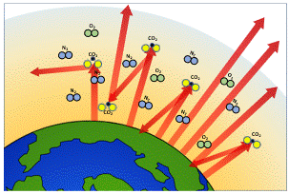
Environmental concerns motivate a new generation of HHC flame suppressants and refrigerants
Compound | Formula | Ozone Depleting Potential [2] | Lifetime (years) | Global Warming Potential [3]
CFC-12 | CCl2F2 | 0.82 | 100 | 10,200
CFC-113 | CCl2FCClF2 | 0.85 | 85 | 5,820
CFC-11 | CCl3F | 1 | 45 | 4,660
HCFC-22 | CHClF2 | 0.04 | 11.9 | 1,760
HFC-134a | CH2FCF3 | 0.000015 | 13.4 | 1,300
Carbon dioxide | CO2 | 0 | 2-20,000^{[4]} | 1
HFO-1234yf | CF3CF=CH2 | 0 | 0.03 | <1
1st Gen
How greenhouse gasses cause global warming [1]
2nd Gen
[1] https://www.museumoftheearth.org/changing-climate/greenhouse-effect
[2] EPA. https://www.epa.gov/ozone-layer-protection/ozone-depleting-substances
[3] https://cen.acs.org/articles/91/i34/Halocarbons-Reassessed.html and Hodnebrog et al. Rev. Geophys. 2013, DOI: 10.1002/rog.20013
[4] Archer, et al. (2009). Atmospheric Lifetime of Fossil Fuel Carbon Dioxide. Annual Review of Earth and Planetary Sciences, v.37, 117-134 (2009).
Notes:
HHC fire suppressants are good at putting out fires, but they are harmful to the environment. The first generation of suppressants, chlorofluorocarbons or CFCs, were potent greenhouse gases and depleted the ozone layer, as shown on the figure in the upper left. A simplified animation of how this happened is shown below.
In the stratosphere, the Carbon-Chlorine bond in CFC dissociates with the absorbance of UV light creating free chlorine radicals. The chlorine radicals abstract an oxygen atom from ozone creating molecular oxygen. The destruction of the ozone layer by CFCs led to the development of a second generation of suppresants, mainly HCFCs and HFCs. Although these suppressants are ozone-friendly, they are strong greenhouse gases with global warming potentials over 1000 times that of carbon dioxide(GWP is defined as the warming potential over a chosen amount of time of 1 kg of a gas relative to 1 kg of CO2, which is given a GWP value of 1). These environmental concerns motivate the need for a new generation of greener and cleaner HHC refrigerant and flame suppressants.
One Dobson Unit is the number of molecules of ozone that would be required to create a layer of pure ozone 0.01 millimeters thick at a temperature of 0 degrees Celsius and a pressure of 1 atmosphere (the air pressure at the surface of the Earth). Expressed another way, a column of air with an ozone concentration of 1 Dobson Unit would contain about 2.69x1016ozone molecules for every square centimeter of area at the base of the column
GWP is defined as the warming potential over a chosen amount of time of 1 kg of a gas relative to 1 kg of CO2, which is given a GWP value of 1.

Slide 17

Environmental concerns motivate a new generation of HHC flame suppressants and refrigerants
Compound | Formula | Ozone Depleting Potential [2] | Lifetime (years) | Global Warming Potential [3]
CFC-12 | CCl2F2 | 0.82 | 100 | 10,200
CFC-113 | CCl2FCClF2 | 0.85 | 85 | 5,820
CFC-11 | CCl3F | 1 | 45 | 4,660
HCFC-22 | CHClF2 | 0.04 | 11.9 | 1,760
HFC-134a | CH2FCF3 | 0.000015 | 13.4 | 1,300
Carbon dioxide | CO2 | 0 | 2-20,000^{[4]} | 1
HFO-1234yf | CF3CF=CH2 | 0 | 0.03 | <1
1st Gen
Why a flammable “flame suppressant” is a bad idea [1]
2nd Gen
3rd Gen
[1] The Simpsons, Season 11, Episode 22
[2] EPA. https://www.epa.gov/ozone-layer-protection/ozone-depleting-substances
[3] https://cen.acs.org/articles/91/i34/Halocarbons-Reassessed.html and Hodnebrog et al. Rev. Geophys. 2013, DOI: 10.1002/rog.20013
[4] Archer, et al. (2009). Atmospheric Lifetime of Fossil Fuel Carbon Dioxide. Annual Review of Earth and Planetary Sciences, v.37, 117-134 (2009).
Notes:
HHC fire suppressants are good at putting out fires, but they are harmful to the environment. The first generation of suppressants, chlorofluorocarbons or CFCs, were potent greenhouse gases and depleted the ozone layer, as shown on the figure in the upper left. A simplified animation of how this happened is shown below.
In the stratosphere, the Carbon-Chlorine bond in CFC dissociates with the absorbance of UV light creating free chlorine radicals. The chlorine radicals abstract an oxygen atom from ozone creating molecular oxygen. The destruction of the ozone layer by CFCs led to the development of a second generation of suppresants, mainly HCFCs and HFCs. Although these suppressants are ozone-friendly, they are strong greenhouse gases with global warming potentials over 1000 times that of carbon dioxide(GWP is defined as the warming potential over a chosen amount of time of 1 kg of a gas relative to 1 kg of CO2, which is given a GWP value of 1). These environmental concerns motivate the need for a new generation of greener and cleaner HHC refrigerant and flame suppressants.
One Dobson Unit is the number of molecules of ozone that would be required to create a layer of pure ozone 0.01 millimeters thick at a temperature of 0 degrees Celsius and a pressure of 1 atmosphere (the air pressure at the surface of the Earth). Expressed another way, a column of air with an ozone concentration of 1 Dobson Unit would contain about 2.69x1016ozone molecules for every square centimeter of area at the base of the column
GWP is defined as the warming potential over a chosen amount of time of 1 kg of a gas relative to 1 kg of CO2, which is given a GWP value of 1.

Slide 18
Current and potential suppressants and refrigerants
are halogenated hydrocarbons
 | Suppressants | Refrigerants
Current | CF3Br CF2ClBr | CH2F2 CF3CHF2 CF3CH2F
Potential | CH2=CBrCF3 (2-BTP) CHF2CF3, CF3CHCl2, CF3H, C2F5H, C3F7H | CH2=CFCF3 CH2=CHCF3 CHF=CFCF3 CHF=CFCH3
Notes:
4. This chart shows come current suppressants and refrigerants, and many greener ones currently being tested and researched. Lets take a closer look at the combustion properties of two of these suppressants, a current one CF3Br and a greener alternative 2-BTP.

Slide 19
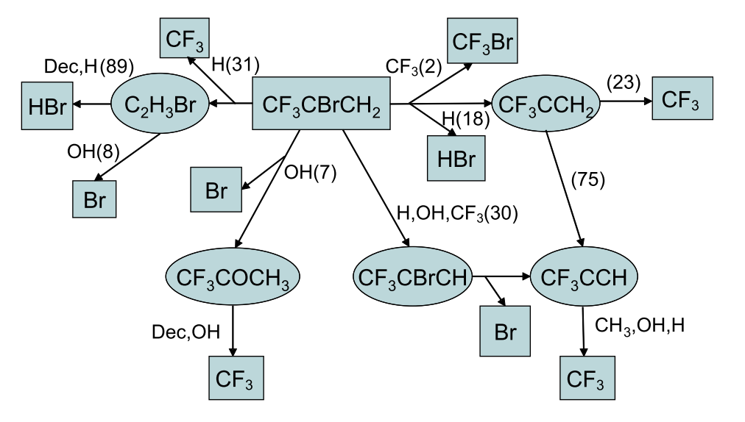
2-BTP Combustion is remarkable and complex
with multiple competing pathways
 | Status | Ozone Depleting Potential | Global Warming Potential
CF3Br | Current | 15.9 | 5800 [2]
2-BTP | Potential | 0.0028 | 0.26 [3]
CF3Br
2-BTP
0.48
Normalized burning velocity of methane/air flame
CH2=CBrCF3
2-BTP
0.53
0.57
ɸ=0.67
0.62
0.57
ɸ=1.00
0.67
0.53
0.92
0.79
Suppressant volume fraction
Reaction Pathway of 2-BTP decomposition [1]
[1] Babushok, V. I., Linteris, G. T., Burgess, D. R., & Baker, P. T. (2015). Hydrocarbon flame inhibition by C3H2F3Br (2-BTP). Combustion and Flame, 162(4), 1104–1112. https://doi.org/10.1016/j.combustflame.2014.10.002
[2] Drage, E. A., Jaksch, D., Smith, K. M., McPheat, R. A., Vasekova, E., & Mason, N. J. (2006). Journal of Quantitative Spectroscopy and Radiative Transfer, 98(1), 44–56. https://doi.org/10.1016/j.jqsrt.2005.05.071
[3] U.N. Environment Program. https://ozone.unep.org/system/files/documents/HTOC_technical_note1_2018.pdf
Notes:
5. The figure on the left shows the flame speeds of methane/oxygen mixtures with respect to volume fractions of the flame suppressants (CF3Br in red and 2-BTP in green). The current suppressant CF3Br behaves as a flame suppressant should. It slows down flame propagation as you add more suppressant. The behavior of 2-BTP is more complex. At low volume fractions, it slows down the flame. However, as you add more 2-BTP, the flame either continues to slow down or speeds up depending on the flame mixture. To understand and predict the unusual behavior of 2-BTP and other potential HHC suppressnats, we need to understand its complicated reaction mechanism with multiple intermediates and competing pathways.

Slide 20

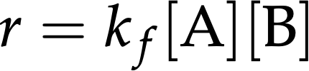
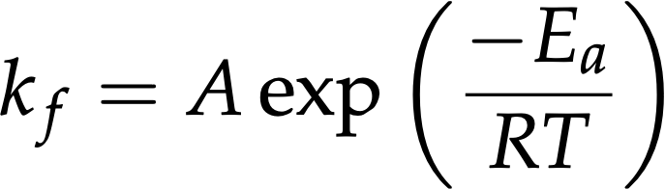
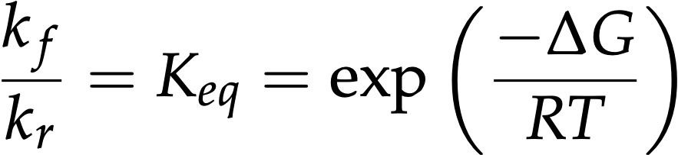

Detailed kinetic modeling is complex
For each chemical reaction
we need:
  forward rate coefficient
  equilibrium constant

Slide 21
Computational Chemistry has two sides
Learning from the computer
Teaching to the computer

Slide 22

Learning chemistry from the computer

Slide 23

Energies can be found ab initio
using quantum chemistry
Solve the Schrödinger wave equation for E.
Can’t solve exactly for multi-electron molecules.
Modern methods give useful results
in reasonable time.
Notes:
The Eigenvalue of the molecular Hamiltonian operator gives the energy of the molecule.
What’s the Hamiltonian operator? big and complicated, but if we pretend the nuclei are in fixed positions, which relative to the speed of the electrons, they pretty much are, we are left with:
the kinetic energy of the electrons, the electric potential energy of the nuclei repelling each other, the potential energy of the electrons in the fixed electric field caused by the nuclei, and the potential energy of the electrons in the electric field caused by the other electrons. This is a problem as we don’t yet know where the other electrons are!
Schrodinger equation can’t be solved for more than one electron, and We have hundreds.
DFT
Nice editorial by Walter Thiel: http://bit.ly/Thiel

Slide 24
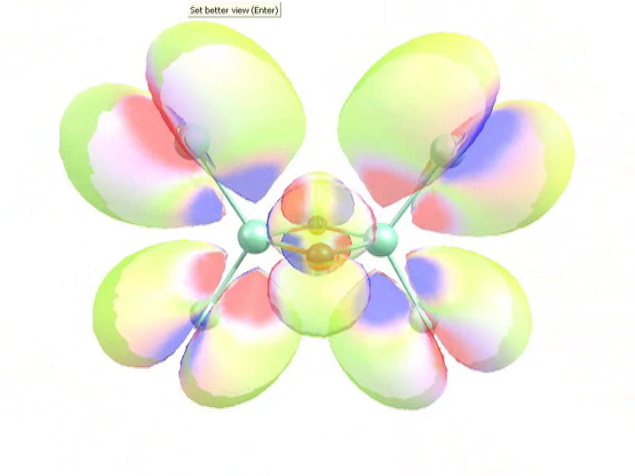
Quantum calculations can provide a lot of things:
Pretty pictures
Electronic energy
Geometry optimization
Rotational constants
Vibrational frequencies
Find temperature variation of Cp, H, S
through Statistical Mechanics
Notes:
pretty pictures
this is the Highest Occupied Molecular orbital of the dimer (Ti2O2Cl4)
..and here are the other 63 occupied orbitals. Alhough they’re less pretty, they all contribute to the electronic energy of the molecule.
Now we can calculate the energy of a bunch of atoms arranged in the shape of a molecule, we can use this to optimize this shape. The geometry with the lowest energy is most like the real geometry.
Now we can also calculate the 3 rotational frequencies, and in this case 18 vibrational modes of the molecule.

Slide 25

Teaching chemistry to the computer

Slide 26
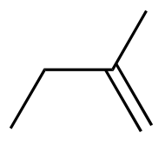
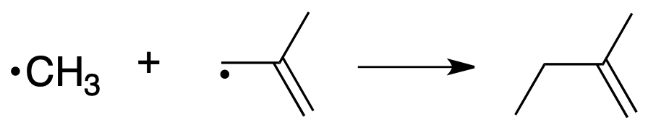
Automatic reaction mechanism generation
needs methods to:
Represent molecules
(and identify duplicates)
Create reactions
(and then new species)
Estimate thermodynamic and kinetic parameters (quickly!)
Choose which reactions to include
Notes:
figure out names :)

Slide 27
Molecules are represented as graphs
H
H
CH3CH2.
=
H
C
C*
H
H

Slide 28
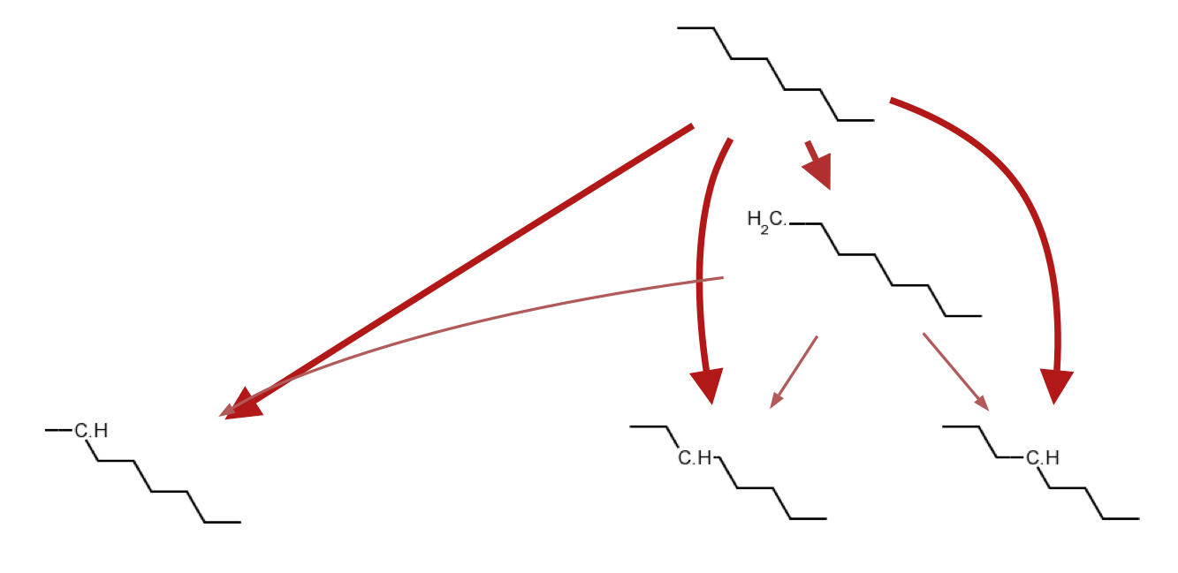
Reaction families propose all possible reactions with given chemical species
Template for recognizing reactive sites
Recipe for changing the bonding at the site
bond breaking and
hydrogen abstraction
intramolecular
H-abstraction

Slide 29
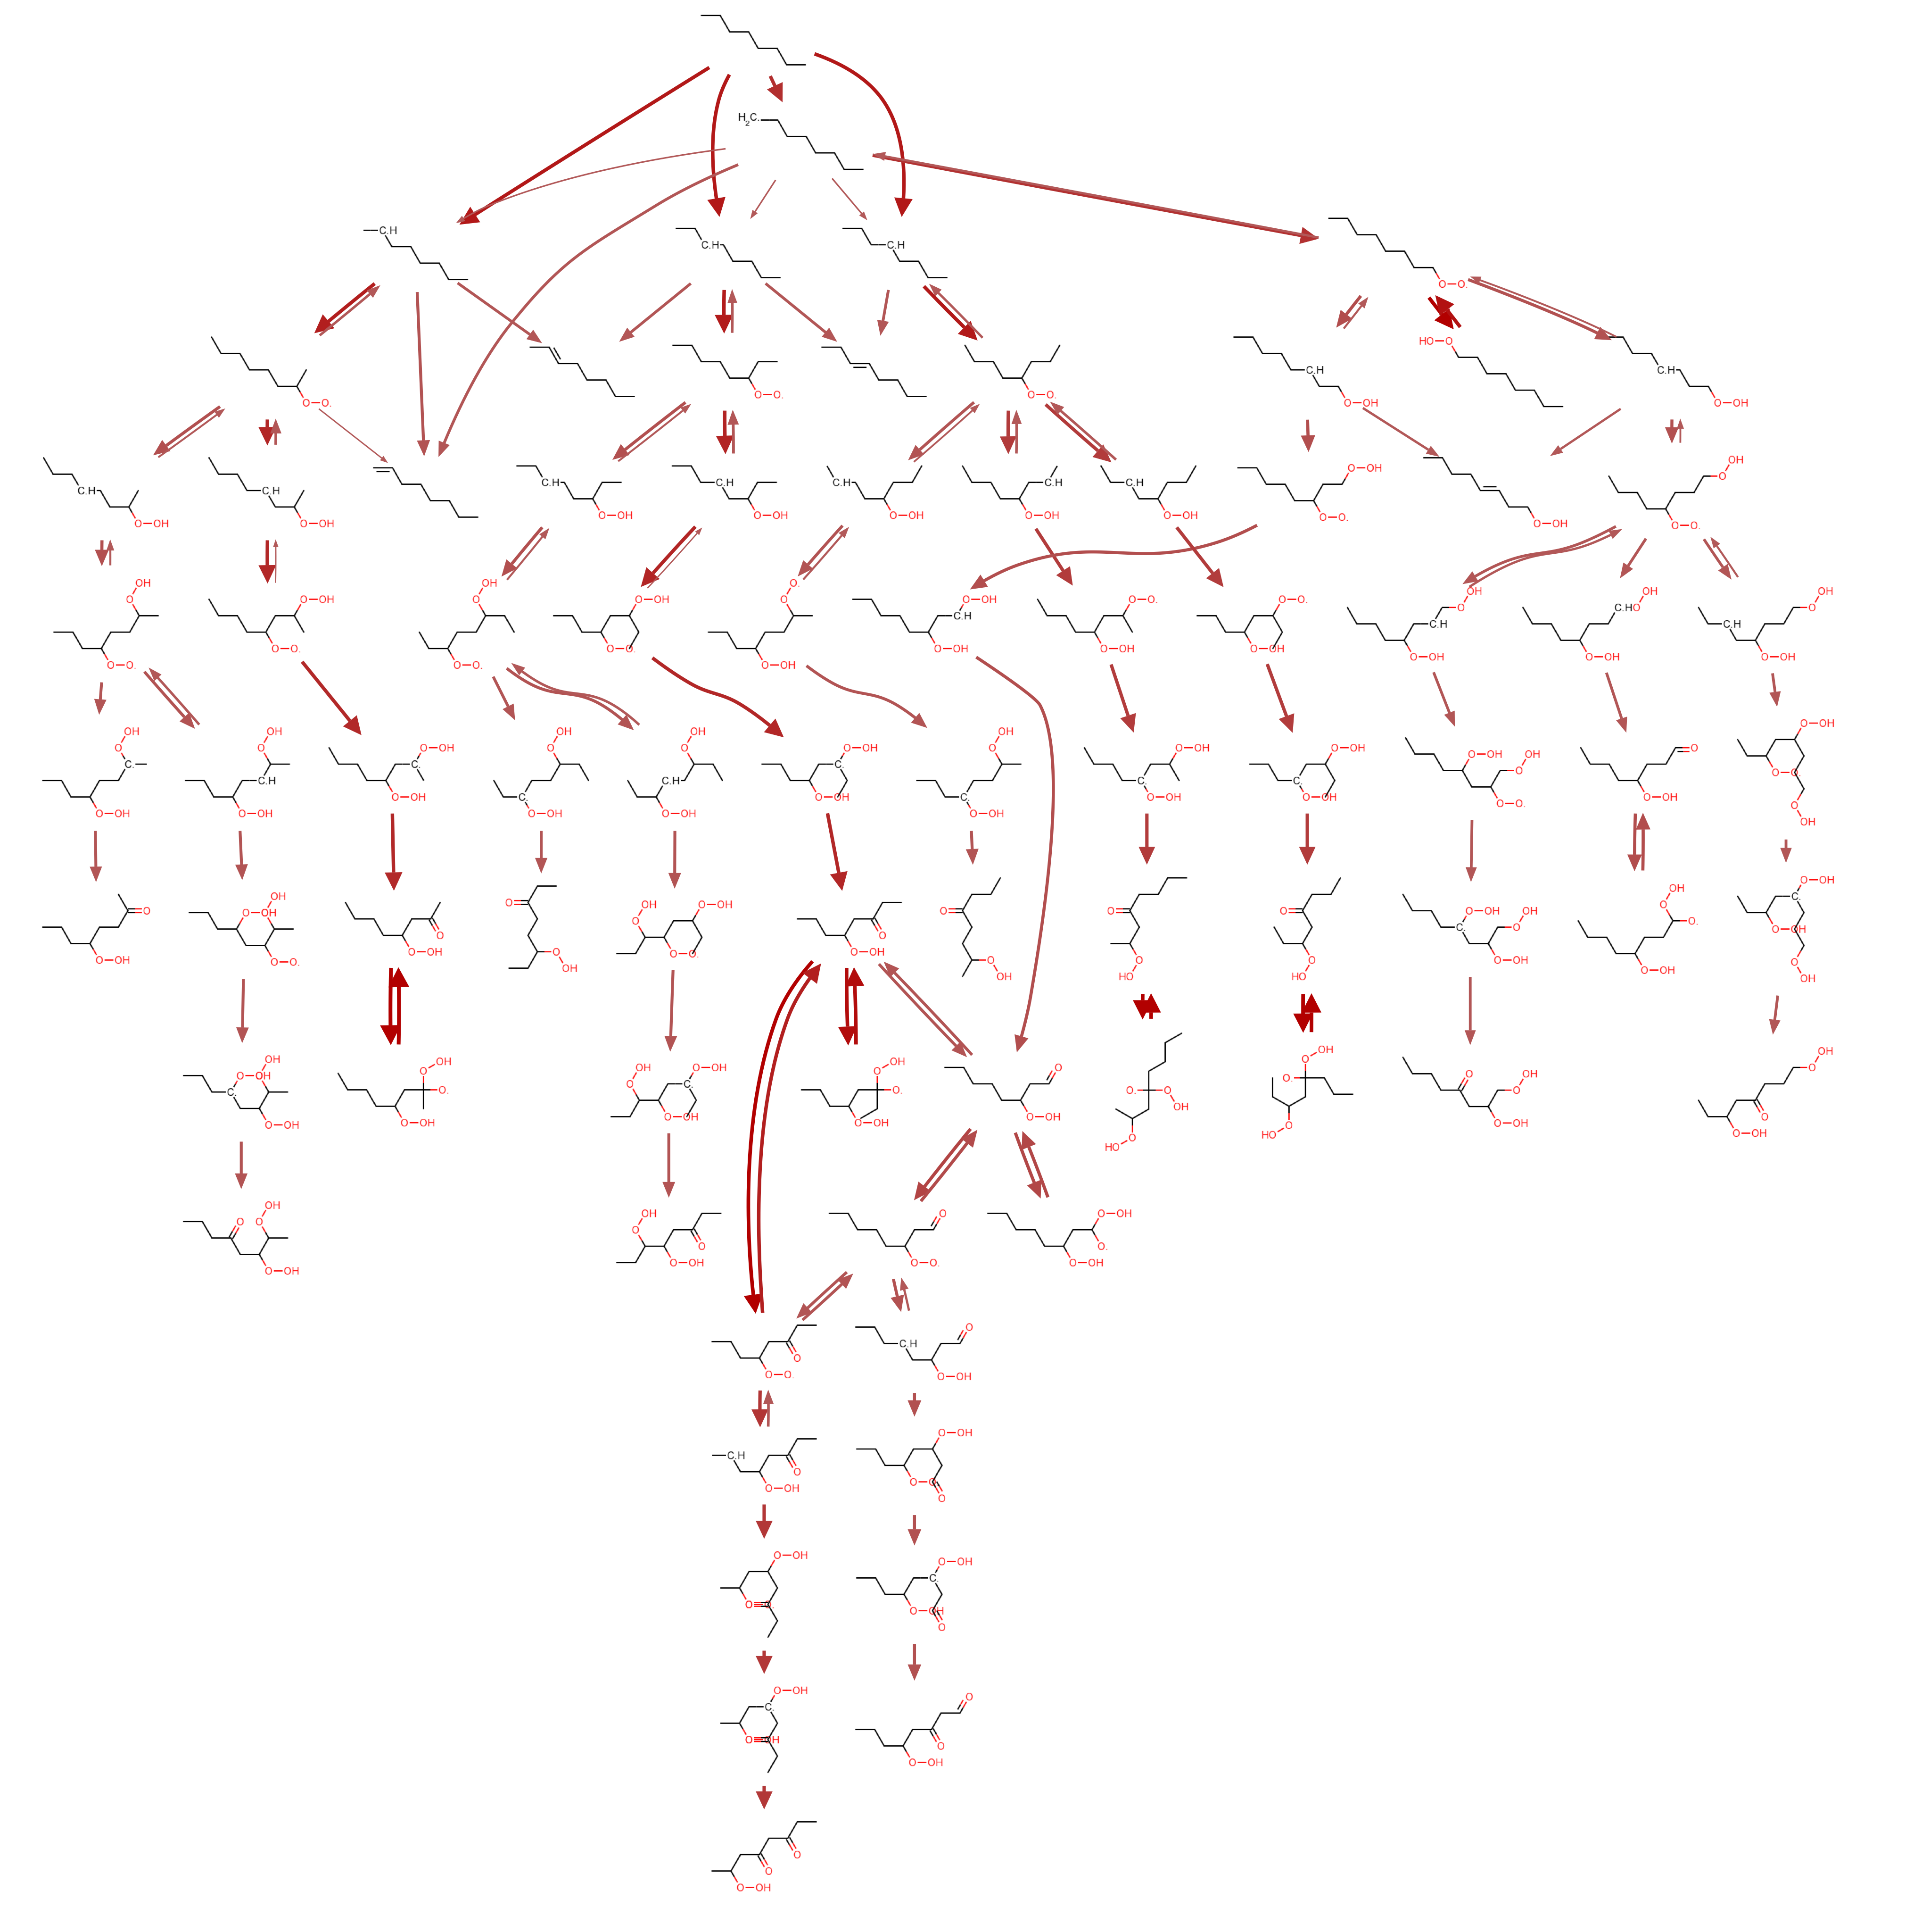
Reaction families propose all possible reactions with given chemical species
Template for recognizing reactive sites
Recipe for changing the bonding at the site

Slide 30
There are usually many pathways

Slide 31
Some pathways go further than others

Slide 32
Faster pathways are explored further
Slower pathways are ignored
B
E
A
D
C
F
H
B
E
A
D
C
G
F

Slide 33
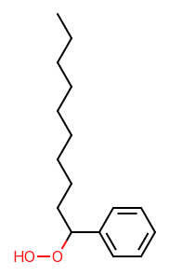
Thermochemistry is (often*) estimated
by Benson group contributions
C-(C)(H)3
C-(C)2(H)2
Cb-(H)
C-(C)(Cb)(O)(H)
*we also have big libraries, and graph convolution neural networks, etc.
Notes:
Molecule is broken into ‘groups’ of atoms
Each group contributes a known amount to the properties

Slide 34
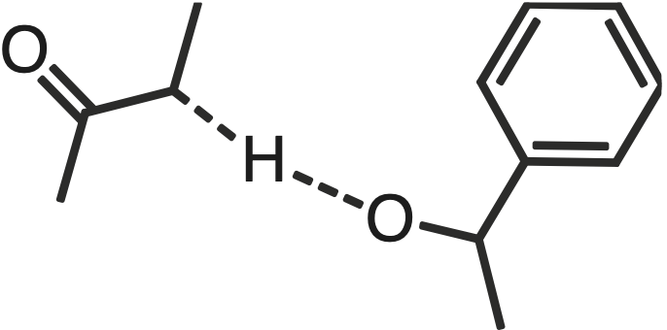
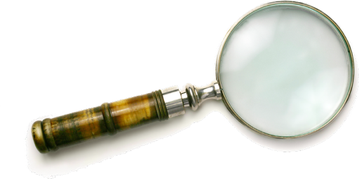
Parameter estimates are based on the local structure of the reacting sites
*we also have big libraries, and graph convolution neural networks, etc.

Slide 35
Model “edge” can be huge
15,000 species
180,000 reactions
100 species
1000 reactions
Notes:
show that 180,000 is a lot. (number of __ in __)

Slide 36













We can do the same for heterogeneous catalysis
Adsorbate Database
XXXXXXXXXXXXXXXXXXXXXXXXXXXXXXXXXXXXXXXXXXXXXXXXXXXXXX
XXXXXXXXXXXXXXXXXXXXXXXXXXXXXXXXXXXXXXXXXXXXXXXXXXXXXX
Pt(111) Adsorbate
Gas phase Database
or
Any Adsorbate
Gas phase
Species
+
or
+
∆ Binding Energy
Gas phase Estimator
LSR
Adsorption Estimator

Slide 37

Learning more chemistry from the computer

Slide 38
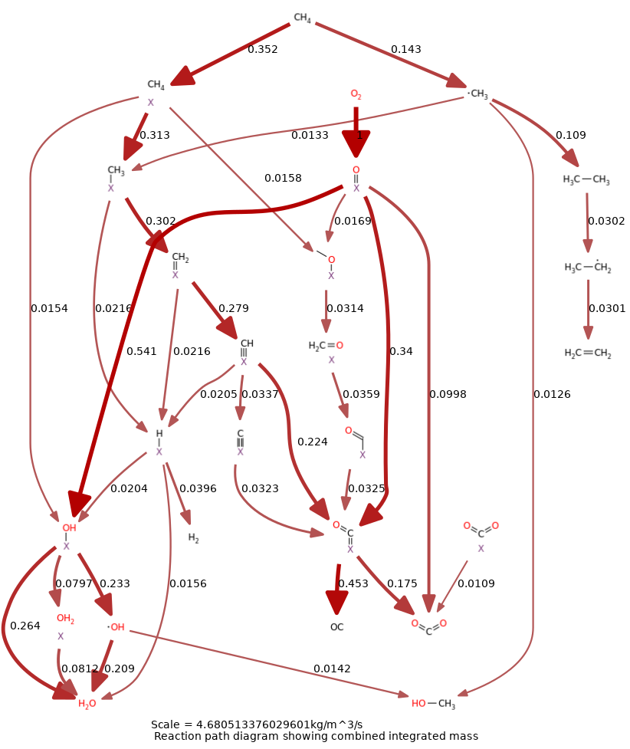
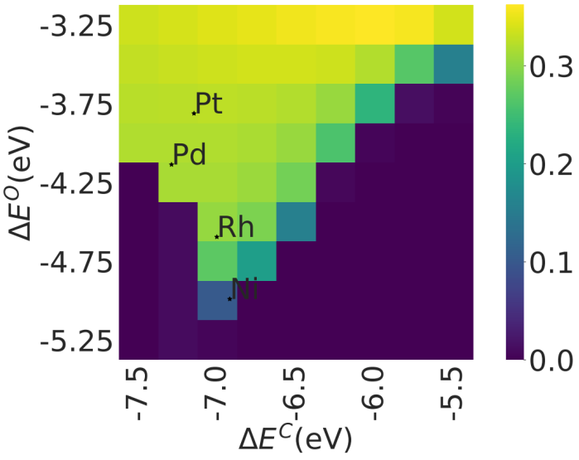
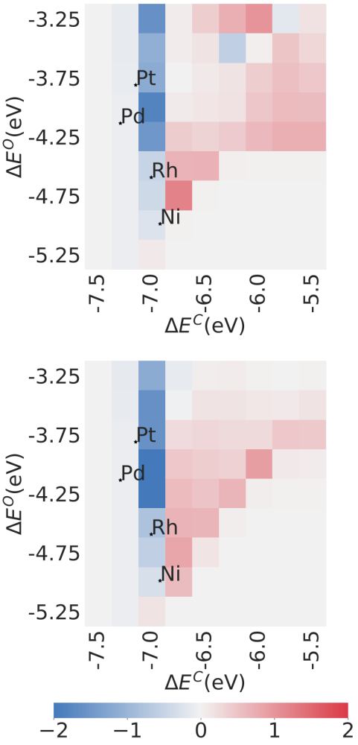
How does it react?
Which catalyst is best?
Why?

Slide 39

Exascale Catalytic Chemistry uses fast computers
(1 ExaFLOP = 1,000,000,000,000,000,000 FLOPS)
Notes:
Aurora has 64k GPUS and almost 2 exaflops peak performance

Slide 40
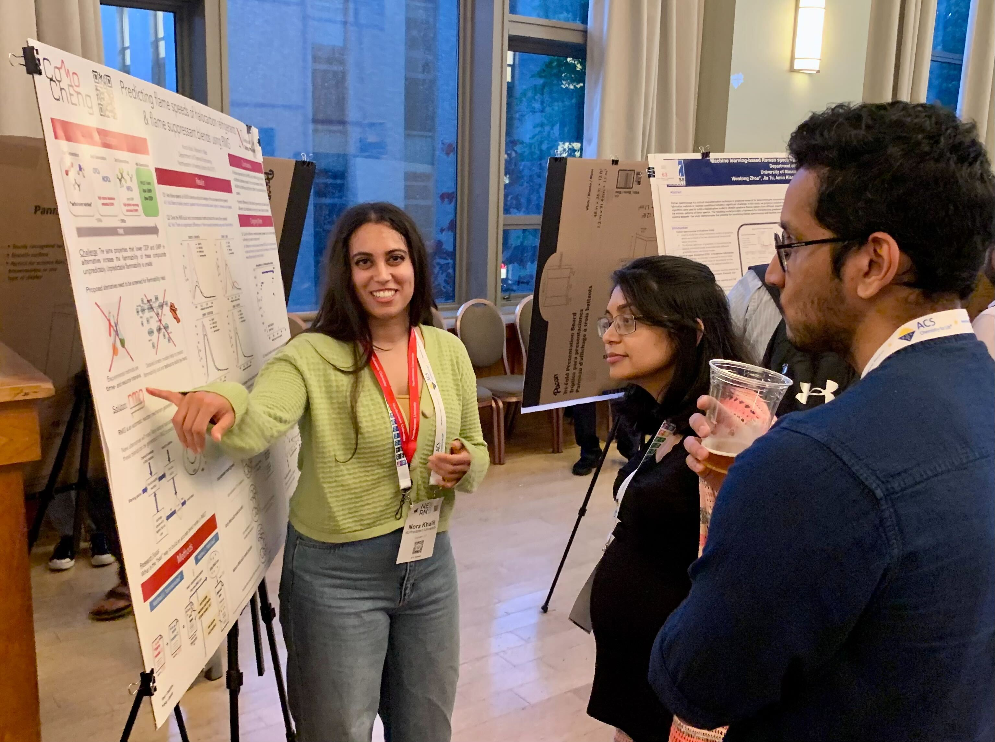

Current projects
Halocarbon Combustion
PFAS incineration
Heterogeneous Catalysis
Electrocatalysis
Pharmaceutical Synthesis
Hydrogen Embrittlement
Siloxane Degradation
Combustion Cyberinfrastructure

Slide 41






M.S. Research Alumni – 2016 to 2018
Name | Rasha Atwi | Krishna Sirumalla | Priyanka Satpute | Shenghui Qin | Chikpezili Ajulu | Mingyu Wan
Before | B.E. ChE, Am. Univ. of Beirut | B.S. ChE, India | B.S. ChE, MIT | M.S. Safety Eng., Nanjing Tech Univ. | B.S. MechE, Northeastern | B.Eng. Energy Eng., North Univ. of China
Research | N-heterocycle formation in algae liquefaction | CNNs for predicting chemical kinetics [DNF thesis] | RMG-Electrocat for solid oxide fuel cell kinetics | Autoignition kinetics of n-heptane blends | Automated kinetic mechanisms for Fischer-Tropsch fuels | Reaction Mechanism Generation, project [DNF thesis]
Next | Ph.D. ChE, Stony Brook | Ph.D. ChE, Northeastern | Senior Consultant, Navigant / Guidehouse | Ph.D. ChE, U. Pittsburgh cancelled (COVID) | Engineer, DNV | Ph.D. ChE, UMass Lowell
Now | Research Scientist, Biogen | Senior Research Scientist ML, Iambic Therapeutics | Associate Director, Guidehouse | China | System Simulation Specialist, Cummins | Assistant Professor, Wuhan Univ. of Sci. & Tech.

Slide 42






M.S. Research Alumni – 2018 to today
Name | Chao Xu | Ting-Chen Lee | Sevy Harris | Kian Mehrabani | Danielle Lucey | You?
Before | B.S. Chemistry, Dalian Jiaotong U | B.S. ChE, Chung Cheng Inst. of Tech. | B.S. EE Ohio State, M.S. EE Stanford | B.S./M.S. ChE, Northeastern (PlusOne) | B.A. Chemistry & Math, Colby College
Research | ChemCheck: a debugging tool for kinetic models | RMG for heterogeneous ammonia oxidation | Uncertainty quantification for microkinetic models [DNF thesis] | Database & web app for detailed kinetic models | Pathways of catalytic CO₂ hydrogenation [DNF thesis]
Next | Ph.D. ChE, Northeastern | R.O.C. Army | Ph.D. ChE, Northeastern | Data Engineer | Ph.D. ChE, Northeastern
Now | Senior Data Scientist, Amgen | Ph.D. National Cheng Kung University, Taiwan | Ph.D. awarded Aug 2026 | Data Engineer, Spotify | Ph.D. student, Northeastern

Slide 43
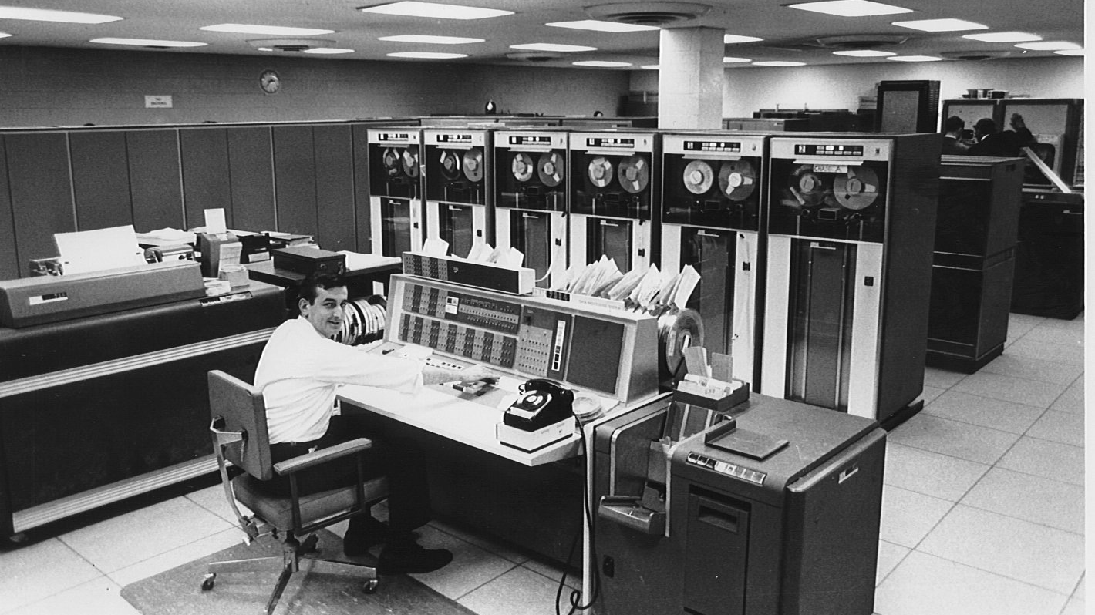

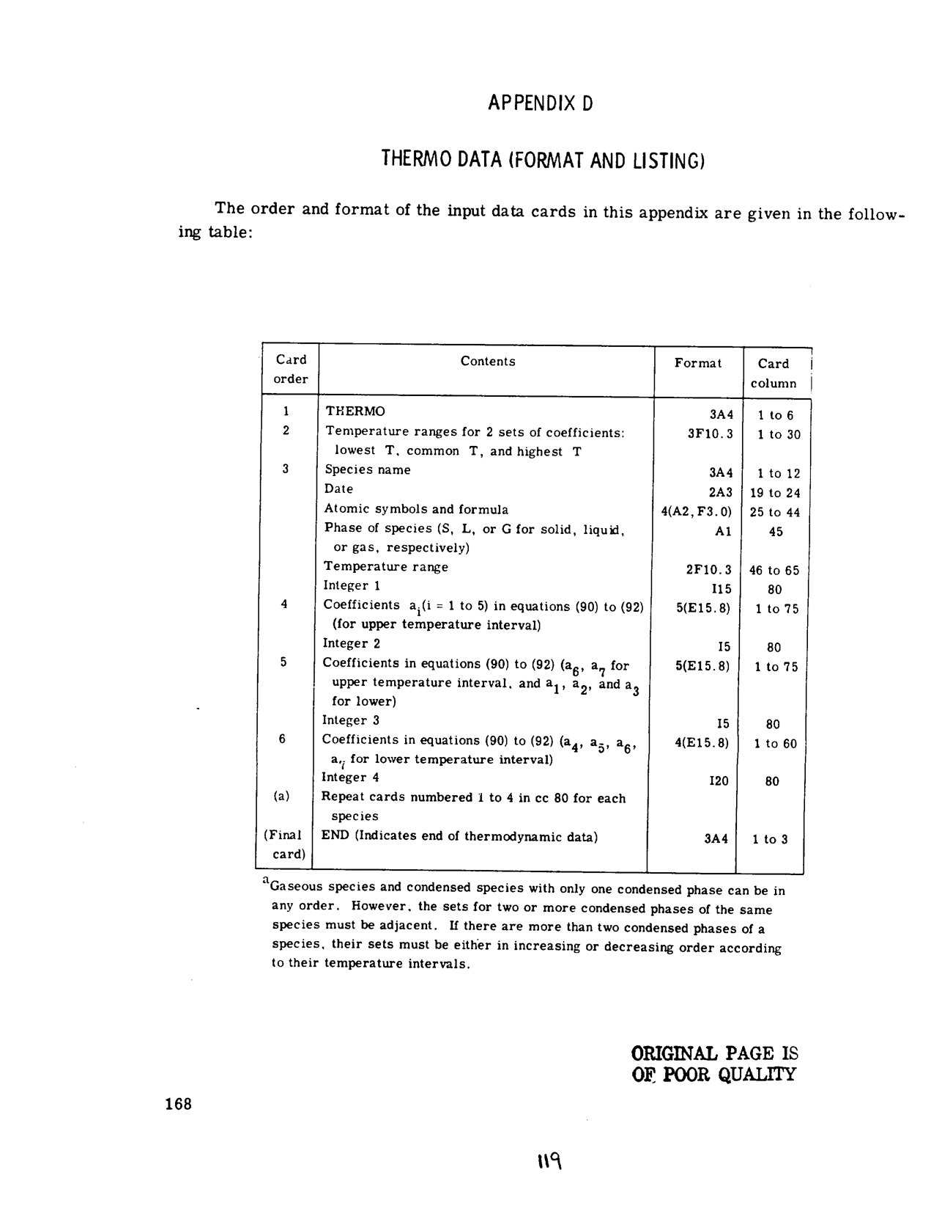
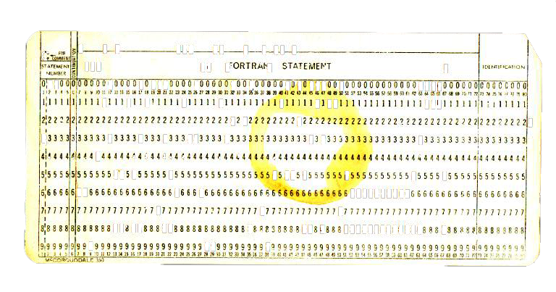
Notes:
This is the computer model Gordon and McBride used when they devised the NASA polynomial format
for thermochemistry (now used in CHEMKIN). It was designed to fit on 80-column punch-cards.

Slide 44
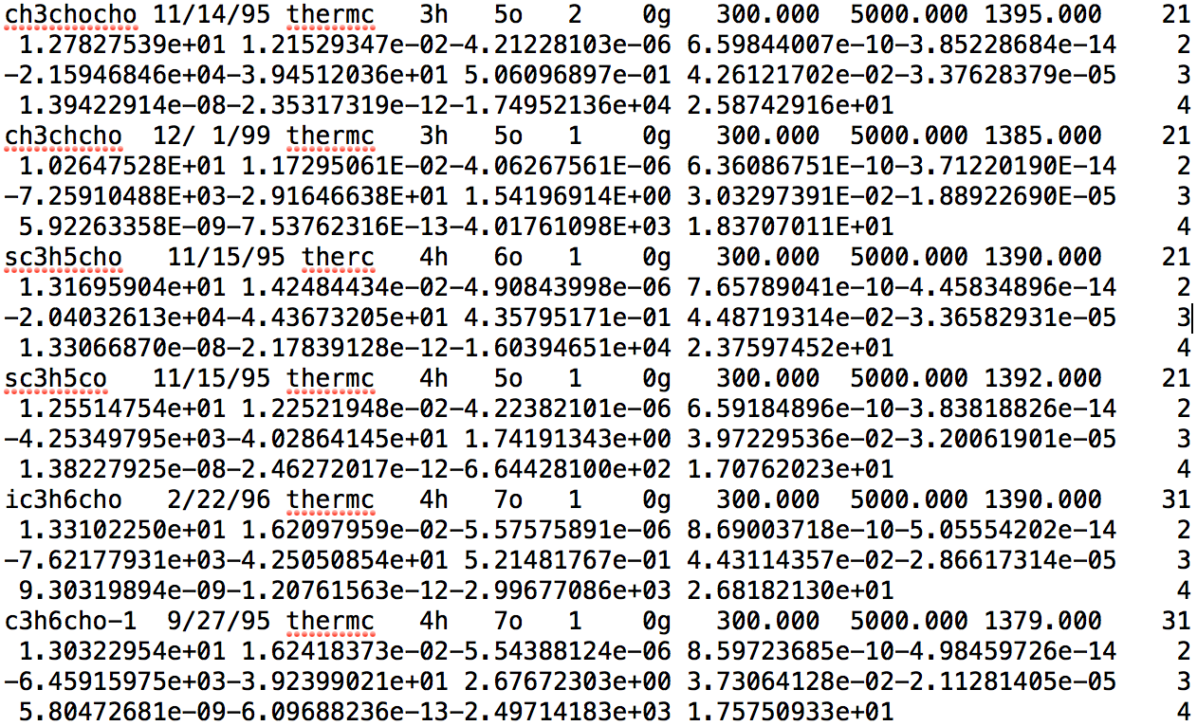
NASA (Chemkin) format is very dense – not much room for species identifiers
Species Name
Chemical Formula
Parameters for H(T), S(T)

Slide 45
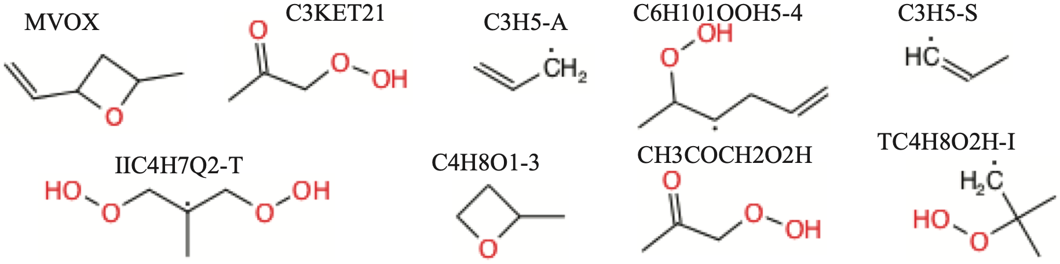
Space constraints led to “creative” naming schemes
Notes:
Notice hydroperoxypropan-2-one has two different names, often in the same mechanism file!

Slide 46

Sometimes the same species appears twice in a model, with different names
C3KET21 is generated from alkyl peroxy radical isomerization pathway
CH3COCH2O2H is generated from low-temperature oxidation of acetone
Notes:
Notice hydroperoxypropan-2-one has two different names, often in the same mechanism file!

Slide 47
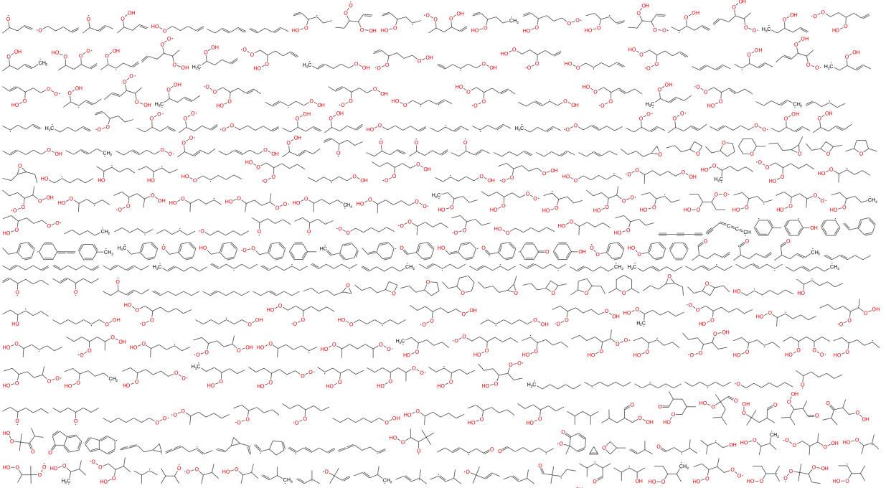
We need a tool to help identify species

Slide 48

Reaction Mechanism Generator (RMG-Py) has many of the required features
Represent molecules and recognize duplicates
Propose reactions from templates and rules
Estimate parameters quickly
Expand model based on known species
Modular and Extensible!

Slide 49
Algorithm is like solving a Sudoku puzzle.
Identify species with only one possible structure
        CO2
        H2O
        C3H8
Then species with "borrowed" thermochemistry
Then “boot-strap” based on how these react…

Slide 50
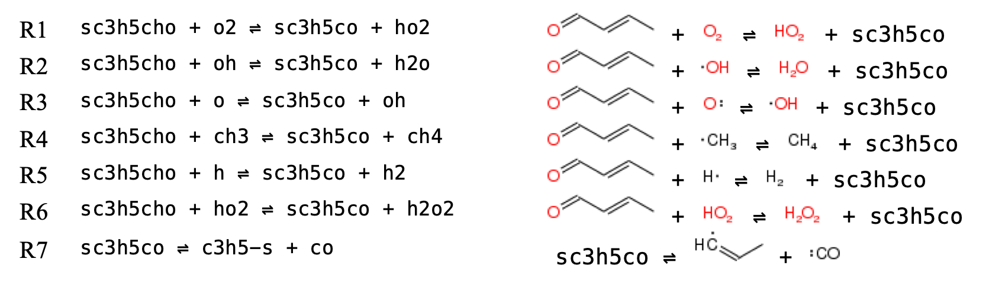




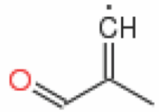
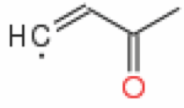

Identifying ‘sc3h5co’ from its reactions:
Notes:
The first 6 reactions are all H-abstractions giving 4 possibilities for sc3h5co.
The 7th reaction is beta-scission, also giving 4 possibilities.

Slide 51
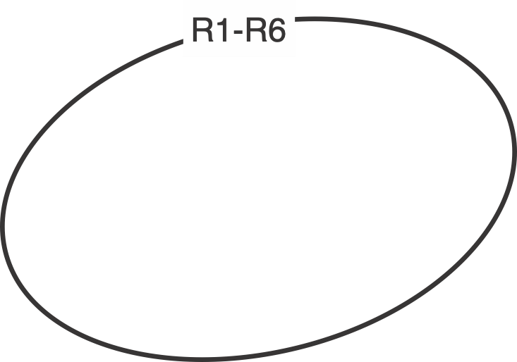
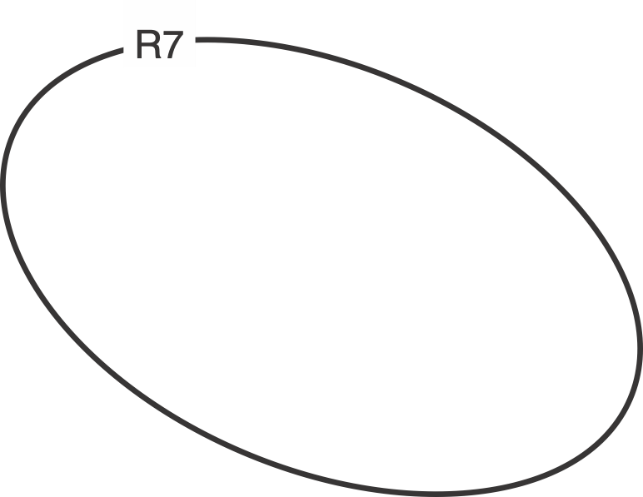
Identifying ‘sc3h5co’ from its reactions:
but-2-enoyl
Notes:
By considering all seven reactions, we can deduce the most likely isomer.

Slide 52
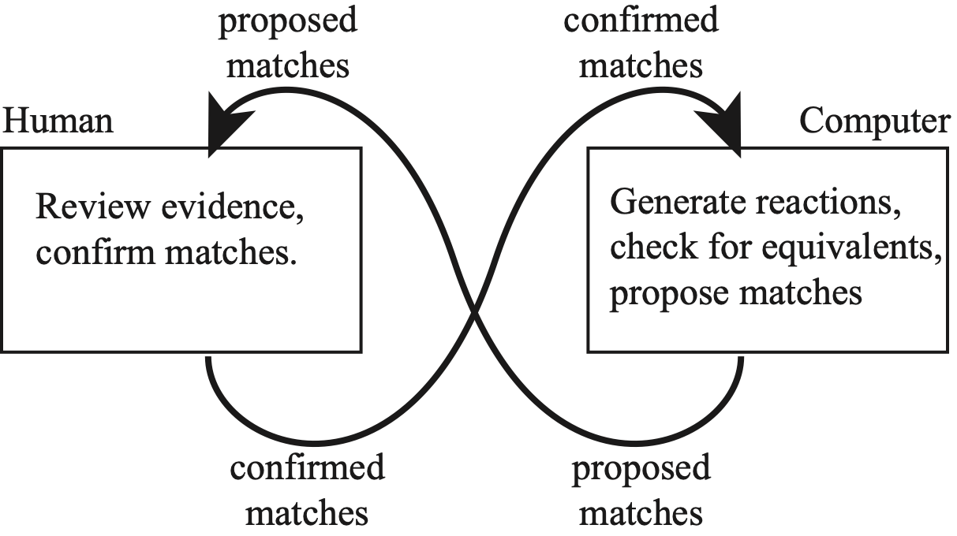
Human-Computer team can
identify species more quickly
Our tool uses RMG to generate reactions
to compare with the target model
A human reviews the evidence and confirms matches.

Slide 53

Notes:
Identified 14,443 species from 65 models

Slide 54


Richard H. West r.west@neu.edu Grant No. 1403171, 2531937
      .edu/comocheng

Slide 55







Ph.D. Graduates
Dr. Pierre Bhoorasingh | Dr. Fariba Khanshan | Dr. Belinda Slakman | Dr. Nate Harms | Dr. Krishna Sirumalla | Dr. Emily Mazeau | Dr. David Farina
Senior Applied Scientist | Associate Director Pharmacometrician | Senior ML Scientist | Senior Data Scientist | Senior Research Scientist ML | Postdoctoral Research Associate | ML Research Scientist II,
Amazon | Novartis | Relay Therapeutics | Valo Health | Iambic Therapeutics | Oak Ridge National Laboratory | Iambic Therapeutics
BS ChBE MIT, MS BioE UPenn | BS ChE, Persian Gulf U | BS ChE, Princeton | BS ChE, Oregon State U | BS ChE, India | BS ChE, RPI | BS Chemistry Boston College
 | https://www.linkedin.com/in/fariba-khanshan-b404a28a/ | https://www.linkedin.com/in/belindaslakman/

Slide 56
R.West@northeastern.edu

Slide 57
How else can I help you?
Global Sensitivity Analysis
    identify causes of uncertainty
Bayesian Parameter Estimation
    sophisticated regression
Research Software Engineering
    trustworthy, reusable, accessible

