Slide 1
Programmable Signal Acquisition and Calibration of Temperature Sensors for Detection of Power Dissipation on Chips
Alexis Chen, YSP Student, Lexington High School
Brendan O’Riordan, YSP Student, Boston Latin School
Thomas Gourousis, Electrical and Computer Engineering, Northeastern University​
Minghan Liu, Electrical and Computer Engineering, Northeastern University​
Yunfan Gao, Electrical and Computer Engineering, Northeastern University
Prof. Marvin Onabajo, Electrical and Computer Engineering, Northeastern University​
Notes:
alexis

Slide 2
AMSIC Research Lab
Abstract
Motivation: The main goal of our project is to ensure hardware security by preventing integrated circuits from being tampered with malicious circuits.
Challenge: The research is meant to be innovative and competitive with already existing methods of detecting inserted malicious circuits (Trojan Circuits).
Vision: The idea of the project is to use temperature sensors to detect the presence of Trojan circuits using amplifiers and machine learning algorithms.
Goals: Automatic calibration to reduce offset errors of amplifiers.
Results: We developed a system-level approach to calibrate amplifier offsets. We sensed the amplifier voltage, compared it to a reference voltage, and developed microcontroller code that controls the output of a digital-to-analog converter to adjust the input voltage of the amplifier.
Programmable Signal Acquisition and Calibration of Temperature Sensors for Detection of Power Dissipation on Chips
Slide 2 / 17 - NEU Young Scholars Program 2023 - August 3, 2023
Notes:
alexis
The main goal of our project is to ensure hardware security in integrated circuits by using temperature sensors to detect the presence of trojan circuits, a type of malicious circuit. We want to use amplifiers and machine learning algorithms to achieve automatic offset calibration of on-chip amplifiers. We first sensed the amplifier voltage, compared it to an expected voltage, and used Arduino code that controlled a digital-to-analog converter to adjust the input voltage of the amplifier.

Slide 3
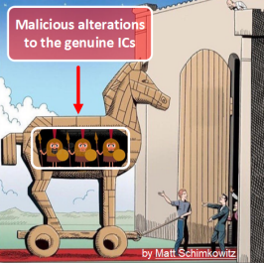
AMSIC Research Lab
Background: Trojan Circuits
Modern circuit design and manufacturing involves too many tasks at different companies around the world to outright prevent Integrated Circuits (ICs) from being tampered with.
Malicious circuits installed on integrated circuits are known as Hardware Trojan (HT) circuits.
They are inserted into empty spaces of the design, and they are too small to detect visually or by weight alone.
Our project focuses on using temperature sensors to detect the presence of Trojan circuits to improve the security of Internet of Things (IoT) devices.
Programmable Signal Acquisition and Calibration of Temperature Sensors for Detection of Power Dissipation on Chips
Slide 3 / 17 - NEU Young Scholars Program 2023 - August 3, 2023
Notes:
alexis
Currently, circuits are being manufactured in many different places all around the world. Sometimes, during production, inconsistencies may occur, or some bad person might want to implant bad circuit on the good circuit that you want. These are called Trojan Circuits, named after the Trojan horse, and are inserted into empty spaces on the printed circuit board. They are too small to detect visually and too light to be detected by weight. Because of this, our project focuses on using temperature sensors instead to detect these malicious circuits to improve the security of Internet of Things devices.

Slide 4
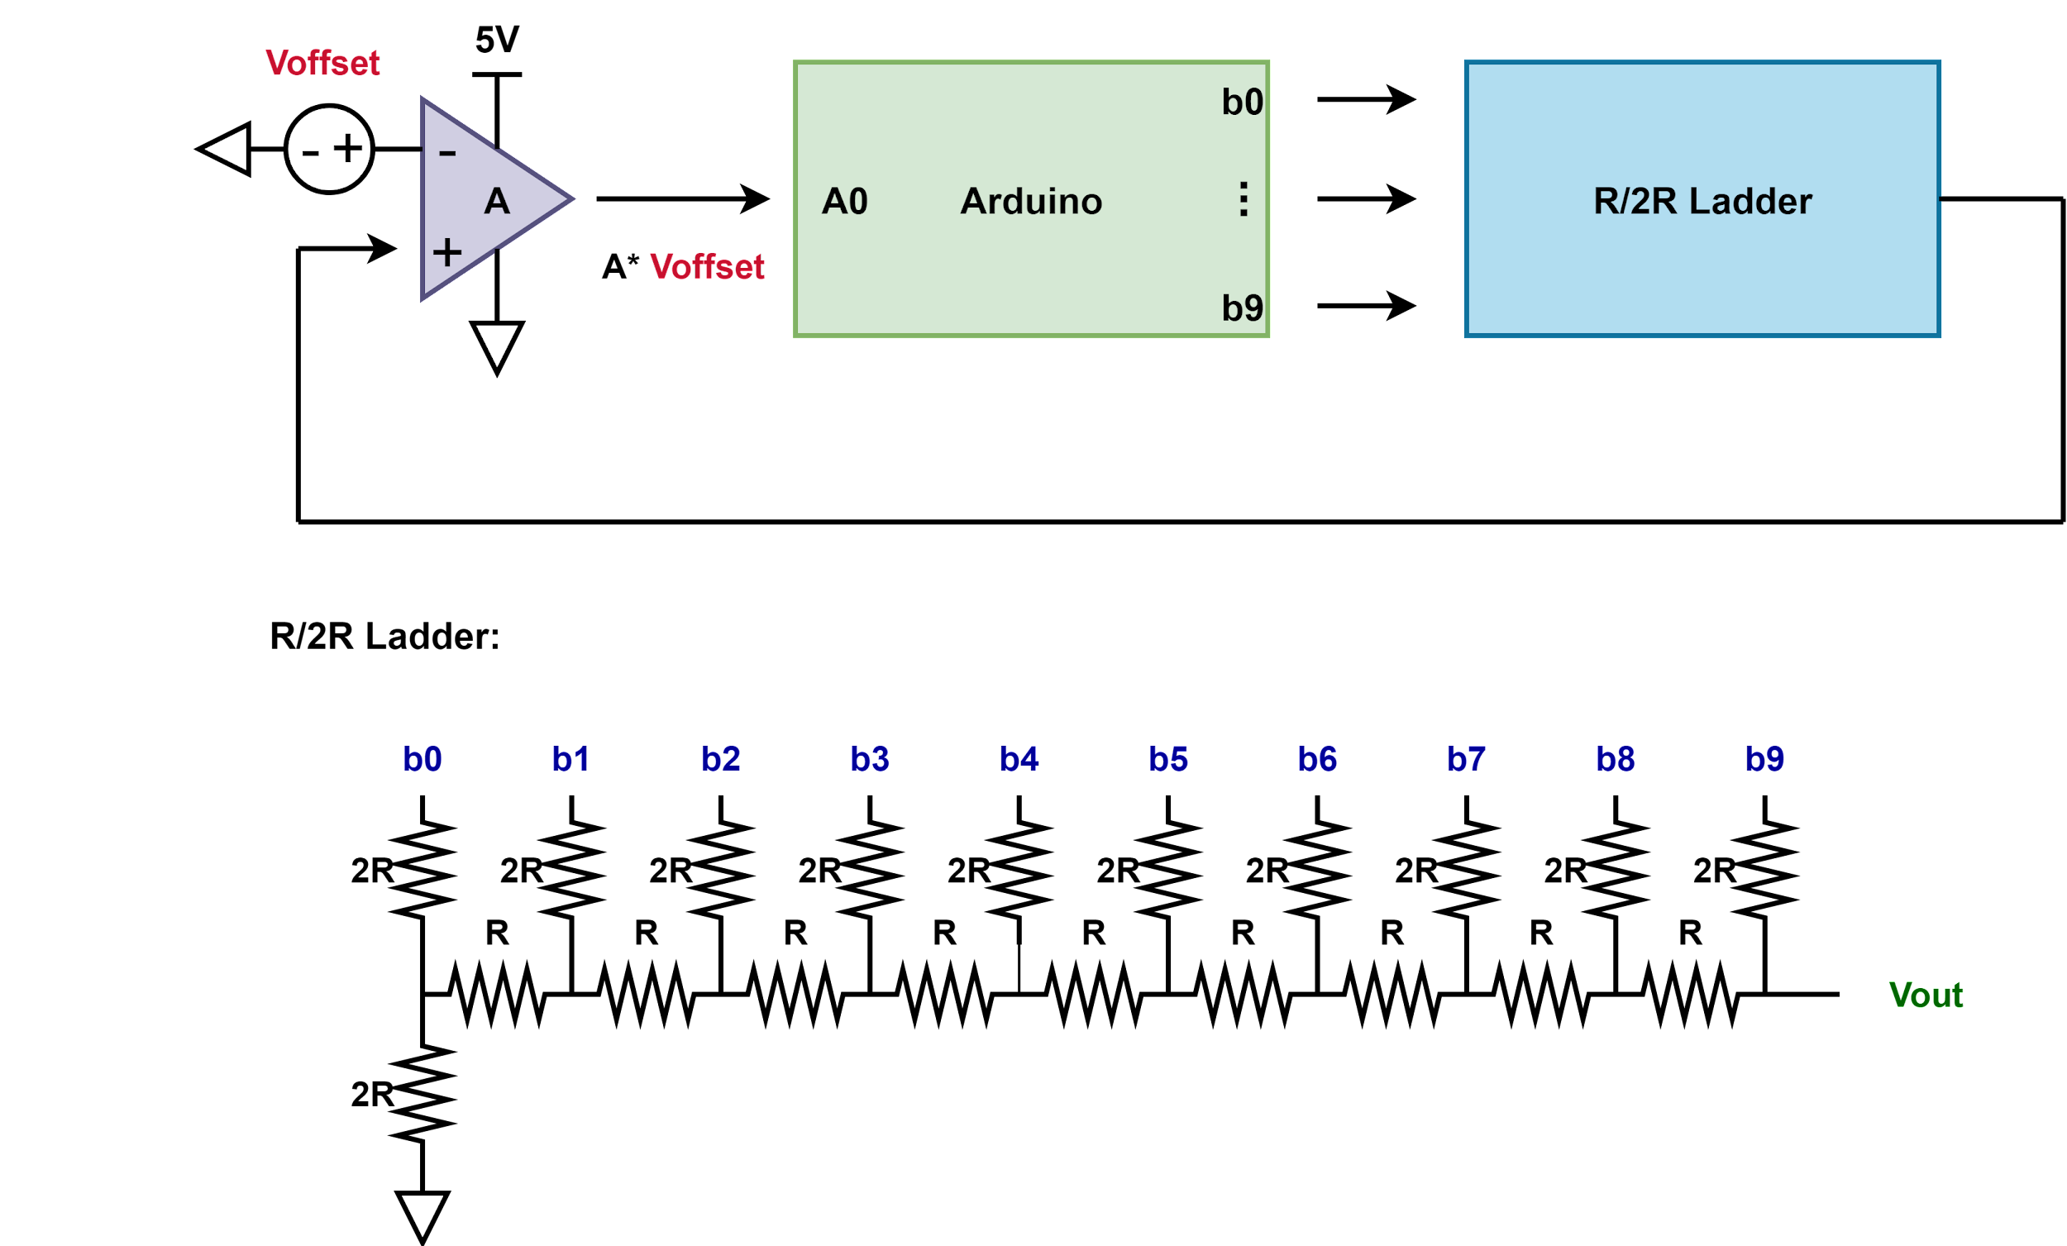
AMSIC Research Lab
Proposed Approach for Offset Calibration: System-Level Overview
Microcontroller
Digital-to-Analog Converter (DAC)
Programmable Signal Acquisition and Calibration of Temperature Sensors for Detection of Power Dissipation on Chips
Slide 4 / 17 - NEU Young Scholars Program 2023 - August 3, 2023
Notes:
Brendan
On the right of the image is the amplifier meant to connect directly to the temperature sensor
The logistics of how this works will be explained in a minute
But basically, this setup is meant to account for errors in the Opamp by comparing its output for known inputs to what it ideally should be
This comparison is made by the Arduino, who sends voltage in one of the outputs to correct the initial error

Slide 5
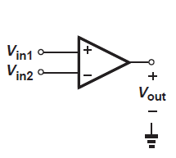
AMSIC Research Lab
Operational Amplifiers (Op-Amps)
An essential part of our design for detecting trojans are amplifiers, which are fundamental building blocks in analog electronics.
“Operational” because they were originally conceived to perform analog signal processing; including mathematical operations such as addition, subtraction, multiplication, division, integration, differentiation.
Shown to the right is an op-amp in open-loop configuration, whose gain (the amount it magnifies its input signal) can be up to within an order of magnitude of a million.
Since op-amp outputs can only reach their power supply levels, such a large gain causes saturation (a term referring to signal components being lost when different circuit elements are operating under near their maximum capability).
(V_{in1} - V_{in2}) × A₀ = V_{out}
Programmable Signal Acquisition and Calibration of Temperature Sensors for Detection of Power Dissipation on Chips
Slide 5 / 17 - NEU Young Scholars Program 2023 - August 3, 2023
Notes:
Brendan
This slide and a few after it are meant to give you a better understanding of what Operational Amplifiers are and why we need to calibrate them
Ideally, operational amplifiers are meant to perform an operation on voltage signals coming in, magnify the result, and send it out
Shown to the left is an operational amplifier that subtracts one input from the other, and them multiples it by what we call the gain, a very high number
This opamp is in what is known as open-loop configuration, where output is not reconnected back to one of the inputs
Because of this, the very large gain is actually a hindrance that takes away from the information that the Amplifier was meant to enhance by bringing the op-amp close to the limits of what it is able to output.

Slide 6
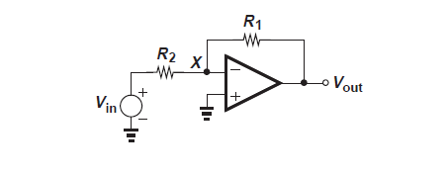
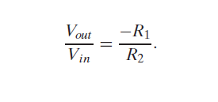
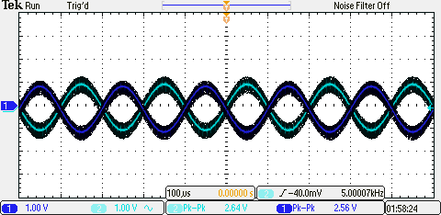
AMSIC Research Lab
Experimental Methods - Inverting Op-Amp Topology
Fig 1.
One type of op-amp configuration that avoids saturation is the closed-loop with feedback resistors (see Fig. 1).
Using specifically the inverting configuration, we are able to control the gain using external components (resistors), and to amplify and invert a voltage signal (see Fig. 2).
Fig 2.
Vin
Vout
Programmable Signal Acquisition and Calibration of Temperature Sensors for Detection of Power Dissipation on Chips
Slide 6 / 17 - NEU Young Scholars Program 2023 - August 3, 2023
Notes:
Brendan
This is an amplifier in what is known as closed-loop configuration
This allows us to control the amount the op-amp magnifies our results
In this configuration, the gain is actually negative, which is demonstrated by the picture on the bottom right
We put one signal into the opamp, and measure another, inverted signal at the output
This also allowed us to verify that we had set up our op-amp correctly

Slide 7
AMSIC Research Lab
Experimental Methods - Inverting Op-Amp Topology
Do we have space to show the experimental setup as well?
-thomas : I don't know. It's definitely crammed as is. Maybe in the appendix??
Popular amplifier topologies : Inverting
Op-amp placed in feedback loop with R₂ = R₁ = 10 KΩ
Measurement results from inverting configuration:
Input signal : 5 KHz and 2.56 V_{pp}
Expected Output : 5 KHZ and 2.56 V_{pp}
However, Vpp = 2.64 V_{pp}. Why is that ?
Resistor mismatch R₂ ≠ R₁
If V_{in} = 0 then we can measure amplifier offset
Programmable Signal Acquisition and Calibration of Temperature Sensors for Detection of Power Dissipation on Chips
Slide 1 / __ - NU Young Scholars Program 2023 - August 3, 2023

Slide 8
AMSIC Research Lab
Operational Amplifiers - Offset Voltage
Random mismatches during manufacturing and packaging lead to an offset in the relationship between input and output signals (see Fig. 3) →
Despite detecting this offset at the output, it is useful to model the offset as a voltage source at the input. (see Fig. 4) →
This makes it easier to find another, opposite input voltage to equalize the offset.
Because of the importance of op-amps, there is high demand for innovative solutions to combat amplifier offset voltages.
Fig 3.
Fig 4.
Programmable Signal Acquisition and Calibration of Temperature Sensors for Detection of Power Dissipation on Chips
Slide 8 / 17 - NEU Young Scholars Program 2023 - August 3, 2023
Notes:
Brendan
Offset is at the core of our project, and relates back to the schematic I showed you earlier
Because of tiny imperfections in amplifier fabrication, real op-amps almost never behave ideally.
On the figure to the top left, in red, is the light that represents the ideal behavior of an op-amp
When both inputs are zero, the output should also be zero
The dark line to the right represents real op-amp behavior, that is offset from the ideal
We can measure this offset is the output of the op-amp, but we model it in the input to allow us to calculate what we might need to input to counteract the offset

Slide 9
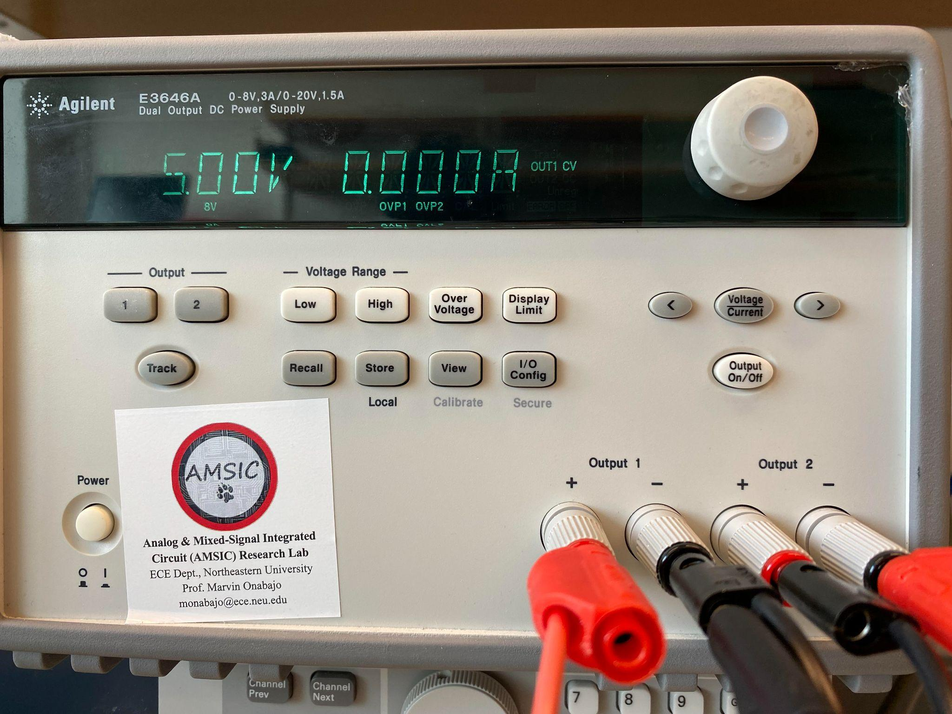
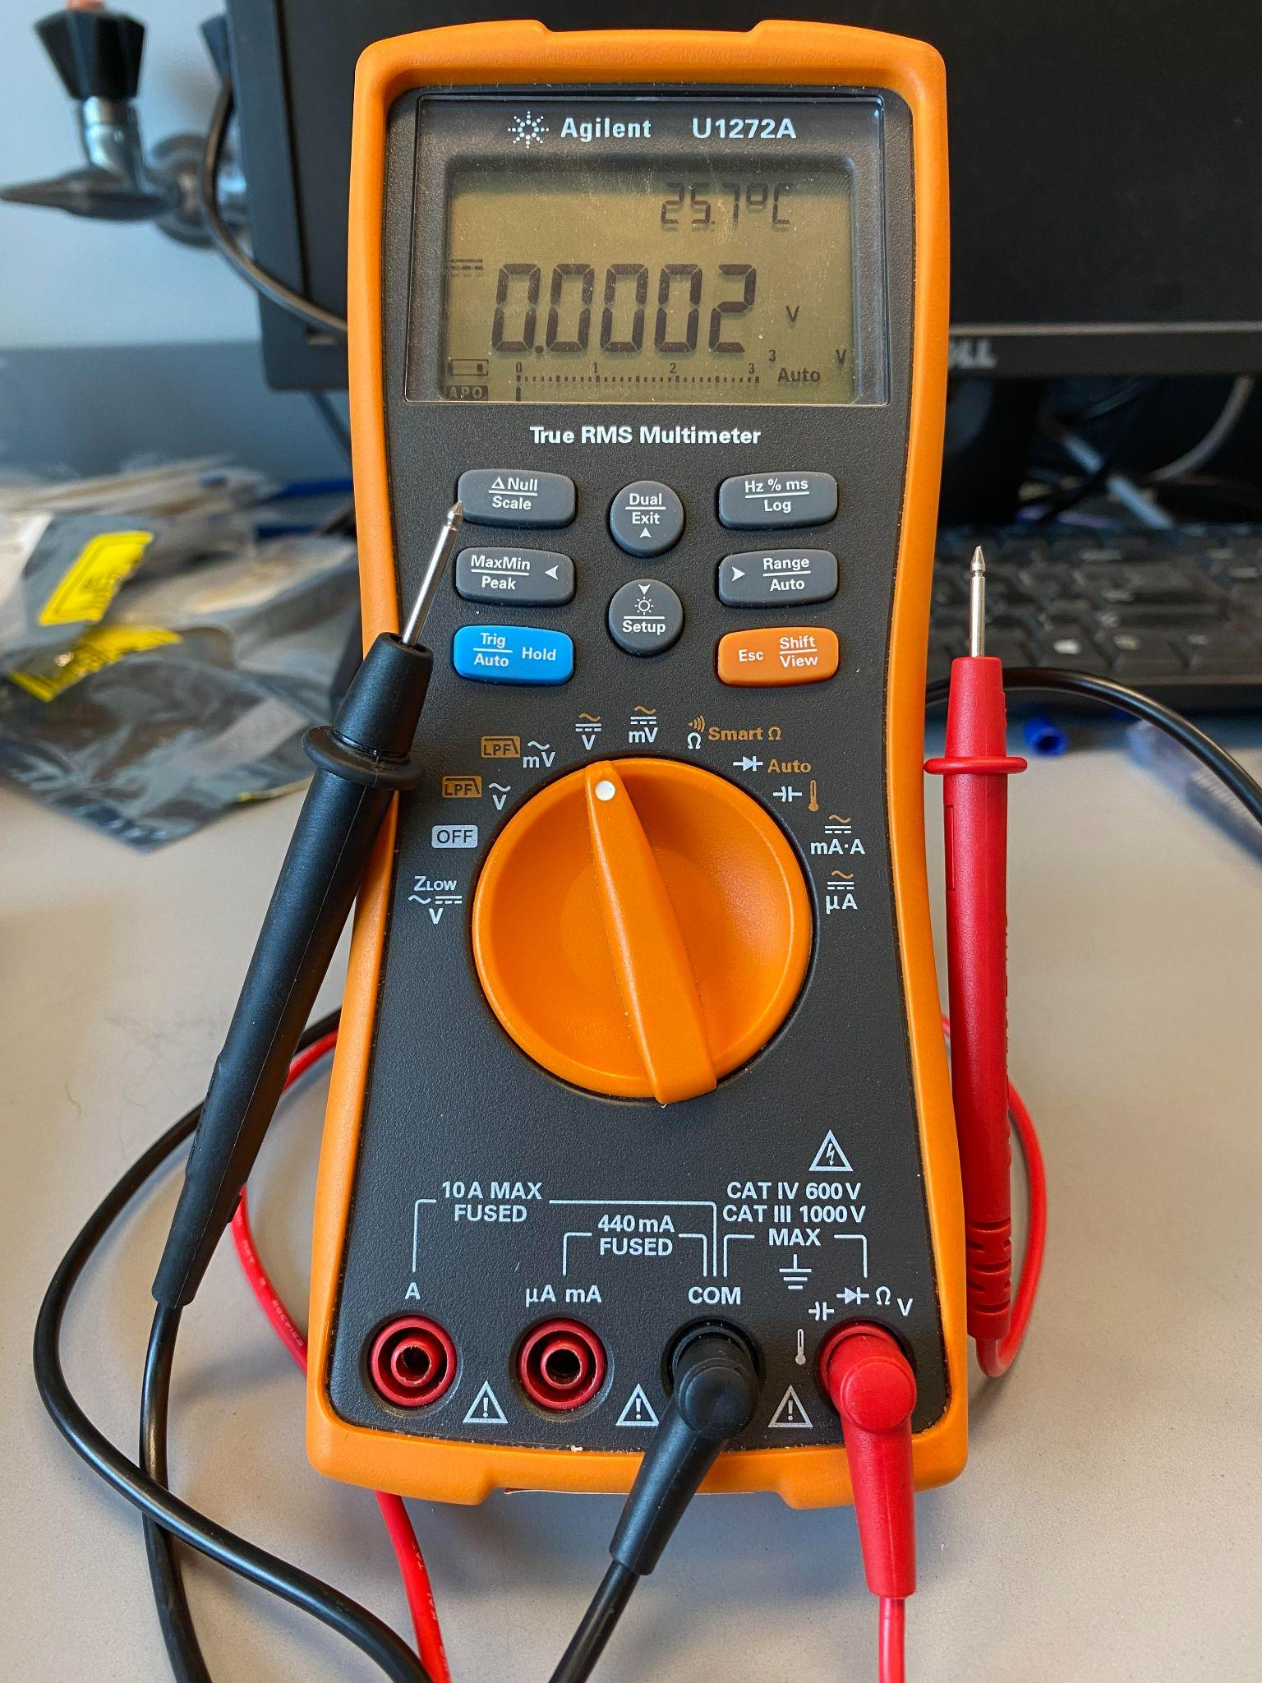
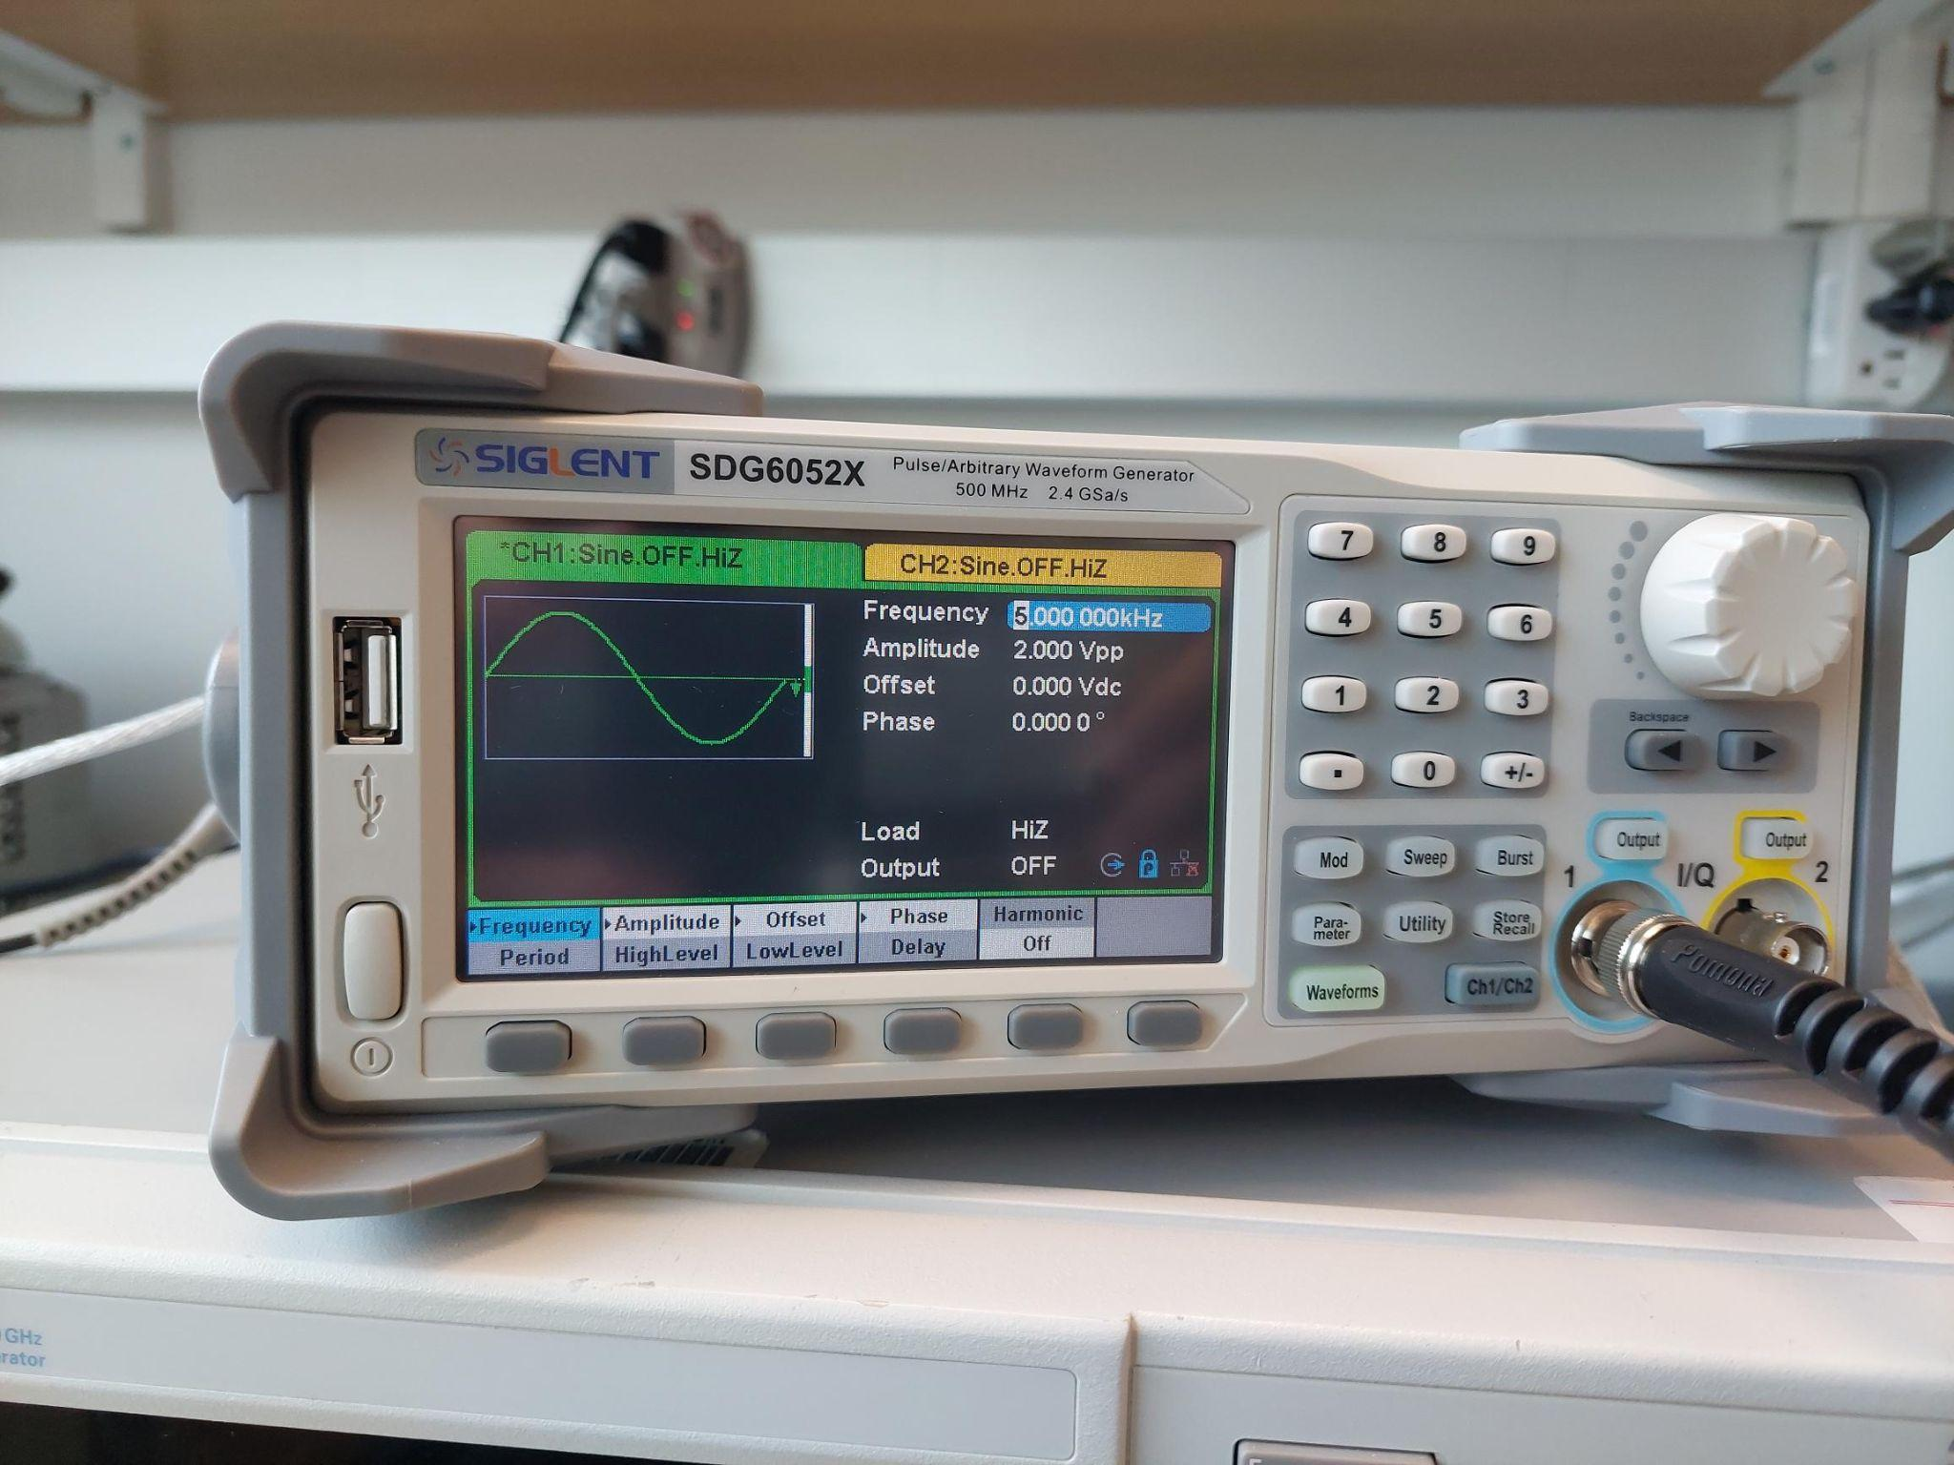
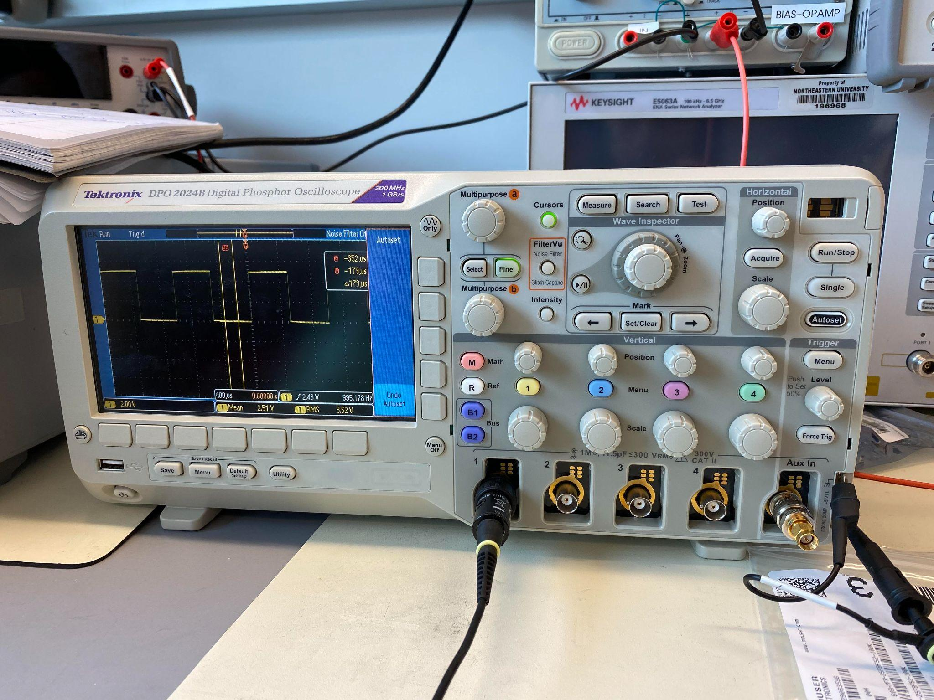
AMSIC Research Lab
Experimental Methods
Equipment:
Modeling →
Breadboard
DC power supply
Signal Generator
Amplifier (op-amp)
Resistors
Arduino
Software→
Arduino IDE
LTSpice
Tinkercad
Measuring →
Multimeter
Oscilloscope
Signal Generator
Programmable Signal Acquisition and Calibration of Temperature Sensors for Detection of Power Dissipation on Chips
Slide 9 / 17 - NEU Young Scholars Program 2023 - August 3, 2023
Notes:
alexis

Slide 10
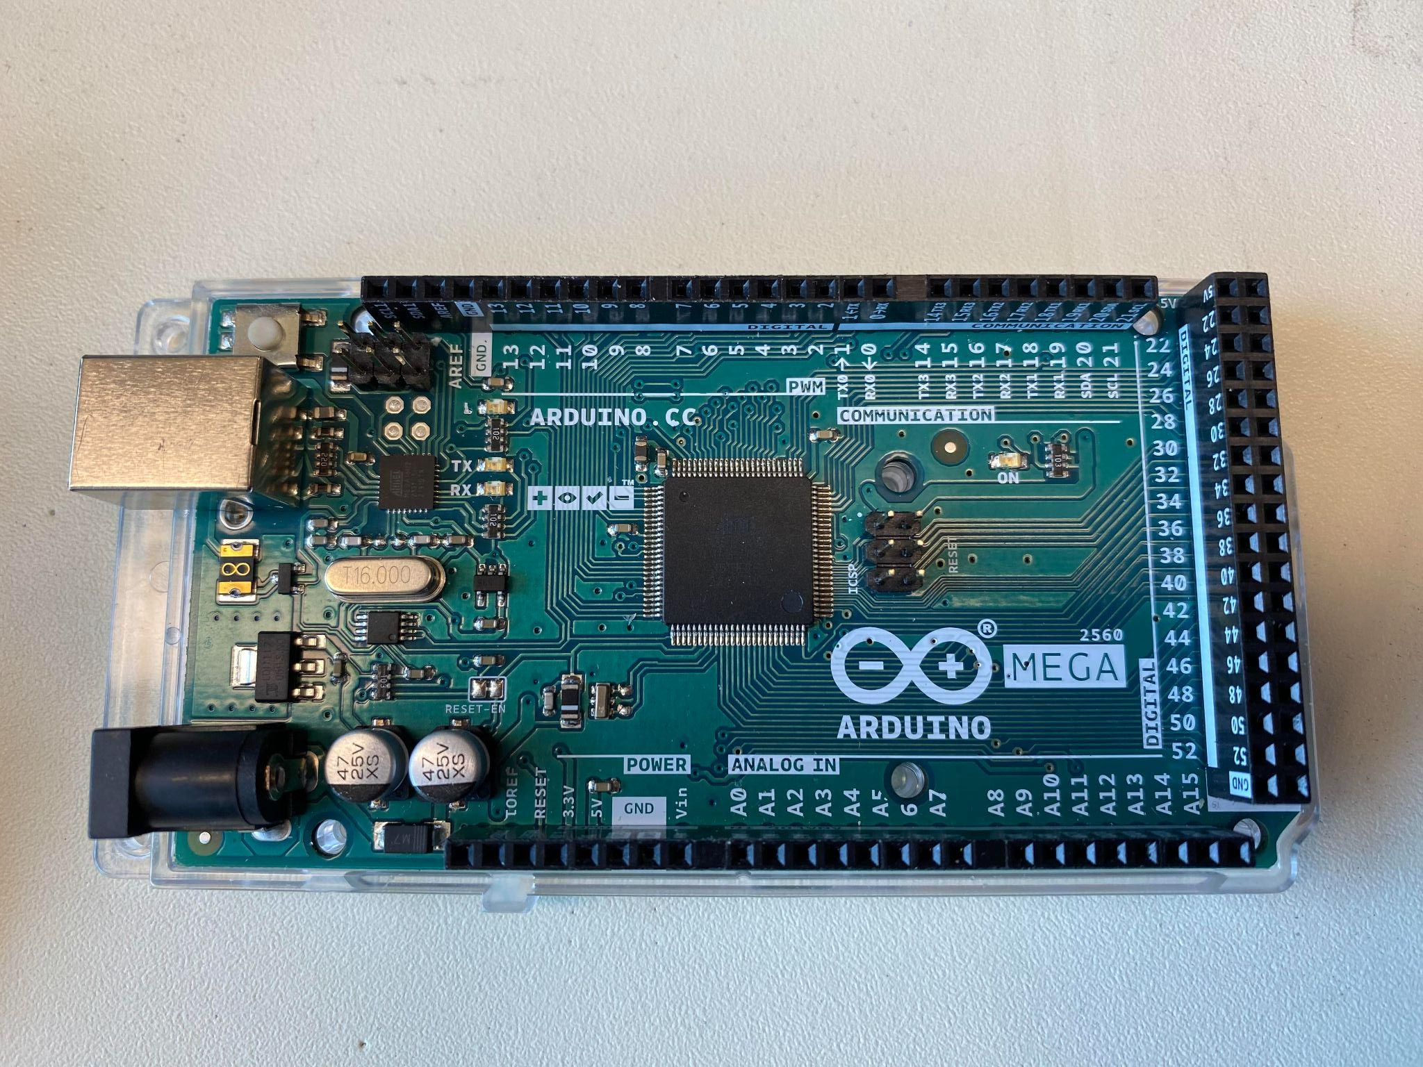
AMSIC Research Lab
Background - Microcontrollers and the Arduino
Microcontrollers and the Arduino
Microcontrollers are small, specialized computers capable of performing tasks
The Arduino is a microcontroller that has hardware necessary to communicate with other devices (pins, oscillator, etc).
Analog and Digital Signals
The Arduino cannot output analog signals.
While analog signals are continuous (they cover infinitely many values in their range), digital signals by themselves are binary (either outputting or not).
To gain access to a broader range of Arduino output voltages, we created a DAC (digital-to-analog converter).
Programmable Signal Acquisition and Calibration of Temperature Sensors for Detection of Power Dissipation on Chips
Slide 10 / 17- NEU Young Scholars Program 2023 - August 3, 2023
Notes:
alexis

Slide 11
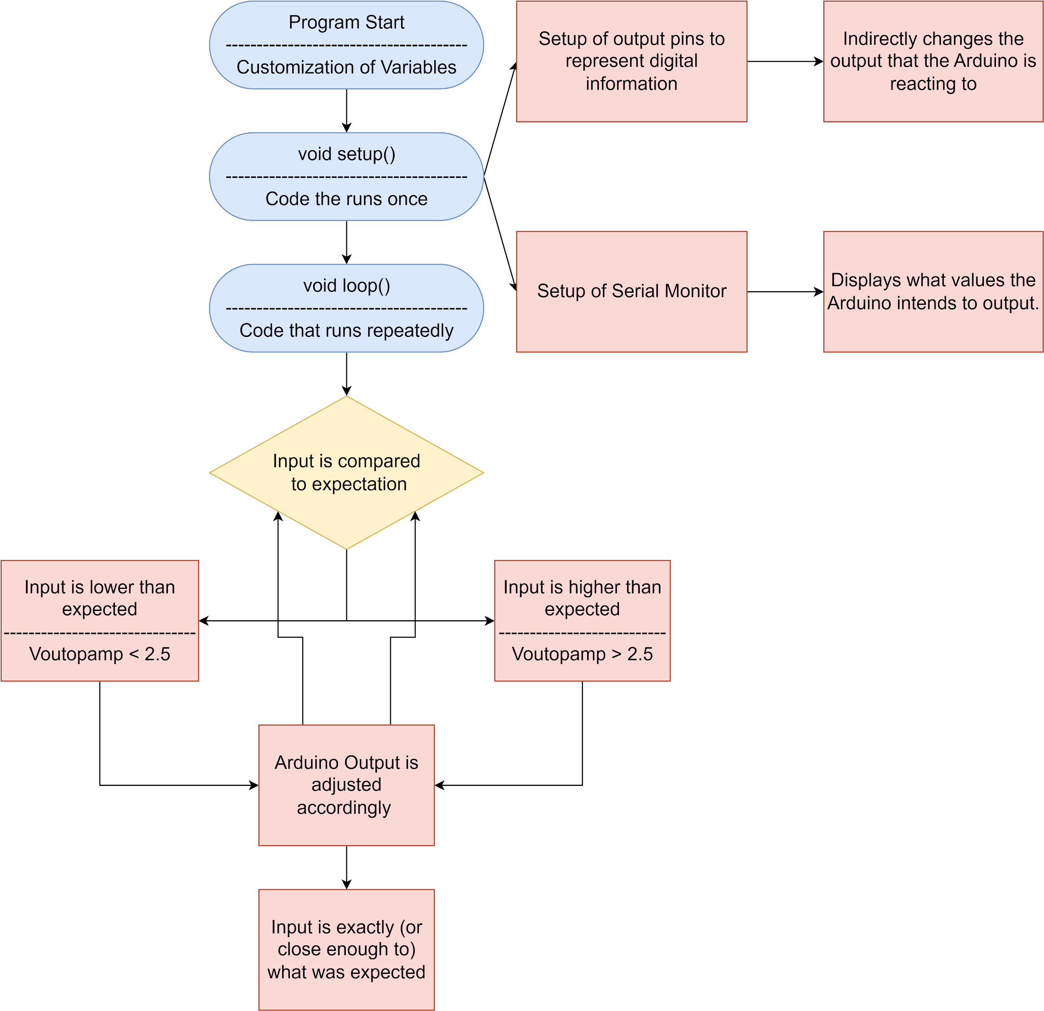
AMSIC Research Lab
Experimental Methods - Algorithm Flowchart
Programmable Signal Acquisition and Calibration of Temperature Sensors for Detection of Power Dissipation on Chips
Slide 11 / 17 - NEU Young Scholars Program 2023 - August 3, 2023
Notes:
alexis
This is an overview of the code that we wrote for the Arduino. When we start the program, we automatically set up the output pins on the Arduino to represent digital information. We also set up the Serial Monitor which allows the user to read the voltages from the computer. The code then enters a loop, which compares the voltage that we read to the expected voltage, which in our case was 2.5V. If the voltage differs from 2.5V, it reenters the loop over and over again until the voltage read is 2.5V or extremely close to 2.5V.

Slide 12
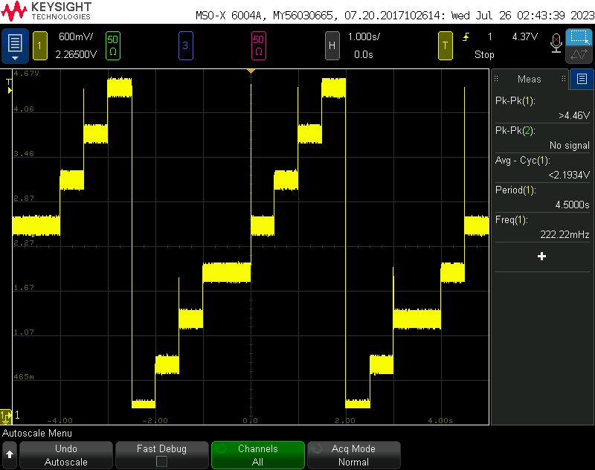
AMSIC Research Lab
Experimental Methods - Digital-to-Analog Converter (DAC)
Digital bits input → analog voltage output
Output voltage only in discrete steps
3-bit DAC: 2³ = 8 possible combinations
Arduino code cycles through 8 possible combinations: 000 - 111
Oscilloscope used for measuring output →
Programmable Signal Acquisition and Calibration of Temperature Sensors for Detection of Power Dissipation on Chips
Slide 12 / 17- NEU Young Scholars Program 2023 - August 3, 2023
Notes:
Brendan
The image on this slide is our proof of concept for our digital to analog converter
Using three alternating digital signals (which would turn on or off) we were able to create a staircase by running those signals through our converter, in ascending order, using our Arduino, and measuring the output on our oscilloscope.
While this output is considered an analog signal instead of a digital one, it is still non-continuous

Slide 13
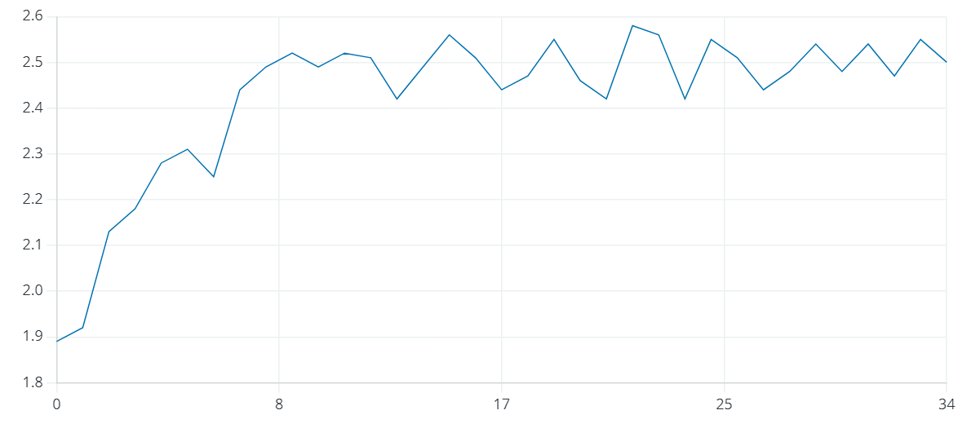
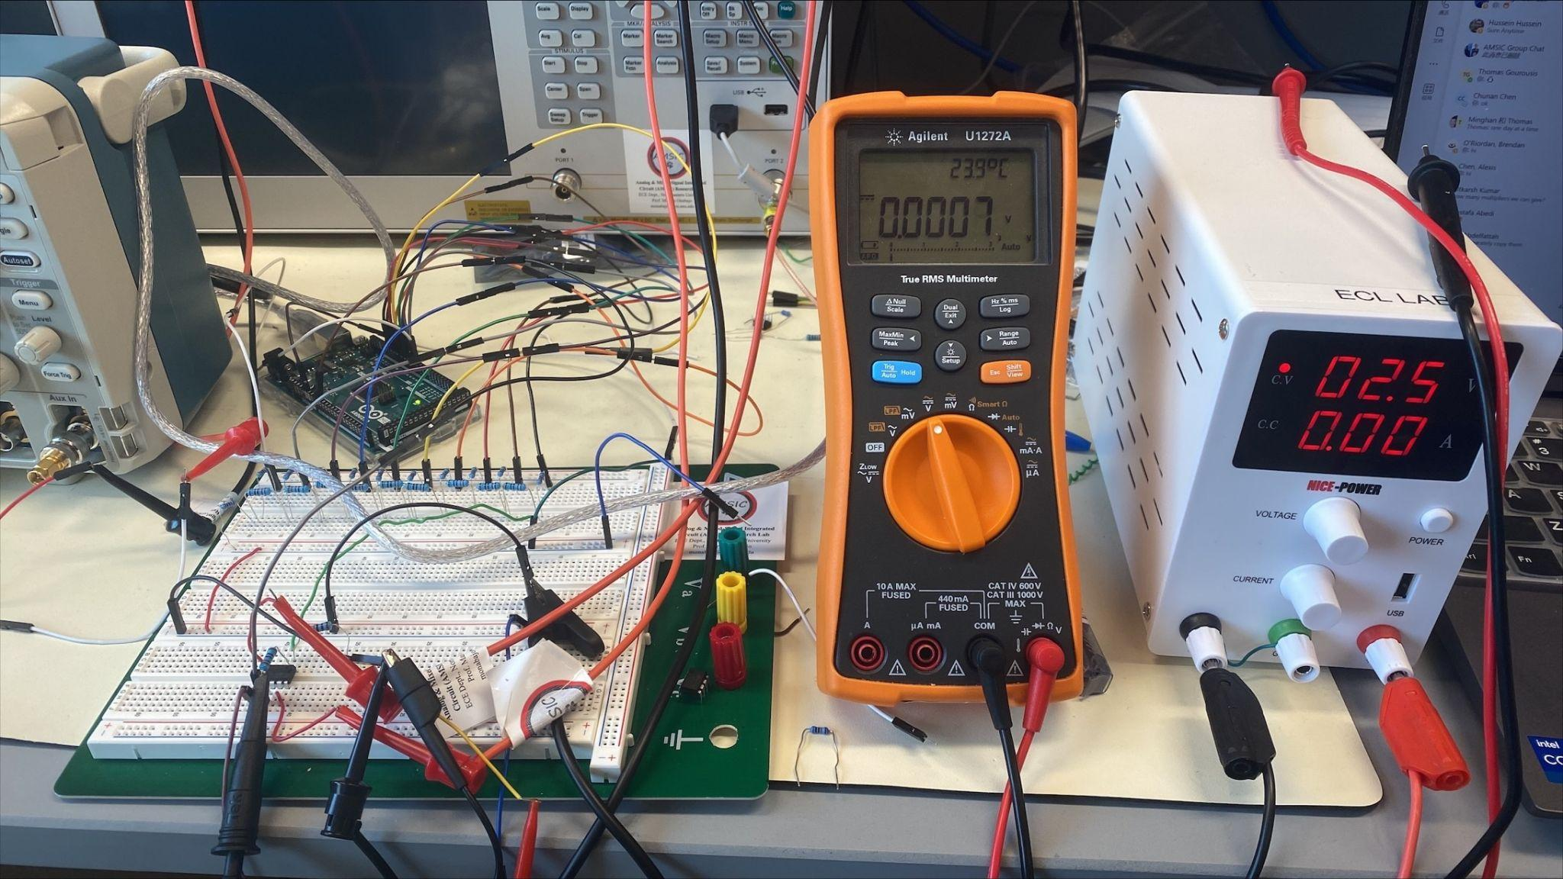
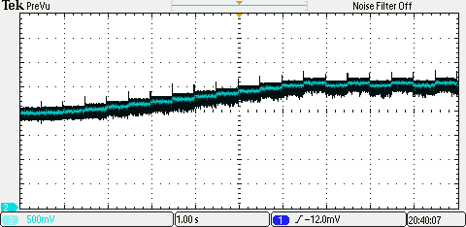
AMSIC Research Lab
Results
Arduino IDE
Oscilloscope
Experimental setup for testing our algorithm
Output voltage settling around the expected value (2.5V)
Programmable Signal Acquisition and Calibration of Temperature Sensors for Detection of Power Dissipation on Chips
Slide 13 / 17- NEU Young Scholars Program 2023 - August 3, 2023
Notes:
Brendan
This slide shows our experimental setup
In the back you can see a green board (our arduino) connected to a series of resistors (our DAC) which is then connected to an op-amp
On the right, you can see that the op-amp’s output behaves as expected, hovering around 2.5 volts when measured by the Arduino itself and by and external device

Slide 14
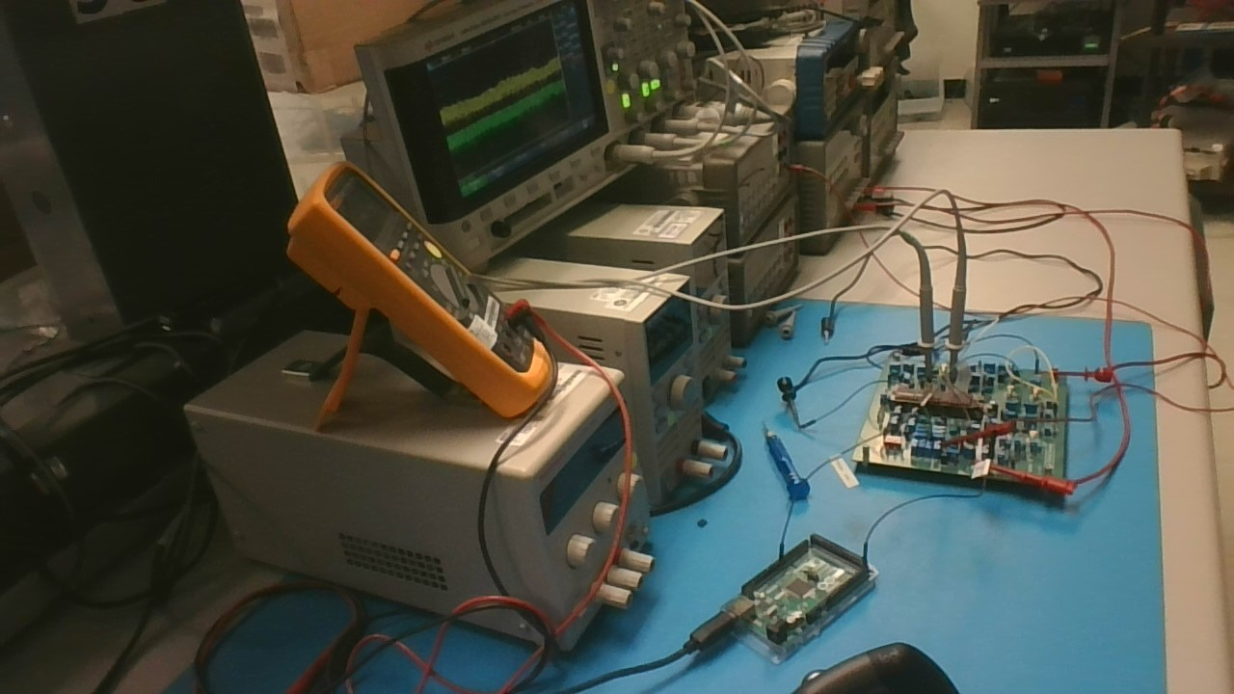
AMSIC Research Lab
Conclusion and Next Steps
Overall, we are content with our contribution to the overall research project.
We expect that our experimental design will be improved to work with the printed circuit board being tested currently →
This could hopefully mean that, eventually, our code might be used without an arduino entirely.
Programmable Signal Acquisition and Calibration of Temperature Sensors for Detection of Power Dissipation on Chips
Slide 14/ 17- NEU Young Scholars Program 2023 - August 3, 2023
Notes:
Brendan

Slide 15
AMSIC Research Lab
Acknowledgements
Department of Electrical and Computer Engineering
Professor Marvin Onabajo, Associate Professor
Thomas Gourousis, Ph. D. Candidate
Minghan Liu, Ph. D. Candidate
Yunfan Gao, Ph. D. Candidate
Center for STEM Education
Claire Duggan, Executive Director
Jennifer Love, Associate Director
Claire Stipp and Yassine Souabny, YSP Coordinators
Nicolas Fuchs, Project Implementation Coordinator
Mary Howley, Administrative Officer
Programmable Signal Acquisition and Calibration of Temperature Sensors for Detection of Power Dissipation on Chips
Slide 15/ 17- NEU Young Scholars Program 2023 - August 3, 2023
Notes:
alexis

Slide 16
AMSIC Research Lab
References
[1] John O’Malley, 2011. Schaum's Outline of Basic Circuit. Analysis Revised Second Edition. McGraw-Hill Education.
[2] Razavi, B., 2021. Fundamentals of Microelectronics. John Wiley & Sons.
[3] M. Yan, H. Wei and M. Onabajo, "On-Chip Thermal Profiling to Detect Malicious Activity: System-Level Concepts and Design of Key Building Blocks," in IEEE Trans. Very Large-Scale Integr. (VLSI) Syst, vol. 29, no. 3, pp. 530-543, March 2021.
[4] T. Gourousis, Z. Zhang, M. Yan, M. Zhang, A. Mittal, A. Shrivastava, F. Restuccia, Y. Fei, and M. Onabajo, “Identification of Stealthy Hardware Trojans through On-Chip Temperature Sensing and an Autoencoder-Based Machine Learning Algorithm,” to appear in Proc. IEEE Intl. Midwest Symp. Circuits Syst. (MWSCAS), Aug. 2023. [Accepted]
[5] Storr, W. (2022). Operational Amplifiers Summary. Basic Electronics Tutorials. https://www.electronics-tutorials.ws/opamp/opamp_8.html
Programmable Signal Acquisition and Calibration of Temperature Sensors for Detection of Power Dissipation on Chips
Slide 16/ 17- NEU Young Scholars Program 2023 - August 3, 2023
Notes:
alexis

Slide 17
AMSIC Research Lab
Thank you,
Questions are welcome!
Alexis Chen*, Brendan O’Riordan*, Thomas Gourousis, Minghan Liu, Yunfan Gao, Marvin Onabajo
*Speakers
Analog and Mixed-Signal Integrated Circuits (AMSIC) Research Laboratory
Dept. of Electrical and Computer Engineering
Northeastern University, Boston, MA, USA
August 3, 2023
This material is based upon work supported by the National Science Foundation under grant no. 2146754 and is supported in part by funds from OUSD R&E, NIST, and industry partners as specified in the Resilient & Intelligent NextG Systems (RINGS) program.
Programmable Signal Acquisition and Calibration of Temperature Sensors for Detection of Power Dissipation on Chips
Slide 17 / 17- NEU Young Scholars Program 2023 - August 3, 2023
Notes:
alexis

