Slide 1
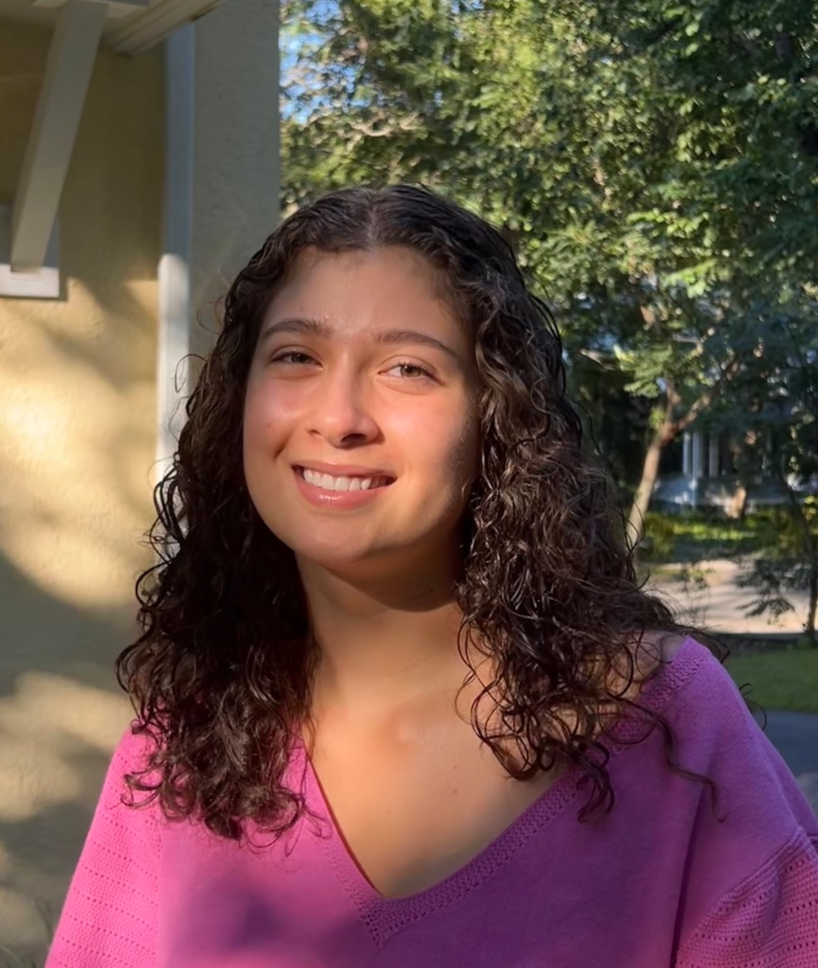
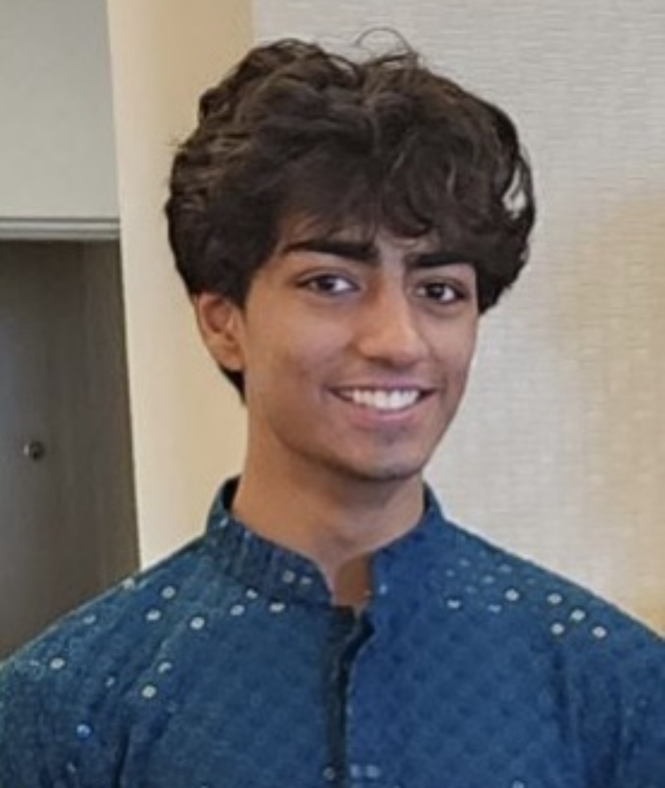
The Impact of Blocking Buffers on Brain Immunohistochemistry
Alexandra Cajiga, YSP Student, Boston Latin School
Neil Patel, YSP Student, Brookline High School
Rachel Shovmer, Dept. of Chemical Engineering, Northeastern University
Dr. Rebecca Willits, Dept. of Chemical Engineering & Dept. of Bioengineering, Northeastern University

Slide 2
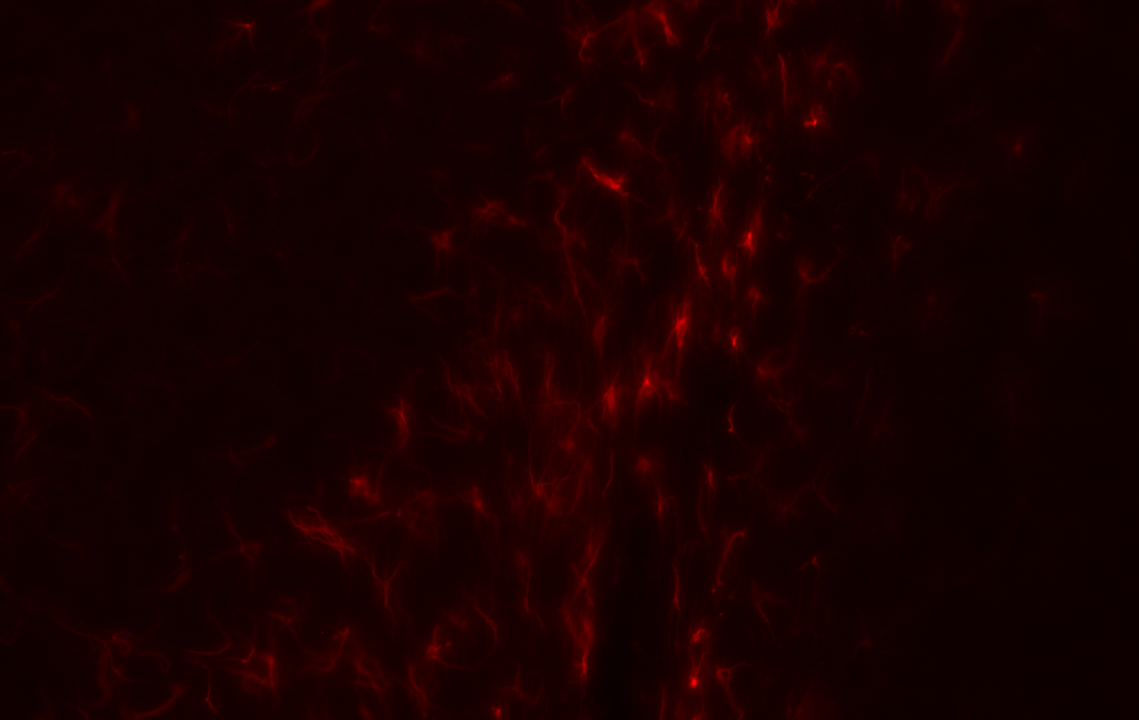
Importance
Immunohistochemistry is an analytical and diagnostic tool used to label proteins ​
Can be used to identify tumor markers in ​cancer cells
With the naked eye, one cannot see certain details in tissue samples such as proteins, or differentiation between certain cells
The Impact of Blocking Buffers on Brain Immunohistochemistry
NEU Young Scholars Program 2023 - August 3, 2023
Notes:
A widely used technique

Slide 3
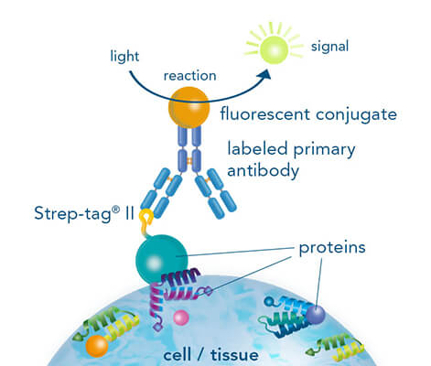
How Immunohistochemistry Works
Antibodies target and bind to certain proteins​
Labeled proteins omit fluorescent
Strep-tag. (n.d.). Immunostaining for protein detection. Retrieved from https://www.iba-lifesciences.com/applications/staining-detection/.
The Impact of Blocking Buffers on Brain Immunohistochemistry
NEU Young Scholars Program 2023 - August 3, 2023

Slide 4
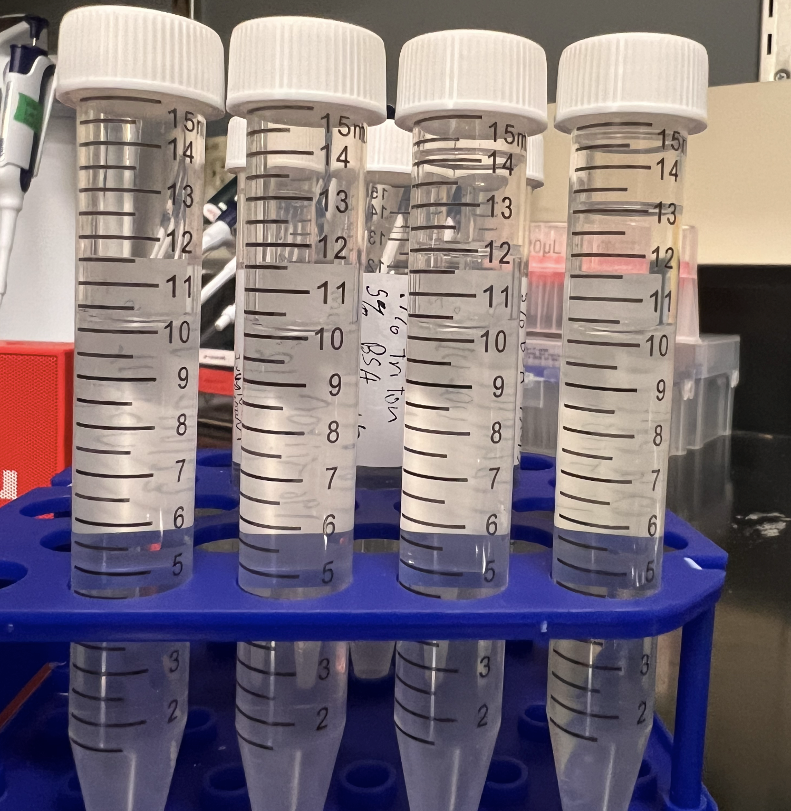
Blocking Buffers
Antibodies are not always perfect
Blocking Buffers have two​ components
Soap
Opens the cell membrane (Triton)
Blocker Protein
Blocks nonspecific binding of antibodies (Donkey Serum and Bovine Serum Albumin (BSA))​
The Impact of Blocking Buffers on Brain Immunohistochemistry
NEU Young Scholars Program 2023 - August 3, 2023
Notes:
But antibodies are not always perfect so we need blocking buffers so prevent false positives

Slide 5
Abstract
Motivation →
Cross reactivity of markers can cause unreliable results
Goal →
Find an optimal blocking buffer composition
Make staining in the lab easier
Challenges →
Blocking buffers sometimes don't fully block all unwanted proteins, making an image with too much background fluorescence
Results →
No statistical differences
Use Bovine Serum Albumin (BSA) as it is cheaper
The Impact of Blocking Buffers on Brain Immunohistochemistry
NEU Young Scholars Program 2023 - August 3, 2023
Notes:
Motivations, goals, results

Slide 6
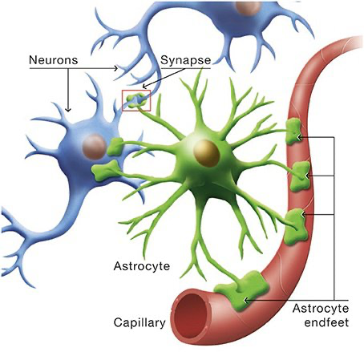
Astrocytes
A subtype of glial cells
30-66% of brain mass
Astrocytes specifically :
Control blood flow
Metabolic support
Recycles waste
What are the main function of astrocytes?. Quora. (n.d.). https://www.quora.com/What-are-the-main-function-of-astrocytes
The Impact of Blocking Buffers on Brain Immunohistochemistry
NEU Young Scholars Program 2023 - August 3, 2023

Slide 7
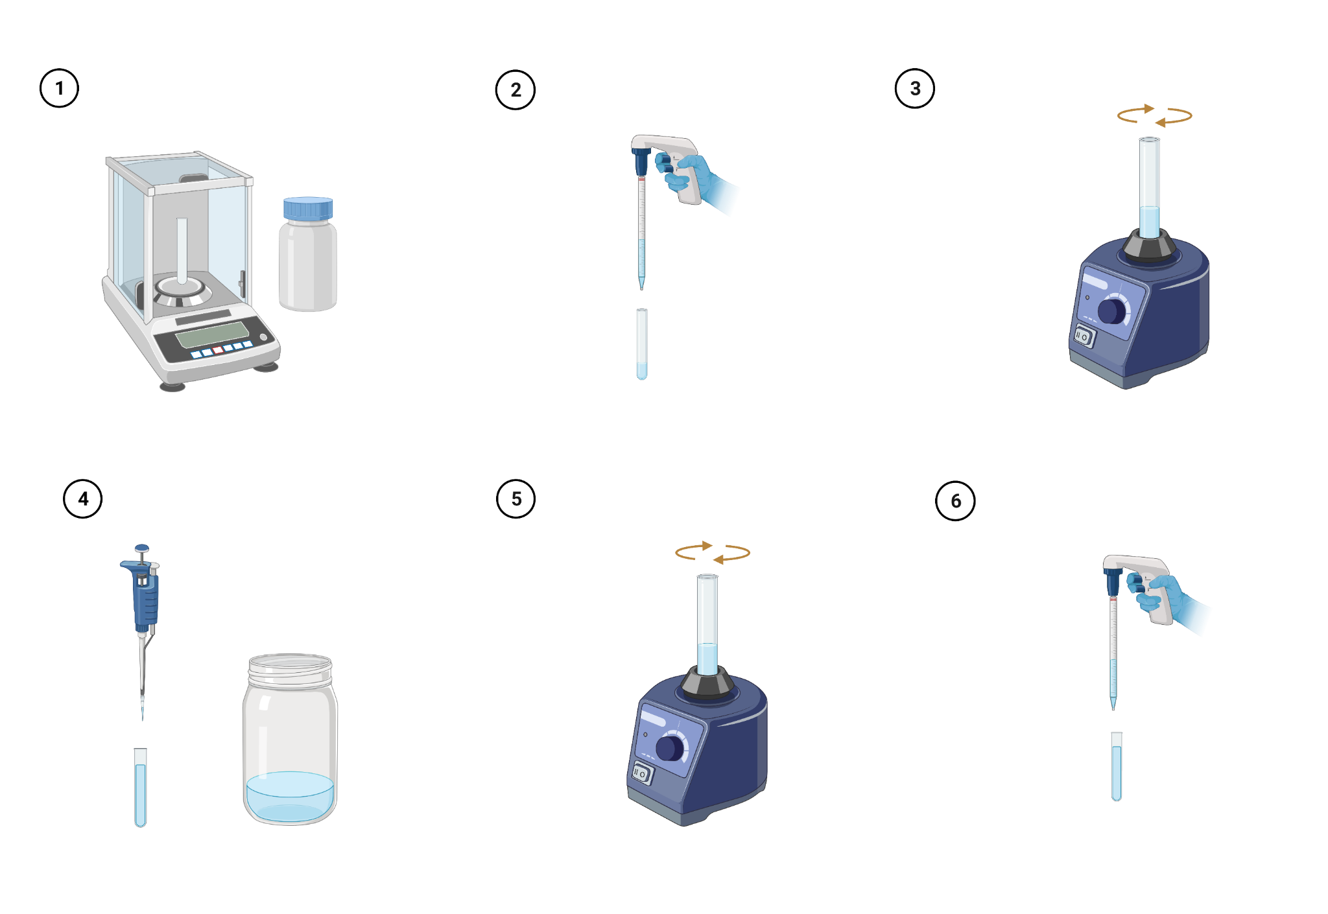
Methodology - Triton
The Impact of Blocking Buffers on Brain Immunohistochemistry
NEU Young Scholars Program 2023 - August 3, 2023
Notes:
Triton is a soap used to open the cell membrane
BSA is used to block unwanted proteins
Added x amount of BSA i
BSA, Triton, and Donkey Serum
What are they and what do they do

Slide 8
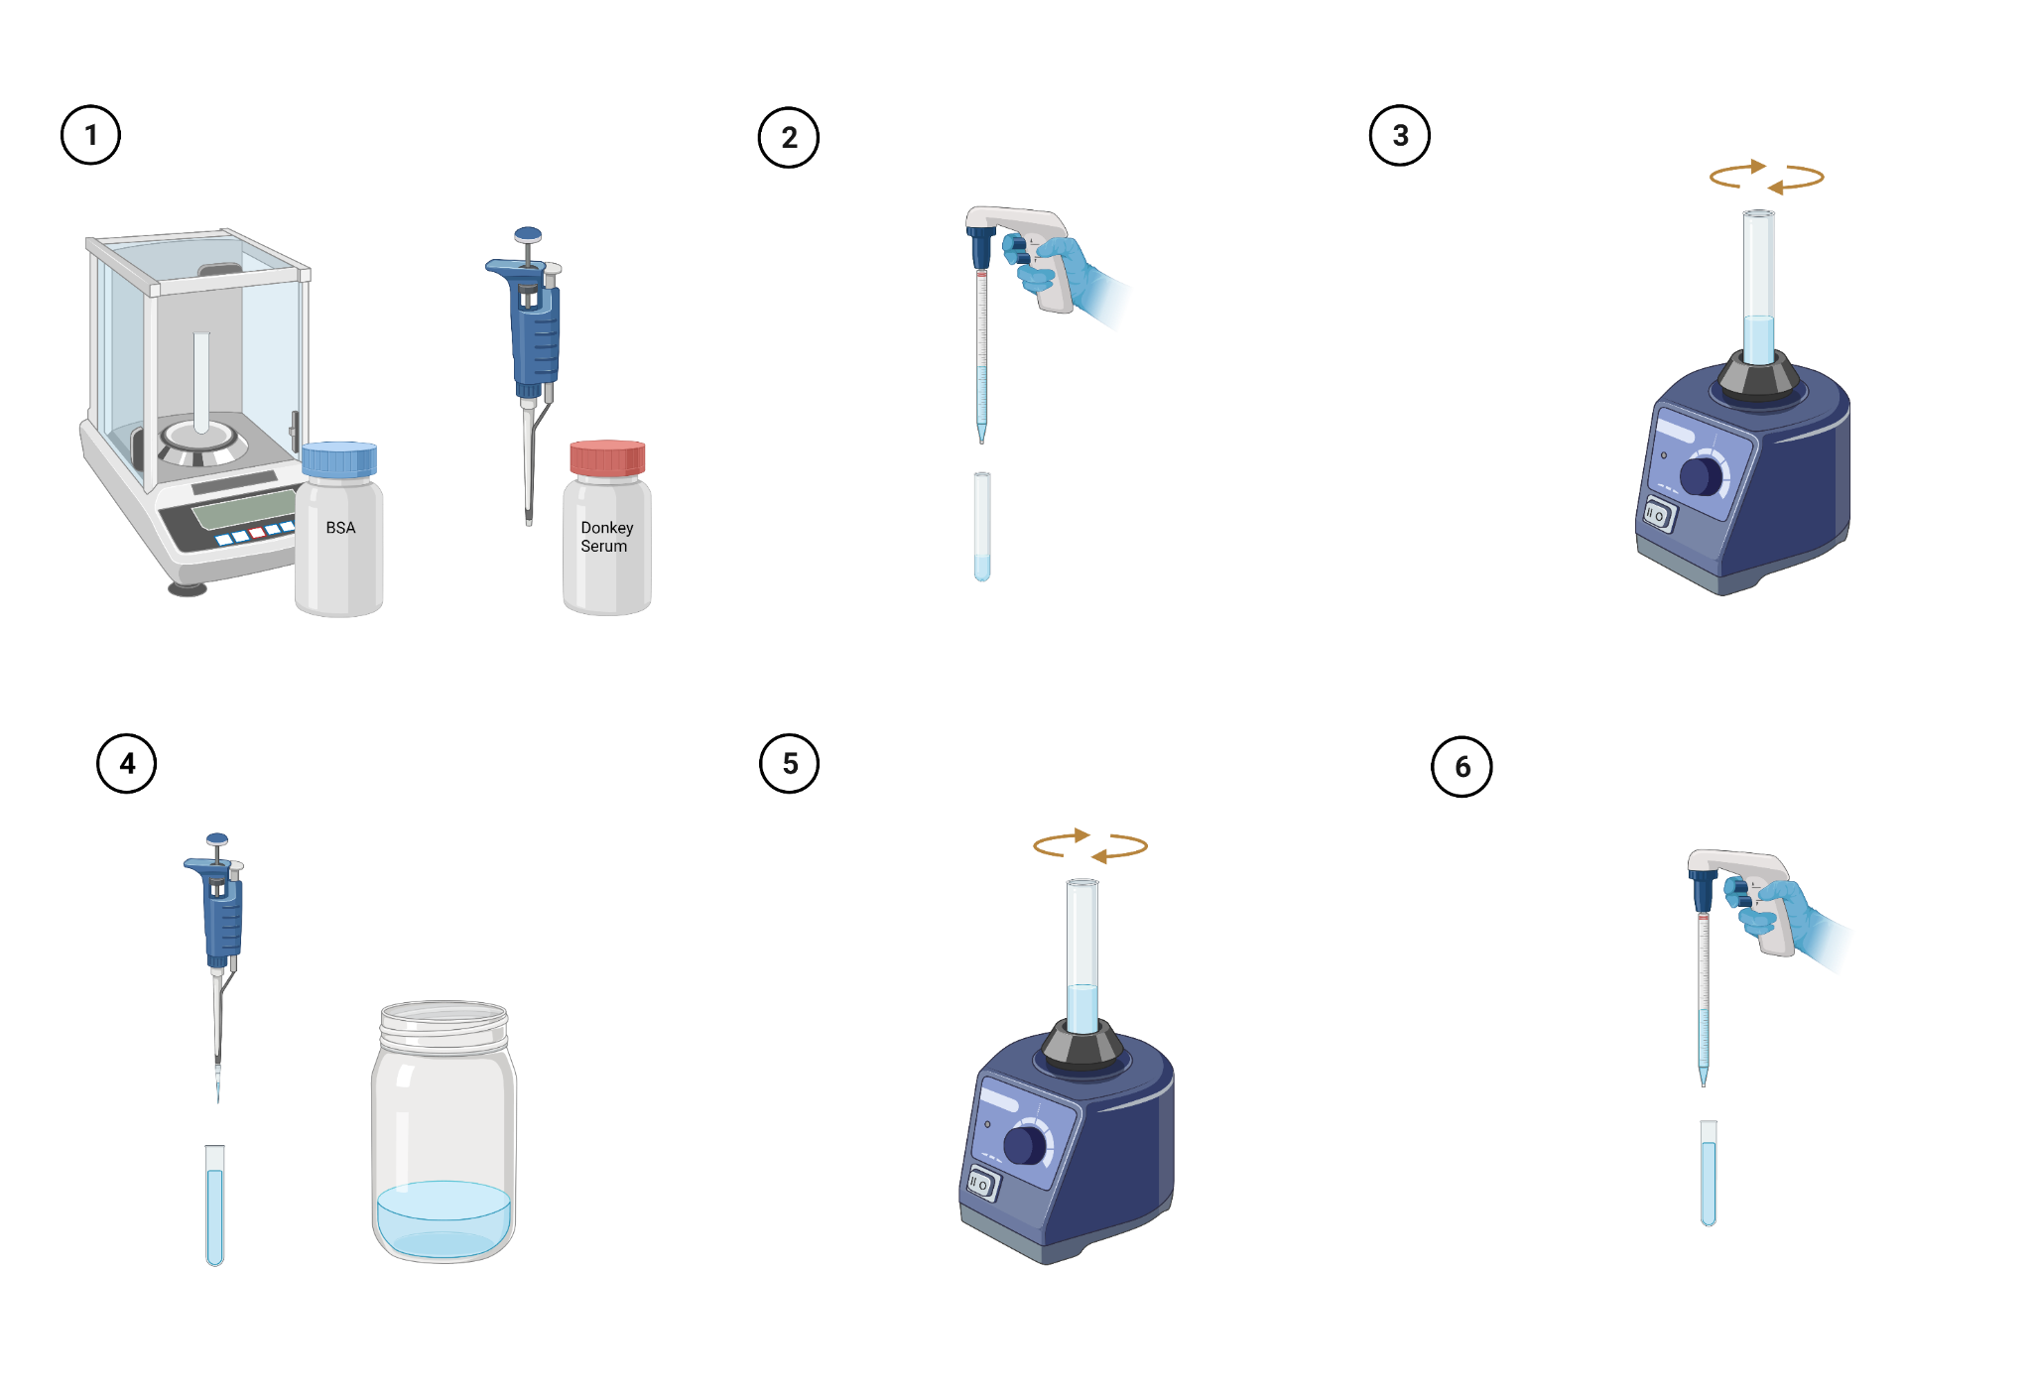
Methodology - Donkey Serum and BSA
The Impact of Blocking Buffers on Brain Immunohistochemistry
NEU Young Scholars Program 2023 - August 3, 2023
Notes:
Phosphate buffered saline

Slide 9
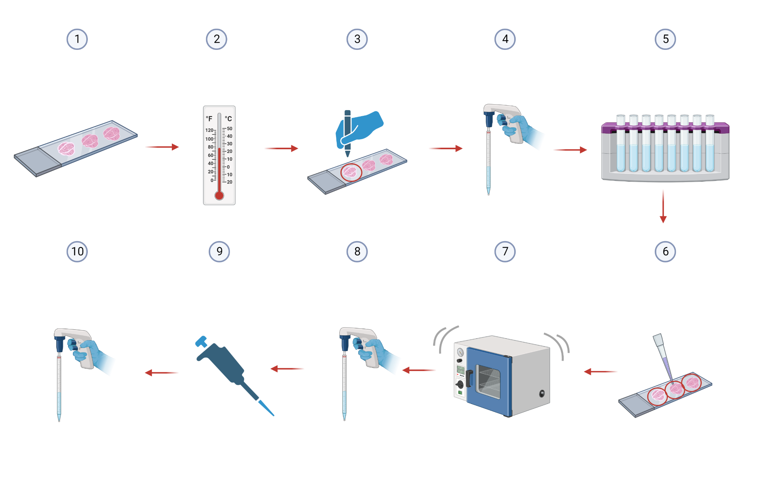
Methodology - Staining
The Impact of Blocking Buffers on Brain Immunohistochemistry
NEU Young Scholars Program 2023 - August 3, 2023

Slide 10
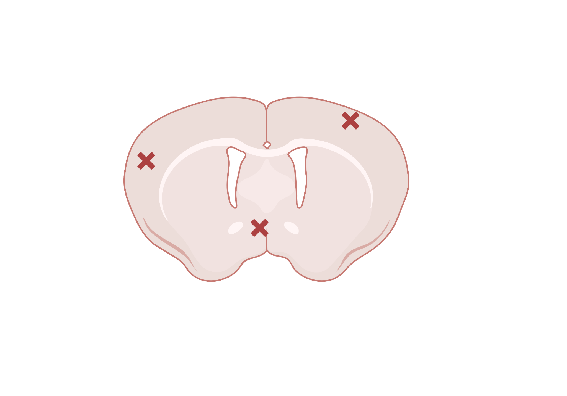
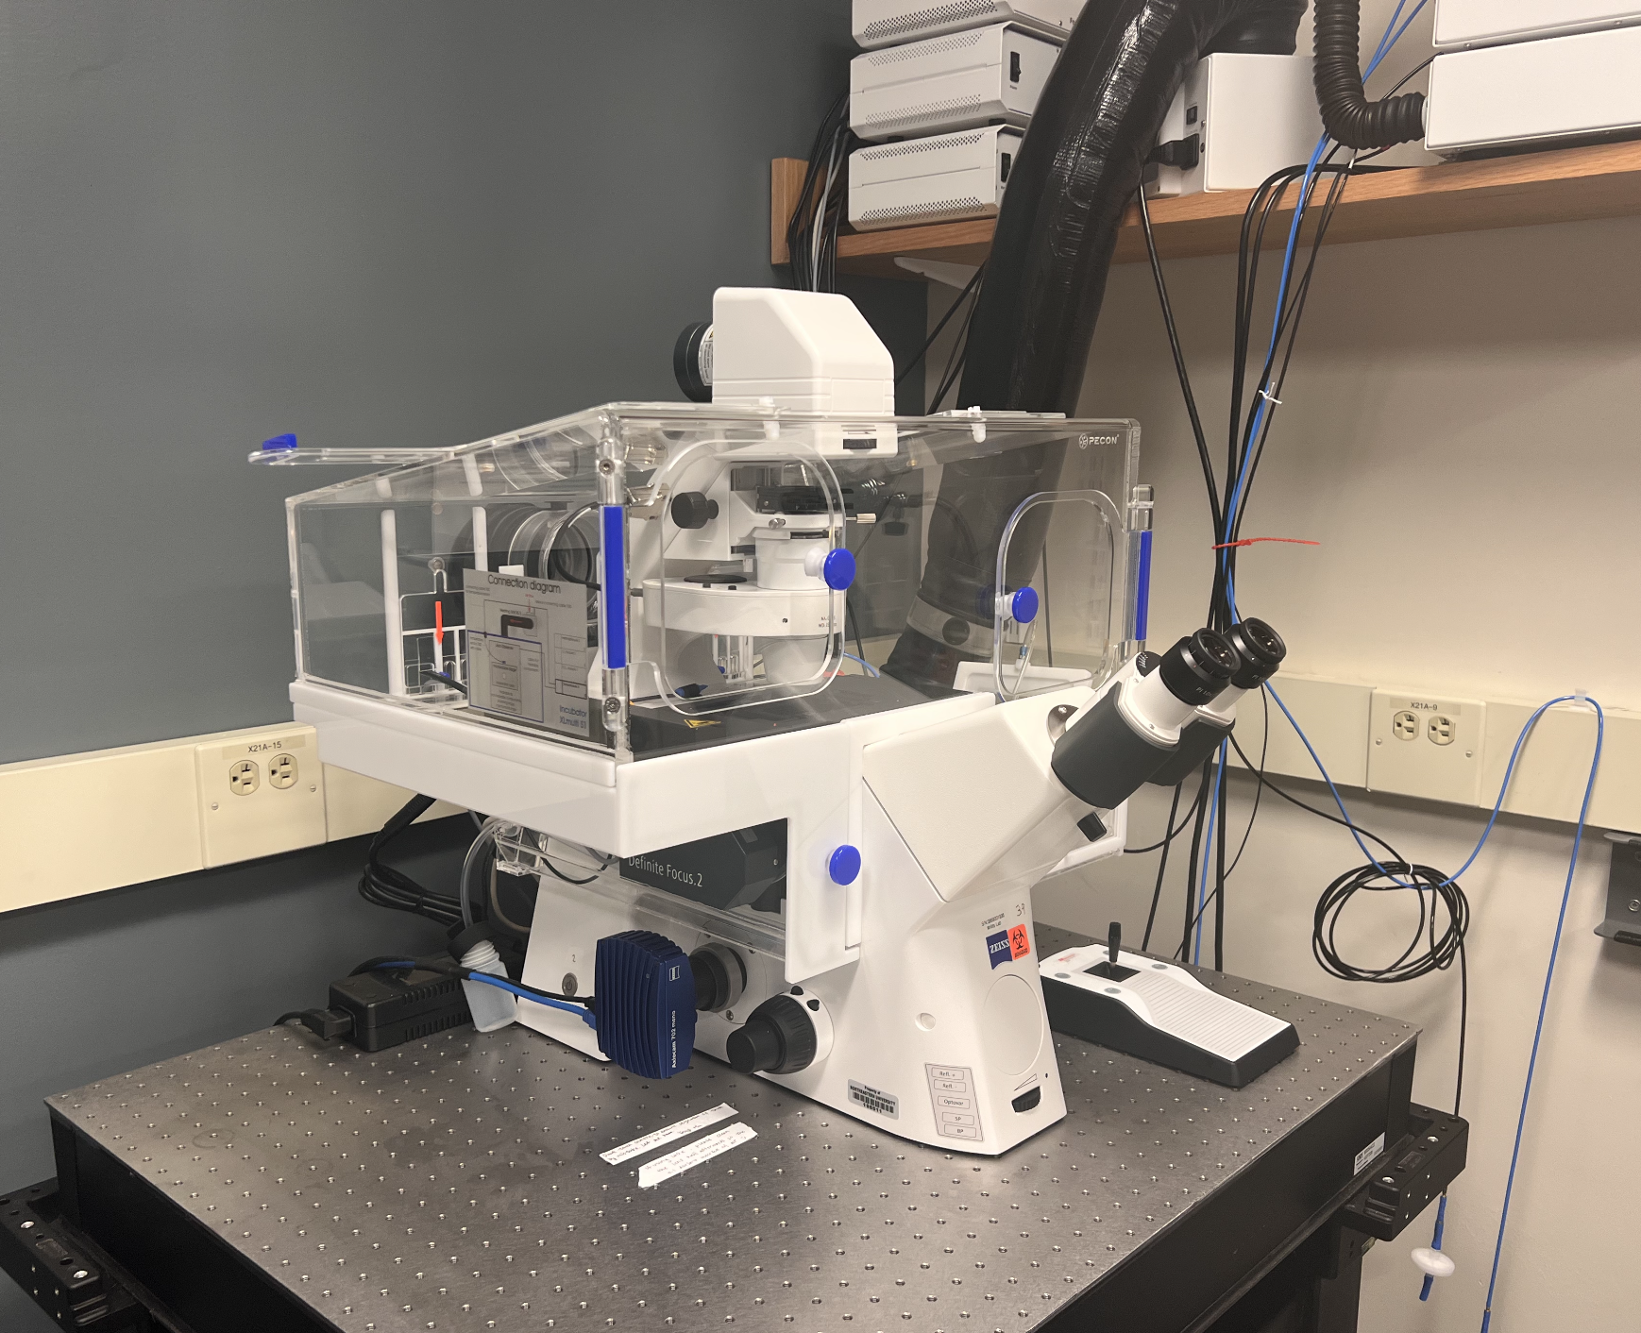
Microscopy Imaging
Reduce variability in data
20x objective
Exposure Time = 3.8s
LED% = 20
Captured in similar spots
Large Sample Size
3 images per brain
3 brains per blocking buffer
The Impact of Blocking Buffers on Brain Immunohistochemistry
NEU Young Scholars Program 2023 - August 3, 2023
Notes:
The fluorescence from the antibodies bind to the glial cells which shows them in these images
Used image j
Inverted fluorescent microscope
Light from the bottom comes up
Chamber is for cell migration studies

Slide 11
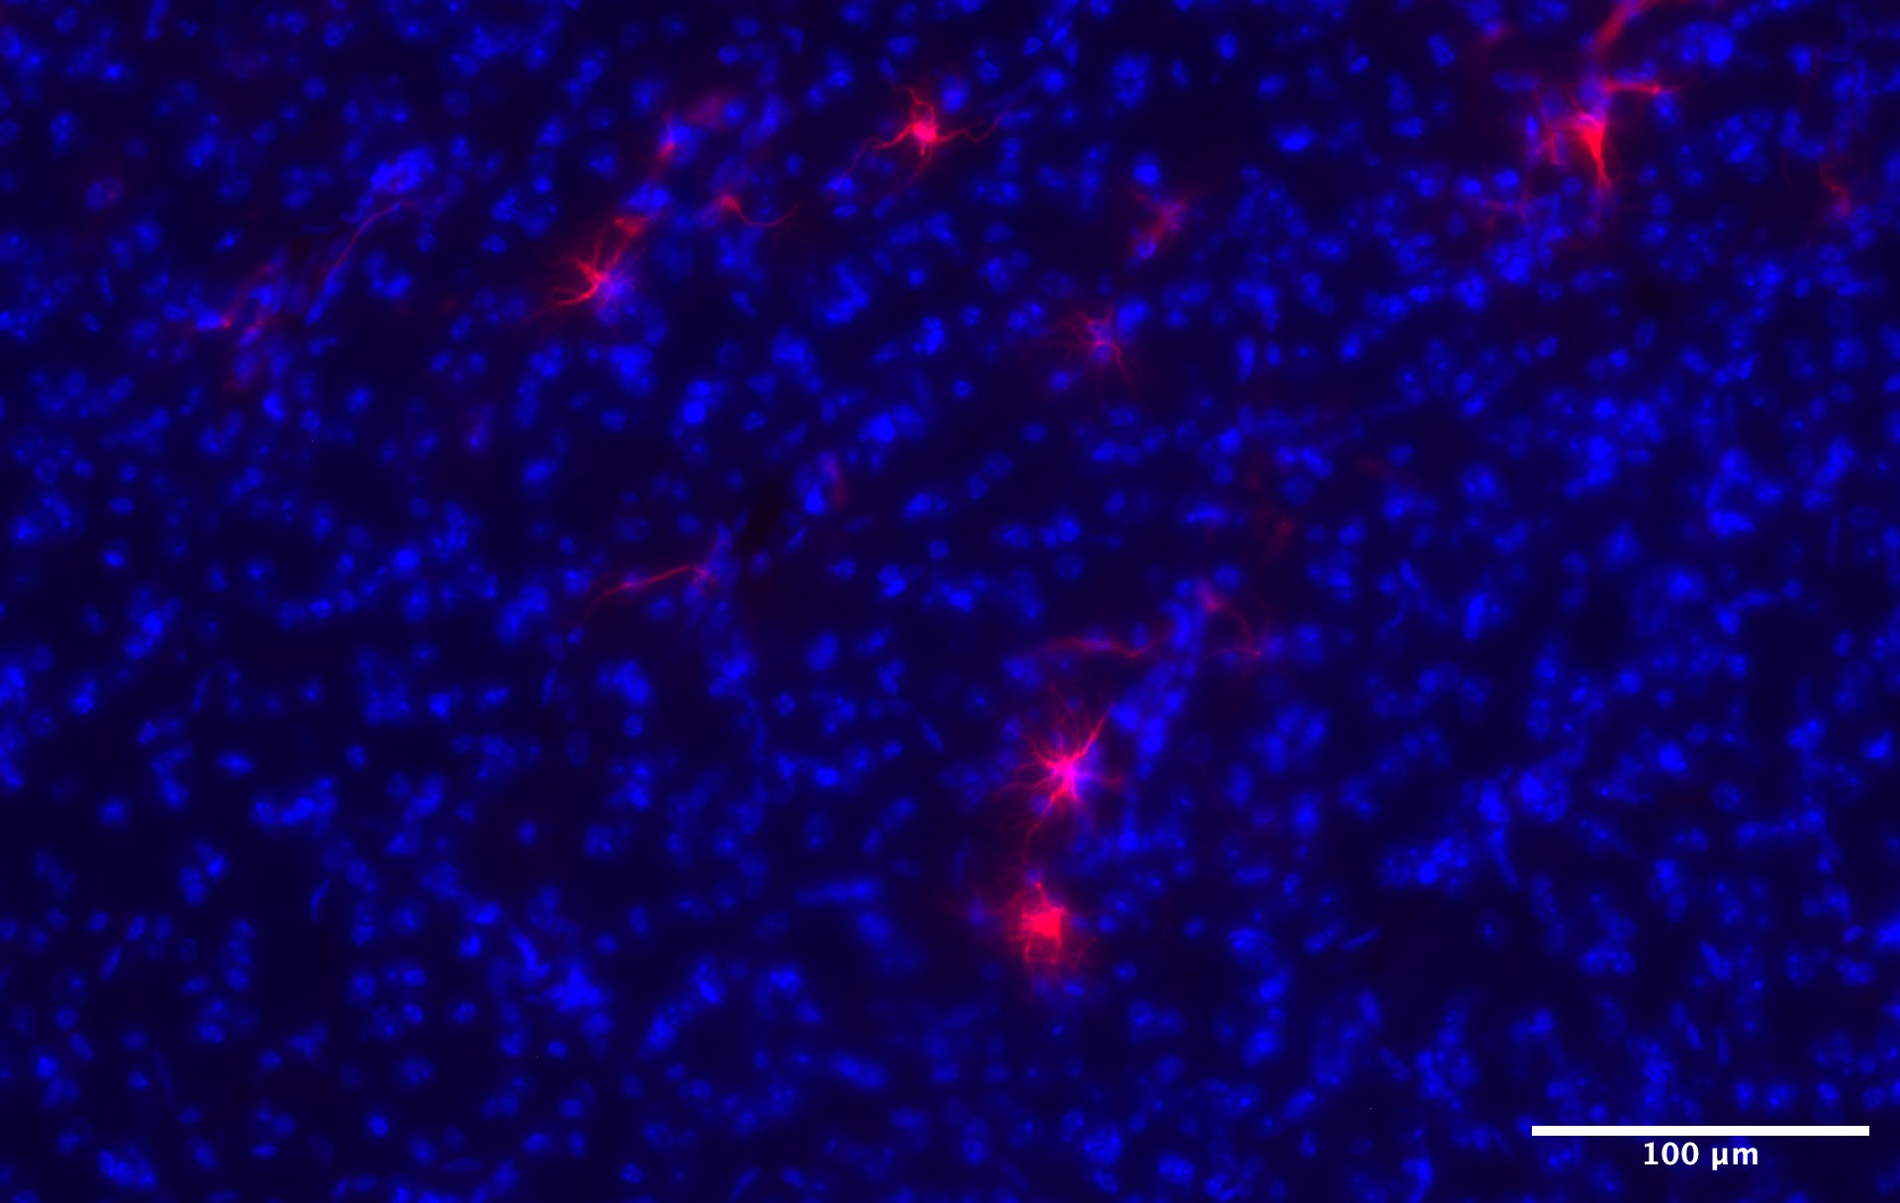
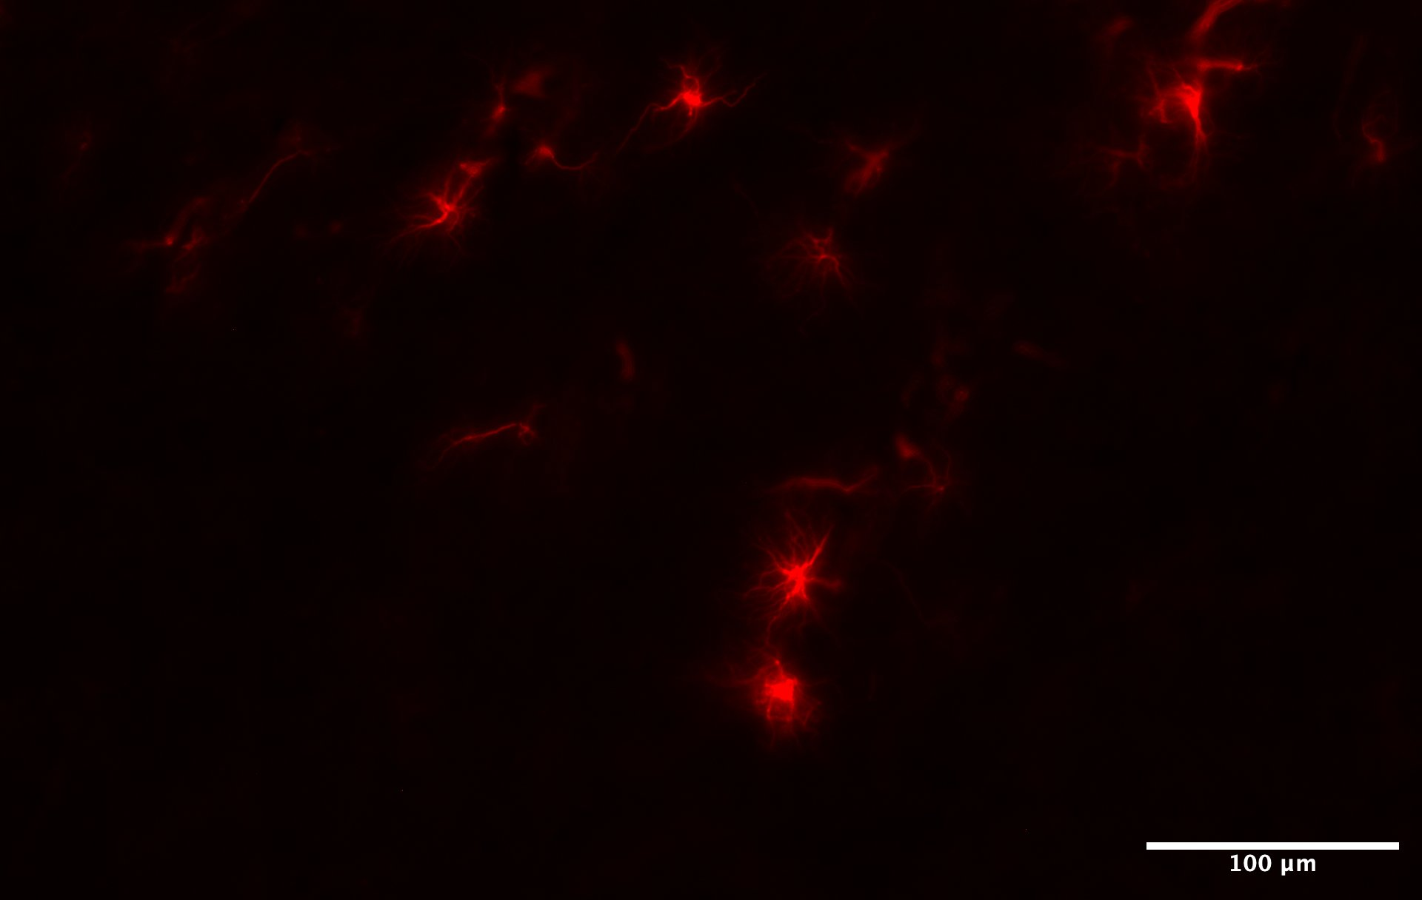
Microscope Images
Nuclei Astrocyte
Astrocyte
The Impact of Blocking Buffers on Brain Immunohistochemistry
NEU Young Scholars Program 2023 - August 3, 2023

Slide 12
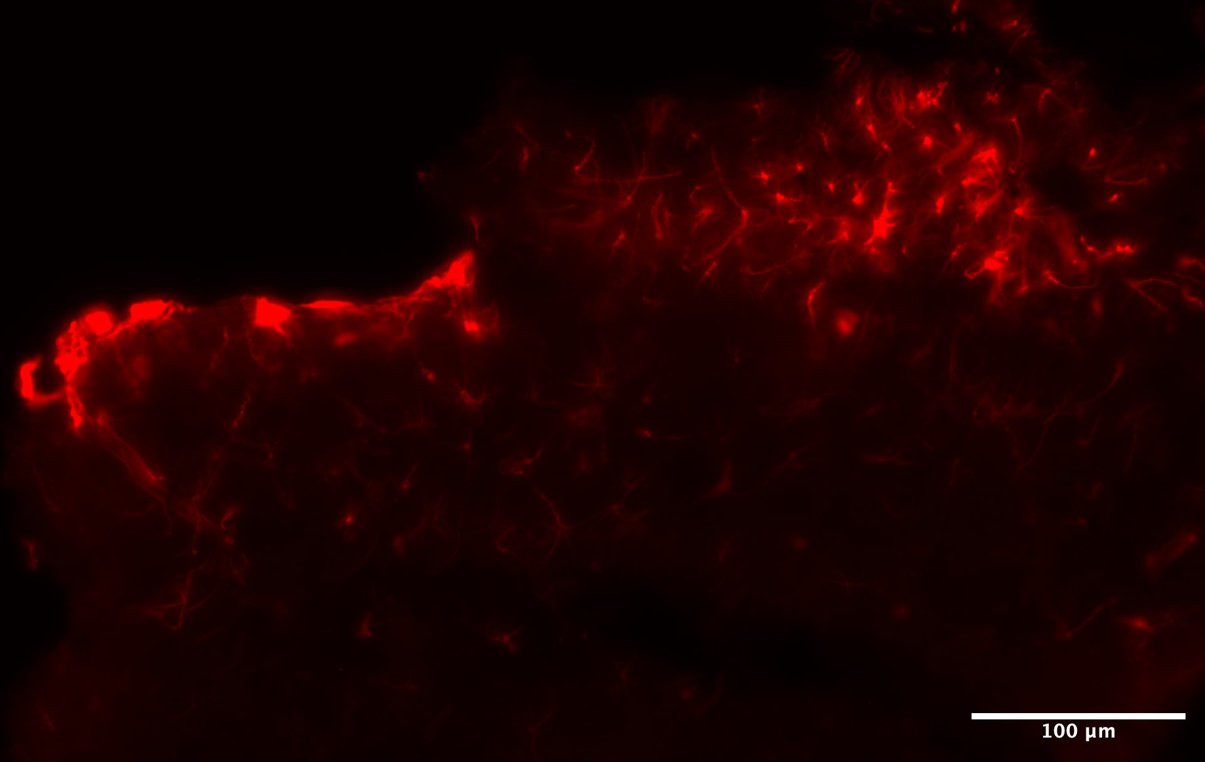
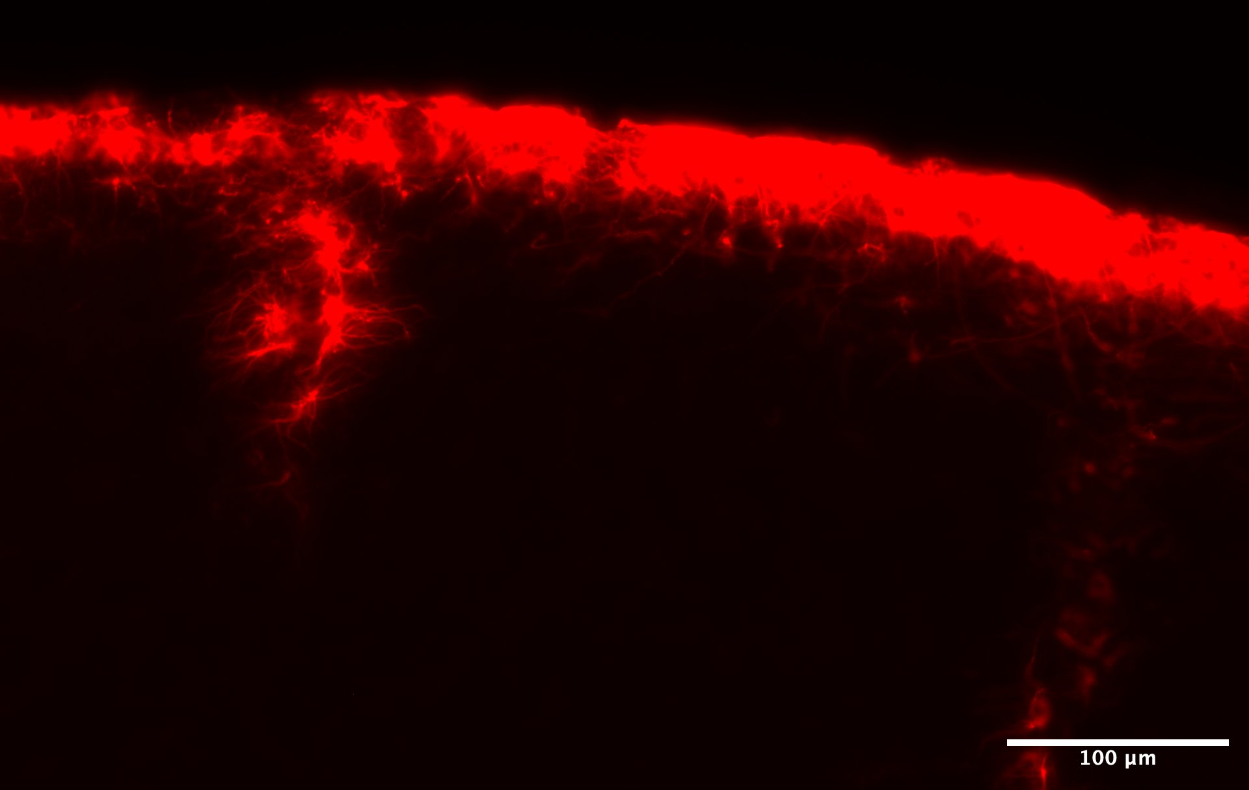
Astrocyte Images
Astrocyte
5% BSA 0% Triton Brain section 1, picture 3
5% BSA 1% Triton Brain section 1, picture 2
Background
The Impact of Blocking Buffers on Brain Immunohistochemistry
NEU Young Scholars Program 2023 - August 3, 2023

Slide 13
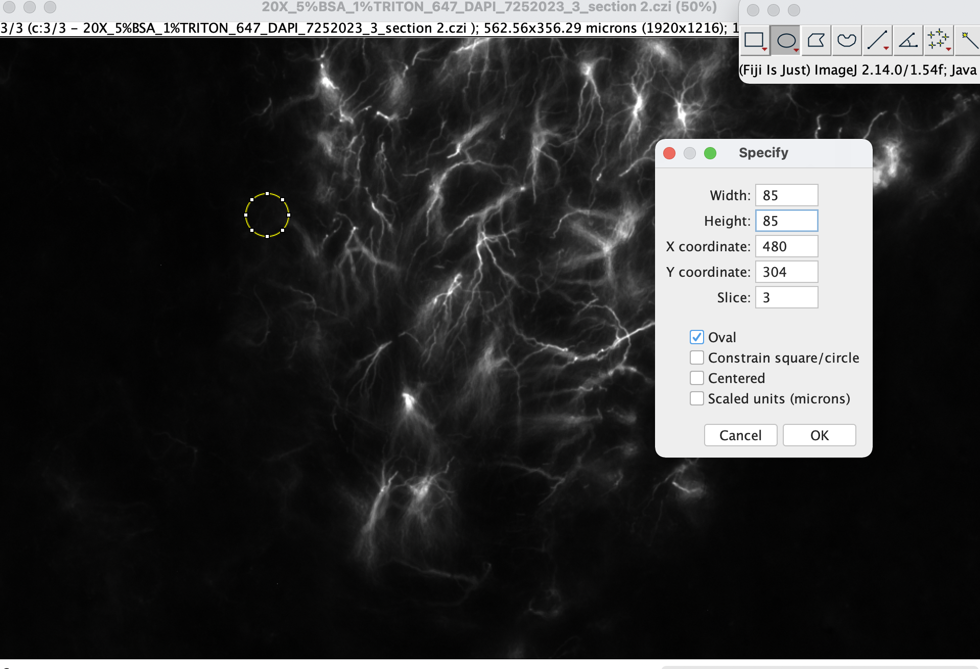
Analysis
Used 85 by 85 pixel circles, taking 3 samples of the background intensity and 3 pictures of the astrocytes
Focused on the mean intensity
The Impact of Blocking Buffers on Brain Immunohistochemistry
NEU Young Scholars Program 2023 - August 3, 2023

Slide 14
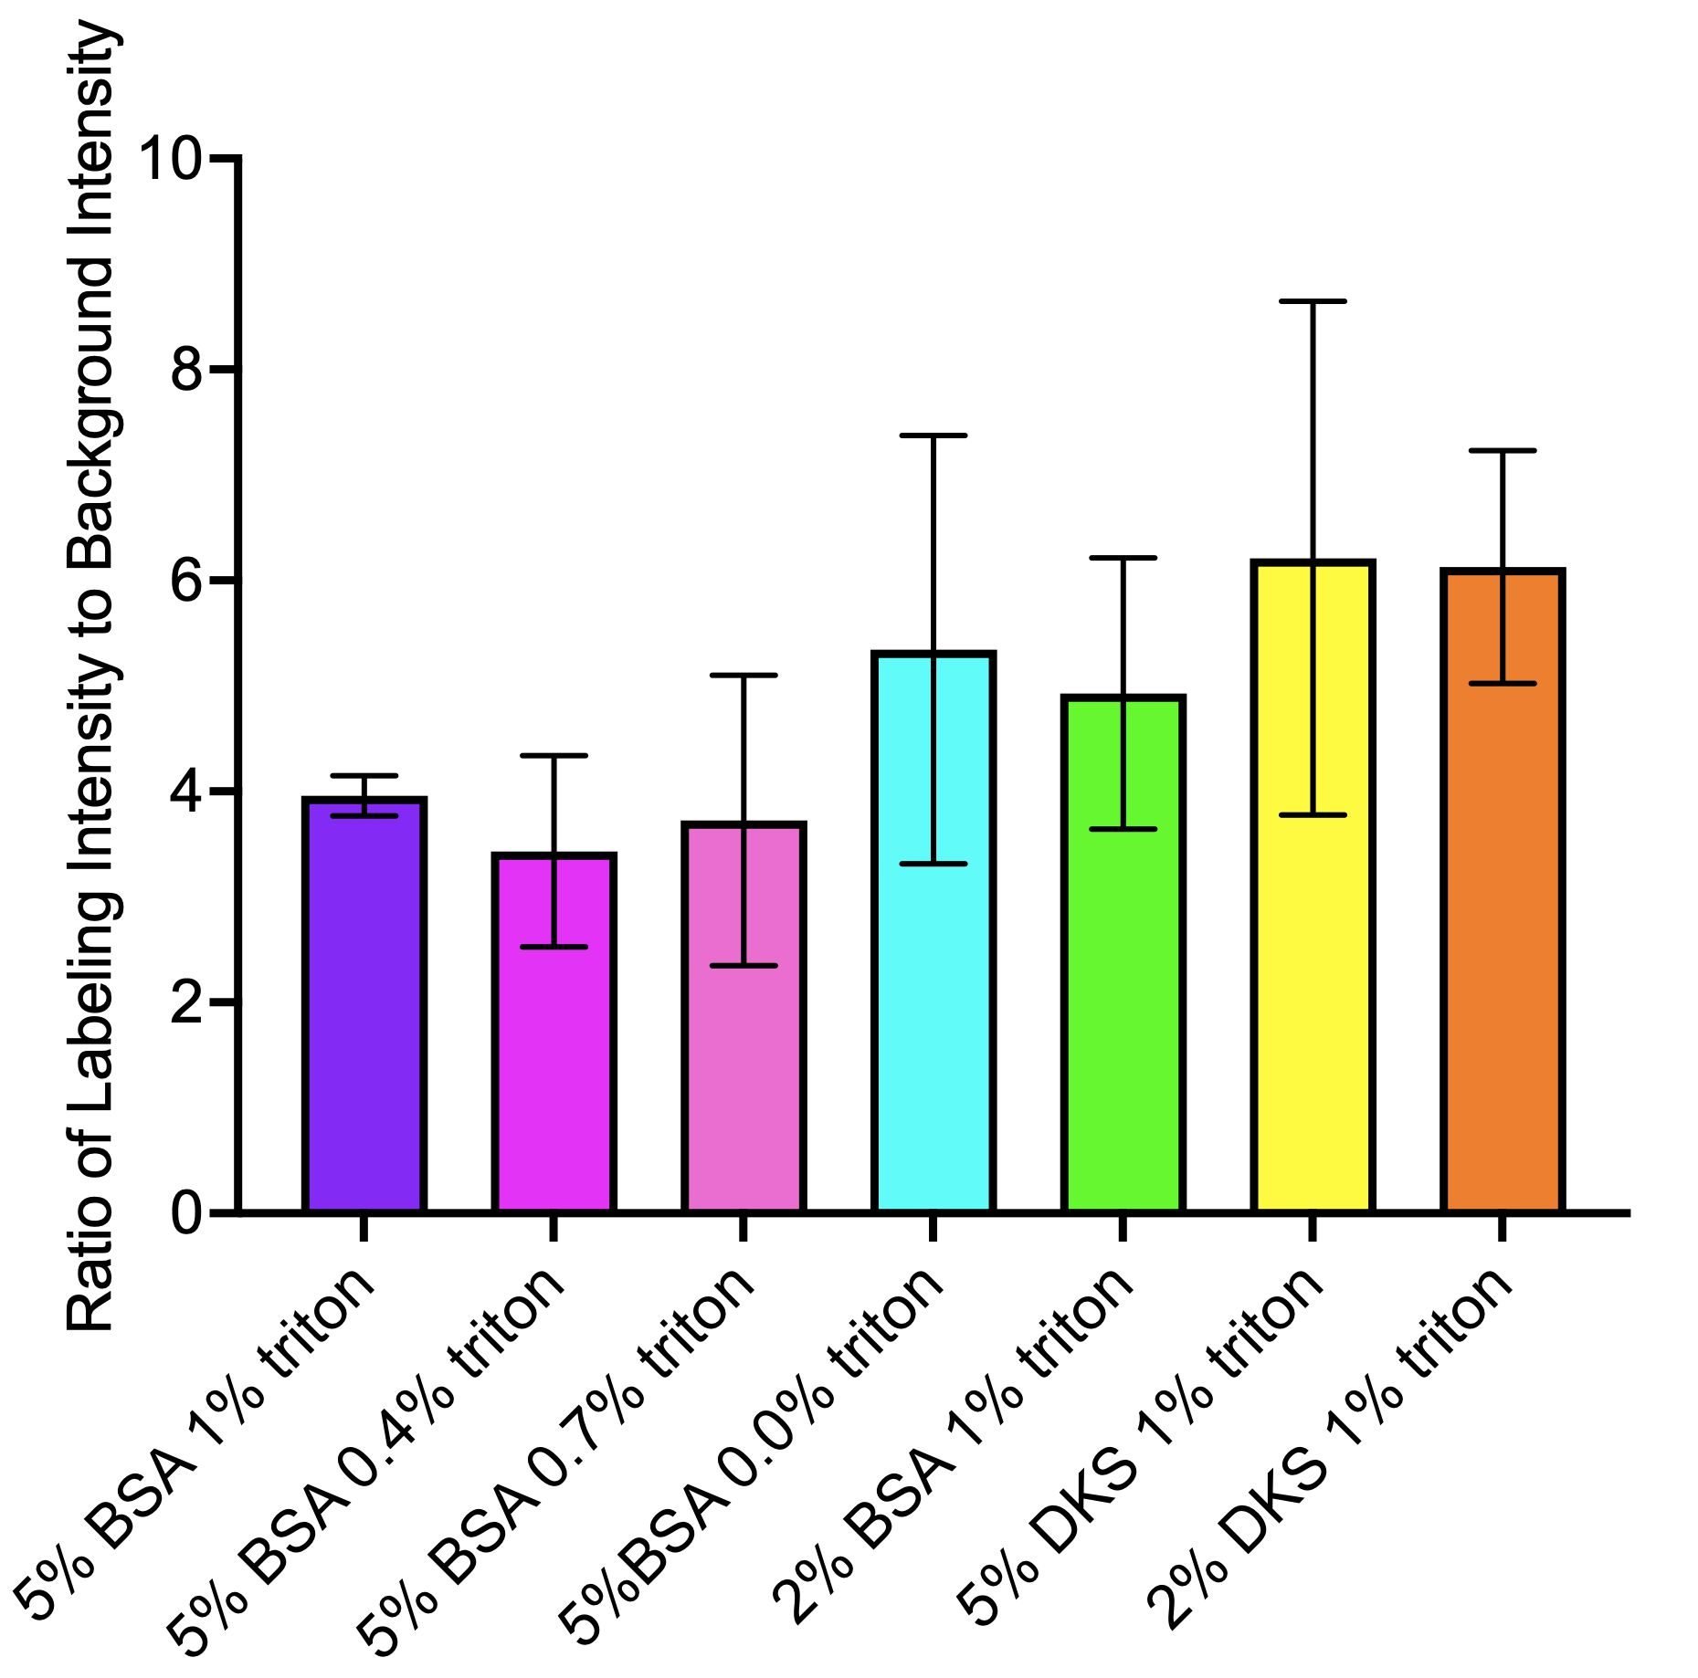
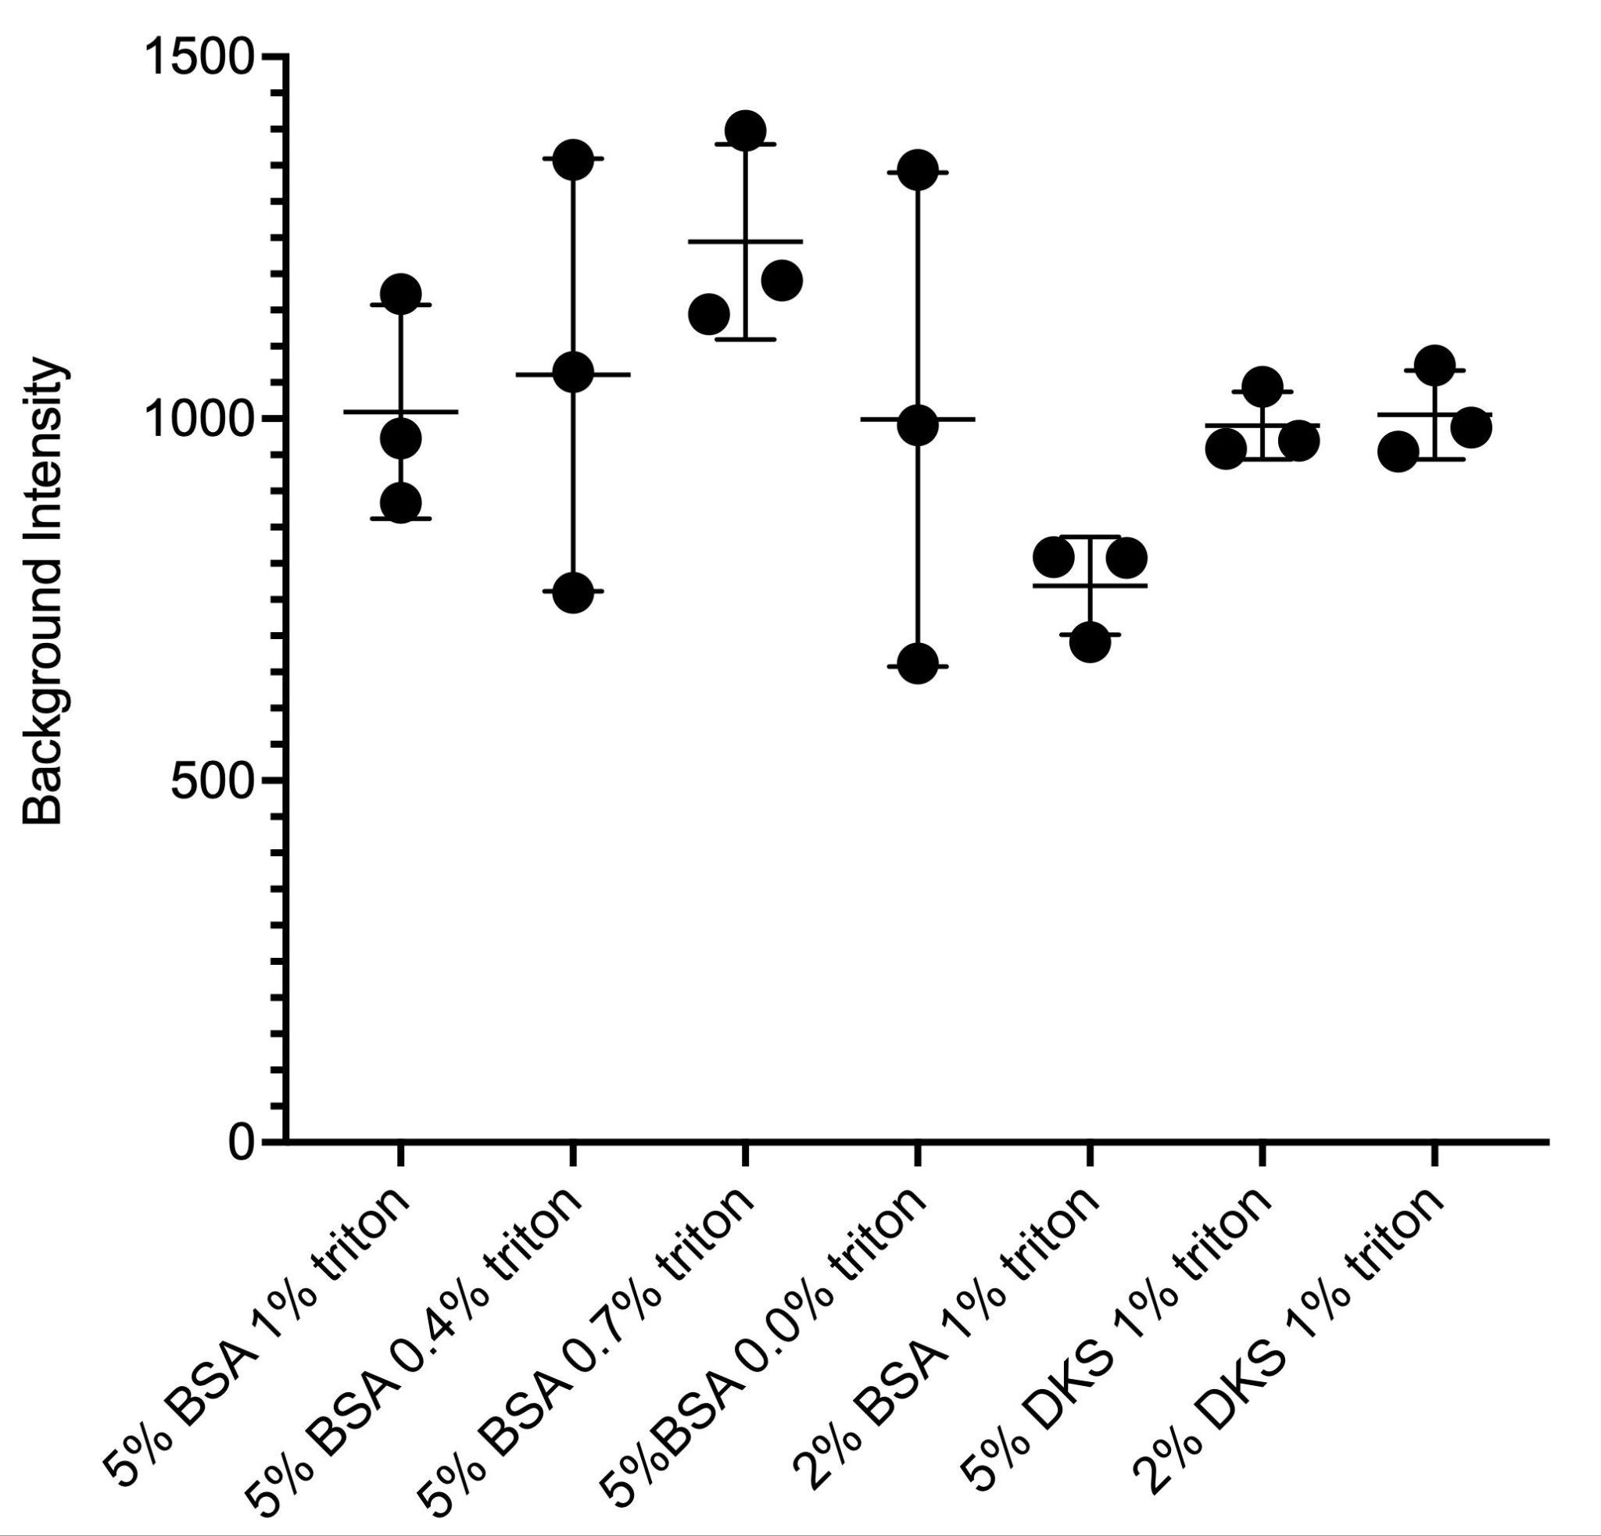
Results
Ran ANOVA test all p values > 0.05
The Impact of Blocking Buffers on Brain Immunohistochemistry
NEU Young Scholars Program 2023 - August 3, 2023
Notes:
These graphs represent mean plus the bar represents standard deviation and p value of 0.05 was used
No statistical difference - however the donkey serum has lower SD but overall there is no difference
trend shows that donkey serum ratio of donkey serum 5% and 2% are bigger
But, the error bars are much larger, saying that the data are not reliable
When comparing the backgrounds, the ratios of all the buffers were similar
The error bar for the donkey serum 5% and 2% were much smaller, meaning less variation in the background
No significant difference between the changes of triton percentages
No significant differences between changes of donkey serum percentages
Used one way ANOVA(Analysis of Variance) p-value of 0.05
P value compares each bar to the mean of the other bars and the value states that their not statistically different
Before running the ANOVA, we checked to make sure the data was fitting the assumptions of the test(which it was)-- so there was no need to run a non parametric test
Tukey’s test -- compares individual groups

Slide 15
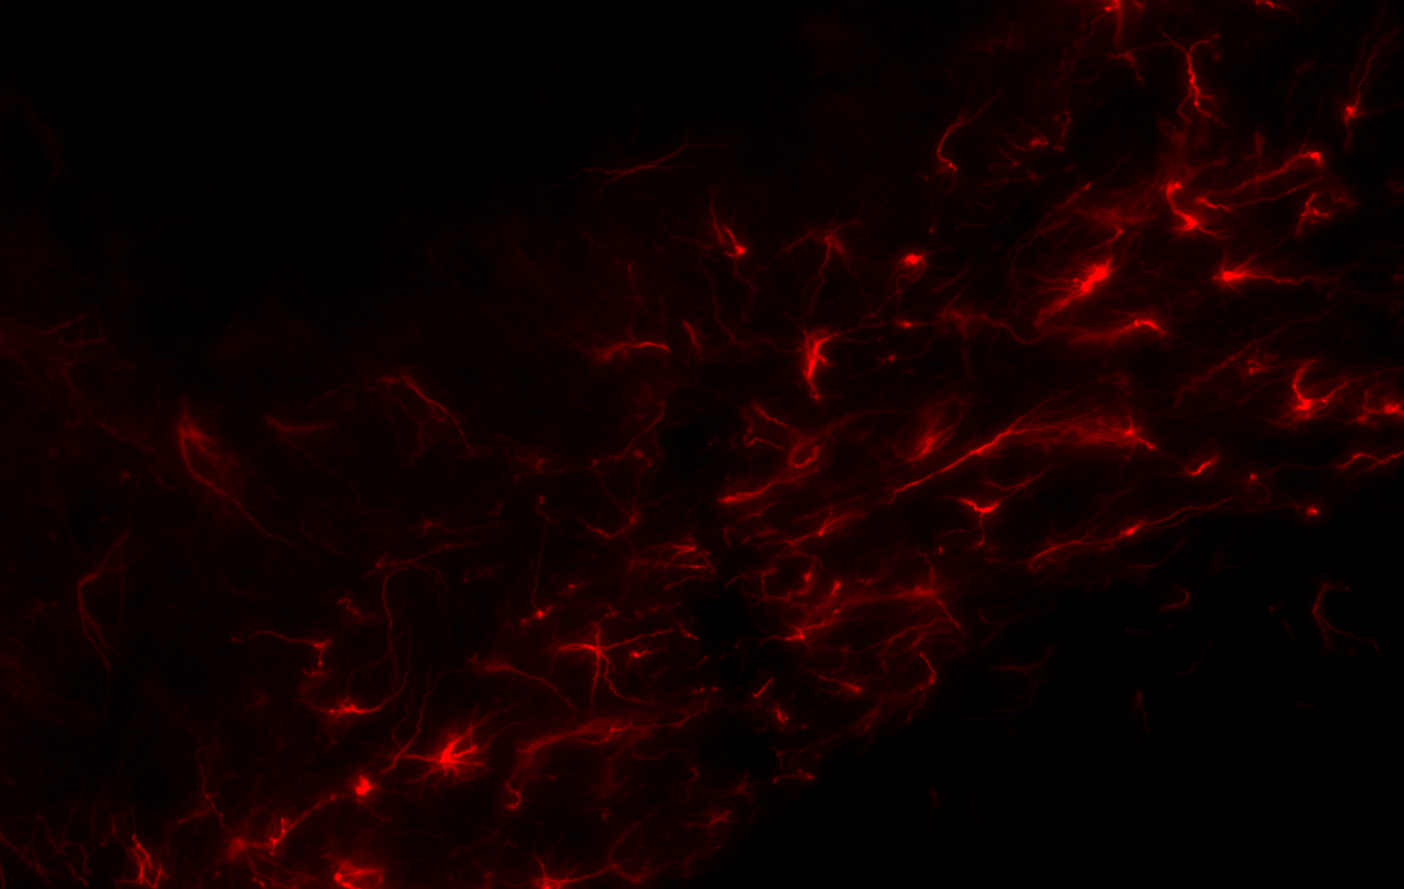
Conclusion and Next Steps
Summary:
No statistical difference in the blocking buffers tested
Due to lack of statistical significance, BSA can be used since it is cheaper
Future work :
Reduce Variation
Obtain more data points
Use similar sections in the brain
Further optimize the protocol
Explore buffers with conc with 0-2% BSA and 0-0.4% Triton
The Impact of Blocking Buffers on Brain Immunohistochemistry
NEU Young Scholars Program 2023 - August 3, 2023

Slide 16
References and Acknowledgements
Department of Chemical Engineering :
Professor Rebecca Willits, Department of Chemical Engineering & Department of Bioengineering
Rachel Shovmer, Ph.D. Student
Diego Gomez-Maldonado, Postdoctoral Research Associate
McKay Cavanaugh, Ph.D. Candidate
Center for STEM Education :
Claire Duggan, Executive Director
Jennifer Love, Associate Director
Claire Stipp and Yassine Souabny, YSP Coordinators
Nicolas Fuchs, Senior Program Implementation Coordinator
Mary Howley, Administrative Officer
Siracusa, R., Fusco, R., & Cuzzocrea, S. (2019, August 30). Astrocytes: Role and functions in brain pathologies. Frontiers. https://www.frontiersin.org/articles/10.3389/fphar.2019.01114/full
Duraiyan, J., Govindarajan, R., Kaliyappan, K., & Palanisamy, M. (2012, August). Applications of immunohistochemistry. Journal of pharmacy & bioallied sciences. https://www.ncbi.nlm.nih.gov/pmc/articles/PMC3467869/
Images generated by BioRender, Graphs and stats with Prism, and images taken on Image J
The Impact of Blocking Buffers on Brain Immunohistochemistry
NEU Young Scholars Program 2023 - August 3, 2023
Notes:
https://www.frontiersin.org/articles/10.3389/fphar.2019.01114/full

Slide 17
