Slide 1
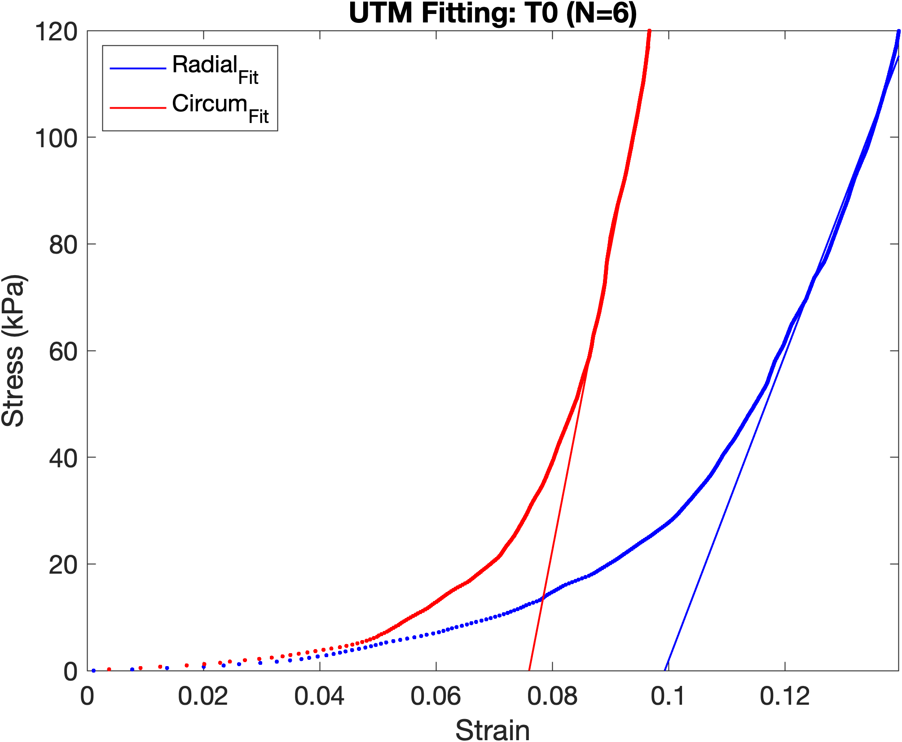
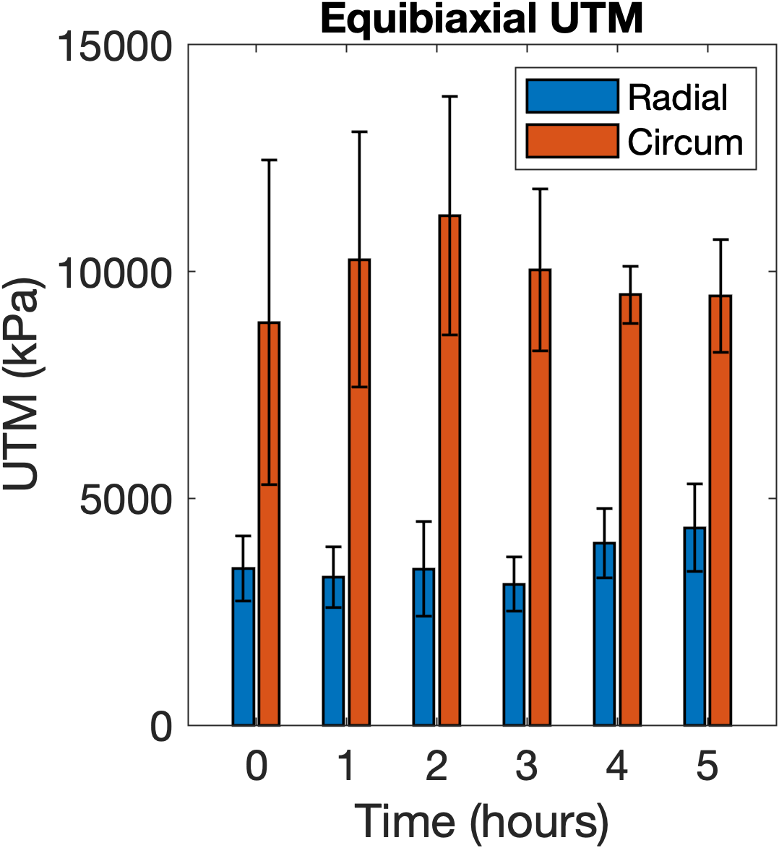
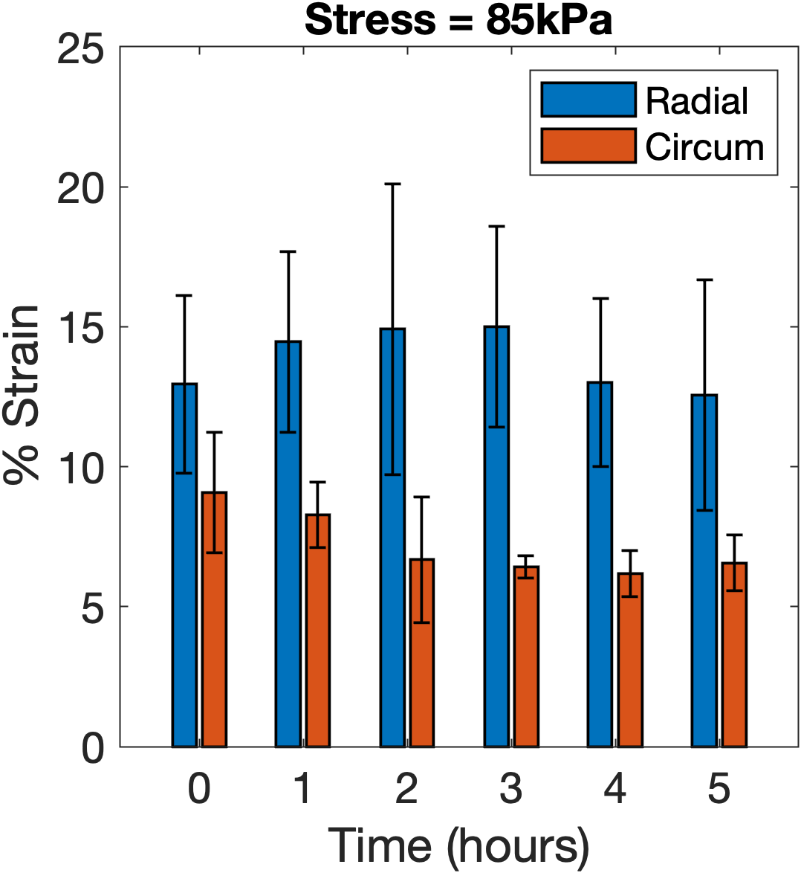
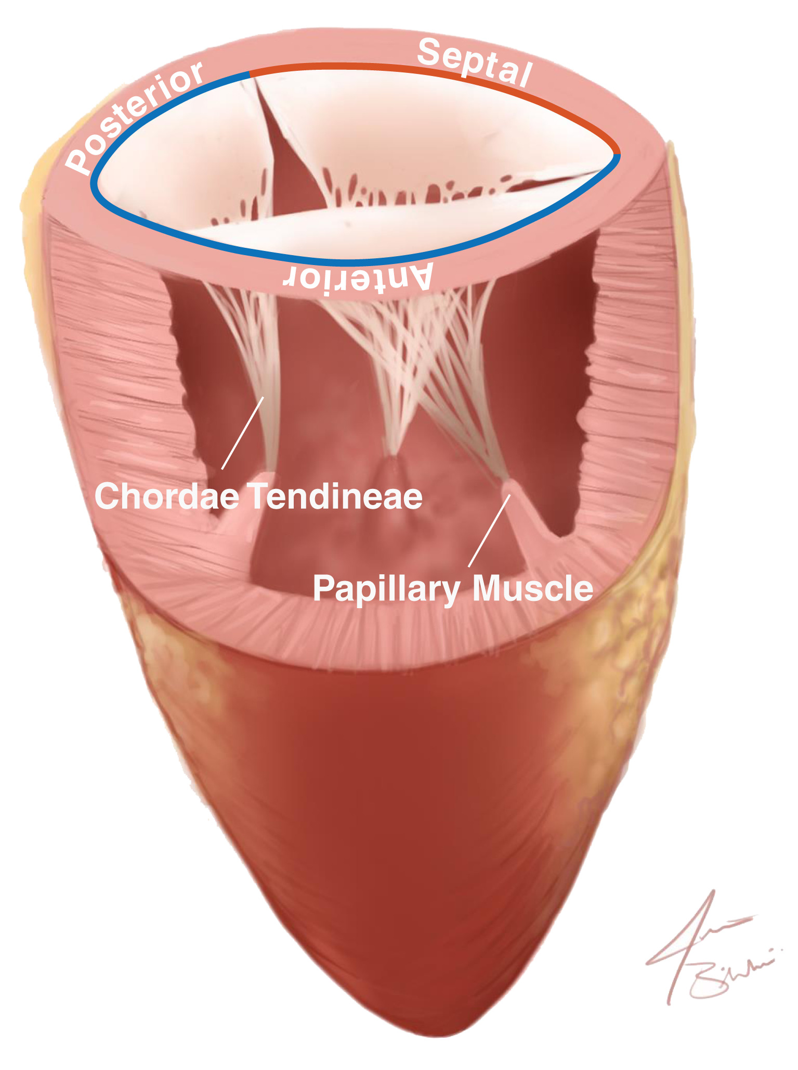
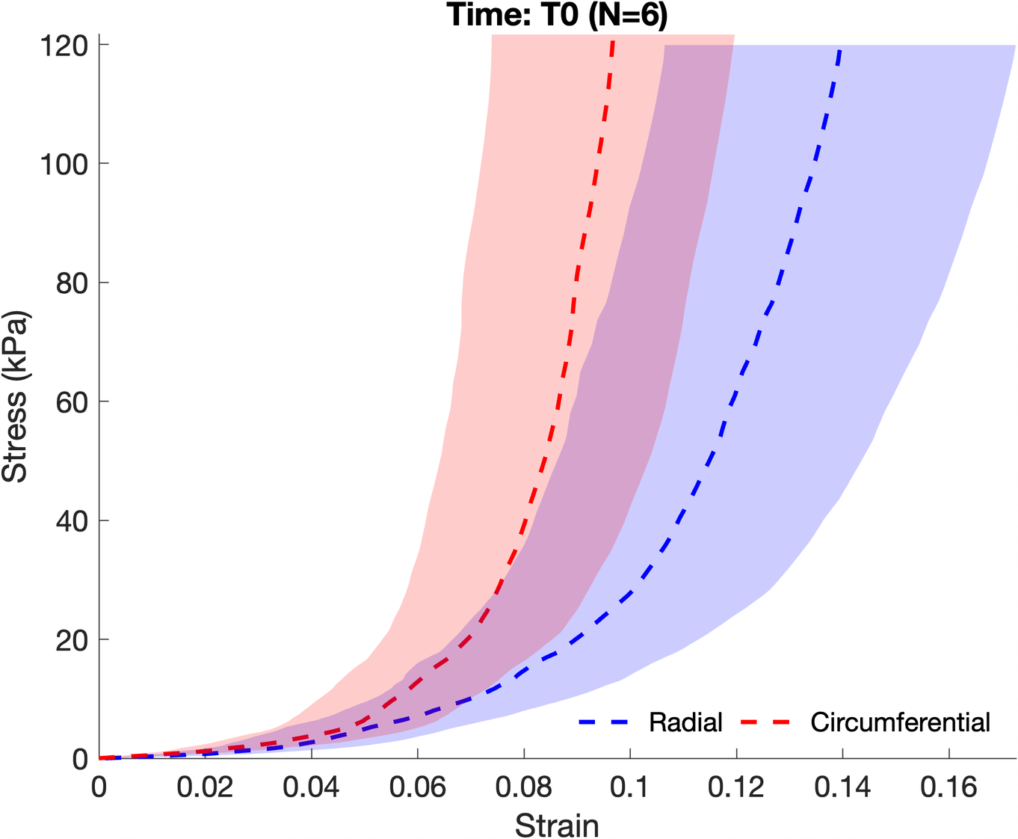
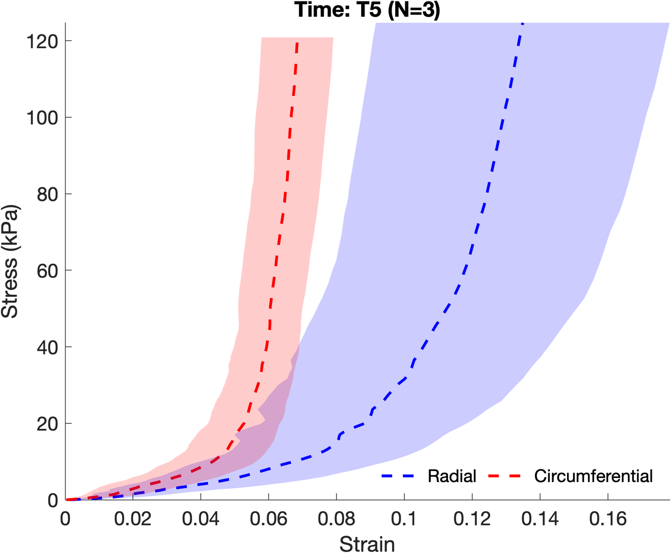
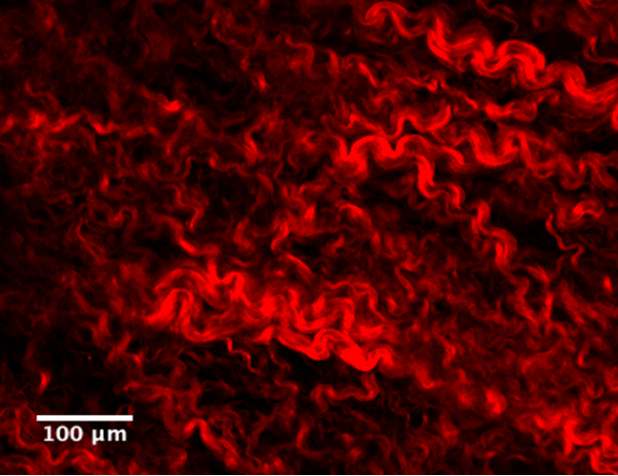
Biomechanical Properties of the Porcine Tricuspid Valve Remained Unchanged Over Time
Dominique Dang¹, Lucas Santos², Julia Clarin³, Rouzbeh Amini^{3,4}
(1) YSP Student, North Quincy High School, Quincy, MA, USA
(2) YSP Student, Brookline High School, Brookline, MA, USA
(3) Department of Bioengineering, Northeastern University, Boston, MA, USA
(4) Department of Mechanical Engineering, Northeastern University, Boston, MA, USA
Abstract
Experimental Methods
Results
The tricuspid valve (TV) leaflets experience a series of stresses and strains in a dynamic environment necessary for ventricular filling. The composition of the TV, primarily collagen and elastin, allows functioning effectively in such an environment. Many ex-vivo mechanical tests require lengthy preparation processes, potentially leaving the fresh tissue samples exposed to conditions that accelerate degradation. It is not known how much the mechanical properties of the TV significantly change during long periods of time when the tissue is maintained in an iso-osmotic environment. In this study, mechanical properties of porcine TV anterior leaflets were characterized at five time points using equibiaxial mechanical testing. Initial data were collected at time zero, then at 1-hour intervals for a total of 6 measurements per sample. Stress-strain plots were obtained for the radial and circumferential directions and the upper tangent modulus (UTM) of elasticity was calculated at each time point. Radial and circumferential UTM did not vary significantly across time points, which indicates that the anterior leaflet mechanical properties did not change over five hours. This experiment provided a basis for future studies on ex-vivo TV mechanical properties and for improving our understanding of TV biomechanics.
Tricuspid valve anterior leaflets (TVALs) were excised from fresh porcine hearts, and radial and circumferential directions were identified.
TVAL thickness was measured. Leaflets were hooked onto a phantom and fiduciary markers were placed at its center.
Samples were tested on a biaxial mechanical machine (Fig. 3) every hour for 5 hours. Axis loads are described in Table 1.
Markers were tracked with a camera, and displacements were obtained using digital image correlation.
No significant difference in UTM was observed for all time points in the radial and circumferential directions.
Fit Region = 50–120kPa
Our results indicate that the TVAL’s mechanical properties do not significantly change over the 5-hour test period.
Figure 3. Leaflet with markers (top), mounted on biaxial machine (bottom).
Figure 5. Representative UTM fit.
(a)
(b)
A custom MATLAB script was used to calculate marker displacements and stress-strain curves.
A linear regression line was used to estimate the upper tangent modulus (UTM).
A one-way ANOVA test was used to test for significance.
Table 1: Biaxial loading protocols
Protocol​ | Load (%)​​ | Load (kPa)​
 |  | Radial​ | Circum.​
1​ | 100 – 100​ | 120 ​​ | 120​
2​ | 100 – 75​ | 120 ​​ | 90​
3​ | 100 – 50​ | 120​​ | 60​
4​ | 75 – 100​ | 90​​ | 120​
5​ | 50 – 100​ | 60 ​​ | 120​
Introduction
The function of the tricuspid valve (TV) is to coordinate blood flow from the right atrium to right ventricle.
TV Anatomy: fibrous annulus, three leaflets, chordae tendineae, papillary muscles (Fig. 1)
Elastin and collagen allowing leaflet tissue to stretch and return to normal shape (Fig. 2)
Anisotropic Tissue: radial and circumferential fiber alignment
Results
Figure 6. Radial and circumferential (a) modulus over fitting region and (b) strains at an applied physiological systolic load of 85kPa.
Average TVAL thickness was 0.47 ± 0.30 mm. Mean circumferential stiffness was significantly higher than the mean radial stiffness (p < 0.005).
Conclusion
Figure 1. Anatomy of the Tricuspid Valve [1]
Our work indicates that ex-vivo tests that require consistent mechanical properties still could produce accurate results, despite lengthy preparation.
Future research includes similar studies with increased sample size, different time intervals, and other TV leaflets.
Specific Aim: To characterize the mechanical properties of ex-vivo porcine TV leaflets at multiple time points.
Certain tests that require fresh tissue mechanical properties have lengthy preparation processes. It is not known whether the mechanical properties significantly change during this time.
References
[1] Rausch et al., GAMM-Mitteilungen, 42(3). 2019
[2] Salinas et al., PLOS ONE, 17(5), 2022
Acknowledgements
Hypothesis: TV anterior leaflet stiffness will decrease over 5 hours.
Figure 2. Two-photon image of collagen fibers in a TV anterior leaflet [2]
Figure 4. Stress-strain curves for radial (red) and circumferential (blue) axes at T0 and T5 calculated using the deformation gradient tensor, Green-Lagrange Strain, and second Piola-Kirchhoff Stress tensors. Standard error is shown by the shaded area.
Funding for this study was provided in part by NSF CAREER #2049088. We extend a special thank you to the Young Scholar’s Program and Center for STEM Education at Northeastern University for their support and resources.
Young Scholar’s Program at Northeastern University Claire Duggan, Program Director
Notes:
1
Change to relevant logos of sponsor, also include grant # if there is one.
Biomechanical properties of the Tricuspid Valve remain unchanged over time
in intro—where it says "fresh tissue[...]"certain tests that require fresh tissue mechanical properties have lengthy processes
Methodology--- correct to "a phantom"
Put grant number in acknowledgements funding was provided in part by NSF ----grant number

