Slide 1
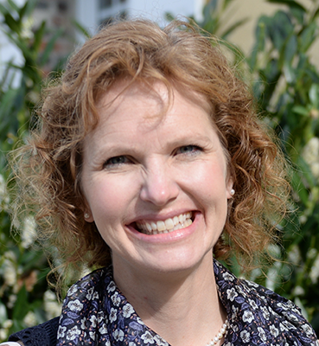
Gait Force Assessment and Analysis
Dr. Sandra Shefelbine
Professor, Mechanical and Industrial Engineering
Professor, Bioengineering
Ananya Katyal
Young Scholar
Lexington High School
Thanks to Philip Huang, Ria Rao, Lindsey Young, Vineel Kondiboya, and Soha Ben Tahar
Max Bean-Tierney
Young Scholar
Boston College High School
Notes:
Introduce names
Lab
Project

Slide 2
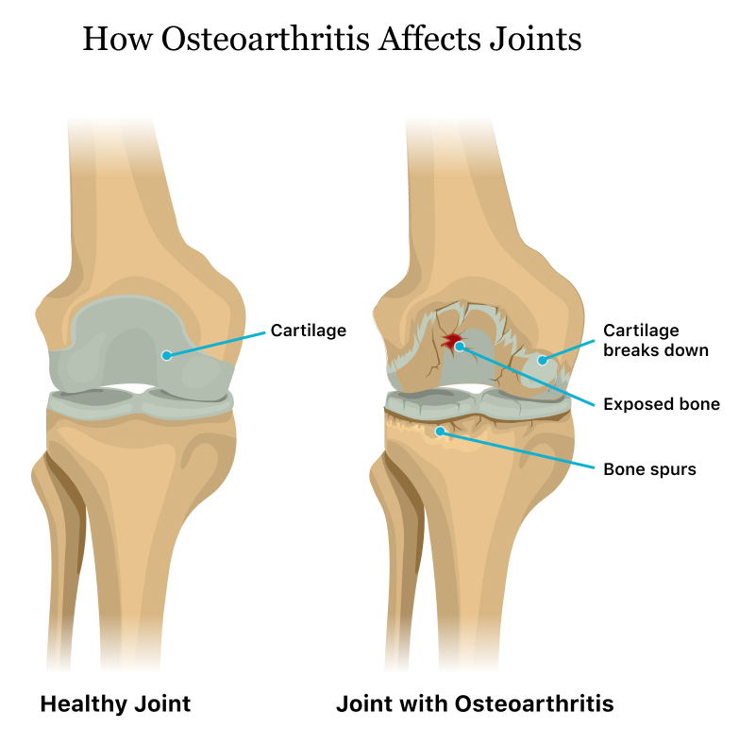
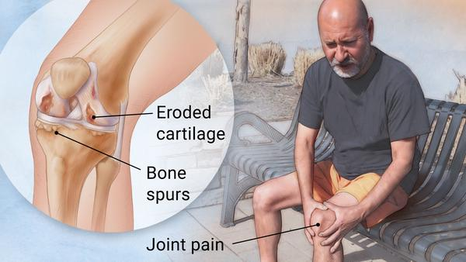
Osteoarthritis (OA)
Degenerative joint disease
“Wear and tear”
Osteoarthritis: Symptoms & Causes - Mayo Clinic, 2021
Osteoarthritis: Symptoms, Complications & Treatment, 2020
Gait Force Assessment and Analysis NEU Young Scholars Program 2023 - August 3, 2023

Slide 3
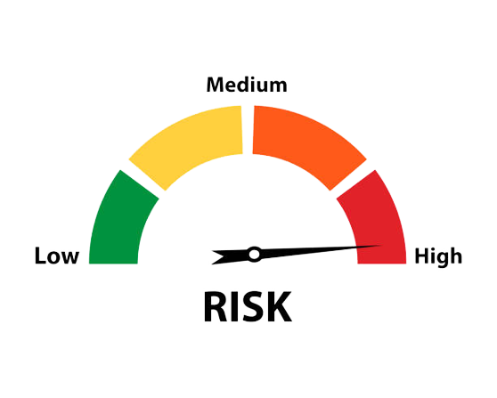
30+ Million Adults
1 in 5 Civilians
40% inactive
1 in 3 Veterans
$2017 in medical costs
Gait Force Assessment and Analysis NEU Young Scholars Program 2023 - August 3, 2023
Gait Force Assessment and Analysis NEU Young Scholars Program 2023 - August 3, 2023
Notes:
Osteoarthritis (OA) is the most frequent cause of disability in the United States

Slide 4
Control Group
A1: normally
A2: normally
Test Group
A1: normally
A2: softly
Why Gait Modification?
Slow progression
Reduce pain
Improve joint function
Non-invasive
Hypothesis
Walking softly will reduce knee joint load.
Gait Force Assessment and Analysis NEU Young Scholars Program 2023 - August 3, 2023
Gait Force Assessment and Analysis NEU Young Scholars Program 2023 - August 3, 2023
Notes:
As mentioned earlier, for people with OA, cartilage wears down and that causes bones to rub together
But it’s important to note that the cartilage doesn’t usually wear away at the whole joint, but at just one of 3 compartments
As you can see in this picture, the 3 compartments are medial, lateral, and patellofemoral
But the two that are relevant to

Slide 5
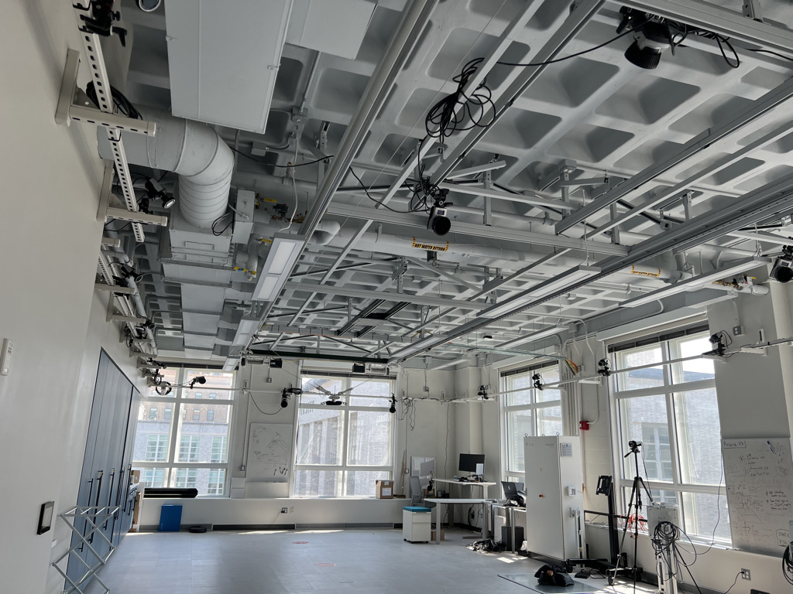
Data Collection
Gait Force Assessment and Analysis NEU Young Scholars Program 2023 - August 3, 2023
Gait Force Assessment and Analysis NEU Young Scholars Program 2023 - August 3, 2023

Slide 6
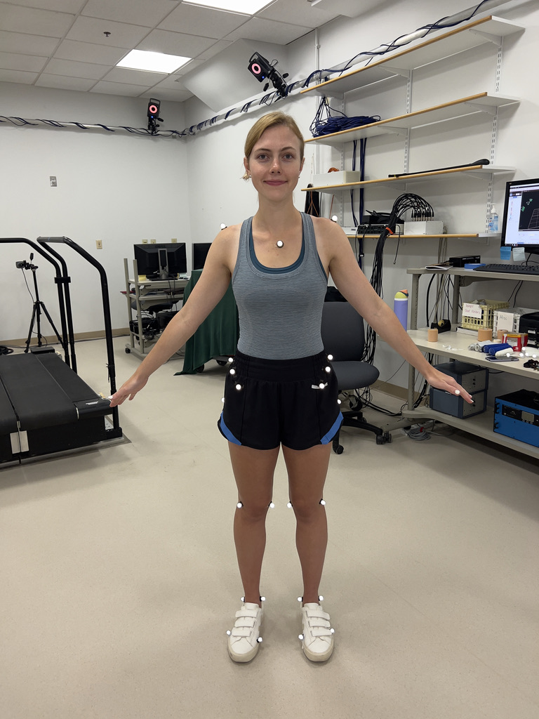
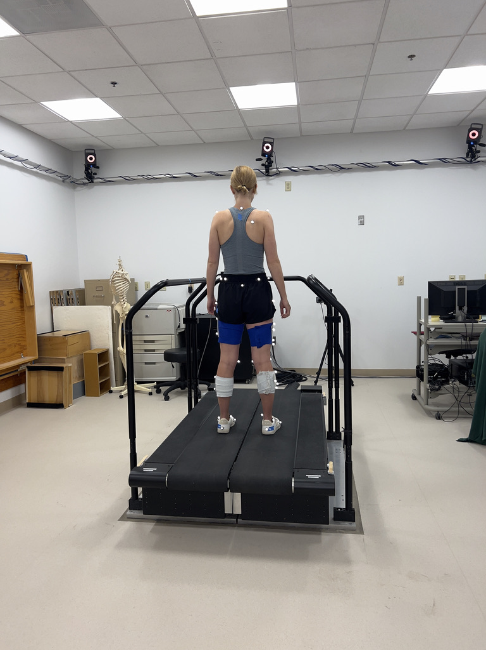
Gait Force Assessment and Analysis NEU Young Scholars Program 2023 - August 3, 2023
Gait Force Assessment and Analysis NEU Young Scholars Program 2023 - August 3, 2023

Slide 7
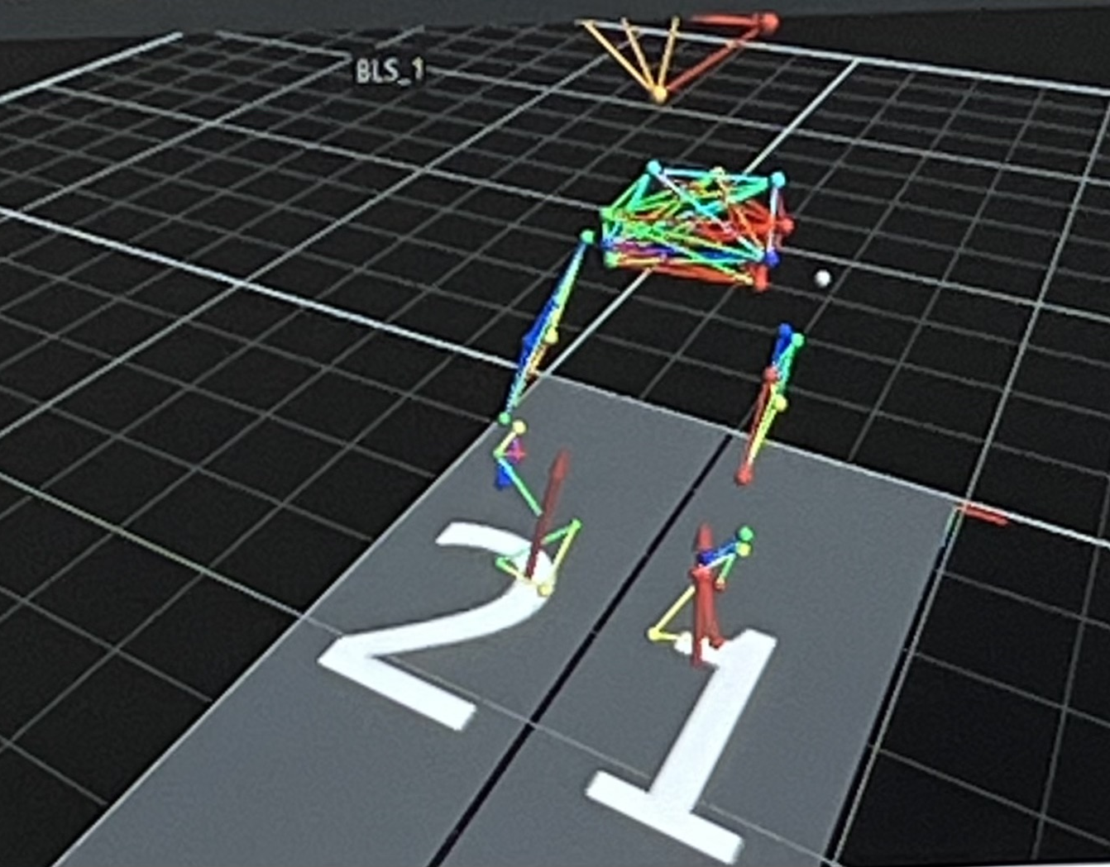
What muscles have to contract to make the body move like that?
Gait Force Assessment and Analysis NEU Young Scholars Program 2023 - August 3, 2023
Gait Force Assessment and Analysis NEU Young Scholars Program 2023 - August 3, 2023

Slide 8
Gait Force Assessment and Analysis NEU Young Scholars Program 2023 - August 3, 2023
Gait Force Assessment and Analysis NEU Young Scholars Program 2023 - August 3, 2023

Slide 9
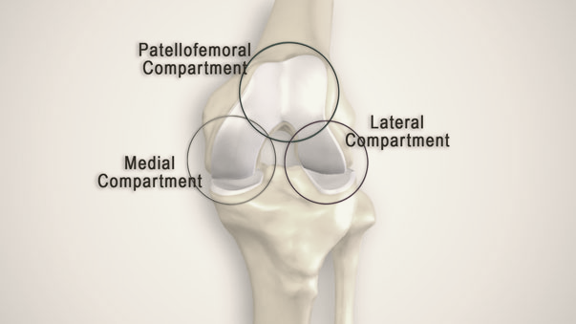
9
Cartilage wears down
Bones rub together
Gait Force Assessment and Analysis NEU Young Scholars Program 2023 - August 3, 2023

Slide 10
22 subjects 2 assessments 2 sides 5 trials 120,000 force measurements 52,800,000 data points
Gait Force Assessment and Analysis NEU Young Scholars Program 2023 - August 3, 2023
Gait Force Assessment and Analysis NEU Young Scholars Program 2023 - August 3, 2023

Slide 11
Automation
Input
Data folder
List of Participants
Compute
Process raw data
Statistical Analysis
Generate
Plot data
Store figures
Gait Force Assessment and Analysis NEU Young Scholars Program 2023 - August 3, 2023
Gait Force Assessment and Analysis NEU Young Scholars Program 2023 - August 3, 2023

Slide 12
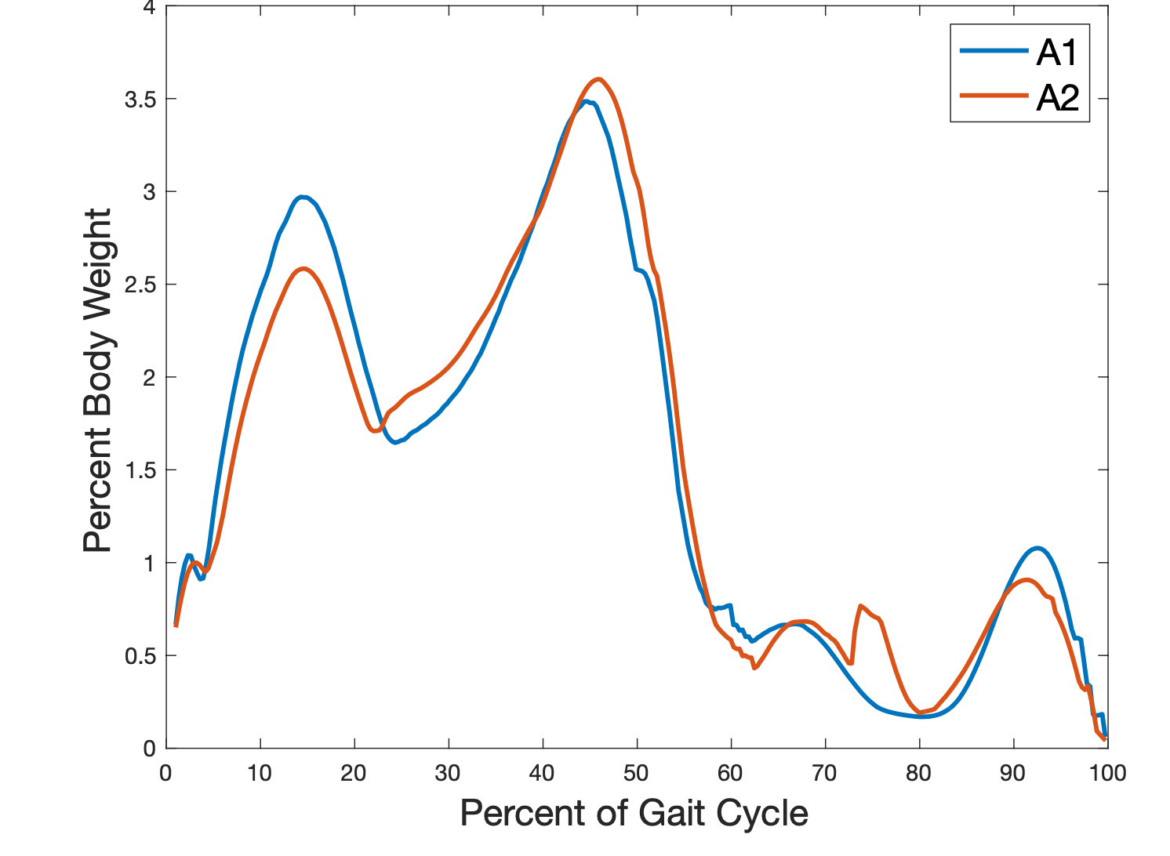
Total Joint Force
Left
Right
Gait Force Assessment and Analysis NEU Young Scholars Program 2023 - August 3, 2023
Gait Force Assessment and Analysis NEU Young Scholars Program 2023 - August 3, 2023

Slide 13
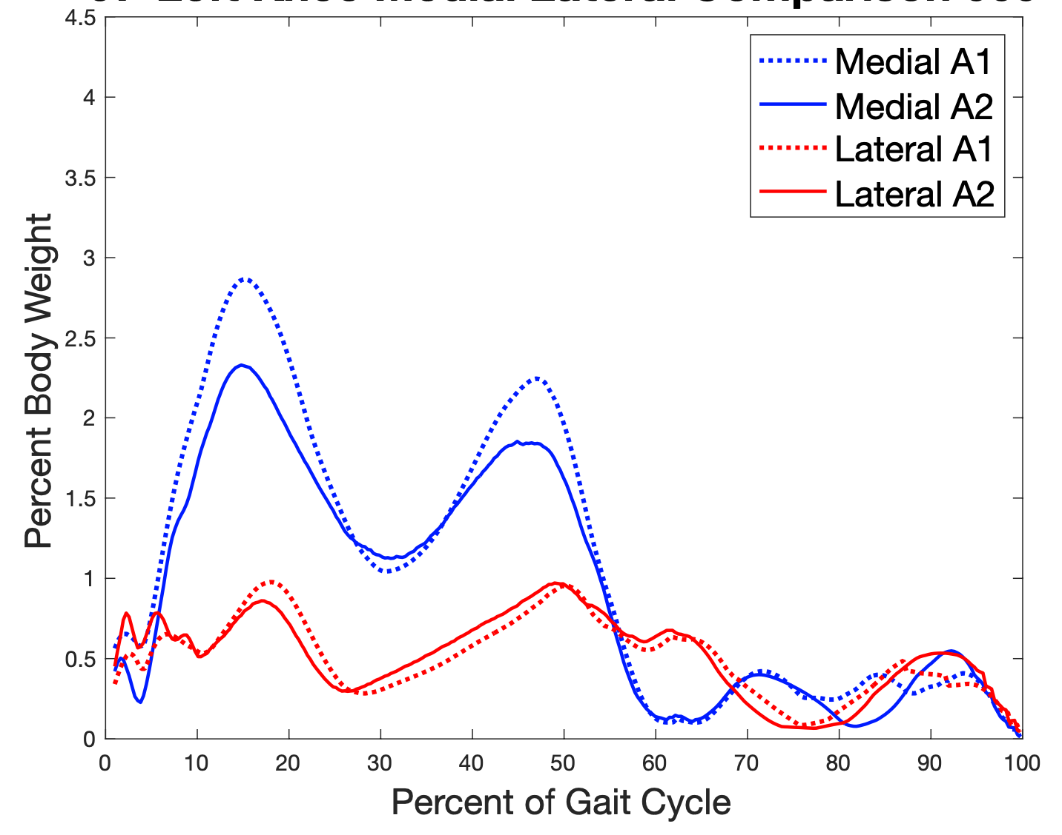
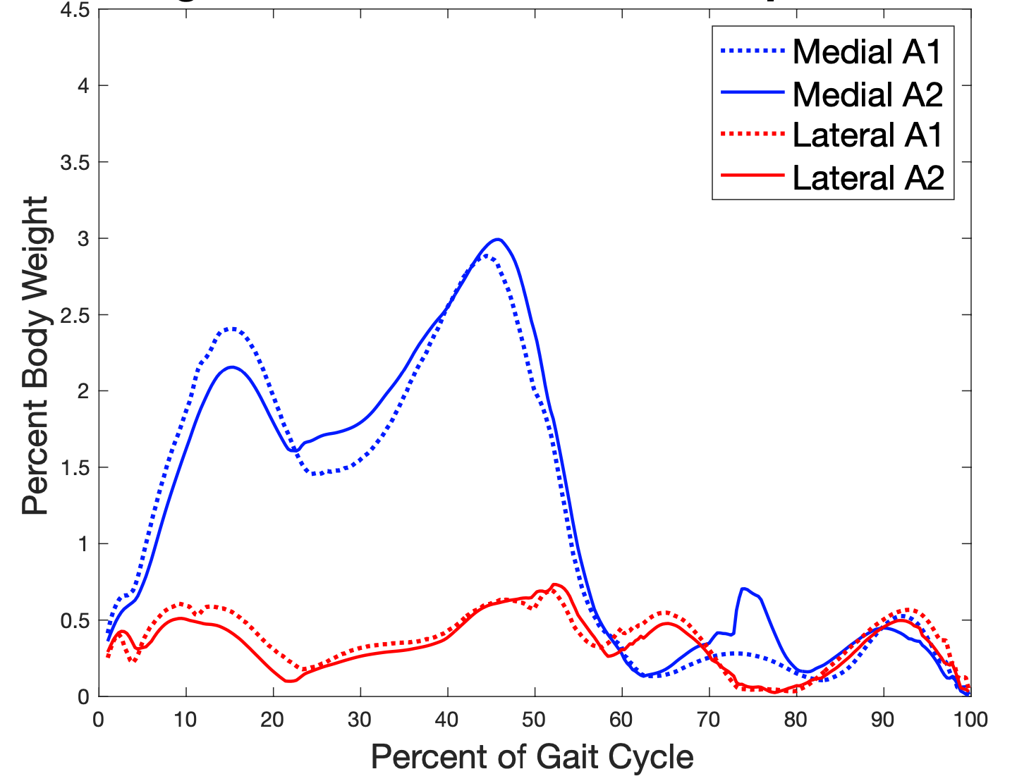
Medial-Lateral Comparison
Left
Right
Gait Force Assessment and Analysis NEU Young Scholars Program 2023 - August 3, 2023
Gait Force Assessment and Analysis NEU Young Scholars Program 2023 - August 3, 2023

Slide 14
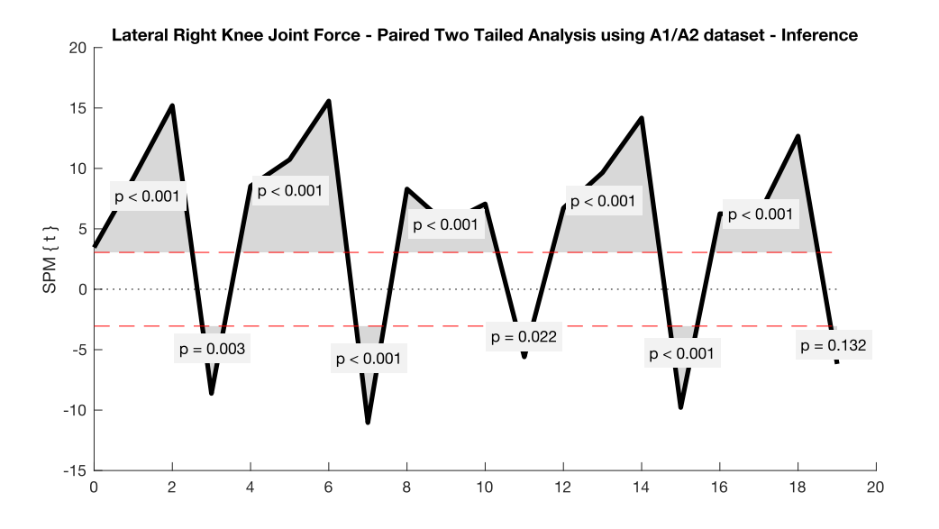
Statistical Significance
Two-sampled t-test compares 2 sets of data
P-value <0.05 means data is consistent >95% of the time
😄
☹️
Gait Force Assessment and Analysis NEU Young Scholars Program 2023 - August 3, 2023
Gait Force Assessment and Analysis NEU Young Scholars Program 2023 - August 3, 2023

Slide 15
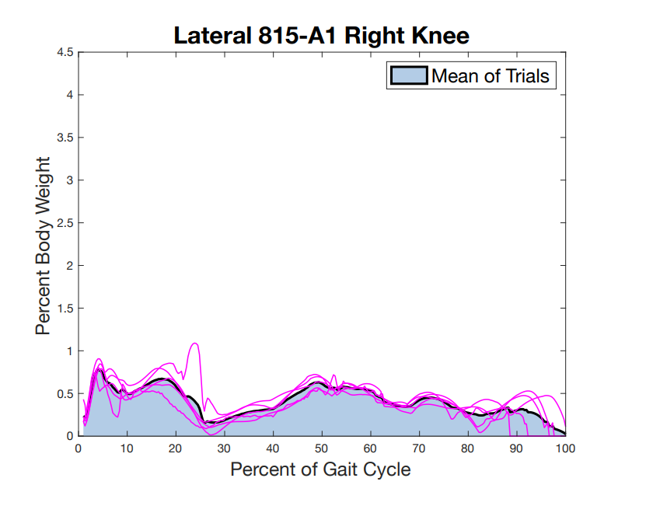
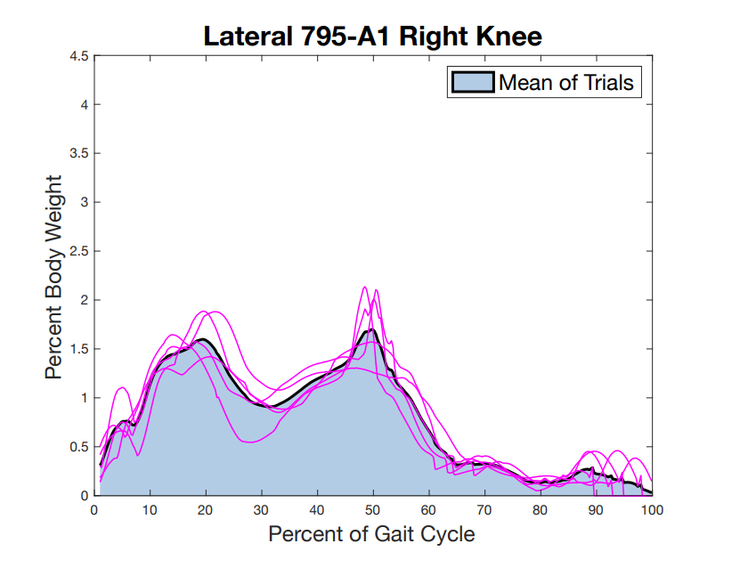
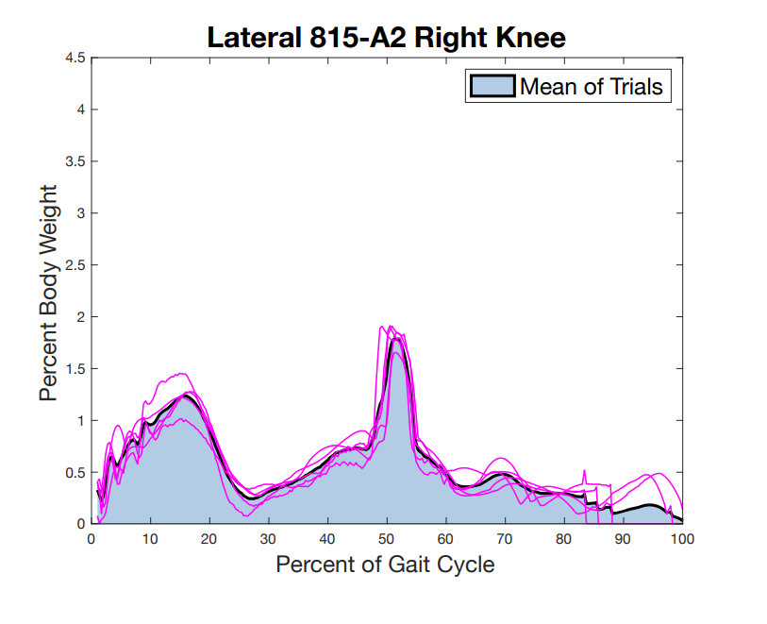
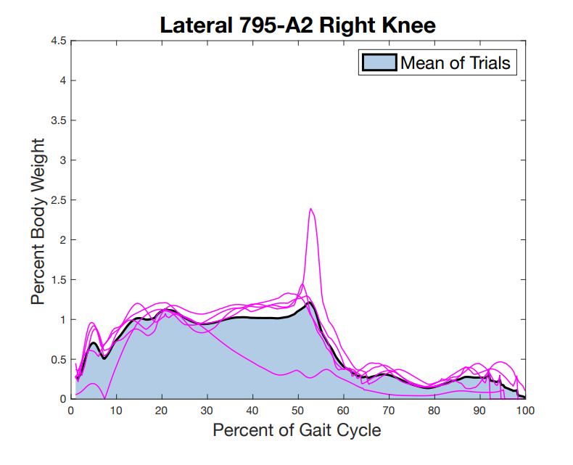
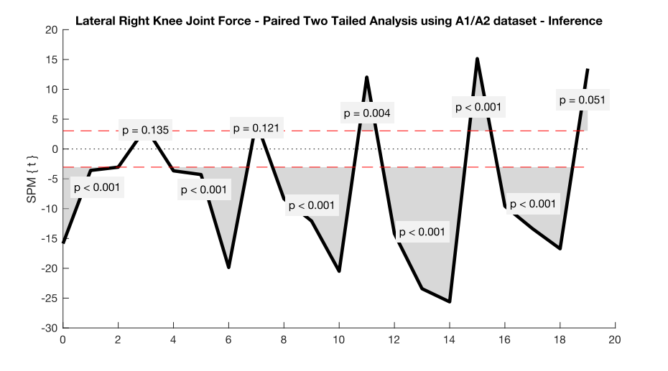
Conclusions
Control
Test
Results in the test group were varied and could not confirm hypothesis
Control group demonstrated behavior similar to the test group
Gait Force Assessment and Analysis NEU Young Scholars Program 2023 - August 3, 2023

Slide 16
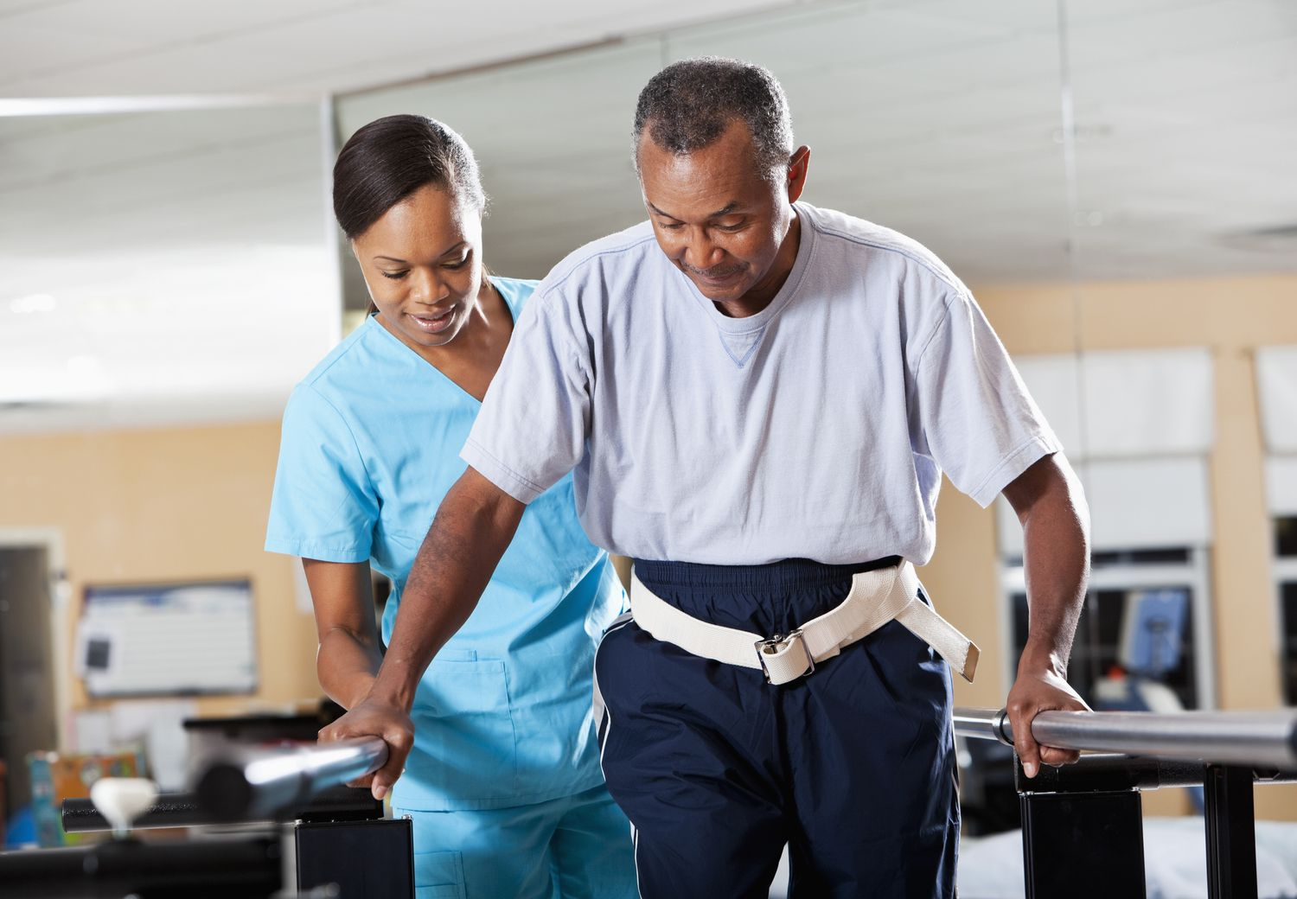
Next Steps
Further examination of statistical analysis figures
Apply physiological understanding
Verbal cues in physical therapy
Drug development, cures
Gait Force Assessment and Analysis NEU Young Scholars Program 2023 - August 3, 2023

Slide 17
Acknowledgements
Shefelbine Lab
Dr. Sandra Shefelbine
Vineel Kondiboya
Soha Ben Tahar
Lindsey Young
Stefanik Lab
Philip Huang
Lewis Lab (BU)
Ria Rao
Zoe Perkins
Avery Kratzer
Center for STEM Education
Claire Duggan, Executive Director
Jennifer Love, Associate Director
Claire Stipp and Yassine Souabny, YSP Coordinators
Nicolas Fuchs, Program Manager
Mary Howley, Administrative Officer
Gait Force Assessment and Analysis NEU Young Scholars Program 2023 - August 3, 2023
Gait Force Assessment and Analysis NEU Young Scholars Program 2023 - August 3, 2023

Slide 18
References
Osteoarthritis-Osteoarthritis - Symptoms & causes - Mayo Clinic. (2021). Mayo Clinic. https://www.mayoclinic.org/diseases-conditions/osteoarthritis/symptoms-causes/syc-20351925
Osteoarthritis | Symptoms, Complications & Treatment. (2020). Drugwatch.com. https://www.drugwatch.com/health/arthritis/osteoarthritis/
Cui, A., Li, H., Wang, D., Zhong, J., Chen, Y., & Lu, H. (2020). Global, regional prevalence, incidence and risk factors of knee osteoarthritis in population-based studies. 29-30, 100587–100587. https://doi.org/10.1016/j.eclinm.2020.100587
Osteoarthritis: A Troubling Picture - Osteoarthritis Action Alliance. (2022, August 11). Osteoarthritis Action Alliance. https://oaaction.unc.edu/policy/osteoarthritis-a-troubling-picture/
Connor, J. O. (2016). Modelling muscle activation during gait - OpenSim [YouTube Video]. In YouTube. https://www.youtube.com/watch?v=EXff_dSM1-A
News-Medical. (2020, March 30). Digital Pathologies Use in Drug Development. News-Medical.net. https://www.news-medical.net/life-sciences/Digital-Pathologies-Use-in-Drug-
Development.aspxhttps://www.facebook.com/verywell. (2020). Problems with Gait or Walking? Your PT Can Help. Verywell Health. https://www.verywellhealth.com/gait-training-in-physical-therapy-5069884
Gait Force Assessment and Analysis NEU Young Scholars Program 2023 - August 3, 2023
Gait Force Assessment and Analysis NEU Young Scholars Program 2023 - August 3, 2023

