Slide 1
Investigating the Impact of Self-Help Groups on Treatment Completion for Adolescents
Angel Le, YSP Student - Randolph High School
Mateo Ashton Jaramillo, YSP Student - Newton North High School
Sahil Shikalgar, Decision Analytics Lab - Northeastern University
Prof. Noor E Alam, Decision Analytics Lab - Northeastern University

Slide 2
Abstract
Motivation:
The Opioid epidemic remains a pressing healthcare crisis in the USA, with a staggering number of overdose-related deaths -over 90%- involving opioids.
The majority of adolescents aren't receiving the care necessary to recover from opioid abuse.
Objective:
Study the effectiveness of participation in self-help groups for Opioid Use Disorder (OUD) treatment completion in adolescents.
Results:
Participation in self-help groups has a positive causal relation with treatment completion in adolescents.
Healthcare Analytics
NEU Young Scholars Program 2023 - August 3, 2023
Notes:
Opioids = Bad (LOL)
Treatment = good
But how good pill?
But how good therapy?
How good both?
result.

Slide 3
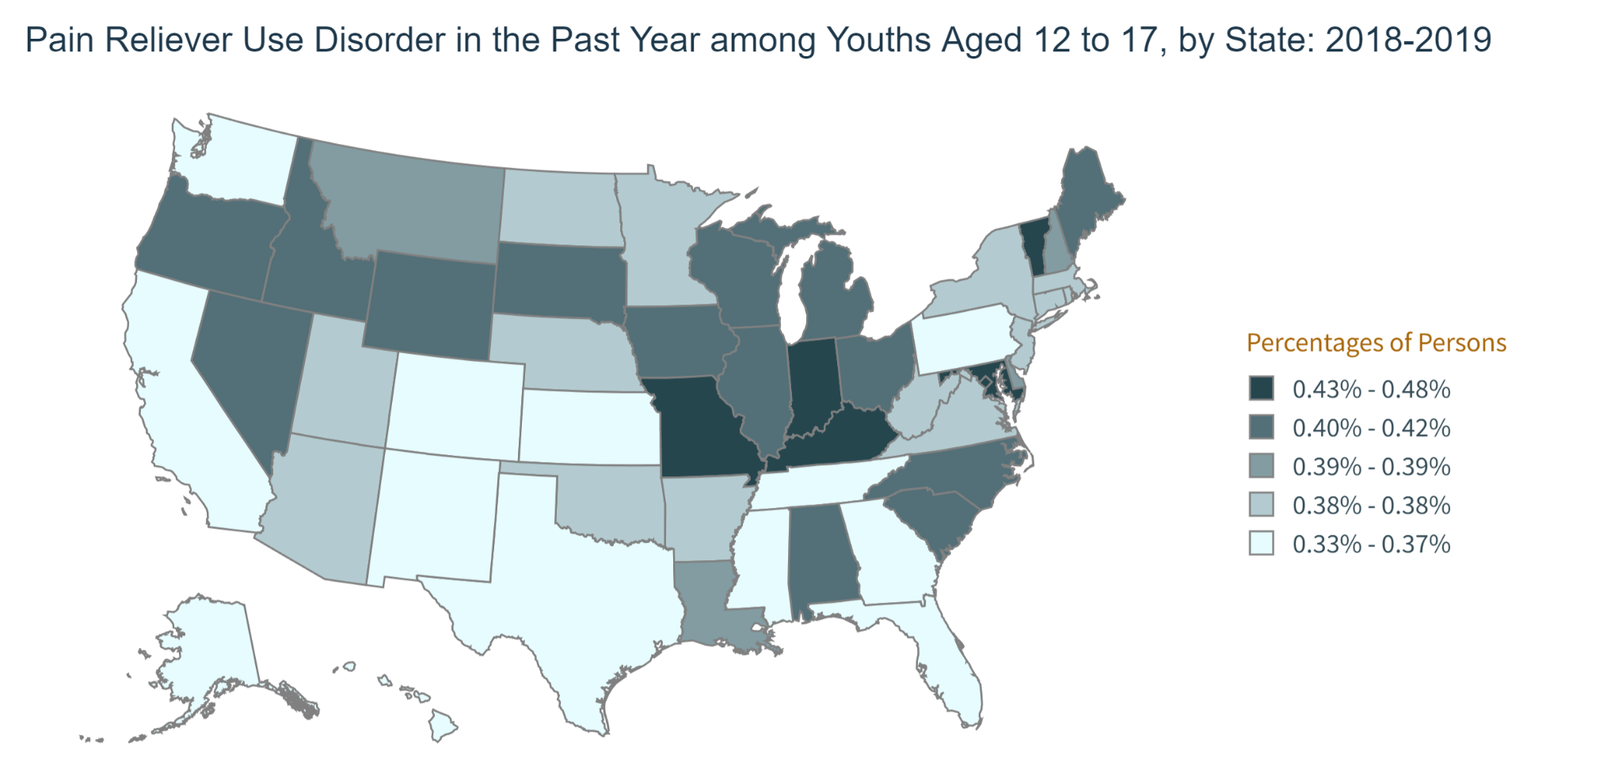
Background - OUD
Opioid Use Disorder (OUD) in America
The OUD epidemic has been rising since 1999 for all ages.
A high percentage of Adolescents use Opioids countrywide as shown on the right.
Overlooking younger patients
Deaths from overdose increased 94% from 2019 to 2020 in 14-18 -year-olds.
Admissions for OUD treatment in adolescents decreased by 63% from 2008-2017.
Project Title
NEU Young Scholars Program 2023 - August 3, 2023
Healthcare Analytics
NEU Young Scholars Program 2023 - August 3, 2023
Healthcare Analytics
NEU Young Scholars Program 2023 - August 3, 2023
Notes:
National overdose deaths involving any opioid number among all ages by gender 1999-2021

Slide 4
Background - The Data Set
Treatment Episode Data Set: Discharges (TEDS-D) A data set within the Substance Abuse and Mental Health Services Administration (SAMHSA) contains annual discharges from substance use treatment facilities across the US. Discharge data from 2015-2019 was used to assess the effectiveness of treatment.
Data We Considered Within TEDS-D Adolescents of ages 12-17 Patients who were admitted with Opioids as their primary substance of abuse Patient has no missing data
Project Title
NEU Young Scholars Program 2023 - August 3, 2023
Healthcare Analytics
NEU Young Scholars Program 2023 - August 3, 2023
Healthcare Analytics
NEU Young Scholars Program 2023 - August 3, 2023
Notes:
We didn’t use covid data bc blah blah, teds d has patient discharge data. :)

Slide 5
Definition of Treatments Administered
Treatments:
Self Help Groups: includes attendance at Alcoholics Anonymous (AA), Narcotics Anonymous (NA), and other self-help/mutual support groups focused on recovery from substance use and dependence
Treatment Outcome :
Treatment completed (1): All parts of treatment plan or program were completed
Treatment not completed (0): Dropped out of treatment or terminated by facility
*The code categorized these two variables as either 1 or 0
Project Title
NEU Young Scholars Program 2023 - August 3, 2023
Healthcare Analytics
NEU Young Scholars Program 2023 - August 3, 2023
Healthcare Analytics
NEU Young Scholars Program 2023 - August 3, 2023
Notes:
Refer to sahil’s slides.

Slide 6
Workflow Chart
Clean data from SAMHSA
Filter out insignificant variables through chi-squared-testing
Calculate Average Treatment Effects with PSM to make causal conclusions
Compile demographics and visualize data
Used logistic regression and Outcome Adaptive Elastic Net to select for confounders
Project Title
NEU Young Scholars Program 2023 - August 3, 2023
Healthcare Analytics
NEU Young Scholars Program 2023 - August 3, 2023
Healthcare Analytics
NEU Young Scholars Program 2023 - August 3, 2023
Notes:
prevePropensity score matching

Slide 7
Step 1 - Data Cleaning
Via SAMHSA’s website, the TEDS-D Codebook was obtained for analysis.
Using python, data that was unrelated to the investigation (ex: People not suffering from OUD, >18…) was removed.
Additionally, variables with more than 20% of values missing and any patient with any information missing were removed.
Project Title
NEU Young Scholars Program 2023 - August 3, 2023
Healthcare Analytics
NEU Young Scholars Program 2023 - August 3, 2023
Healthcare Analytics
NEU Young Scholars Program 2023 - August 3, 2023
Notes:
Gathered and cleaned data via the steps above
Treatment Episode Data Set: Discharges

Slide 8
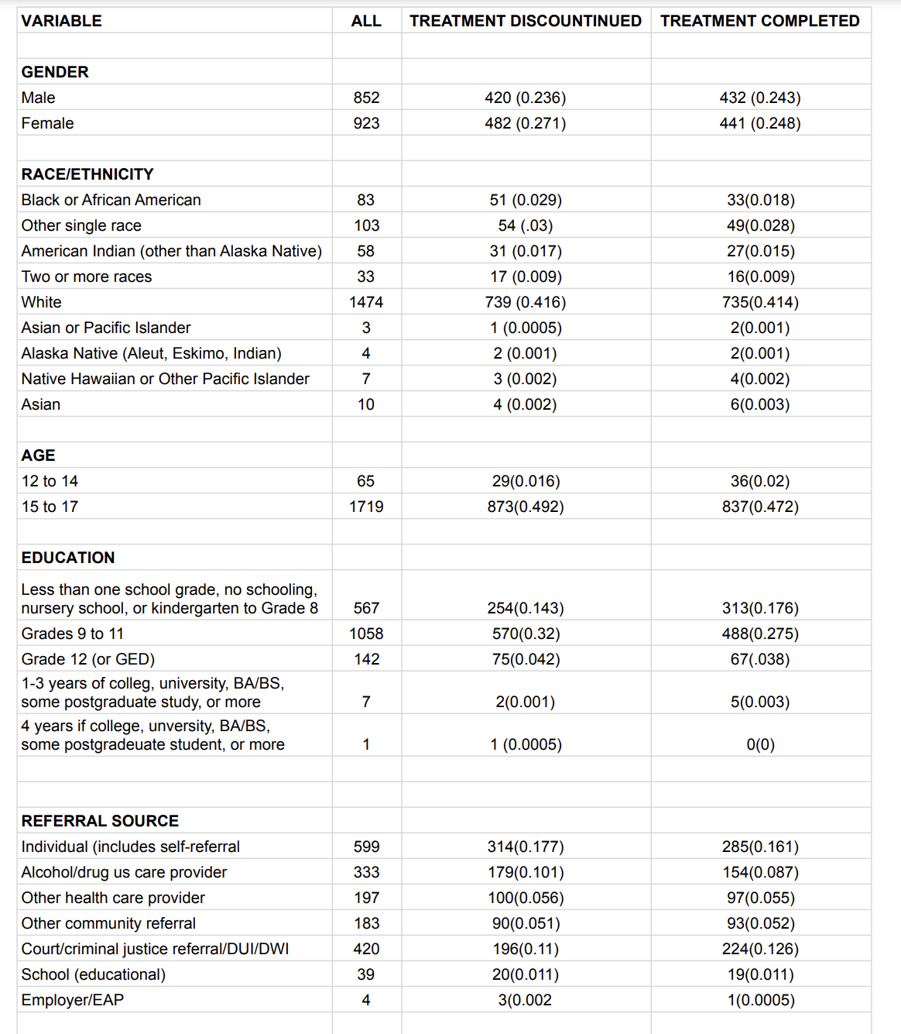
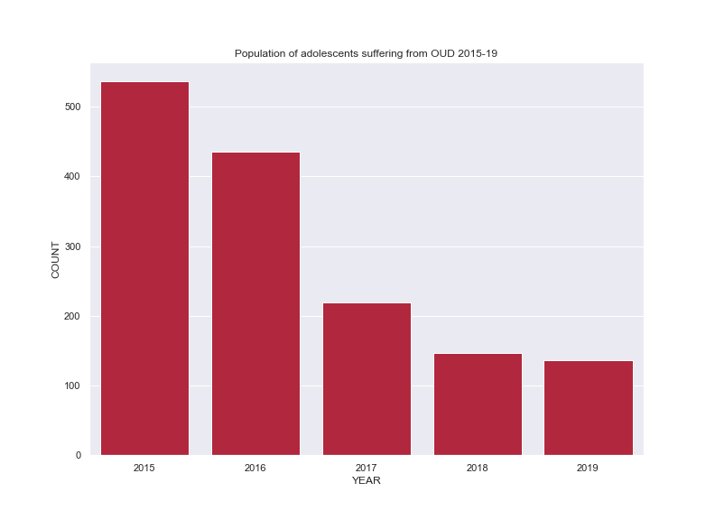
Step 2 - Visualizing Data
Project Title
NEU Young Scholars Program 2023 - August 3, 2023
Healthcare Analytics
NEU Young Scholars Program 2023 - August 3, 2023
Healthcare Analytics
NEU Young Scholars Program 2023 - August 3, 2023
Notes:
Demographics chart:
We produced a demographic charts to see the different populations of people in our data
Note that we do have a limited population size of only 1,476 people in total

Slide 9
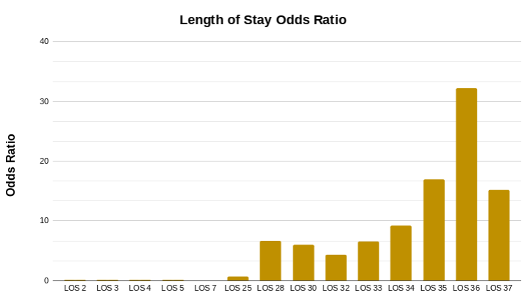
Step 3 - Tests & Models
Chi-Squared Testing: Found 16 statistically significant variables from the original 55 Significant variables included: education, services, LOS, Living Arrangements, etc. | Logistic Regression: Calculate the odds ratio (OR) for the variables Notable variables were Division 15 with an OR of 15.618 and Heroin with an OR of 0.17 | Outcome Adaptive Elastic Net (OAENET): Identified confounding variables for self-help group participation and treatment completion Confounders: Education and Services
Project Title
NEU Young Scholars Program 2023 - August 3, 2023
Healthcare Analytics
NEU Young Scholars Program 2023 - August 3, 2023
Healthcare Analytics
NEU Young Scholars Program 2023 - August 3, 2023
Notes:
Through written code, we used these tests and models to make interpretations of our data. There are mathematical equations to execute what we did by hand, but on the scale of information that we worked on, descriptive statistics
Division 15 is east south central US (alabama, kentucky, mississippi, tennessee), so geographics matter too.

Slide 10
Results & Discussion
Logistic regression model show that Census Division, Length Of Stay in Treatment, and Living Arrangement are strong predictors of treatment completion
We selected confounders using Outcome Adaptive Elastic Net and used propensity score based Nearest Neighbor matching technique, which provided ATT = 0.135
The result suggests that involvement in self-help groups can lead to a considerable 13.5% improvement in treatment completion rates
Our study provides valuable insights for healthcare policymakers to take necessary action to promote the utilization of self-help groups for OUD patients
Project Title
NEU Young Scholars Program 2023 - August 3, 2023
Healthcare Analytics
NEU Young Scholars Program 2023 - August 3, 2023
Healthcare Analytics
NEU Young Scholars Program 2023 - August 3, 2023

Slide 11
Limitations and Future
Limitations of dataset:
This is a preliminary causal study, which is limited by a small dataset which could impact the results
There is a lack of knowledge on the severity of OUD condition of the patient
Unknown confounders outside of observable data can skew our results
Future:
Future research can focus on the effectiveness of medication and self-help groups in holistic treatment plans
Healthcare Analytics 11
NEU Young Scholars Program 2023 - August 3, 2023
Notes:
Exclude data the came from covid years since they are an exception to our data.
Unknown Confounders… are unknown! We don’t know what they are so the conclusions should be taken with a grain of salt.
The young patient’s parent using opioids could be an unobservable confounder due to the nature of the fact the adolescent might have easier access to opioids.

Slide 12
Works Cited
Borodovsky, J. T., Levy, S., Fishman, M., & Marsch, L. A. (2018). Retrieved from https://www.ncbi.nlm.nih.gov/pmc/articles/PMC5970018/#R119
Fortuna, R. J., Levy, S., Han, B., & Woody, G. E. (2017). Medication-assisted treatment for adolescents in specialty treatment for opioid use disorder. Retrieved from https://www.sciencedirect.com/science/article/pii/S1054139X17300228
Drug overdose deaths among persons aged 10–19 years — United States ... (n.d.). https://www.cdc.gov/mmwr/volumes/71/wr/pdfs/mm7150a2-H.pdf
2019 TEDS-D codebook - substance abuse and mental health services ... (n.d.-a). https://www.datafiles.samhsa.gov/sites/default/files/field-uploads-protected/studies/TEDS-D-2019/TEDS-D-2019-datasets/TEDS-D-2019-DS0001/TEDS-D-2019-DS0001-info/TEDS-D-2019-DS0001-info-codebook.pdf
Project Title
NEU Young Scholars Program 2023 - August 3, 2023
Healthcare Analytics
NEU Young Scholars Program 2023 - August 3, 2023
Healthcare Analytics
NEU Young Scholars Program 2023 - August 3, 2023
Notes:
Um alam’s paper

Slide 13
Acknowledgement
LAB
Prof. Noor E Alam, Industrial Engineering, Northeastern University
Sahil Shikalgar, Industrial Engineering, Northeastern University
Sining Chai, Industrial Engineering, Northeastern University
Center for STEM Education​
Claire Duggan, Executive Director
Jennifer Love, Associate Director
Claire Stipp & Yassine Souabny, YSP Coordinators​
Nicolas Fuchs, Project Implementation Coordinator​
Mary Howley,Administrative Officer
Project Title
NEU Young Scholars Program 2023 - August 3, 2023
Healthcare Analytics
NEU Young Scholars Program 2023 - August 3, 2023
Healthcare Analytics
NEU Young Scholars Program 2023 - August 3, 2023
Notes:
Refer to sahil’s slides.

Slide 14
Put poster here. 0-0

Slide 15
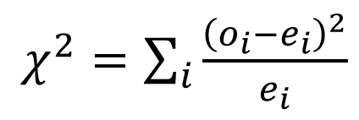
Statistical Methodology Used
Chi-Squared Testing:
Excluded variables included: Age, gender, marital status
Logistic Regression Model:
Provides the odds ratio if a patient will complete treatment based on a specific variable.
Outcome Adaptive Elastic Net (OAENet):
Determined the confounding variable for each type of treatment the patient underwent.
Treatments consisted of either Self Help Groups (SGH) or Medications for OUD.
Project Title
NEU Young Scholars Program 2023 - August 3, 2023
Healthcare Analytics
NEU Young Scholars Program 2023 - August 3, 2023
Healthcare Analytics
NEU Young Scholars Program 2023 - August 3, 2023
Notes:
Chi-Sq
The test evaluated which variable had a significant association with treatment completion
We took out data that was deemed insignificant to treatment completion through chi-squared testing

