Slide 1
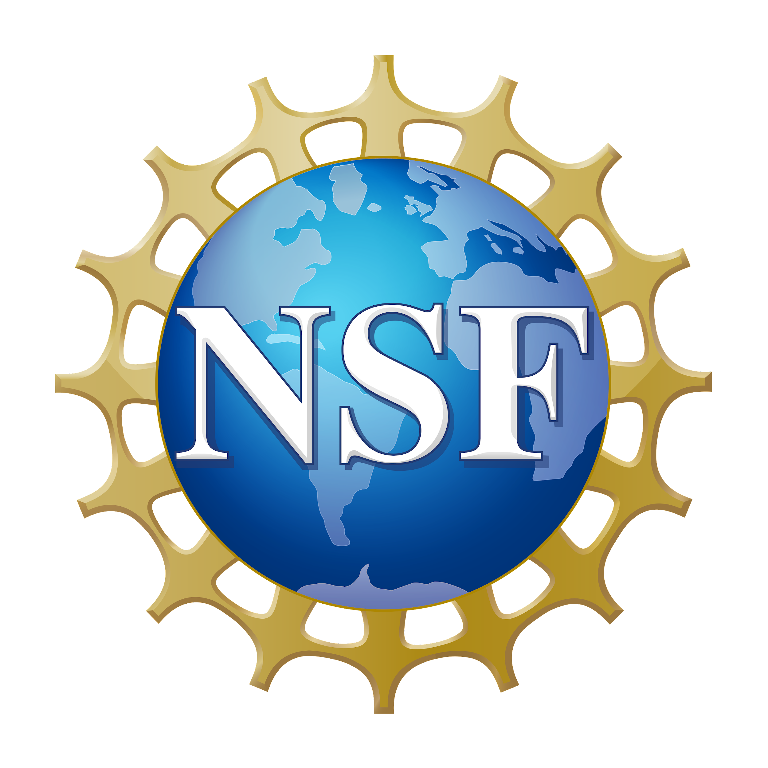
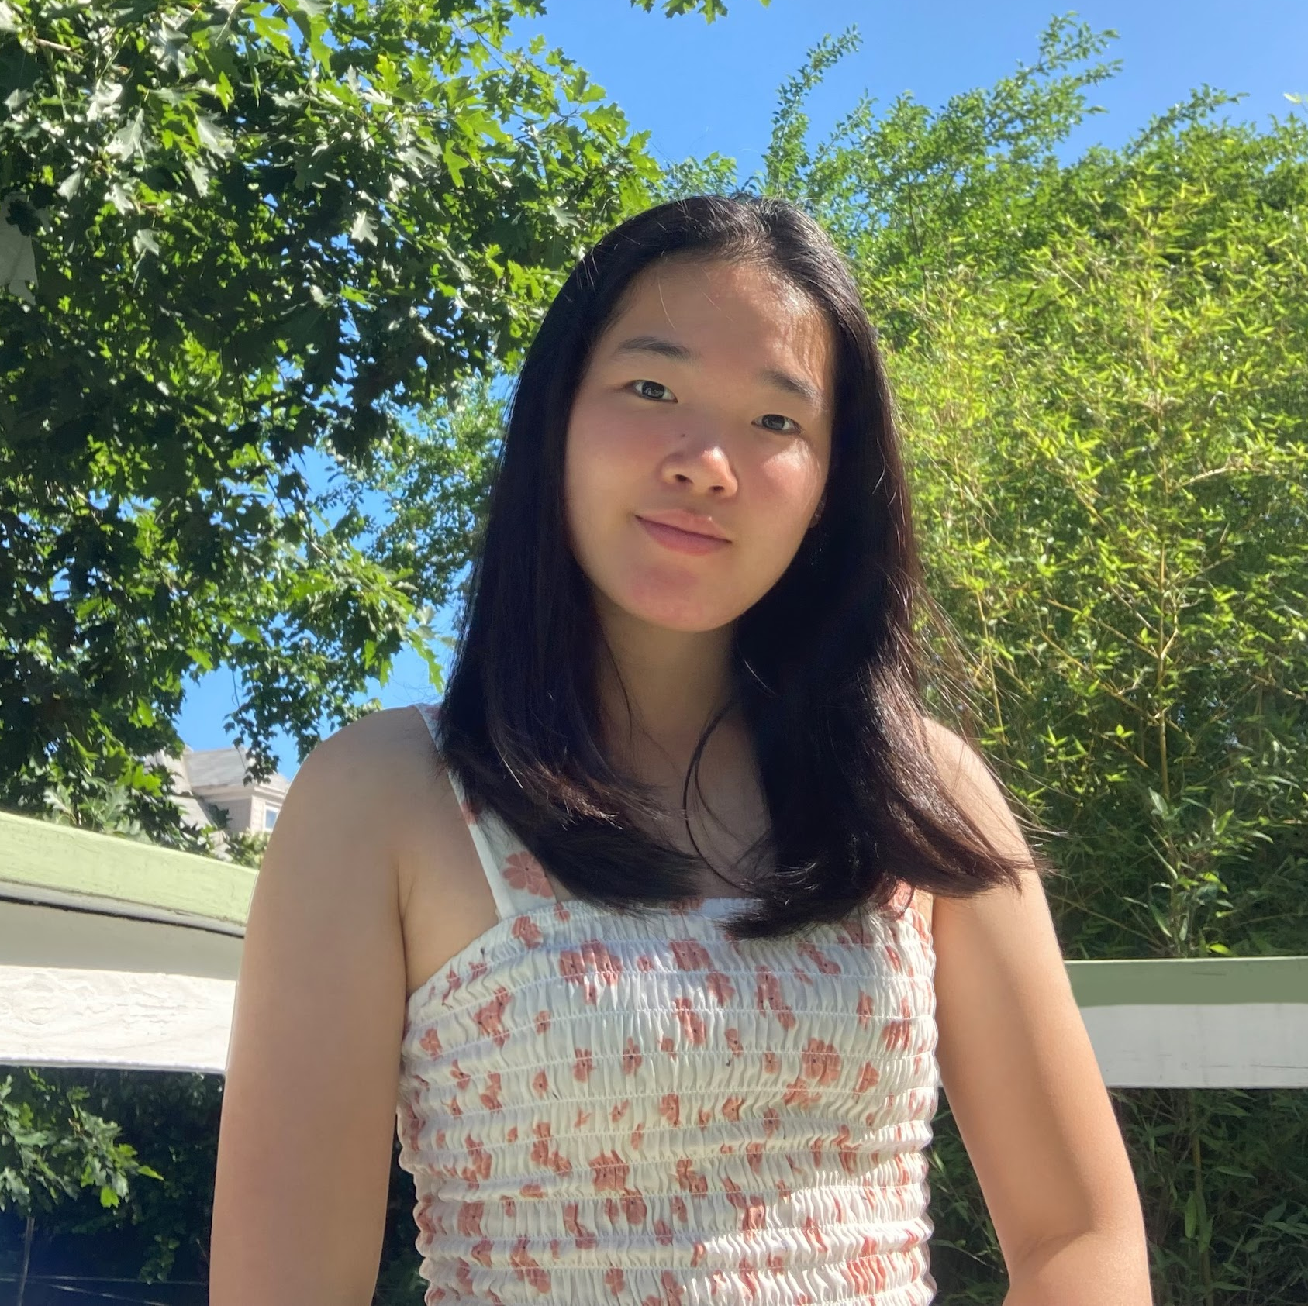
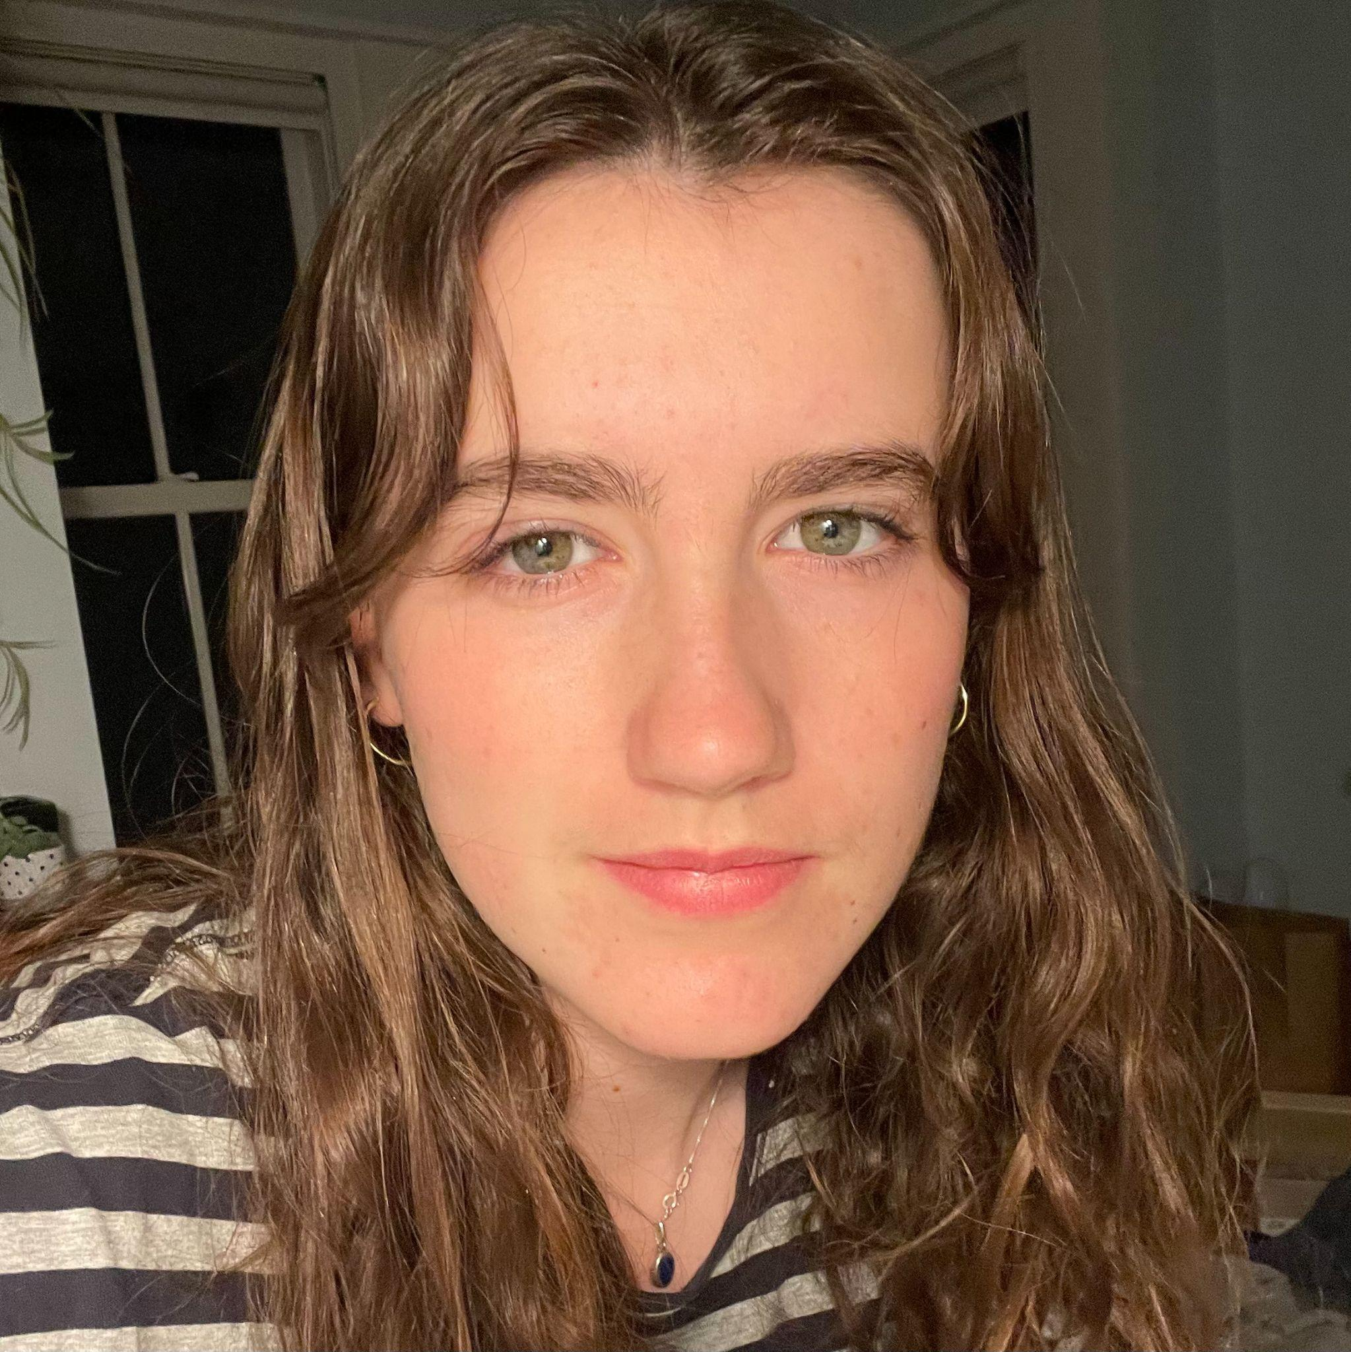
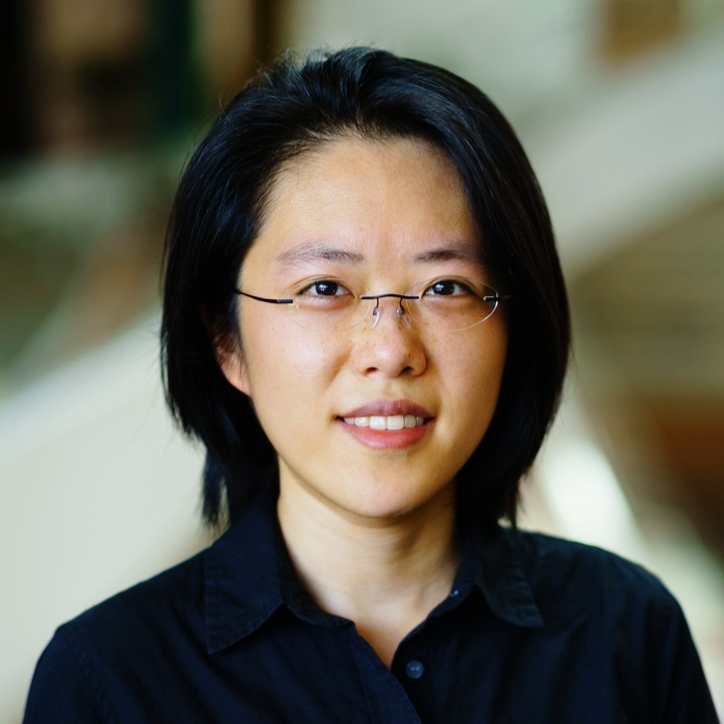
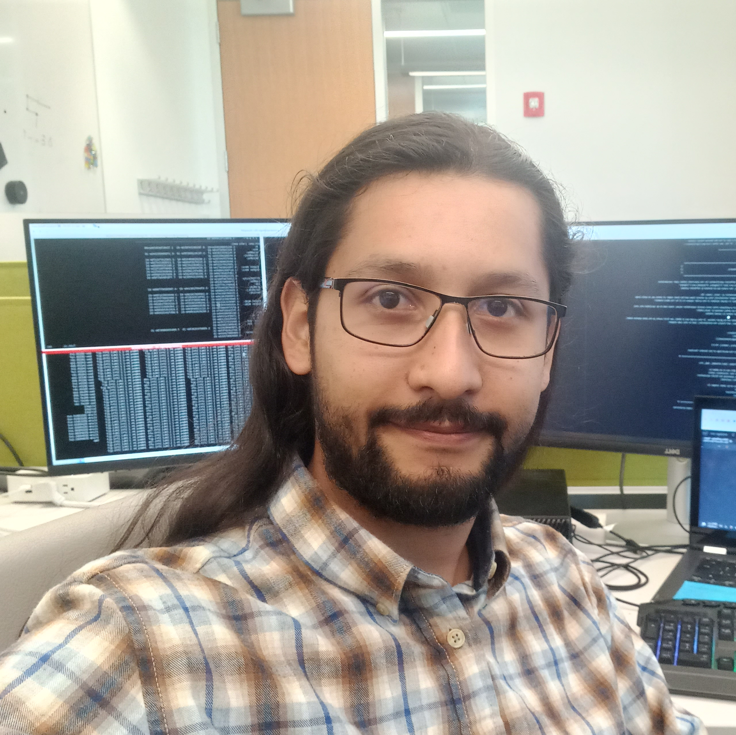
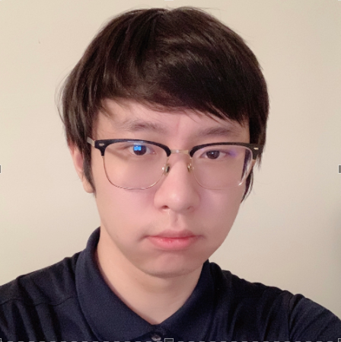
COMPUTATIONAL PHOTOENZYME DISCOVERY AND DESIGN
Julia Chen, YSP Student, North Quincy High School
Annie Stone-Peterson, YSP Student, Cambridge Rindge and Latin School
Gustavo Mondragon, Chemical Sciences, Northeastern University
Zheyu Zhang, Bioinformatics, Northeastern University
Professor Sijia Dong, Chemistry and Chemical Biology, Northeastern University

Slide 2
ABSTRACT
Personal Objectives
Determine the substrate(s) and cofactor(s) for the enzymes with the FMN (Flavin Mononucleotide) or NAD+ (Nicotinamide Adenine Dinucleotide) cofactor
Update the FMN and NAD+ Excel Spreadsheets
Create a new database for enzymes with more than one cofactor
Develop a deeper understanding of enzyme catalysis and molecular interactions
Motivation
Characteristics of enzymes have to be researched and described before biological and industrial uses
Goal is to develop a large database with enzyme structure and catalysis descriptions → create a model to predict substrates and chemical reactions of enzymes
Future applications: conduct further research on the potential photoenzymes
Results
Substrates and cofactors were determined for the enzymes with the FMN or NAD+ cofactor
Of the 662 enzymes containing the FMN cofactor, it was found that 74.2% of the enzymes had only one cofactor and 25.8% of the enzymes contained more than one cofactor.
Computational Photoenzyme Discovery and Design Northeastern University
NEU YSP Program June 26- August 3, 2023 College of Science
2

Slide 3
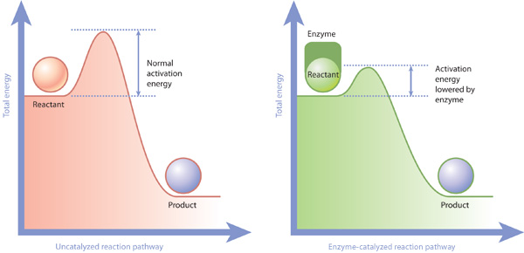
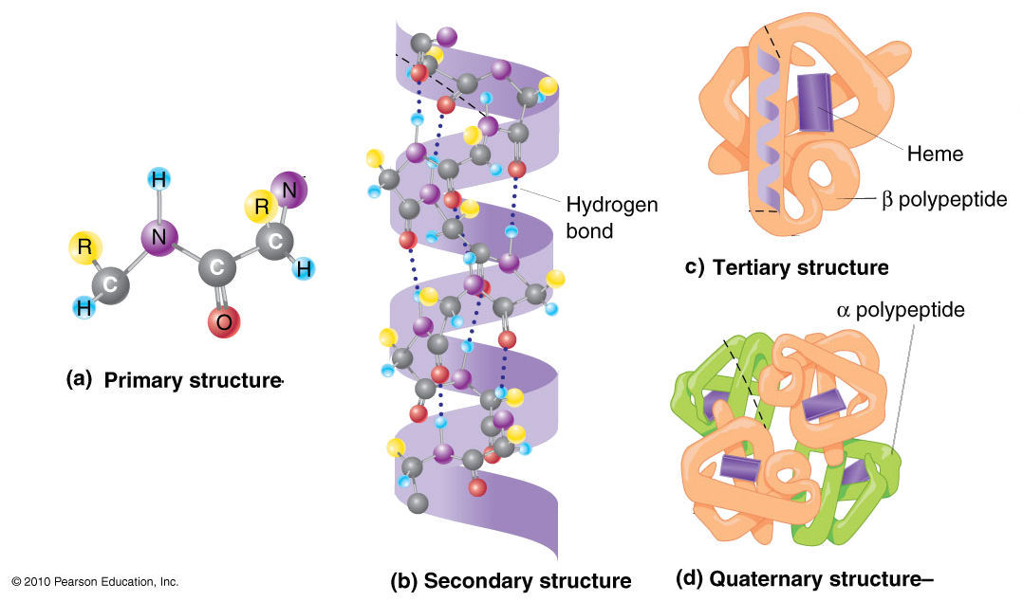
Background
Protein: large, complex macromolecules made up of amino acid residues connected by peptide bonds, creating polypeptide chains
Enzyme: proteins that function as catalysts to accelerate and regulate biochemical reactions
Lowers the activation energy by stabilizing the transition state → speeding up reaction rates
Components: substrate, active site, inhibitor
Photoenzyme: enzymes that catalyze chemical reactions under the presence of light
Computational Photoenzyme Discovery and Design Northeastern University
NEU YSP Program June 26- August 3, 2023 College of Science
3

Slide 4
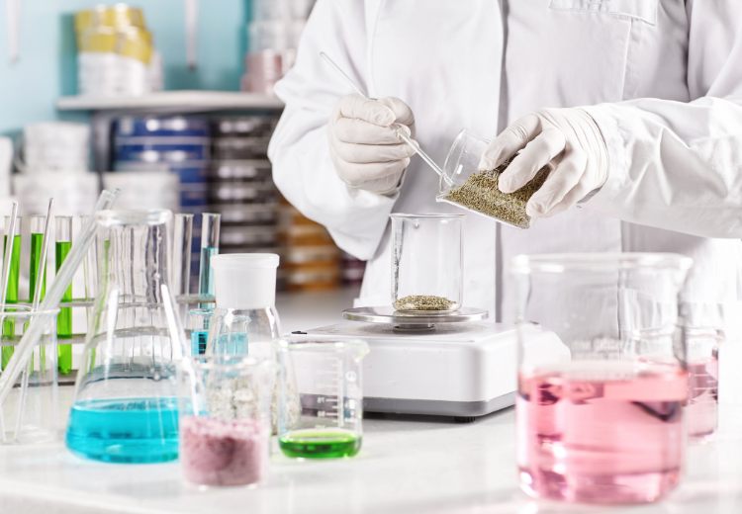
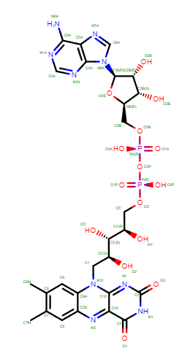
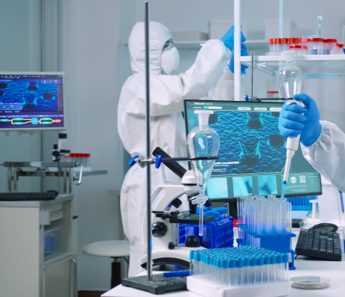
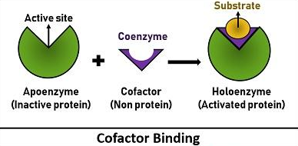
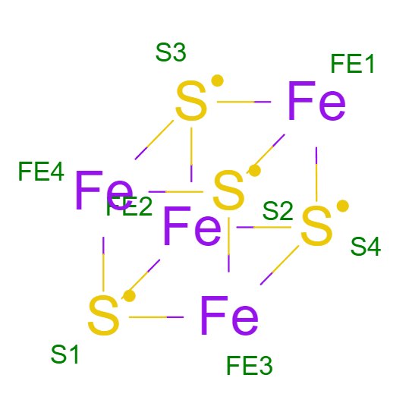
Background
Why Study Enzymes?
Biological and industrial uses: cellular metabolism, drug delivery, diagnosis of illnesses, and manufacture of medicine
Cofactor: a non-protein molecule that is required by the enzyme to perform its catalytic reaction(s)
Inorganic cofactors: metal ions (e.g., iron-sulfur clusters)
Organic cofactors: small organic molecules derived from vitamins (e.g., FAD)
FAD
SF4
Computational Photoenzyme Discovery and Design Northeastern University
NEU YSP Program June 26- August 3, 2023 College of Science
4

Slide 5
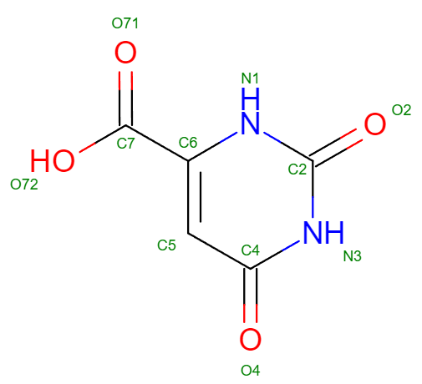
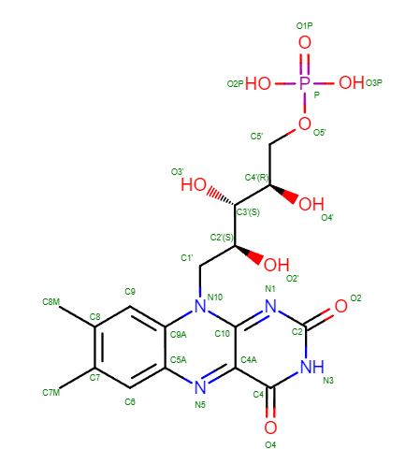
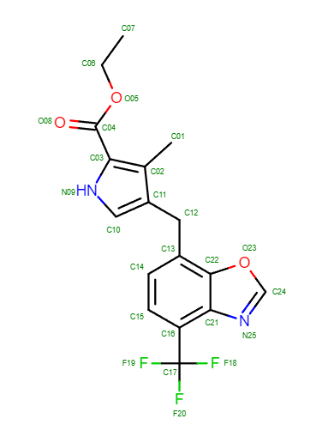
Background: FMN
FMN: Flavin Mononucleotide
Substrates: simple molecules with double bonds and aromatic rings, weak interactions
e.g., ORO
ORO
FMN: a biomolecule synthesized by riboflavin (vitamin B₂) that acts as a cofactor in blue-light photoreceptors
A strong oxidizing agent
Found in tissues (muscles) and cells (RBC)
Plays a critical role in vitamin B6 metabolism and riboflavin metabolism
Inhibitors: halogen groups (F and Br), excessive nitro groups, guanidine groups, strong interactions
e.g., XAJ
FMN
XAJ
Computational Photoenzyme Discovery and Design Northeastern University
NEU YSP Program June 26- August 3, 2023 College of Science
5

Slide 6
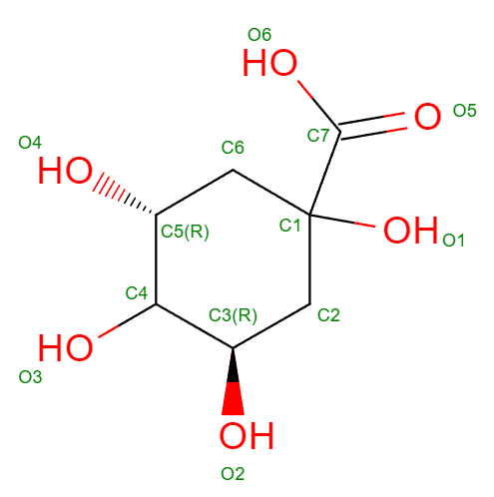
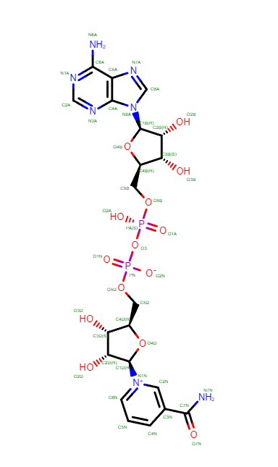
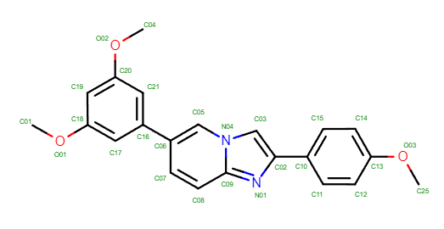
Background: NAD+
NAD+: Nicotinamide Adenine Dinucleotide
Substrates: alkane chain with hydrogen attached, fatty acids, steroids, carcinogens, nitro groups
e.g., QIC
QIC
NAD+: cofactor that regulates pathways in cellular metabolism through redox reactions
Transfer of electrons between NAD+ (oxidized) and NADH (reduced)
Glycolysis, β-oxidation, and oxidative phosphorylation
Inhibitors: halogen groups (F and Br), excessive nitro groups, guanidine groups, strong interactions
e.g., N4Q
NAD+
N4Q
Computational Photoenzyme Discovery and Design Northeastern University
NEU YSP Program June 26- August 3, 2023 College of Science
6

Slide 7
Experimental Methods: FMN/NAD+ Cofactor
Study intermolecular interactions within proteins and enzymes using literature reviews and research the FMN/NAD+ cofactor
Input enzyme name with the FMN/NAD+ cofactor and identify substrates, inhibitors, and cofactors for the specific enzyme
FMN/NAD+ Excel Spreadsheet
RCSB Protein Data Bank (PDB)
Conduct statistical analysis on the data collected for the enzymes with the FMN cofactor
Update the FMN/NAD+ Excel Spreadsheet with the potential substrate(s)
One cofactor (FMN/NAD+)
Extract the enzyme from the FMN/NAD+ Excel Spreadsheet and input its information onto the new database
Create new database/spreadsheet to document enzymes found to contain more than one cofactor
1+ cofactor
Computational Photoenzyme Discovery and Design Northeastern University
NEU YSP Program June 26- August 3, 2023 College of Science
7

Slide 8
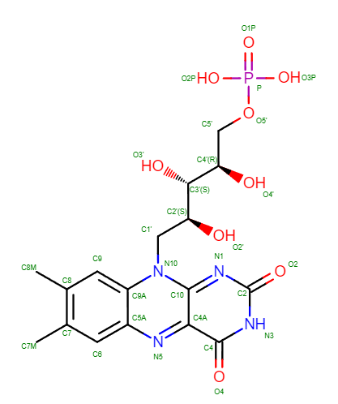
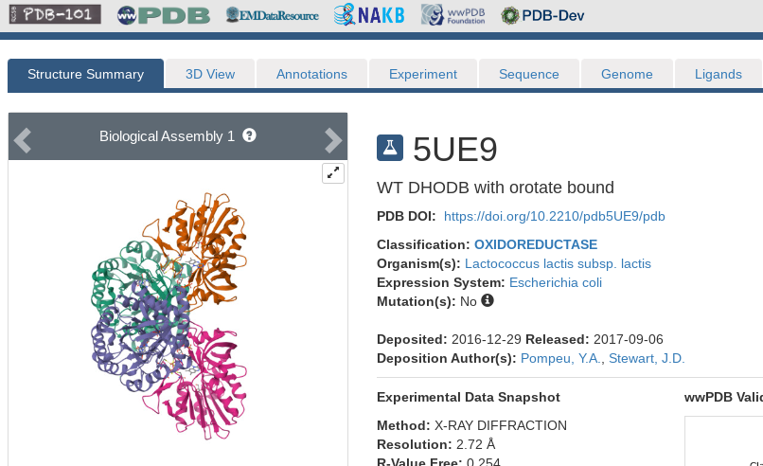
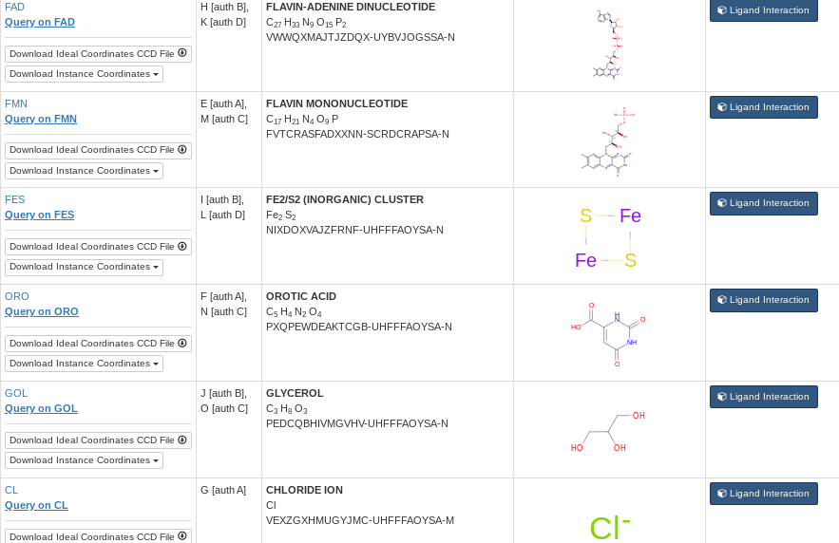
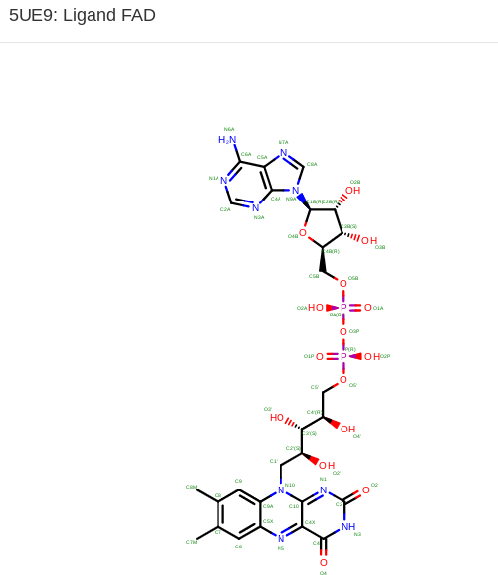
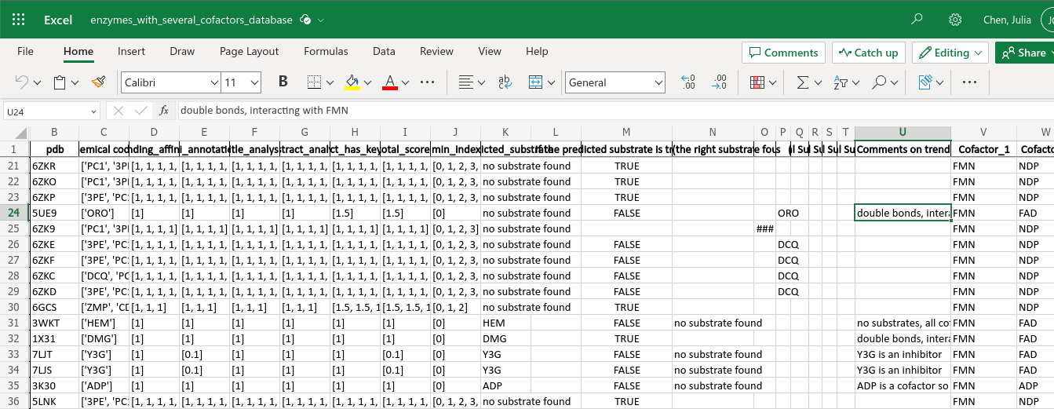
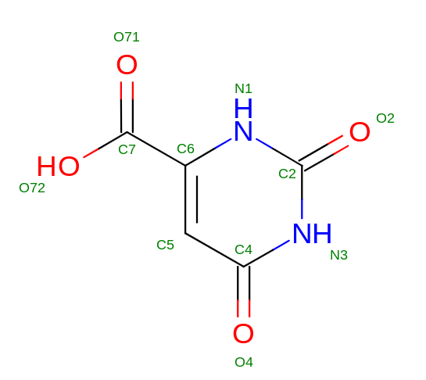
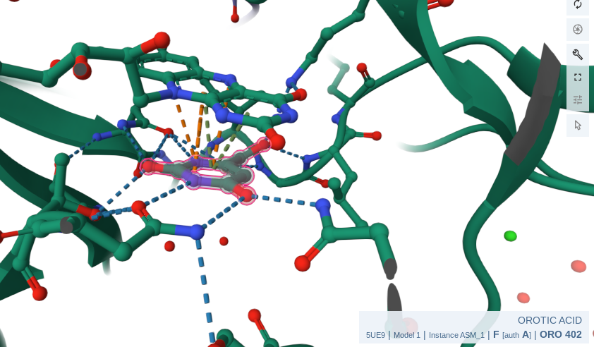
Experimental Methods: FMN/NAD+ Cofactor
FMN
FAD
ORO
Computational Photoenzyme Discovery and Design Northeastern University
NEU YSP Program June 26- August 3, 2023 College of Science
8

Slide 9
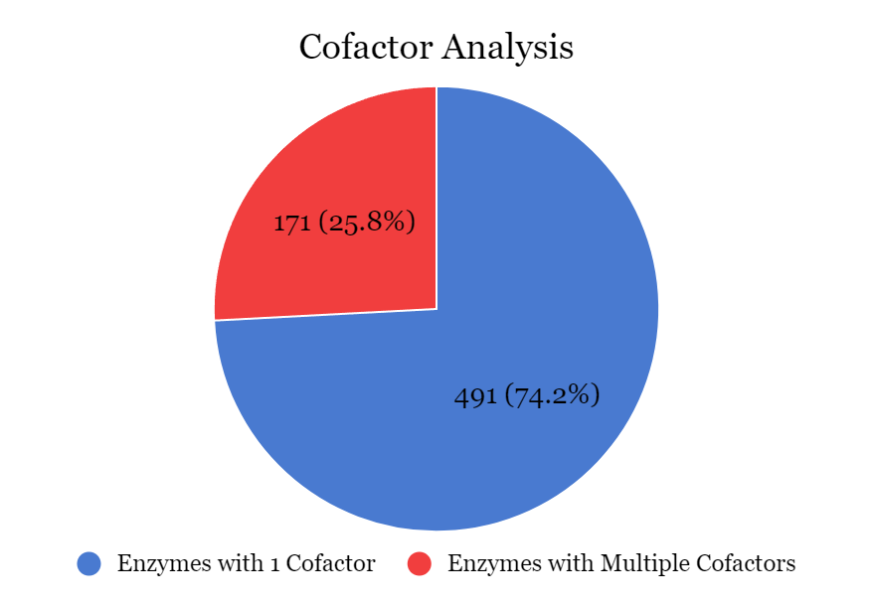
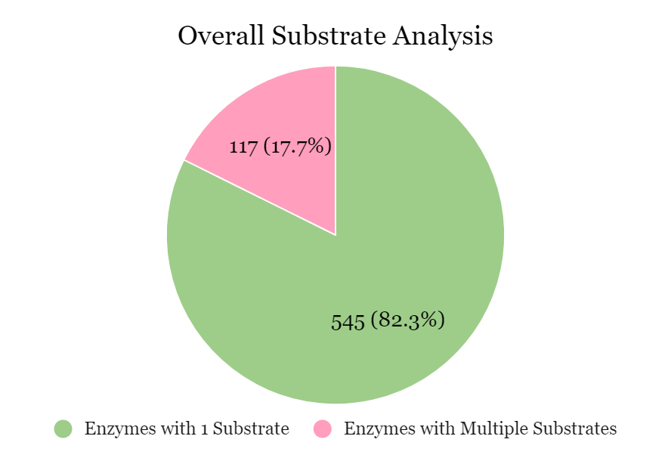
Results
Short terms
Figure 1: The pie chart shows the number of enzymes with one cofactor vs. multiple cofactors.
Figure 2: The pie chart shows the number of enzymes containing one substrate vs. multiple substrates.
Computational Photoenzyme Discovery and Design Northeastern University
NEU YSP Program June 26- August 3, 2023 College of Science
9

Slide 10
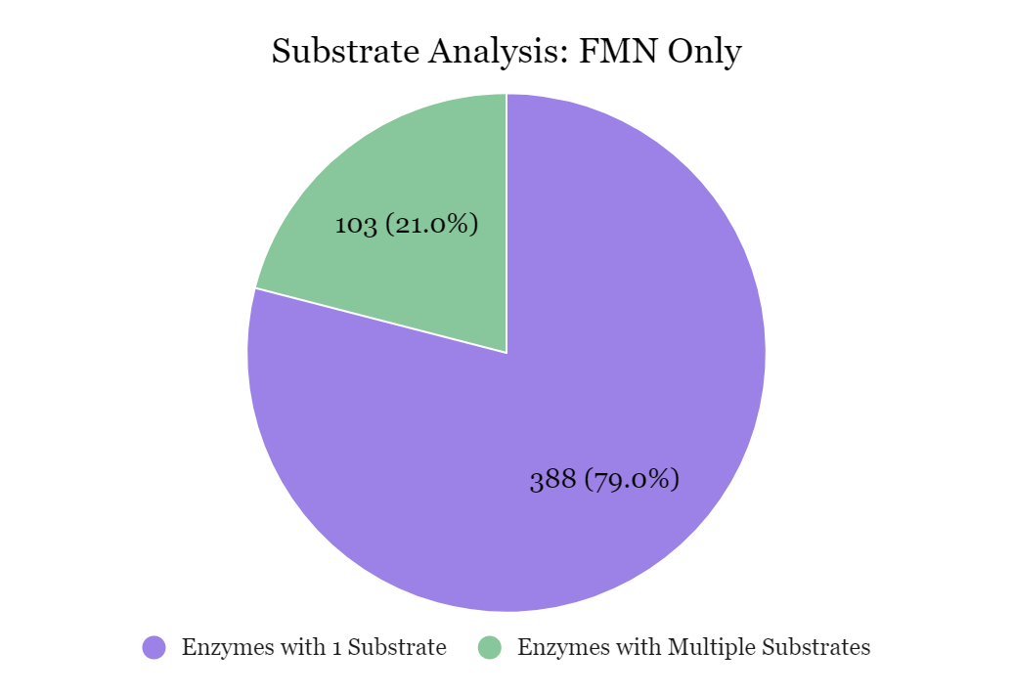
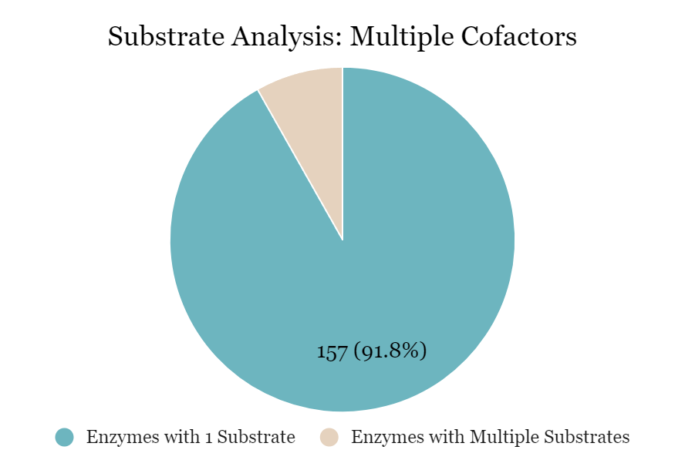
Results
Short terms
14 (8.2%)
Figure 3: The pie chart shows the number of enzymes containing the FMN cofactor with one substrate vs. multiple substrates.
Figure 4: The pie chart shows the number of enzymes containing multiple cofactors with one substrate vs. multiple substrates.
Computational Photoenzyme Discovery and Design Northeastern University
NEU YSP Program June 26- August 3, 2023 College of Science
10

Slide 11
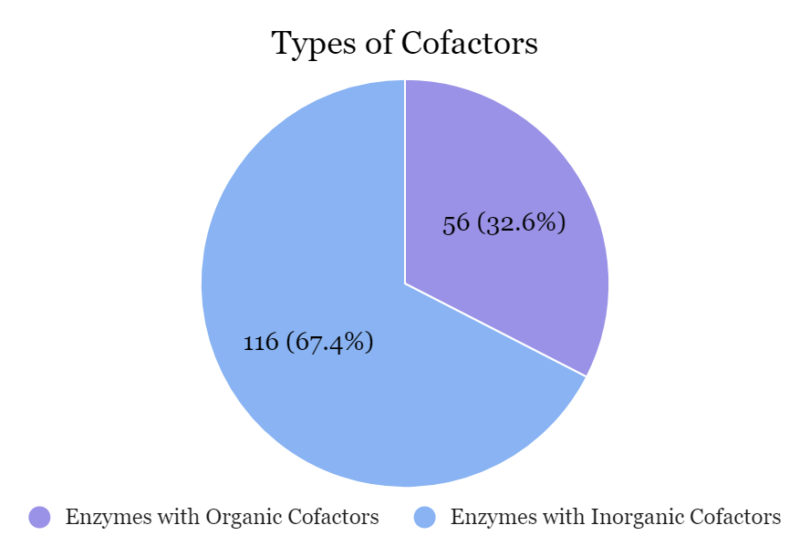
Results
Figure 5: The pie chart shows the number of enzymes containing organic cofactors vs. inorganic cofactors.
Computational Photoenzyme Discovery and Design Northeastern University
NEU YSP Program June 26- August 3, 2023 College of Science
11

Slide 12
Conclusion anD Future STeps
General Conclusion
Analyzed data helps to improve accuracy of predicting substrates, inhibitors, and cofactors for enzymes
Molecular interactions between substrates and the protein structure documented for enzymes containing the FMN or NAD+ cofactor
New database created for enzymes with more than one cofactor
Further research to be carried out to analyze their intermolecular interactions and reactivity
Broader Implications
Enzymes can be used for biological and industrial purposes
Information to be published for future researchers and students
Data shows conditions needed for enzymes to carry out chemical reactions
Future Steps
Continue looking through six other databases with different cofactors: NAD+, NDP, NAP, FAD, NAI, and PLP
Identify their substrates, intermolecular interactions, and chemical reactions the enzymes carry out
Computational Photoenzyme Discovery and Design Northeastern University
NEU YSP Program June 26- August 3, 2023 College of Science
12

Slide 13
References
Biology Online Editors. (2021, July 21). Flavin mononucleotide. Biology Articles, Tutorials &amp; Dictionary Online. https://www.biologyonline.com/dictionary/flavin-mononucleotide#:~:text=FMN%20is%20a%20mononucleotide%20that,erythrocytes%20and%20platelets)
Cibulka, R., &amp; Fraaije, M. W. (2021). Modes of flavin‐based catalysis. Flavin‐Based Catalysis, 97–124. https://doi.org/10.1002/9783527830138.ch4
Enzyme. Genome.gov. (2023, July 26). https://www.genome.gov/genetics-glossary/Enzyme
Koshland, D. E., &amp; Haurowitz, F. (2023, June 1). Protein. Encyclopædia Britannica. https://www.britannica.com/science/protein
Lewis, T., &amp; Stone, W. L. (2023, April 24). Biochemistry, proteins enzymes - statpearls - NCBI bookshelf. National Library of Medicine. https://www.ncbi.nlm.nih.gov/books/NBK554481/
N, S. (2021, July 13). Difference between cofactor and coenzyme (with comparison chart). Biology Reader. https://biologyreader.com/difference-between-cofactor-and-coenzyme.html
Nicholls, B. T., Oblinsky, D. G., Kurtoic, S. I., Grosheva, D., Ye, Y., Scholes, G. D., &amp; Hyster, T. K. (2021). Engineering a non‐natural photoenzyme for Improved Photon Efficiency**. Angewandte Chemie, 134(2). https://doi.org/10.1002/ange.202113842
Page, C. G., Cooper, S. J., DeHovitz, J. S., Oblinsky, D. G., Biegasiewicz, K. F., Antropow, A. H., Armbrust, K. W., Ellis, J. M., Hamann, L. G., Horn, E. J., Oberg, K. M., Scholes, G. D., &amp; Hyster, T. K. (2020). Quaternary charge-transfer complex enables photoenzymatic intermolecular hydroalkylation of olefins. Journal of the American Chemical Society, 143(1), 97–102. https://doi.org/10.1021/jacs.0c11462
Rogers, K. (2023, April 26). Induced-FIT theory. Encyclopædia Britannica. https://www.britannica.com/science/induced-fit-theory
Sandoval, B. A., Meichan, A. J., &amp; Hyster, T. K. (2017). Enantioselective hydrogen atom transfer: Discovery of catalytic promiscuity in flavin-dependent ‘ene’-reductases. Journal of the American Chemical Society, 139(33), 11313–11316. https://doi.org/10.1021/jacs.7b05468
Yokoyama, Dr. M. (2023, July 18). What is an enzyme cofactor?. News. https://www.news-medical.net/life-sciences/What-is-an-Enzyme-Cofactor.aspx#:~:text=Some%20enzymes%20require%20the%20addition,becomes%20the%20active%20%E2%80%9Choloenzyme%E2%80%9D
Yaku, K., Okabe, K., Gulshan, M., Takatsu, K., Okamoto, H., &amp; Nakagawa, T. (2019). Metabolism and biochemical properties of nicotinamide adenine dinucleotide (NAD) analogs, nicotinamide guanine dinucleotide (NGD) and nicotinamide hypoxanthine dinucleotide (NHD). Scientific Reports, 9(1). https://doi.org/10.1038/s41598-019-49547-6
Nature Publishing Group. (n.d.). Enzymes allow activation energies to be lowered. Nature news. https://www.nature.com/scitable/content/enzymes-allow-activation-energies-to-be-lowered-14747799/
Levels of Protein Structure. Four levels of protein structure. (n.d.). https://www.mun.ca/biology/scarr/iGen3_06-04.html
Pharmaceutical enzymes: Enzymes for pharmaceutical industry. Ultreze Enzymes. (2023, August 1). https://ultrezenzymes.com/services/enzymes-for-pharmaceutical-industry/
Computational Photoenzyme Discovery and Design Northeastern University
NEU YSP Program June 26- August 3, 2023 College of Science
13

Slide 14
Acknowledgments
Center for STEM Education
Claire Duggan, Executive Director
Jennifer Love, Associate Director
Claire Stipp and Yassine Souabny, YSP Coordinators
Nicolas Fuchs, Program Manager
Mary Howley, Administrative Officer
Department of Chemistry and Chemical Biology
Dong Theoretical and Computational Chemistry Lab
Professor Sijia Dong, Assistant Professor
Gustavo Mondragon, Postdoctoral Scholar
Zheyu Zhang, Ph. D. Candidate
Computational Photoenzyme Discovery and Design Northeastern University
NEU YSP Program June 26- August 3, 2023 College of Science
14

Slide 15
