Slide 1











Filtering Temperature Sensor Outputs for Power Dissipation Monitoring
Aryaa Mutha, YSP Student, The Brimmer and May School
Eric Nie, YSP Student, Phillips Academy
Thomas Gourousis, Electrical and Computer Engineering, Northeastern University
Minghan Liu, Electrical and Computer Engineering, Northeastern University​
Junyi Yang, Electrical and Computer Engineering, Northeastern University​
Professor Marvin Onabajo, Electrical and Computer Engineering, Northeastern University​
Notes:
Hello everybody, my name is Aryaa Mutha and I’m a rising senior at the Brimmer and May school.
Hi, I’m Eric Nie and I’m a rising senior at Phillips Academy.
And today we will be talking about Filtering Temperature Sensor Outputs for Power Dissipation Monitoring.

Slide 2


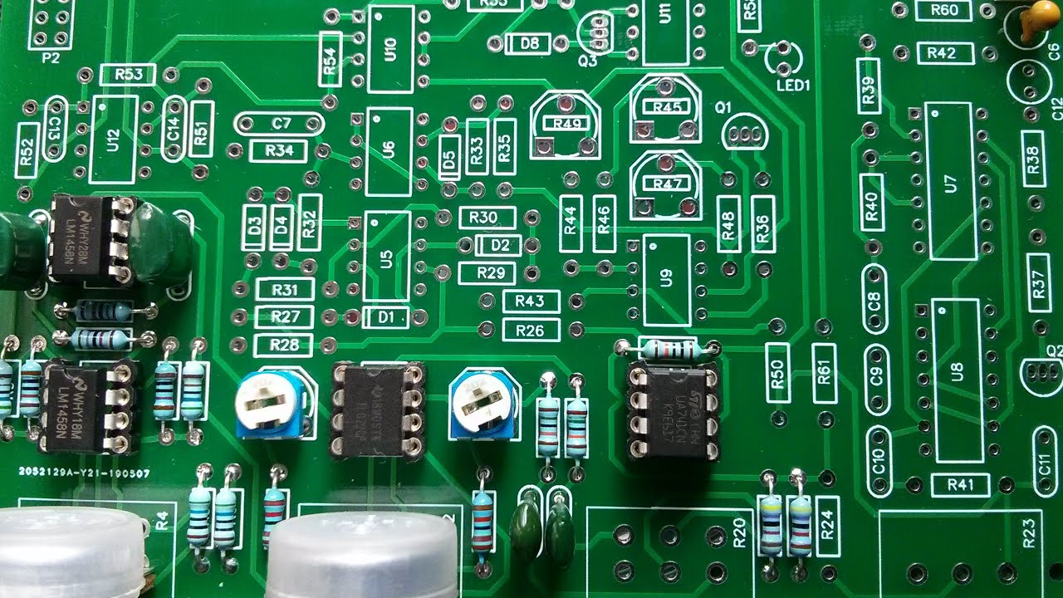



AMSIC Research Lab
Problem
Hardware Trojans (HT): Malicious modifications hidden in electronic chips
Difficult to detect due to stealthiness and low-power consumption
Current methods struggle to identify subtle signal changes caused by HTs
Effects: Security breaches, data corruption, system failure, loss of user trust
Filtering Temperature Sensor Outputs for Power Dissipation Monitoring
Slide 02 / 16 - NEU Young Scholars Program 2025 - July 30, 2025
Notes:
ERIC:
Firstly, it is important to understand the problem we are addressing.
Everyone knows what a software trojan is, right? We all know someone who has gotten harmful software from downloading movies or opening attachments on suspicious emails. Now imagine if these malicious components were built into the hardware of your systems.
Hardware Trojans are these malicious modifications in electronic chips. They're difficult to detect because they consume little power and operate stealthily. Hardware trojans can seriously impact a system, leading to data corruption, system malfunctions/failures, and security breaches.

Slide 3
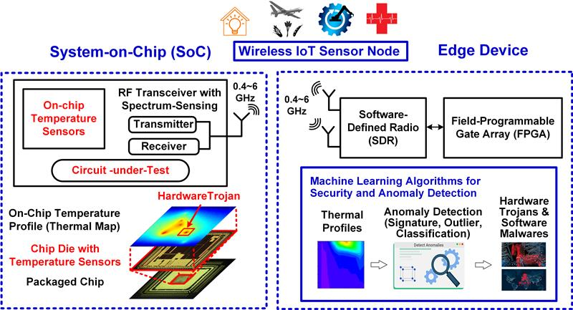
AMSIC Research Lab
Overview
Current HT detection methods use temperature sensors in Internet of Things systems (IoT)
Accuracy is limited by the inherent electrical noise present before digitization
Harder to spot anomalies
Proposed Solution: An analog integrator that functions as a low-pass filter
Integrate temperature signals to filter out noise
Easier to see subtle changes
Enhance the detection capability for HT detection
Filtering Temperature Sensor Outputs for Power Dissipation Monitoring
Slide 03 / 16 - NEU Young Scholars Program 2025 - July 30, 2025
Notes:
ARYAA:
Right now, some ways to detect Hardware Trojans use temperature sensors in smart devices. But one of the main problems is that the signals often have a lot of electrical noise before they’re digitized. This noise makes it harder to spot anything unusual. To help with that, we designed an analog integrator that acts like a low-pass filter. It smooths out the noisy signal, making it easier to see subtle changes that could point to a Trojan.

Slide 4
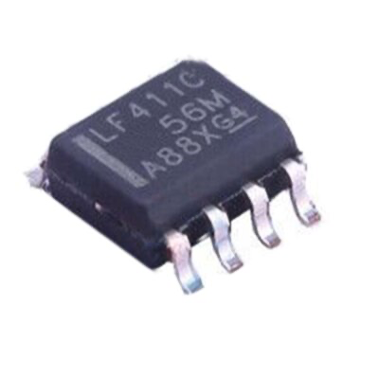


AMSIC Research Lab
Operational Amplifier (Op-Amp)
Operational Amplifier (Op-Amp)
Fundamental building block in analog electronics
Originally conceived to perform mathematical operations in analog computers
Amplifies the difference between the input voltages
Predominantly used in feedback configurations
Texas Instrument LF411C
Low cost, low offset commercially available op-amp
Filtering Temperature Sensor Outputs for Power Dissipation Monitoring
Slide 04 / 16 - NEU Young Scholars Program 2025 - July 30, 2025
Notes:
ERIC:
The operational amplifier, or op-amp, is a key component in analog electronics. Its name comes the fact that it was originally designed to perform mathematical operations in analog computers. It works by amplifying the difference between the input voltage terminals (as you can see in this equation), with the gain being ideally infinite, but oftentimes over 100,000. This makes it suitable for feedback configurations. For our project, we used a texas instrument LF411C chip, a low-cost, low-offset op-amp that served as our main building block.

Slide 5
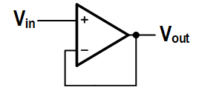
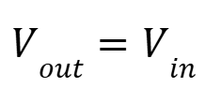
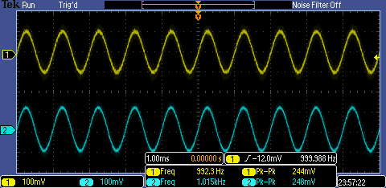
AMSIC Research Lab
Unity-Gain Buffer Configuration
Unity-Gain Buffer
Feedback configuration
Keeps signal strong
Prevents loading effects between cascaded stages
Directly connected
Example:
Gain ≈ 1
Input (Yellow) = 244 mVpp
Output (Blue) = 248 mVpp
Filtering Temperature Sensor Outputs for Power Dissipation Monitoring
Slide 05 / 16 - NEU Young Scholars Program 2025 - July 30, 2025
Notes:
ARYAA:
The unity-gain buffer amplifier gives an output that’s almost the same as the input. It keeps the signal strong as it moves between different parts of the circuit. This helps stop one part of the circuit from messing with another, which can happen if they’re directly connected. In our example, the input was around 244 millivolts, and the output was very close at 248 millivolts. That shows the buffer is doing its job—keeping the signal steady without changing it.

Slide 6
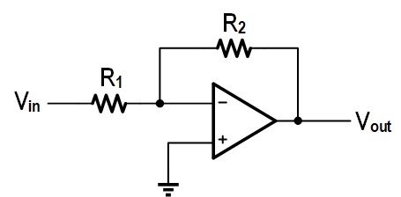
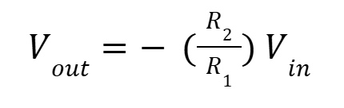
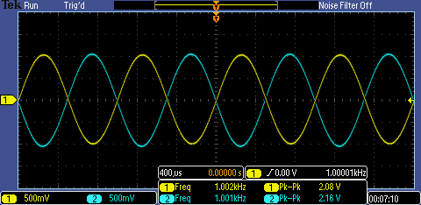
AMSIC Research Lab
Inverting Voltage Amplifier
Inverting Voltage Amplifier
Converts a positive voltage to negative, and vice versa (180° phase change)
Helpful for creating opposing signal phases in analog systems
Example:
Gain ≈ -1 (R₁ ≈ R₂ ≈ 10 KΩ)
Input (Yellow) = 2.08 Vpp
Output (Blue) = 2.16 Vpp
Filtering Temperature Sensor Outputs for Power Dissipation Monitoring
Slide 06 / 16 - NEU Young Scholars Program 2025 - July 30, 2025
Notes:
ERIC:
As seen in this equation, the inverting voltage amplifier flips the input signal—positive becomes negative and vice versa—causing a 180° phase shift. This makes them useful for generating opposing signal phases in analog systems. In our example, with R1 and R2 both around 10 KΩ, we expected a gain of about -1, which can be seen in the graph. Slight variation in resistor values explains the small amplitude difference from the exact gain.

Slide 7
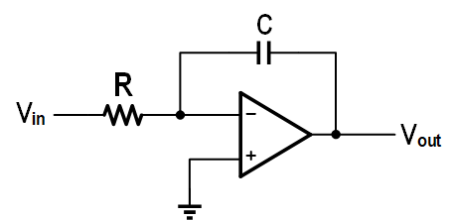
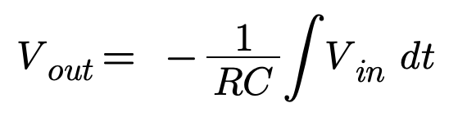
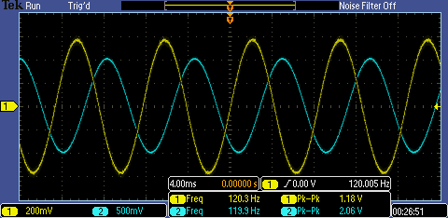
AMSIC Research Lab
Resistor-Capacitor (RC) Integrator
RC Integrator
Produces an output that is the time-integral of the input signal
Smoothens rapid changes over time
Reduces high-frequency noise
Useful for detecting slow and subtle changes in signals
Example:
Input (Blue) = 2.06 Vpp
Output (Yellow) = 1.18 Vpp
Filtering Temperature Sensor Outputs for Power Dissipation Monitoring
Slide 07 / 16- NEU Young Scholars Program 2025 - July 30, 2025
Notes:
ARYAA:
The RC integrator takes in a signal and creates an output that smooths it over time. This helps get rid of fast, sudden changes or “noise” that can make it hard to read the signal clearly. By doing this, it’s easier to see slow and small changes in the signal, which is helpful when looking for problems like hidden issues in a system. In our example, the input was about 2.06 volts, and the output dropped to around 1.18 volts, showing how the circuit filtered and smoothed the signal.
The blue sine wave is transformed into the yellow cosine wave

Slide 8
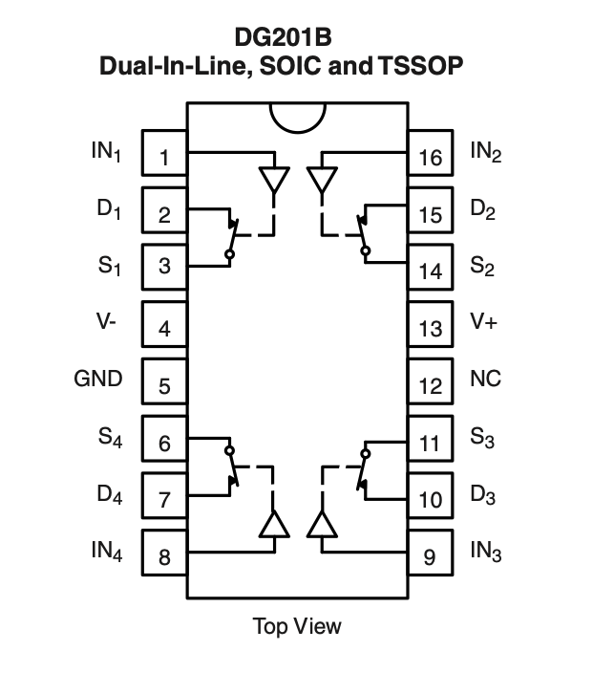
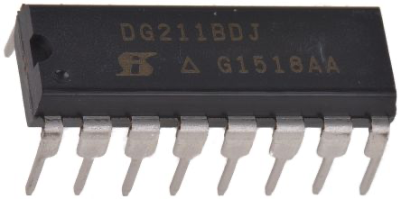
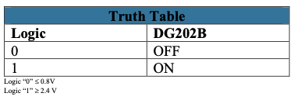
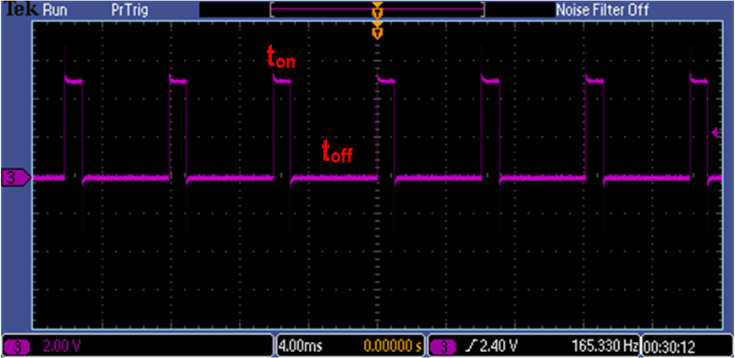
AMSIC Research Lab
Analog Switch
Vishay DG202B
Analog switch that routes signals electronically
Controlled by a digital input (e.g., Arduino)
Enables or disables parts of the circuit without mechanical movement
Control signal
On Time (t_{on}) : 1 ms
Off Time (t_{off}): 5 ms
Filtering Temperature Sensor Outputs for Power Dissipation Monitoring
Slide 08 / 16 - NEU Young Scholars Program 2025 - July 30, 2025
Notes:
ERIC:
In order to prevent saturation in our integrator, we used an analog switch to perform a reset. It is controlled by a digital input, like from an Arduino, allowing parts of the circuit to be enabled or disabled. In our setup, the control signal has an on time of 1 ms and an off time of 5 ms, which can be seen in the short bursts of high voltage and long bursts of low voltage in the graph.

Slide 9
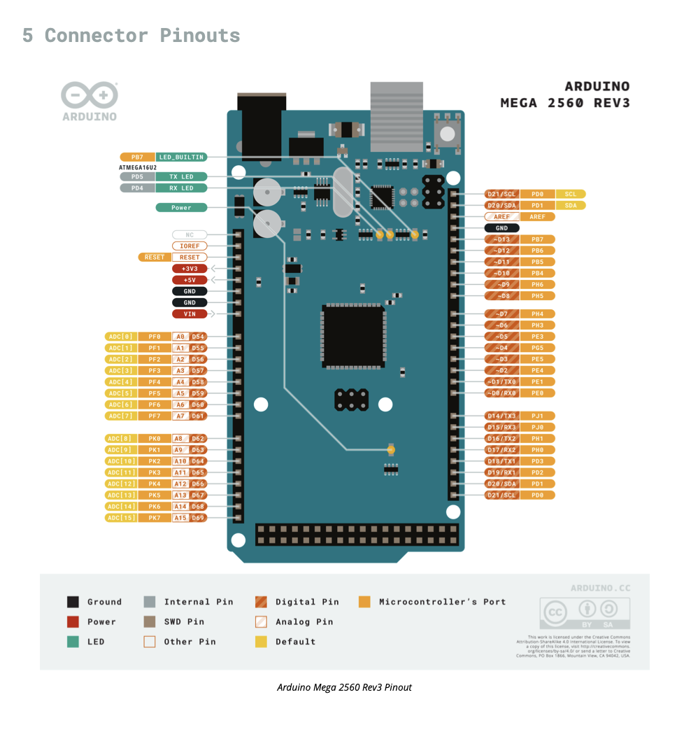
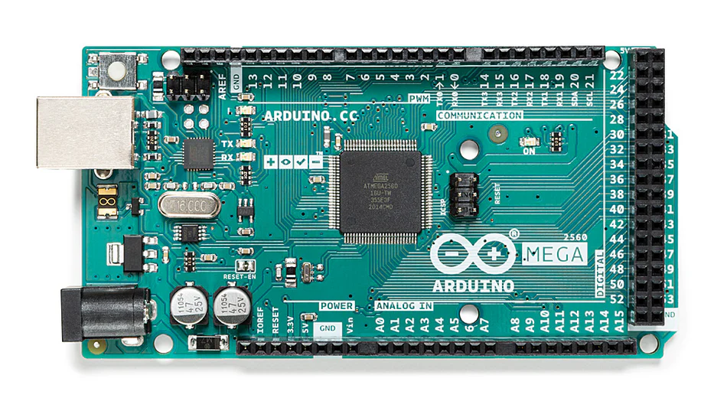
AMSIC Research Lab
Arduino
Arduino Mega 2560 Rev3
Microcontroller board used to control parts of integrator circuit
Send timing signals for reset (e.g., switching)
Many input/output pins for complex setups
Filtering Temperature Sensor Outputs for Power Dissipation Monitoring
Slide 09 / 16 - NEU Young Scholars Program 2025 - July 30, 2025
Notes:
ARYAA:
The Arduino Mega controls parts of our integrator circuit. We used it to send timing signals and to reset the circuit when needed. Its many input and output pins made it easy to connect to components like the analog switch and monitor signals during testing.

Slide 10
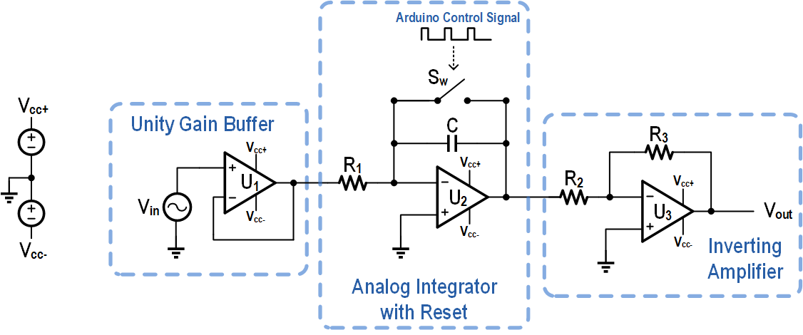
AMSIC Research Lab
Research Objective
Component Values:
R₁: 1 kΩ R₂: 10 kΩ R₃: 10 kΩ C: 1 µF S_{W}: DG202B U₁₋₃: LF411C
Design, simulate, and test an analog integrator circuit that acts as a low-pass filter (LPF)
Apply the integrator as a LPF to suppress noise during signal measurements
Arduino controls the on/off time from the switch
Filtering Temperature Sensor Outputs for Power Dissipation Monitoring
Slide 10 / 16 - NEU Young Scholars Program 2025 - July 30, 2025
Notes:
ERIC:
Taking all the circuit components that we just introduced (the buffer, integrator, and inverting amplifier), we used them to construct a low-pass filter with the goal to suppress higher-frequency noise in signal measurements. An Arduino is used to control the on and off timing of the switch in the circuit.

Slide 11
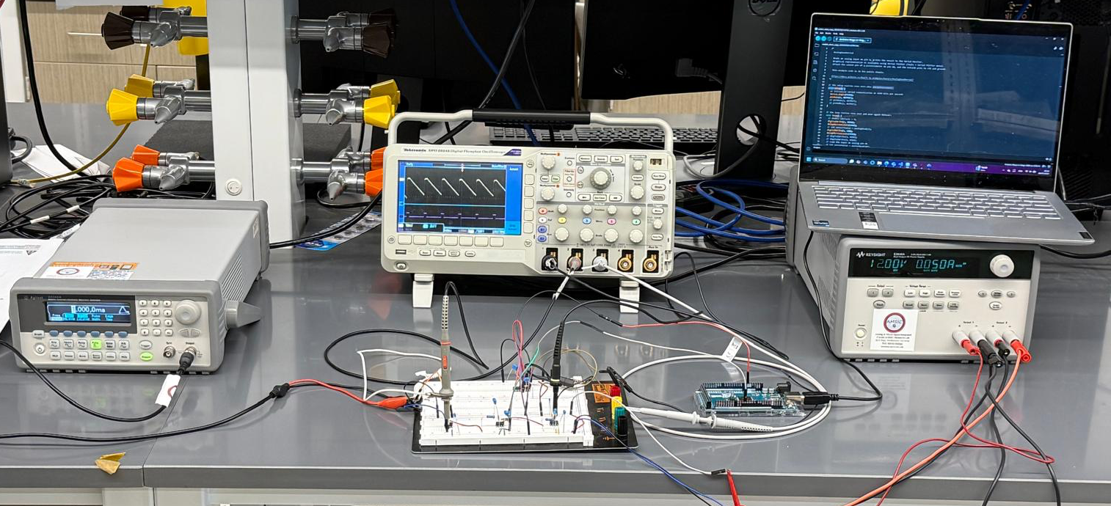
AMSIC Research Lab
Measurement Setup
Function Generator: Generates incoming signals that can be both AC (Sine, Pulse, and Square) and DC
Power Supply: Provides constant DC bias used to power op-amps
Digital Oscilloscope: Measures transient voltage signals
Arduino: Provides periodic pulse signals for switch control
Personal Computer: Controls Arduino
Function Generator
Oscilloscope
Code
Breadboard
Arduino
Power Supply
Filtering Temperature Sensor Outputs for Power Dissipation Monitoring
Slide 11 / 16 - NEU Young Scholars Program 2025 - July 30, 2025
Notes:
ARYAA:
In the diagram above, you can see all the machines and tools we used in our setup. First, the function generator creates incoming signals that can be AC—like sine, pulse, or square waves—as well as DC signals. The power supply provides a constant DC bias that powers the op-amps in the circuit. To observe how voltages change over time, we use a digital oscilloscope. Our system is powered by a steady 12-volt power supply. Finally, the Arduino generates periodic pulse signals to control the switches in the circuit, as shown in the diagram. Each component plays an important role in making the whole system work smoothly.
WE USE THE FUNCTION GENERATOR TO MIMIC THE REAL TEMPERATURE SENSOR DATa

Slide 12
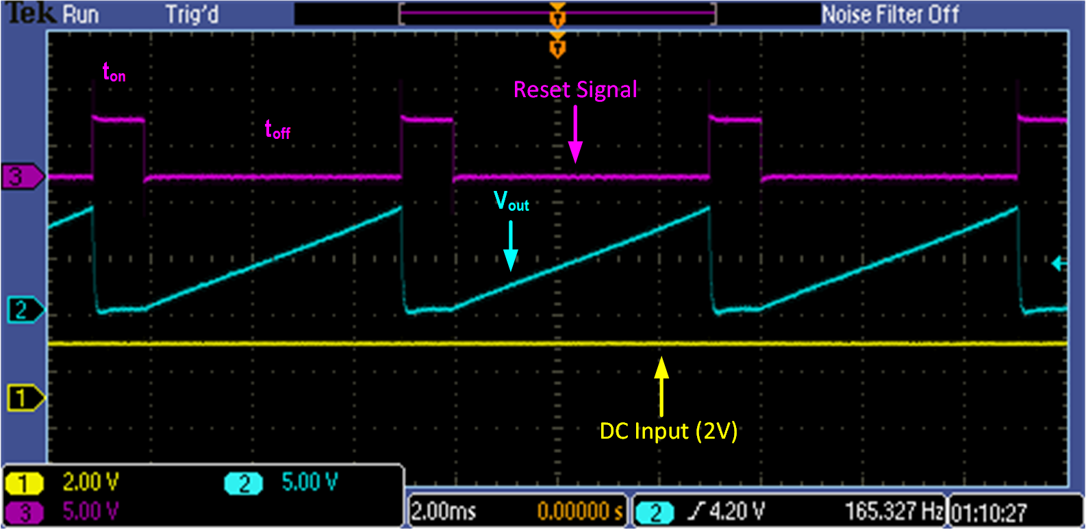
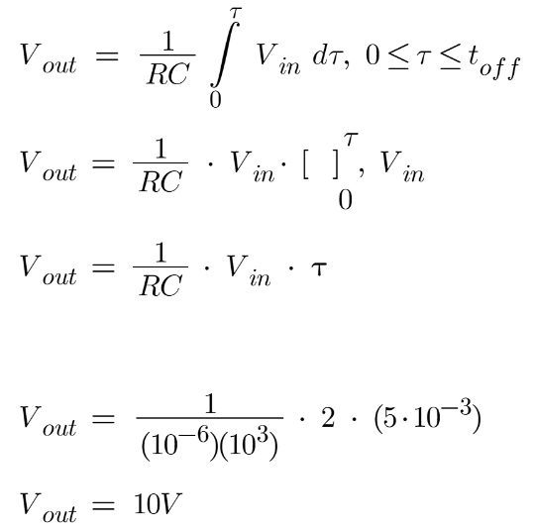

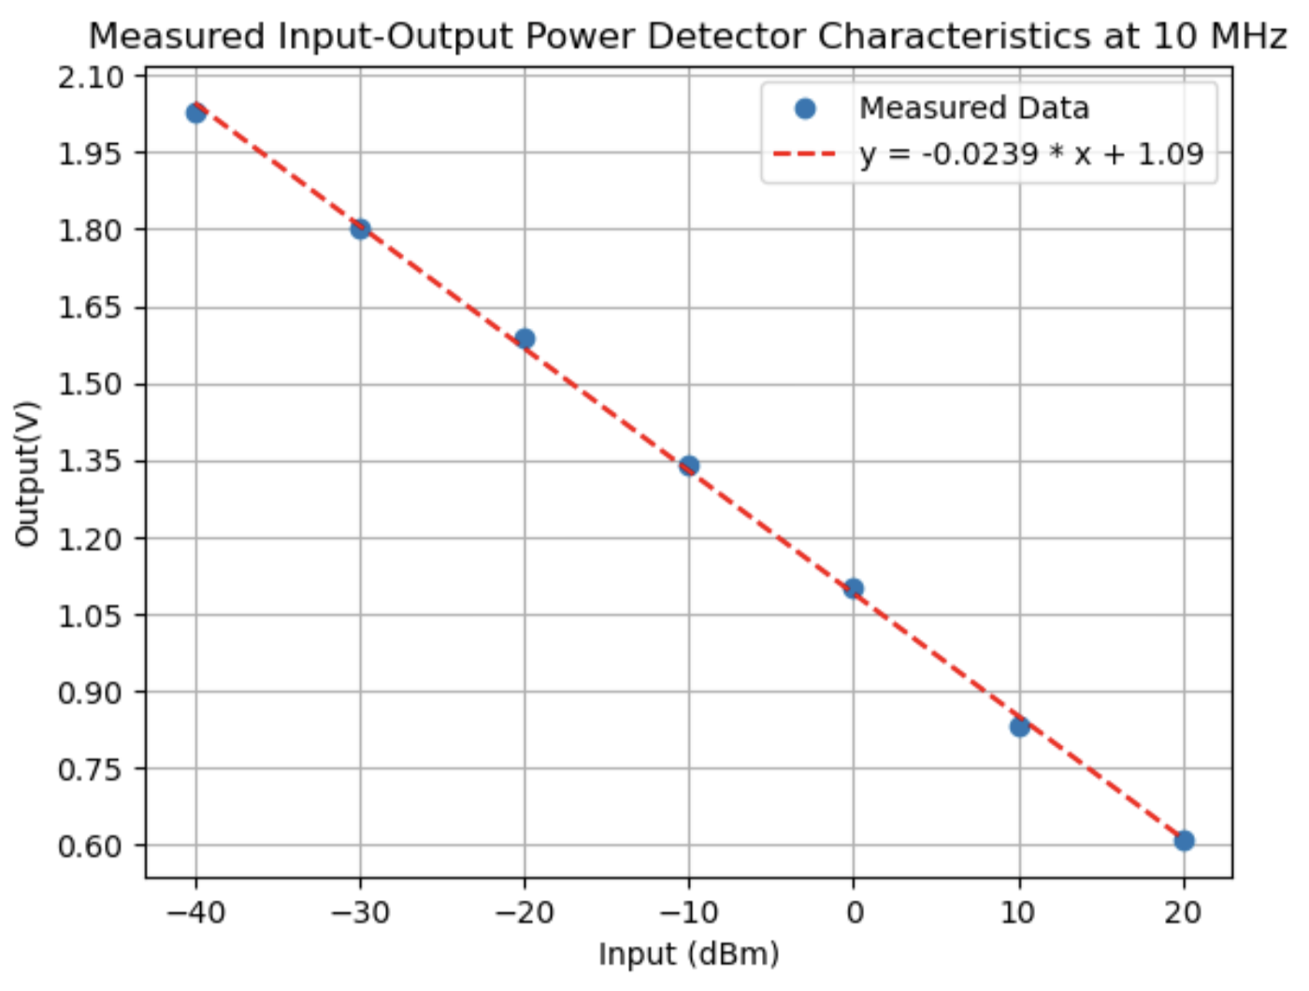
AMSIC Research Lab
Signal Output after Analog Integration
assumed constant
10 V
(straight line equation)
:
For
Integrator produced expected ramp output (blue) in response to DC input (yellow)
Results match theoretical calculations
Amplifier factor of 5 (2V to 10V)
Filtering Temperature Sensor Outputs for Power Dissipation Monitoring
Slide 12 / 16 - NEU Young Scholars Program 2025 - July 30, 2025
Notes:
ERIC:
In order to show that the integrator worked as expected, we tested it with a DC input, or a positive constant input voltage. Intuitively, you can expect the time integral of this (which is taking the total amount of something over a period of time) to be a linear, accumulating function. As you can see, this is exactly what we saw in the output (blue line). Furthermore, these results lined up with our theoretical calculations (as seen in the measured 10V magnitude), confirming the circuit’s expected behavior.

Slide 13
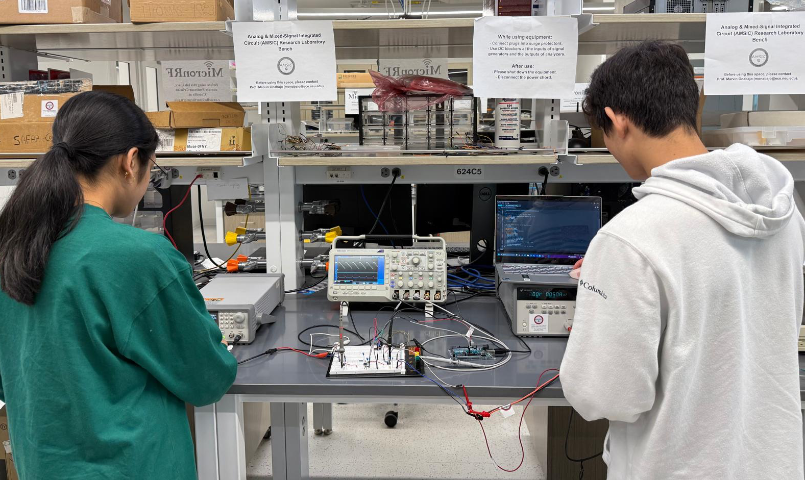
AMSIC Research Lab
Conclusion and Next Steps
Contribution
Our results for the designed integrator circuit indicate that it performs as an integrator and a low-pass filter
Successfully reduce noise and amplify anomalies
Next Steps
`
Prepare the circuit for testing with real temperature sensor inputs with noise
Process the filtered data with machine learning algorithms in order to confirm the expected improvement in detection accuracy
Filtering Temperature Sensor Outputs for Power Dissipation Monitoring
Slide 13 / 16 - NEU Young Scholars Program 2025 - July 30, 2025
Notes:
ARYAA:
Our circuit worked the way we expected—it acted like an integrator and a low-pass filter. It helped reduce noise in the signal and made it easier to see unusual changes.Next, we plan to connect the circuit to a real temperature sensor with some added noise. After that, we’ll look at how the cleaner signal works with detection methods, possibly including machine learning, to see if it improves how well we can find hardware problems.

Slide 14
AMSIC Research Lab
References
[1] Arduino. Mega 2560. Accessed 14 July 2025.
[2] Gourousis, Thomas, et al. “Identification of Stealthy Hardware Trojans through On-Chip Temperature Sensing and an Autoencoder-Based Machine Learning Algorithm.” 2022 IEEE 65th International Midwest Symposium on Circuits and Systems (MWSCAS), 6 Aug. 2023, pp. 30–34, https://doi.org/10.1009/mwscas57524.2023.10405958. Accessed 22 Mar. 2025.
[3] Mittal, Ankit, et al. “Sub-6-GHz Energy-Detection-Based Fast On-Chip Analog Spectrum Sensing with Learning-Driven Signal Classification.” IEEE Internet of Things Journal, vol. 10, no. 14, 24 Apr. 2024, pp. 25033–25046, ieeexplore.ieee.org/stamp/stamp.jsp?tp=&arnumber=10507856, https://doi.org/10.1009/jiot.2024.3392428. Accessed 10 Apr. 2025.
[4] Texas Instruments. LF411C Operational Amplifier. Accessed 14 July 2025.
[5] Vishay. DG202B Switch. Accessed 14 July 2025.
References:
Filtering Temperature Sensor Outputs for Power Dissipation Monitoring
Slide 14 / 16 - NEU Young Scholars Program 2025 - July 30, 2025
Notes:
ERIC:
Here are our references

Slide 15





AMSIC Research Lab
Acknowledgements:
Department of Electrical and Computer Engineering
Professor Marvin Onabajo
Thomas Gourousis, Ph. D. Candidate
Minghan Liu, Ph. D. Candidate
Junyi Yang, M.S. Candidate
Center for STEM Education
Claire Duggan, Executive Director
Jennifer Love, Associate Director
Victoria Berry, Dmitra Mukasa, and Ahmed Othman,
YSP Coordinators
Nicolas Fuchs, Program Manager
Mary Howley, Administrative Officer
Analog and Mixed-Signal Integrated Circuits (AMSIC) Research Laboratory
This work has been funded by the National Science Foundation (NSF) under award #2146754 and partly by OUSD R&E, NIST, and industry partners in the RINGS Program.
Filtering Temperature Sensor Outputs for Power Dissipation Monitoring
Slide 15/16 - NEU Young Scholars Program 2025 - July 30, 2025
Notes:
ARYAA:
And a big thank you to Professor Onabajo and our mentors, Thomas, Minghan and Junyi; as well as the Center for STEM Education for guiding us through this process.

Slide 16
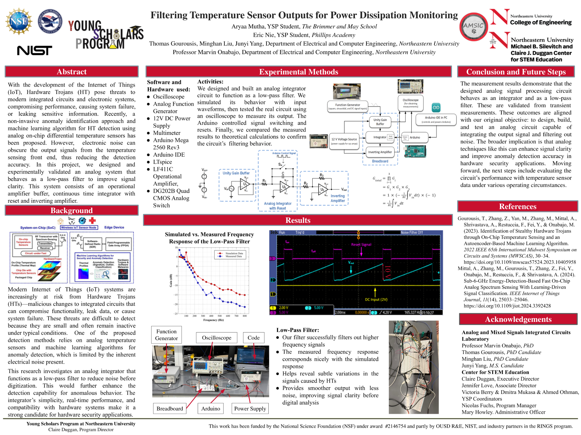
Notes:
ERIC:
And lastly this is our poster that will be displayed during the Poster Session. We are happy to take questions now. Thank you.

Slide 17
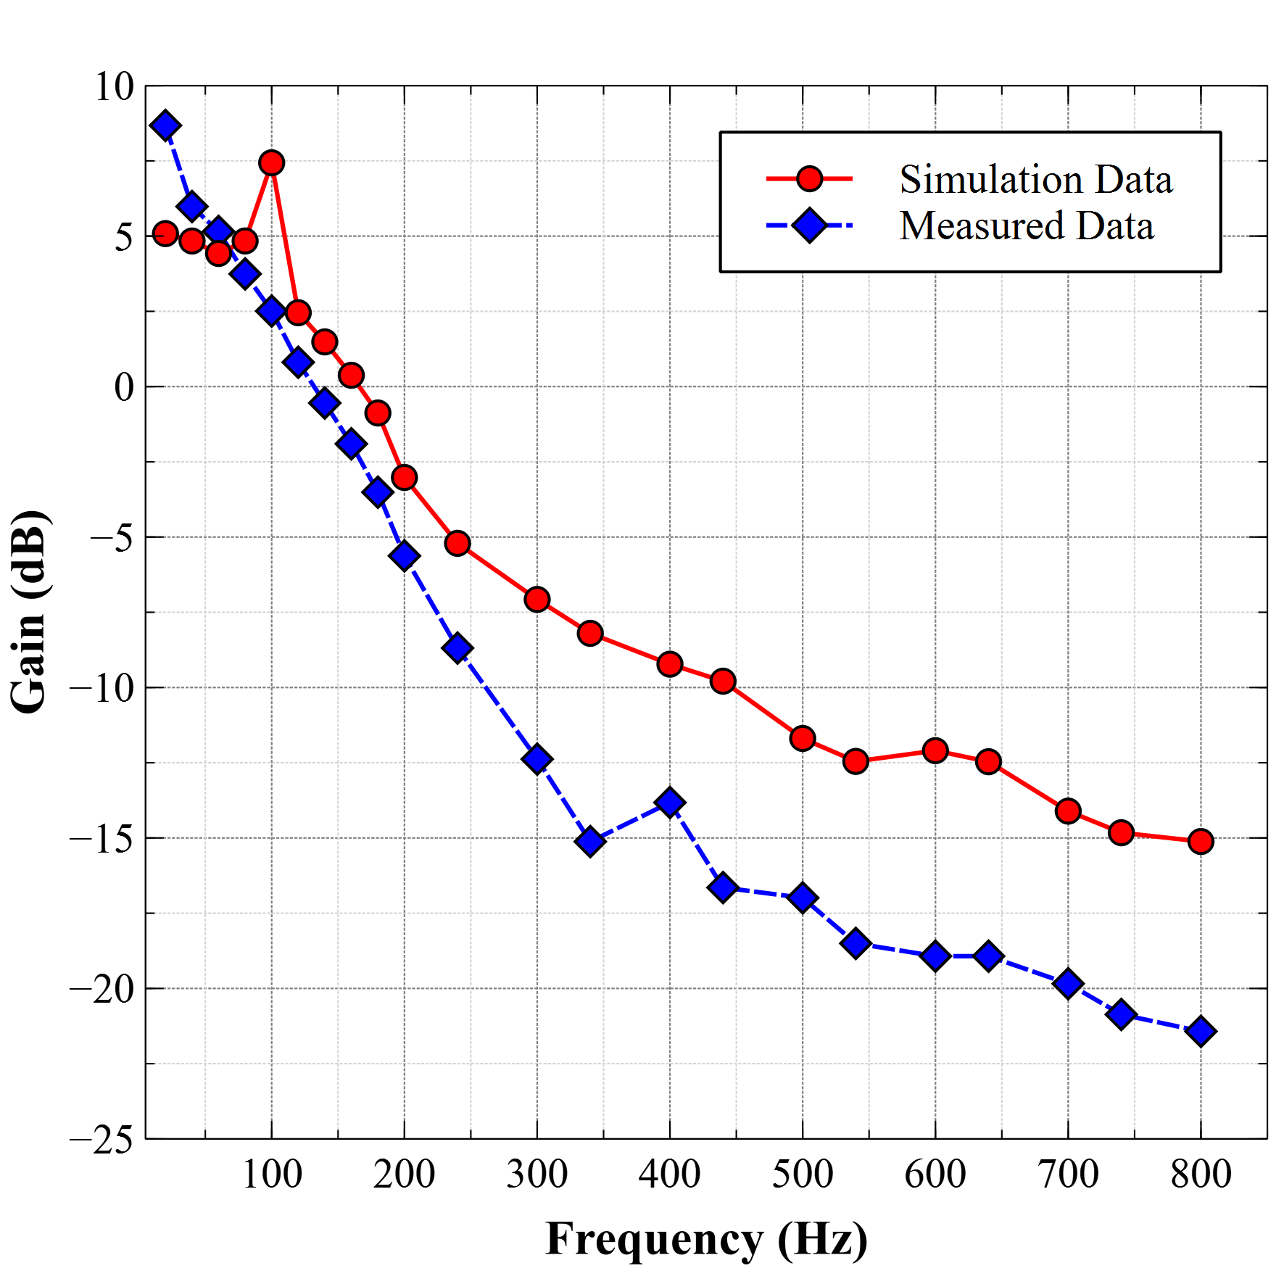
AMSIC Research Lab
Appendix: Simulated vs. Measured Frequency Response of Low-Pass Filter
Filtering Temperature Sensor Outputs for Power Dissipation Monitoring
NEU Young Scholars Program 2025 - July 30, 2025
Notes:
ERIC:
Connecting back to the main objective of our project, we also visualized the frequency response of our low-pass filter. As you can see here, as the frequency increased, the gain decreases, meaning that the low-pass filter amplifies lower frequency and attenuates higher frequency signals.

Slide 18
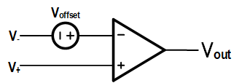
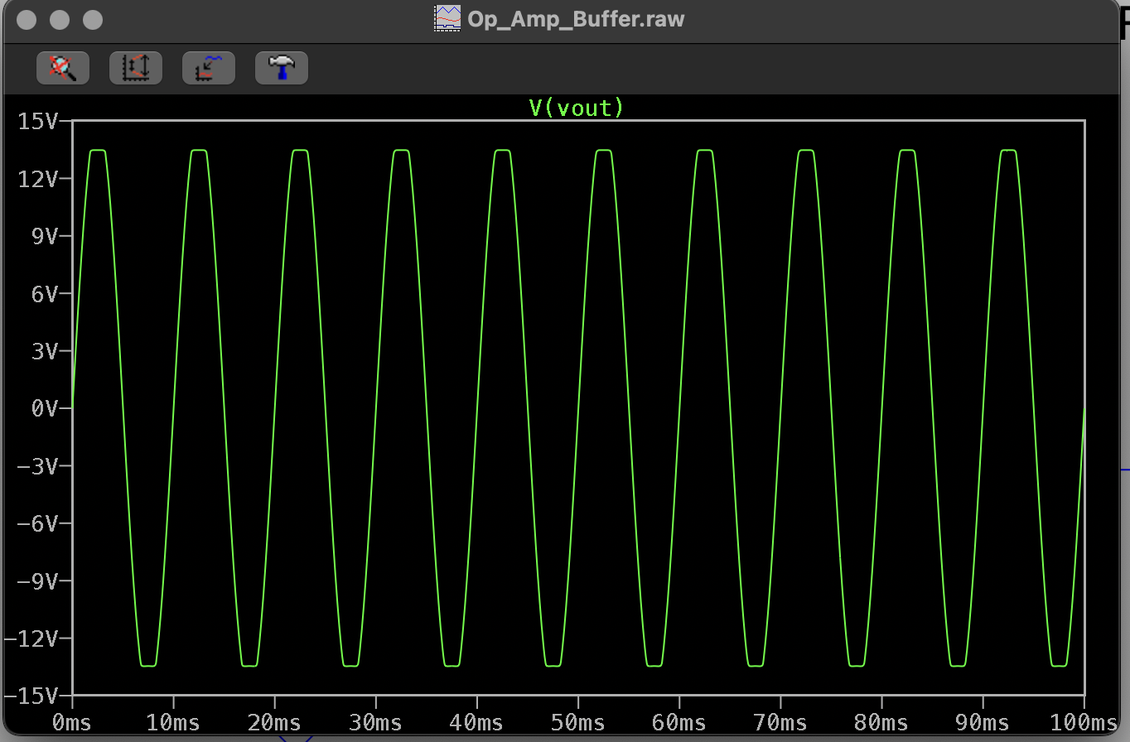
AMSIC Research Lab
Appendix: Op-amp Offset Voltage
Ideal Model:
Op-amp Offset Voltage
Small voltage difference between op-amp inputs
Causes output drift in integrator circuits
Offset builds up over time during integration
Posing significant risk of saturation
Offset compensation, including feedback resistors and discharge switches
Can help maintain stable output
Model with Offset:
Filtering Temperature Sensor Outputs for Power Dissipation Monitoring
NEU Young Scholars Program 2025 - July 30, 2025

Slide 19
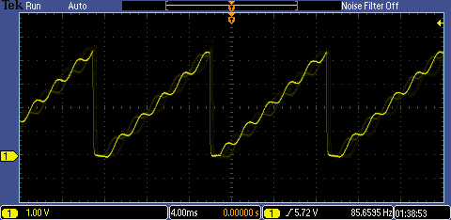
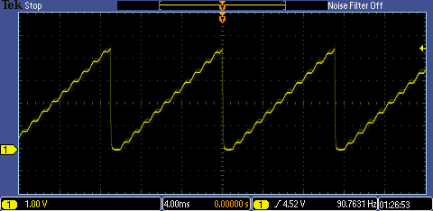

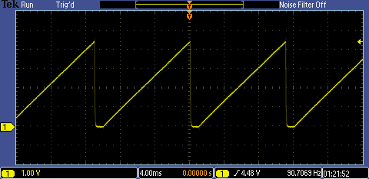
AMSIC Research Lab
Appendix: Frequency Response of Low-Pass Filter
500 Hz
1 kHz
2 kHz
10 kHz
Filtering Temperature Sensor Outputs for Power Dissipation Monitoring
NEU Young Scholars Program 2025 - July 30, 2025

