Slide 1
Human-AI Systems at the Extremes
Darius Daftarian Computer Science
Brendan Brassil Computer Science
Dr. Taskin Padir Associate Professor, E.C.E.
Katiso Mabulu Scholar Mentor

Slide 2
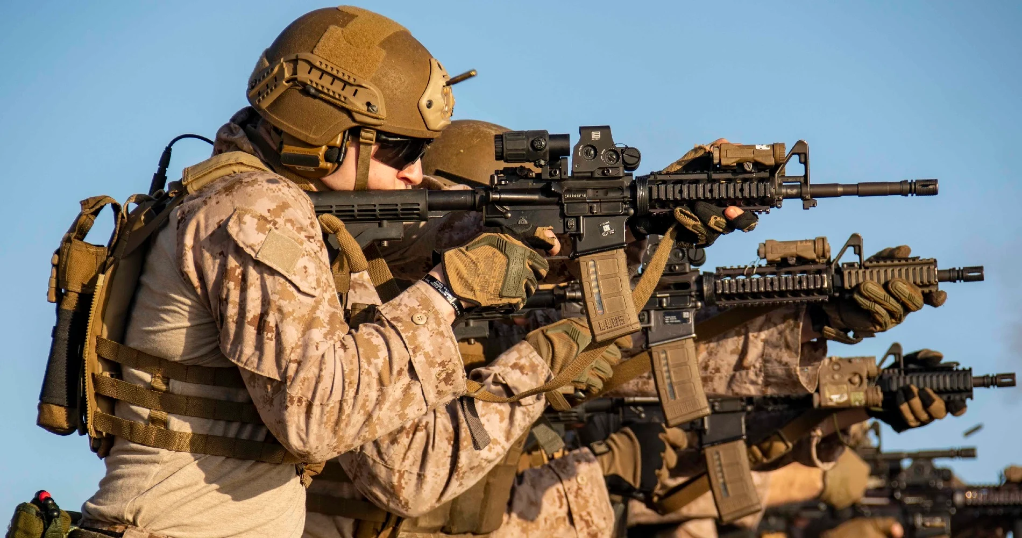
What is VUCA?
VUCA stands for Volatility, Uncertainty, Complexity, and Ambiguity.
VUCA was first implemented by the United States Army in 1987 to give officers information on a changing and unknown battlefield.
Today, VUCA is used as a management strategy to handle all situations.
Business leaders recognize that we live in a VUCA world. The increase in volatility, uncertainty, complexity and ambiguity means leaders have to seek a new approach to modern problems.

Slide 3
Ranking VUCA: Phase I
A person is making tea for three. While waiting for the water to boil, they begin measuring the tea leaves and realize there is only enough tea for two.
Volatility | 3.2
Water could keep boiling and evaporate or get cold | 3
Leaving the kettle unattended could cause an accident | 1
Guests could get upset or impatient | 3

Slide 4
Ranking VUCA: Phase II

Slide 5
Factor | V | U | C | A
Fire | 3 | 2 | 2 | 2
Light Smoke | 1 | 1 | 1 | 1
Dark Smoke | 2 | 1 | 1 | 1
11 Firefighters | -2 | -1 | 2 | 2
2 Ladders | -1 | -1 | 1 | 0
3 Hoses | -3 | -1 | 1 | 1
Door | 0 | -1 | 1 | 0
Window | 0 | -1 | 1 | 1
3 Oxygen Tanks | -1 | -1 | 1 | 0
Total | -1 | -2 | 11 | 8

Slide 6
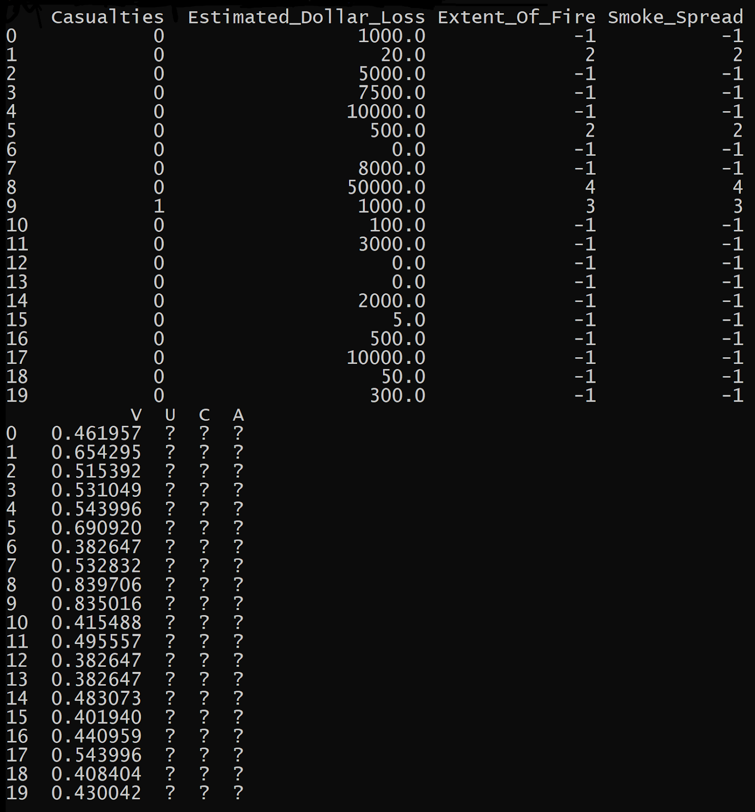
Research
We needed data to help us determine what features to use in our scenarios
We found a dataset including all data regarding fire incidents in Toronto from 2011 to 2017^{[1]}
We also analyzed statistics on the FEMA website^{[2]}
This data was used to visualize the frequency of certain sources of ignition and flammable materials (e.g. trash, cigarette, candle, electronics)

Slide 7
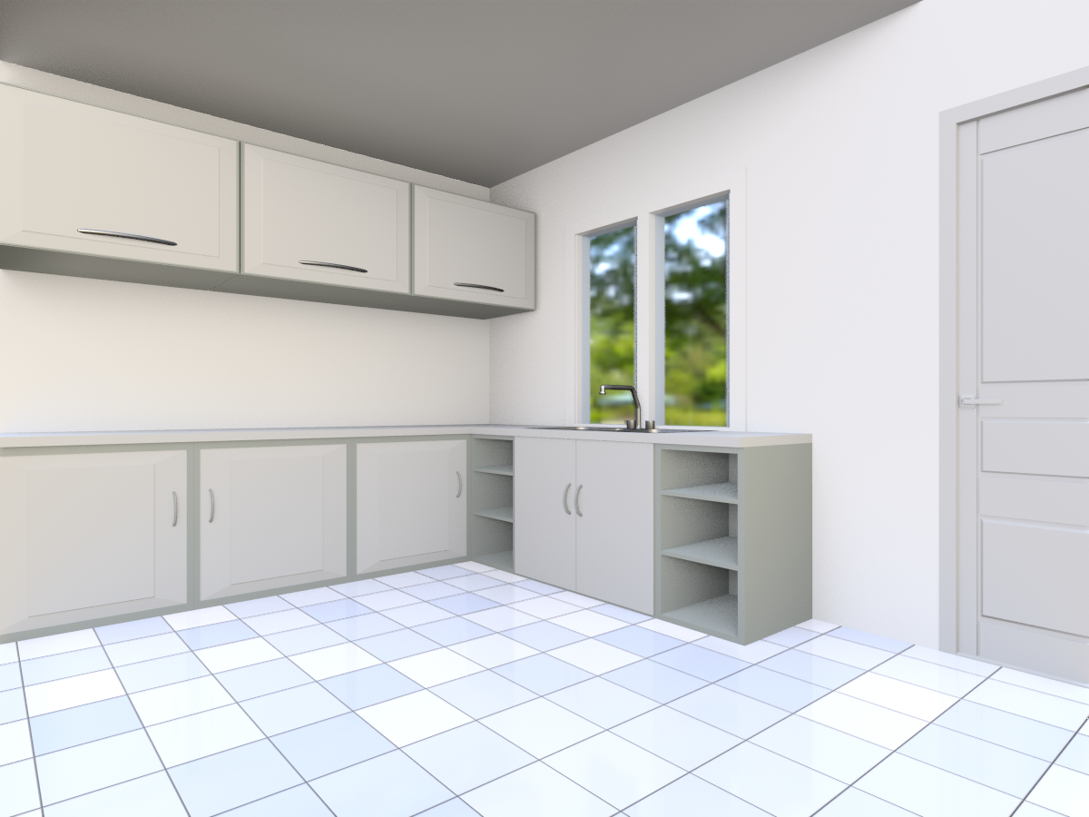
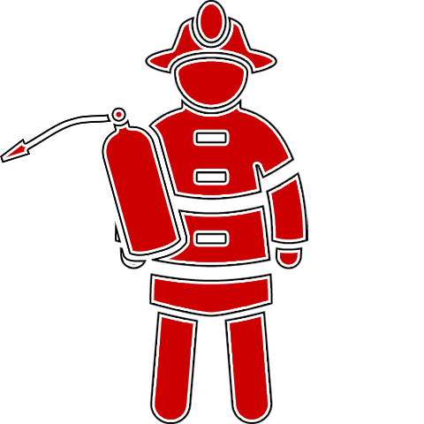
Creating a Survey
To gather more data, we decided to create a survey to ask how specific features impact the VUCA score of a scenario.
We began developing a pipeline to generate scenario images catered to these features
The backgrounds of the images were generated from a 3D model of a house in Blender.
We found icons to represent the features through various online sources.

Slide 8
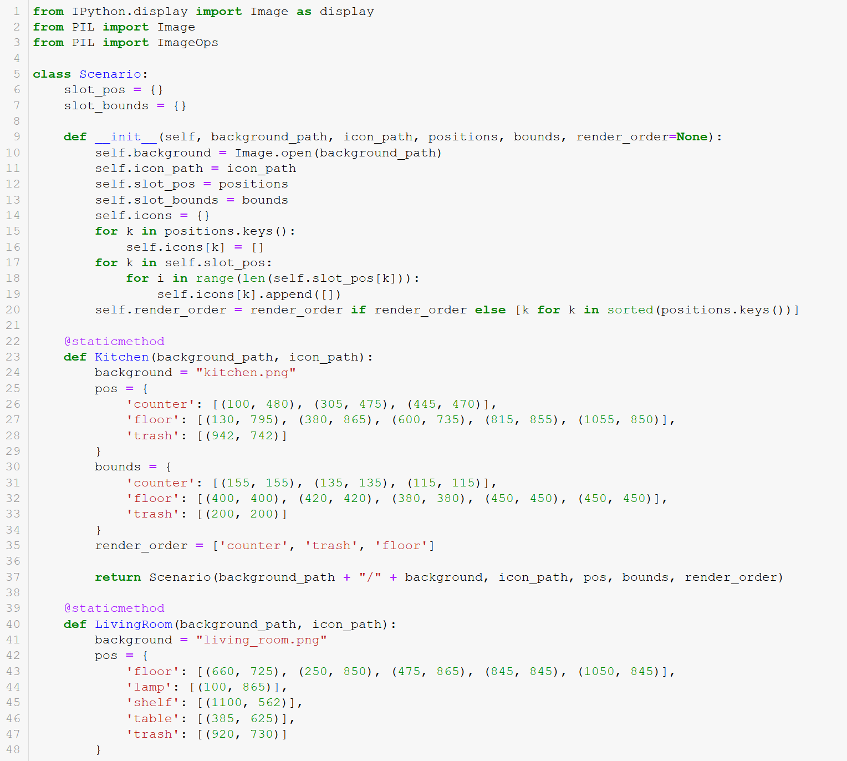
Code for the Survey
Next, we created a Python program to generate scenario images.
This program included functions that place, resize, and reshape images so they could be placed into appropriate spots in a room.
Most importantly, the code included a large dictionary of all icons for each feature.

Slide 9
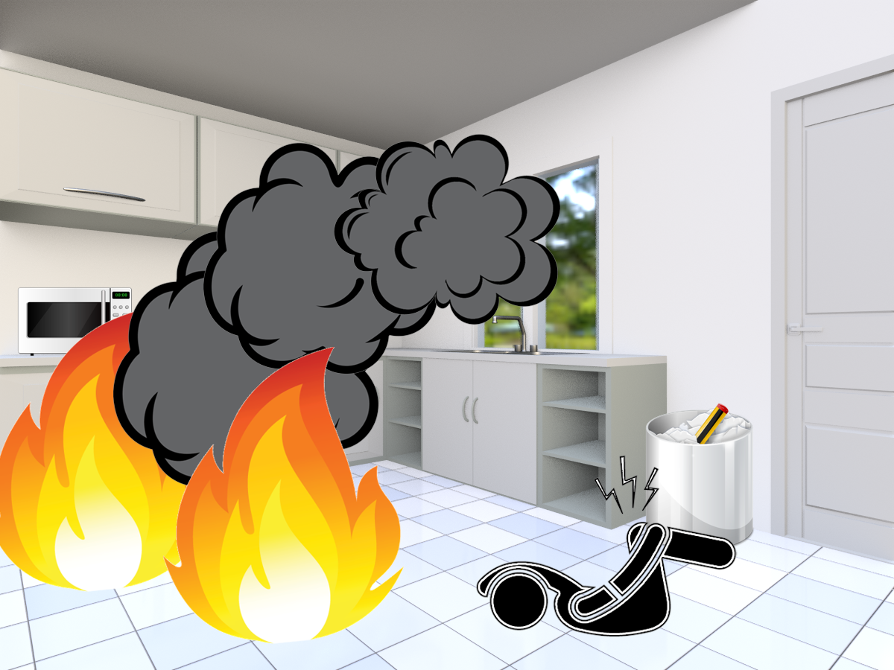
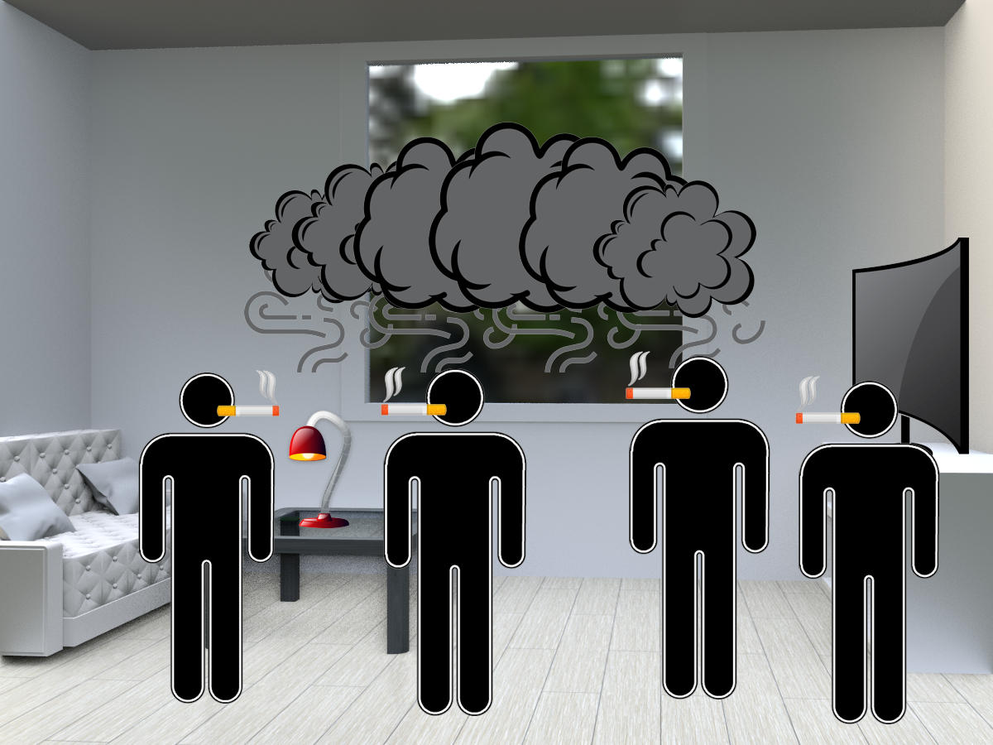

Slide 10
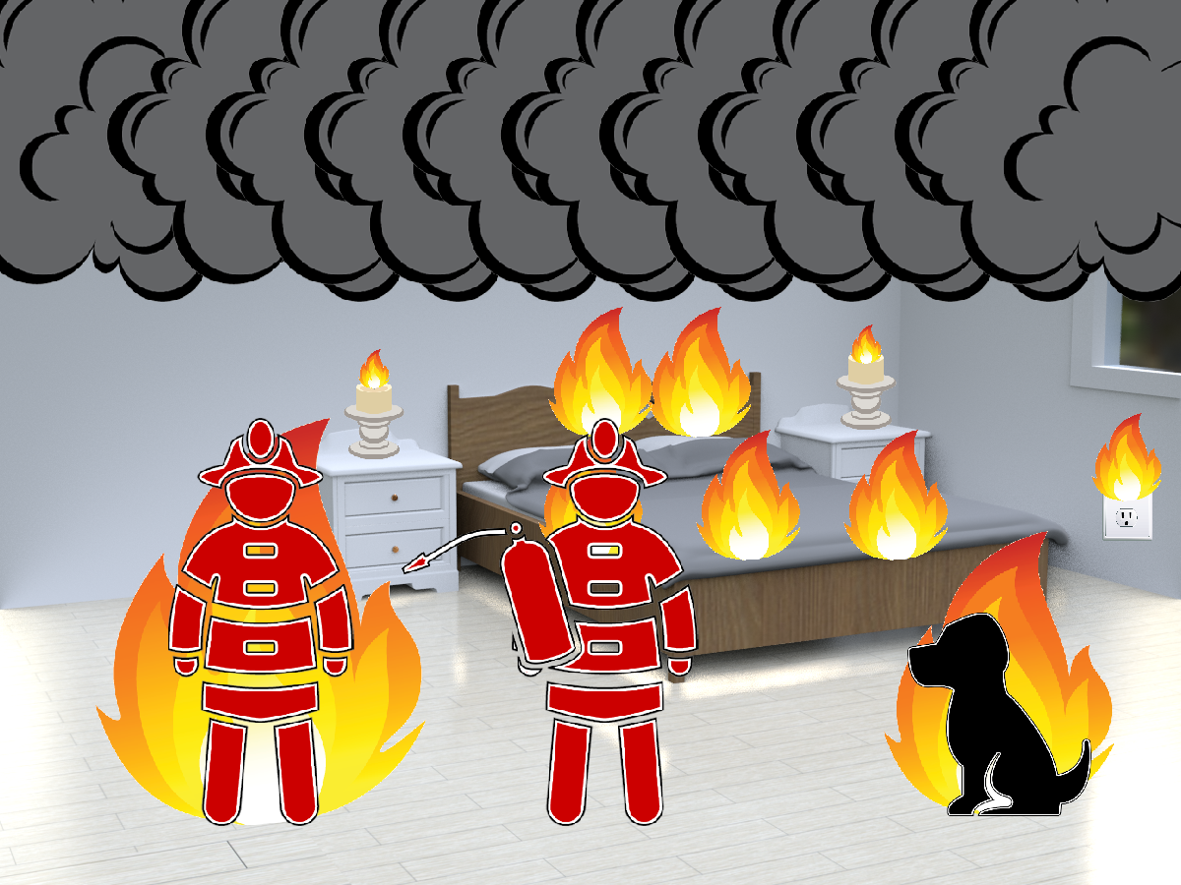
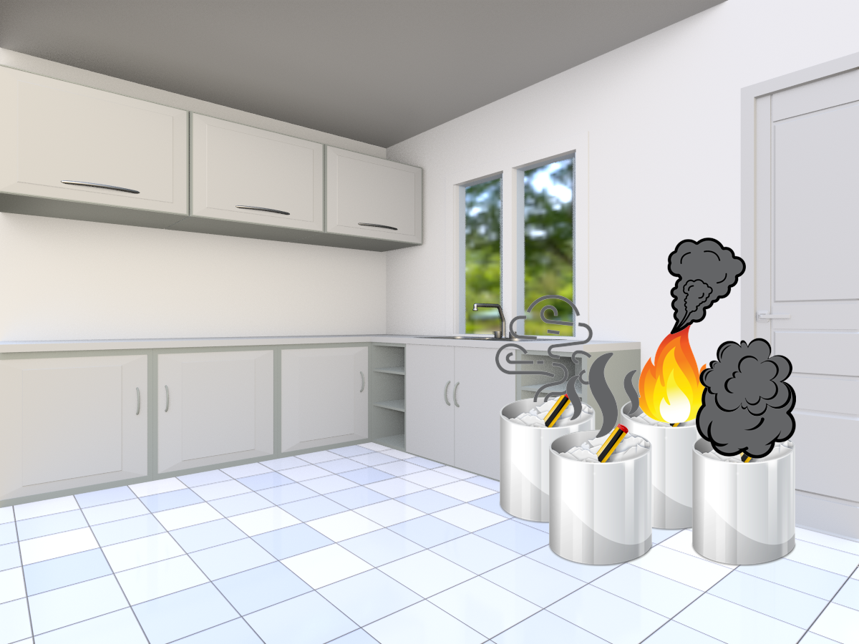

Slide 11
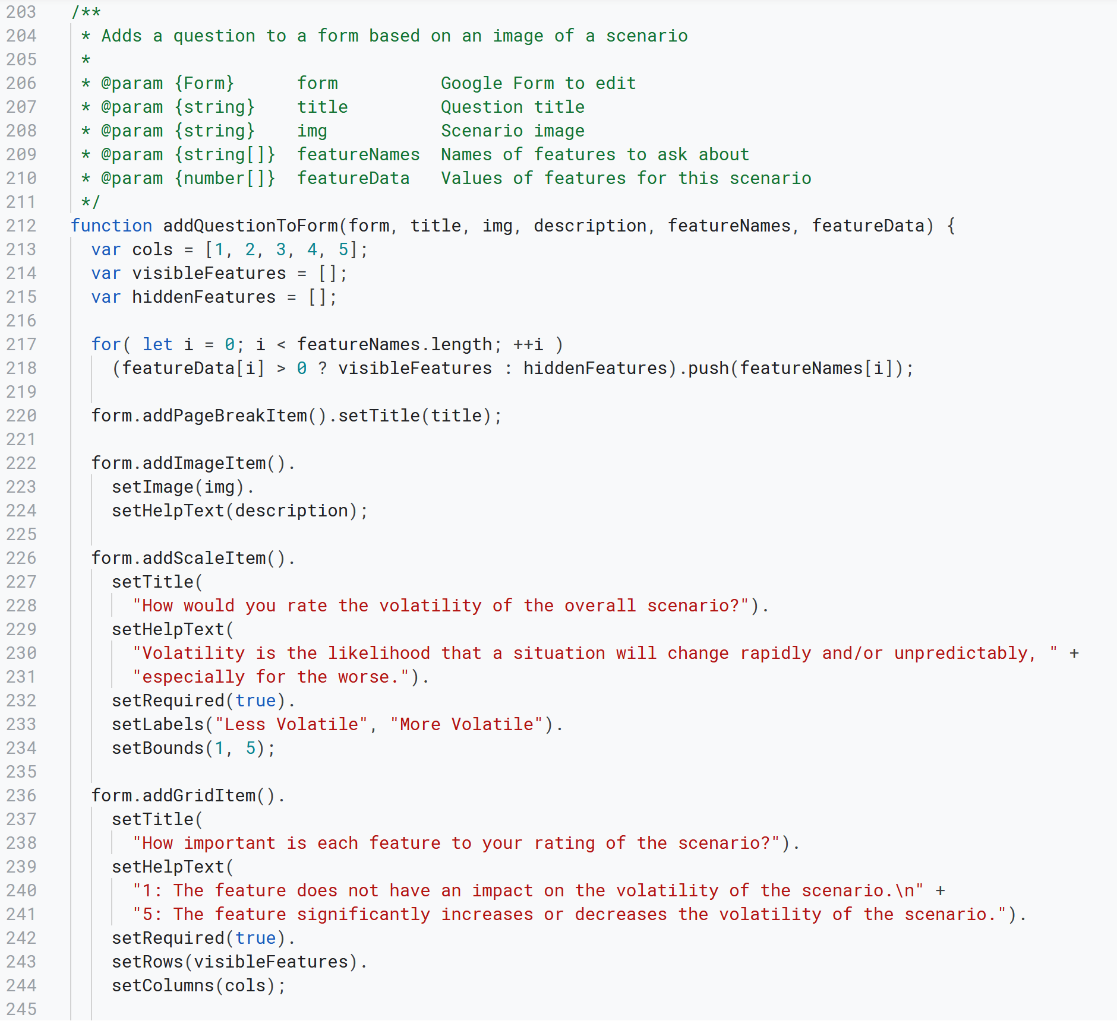
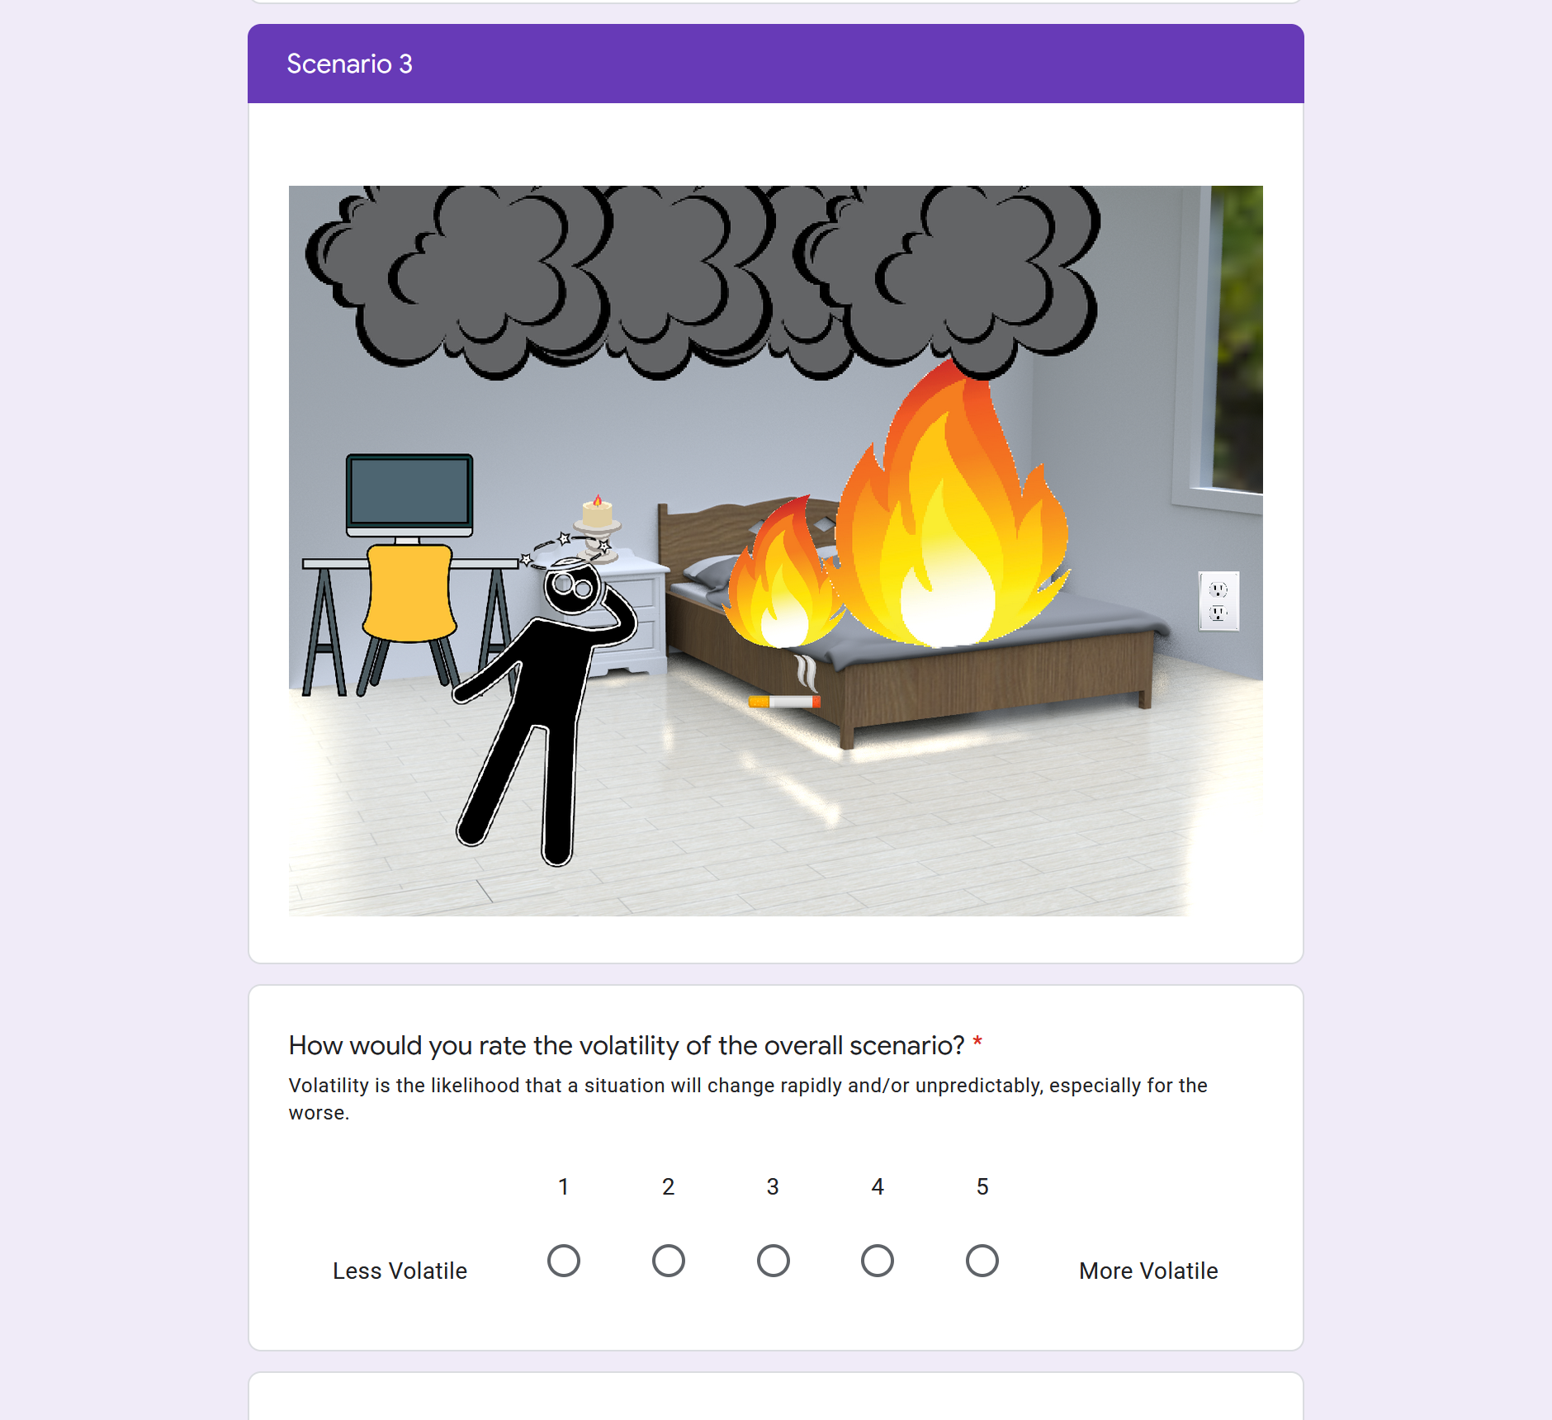

Slide 12
Problems with the Survey
The first survey we created consisted of 15 scenarios.
We had 35 contracts open for Workers on Amazon MTurk.
The Workers on MTurk responded very quickly—within 2 hours we had almost all 35 responses.
Unfortunately, after reviewing the individual responses, we found that they were less than ideal.
Almost half of the responses were easily identifiable as fake because of either: straight-lining, back-and-forth patterns, answers that did not make sense, and other false survey tactics.

Slide 13
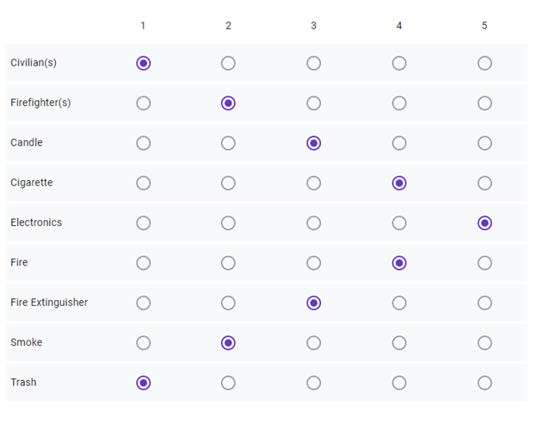

Slide 14
Solution to the Survey Problems
After rejecting many submissions for the first survey, we knew we needed more data.
So, moving forward we created 30 more scenarios that would be used in 2 new surveys.
To counteract some of the false responses, we created an attention-grabbing question. This question asked to count the number of cats in the scenario.

Slide 15
Final VUCA Ranking System: Volatility
Once we started to acquire survey data, we began building a VUCA calculator system.
Volatility is calculated by asking the respondents to rate the overall volatility of a given scenario, then averaging out these answers.

Slide 16
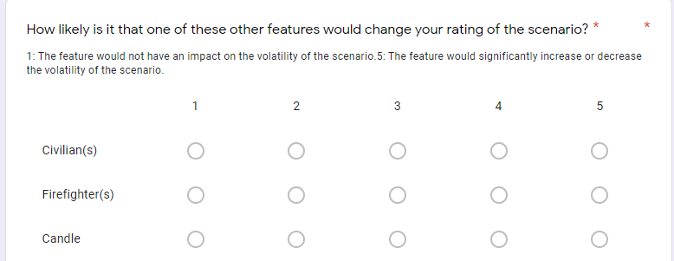
Final VUCA Ranking System: Uncertainty
Uncertainty is calculated by asking the respondent the likelihood that a one of the other features not visible in the scenario would change the rating if it were present.
Each rank is added together and then divided by the maximum possible uncertainty, which is 50 (number of features = 10, highest rating = 5, 10 * 5 = 50).

Slide 17
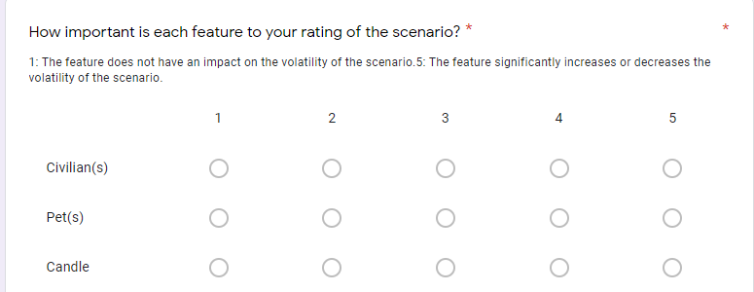
Final VUCA Ranking System: Complexity
Complexity is calculated by asking the respondents how important each feature is to the scenario’s rating.
Each rank is added together and then divided by the maximum possible complexity, which is 50 (number of features = 10, highest rating = 5, 10 * 5 = 50).

Slide 18
Final VUCA Ranking System: Ambiguity
Ambiguity in calculated by using the standard deviation of all three questions.
For each question, we took the standard deviation of the responses and divided by the theoretical maximum standard deviation.
The maximum standard deviation would be recorded if half the responses were the minimum value and half were the maximum value.
This gave us a percentage for each question, and then we averaged the percentages of all three questions.

Slide 19
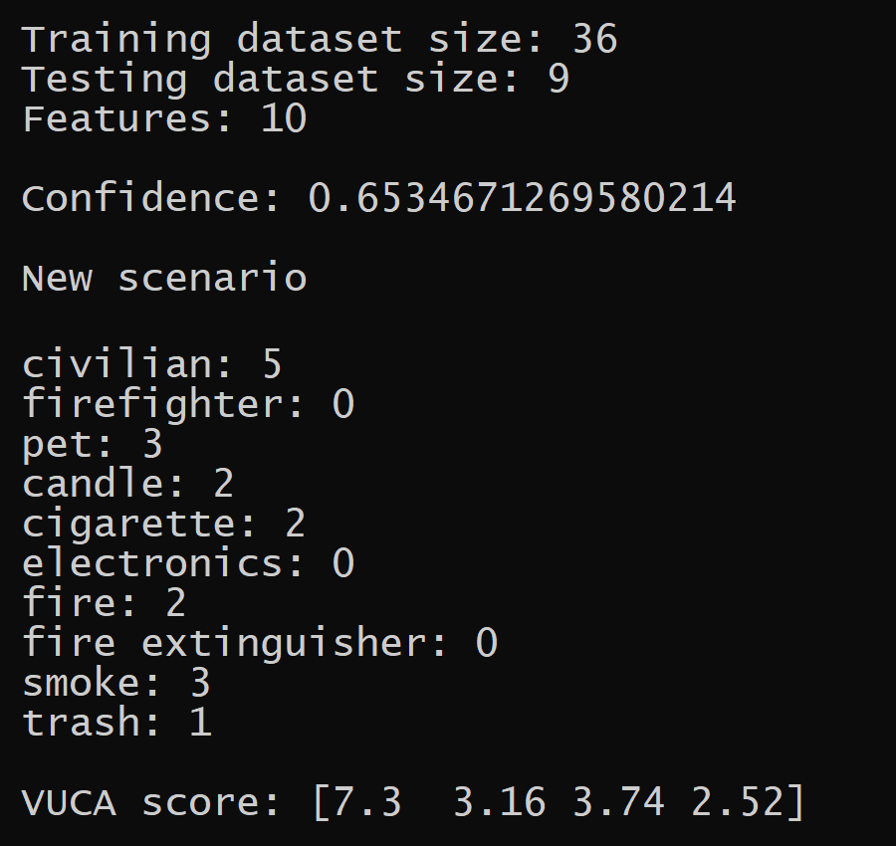
Machine Learning
We used the scikit-learn^{[3]} library to develop an algorithm to apply a VUCA score to any scenario.
This algorithm was trained on the VUCA scores calculated from our surveys.
We tried a few different regression algorithms, but more data is needed to determine which model would be the most accurate.

Slide 20
Acknowledgements
This work was supported by the National Science Foundation Grant #17576507
Brad Lehman, Principal Investigator of REU-Power 2021
Claire Duggan, Director for Program
Nicolas Fuchs, Project Implementation Coordinator
Tyree Thompson, Program Coordinator
Mary Howley, Administrative Support
Dr. Taskin Padir, Associate Professor, Electrical and Computer Engineering
Katiso Mabulu, Scholar Mentor

Slide 21
Works Cited
https://www.kaggle.com/phyxle/toronto-fire-incidents?select=Fire+Incidents+Data.csv
https://www.usfa.fema.gov/data/statistics/
Scikit-learn: Machine Learning in Python, Pedregosa et al., JMLR 12, pp. 2825-2830, 2011.

