Slide 1
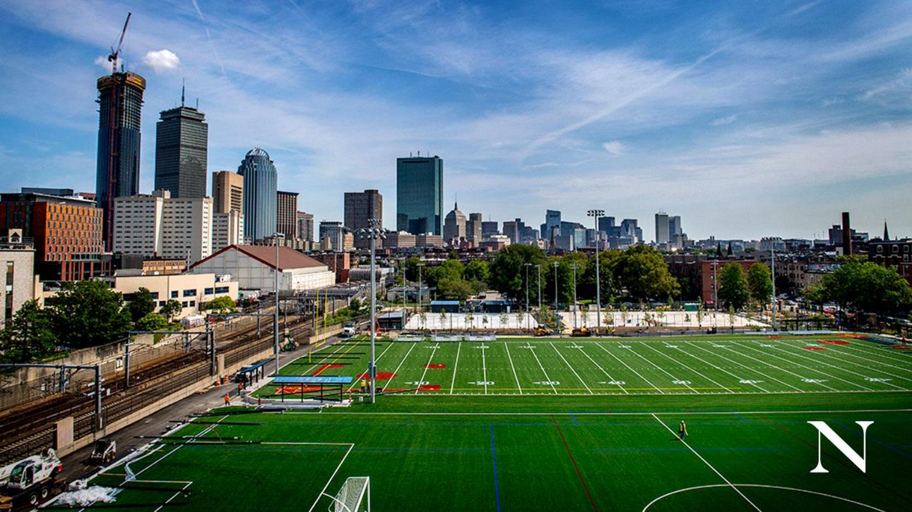
Sumo Hexbugs
Design Challenge

Slide 2


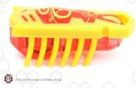

Engineering Design of Hexbugs
2007 - Innovation First International introduced the Hexbug.
“HEXBUG Nano fascinates children and adults alike with its lifelike behavior while it exposes them to concepts such as cause-and-effect, momentum, center of gravity and randomness.”

Slide 3
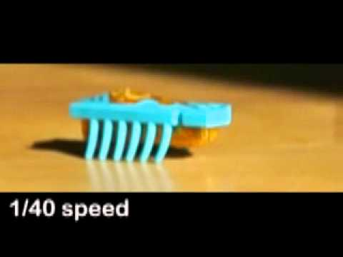
Hexbug Movements
https://www.yout-ube.com/watch?v=EwrpBd_iiGc
Hexbug slow-motion video

Slide 4
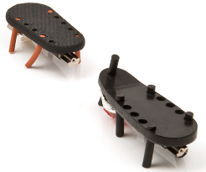
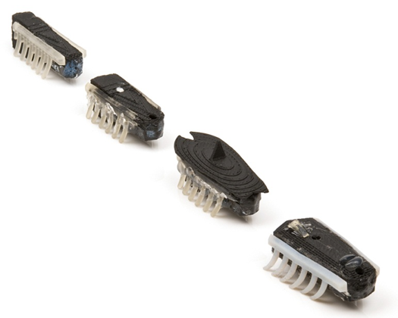
Engineering Design of Hexbugs
1st prototypes - motor underneath chassis for stability
Rapid prototyped parts were used in the engineering design process to improve the design of the Hexbug, especially its legs.
Once the basic engineering concepts were established, engineers focused on getting the Hexbug to move forward and flip back over if it fell onto its back.

Slide 5
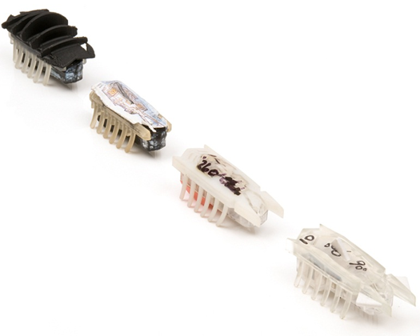
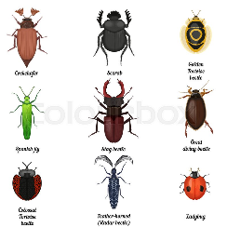
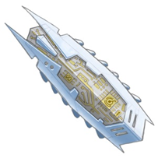
Engineering Design of Hexbugs
Design & development continued with a more finished looking Hexbug Nano.
Concept sketches began to illustrate what the finished product might look like, inspired by nature and real bugs.

Slide 6
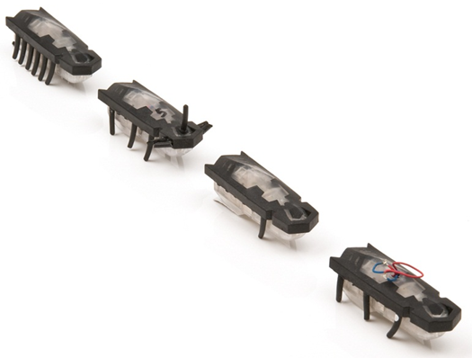
Engineering Design of Hexbugs
The horn design was replaced with a closed nose shape. Why do you think the nope shape was changed from pointed to rounded? Hint: think about safety with intended users (kids) & durability (product lifespan).
Prototypes were made with different leg configurations with different leg lengths and shapes in order to understand their engineering function.

Slide 7
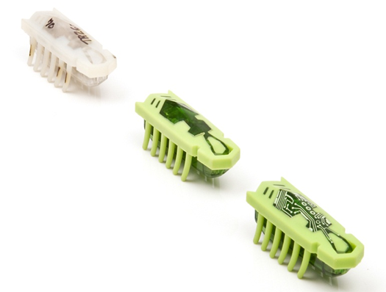
Engineering Design of Hexbugs
Final engineering design was proven, tested and selected for production.
Most significant challenge was manufacturing the components so that every Hexbug Nano performed the same, regardless of which production injection mold made the legs.

Slide 8
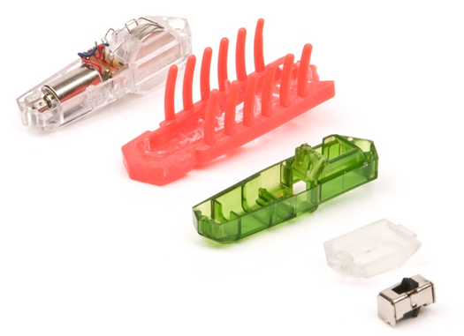
Engineering Design of Hexbugs
Hexbug Nano was “designed for manufacturing and assembly” so that multiple color options could be achieved in the fewest number of parts possible.
= Modular Design

Slide 9
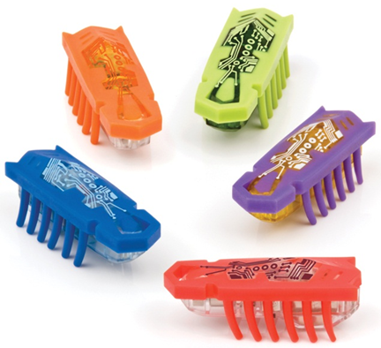
Engineering Design of Hexbugs
Some of the final colors of the first group of Hexbug Nanos were produced in smaller numbers so that they would be harder to find in the market, making them more rare.

Slide 10
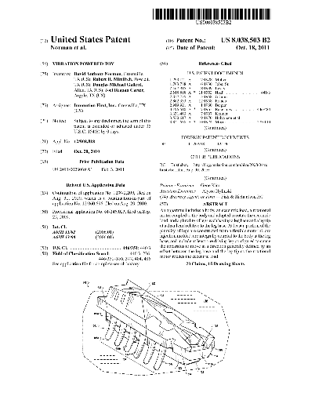
Intellectual Property
Patent applications to protect intellectual property in the United States & around the world.
Several patent infringement cases against “copycat” manufacturers in China & their associated retailers in the United Kingdom for selling “knock-off” Hexbug Nanos.
Hexbug intellectual property also protected through trademarks and copyrights in the U.S.

Slide 11

Hexbug Random Movements
loops…
straight…
zig-zag…
random…
Can you design an add-on that helps your Hexbug stay in the sumo ring?

Slide 12
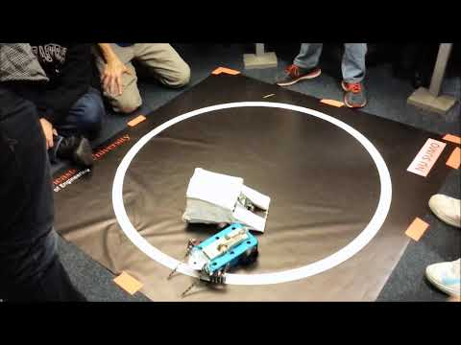
Arduino Sumo Robots
Sumo Robot Competition
https://youtu.be/dq_5_uaqGW4

Slide 13
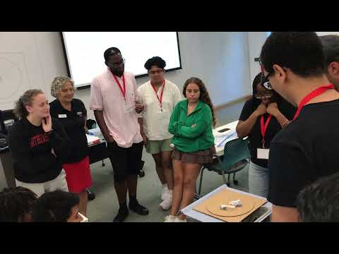
Sumo Hexbugs Design Challenge
Goal
Design your Hexbug so that it STAYS in the ring!
You’re OUT if your Hexbug leaves the sumo ring circle (or is pushed out).
Battle Bugs! Challenge another Hexbug face-to-face.

Slide 14


Sumo Hexbugs
Supplies:
One (1) Hexbug per team (2-3 students per team).
One (1) cardboard sumo mat
One (1) index card
One (1) roll of scotch tape
One (1) pair of scissors
Rule #1: You may ONLY attach pieces of tape & index card to Hexbug, nothing else.
Rule #2: Your Hexbug must START upright on its feet at the beginning of each battle.
Rule #3: Once battle has begun, no human interference allowed.
Winner is the Hexbug that remains in the circle!
N
Battle Bugs!
Notes:
leave this slide up during the build and Battle Bug matches

Slide 15
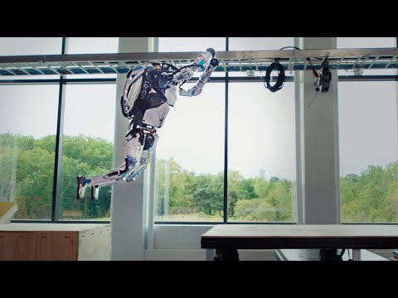
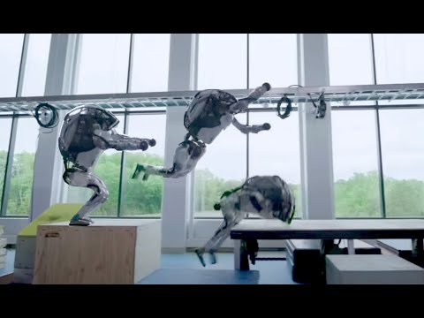
Humanoids by Boston Dynamics (Waltham, MA)
ATLAS robot

Slide 16
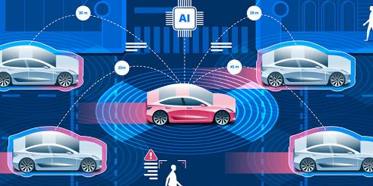
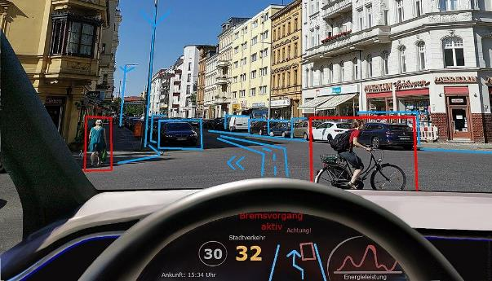
Autonomous (Self-Driving) Vehicles
What types of engineers & scientists design self-driving vehicles?
bioengineers, mechanical engineers, civil engineers, industrial engineers, computer engineers, transportation engineers, electrical engineers, acoustic engineers, artificial intelligence engineers & scientists, mathematicians, computer scientists… and more!

Slide 17
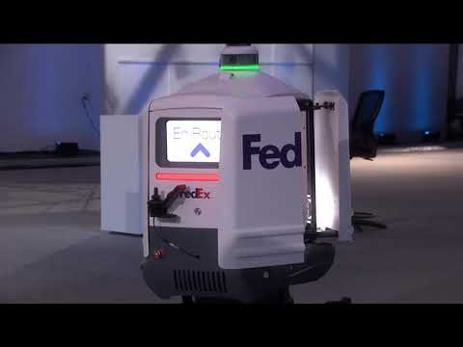

Autonomous Package Delivery
The last mile of package delivery is the most expensive & most energy consuming!

Slide 18
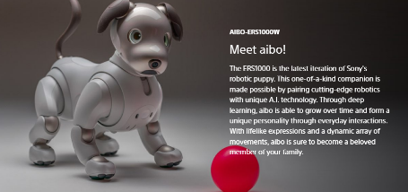

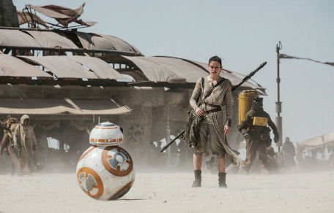
Thoughts? Questions & Answers
“the dawn of the robot age will be an opportunity, not a threat”
- Joseph E. Aoun, President Northeastern University
Notes:
pop culture examples of autonomous robots that young students may recognize and relate to…

