Slide 1
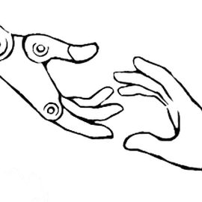
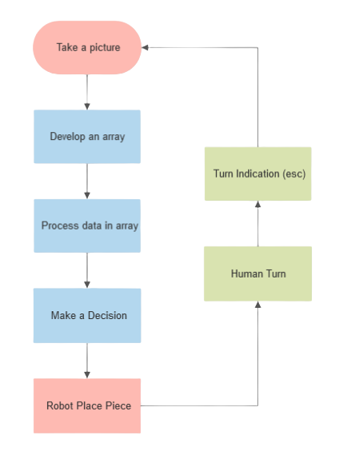
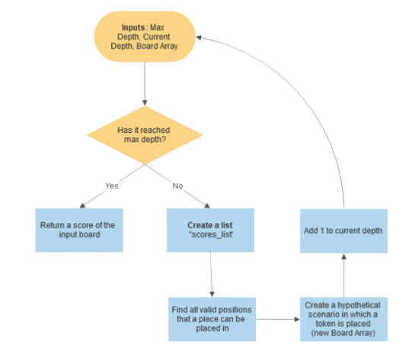
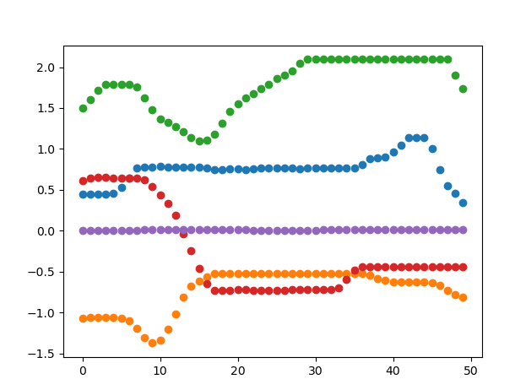
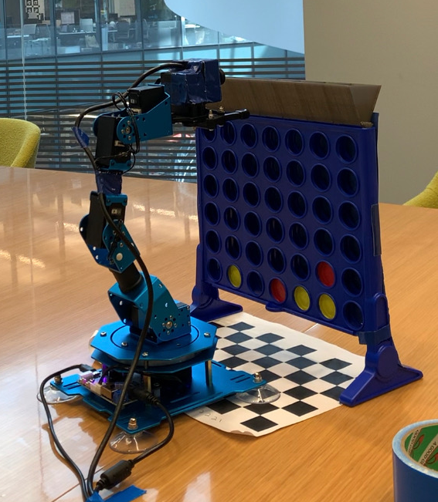
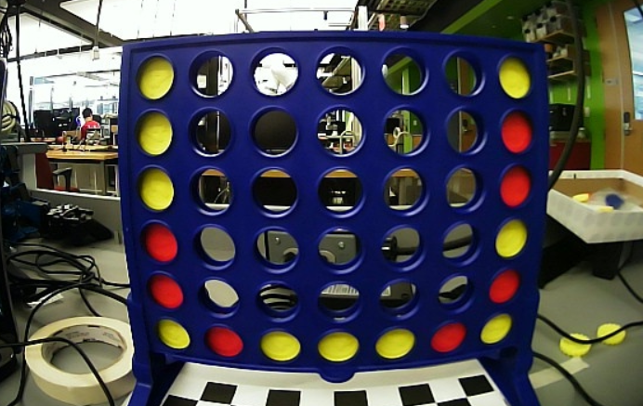
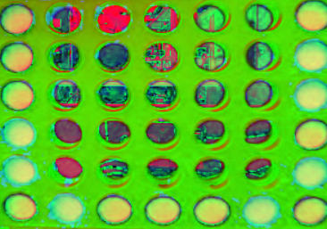
Applications of AI - Using a Minmax Algorithm to Play Connect 4
Divya Rajaraman, YSP Student, Brookline High School
David Barber, YSP Student, High School
Colin Keil, PhD student, Northeastern University
David Klee, PhD student, Northeastern University
PI/Professor, Department, Northeastern University
Abstract
Experimental Methods
Results Continued
We are working on programming the robotic Nuro Arm to perform a series of motions to play connect four. The use and testing of the Nuro Arm is part of the lab’s overall goal of providing robotic assistance on a more affordable and accessible level, and on a more long term scale to increase the possibility of having a cheaper robot perform daily tasks within households. We are currently programming a robot to be able to respond to moves made by an opponent during the game of connect 4, utilizing openCV image recognition software to detect the location of pieces, and then developing code in python to make decisions based on piece locations.
Steps taken to successfully play game
Building the Nuro Arm robot and mounting camera onto the arm
Utilizing OpenCV software to capture a frame from camera stream, using the 5th frame to detect colors of game board
Camera calibration to fix distorted frame from camera stream, cropping image and finding average value of pixels for each place on board
Based on collected HSV values of pixels, define a 7 by 6 array to represent the game board
Creating Algorithm: write a series of functions to determine optimal positioning of pieces on game board in order to place 4 chips in a row.
3D printing funnel and determining positions for robot to move to in order to accurately place chips on the game board
Our minmax algorithm will determine an optimal move by assigning a score based on the end result of placing a piece in one of the 7 possible locations. It utilizes a recursive function to evaluate a game tree to a specified depth and determine the most optimal move assuming that the opponent plays an optimal game as well. On each call of the recursive algorithm, a hypothetical board is formed, differing by 1 piece than the board made one move prior, then a score is assigned to the hypothetical board to determine whether placing a piece in the specified location is the best move.
Background
Accessible Robotics: Robotics technology is being created and used more frequently in our modern age. With this creation of new technologies comes great expenses to build precise robots that are able to perform complex functions. One of the lab’s goals is to increase robotics outreach using cheap and accessible materials, such as the Nuro arm robot, to perform tasks using image recognition software and decision based artificial intelligence programs.
Conclusion and Future Steps
We have utilized openCV image recognition, and the numpy library to process data in the form of a connect four board, and run the data through an algorithm to determine the best possible next move a player could make. The algorithm we have created allows the robot to play connect four against a human, and defeats or ties against the opponent in the matches played. We changed our code to create a minmax algorithm that creates a decision tree to evaluate a move based on the outcome of the move steps ahead.This same thorough process can be applied to a very broad range of situations ranging from cooking food to exploring space. A fairly simple idea of assigning a score to a hypothetical scenario allows the quantification of everyday tasks, which enables computers to make more knowledgeable decisions that will benefit us in the long term.
Results
The world can be divided into 6 degrees of movement: 3 rotational axis and 3 translational axis. Modern robotic arms oftentimes have 6 or 7 rotational axis in order to access as many places within a certain radius. The Nuro arm uses 5 servo motors, which still gives it quite a bit of freedom, and the ability to manipulate objects fairly efficiently. The robot is controlled in 2 different manners: Joint position control and End Effector control.
Acknowledgements
We graphed the position values of the 5 joints of the robots over a position of time in order to find specific positions that we want to set the robot to move to with minimal error and speed.
Professor Robert Platt, Professor in Khory College of Computer Science
Colin Keil, PhD student
David Klee PhD student
Department of STEM Claire Duggan, Director of Programs and Operations, Center for STEM Education
Franklin Ollivierre and Katherine Aristizabal, YSP Coordinators
Nicholas Fuchs, Project Implementation Coordinator
We calibrated the camera to account for the fish eye lens, turning the warped image into one of normal scale. Each frame is also cropped and set to HSV color scale in order for us to retain the colors of the connect four chips by detecting the HSV values of individual pixels.
Notes:
1
Change to relevant logos of sponsor, also include grant # if there is one.
Step 1
Building the Nuro Arm robot and mounting camera onto the arm
Utilizing OpenCV software to capture a frame from camera stream, using the 5th frame to detect colors of game board
Step 2
Camera calibration to fix distorted frame, cropping image and finding average value of pixels for each place on board
Step 3
Based on collected HSV values of pixels, define a 7 by 6 array to represent the game board
Step 4
Creating Algorithm: write a series of functions to determine optimal positioning of pieces on game board in order to place 4 chips in a row.
Step 5
3-D printing funnel and determining positions for robot to move to in order to accurately place chips on the game board

