Slide 1
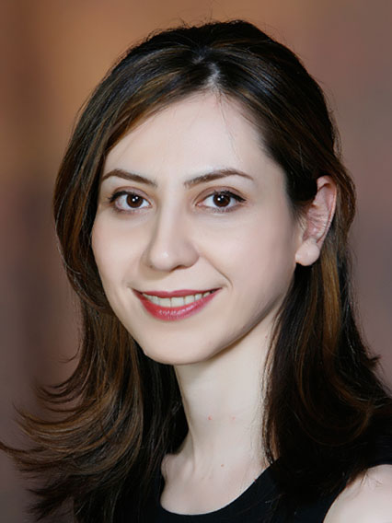
Developing a linear DC-DC converter for solar powered phone chargers
Abigail Wojtaszek, YSP Student, Burlington High School
Eleanor Palmer, YSP Student, Cambridge Rindge & Latin School
Mojtaba Salehi, Electrical & Computer Engineering, Northeastern University
Prof. Mahshid Amirabadi, Electrical & Computer Engineering, Northeastern University
August 3rd , 2023

Slide 2
Abstract
Motivation:
Renewable energy sources decrease the use of fossil fuels and sustainably power the grid
Photovoltaic (PV) panels use solar energy to supply different loads
Goals:
Develop a linear converter to use the energy generated from a photovoltaic panel to charge a Li-ion battery
Simulate the design using PSIM software, where we also tested factors such as:
Irradiation level
Temperature
Variable load
Find the ideal conditions for maximized output power
Results:
Converter changes the input DC voltage to a different amplitude DC voltage
To obtain maximum output power, there is an ideal temperature, irradiation level, and load
Various converters that can be used within circuits
Voltage divider linear converters
Transistor based converters
Switching converters.

Slide 3
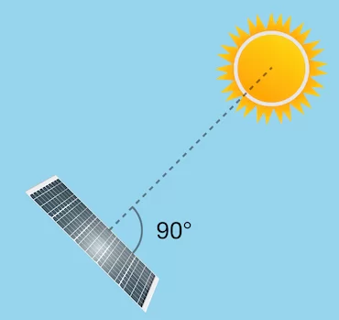
Background
The charger is an example of sustainable and clean energy
Renewable energy sources are needed to face climate change and decrease the use of fossil fuels
PV panels only have 20%-30% efficiency, so it is important to maximize their output
PV panel efficiency changes with varying temperature and irradiance levels
A 90 degree angle with the sun generates the most power, meaning the solar panel’s angle from the ground is important
(Electronics Hub)

Slide 4
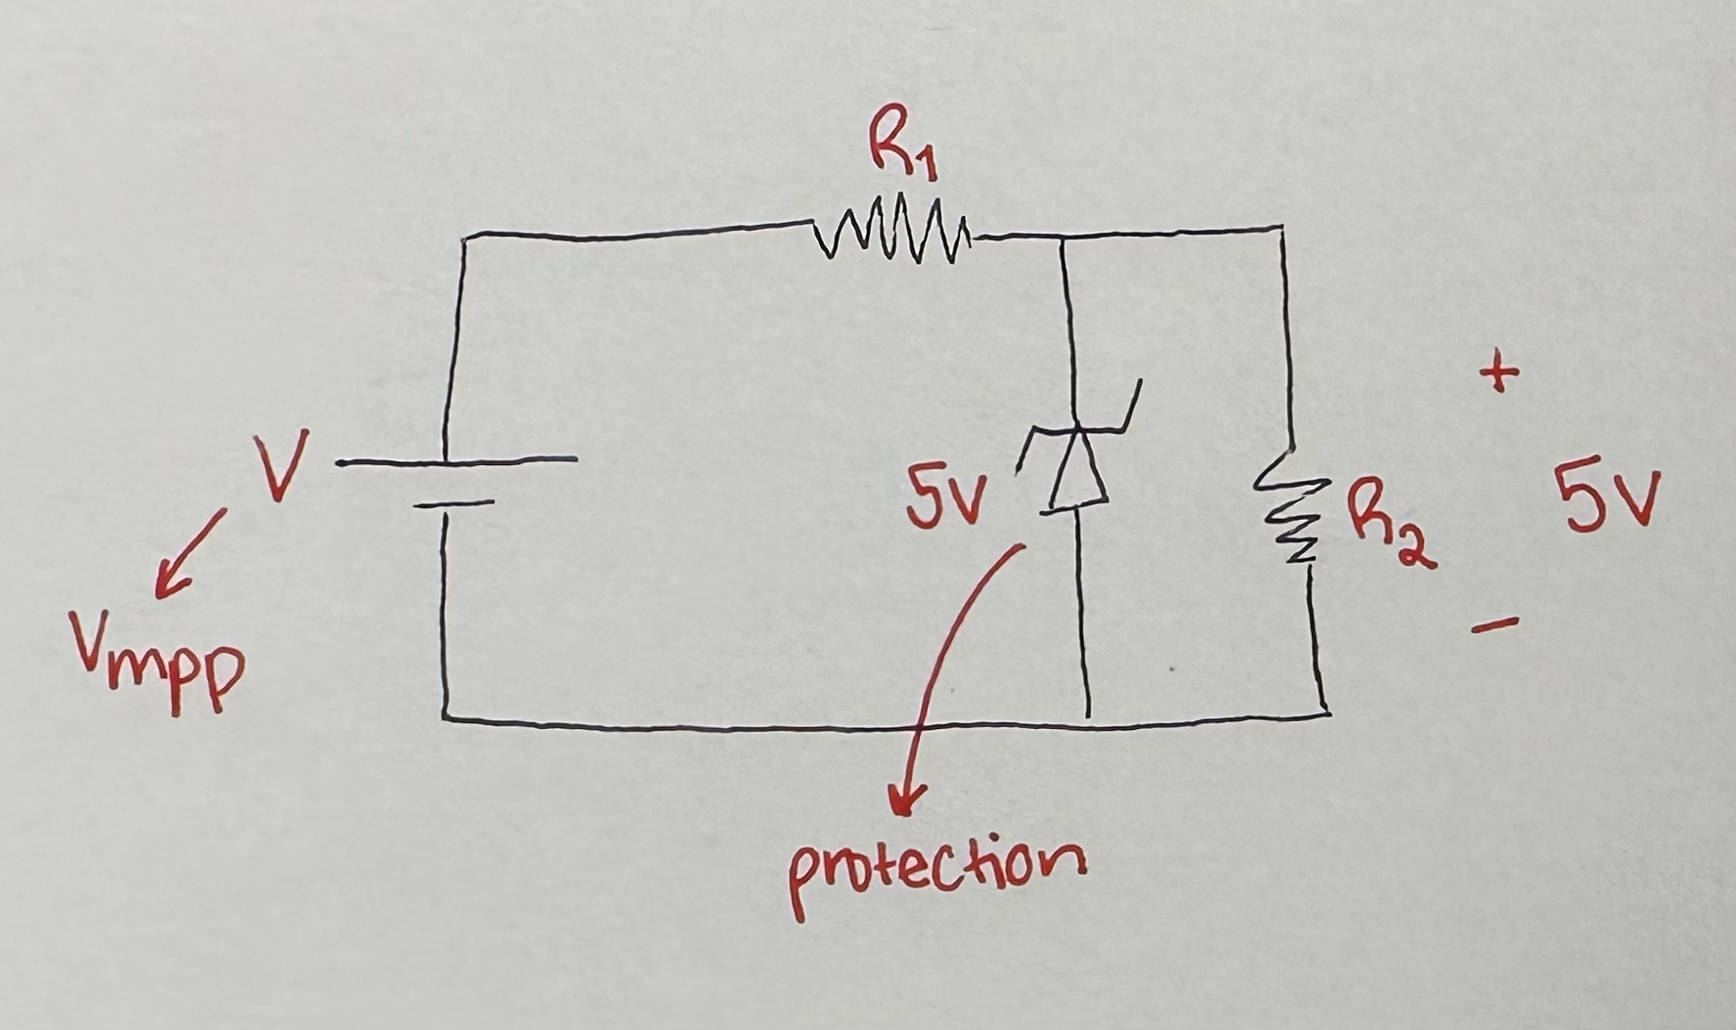
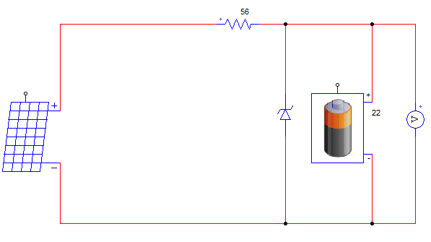
Background
Power electronics is a branch of electrical engineering that involves the processing of voltages and currents for different applications
Voltage (V) - potential energy difference between two points
Current (I) – the rate electrons flow through a point
Resistance (R) - how much the current is impeded
Resistors limit electron flow
Zener diode
Diode that allows current to flow in reverse when a specific “Zener voltage” is reached (used as protection)

Slide 5
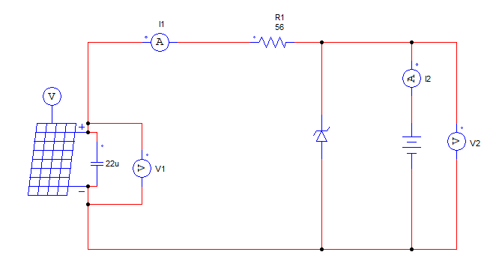
Background
Although the panel creates a DC voltage already, the linear converter is needed to convert the amplitude of the input voltage
The input voltage from the solar panels will be measured (V1)
The output voltage (V2) will be 5 volts and have the ability to power a lithium-ion phone battery

Slide 6
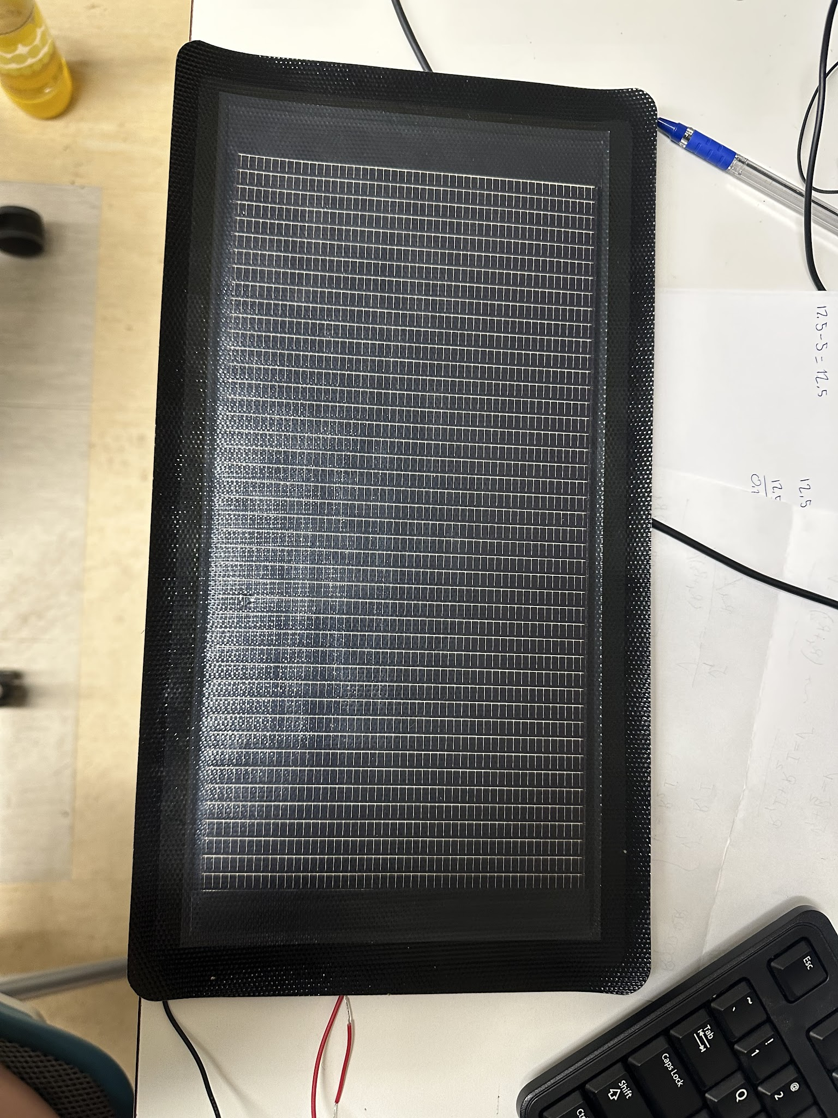
Experimental methods – collecting data
Solar panel was tested in direct sunlight
First tested to find optimal angle
Tested for voltage and current at varying resistances
Used multimeter and variable resistor for testing
Data collected in google sheets to be used to calculate maximum power point
Had to retest or wait for consistent sun conditions
Also changed solar panels from a 12 V to 25 V panel, so new data was collected.

Slide 7
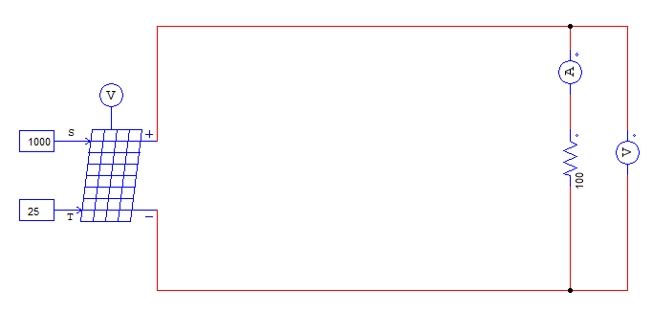
Experimental methods – Calculating Maximum power point(Pmax)
Simulated solar panel on PSIM
Measured voltage and current on PSIM (same as real panel to use as reference)
Data from PSIM collected in google sheets
Varied resistance while keeping temperature and irradiance constant
Notes:
To make sure our results were accurate, we also simulated data from the solar panel on PSIM. We kept temperature and irradiance constant (point to constants on circuit), while varying resistance

Slide 8
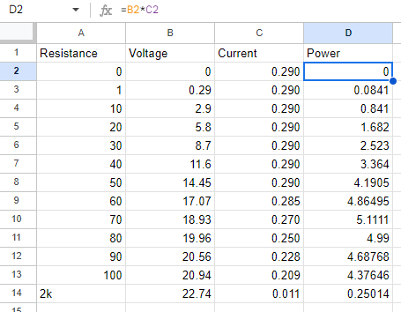
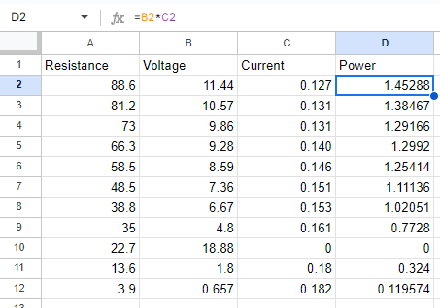
Experimental methods – Equations & Results
Power - the rate at which energy is transformed or transferred
Power = (current)(voltage)
Used to calculate power in sheets for graphing
Power vs. Voltage (PV) and Current vs. Voltage (IV) graphs made from collected data
Two sets of graphs: one from PSIM data and one from experimental data
Graphs used to identify Pmax of solar panel
PSIM
Experimental

Slide 9
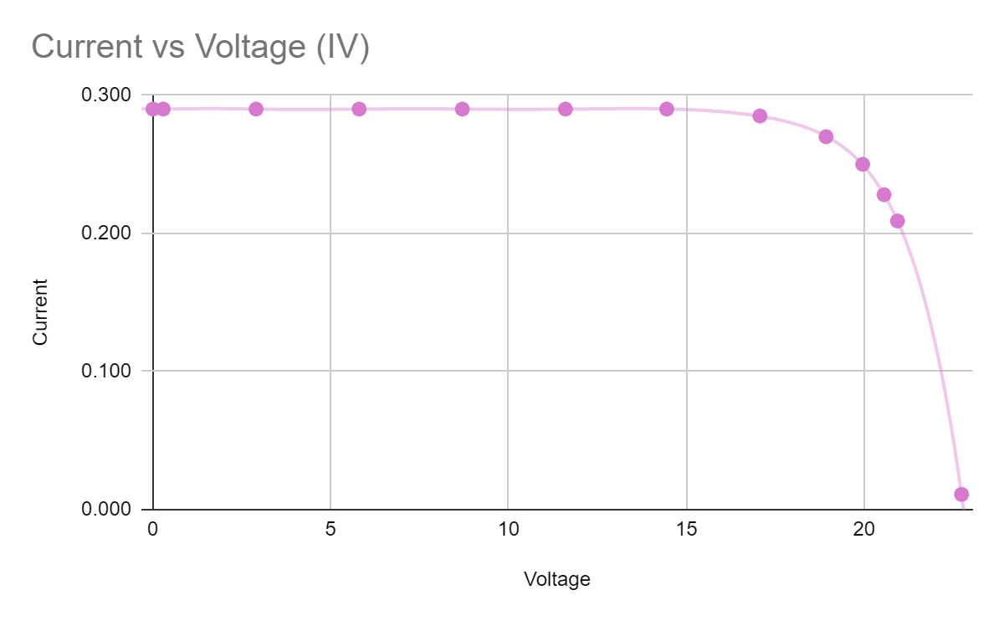
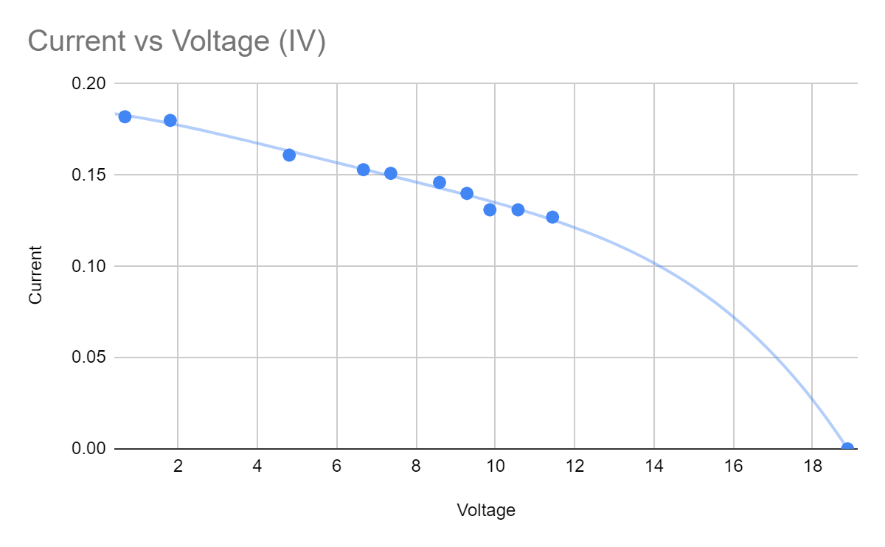
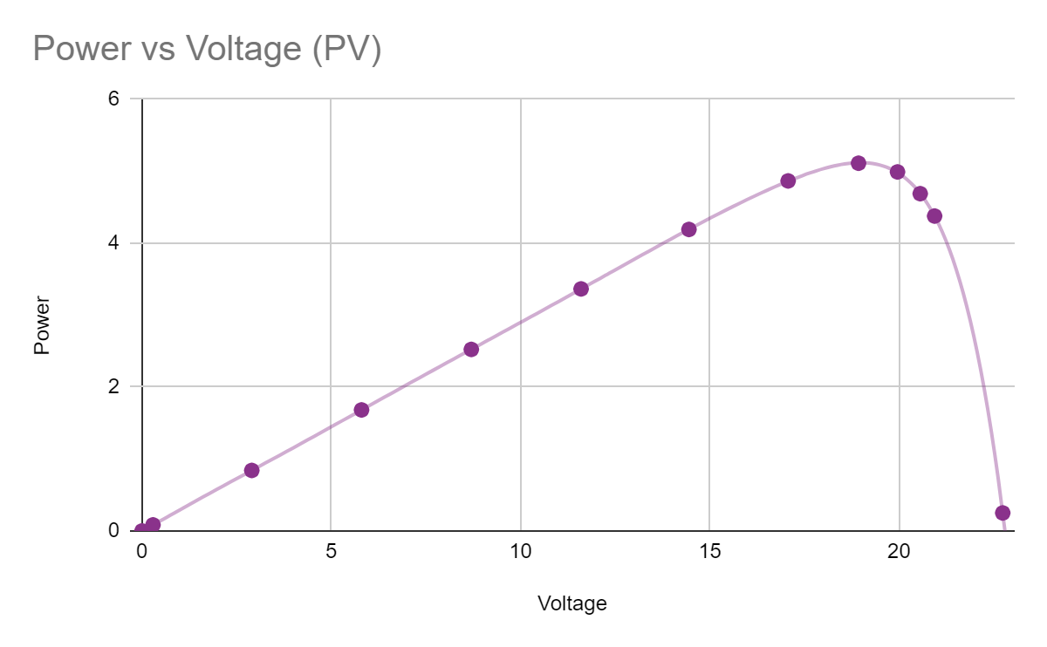
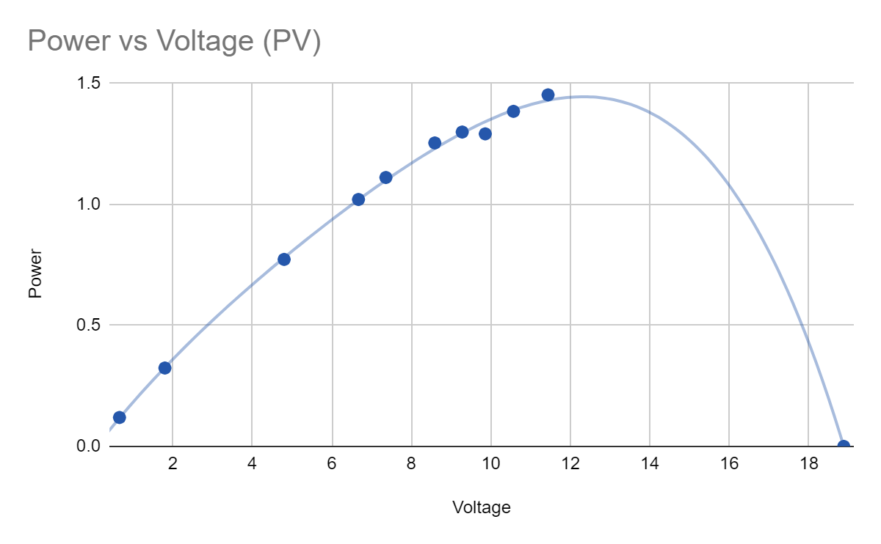
Results Graphs
IV Graphs
PV Graphs
PSIM
Experimental
Notes:
Pmax (lower two graphs highest point), different trials until curves matched simulation

Slide 10
Experimental methods Calculating Optimal Irradiance & Temperature
Simulated solar panel on PSIM
Data from PSIM collected in google sheets
Varied irradiance while keeping temperature (25 °C) and resistance (70 ohms) constant
Varied temperature while keeping irradiance (1000) and resistance (70 ohms) constant
Power was the highest at a resistance of 70 ohms, so we used that resistance when testing temperature and irradiance
Power vs. Irradiance and Power vs. Temperature graphs made from data

Slide 11
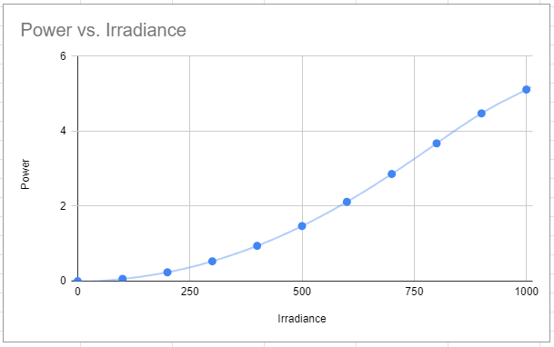
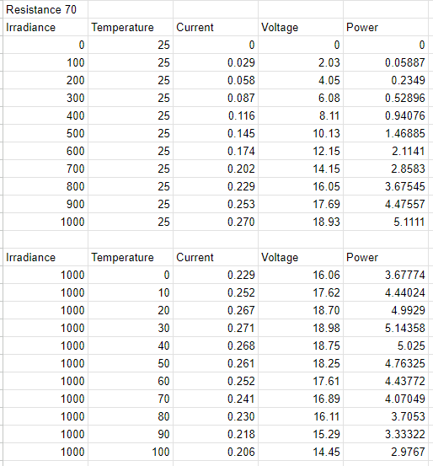
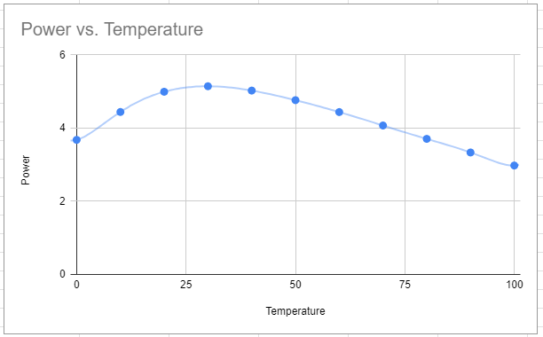
Results Graphs
Irradiance
Temperature
PSIM
Notes:
Temperature: 30, Irradiance: 1000, kept resistance constant
While testing irradiance, kept temperature constant at 25 degrees to find optimal of 1000
While testing temperature, kept irradiance constant at 1000 to find optimal of 25 degrees

Slide 12
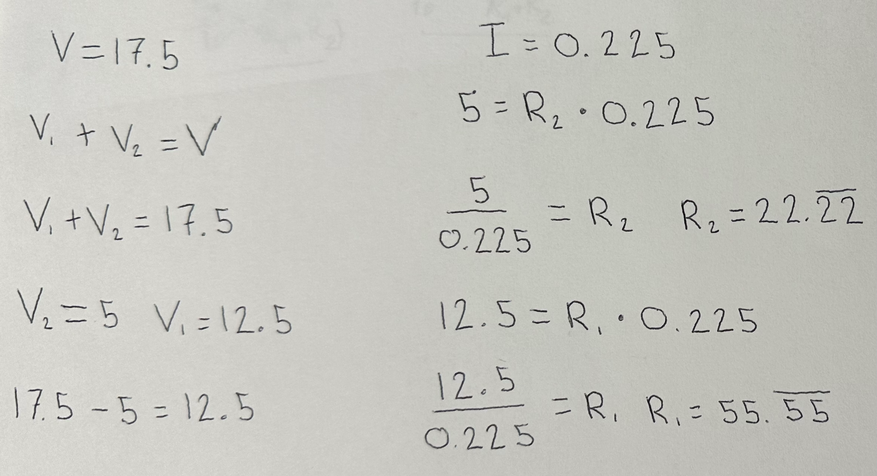
Experimental methods Equations & Results
Ohm’s law
V = IR, voltage = (current)(resistance)
Used to calculate resistances in converter
Since V2 was known (5 V), and Vmpp was known (17.5 V), as it was displayed on the solar panel, we could calculate the resistances needed as pictured to the right.

Slide 13
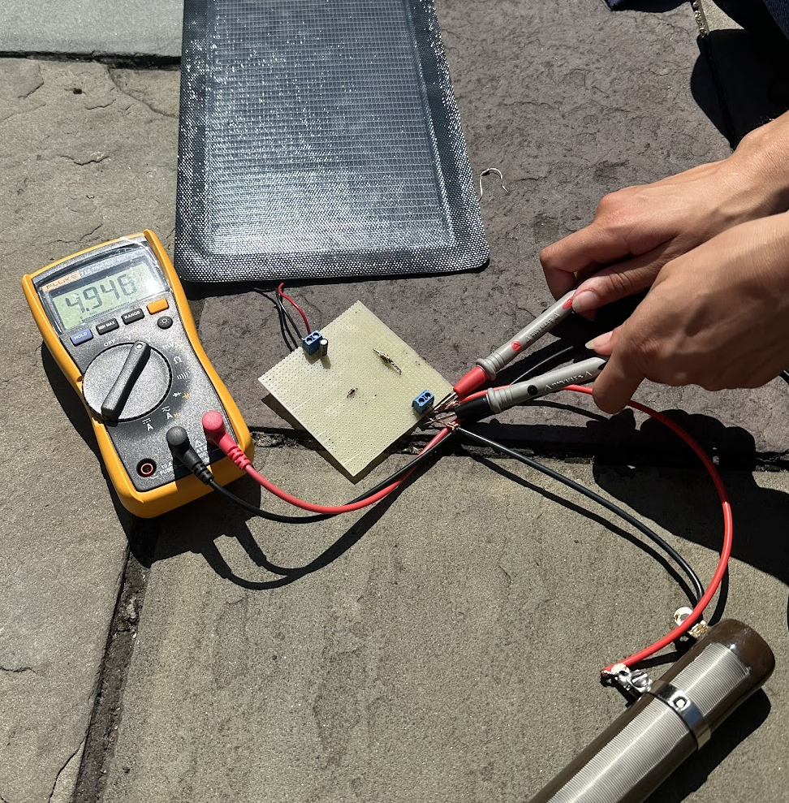
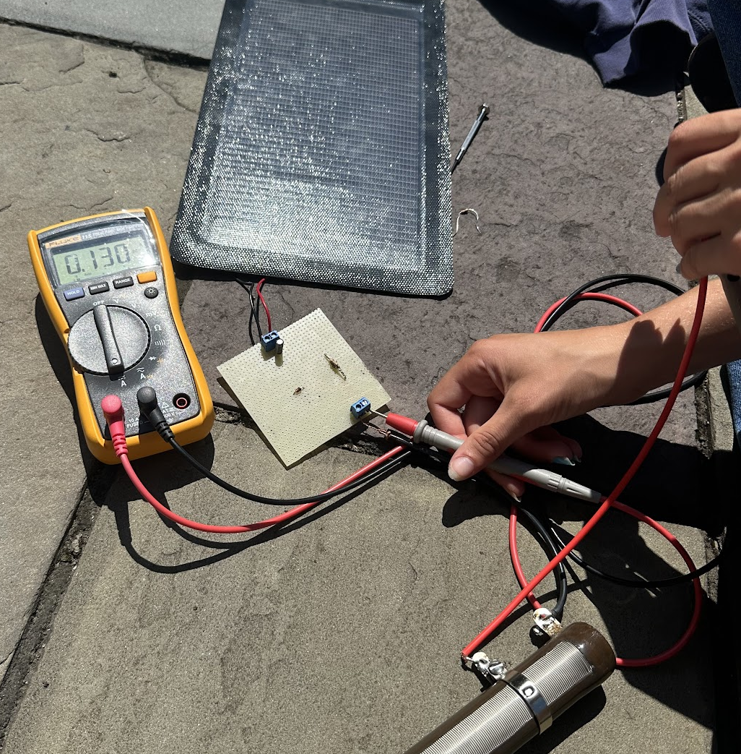
Results Voltage & Current
Linear Converter
Tested outside in direct sunlight for voltage and current, used variable resistor
Notes:
Calculated 22 ohms, but reached 5 V with 38 ohms on variable resistor

Slide 14
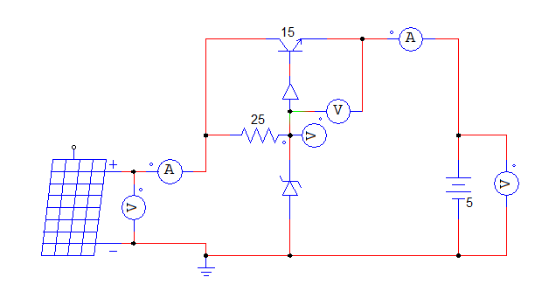
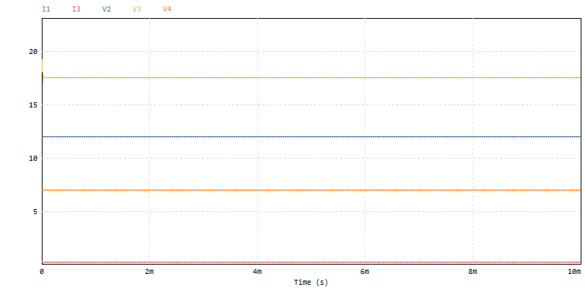
Experimental methods – Other Converters
Determining V_{CE} and resistance
Transistor Based Linear Converter
Notes:
Vce – voltage across collector emitter

Slide 15
Results PSIM
Maximum Power Point (PSIM): 5.14 watts
Maximum power extracted at:
Irradiance: 1000 W/$m^{2}$
Temperature: 30 ℃
Resistance: 70 Ω
Future Steps:
Voltage divider linear converters are inefficient, but other variations such as the transistor based linear converter and switching converters are more reliable
The development of universal power converters
Notes:
Reduce heat loss; can lower voltage while increasing current, conserving electrical power and energy

Slide 16
Acknowledgements
Power Electronics and Renewable Energy Systems Laboratory
Professor Mahshid Amirabadi, Ph.D.
Mojtaba Salehi, Ph.D. Student
Center for STEM Education​
Claire Duggan, Executive Director​
Jennifer Love, Associate Director
Claire Stipp & Yassine Souabny, YSP Coordinators​
Nicolas Fuchs, Project Implementation Coordinator​
Mary Howley, Administrative Officer
REFERENCES
Amirabadi, M. (2021, February 11). CAREER: Universal SiC-Based Power Converters for Renewable Energy Systems. NSF AWARD SEARCH: Award # 2047213 - career: Universal SIC-based power converters for renewable energy systems. https://www.nsf.gov/awardsearch/showAward?AWD_ID=2047213&HistoricalAwards=false

