Slide 1
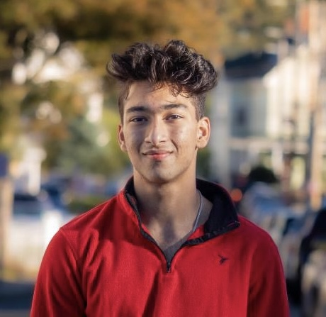
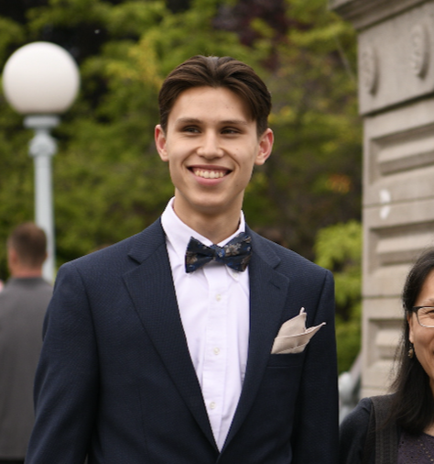
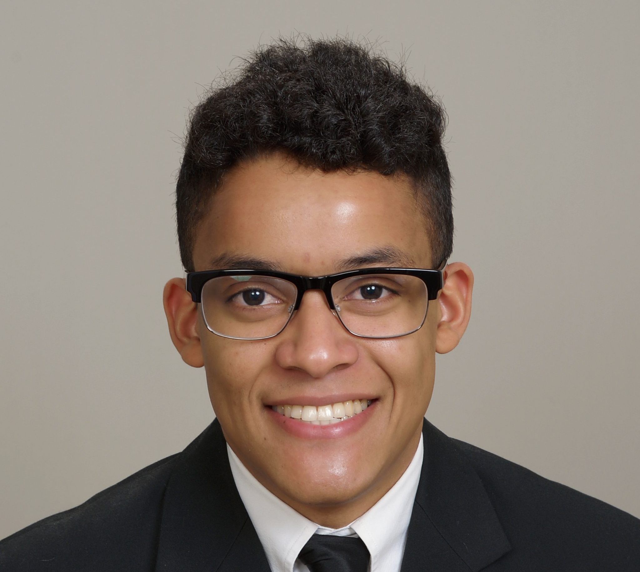
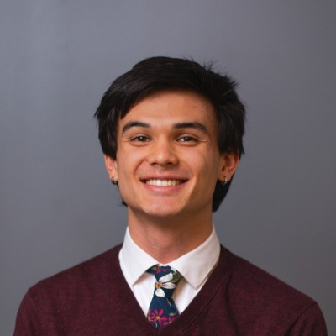
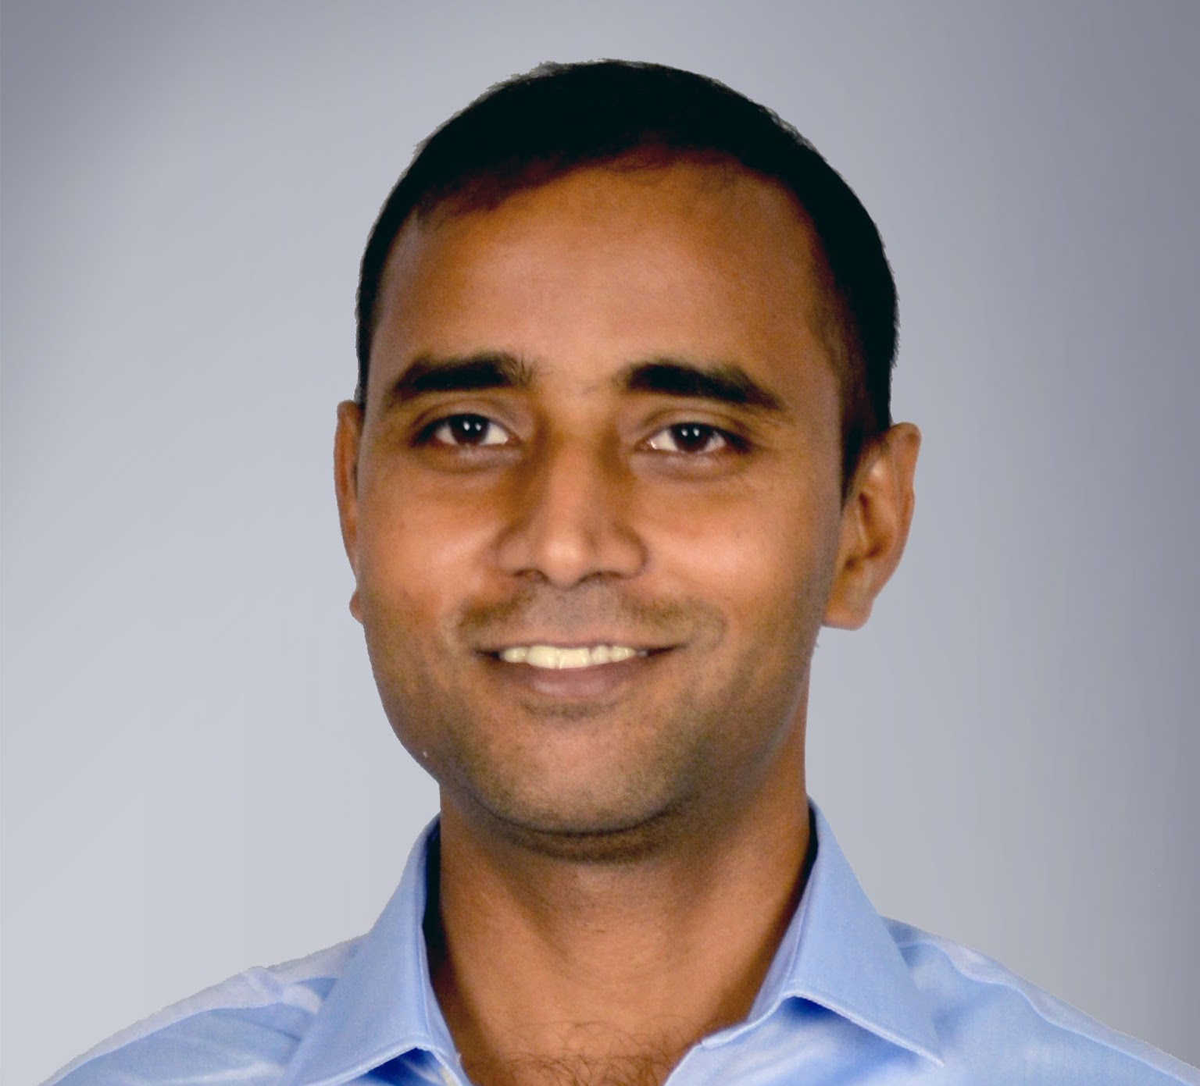
Circuit as a Puzzle Game (Circuitopia)
Zaraius Bilimoria, YSP Student, Revere High School
Ethan Andersson, YSP Student, Boston Latin School
Kayland Harrison, Electrical Engineering, Northeastern University
Kaden Du, Electrical Engineering, Northeastern University
Professor Aatmesh Shrivastava, Electrical Engineering, Northeastern University

Slide 2
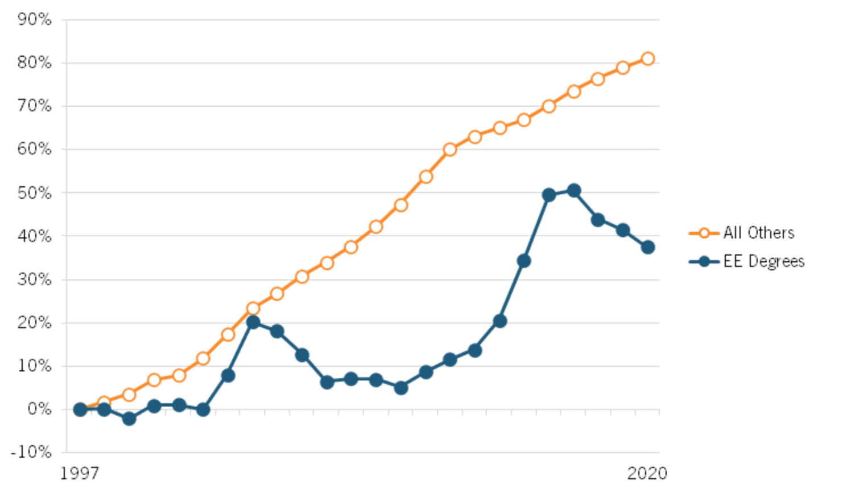
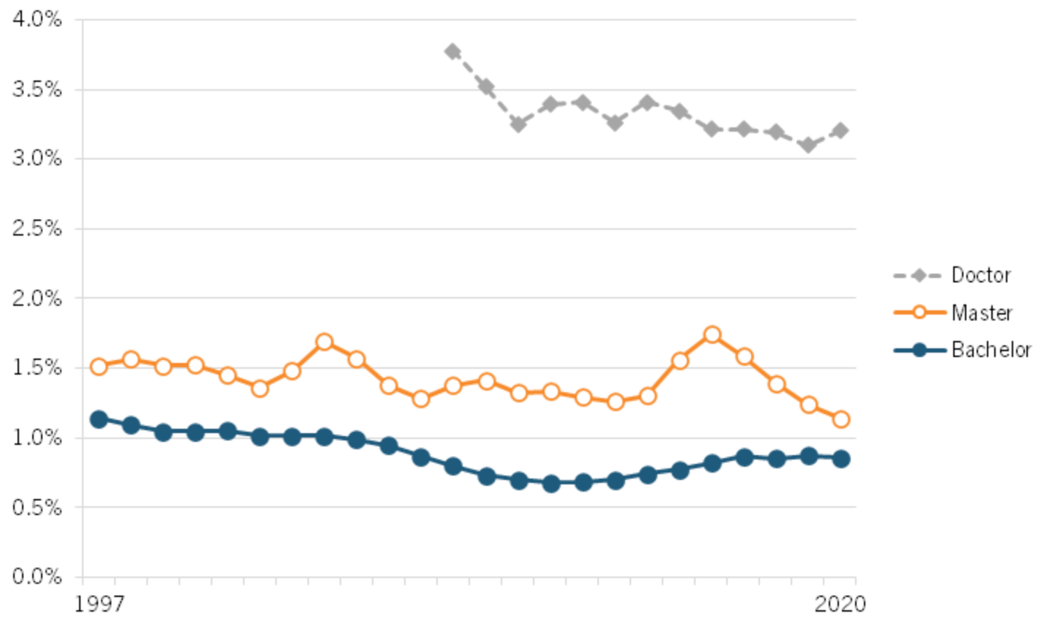
Declining EE Graduation Rates
"Studies have found that nearly 98 percent of students switching out of engineering cited “poor teaching,” also resulting in boring classes and a challenging first year."
Source: https://itif.org/publications/2023/04/24/short-circuited-electrical-engineering-degrees-in-the-united-states/

Slide 3
Our Goal: Revive interest in Electrical Engineering
Motivation:
Lack of a fun and interactive way to solve circuits
Get students interested and excited in electrical engineering
How:
Use computer science concepts to create an educational circuit game
Vision:
This game will be used in high school/undergrad classes to revive interest in electrical engineering
Would you want to solve this circuit hundreds of times??
Notes:
To solver this problem we are creating a game

Slide 4
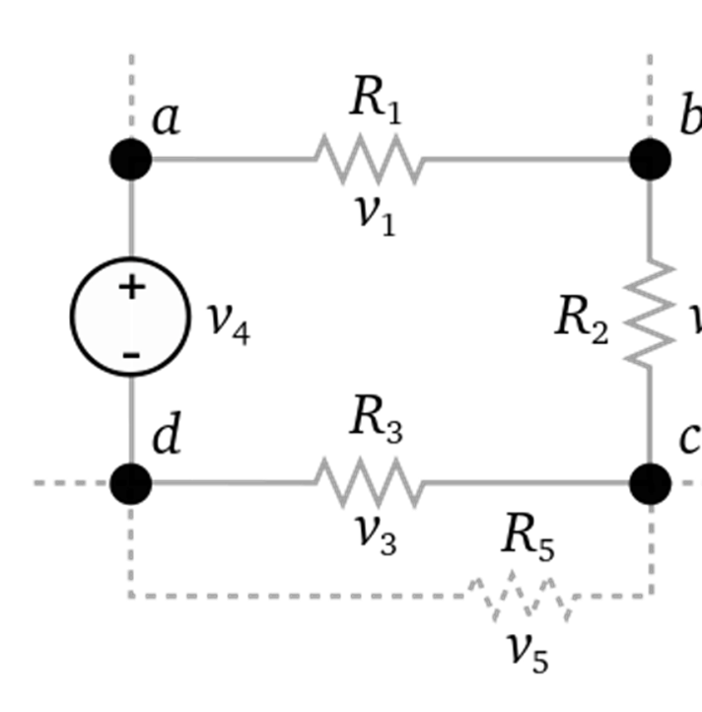
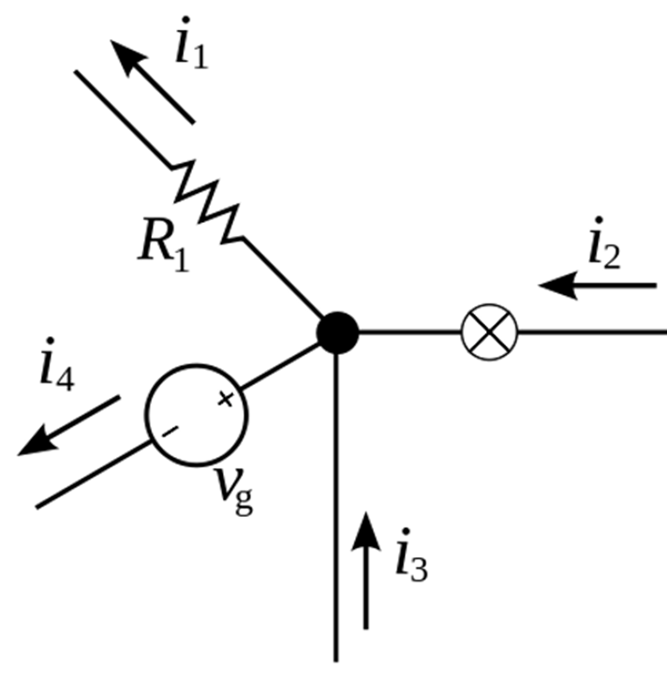
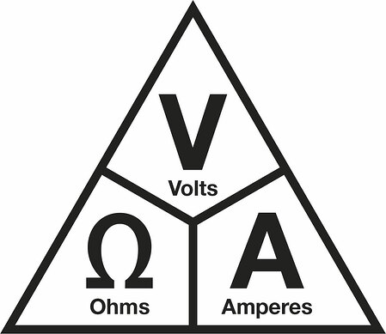
Background
Kirchhoff’s voltage law: Kirchhoff’s current law: Ohm's law:
Sum of voltage around a circuit is zero Sum of current entering and exiting a circuit is equal V = IR

Slide 5
Background
Inheritance
Recursion
JavaScript, Pixi.js, HTML CSS, and PySpice, along with GitHub
Resources: StackOverflow.com, Geeksforgeeks.org

Slide 6
Code Structure
Inheritance – Part, Wire, Basic Component, etc.
Board is a 2D Matrix – common concept in computer science
Cells contain Parts

Slide 7
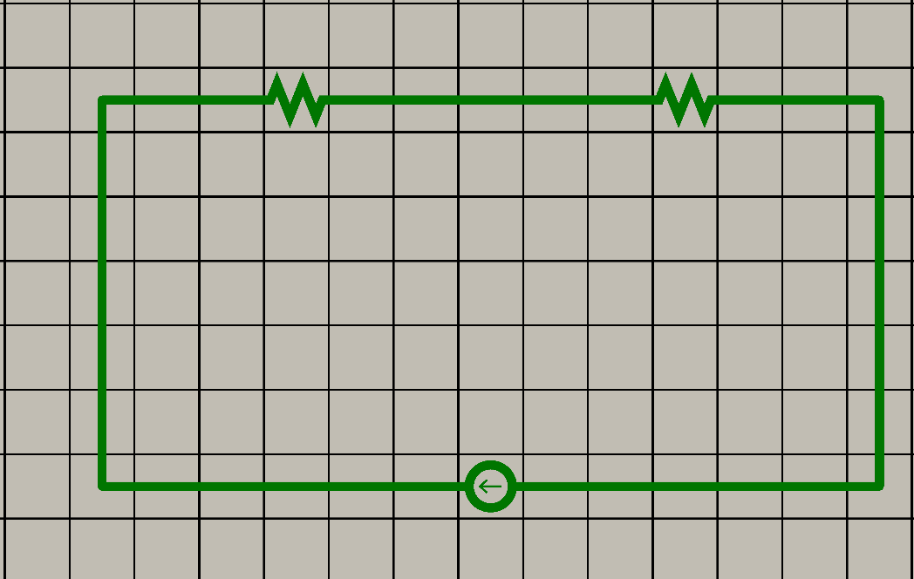
Creating a Netlist
Scan Circuit
Identify Components
Label Nodes
Why do we make a netlist?
Depth-first recursive searching method
How is a node defined?

Slide 8
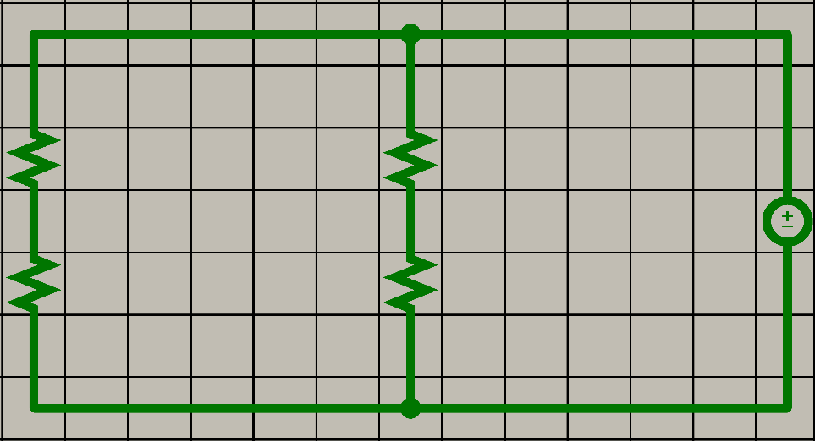
Our Searching method:

Slide 9
Identify Components and their connected nodes + netlist (add labels)

Slide 10
Our Website:

Slide 11
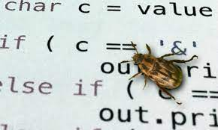
Future work
This is a long-term project, and we have laid a solid foundation for others to build upon. Some future goals include:
Further develop the interactive aspect
More complicated circuits as more levels
Bug fixes

Slide 12
Acknowledgements
Department of Electrical and Computer Engineering:
Dr. Aatmesh Shrivastava – Professor, ECE
Kayland Harrison - Graduate Student
Kaden Du – Undergraduate Student
NSF Career Grant #2144703
Center for STEM Education:
Claire Duggan, Executive Director
Jennifer Love, Associate Director
Claire Stipp and Yassine Souabny, YSP Coordinators
Nicolas Fuchs, Program Manager
Mary Howley, Administrative Officer

Slide 13
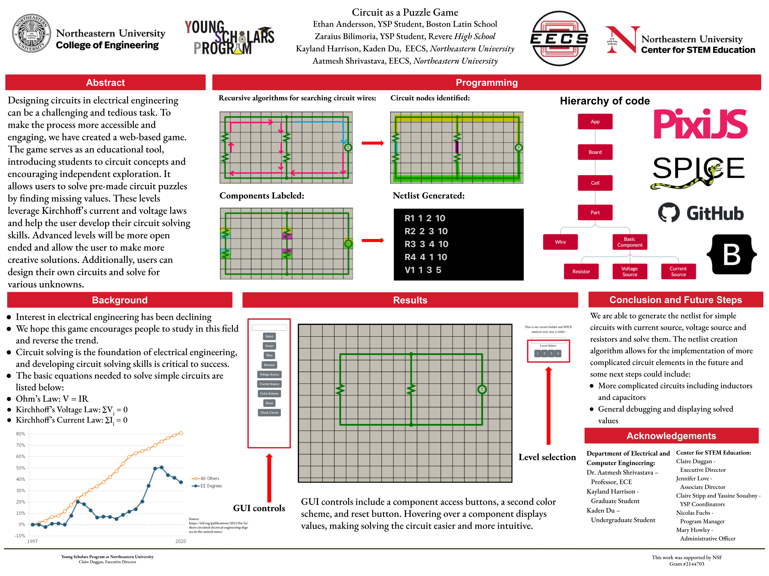
OKOK

