Slide 1
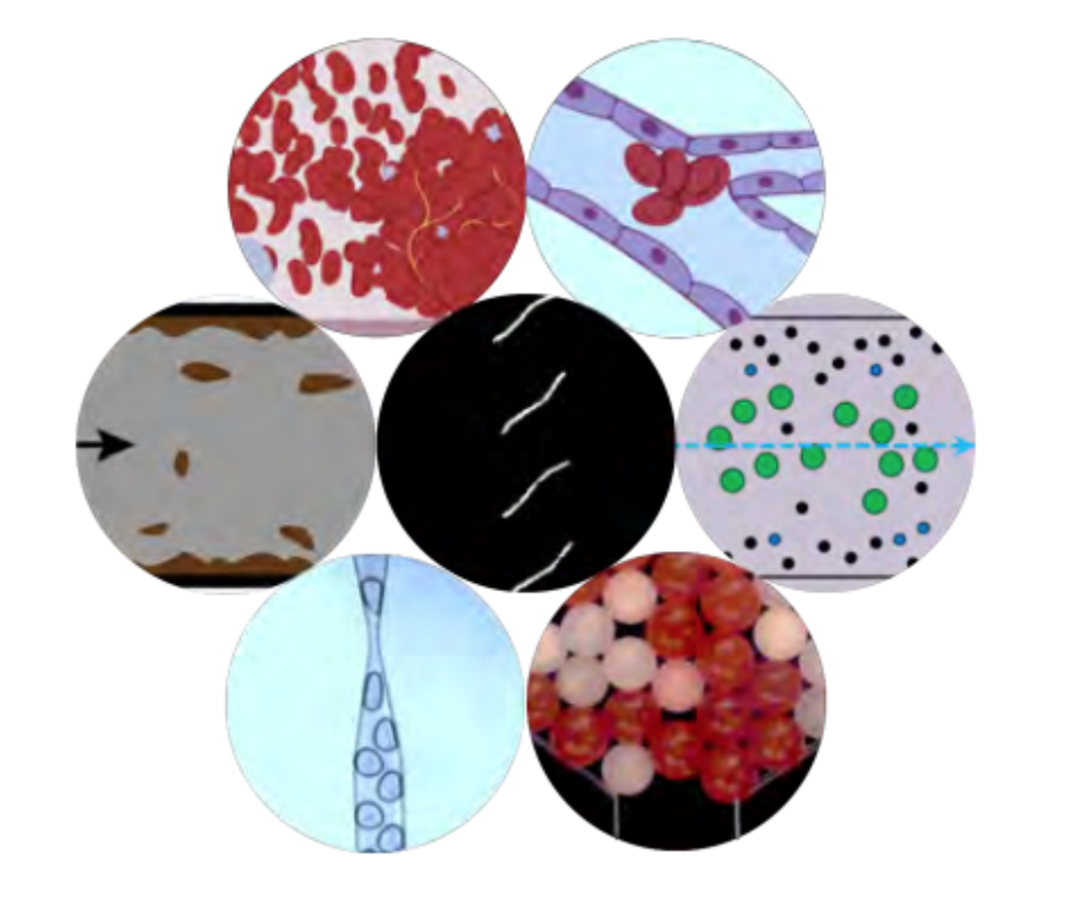
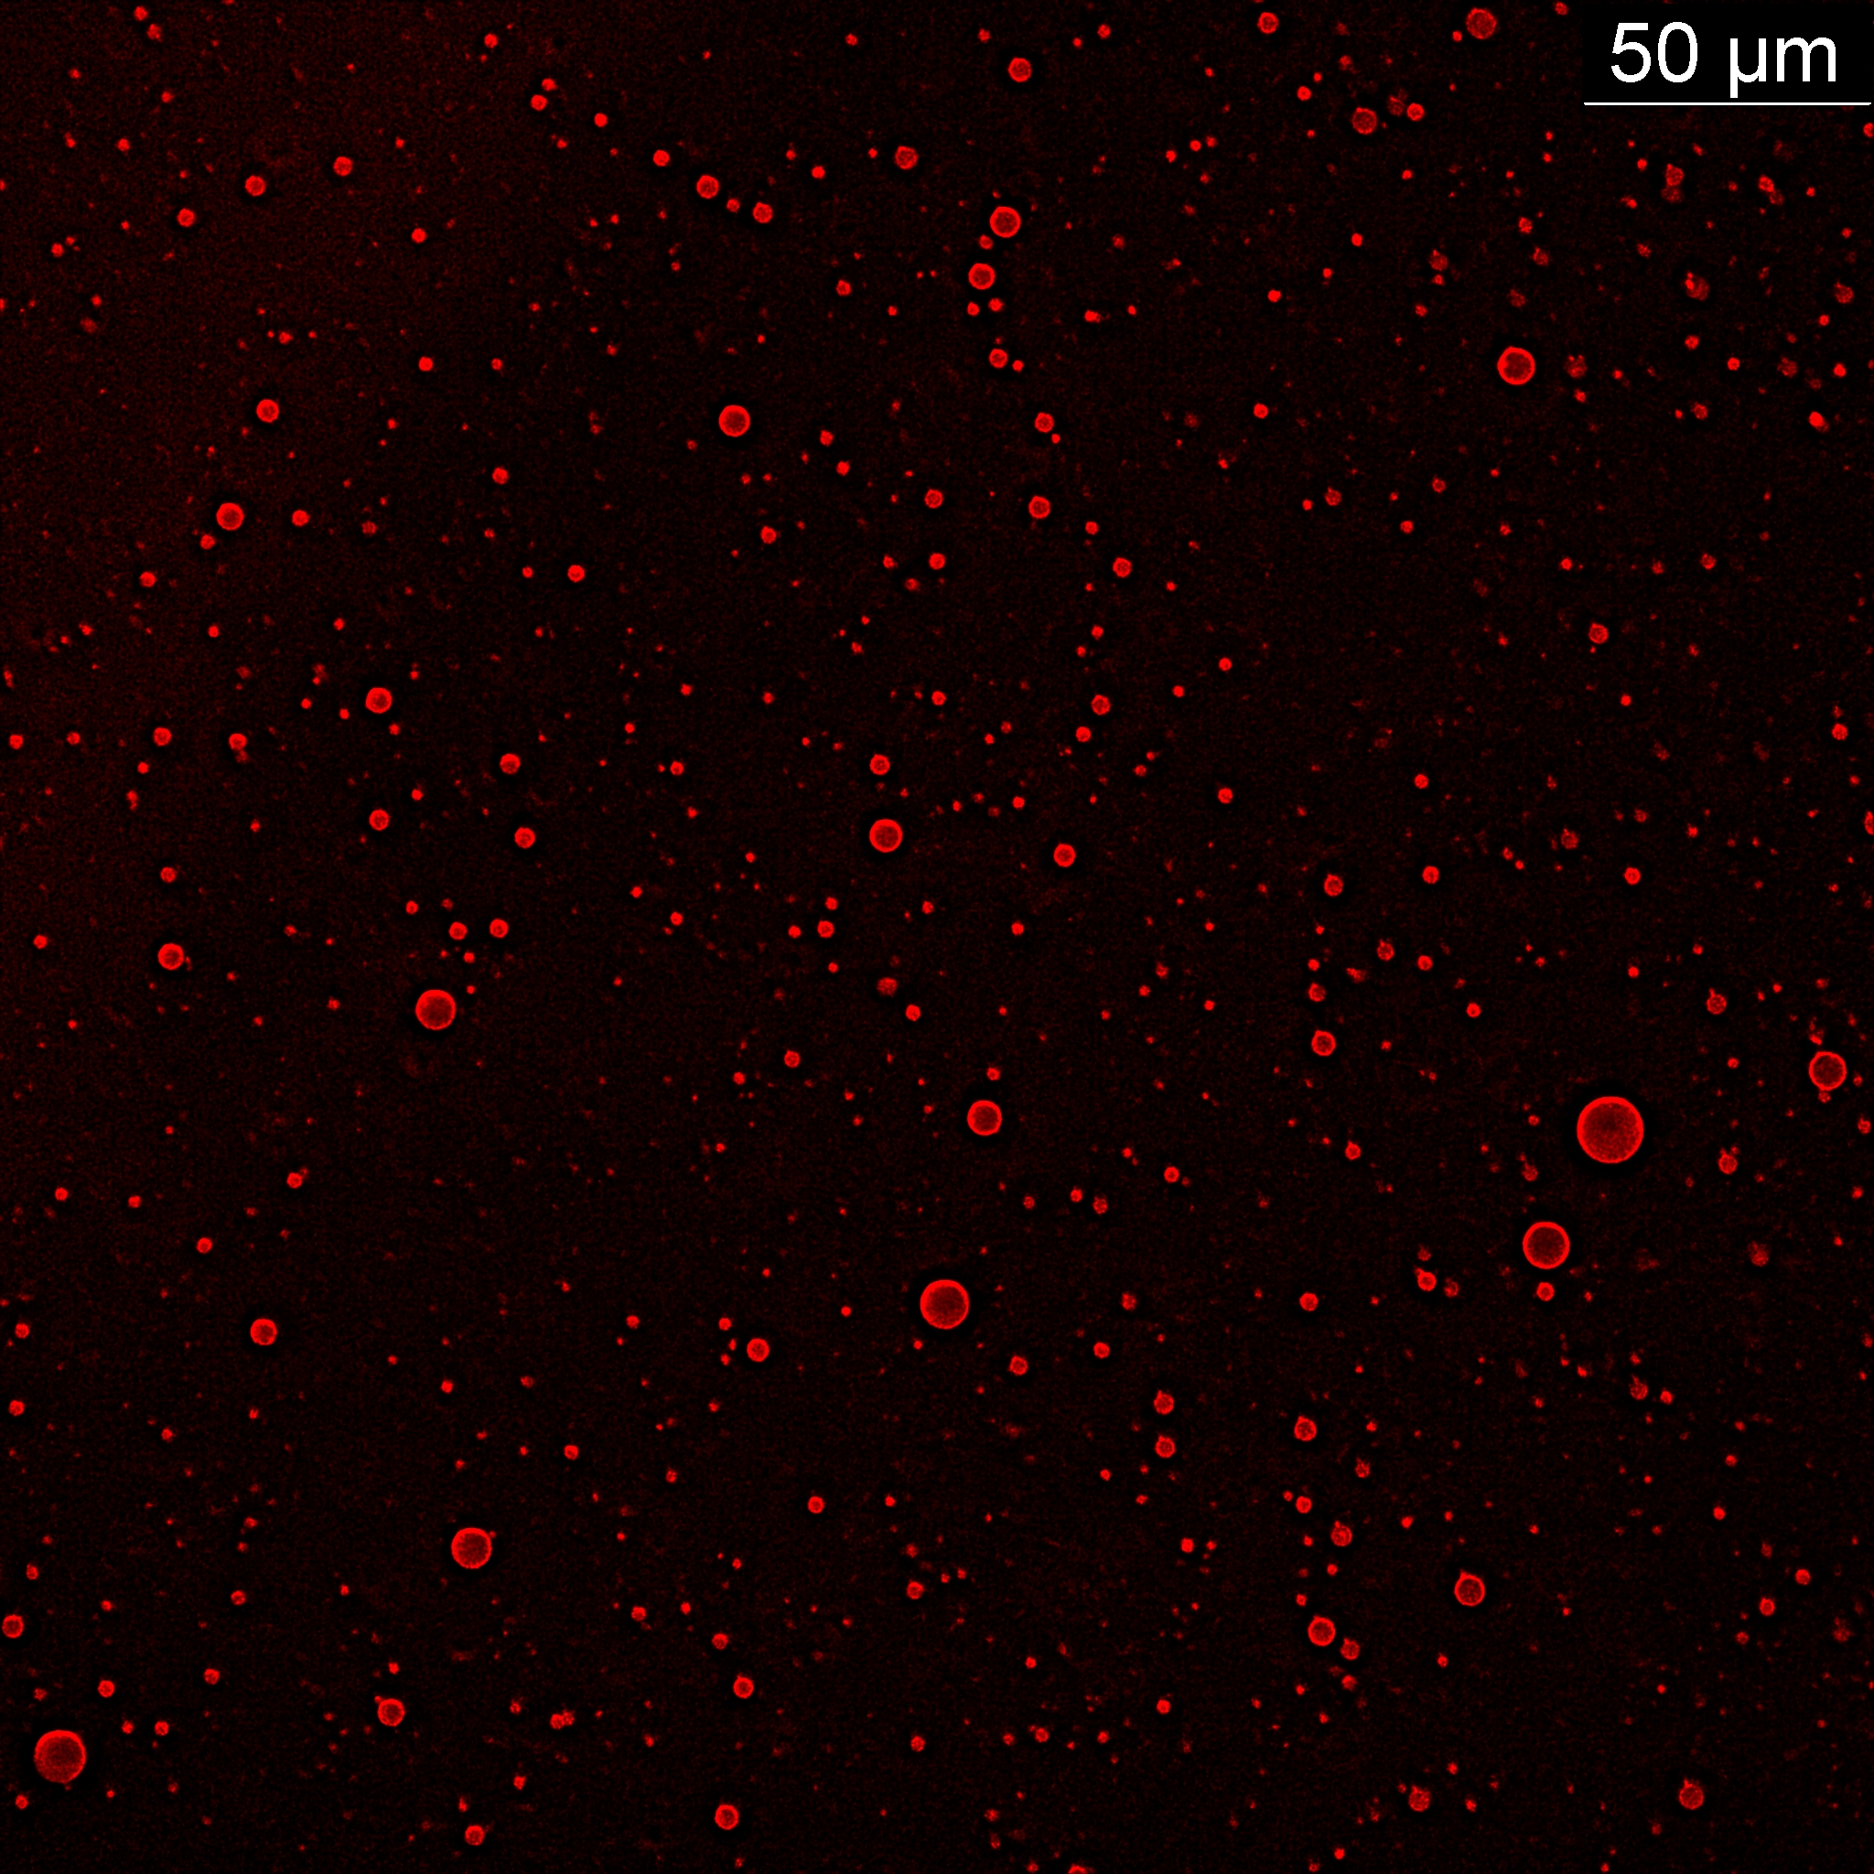
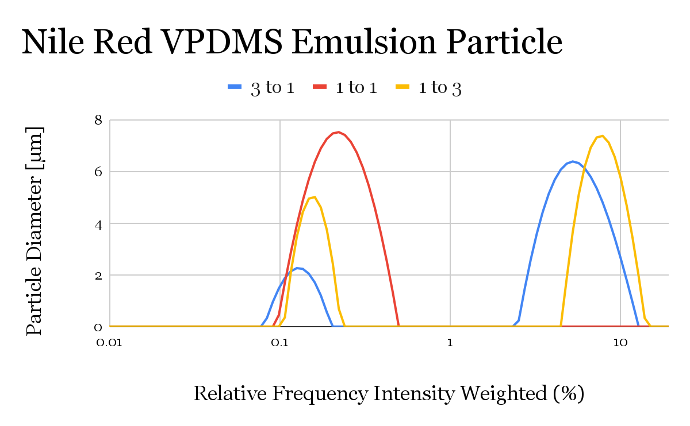
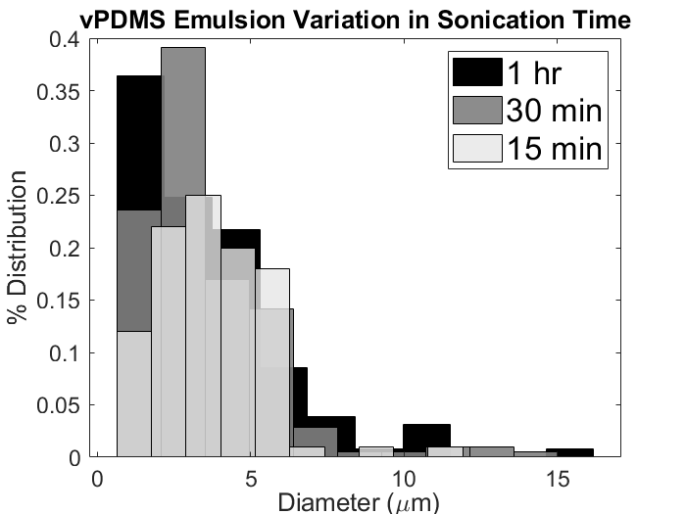
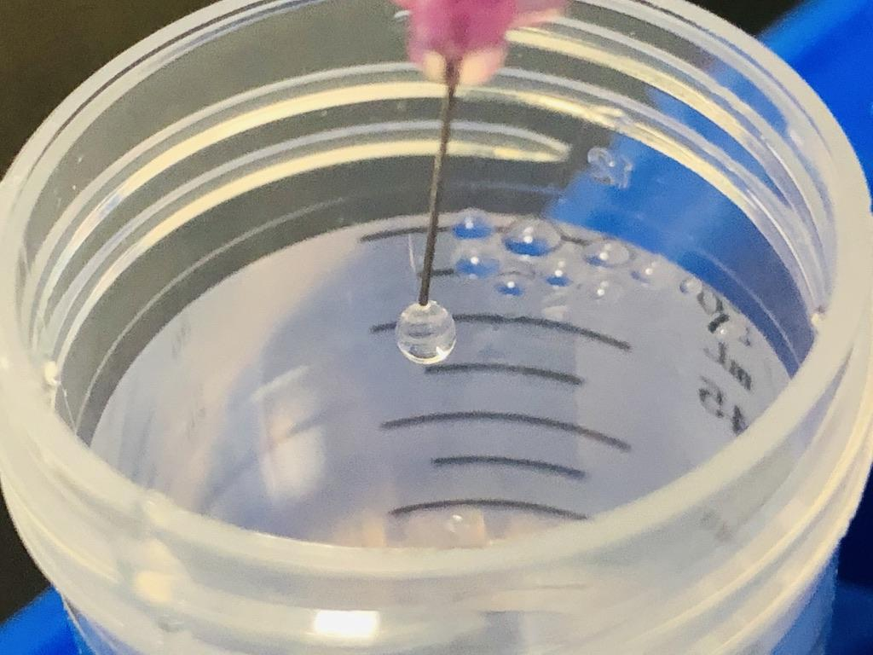
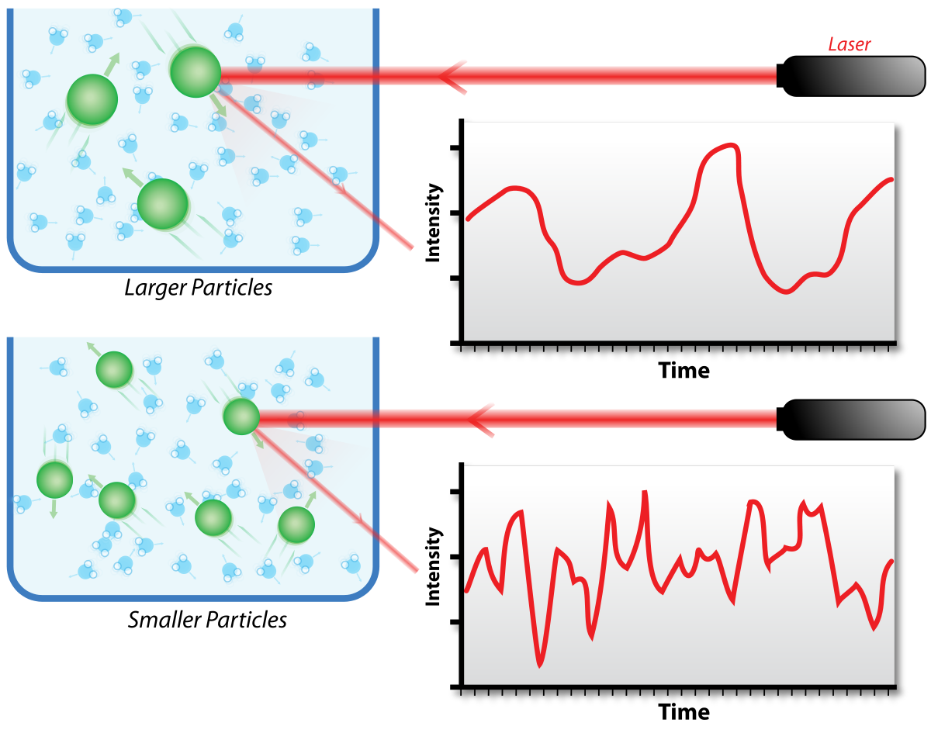
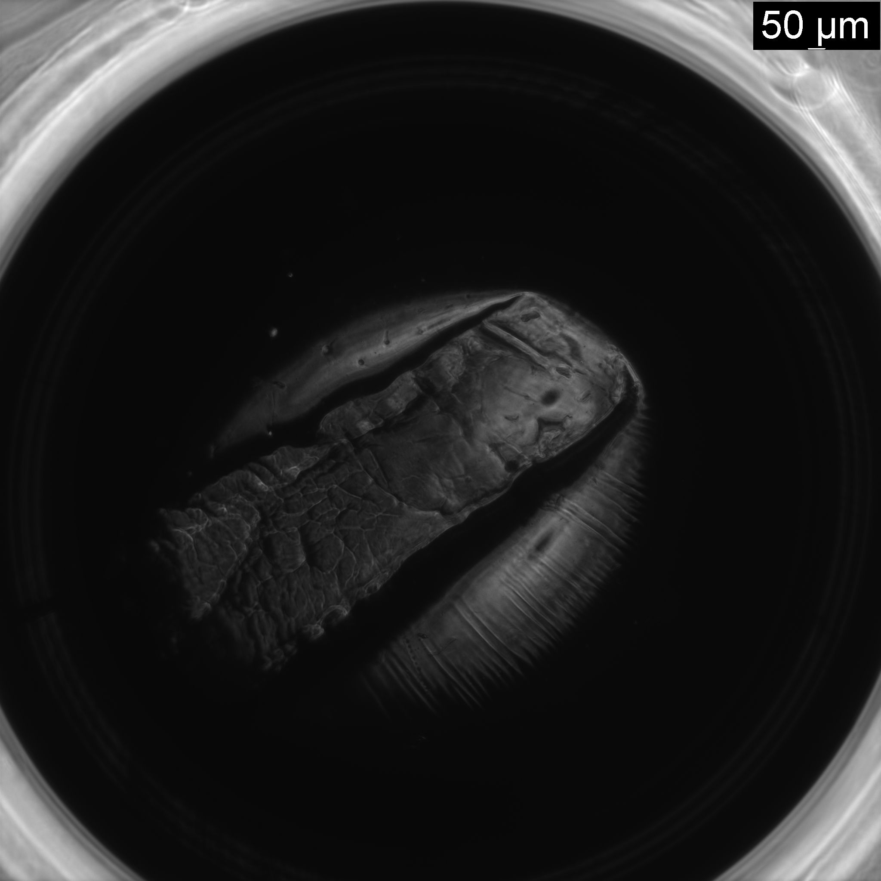
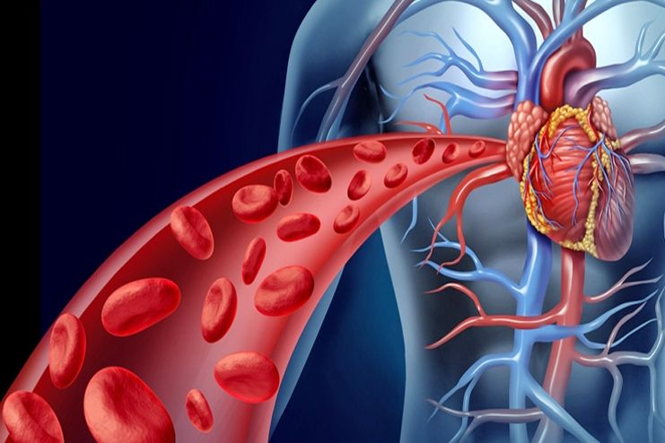
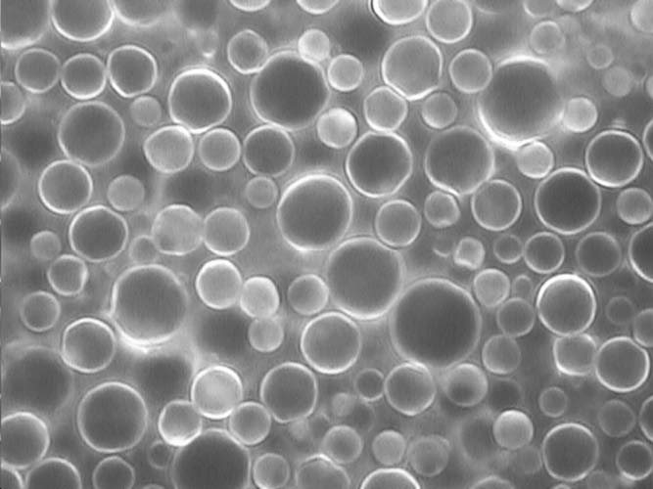
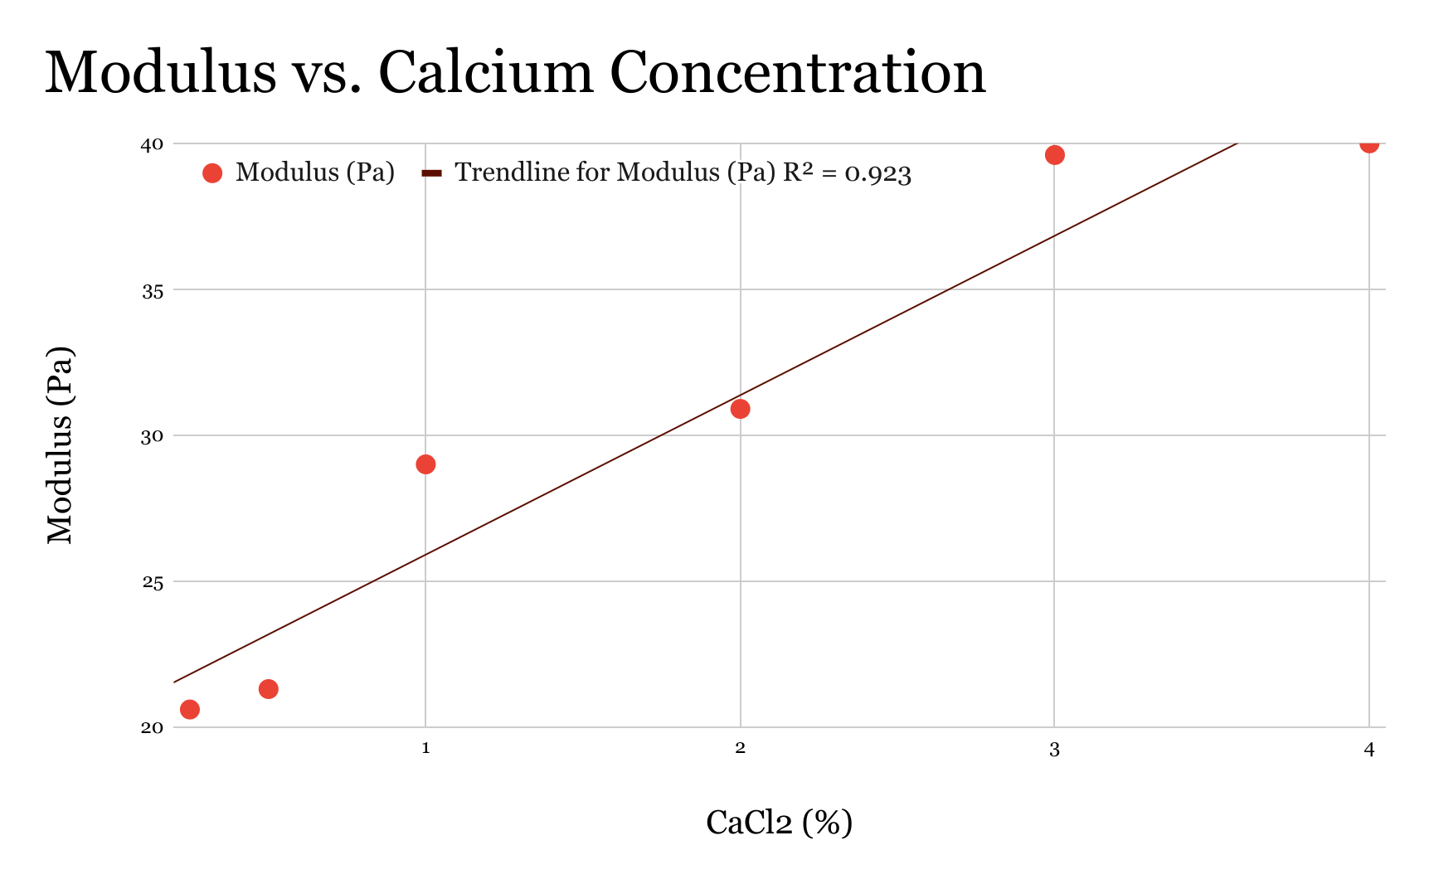
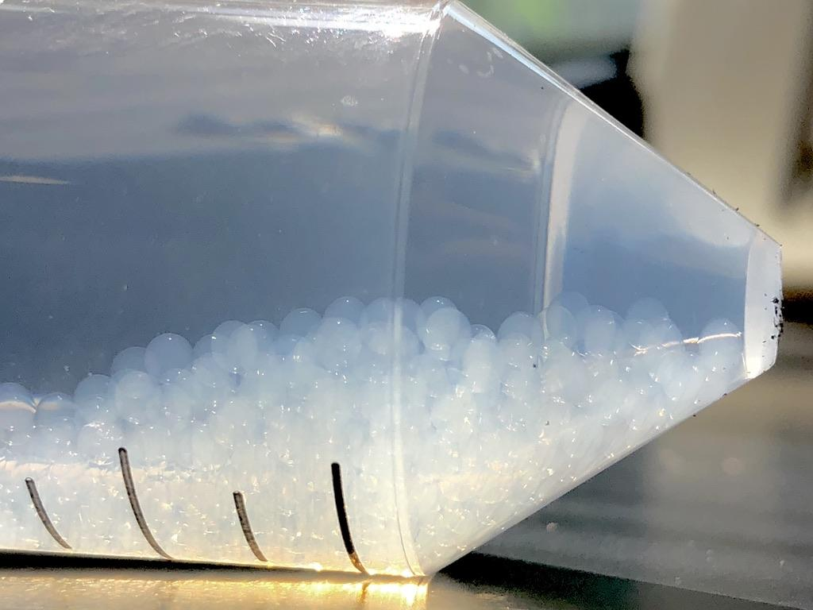
Particle Synthesis with Micro and Macro Fluidic Devices
Kamala Albrecht, YSP Student, Winchester High School
Nathan Hammerschmitt Le Gal, YSP Student, Essex North Shore Agricultural & Technical School
Sabrina Marnoto, Chemical Engineering, Northeastern University
Assistant Professor Sara M. Hashmi, Chemical Engineering, Northeastern University
Abstract
Experimental Methods
Results Continued
The goal of this research is to synthesize microparticles with a tunable softness for future use across a variety of fields. Applications include drug delivery through encapsulation of other microparticles, as well as computer modeling the flow and properties of complex fluids such as blood. Microparticles offer a unique set of properties that could prove useful when controllable and ideal in pharmaceutical settings. First, macro particles are created by utilizing the natural gelation between sodium alginate and calcium chloride, and subsequently, micro particles are produced using vinyl terminated polydimethylsiloxane (vPDMS) in an emulsification process. Microfluidic droplet-makers were used, but yielded no consistent microparticles. The properties of each particle batch is varied by changing chemical concentrations, and such changes were measured through mechanical testing to quantify physical characteristics.
Goal Characteristics of particles:
Tunable softness, squishiness, or elastic modulus
Monodispersed, or of uniform size
Stable over time
Fluorescent
Syringe Dropwise
1. Syringe pump used to force droplets of sodium alginate into a calcium chloride bath
2. Alginate droplets gelled, cross-linked, upon immersion in the calcium chloride bath
3. Concentrations of alginate and calcium varied to investigate impact on particle modulus
4. Quantified mechanical properties using rheometer and determined particle size using caliper and microscope
Vinyl terminated polydimethylsiloxane (vPDMS) Emulsification
1. Produced microparticles by sonication and vortexing vPDMS water in controlled cycles
2. Used catalyst and crosslinker to crosslink vPDMS emulsion
3. Labeled microparticles using Nile Red dye
4. Measured particle size using a DLS (see below)
5. Quantified samples through MATLAB analysis of microscope images
Microfluidic Droplet-maker
1. Used microfluidic device created through heat-cured mold
2. Applied either a sodium alginate system with calcium chloride or a vPDMS system with catalyst, crosslinker, and surfactant
Dynamic Light Scattering (DLS)
1. DLS used degree of light scattering to determine how large a given sample of particles is
2. Determined particle size and polydispersity index
Figure 9: Graph of dyed vPDMS microparticles displayed earlier. Polydispersity was present in all vPDMS samples, though to a larger degree in some.
Figure 8: vPDMS emulsion dyed nile red under microscope. Different vPDMS emulsions were produced using specific sonication times and size determined using DLS and microscopy
Figure 10: Bar graph of vPDMS particle diameter in samples of increasing sonication time. vPDMS samples were sonicated for 15 minutes, 30 minutes, 45 minutes, and 60 minutes. This graph demonstrates that increasing the sonication time does decrease particle diameter.
Background
Figure 3: Image of syringe dropwise method
Figure 4: Diagram of DLS process
Microparticle synthesis was the goal of this research due to its relevance in particle flow and behavior. If microparticles could be produced with a tunable softness, then the impact of particle softness on the flow of particles could be understood at a deeper level. Microparticle synthesis has applications in a variety of complex fluids, most notably blood. Some more specific applications in blood would be understanding thrombosis and vascular occlusion phenomena. Lastly, microparticles have been shown to encapsulate smaller particles and cells, which makes them a potential vehicle for drug delivery.
Conclusion & Future Steps
Conclusions:
Sodium alginate macroparticles can be produced using a syringe dropwise method
Sodium alginate particle softness could be changed by shifting the concentration of calcium chloride
vPDMS emulsions yield microparticles with a relatively high degree of polydispersity
Emulsified VPDMS particles that saw increased sonication time also decreased further in size
Potential Future Steps:
Establish a method of controlling polydispersity to make more consistently sized particles
Further investigate the relationship between calcium concentration, alginate concentration, and modulus
Focus on refining and tuning the droplet maker for creating both sodium alginate and vPDMS microparticles
Results
Figure 5: Image of sodium alginate particles produced using the syringe dropwise method. Batches of these particles were made using alginate concentrations of 2%, 4%, 6%, and 8% as well as calcium chloride concentrations of 1%, 2%, 3%, and 4%
Figure 6: Image of alginate macroparticle under microscope. Each batch of syringed particles was sized under the microscope and using a caliper
Acknowledgements & References
Department of Chemical Engineering
Professor Sara Hasmi, Assistant Professor
Sabrina Marnoto, Ph.D. Candidate
Department of STEM Education
Claire Duggan, Director of Programs and Operations, Center for STEM Education
Franklin Olivierre III, Katherine Aristizabal Norena, YSP Coordinators
Nicolas Fuchs, Project Implementation Coordinator
Image Sources:
Figure 1, https://depositphotos.com/27799605/stock-photo-heart-blood-health.html
Figure 2, https://www.westonaprice.org/health-topics/modern-foods/microphotography-of-raw-and-processed-milk/#gsc.tab=0
Figure 4, https://chem.libretexts.org/Bookshelves/Analytical_Chemistry/Physical_Methods_in_Chemistry_and_Nano_Science_%28Barron%29/02%3A_Physical_and_Thermal_Analysis/2.04%3A_Dynamic_Light_Scattering
Figure 7: Calibration curve comparing modulus and percentage of Calcium Chloride. As the concentration increases, so does the modulus of the particles.
Figure 1: Illustration of blood flow within circulatory system; red blood cells make the fluid complex and relevant to understanding particle flow
Figure 2: Image of lipid emulsion in milk, another complex fluid. The micelles of fat are similar to the vPDMS particles created through sonication
Young Scholar’s Program at Northeastern University Claire Duggan, Program Director
This work was supported by the National Science Foundation Grant #
Notes:
1
Change to relevant logos of sponsor, also include grant # if there is one.

