Slide 1
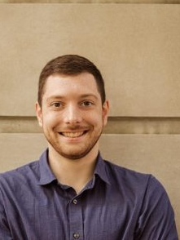
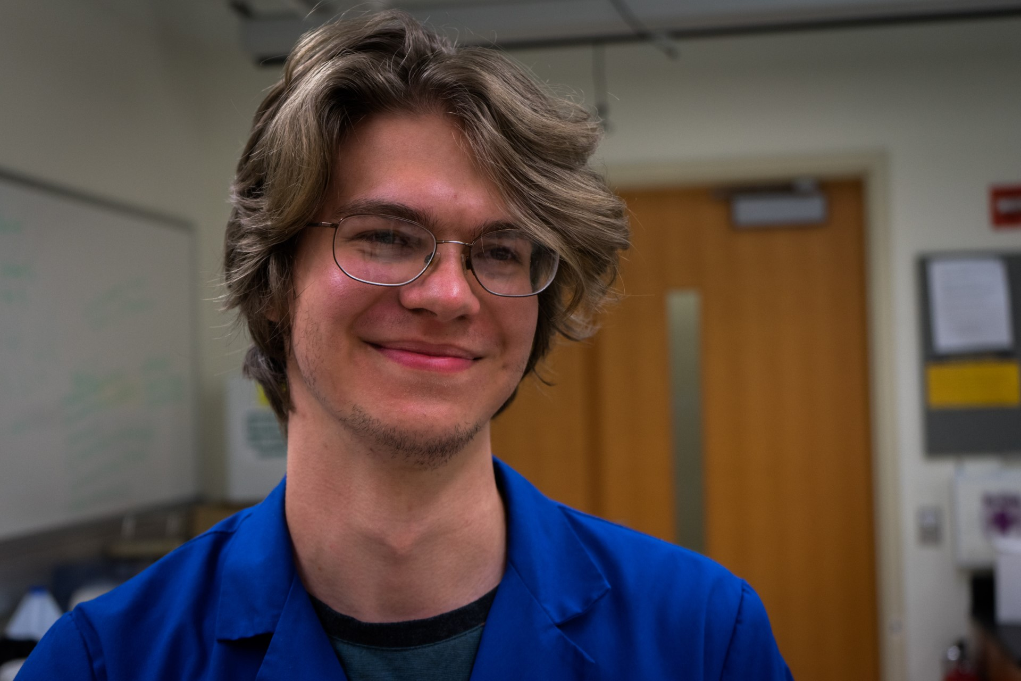
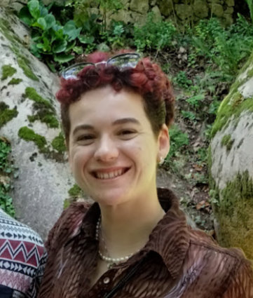
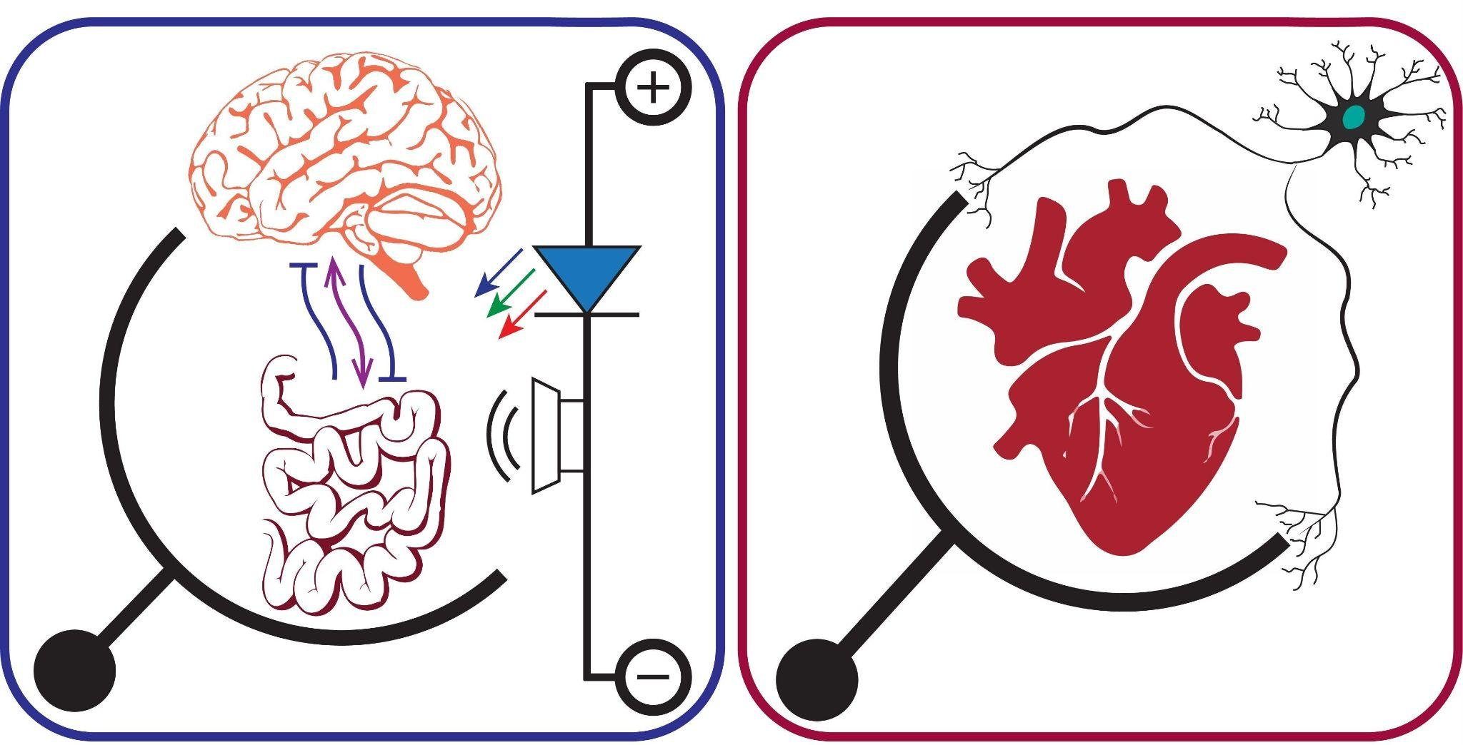
Next Generation Organ on Chip Platforms
Cooper Love, YSP Student, Milton Academy
Kyle Denny, YSP Student, Milton High School
Nolan Burson, Chemical Engineering, Northeastern University
Bryan Schellberg, Chemical Engineering, Northeastern University
Kat Nilov, Chemical Engineering, Northeastern University
Professor Ryan Koppes, Chemical Engineering, Northeastern University

Slide 2
Abstract
Motivation
- The epithelial cell barrier, in the colon, is a common target for ingestible drug delivery.
- Research aims to accurately model biological phenomena in vitro.
- Current pharmaceutical testing methods are costly.
- The field struggles to standardize procedures, materials, and geometry for examining biological responses in a flowing system.
Goal
- Model diffusion across a membrane emulating the intestinal cell barrier, by changing the membranes geometry (rectangle, short trapezoid, long trapezoid).
- Explore how different designs with consistent area yield diffusion corresponding to drug release across a membrane.
Findings
- Short trapezoid chip reaches equilibrium faster than the long trapezoid and rectangle
- The competing factor of length is a greater determination in diffusion because the short chip starts with a greater membrane cross sectional area.

Slide 3
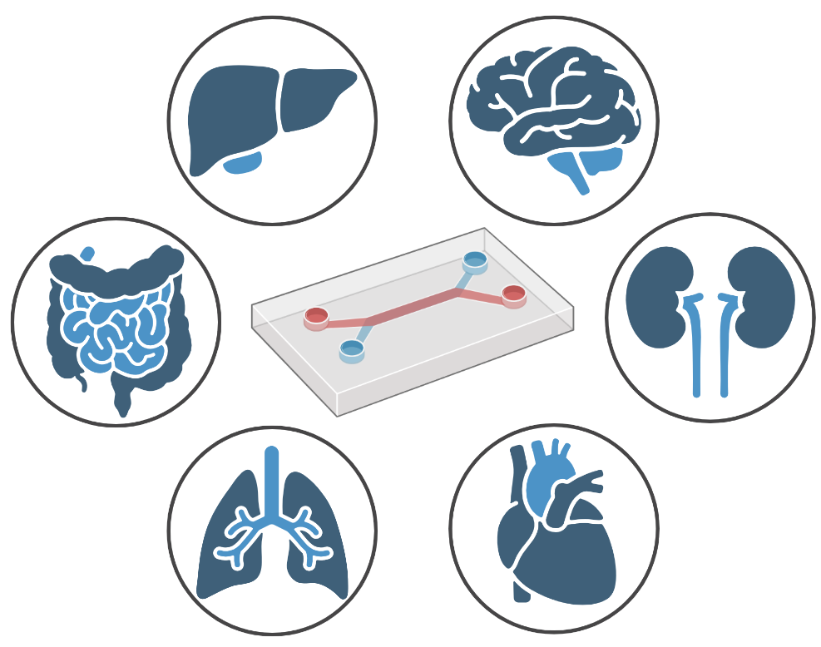
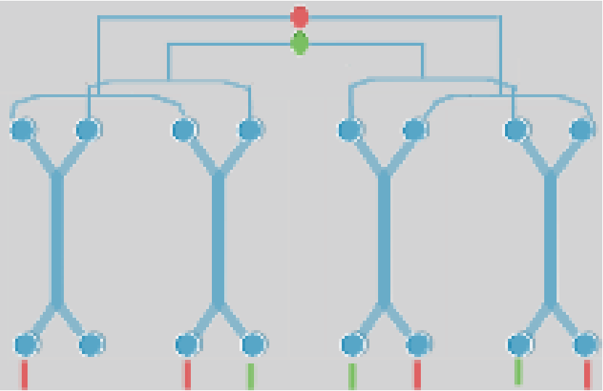
Background on Organ On a Chip Platform (O.O.C.)
- Organ chips are small plastic devices used to model biological phenomena
- Current chips are made of two flow channel divided by a barrier (cellular and/or material)
- Our chips are high-throughput
Figures created in Biorender
Notes:
The pharmaceutical application Pair permeability with drug release
An application: “paramedical crosiing into the bloodstream through small intestine”

Slide 4
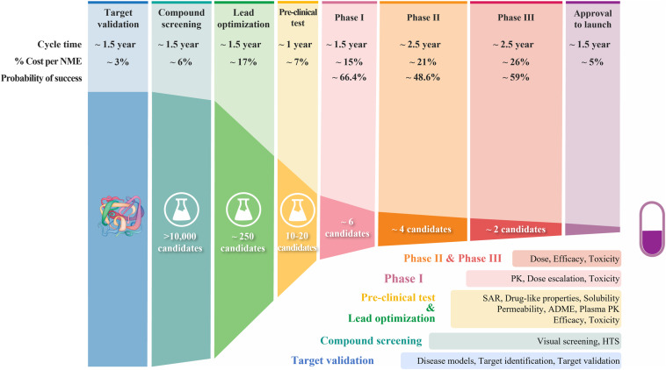
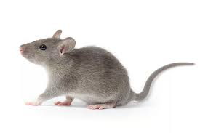
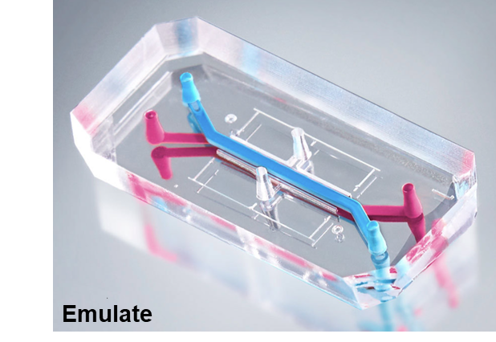
Background: O.O.C - what is it ?
D Sun. Acta Pharmaceutica Sinica B (2022)
emulatebio.com
Notes:
Point to green / yellow region

Slide 5
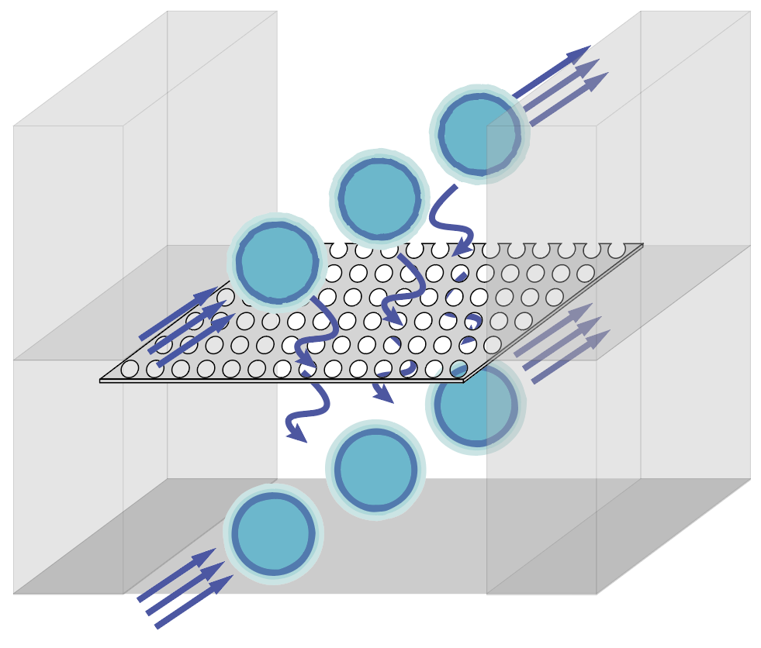
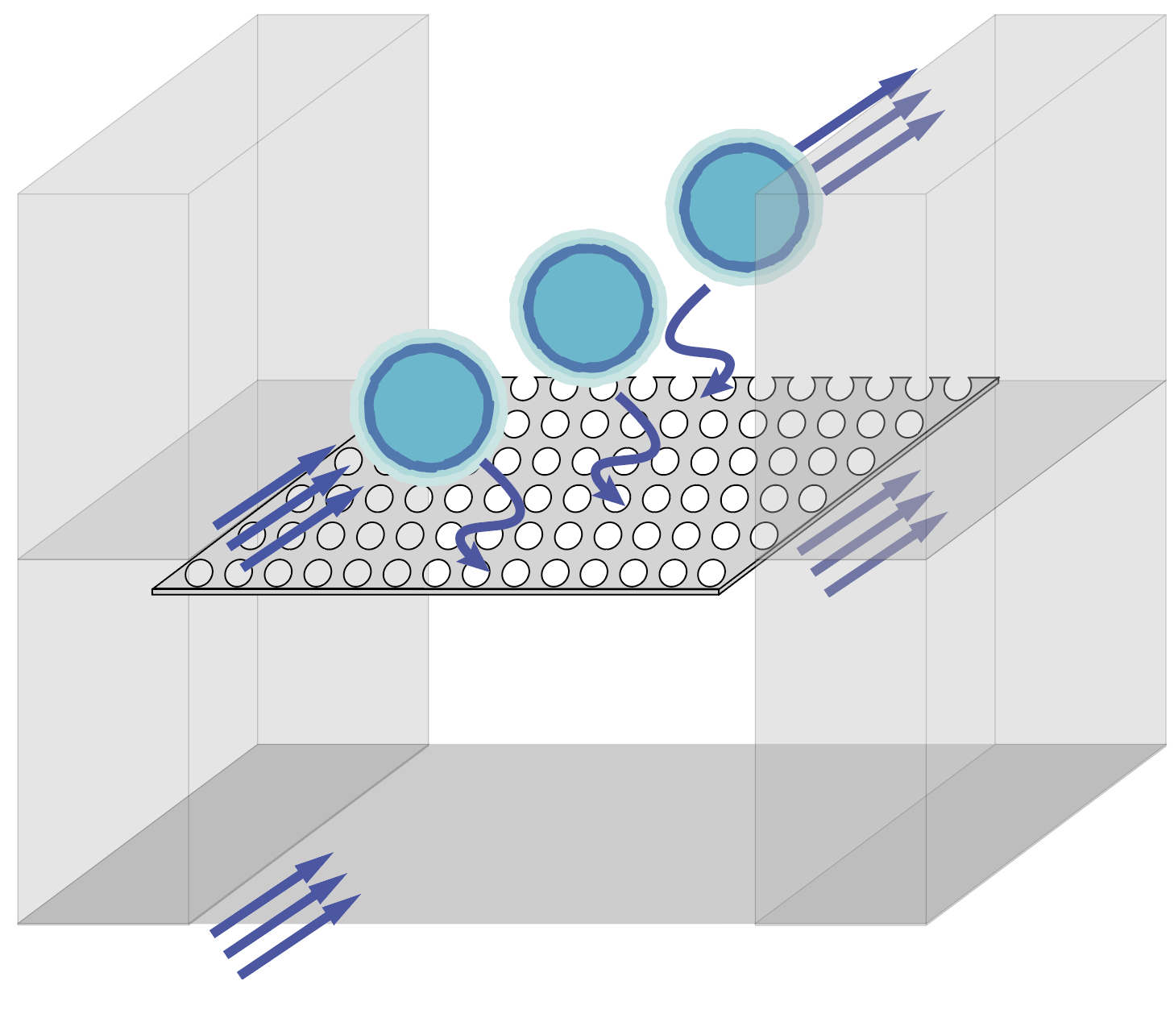
Diffusion on Our System
Notes:
Define driving force
Say that small differences in pressure matter think leaky air
Be geeral

Slide 6
Our Role and How it Works
Properties known to affect diffusion on O.O.C
Concentration gradient
Time
Area
Thickness of membrane
Size of molecule
Cellular Monolayers (additional medium)
Properties affecting our system
Concentration gradient is the main driving factor for diffusion in a volume
Parallel flow direction
Notes:
Talk about the biological inputs for each channel (whats going through) we can seed cells on top of membrane
Here is the cross section of o.o.p.c
A biological parameter could be to seed cells on to the membrane, but we decided to investigate various physical properties

Slide 7
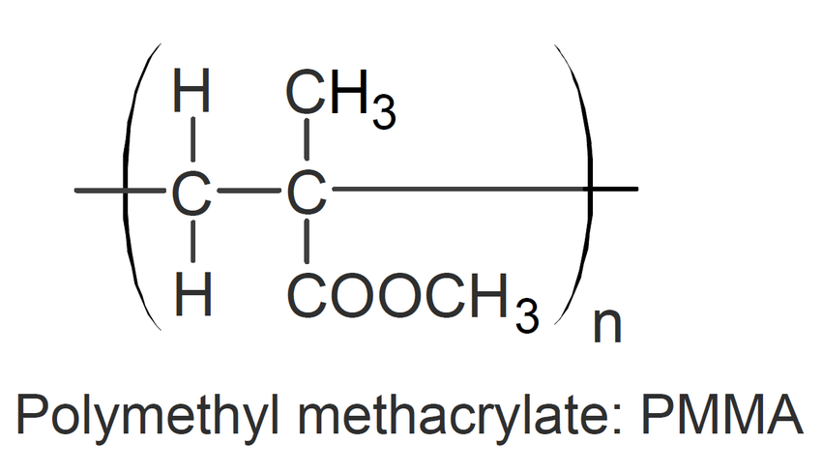
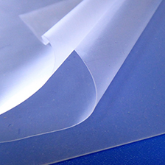
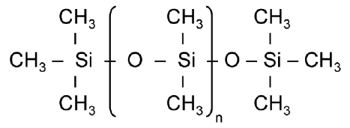
Background - polymers (PDMS vs PMMA / PET)
PDMS (Polydimethylsiloxane)
Pros:
Flexible for heat expansion
Consistent production
PMMA/PET (Polymethyl methacrylate)
Pros:
Partially automated
Mass producible
Inexpensive
PMMA
Cons:
Drug diffusion
Oxygen infiltration
Expensive
Cons:
Human error
Lengthy assembly
PDMS

Slide 8
Workflow Chart
Design
Testing

Slide 9
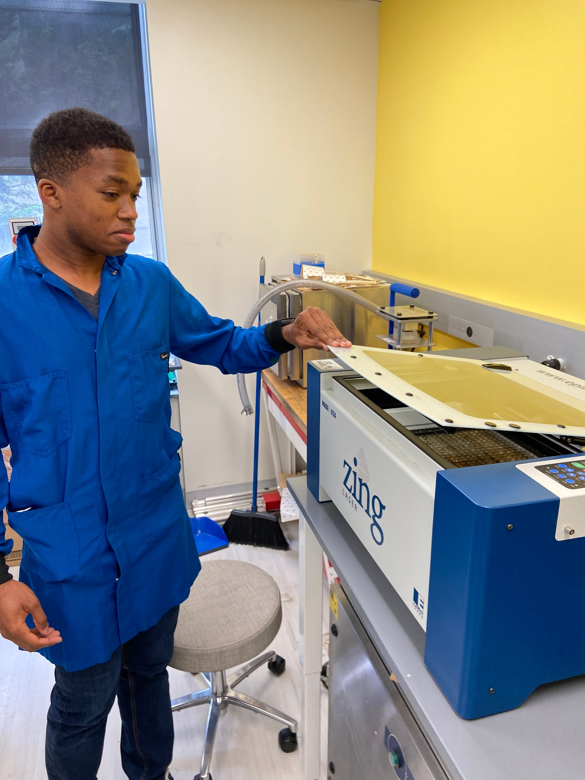
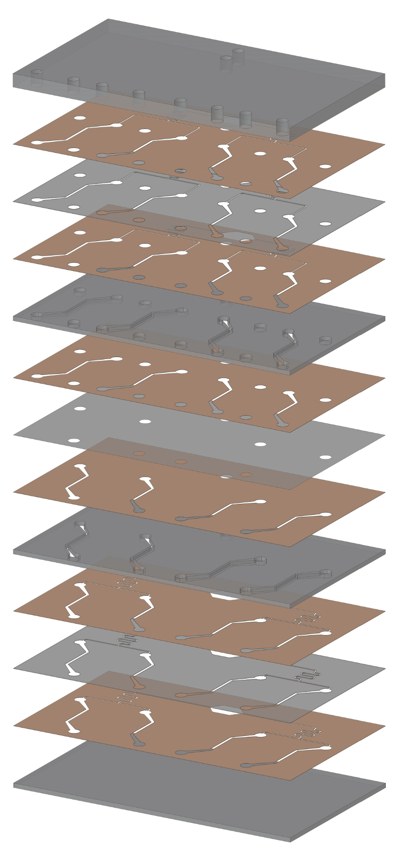
Fabrication
Our OOC:
Materials:
1 µm pore size membrane
3/16 PMMA
1/16 PMMA
3M tape
1/16 PET
Usage of the Class 4 laser cutter in the lab

Slide 10
Final Product (control group / replicate #1)
Sealed “barb” inlet
flow rate equal division
membrane overlap
Notes:
Only place where diffusion can occur

Slide 11
Experimental Background
Goal: vary geometry of membrane to explore fluid mechanics and Fick’s law of diffusion
Positive Control Treatment group#1 Treatment group #2
Not drawn to scale
50.518 mm^3
50.518 mm^3
50.518mm^3

Slide 12
Which One Incites More Diffusion?
Positive Control Treatment group#1 Treatment group #2
Not drawn to scale
50.518 mm^3
50.518 mm^3
50.518mm^3

Slide 13
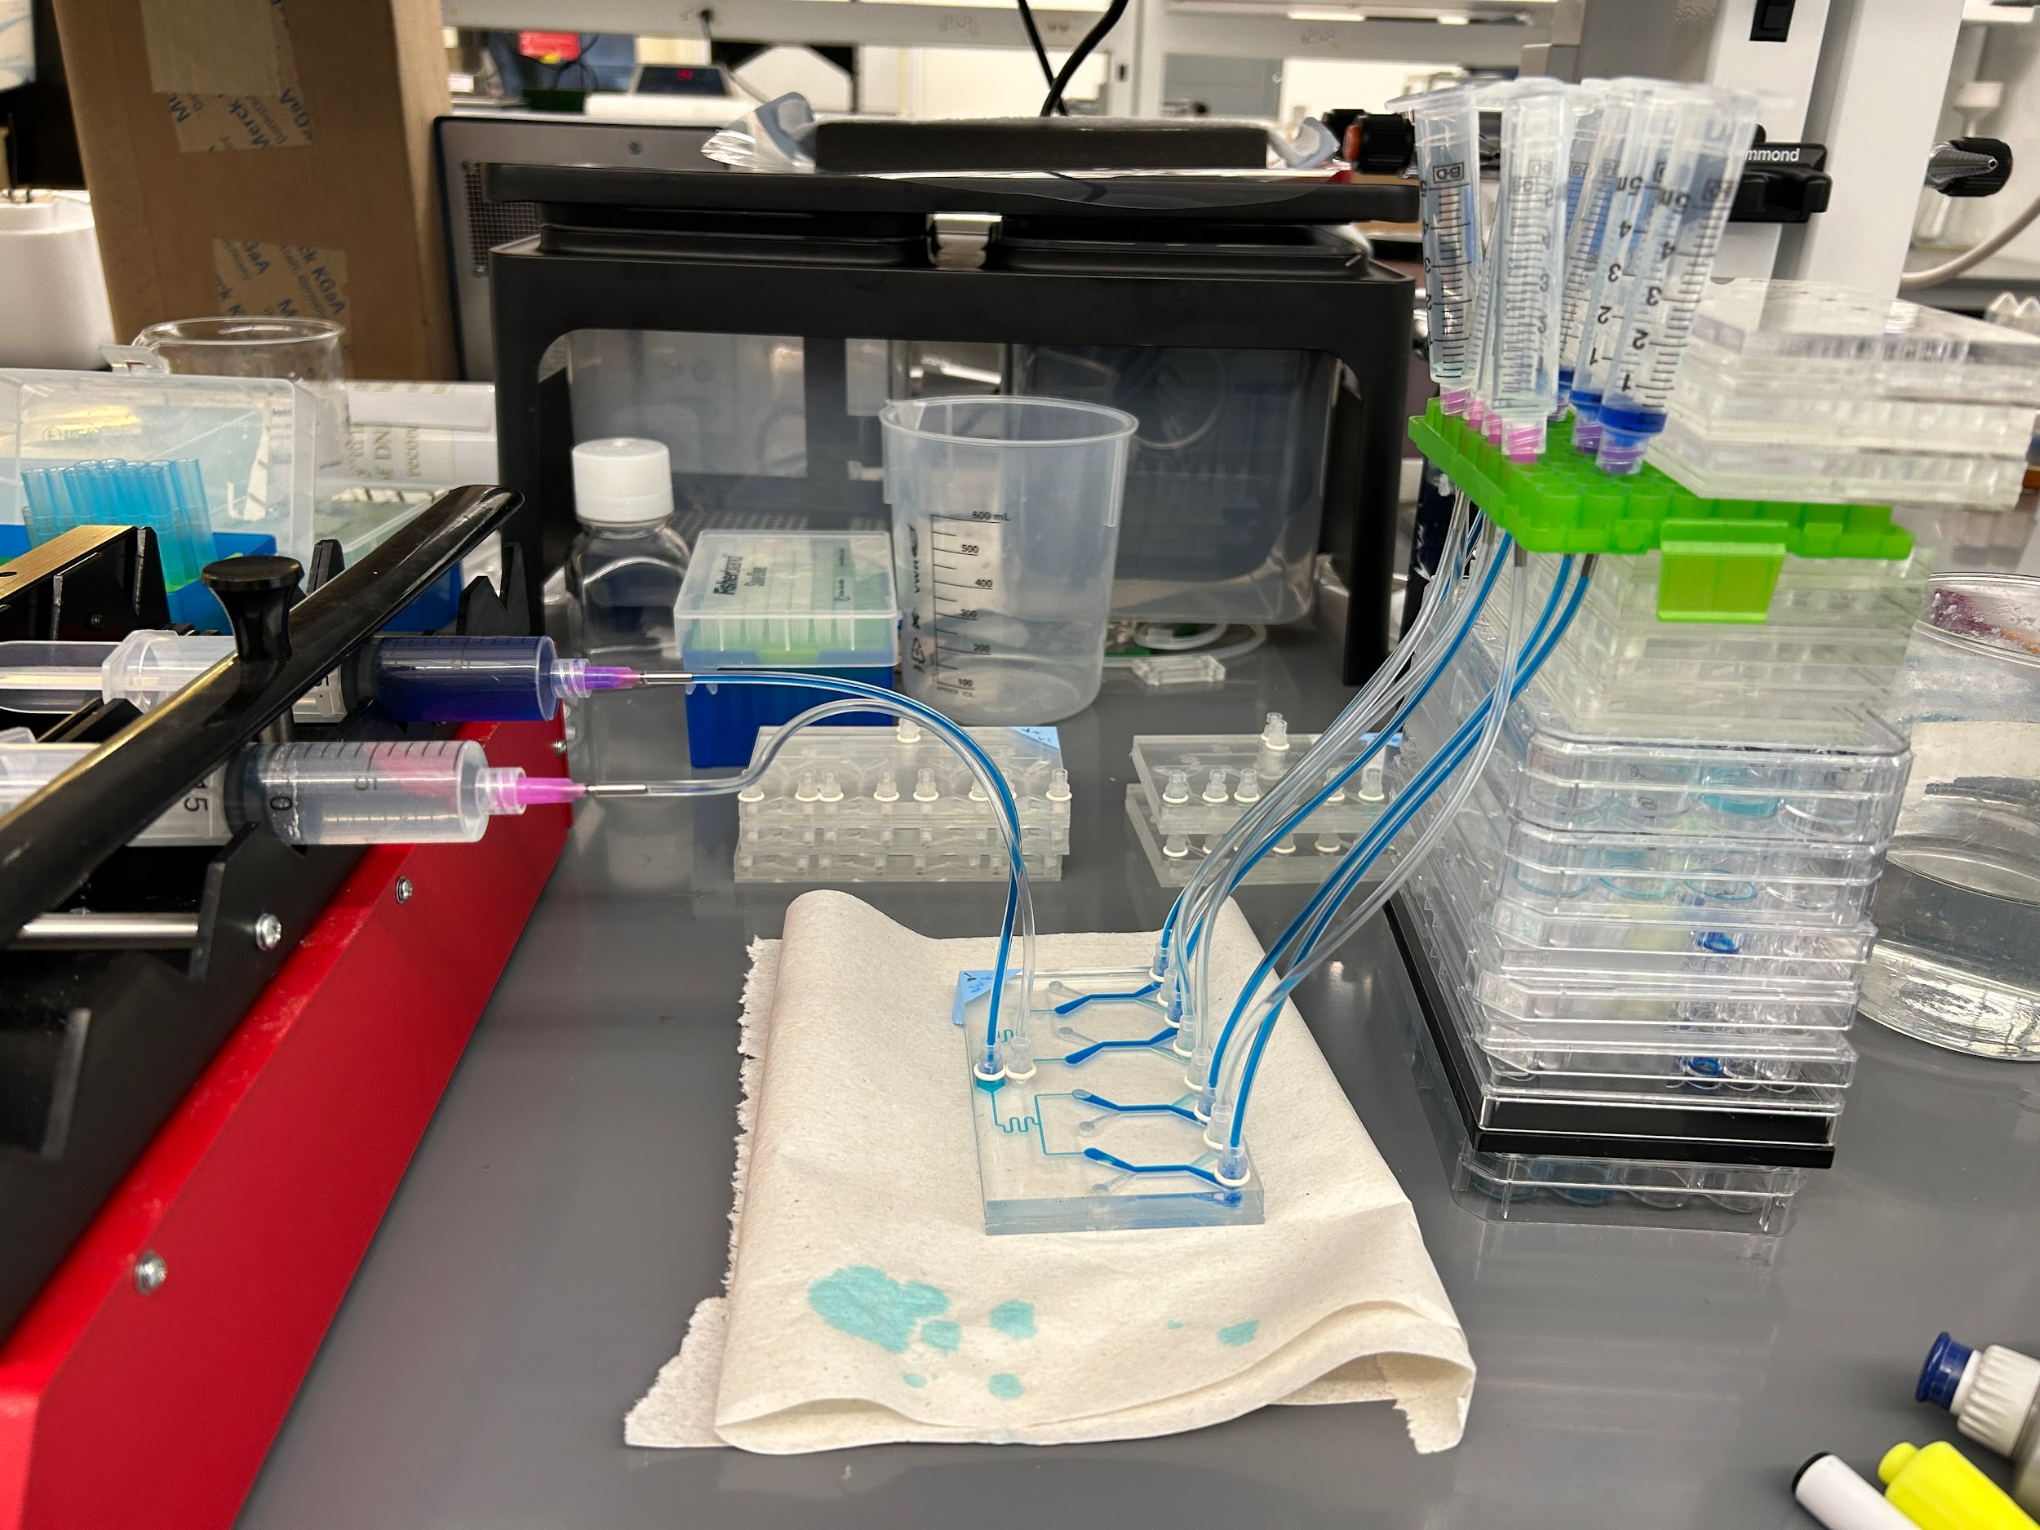
Experimental Methods
Procedure
flow rate = 200 uL / min over 4 channels
flush through air bubbles at high flow rate
run replicate for 60mins with 5min time points
extract 250uL every 5min time point
5. change out for each experimental control
Syringe pump keeps constant flow rate and negates the air pressure and hydrostatic pressure P=ρgh
Flow system for an initial preliminary control test of flow rate. Aiming for qualitative differences in the color of “light blue” food dye.
Notes:
Don’t say specifics

Slide 14
Results

Slide 15
Results
Notes:
The theory has something to do with length, because its wider can you caulk it up to void space ? Nolan no
The two velocity's are completely different
The membrane of the channel has dead zones and thus don’t accelerate as fast
Since the 3.5 wider start there is more area there is larger concentration difference in flux we are controlling are with varying length rather than other way round
This hypothesis didn’t correlate with hypothesis
The absorbance values are not different enough to prove a hypothesis

Slide 16
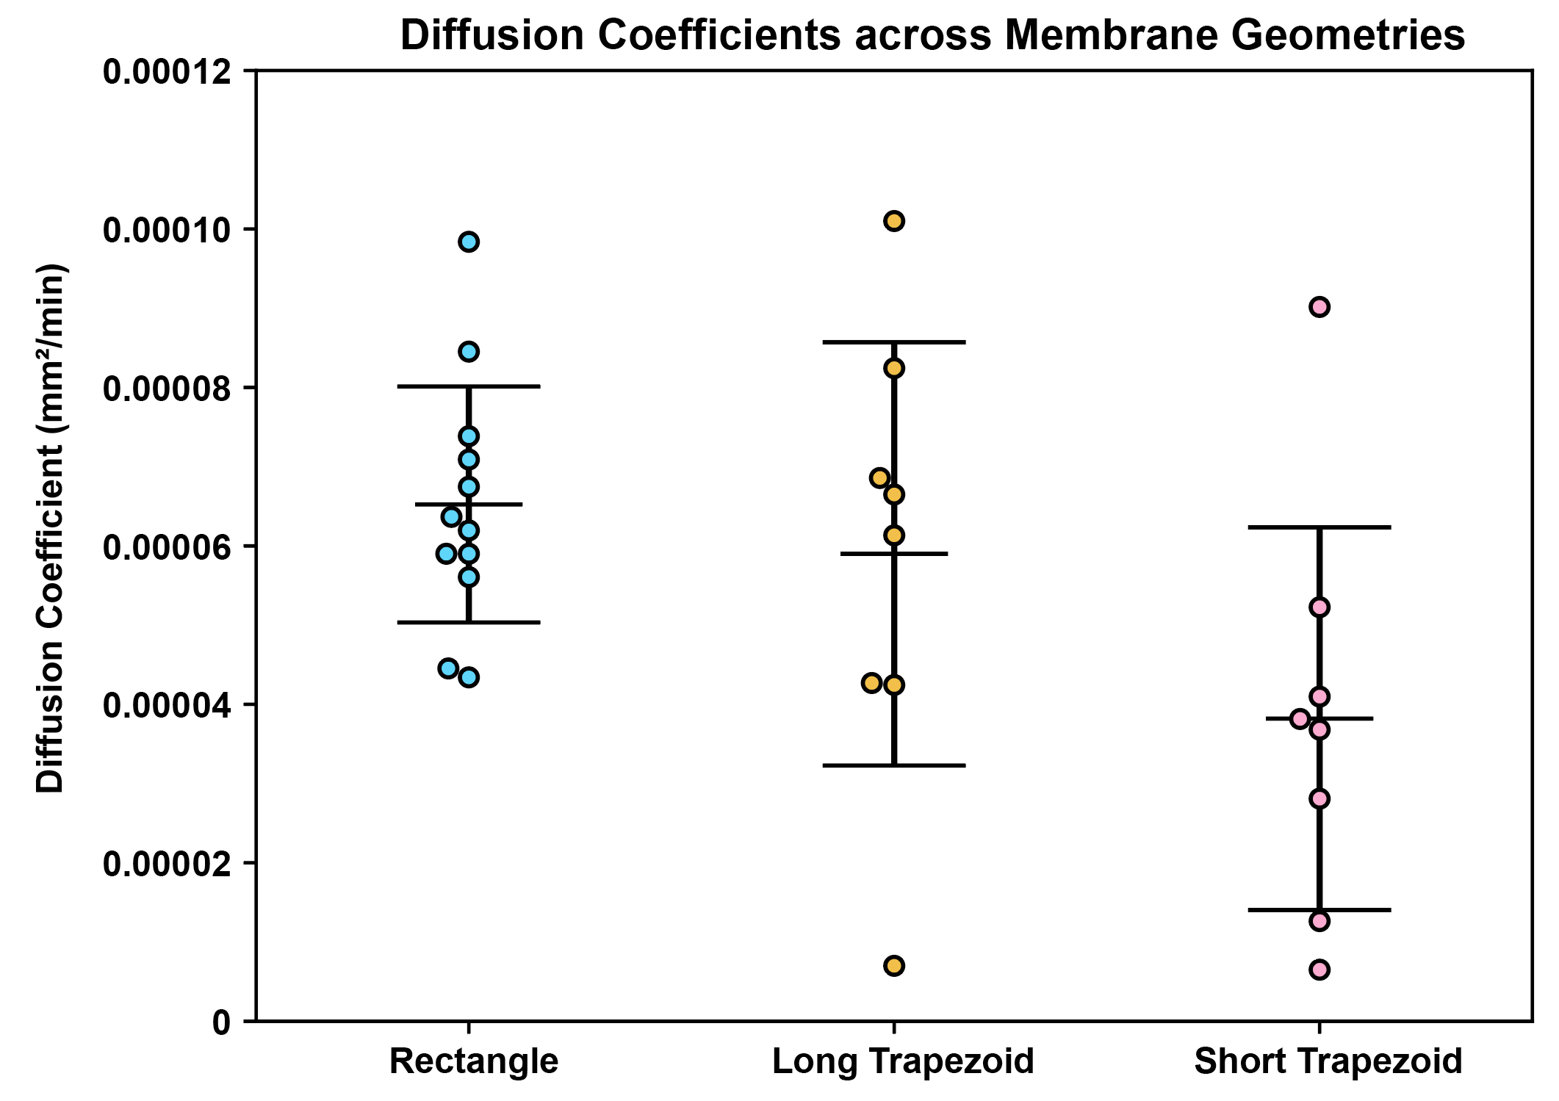
Results
Notes:
Shorter trapezoid reaches equim faster
Diff coe is how fast the particle gets through the membrane

Slide 17
Conclusion
Positive Control Treatment group#1 Treatment group #2
3.5mm
Not drawn to scale
50.518 mm^3
50.518 mm^3
50.518mm^3
9mm
21mm
7x velocity change between the wide inlet and narrow outlet
2.3x change between the wide inlet and narrow output
Even though the velocity increase is more substantial than length increase, we cannot prove our hypothesis.
0.5mm

Slide 18
Conclusions
Long trapezoid length (21.74mm)
Rectangle length (12.975mm)
Short trapezoid length (9.589mm)
Notes:
Competing factors stubby has a longer time over each pore but the skinny chip has a faster speed to get through the pore
The particles don’t move from top to bottom and bounce around and mass transport is higher level than experiment can measure
Always lateral diffusion and how can we measure that

Slide 19
Future Implications and Considerations
- Used to help make better predictive models of human processes in the body
- This can help give others a better understanding of diffusion in Organ on a Chip platforms
- Allow for this to be tested on biological systems where cells can be applied
- User interaction with high through-put organ chips to understand where further work is needed
- Better understand meaningful changes for future designs for drug release
- Fluid mechanics simulations
- We cannot prove length is overall factor, but more research is necessary to explore hypothesis
Notes:
This design factor does not play an important role in organ chip design and therefore others can prioritize known factors such as membrane area and length. For example the original file is meant for gut chip and

Slide 20
References
Abariga, T. (n.d.). The benefits of small length scales in microscale systems. OpenWetWare. Retrieved July 27, 2023, from https://openwetware.org/wiki/The_Benefits_of_Small_Length_Scales_in_Microscale_Systems_-_Telvin_Abariga
Bourbaba, H., achaiba, C. B., & Mohamed, B. (2013). Mechanical Behavior of Polymeric Membrane: Comparison between PDMS and PMMA for Micro Fluidic Application. Energy Procedia, 36, 231-237. https://doi.org/10.1016/j.egypro.2013.07.026
Bruzewicz, D. A., Reches, M., & Whitesides, G. M. (2008). Low-cost printing of poly(dimethylsiloxane) barriers to define microchannels in paper. Analytical chemistry, 80(9), 3387–3392. https://doi.org/10.1021/ac702605a
Materials for microfabrication. (n.d.). Ufluidix. Retrieved July 27, 2023, from https://www.ufluidix.com/microfluidic-technical-knowledgebase/materials-for-microfabrication/#:~:text=Gas%20permeability%3A%20PDMS%20is%20a,in%20long%20term%20cell%20cultures
PDMS: A review. (n.d.). Elve Flow. Retrieved July 27, 2023, from https://www.elveflow.com/microfluidic-reviews/general-microfluidics/the-polydimethylsiloxane-pdms-and-microfluidics/#:~:text=PDMS%20is%20one%20of%20the,microfluidic%20chips%20from%20a%20mold

Slide 21
Acknowledgements
Department of Chemical Engineering
Professor Ryan Koppes, Ph.D.
Professor Abigail Koppes, Ph.D.
Dr. Jessica Snyder, Ph.D.
Nolan Burson, Ph.D. Student
Bryan Schellberg, Ph.D. Candidate
Kat Nilov, Ph.D. Student
Selina Banerjee, Ph.D. Candidate
Kyla Nichols, Ph.D. Candidate
Katelyn Neuman, Ph.D. Candidate
Justin Hayes, Ph.D. Candidate
Bill Doherty, Ph.D. Candidate
Brent Buchinger, Ph.D. Student
Center for STEM Education​
Claire Duggan, Executive Director ​
Jennifer Love, Associate Director
Claire Stipp & Yassine Souabny, YSP Coordinators​
Nicolas Fuchs, Project Implementation Coordinator​
Mary Howley. Administrative Officer

Slide 22
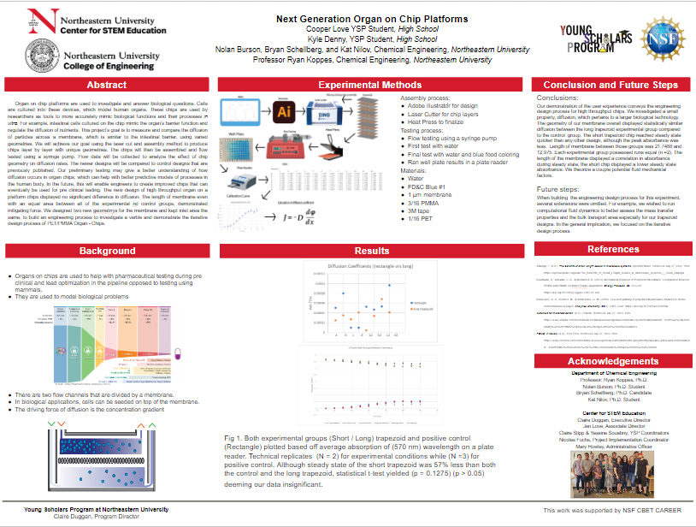

Slide 23
Extra slides

Slide 24
Investigating membrane geometry on diffusion (D) in a microfluidic system
Notes:
Two driving forces and we know diffusion happens that’s not new /// for high through put its new in the lab space
1 diffusion high to low
2. Air resistance pressure
3. Hydrostatic pressure
4. Latteral diffusion
5. Set flow rate

Slide 25
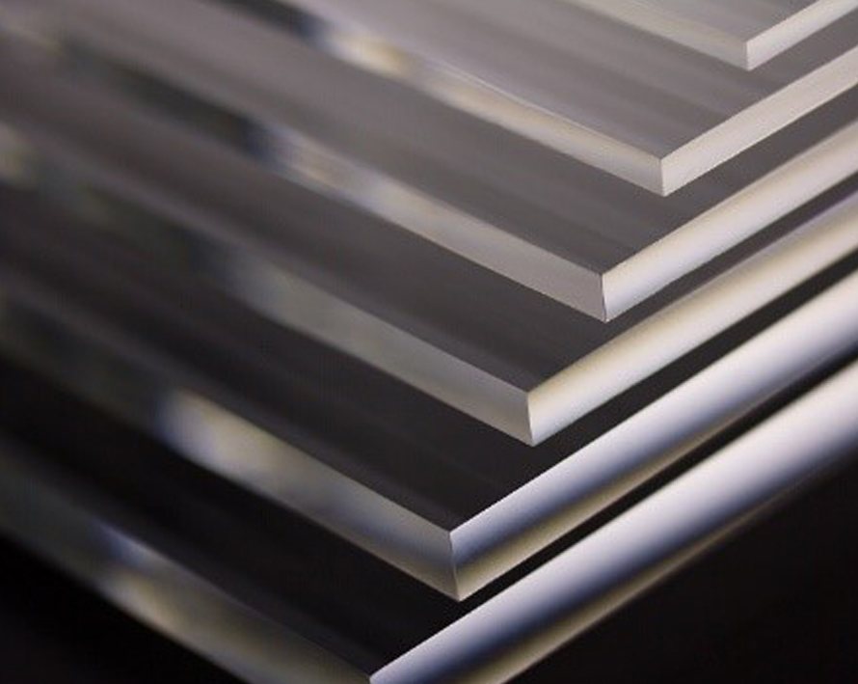
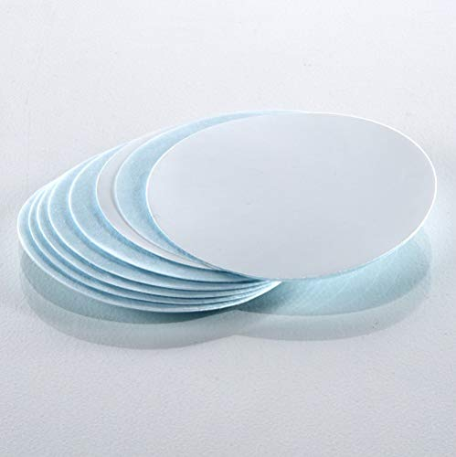
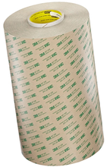
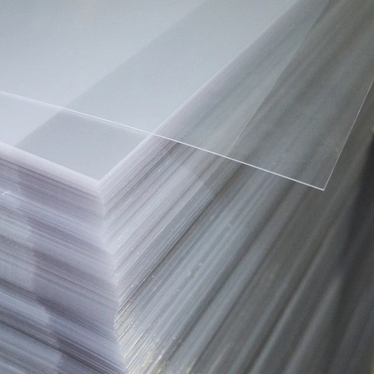
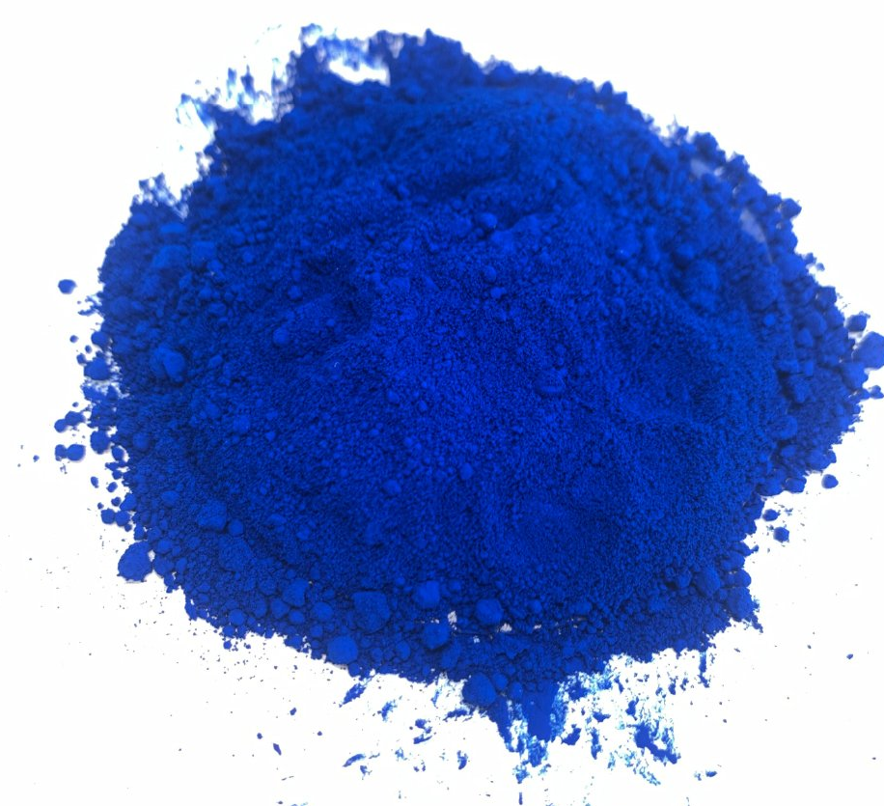
Materials
Water
FD&C Blue #1
1 µm membrane
3/16 PMMA
1/16 PMMA
3M tape
1/16 PET

Slide 26
Experimental Methods
software learned --------------------------------->
Fig. Layers for (V2 R) (V2 S) lined up

Slide 27
Experimental Methods (fluid mechanics) { = 30 seconds}
side view of membrane in a flowing system
Velocity is proportional to area since q1xv1 = v2xq2
Does leaving dye create entropy for the water to fill in space?
Drift and Navier stokes
top view
top view
top view

Slide 28
Results
Notes:
Rectangular membrane and long trapezoid were statistically the same

Slide 29
Results

Slide 30
Results
Notes:
The theory has something to do with length, because its wider can you caulk it up to void space ? Nolan no
The two velocity's are completely different
The membrane of the channel has dead zones and thus don’t accelerate as fast
Since the 3.5 wider start there is more area there is larger concentration difference in flux we are controlling are with varying length rather than other way round
This hypothesis didn’t correlate with hypothesis

Slide 31
