Slide 1
Evaluating Lung Function Changes with Environmental Exposures
Lucca Valdes, Somerville High School, YSP student
Yosef Elbehisy, Al-Noor Academy, YSP Student
Professor Jessica Oakes, Bioengineering, Northeastern University
Jackie Matz, Bioengineering, PhD candidate
Matthew Eden, Bioengineering, PhD candidate
Hannah Kim, Undergraduate
Integrated Cardiovascular and Pulmonary Team (ICAP)

Slide 2
Abstract
Motives and Objectives – 3D Modeling
Understand how e-cigarette exposure remodels lungs over time
Create a 3D model of the nasal passages of the female mouse to be utilized in the future to predict aerosol dosimetry, needed for experimental planning purposes
Motives and Objectives – Data Analysis
Investigate the biological underpaintings of the respiratory system following aerosol exposure
Quantify and evaluate immunofluorescent markers of aSMA, using images of mice exposed to e-cigarettes
Rising rates of e-cigarette usage among high school students in the US; studying long-term impact
Hypothesis
Exposed mice would acclimate to the e-cigarette exposure, leading to a decline in smooth muscle activity in comparison to the initial increase
Lung Function Changes with Environmental Exposures NEU Young Scholars Program 2023 – August 3, 2023
Notes:
Concluding: their resistance was same as control

Slide 3
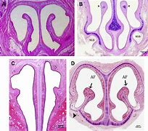
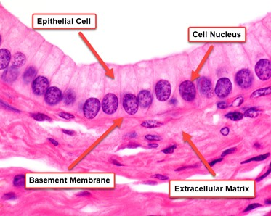
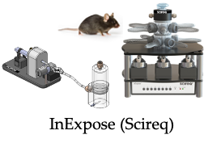
Background
3D Modeling
3D modeling technology utilized to create detailed maps of the nasal cavity in mice
Enhanced understanding of airflow through nasal passages and particle filtration
Research aims to develop new respiratory treatments, including for asthma and allergies
Data Analysis
Mice subjected to e-cigarette smoke for prolonged periods of time, utilizing InExpose for exposure (three test ranges)
Lung sections stained for smooth muscle actin to measure muscle content in airways, specifically epithelial cell nucelli and smooth muscle tissue
Methacholine used to quantify constrictions of airways
Hypothesized transient abnormalities in smooth muscle cells
Lung Function Changes with Environmental Exposures NEU Young Scholars Program 2023 – August 3, 2023
Notes:
***explain we did two different projects

Slide 4
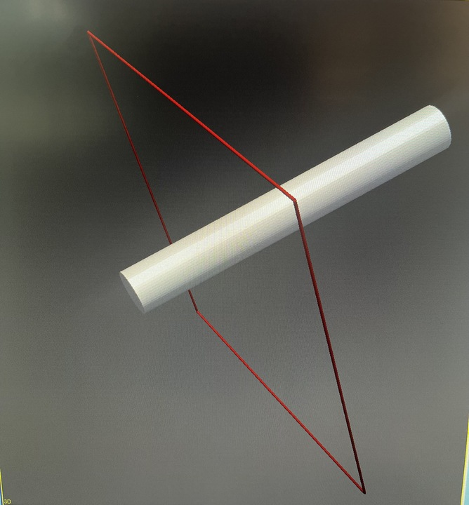
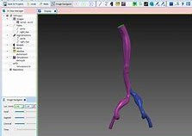
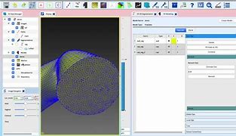
Experimental Methods
Powerful software for cardiovascular modeling and simulation.
Can be used to visualize complex anatomical structures, including the mice nasal cavity.
Utilized to create detailed 3D models of the nasal cavity in a female mouse.
High-resolution CT imaging data were employed for accuracy and thorough analysis.
The 3D model will be used in future research for predicting aerosol dosimetry and aiding in experimental planning.
Lung Function Changes with Environmental Exposures NEU Young Scholars Program 2023 – August 3, 2023

Slide 5
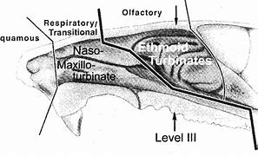
Model Construction
3D model created using SimVascular
allowed for a detailed visualization of mice nasal cavity
Key anatomical structures observed and analyzed Turbinates, olfactory epithelium
Cross-sectional views + virtual tours used to enhance understanding
3D model constructed using SimVascular through a step-by-step process.
Key features of the mice nasal cavity incorporated into the model.
Addressed challenges during modeling process using various techniques.
Lung Function Changes with Environmental Exposures NEU Young Scholars Program 2023 – August 3, 2023

Slide 6
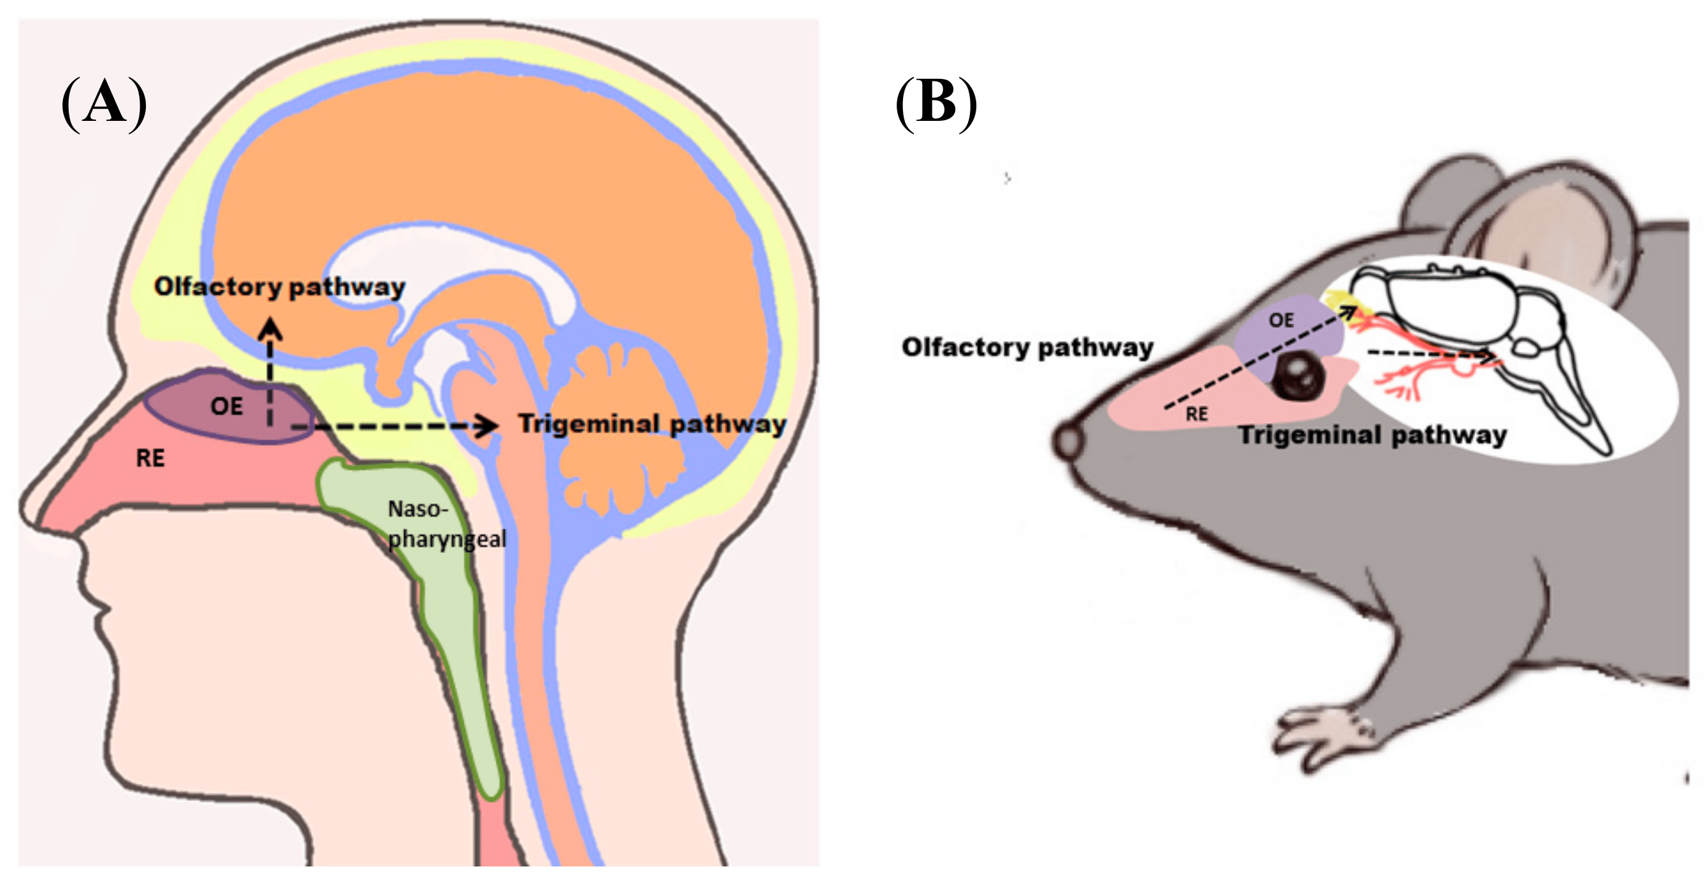
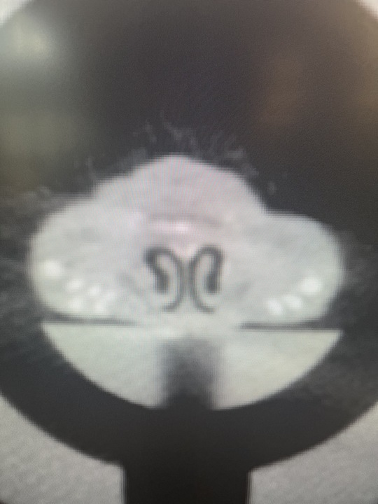
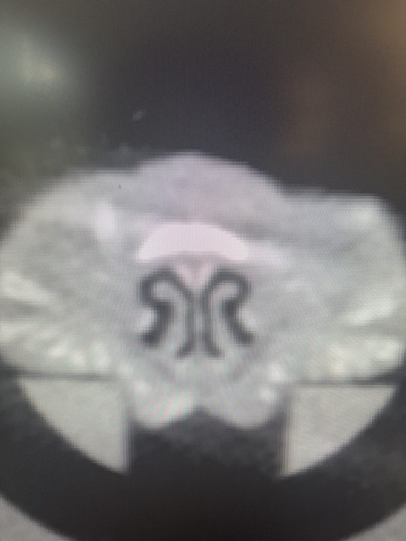
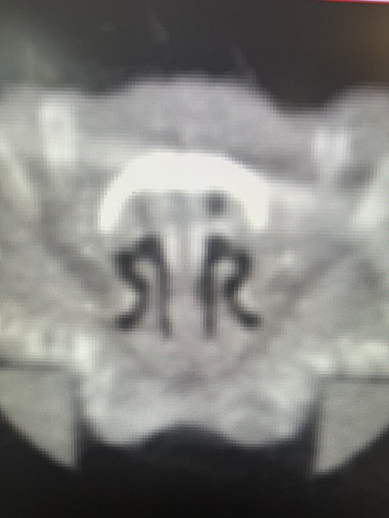
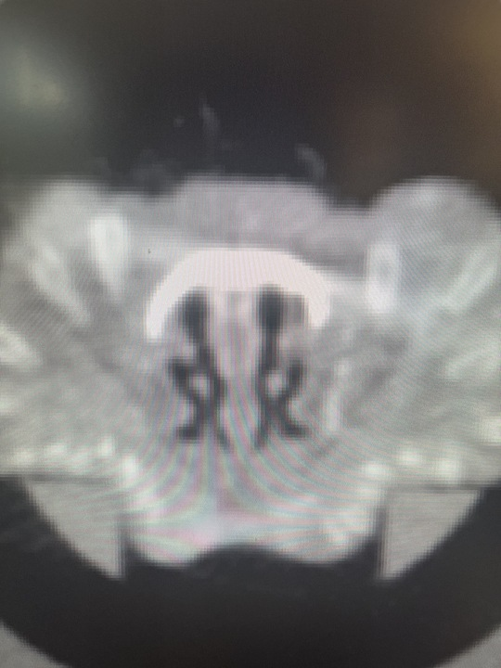
Results - 3D Modeling of Mice Nasal Cavity
3D models of mice nasal cavity showed expected positions of all components.
Airflow pathways within the nasal cavity were clear and unobstructed.
Indication of a normal and undamaged nasal cavity conducive to proper breathing.
Lung Function Changes with Environmental Exposures NEU Young Scholars Program 2023 – August 3, 2023

Slide 7
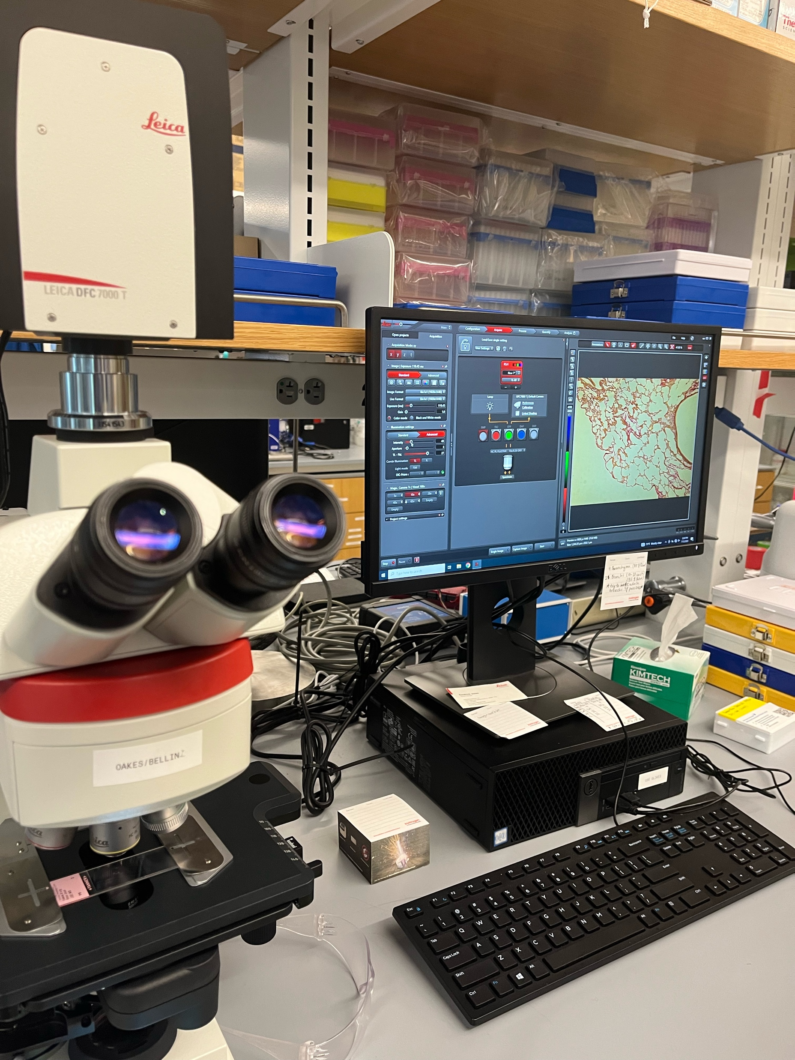
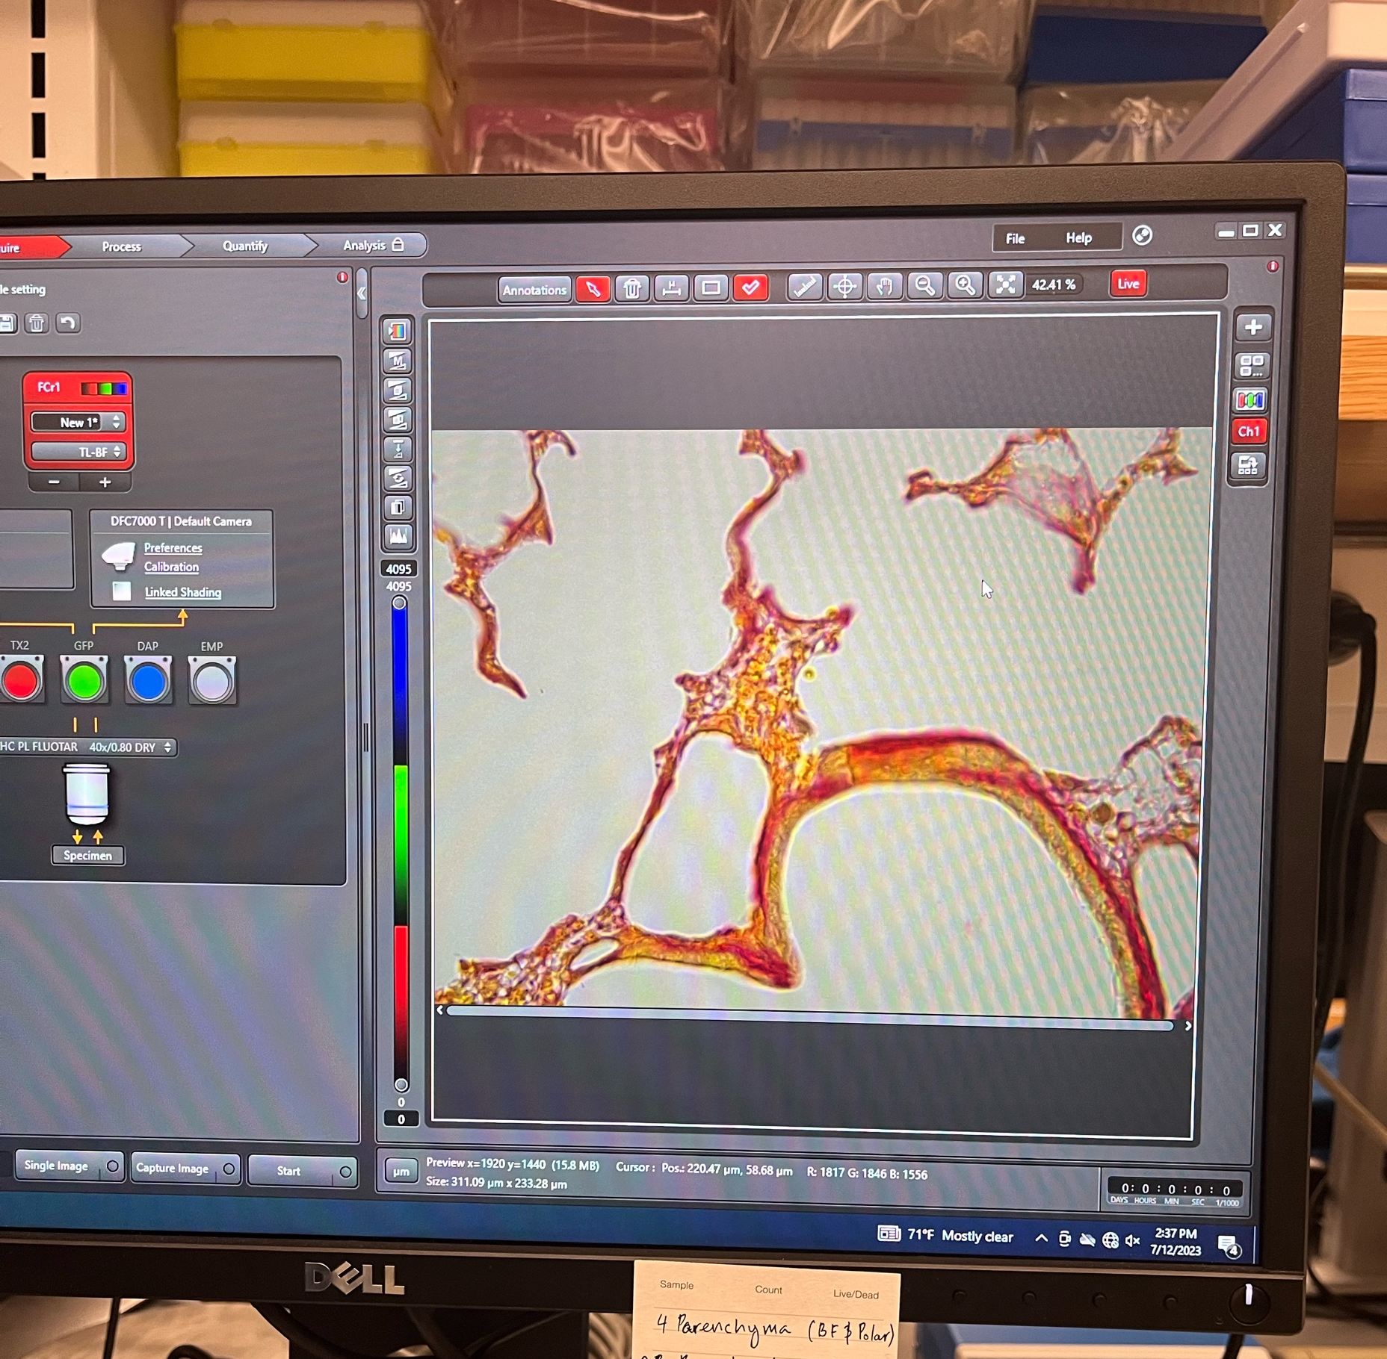
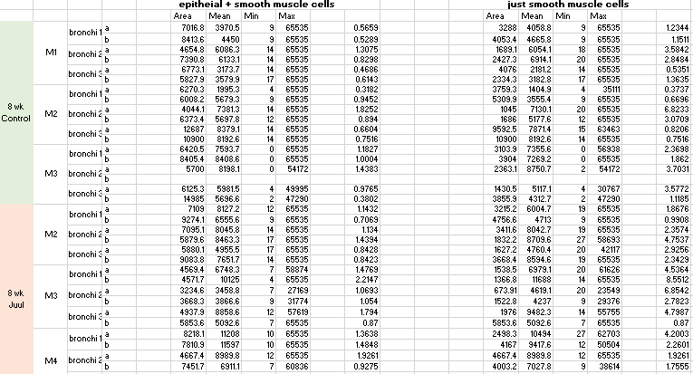
Experimental Methods - Data Analysis
Lung cross sections analyzed (bronchi)
Bright-field Fluorescent microscope
Image-J FIJI Analysis Software
Quantify mean intensities of smooth muscle tissue to be later compiled in an excel sheet
Brightfield and Polarized images taken to analyze Picrosirius red collagen stains
Find differences that are meaningful with exposure to pollutants
Lung Function Changes with Environmental Exposures NEU Young Scholars Program 2023 – August 3, 2023
Notes:
Cross section images of mice airways taken on microscope
Analyze cross sections images of the bronchi of mice exposed to the aerosol for 8 wks, 16wks, and 24wks and also the control group
Polarized imaging uses different wavelengths to get a clearer image of certain products, collagen in our case

Slide 8
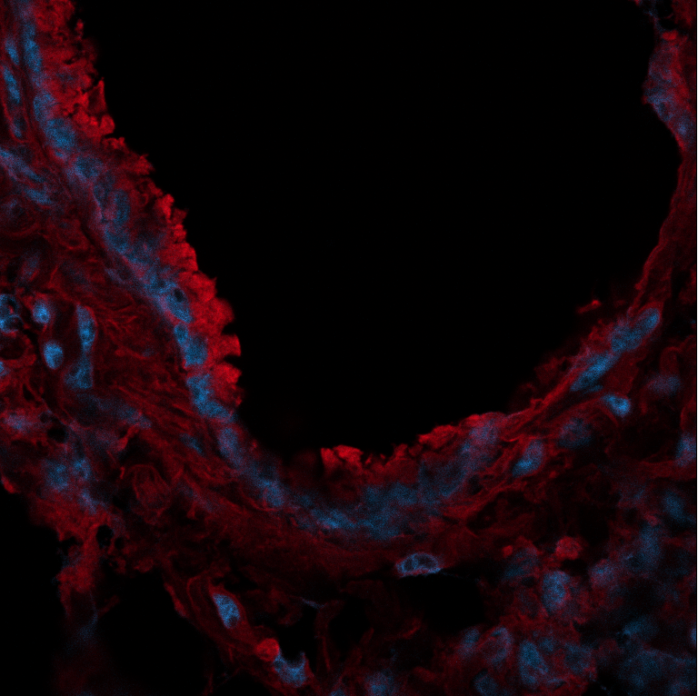
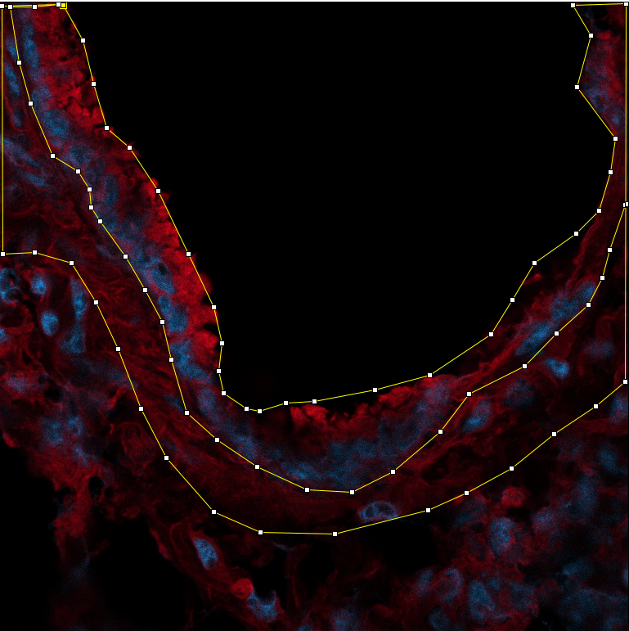
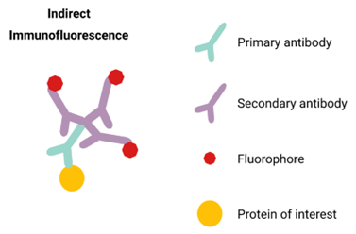
Immunofluorescent Staining
Multiple Antibody Imaging
Permits visualization of tissues / proteins of interest to quantify and highlight characteristics
Determines the presence of antibodies by their specific ability to react with antigens
Juul 8-week exposure group
Lung Function Changes with Environmental Exposures NEU Young Scholars Program 2023 – August 3, 2023
Notes:
Used to quantify protein of interest
Geometry differentiated by morphology
Explain what I was looking for in the image j pictures (red and blue)

Slide 9
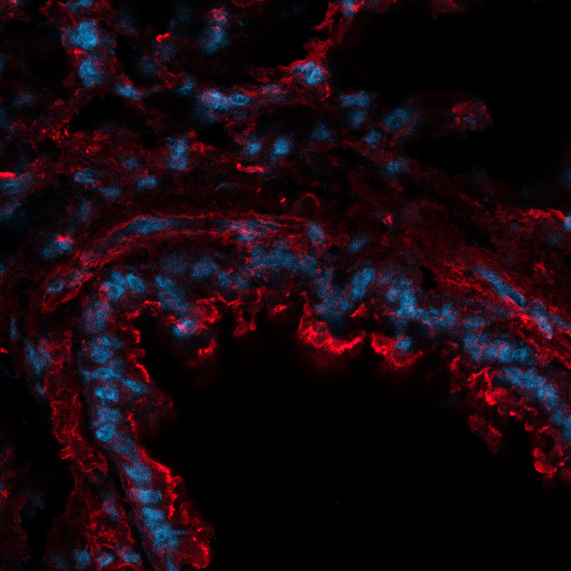
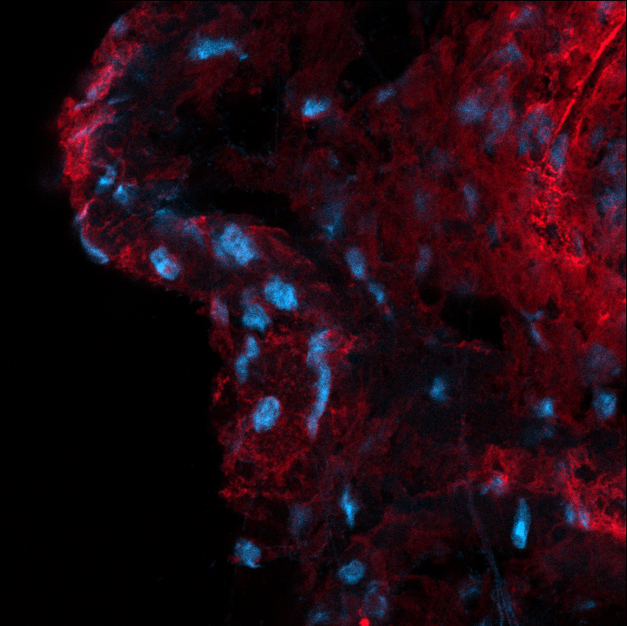
Results
Discontinuities in aSMA at 24 weeks, and transient abnormalities in smooth muscle cells (changes with exposure)
T-tests employed to analyze statistical differences
Hypertrophy is associated with airway responsiveness
8-week control
8-week Juul
T-test: 0.0194
T-test: 0.0116
T-test: 0.2605
9
Lung Function Changes with Environmental Exposures NEU Young Scholars Program 2023 – August 3, 2023
Notes:
Methacholine makes airways constrict
Following exposure, mice produce excess collagen in attempts to compensate for the damage the smoke causes, consequently constricting the airways and making it more difficult for them to expand
Image j revealed mice exposed for 8wks responded at highest dose, 16wks responded much lower dose, 24 weeks didn’t’ respond at all (their resistance was same as control)
Look at value and spread of data (box plot)
Narrower box, smaller range (generally good)
At 8 weeks → STATISTICAL DIFFERENCE
24 weeks →no difference (recent result, still studying the short term effects because these are what are so puzzling)
Tall graph
Measures methacholine resistance, and smooth muscle hypertrophy (an increase in area) resulted from an increased resistance to the drug
In addition to providing results for our project, these findings also suggest that regulating airway muscle hypertrophy could be a potential therapeutic target treatment in asthma

Slide 10
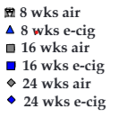
Results
Constriction of aSMA measured using methacholine exposure
Methacholine causes airways to constrict
Measured body’s ability to resist
No resistance at 24 weeks; comparable to resistance of control group
10
Lung Function Changes with Environmental Exposures NEU Young Scholars Program 2023 – August 3, 2023
Notes:
Methacholine makes airways constrict
Following exposure, mice produce excess collagen in attempts to compensate for the damage the smoke causes, consequently constricting the airways and making it more difficult for them to expand
Image j revealed mice exposed for 8wks responded at highest dose, 16wks responded much lower dose, 24 weeks didn’t’ respond at all (their resistance was same as control)
Look at value and spread of data (box plot)
Narrower box, smaller range (generally good)
At 8 weeks → STATISTICAL DIFFERENCE
24 weeks →no difference (recent result, still studying the short term effects because these are what are so puzzling)
Tall graph
Measures methacholine resistance, and smooth muscle hypertrophy (an increase in area) resulted from an increased resistance to the drug
In addition to providing results for our project, these findings also suggest that regulating airway muscle hypertrophy could be a potential therapeutic target treatment in asthma

Slide 11
Conclusion
Data Analysis
Continuing investigation on the 24-week exposure group to deepen understandings of the long-terms effects of aerosol exposure
Study emphasizes the importance of understanding the mechanisms underlying ASM remodeling in asthma
Findings suggest that regulating airway muscle hypertrophy could be a potential therapeutic target in asthma
3D Modeling
Studies to be conducted on the mice nasal cavities post-aerosol exposure, making this a long-term project utilizing different researchers to build upon each other
Our final project helps researchers understand how smoke inhalation affects the mice nasal cavities
Sketches of nasal cavities drawn before and after exposure, giving researchers a visual means of comparing the discontinuities to better understand the effects of smoke exposure on the respiratory system
Essential for understanding how smoke might impact the respiratory health of both mice and humans
Lung Function Changes with Environmental Exposures NEU Young Scholars Program 2023 – August 3, 2023

Slide 12
Acknowledgements
Principle Investigator
Jessica Oakes
Lab members
Jacqueline Matz, PhD Candidate
Matthew Eden, PhD Candidate
Hannah Kim, Undergraduate
Lucca Valdes, YSP Student
Yosef Elbehisy, YSP Student
Center of STEM Education
Claire Duggan, Executive Director
Jennifer Love, Associate Director
Claire Stipp and Yassine Souabny, YSP Coordinators
Nicholas Fuchs, Program Manager
Mary Howley, Administrative Officer
Funding
NIH/NHLBI grant 1R01HL168719
References
Plant, P. J., North, M. L., Ward, A., Ward, M., Khanna, N., Correa, J., Scott, J. A., & Batt, J. (2012). Hypertrophic airway smooth muscle mass correlates with increased airway responsiveness in a murine model of asthma. American Journal of Respiratory Cell and Molecular Biology, 46(4), 532–540. https://doi.org/10.1165/rcmb.2011-0293OC
Matz, J., Farra, Y. M., Cotto, H. M., Bellini, C., & Oakes, J. M. (2023). Respiratory mechanics following chronic cigarette smoke exposure in the Apoe - / - mouse model. Biomechanics and Modeling in Mechanobiology, 22(1), 233–252. https://doi.org/10.1007/s10237-022-01644-8
Eden, M. J., Matz, J., Garg, P., Gonzalez, M. P., McElderry, K., Wang, S., Gollner, M. J., Oakes, J. M., & Bellini, C. (2023). Prolonged smoldering Douglas fir smoke inhalation augments respiratory resistances, stiffens the aorta, and curbs ejection fraction in hypercholesterolemic mice. The Science of the total environment, 861, 160609. https://doi.org/10.1016/j.scitotenv.2022.160609
Integrated Cardiovascular and Pulmonary Team (ICAP)
Lung Function Changes with Environmental Exposures NEU Young Scholars Program 2023 – August 3, 2023

