Slide 1
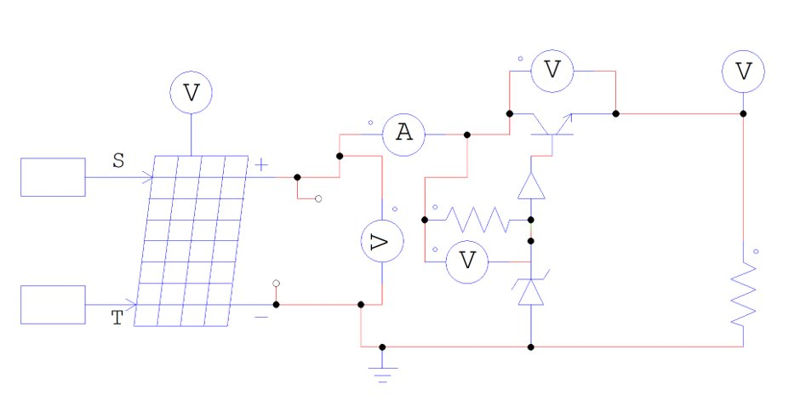
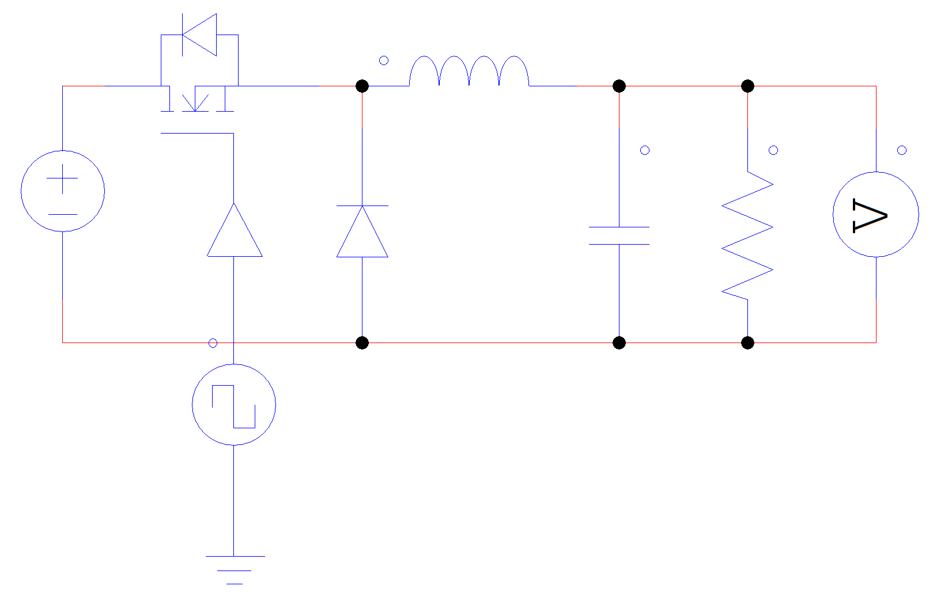
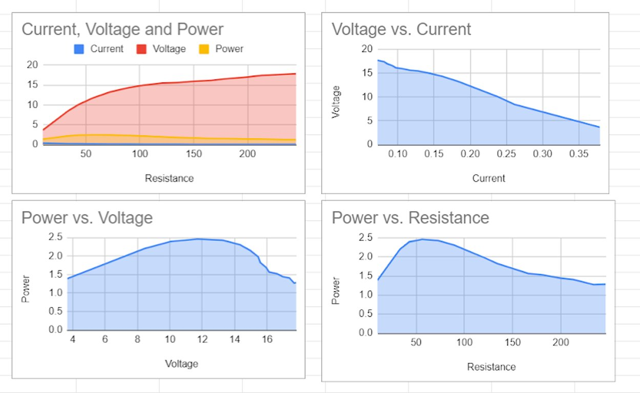
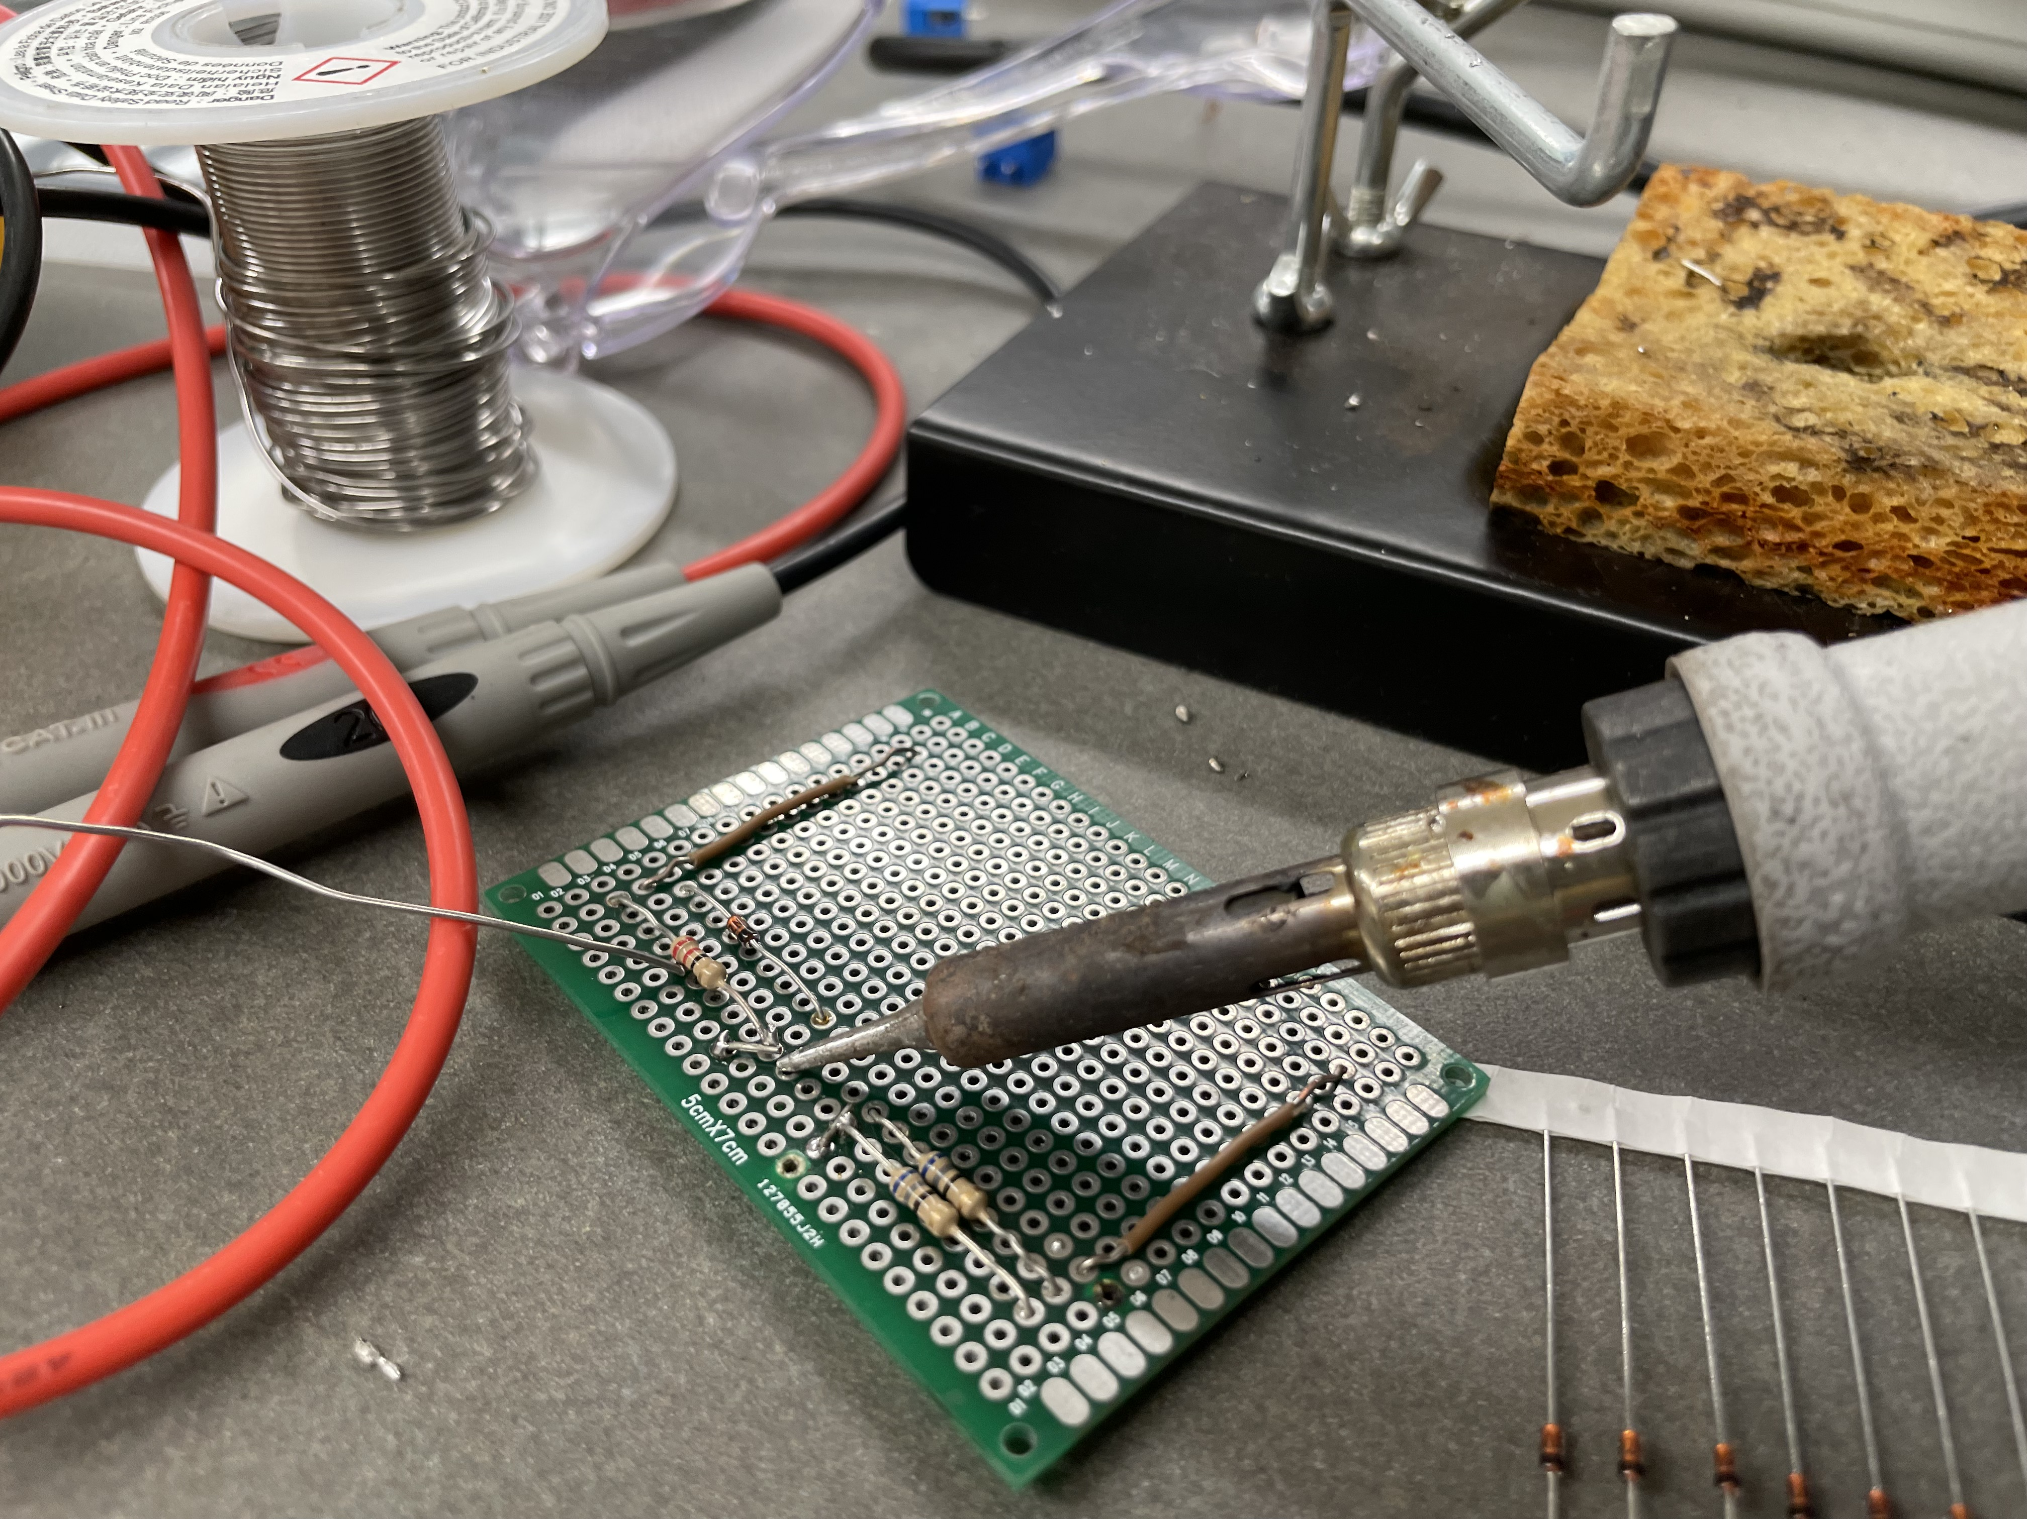
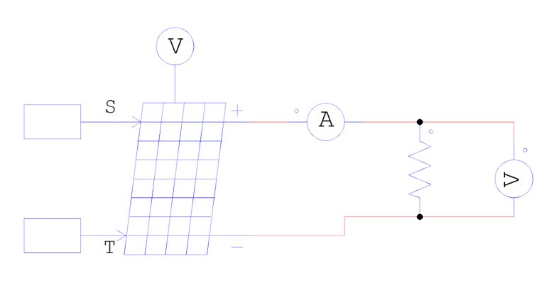
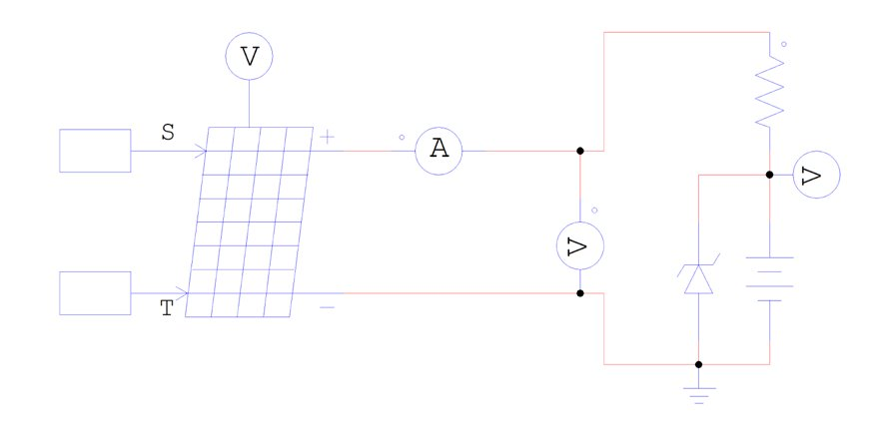
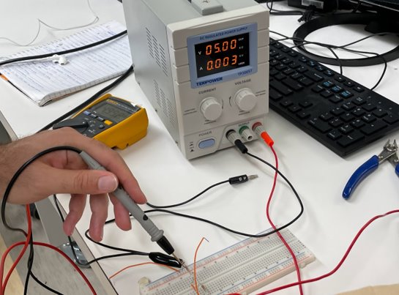
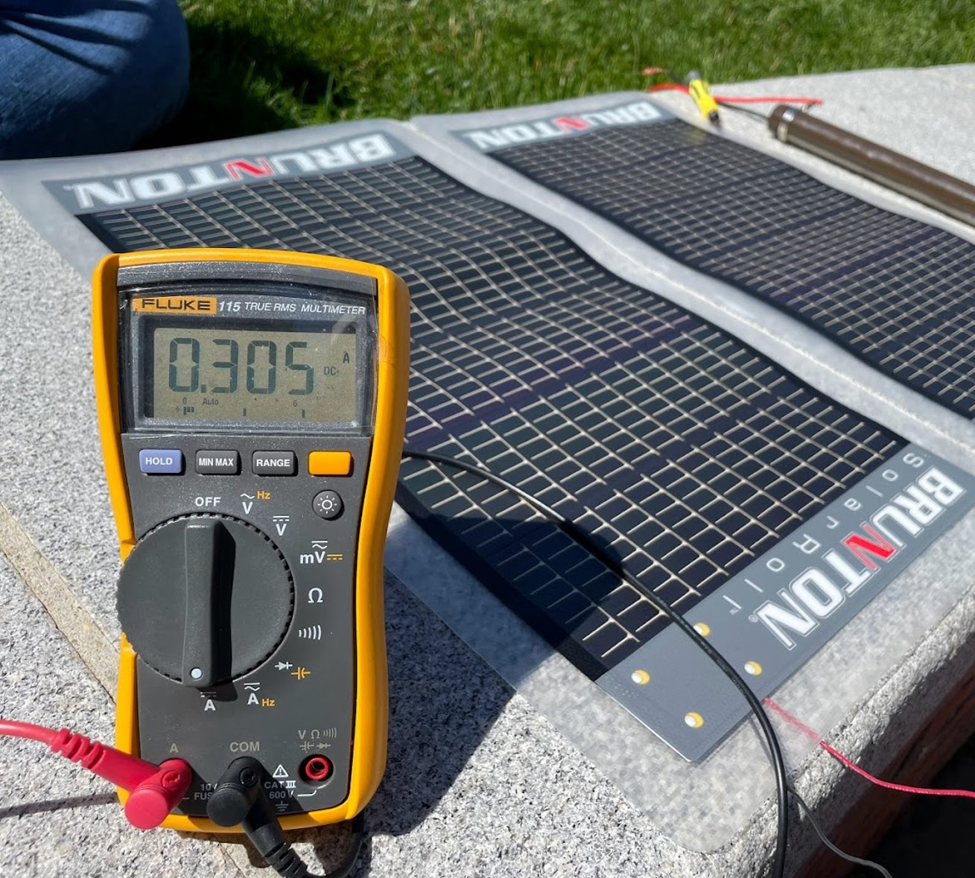
Designing Linear & Switching DC-DC Converters for Solar-Powered Phone Chargers
May Ng, YSP Student, Braintree High School
Miles Luther, YSP Student, Brookline High School
Mojtaba Salehi, PhD Student, Northeastern University
Professor Mahshid Amirabadi, Electrical and Computer Engineering, Northeastern University
Abstract
Powersim Simulation (cont.)
Experimental Results
Motivation:
To redefine the scope of inexhaustible and renewable energy through solar power
To reduce dependent use on fossil fuels and providing a clean way to power the planet
Challenge:
Low efficiency in photovoltaic modules in converting sunlight to usable electric power.
Goals:
To use a PSIM simulation to determine the most effective conditions that maximize extracted solar power output
To design DC-DC converters for solar-powered phone chargers and determine the best way to harness solar energy and power the planet in a safe, sustainable, and clean way
Circuit design: simulate photovoltaic (PV) modules connected to linear DC-DC converters on PSIM & experiment in realistic weather conditions
Circuit analysis: 1) solve the circuits 2) chart & graph the experimental data/ model waveforms
Figure 10. Graph of data collected from PV module experiments
Figure 3. Transistor Series Voltage Regulator
Figure 4. Buck Converter
Graph I-V P-V curves based on field data
Multimeter highlights the output load voltage is consistent at 5V in the connected circuit
Conclusions and Future Steps
Figure 5. Waveform of Temperature Variation
Figure 6. Waveform of Irradiance Variation
In PSIM: maximum power point = 60.53 watts, highest extracted power efficiency at irradiance of 1000 W/m^2 and temperature of 25°C
Voltage divider linear regulators are inefficient, but simple and low-cost
Buck switching converters can be more efficient compared to linear regulators – better and more precise depending on the application
Buck converter can provide variable output, whereas linear voltage regulator has only one output level
Dissipates less power by increasing the current
Future Studies:
Cleanse P-V I-V curve field data
Construct a buck converter; experiment, collect, and analyze data
Determine functional differences between DC-DC switching and linear regulators; explore advantages for different usages
Model and solve the above circuits using PSIM software for a fixed output of 5V
Run PSIM simulations with variance to temperature and irradiance and to plot Figures 6 and 7
Data highlights that the maximum extracted efficiency is at irradiance of 1000 W/m^2 and temperature of 25C
Background
Power electronics: deliver power from the source to the load and control the conversion of electric power to another
DC Source: PV module
DC Load: Phone battery
Challenge: unstable solar voltage is unsuitable for battery charging
Research focus: regulating the output voltage with different DC-DC converters
Experimental Methods
Determine resistance values for the voltage divider from PSIM simulations
Practice using circuits on breadboards
Solder a voltage divider linear regulator on a PCB board
Experiment and gather data of irradiance and load resistance variance on current (I), voltage (V), and extracted power using a multimeter connected to a PV module, and ensure that the data is collected under direct sunlight which guarantees consistency
Powersim Simulation
Figure 7. Soldering a voltage divider linear regulator
Acknowledgements
Department of Electrical and Computer Engineering
Mahshid Amirabadi, Associate Professor
Mojtaba Salehi, Ph.D. Student for Electrical Engineering
Center for STEM Education
Claire Duggan, Director of Programs and Operations, Center for STEM Education
Nicolas Fuchs, Project Implementation Coordinator
Franklin Ollivierre III and Katherine Aristizabal Norena, YSP Coordinators
Figure 1. Simulation of PV Module
Figure 2. Voltage Divider Linear Regulator
Figure 9. Voltage measurements of PV module connected to load resistor
Figure 8. Measure voltage with a DC power supply on breadboard circuit
Young Scholar’s Program at Northeastern University Claire Duggan, Program Director
Notes:
1
Change to relevant logos of sponsor, also include grant # if there is one.

