Slide 1
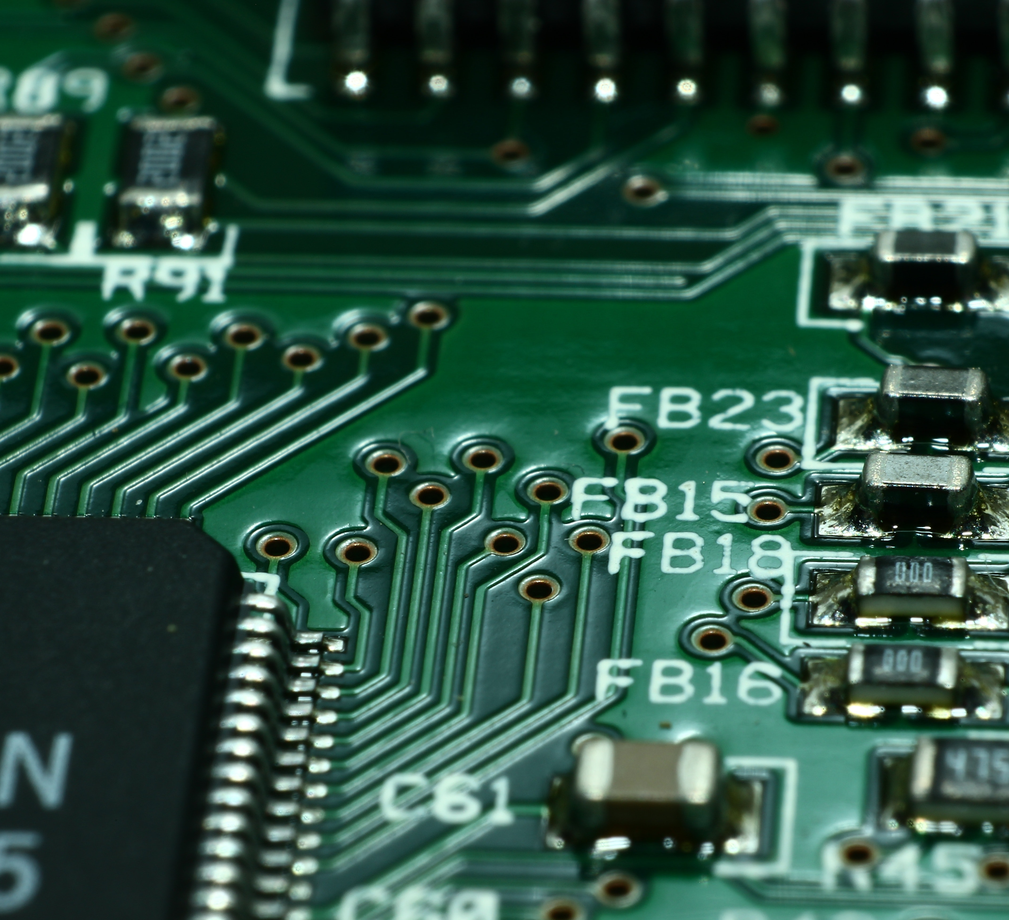
Designing Linear and Switching DC-DC Converters for Solar-Powered Phone Chargers
May Ng
Miles Luther
May Ng, YSP Student, Braintree High School
Miles Luther, YSP Student, Brookline High School
Mojtaba Salehi, Ph.D. Student, Northeastern University
Professor Mahshid Amirabadi, Electrical and Computer Engineering, Northeastern University
Mojtaba Salehi
Professor Mahshid Amirabadi

Slide 2
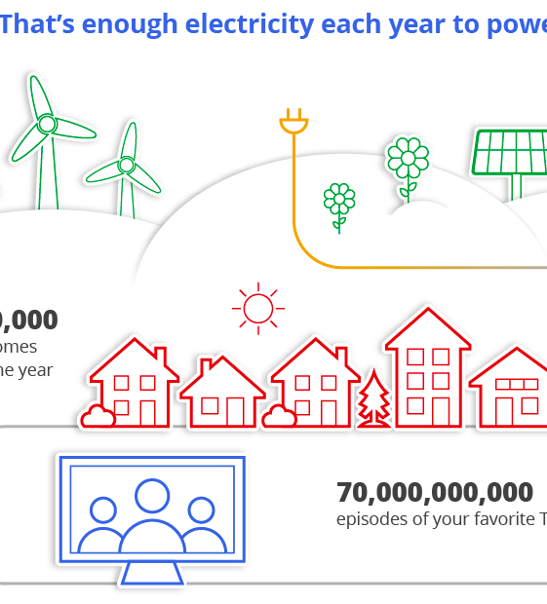
ABSTRACT
Motivation: Solar energy has the power to redefine the scope of inexhaustible and renewable energy, thus reducing dependent use on fossil fuels & providing a clean way to power the planet.
Vision: Use a PSIM simulation to determine the most effective conditions that maximize extracted solar power output.
Challenge: Low efficiency in photovoltaic modules in converting sunlight to usable electric power.
Notes:
Miles

Slide 3
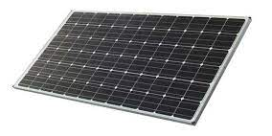
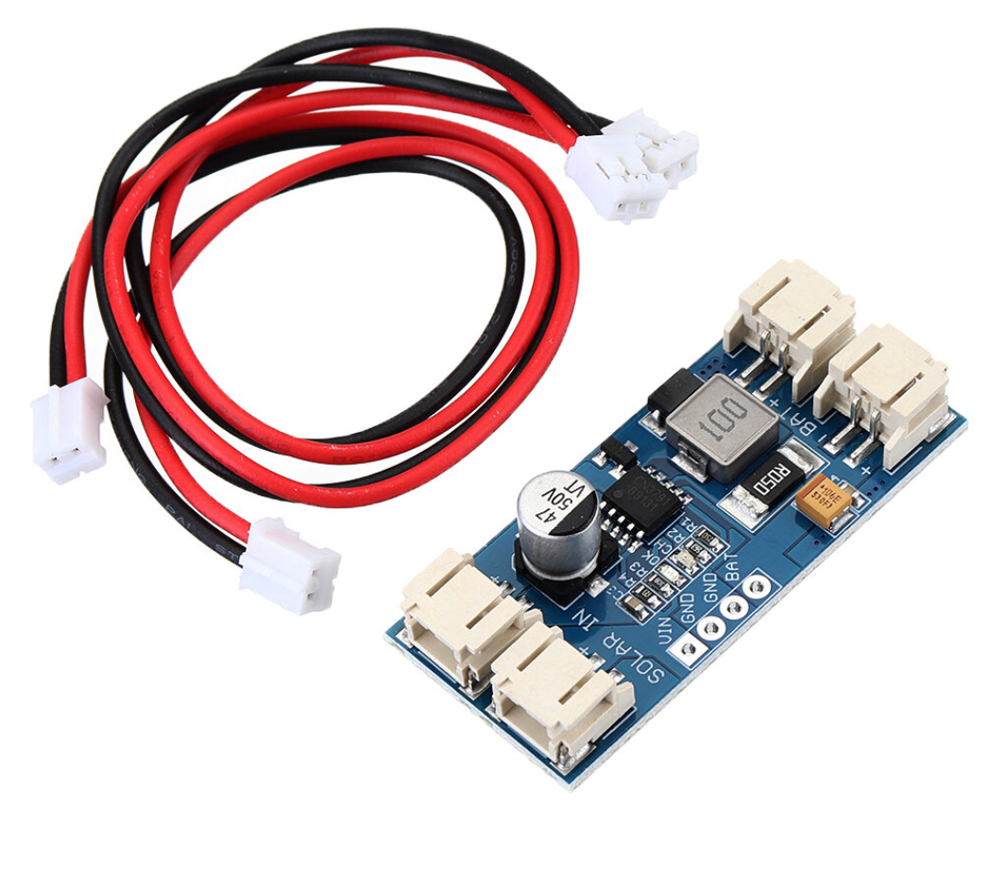
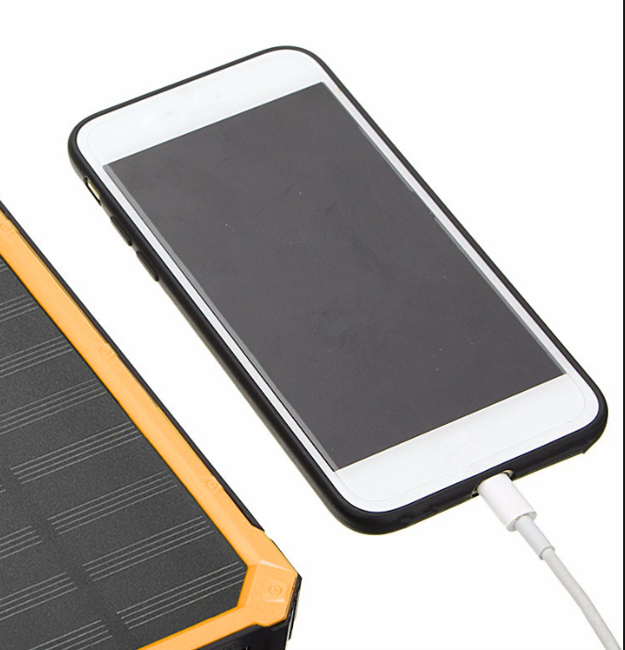
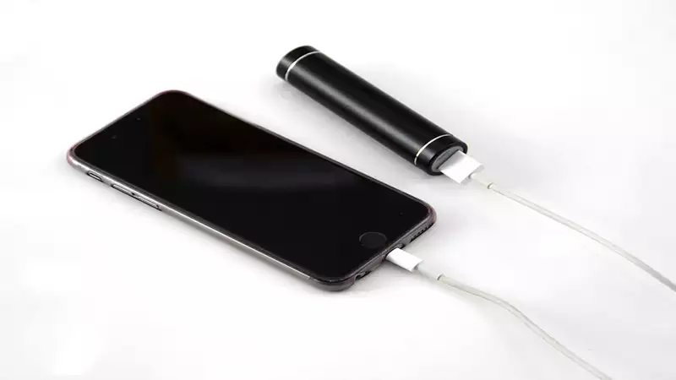
ABSTRACT - Continued
Goals: To design DC-DC converters for solar-powered phone chargers, thus determining the best way to harness solar energy & power the planet in a safe, sustainable, & clean way.
Circuit design: simulate photovoltaic (PV) modules connected to linear DC-DC converters- such as voltage dividers, LDOs, & transistor series voltage regulators- on PSIM & experiment in realistic weather conditions.
Circuit analysis: solving the circuits; chart & graph the PSIM & experimental data, modeling waveforms of load, irradiance, & temperature variation on current, voltage, extracted power, & maximum power in PV modules.
Power Electronics
Notes:
May

Slide 4
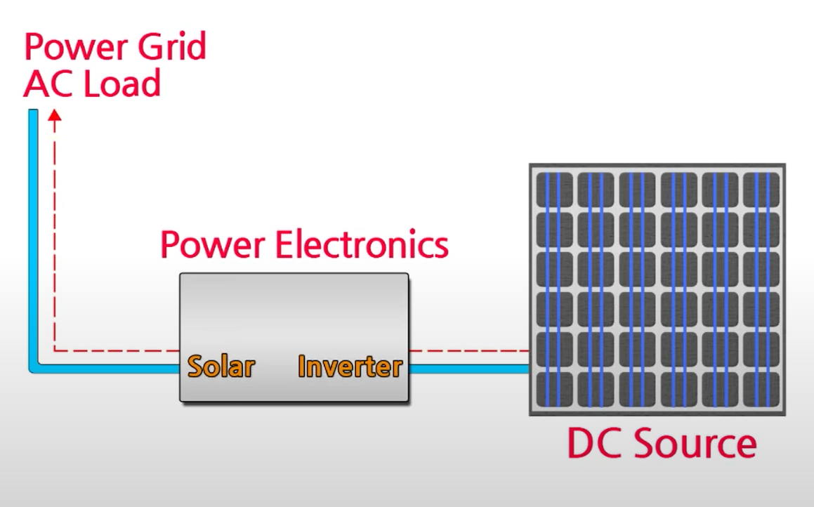
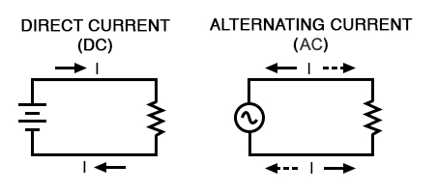
Background: Power Electronics
Purpose: Delivers power from the source to the load; controls the conversion of electric source to load; helps to regulate the output voltage and to control the output power
Different types of sources / loads: DC (Direct Current) vs AC (Alternating Current)
DC examples: PV panel / battery
AC examples: wall outlet, motors
Figure 1. Diagram of Power Electronics System
Figure 2. Circuitry differences between AC and DC
Notes:
May

Slide 5
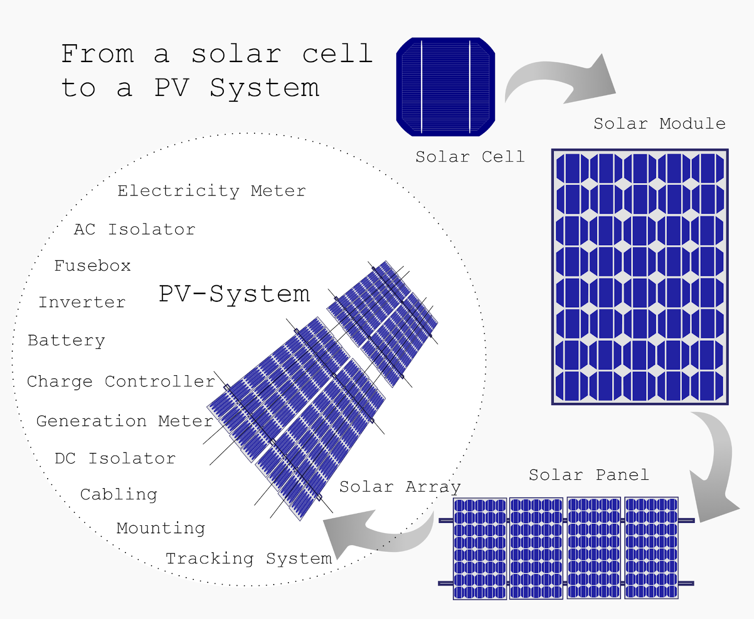
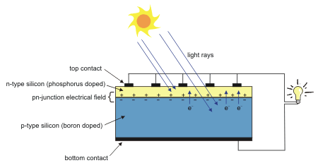
Solar Energy
Solar energy is extracted from PV modules that convert sunlight directly into electricity
How do Photovoltaics Work?: When sunlight hits a solar cells, the energy from the light photons is absorbed, which – in junction with the semiconductor material - allows the free flow of electrons & an electric current output
Figure 4. Model of PV Cell Composition​
Figure 3. Diagram of PV System Make-up
Notes:
Miles

Slide 6
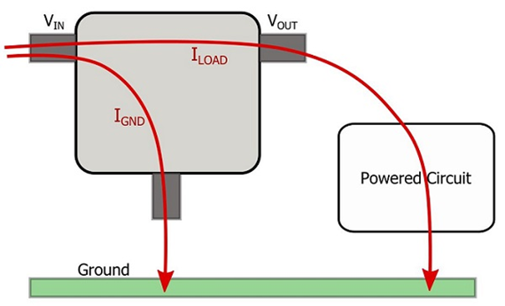
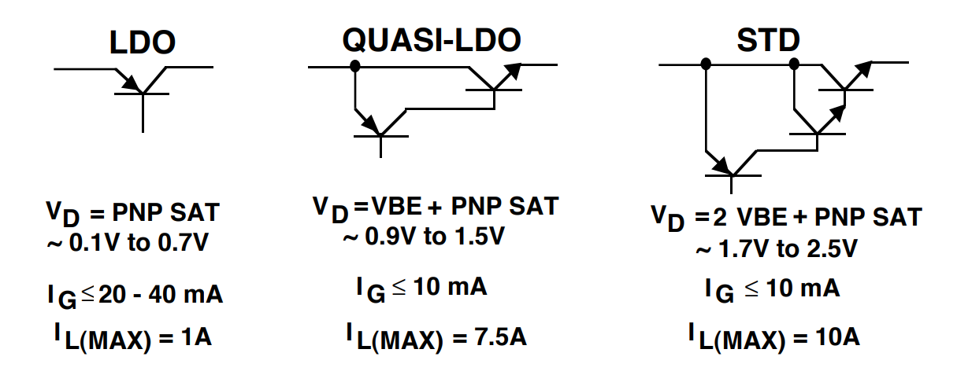
Linear Regulators
Linear Voltage Regulator Applications:
Usage: maintains a steady output voltage by dividing the input voltage into output voltage and waste heat
Types: Low-dropout regulators, Quasi-LDO regulators, standard linear regulators
Thermal Precautions:
Dissipated power increases component temperature, which will impair the device without proper thermal design
Figure 5. Diagram of Linear Regulator
Notes:
Miles

Slide 7
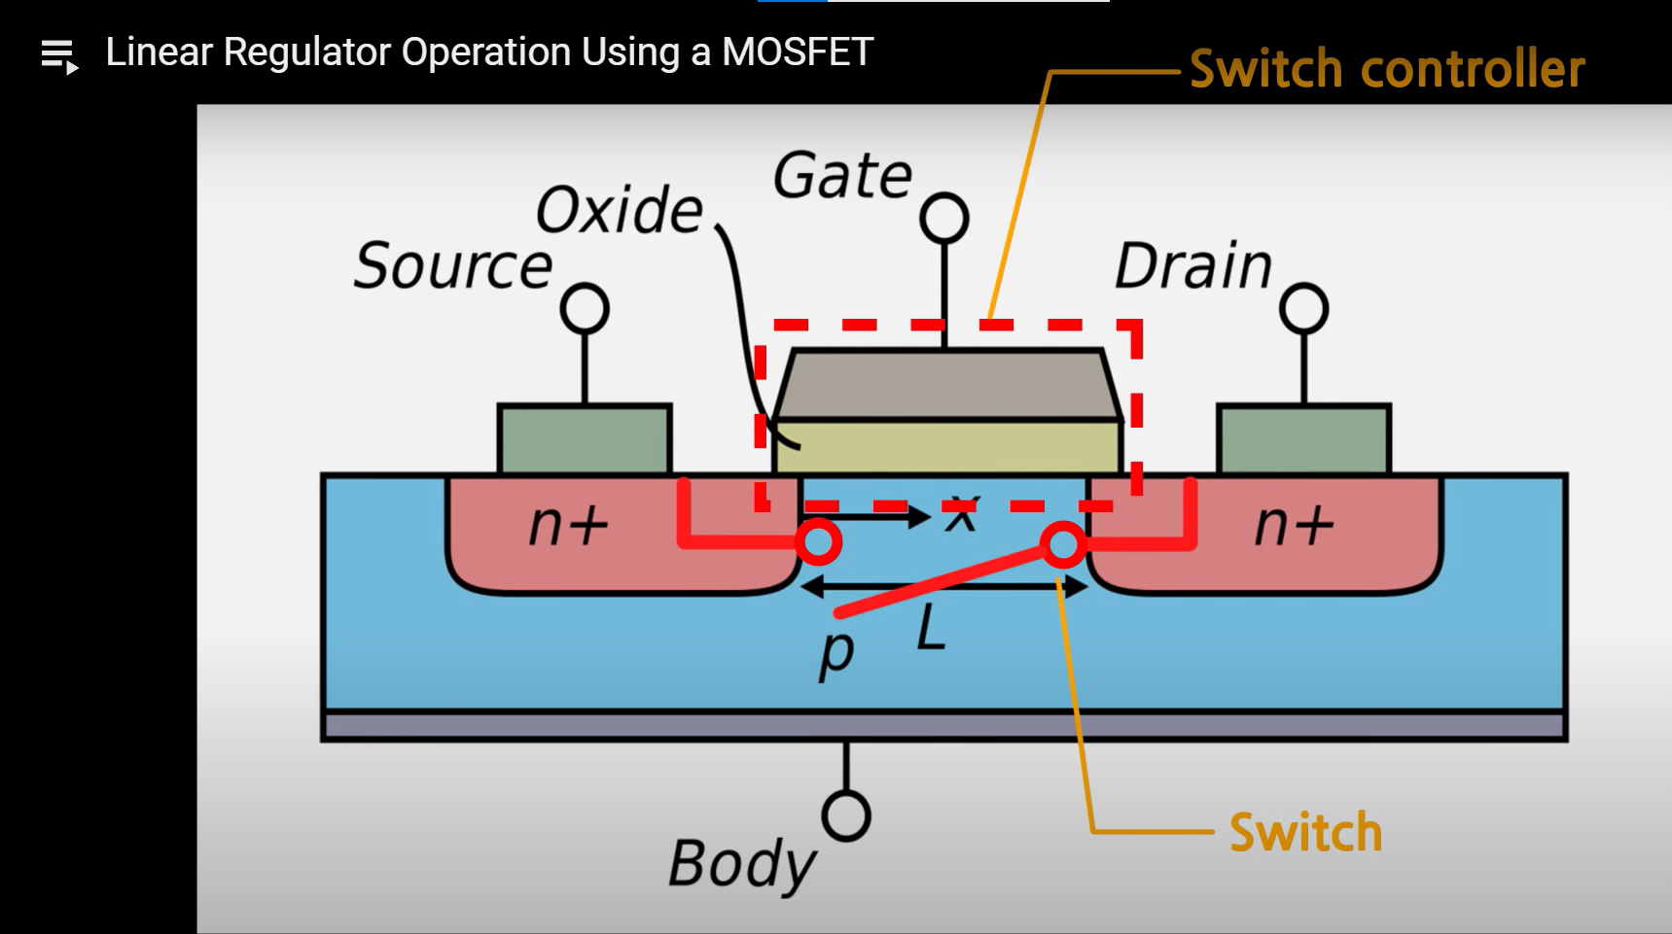
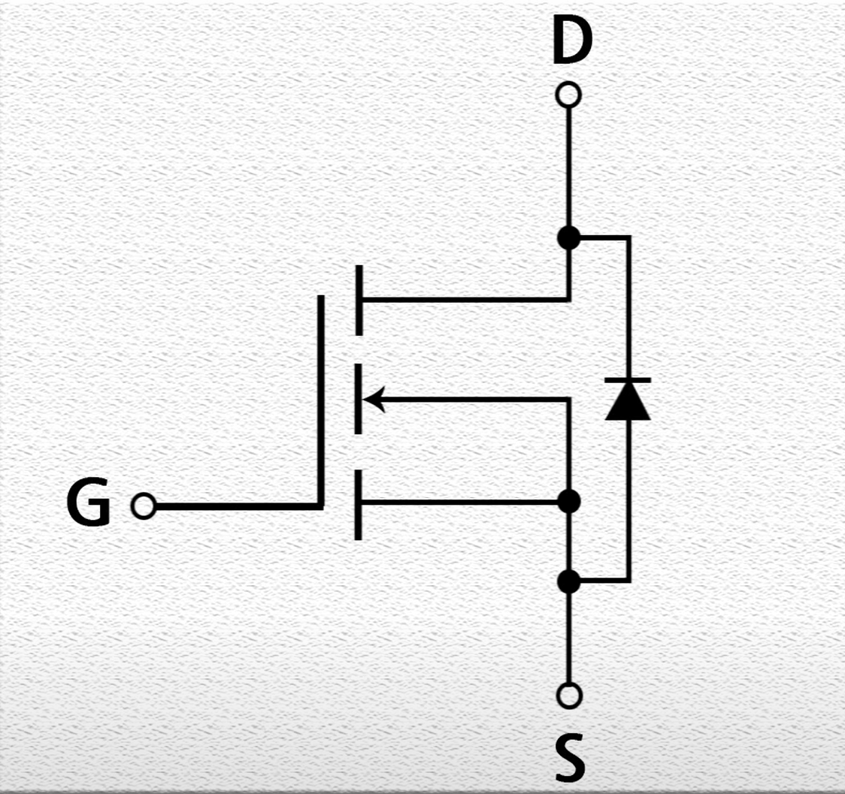
Switching Regulators
MOSFET: Metal-Oxide Semiconductor Field-Effect Transistor / IGBT: Insulated-Gate Bipolar Transistor
The voltage between the gate and source decides if current can flow from drain to source
Requires a voltage > than threshold voltage to turn the transistor on
Signal to the gate (voltage) allows current flow
Buck Converters
Switching regulator has higher power conversion efficiency + increased design flexibility
Buck converter: reduces a DC voltage to a lower DC voltage (same polarity)
3 pins: gate (g), source (s), drain (d)
Notes:
Mayyy

Slide 8
Circuit design
PV Module
Voltage Divider Linear Regulator
Transistor Series Voltage Regulators
Buck Converters
PSIM Software
Notes:
Miles
- in increasing complexity order

Slide 9
PSIM SIMULATION
PV Module
Voltage Divider Linear Regulator
Vin
R1
V out
R2
Zener diode regulates and maintains a fixed output voltage
Notes:
Miles
Revise equation

Slide 10
PSIM Simulation (cont'd)
Transistor Series Voltage Regulator
Buck Converter
MOSFET
Vbe
Ib
Ir
Vout
Iz
Vz
KCL and KVL
R1 = (Vi - Vz) / (Iz + [I out / hFE])
Buck converters ideally have no power loss; current increases as voltage decreases
Rout = V out / I out = V out / (Ib * hFE)
Notes:
May
- had to calculate resistance, zener diode voltage, duty cycle values to have load voltage at 5 volts
- change ground

Slide 11
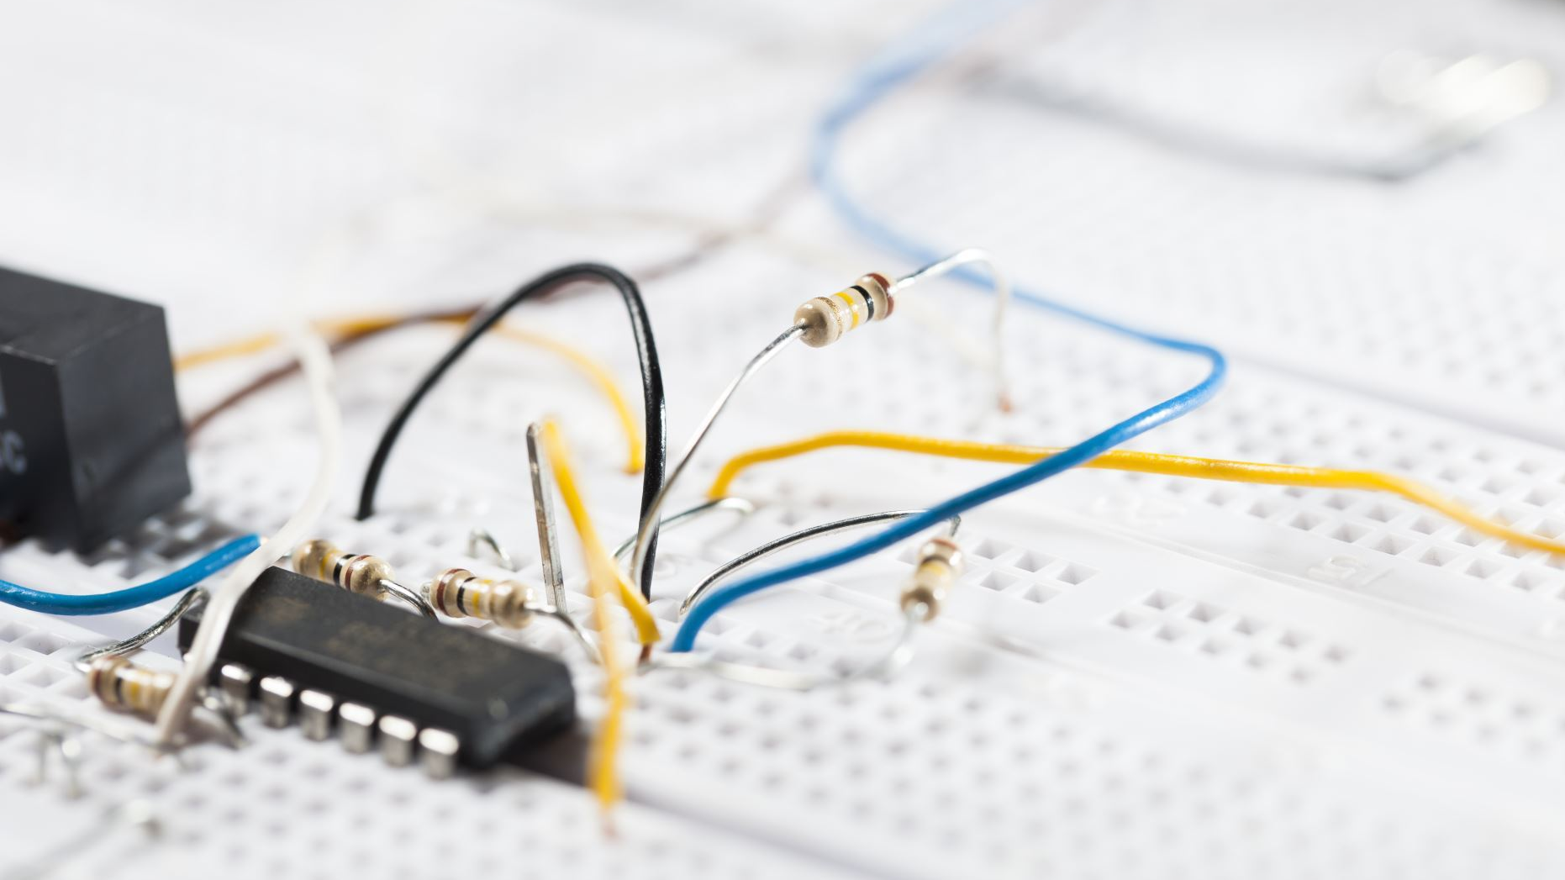
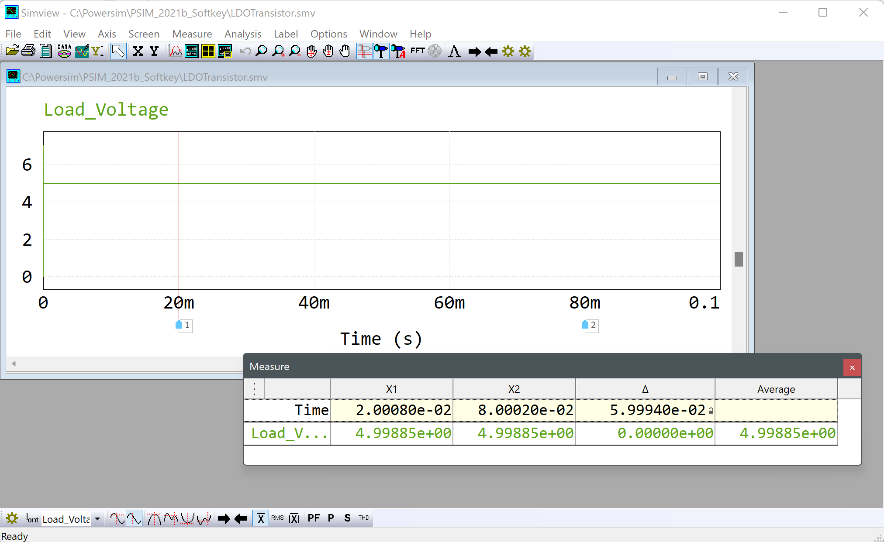
Circuit analysis
Solving circuits, Iv-pv curves, waveforms
Figure 76 PSIM Simulation- Desired load output of 5V achieved
Notes:
Miles

Slide 12
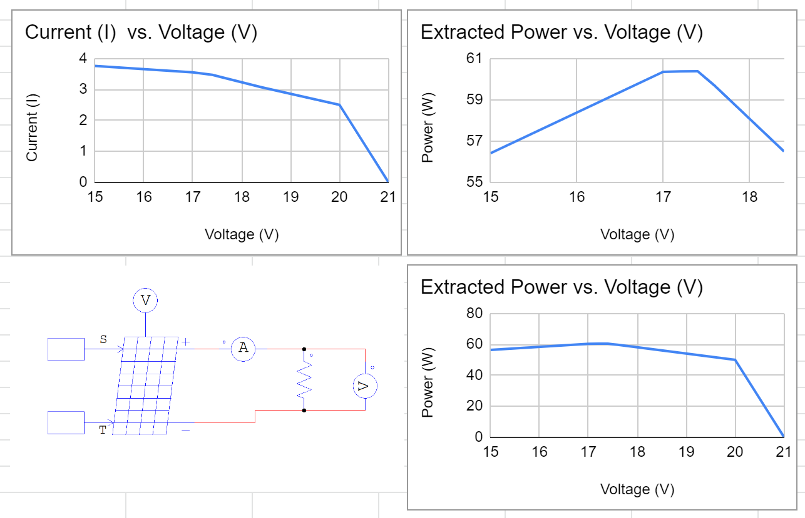
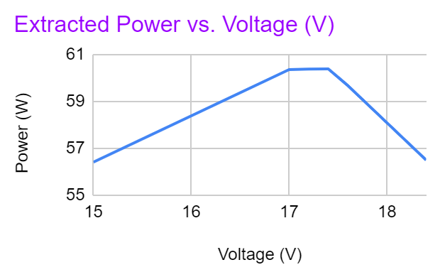
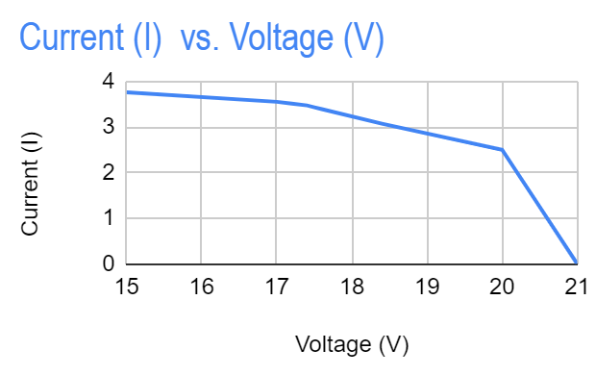
Simulation Results: Load Variation
Notes:
May
Increments of 100 W/m^2

Slide 13
Simulation Results: Temperature Waveform
Notes:
May
Increments of 5C

Slide 14
Simulation Results: Irradiance Waveform
Notes:
Miles
Increments of 100 W/m^2

Slide 15
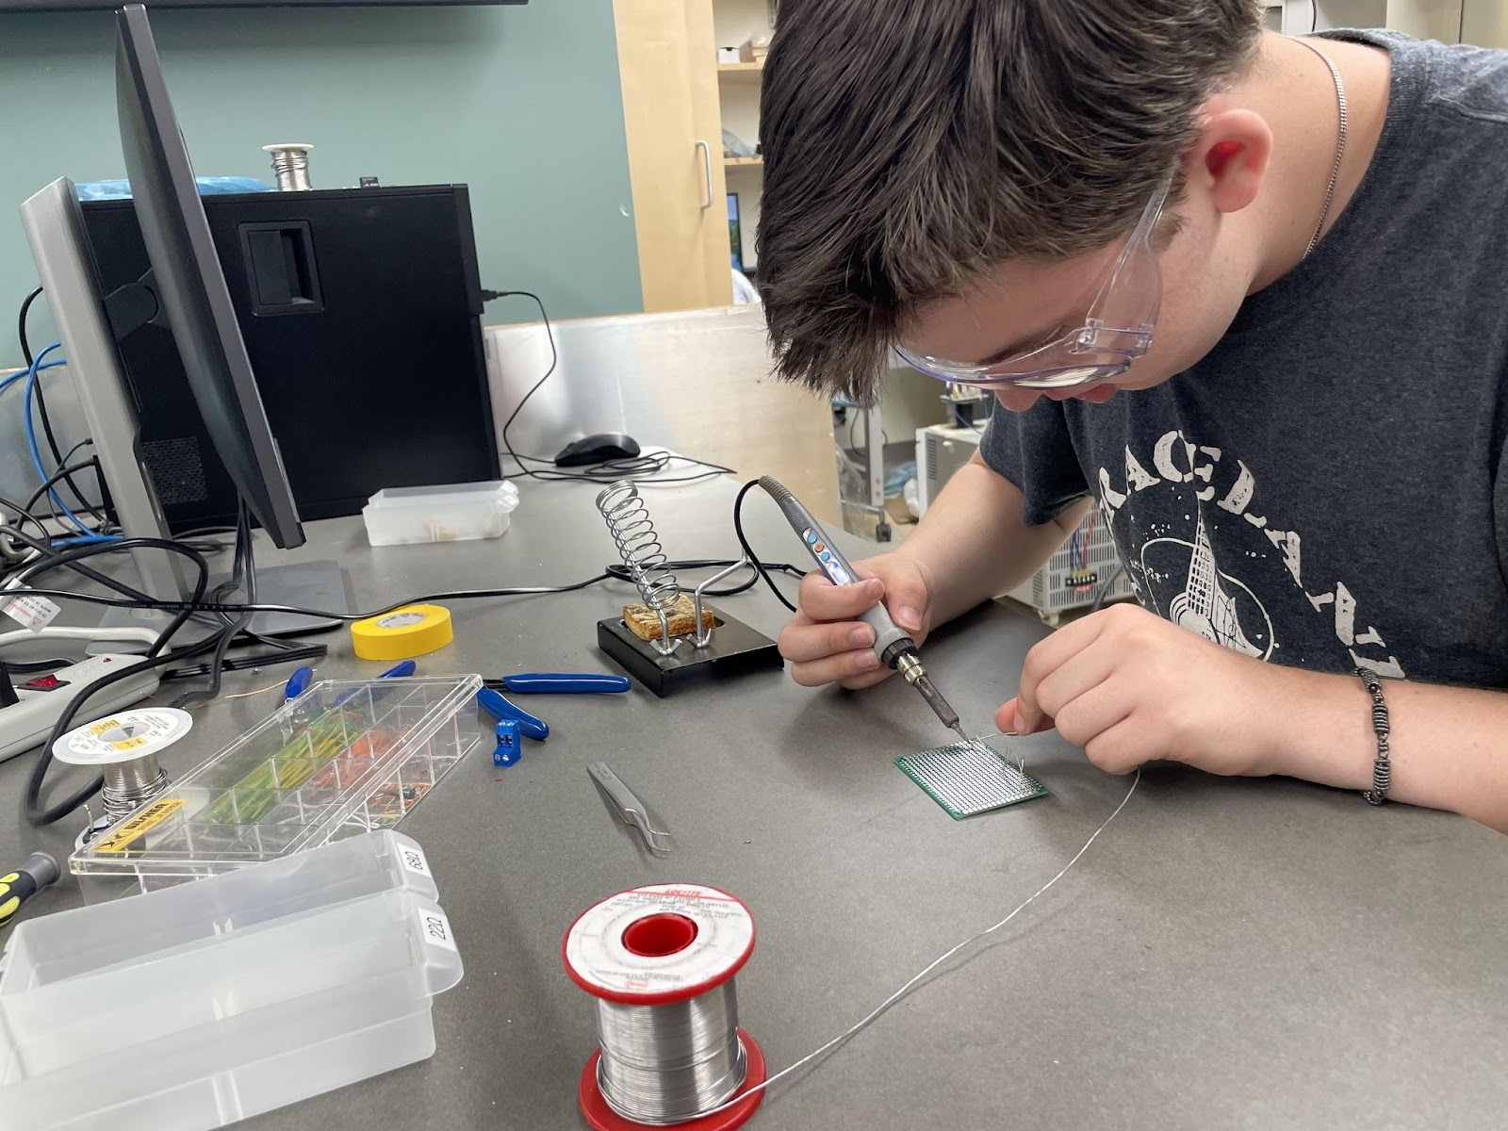
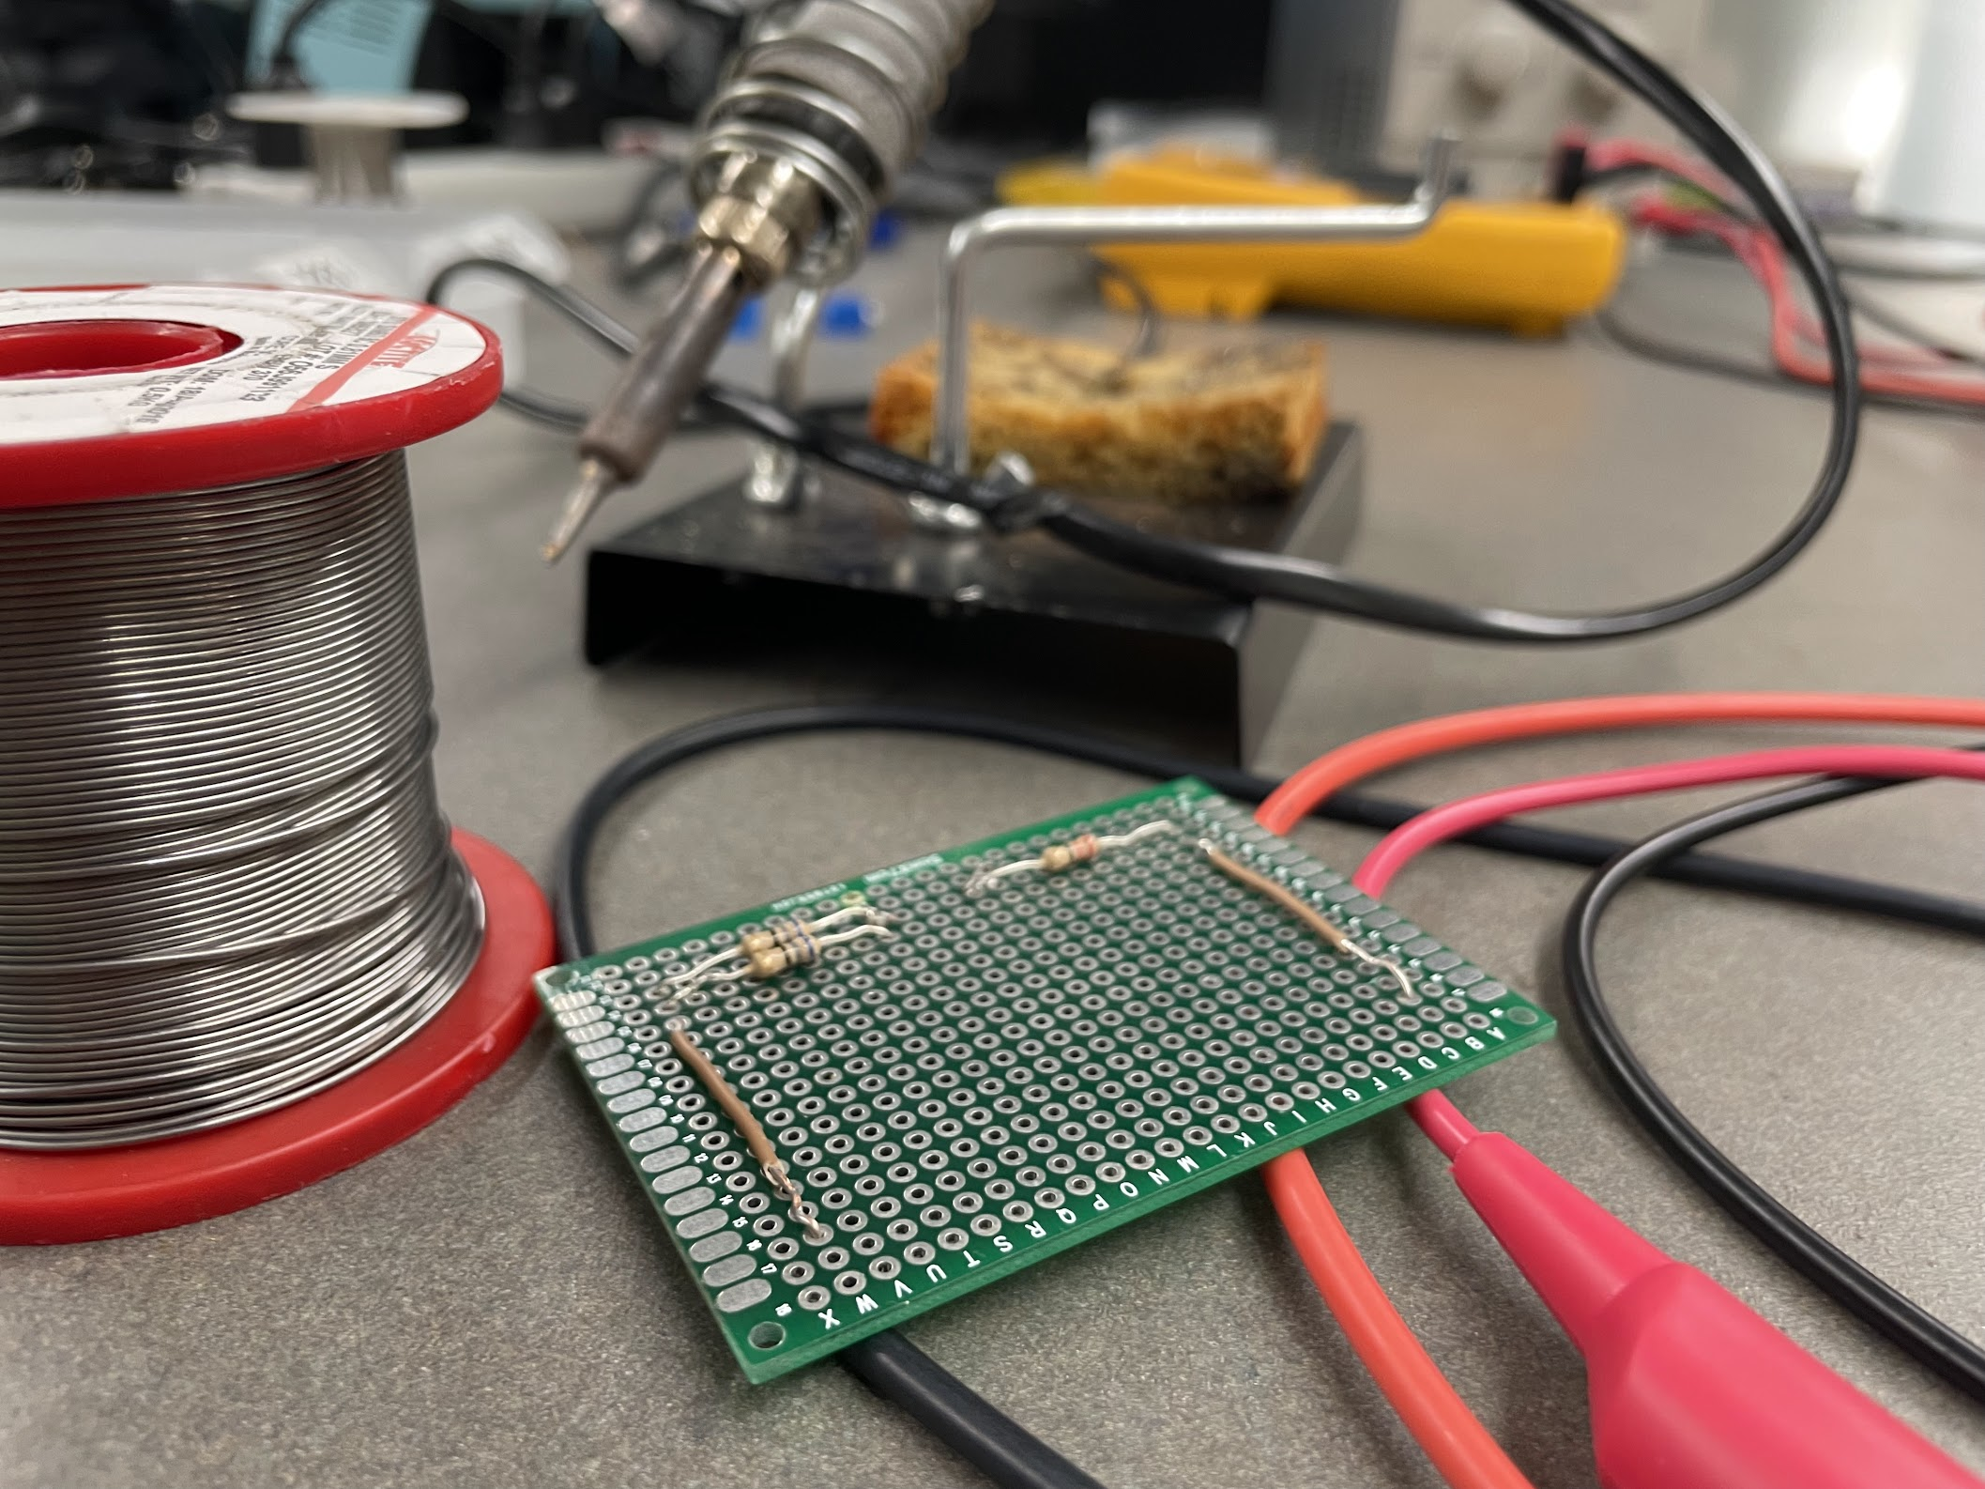
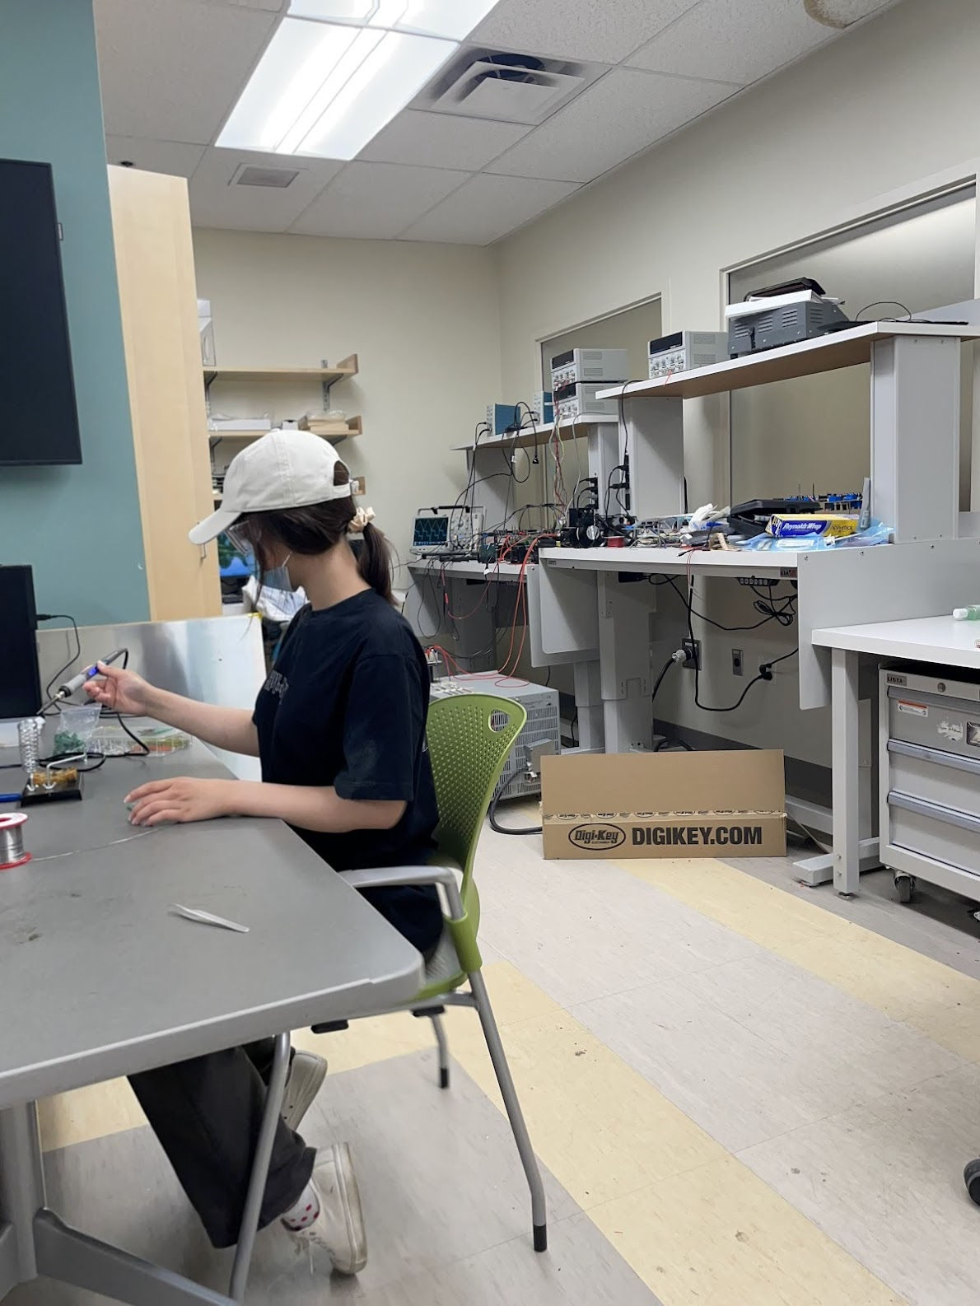
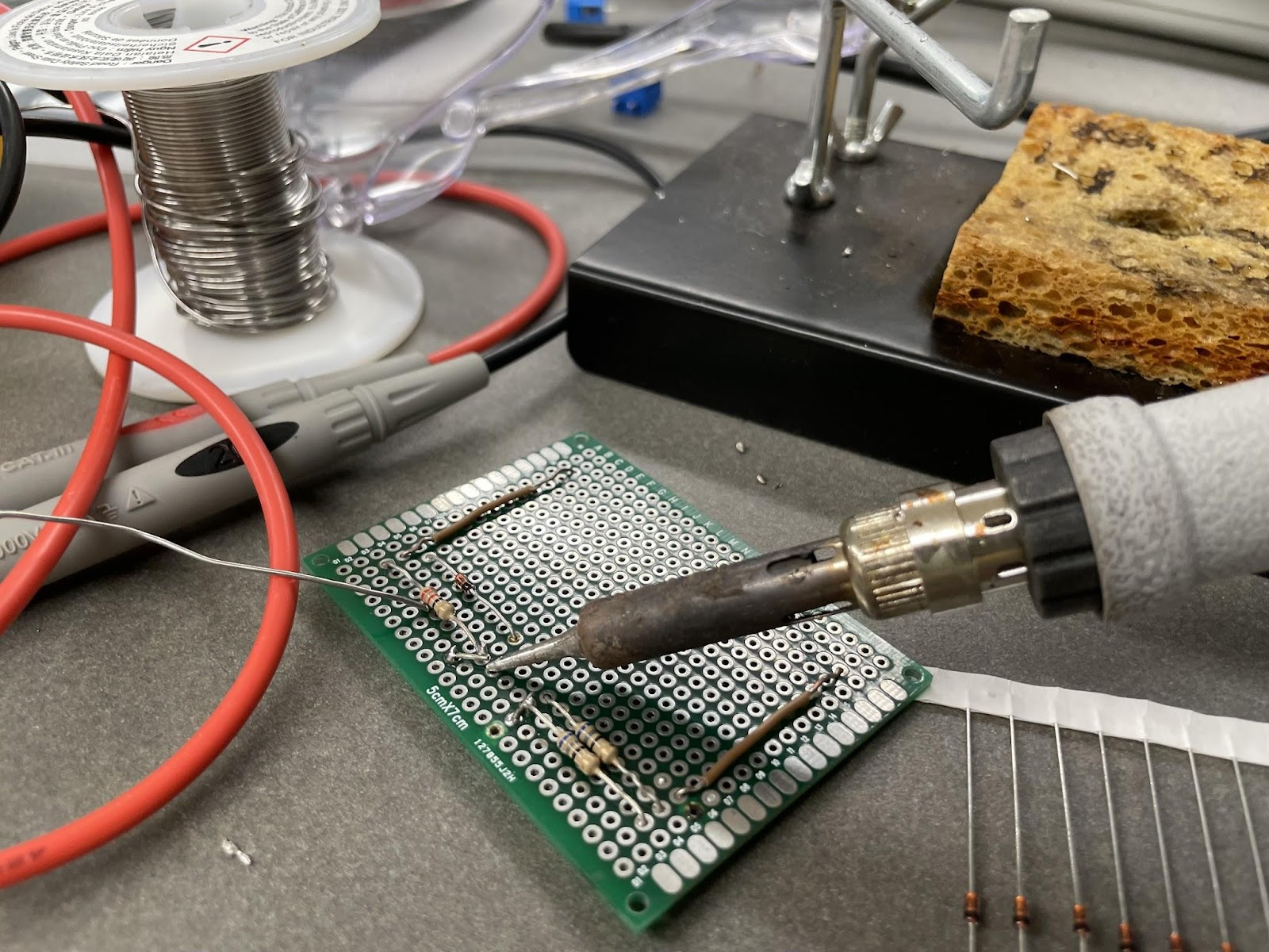
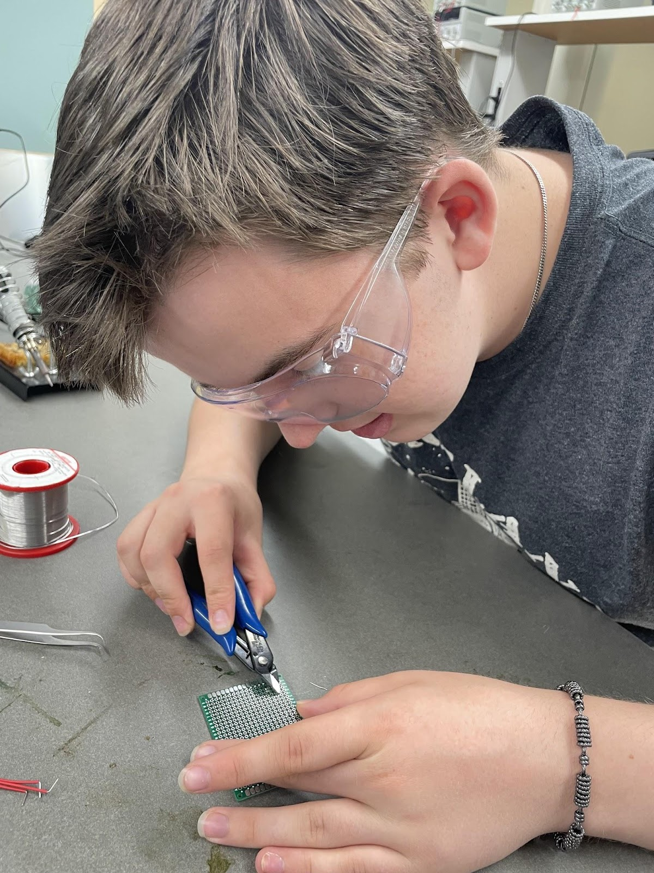
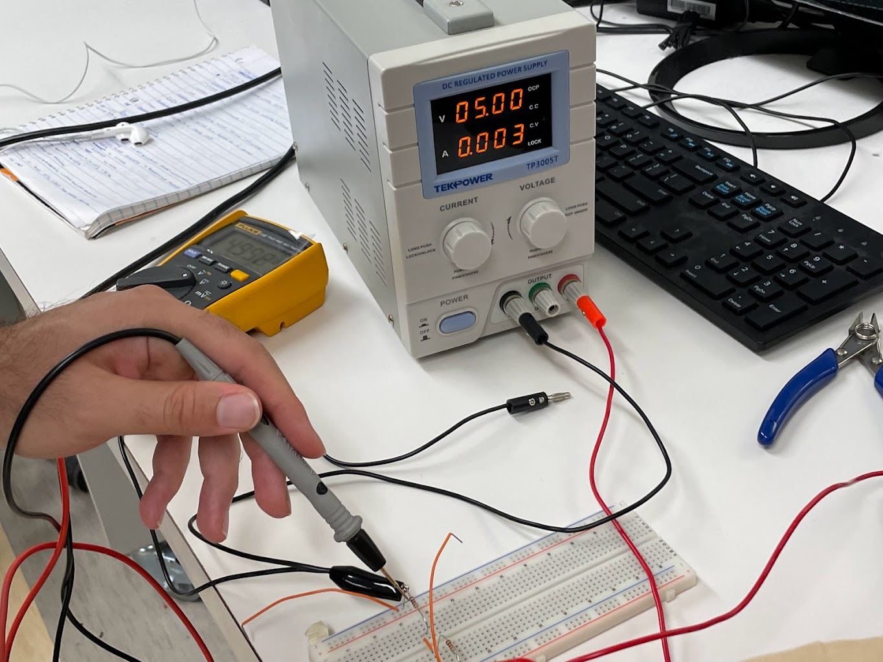
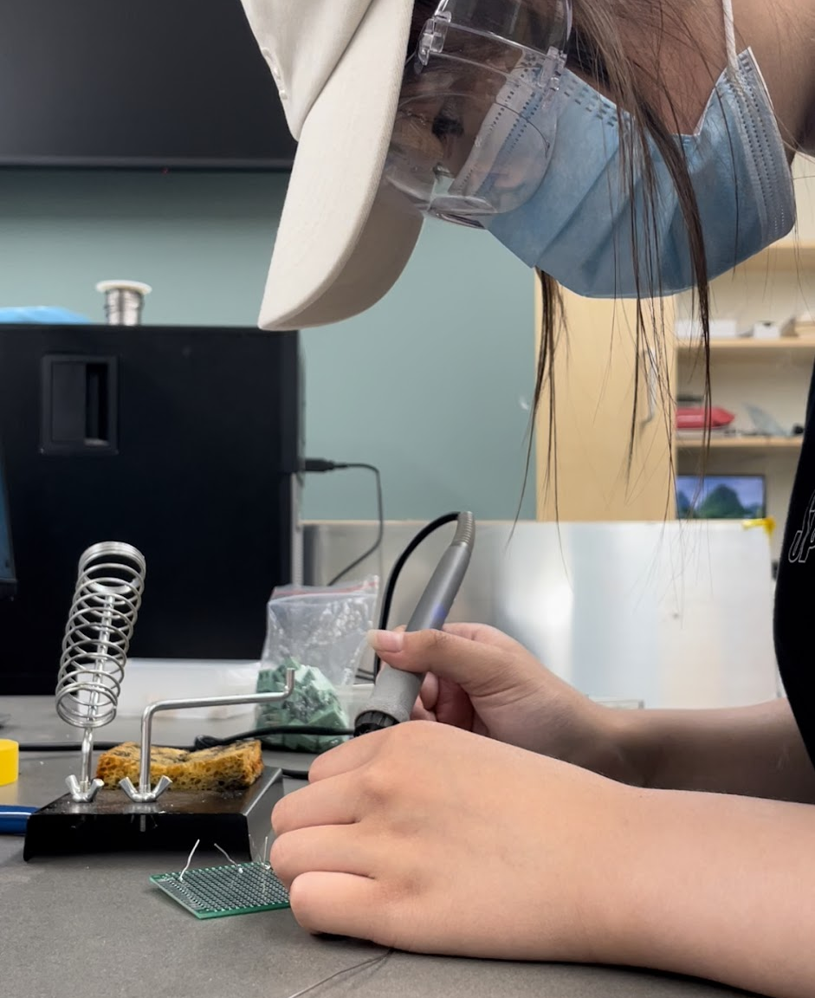
Soldering our circuit
Solder iron
Solder wire
PCB Boards
Breadboards
Resistors
Zener Diode
Safety goggles
Notes:
May
- solder smoke can be hazardous, eye and upper respiratory tract irritation.
- mention lab possible hazards

Slide 16
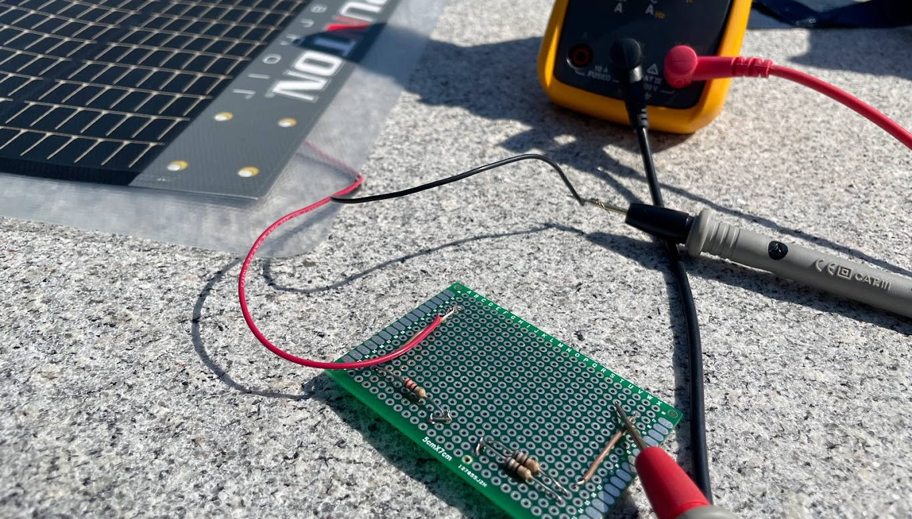
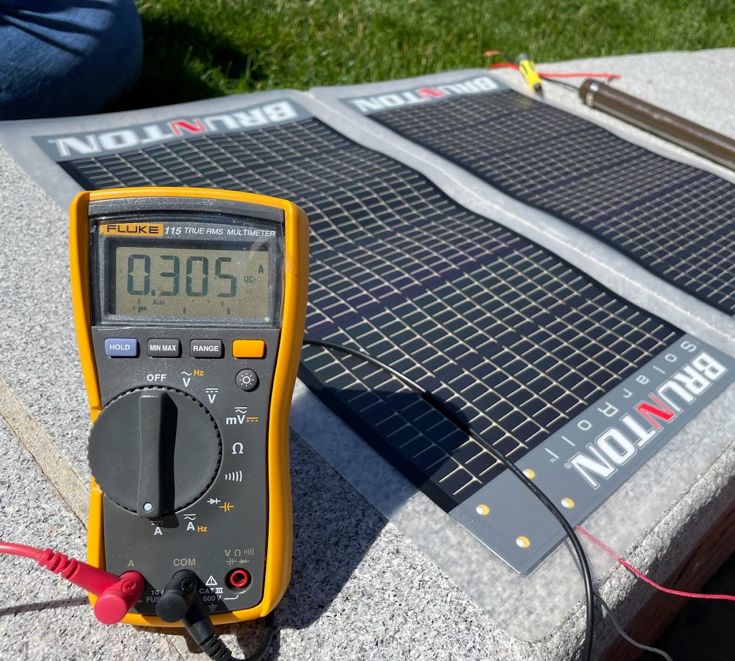
PV Module Experiments
PV Module (Brunton SolarRoll)
Multimeter
Variable resistor
Screwdriver
Notes:
Miles

Slide 17
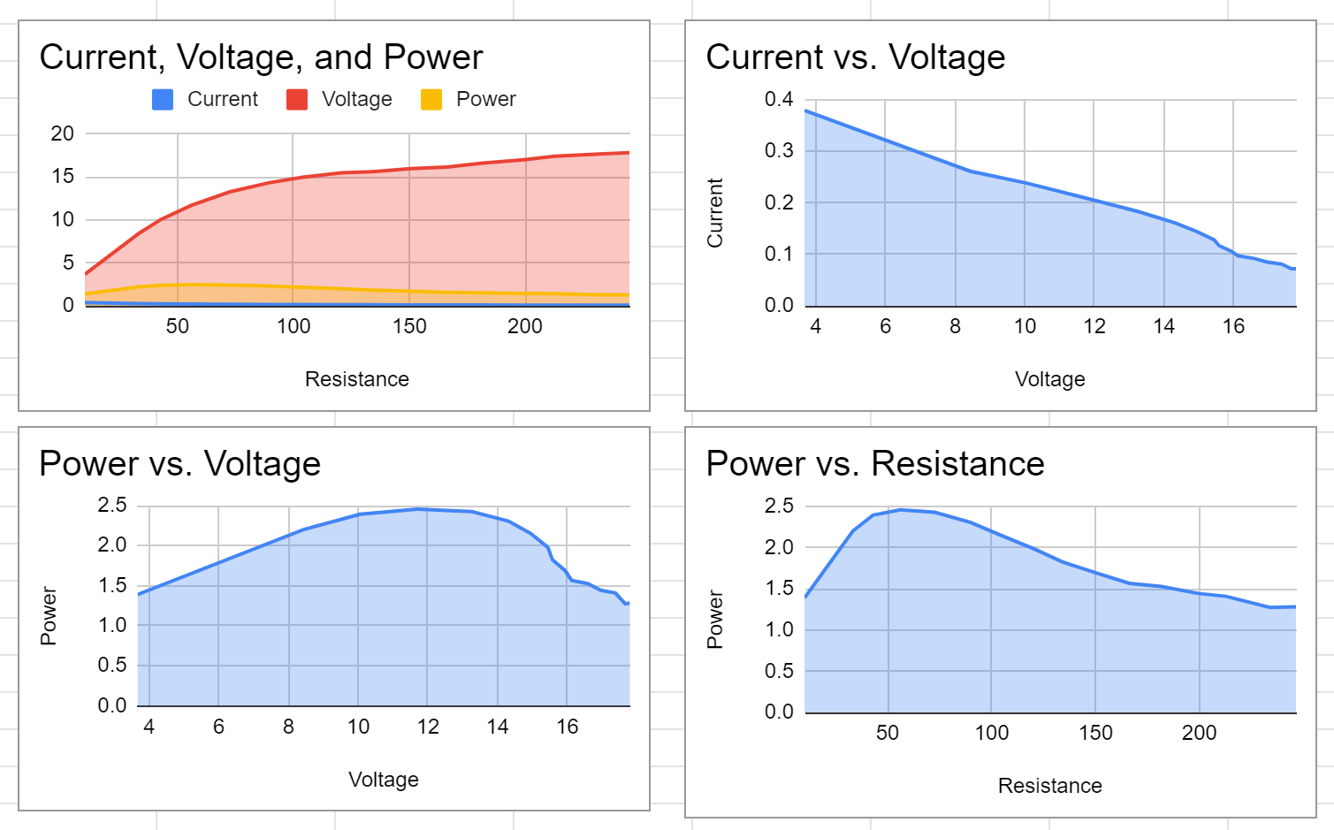
experimental Results
Figure 7
Figure 8
Figure 9
Figure 7. I-V Curve
Figure 8. P-V Curve
Figure 9. Data of load resistance
Notes:
May
Mention it's load resistor (change power vs. Resistance to power vs. Load)

Slide 18
Conclusions & Proceedings
In PSIM: maximum power point at 60.53 watts, highest extracted power efficiency at irradiance of 1000 W/m^2 and temperature of 25°C
Voltage divider linear regulators are inefficient, but simple and low cost
Buck switching converters can be more efficient compared to linear regulators – better or more precise depending on the application
Buck converter can provide variable output, whereas linear voltage regulator is stuck at only one output level
Highly efficient and wastes less power
Challenges:
Work around the sun and weather conditions
Resistor values had to increase by precise increments
Future Studies:
Cleanse P-V I-V curve field data
Construct a buck converter, experiment, collect, and analyze data
Determine functional differences between DC-DC switching and linear regulators
Notes:
May (left)
Miles (right)
Comparing dc-dc converters
- more clearer with voltage divider vs voltage divider linear regulator (with zener diode)

Slide 19
Acknowledgements
Special thanks to:
Department of Electrical and Computer Engineering
Mahshid Amirabadi, Associate Professor
Mojtaba Salehi, Ph.D. Student
Center for STEM Education
Claire Duggan, Director of Programs and Operations
Nicolas Fuchs, Project Implementation Coordinator
Franklin Ollivierre III and Katherine Aristizabal Norena, YSP Coordinators
Notes:
Miles

Slide 20
references
Day, Michael. “Understanding Low Drop Out (LDO) Regulators .” Texas Instruments, 23 Dec. 2005.
Simpson, Chester. “Linear and Switching Voltage Regulator Fundamental Part 1.” Texas Instruments, 7 Dec. 2011.
“Solar Photovoltaic Cell Basics.” Energy.gov, www.energy.gov/eere/solar/solar-photovoltaic-cell-basics
“Solar PV Modules: Features, Applications and How Do They Work.” The Economic Times, economictimes.indiatimes.com/small-biz/productline/power-generation/solar-pv-modules-features-applications-and-how-do-they-work/articleshow/69130699.cms.
“Power Supply Design Notes: Spice Models for Linear Regulators.” Power Electronics News, 6 Aug. 2020, www.powerelectronicsnews.com/power-supply-design-note-spice-models-for-linear-regulators/.
Keim, Robert. “What Is a Linear Voltage Regulator? - Technical Articles.” All About Circuits, www.allaboutcircuits.com/technical-articles/what-is-a-linear-voltage-regulator.
“What Is a Resistor?: Resistor Fundamentals: Resistor Guide.” EEPower, eepower.com/resistor-guide/resistor-fundamentals/what-is-a-resistor/#.
Notes:
Miles

Slide 21
Notes:
Add poster

