Slide 1
.
Communications and Signal Processing for 6G THz Networks
Ollaya Krikib, YSP Student, Boston Latin Academy
Logan Roberts, YSP Student, Catholic Memorial
Duschia Bodet, Graduate Research Assistant
Josep Jornet, Lab Director and Associate Professor
Notes:
Change ThZ to THz

Slide 2
Outline
Why THz?
Creating Signals
THz Channel
Signal Optimization

Slide 3
Why THz?
Wireless communication in the THz band will alleviate the spectrum scarcity and capacity limitations of current wireless systems, and enable new applications both in classical networking domains as well as in novel nanoscale communication models. The bandwidth in current wireless communications is rather scarce and limits advanced data rates. With advancements in the THz bands using 6g Terabit-per-second (Tbps) links we can create systems with far greater bandwidth which opens the door to a variety of applications which demand ultra-high data rates.

Slide 4
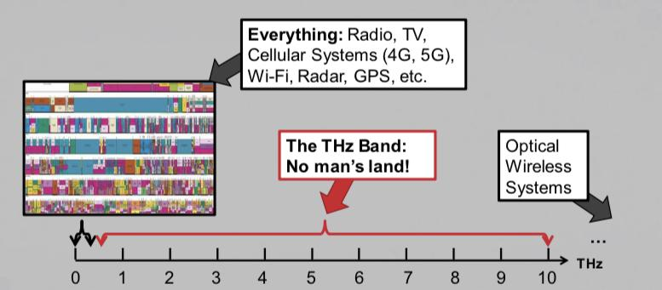

Slide 5
Creating and Receiving THz Signals 101
Code Your Signal on Matlab
Modulate the information you want to be sent onto your sinusoid
ASK, FSK, PSK, QAM, etc.
Create a Constellation Plot to Represent Your Data Points
Create a Pilot
Create a Header
Send Your Signal Through the Transmitter
Receive the Signal Through Your Receiver
With A Lot of Noise that needs to be filtered out
Demodulate Your Signal and Receive The Information

Slide 6
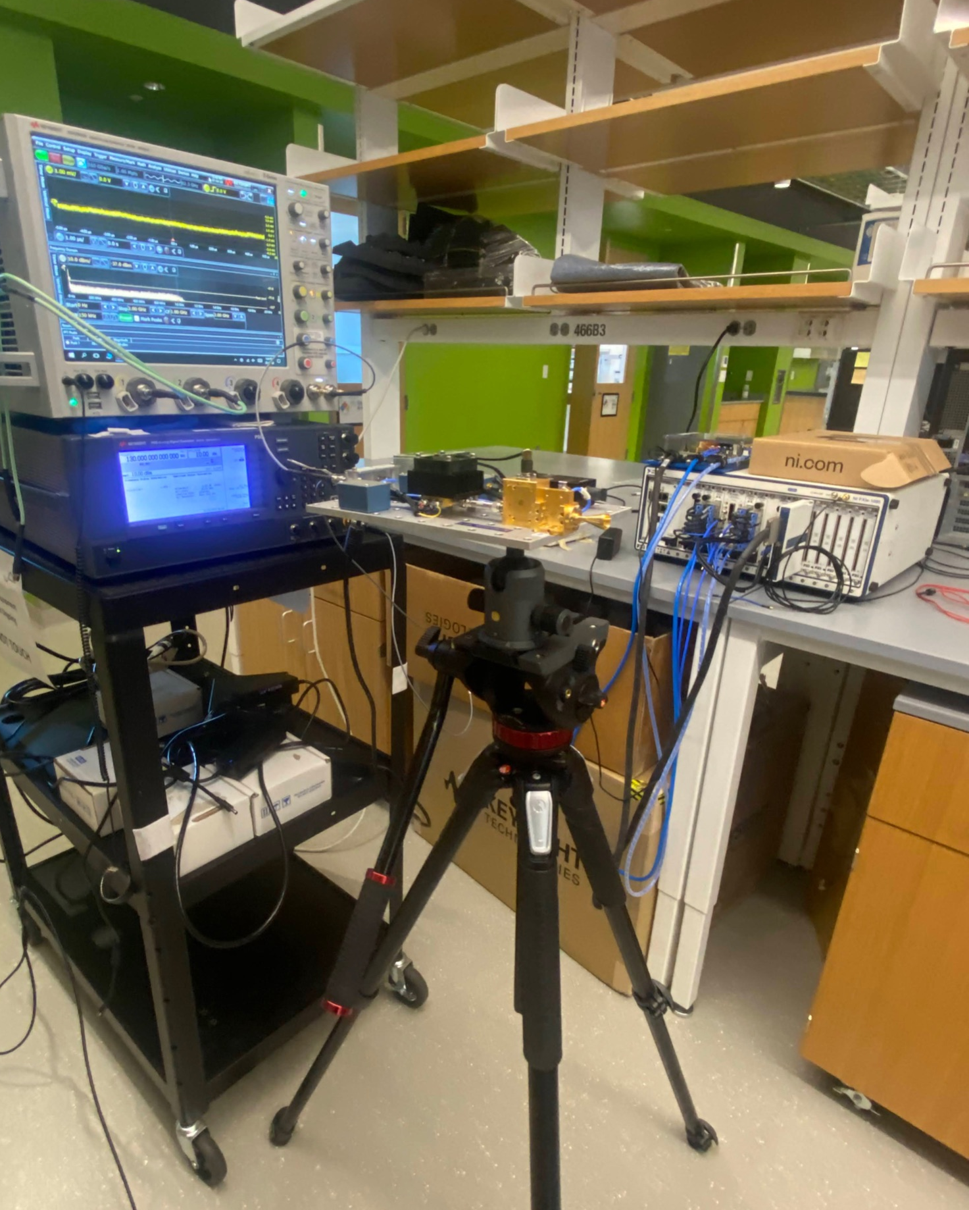
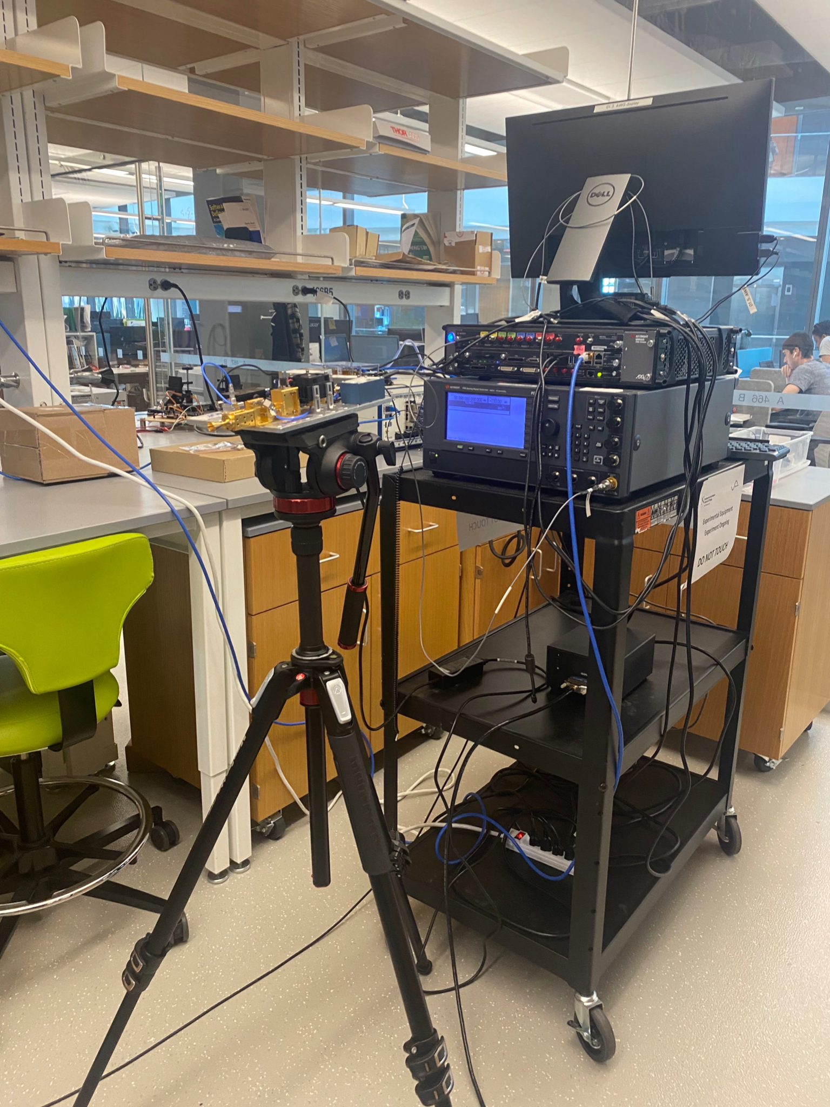

Slide 7
Spread Loss

Slide 8
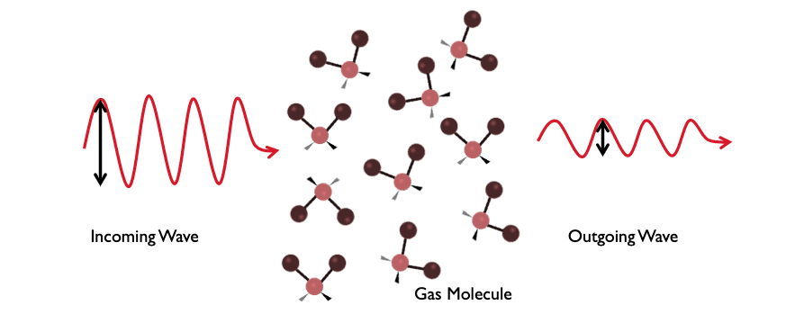
Absorption Loss (H2O)

Slide 9
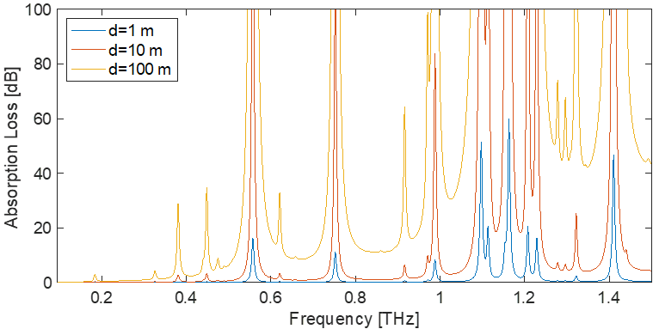
We have to choose frequencies that will not be eaten by water molecules AND won't suffer from mass spread loss

Slide 10
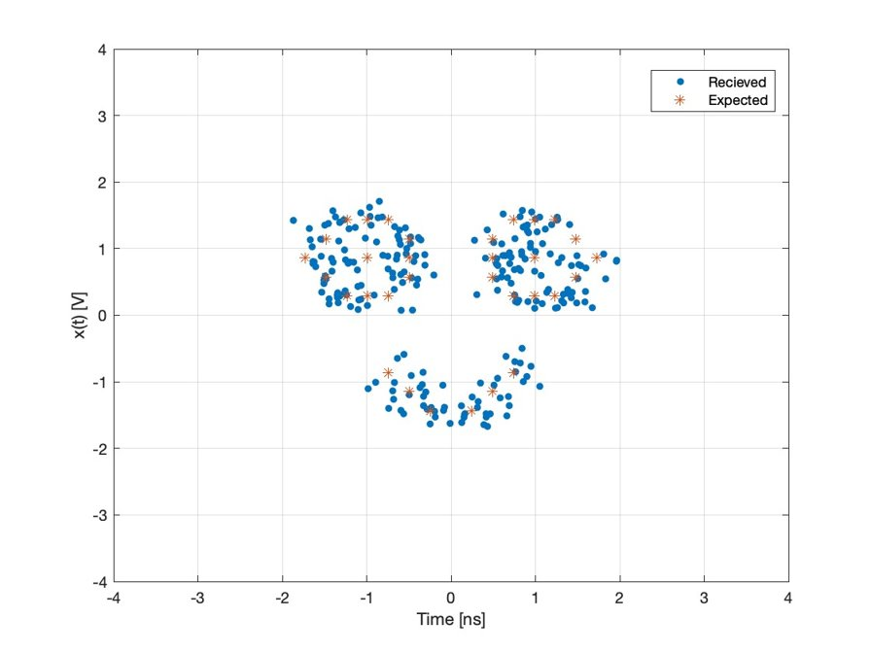
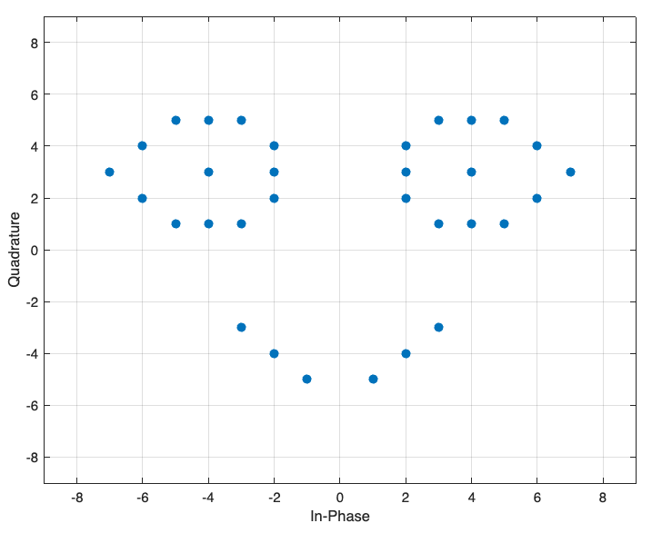
Ollaya’s Signal & Constellation

Slide 11
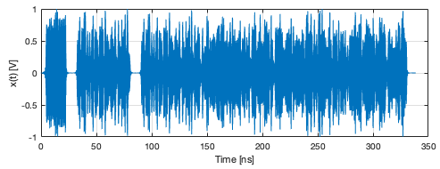
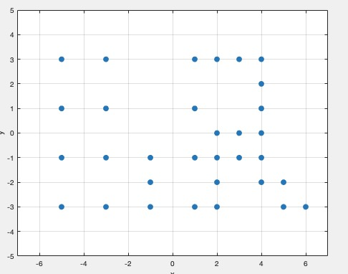
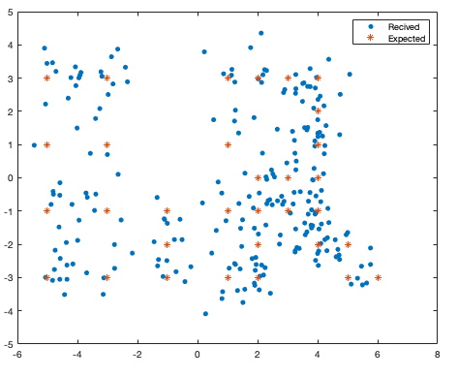
Logans Signal & Constellation

Slide 12
Creating and Receiving THz Signals 101
Code Your Signal on Matlab
Modulate the information you want to be sent onto your sinusoid
ASK, FSK, PSK, QAM, etc.
Create a Constellation Plot to Represent Your Data
Create a Pilot
Create a Header
Send Your Signal Through the Transmitter
Receive the Signal Through Your Receiver
With A Lot of Noise that needs to be filtered out
Demodulate Your Signal and Receive The Information

Slide 13
Optimizing the length of the UN Lab’s pilot sequence
A signals pilot allows the receiver to equalize the signal received and reverse as much noise/ interference as possible
I know the pilot is SUPPOST to equal 6 but I'm hearing 3...
6
3
Notes:
Pilot allows you to correct the channel and the process is called equalization

Slide 14
How does a pilot help optimization?
The receiver now knows that somewhere between when the transmitter transmitted the signal and the reciver received the signal some type of interference divided the entire signal by 2
I know the pilot is SUPPOST to equal 6 but I'm hearing 3...
2
6
3
Notes:
Pilot allows you to correct the channel and the process is called equalization

Slide 15
How does a pilot help optimization?
The receiver now knows that somewhere between when the transmitter transmitted the signal and the reciver received the signal some type of interference divided the entire signal by 2
I know the pilot is SUPPOST to equal 6 but I'm hearing 3...
2
6
3
Now the receiver knows it must multiply the entire signal by 2 in order to reverse the affects of the channel
Notes:
Pilot allows you to correct the channel and the process is called equalization

Slide 16
Optimizing the length of the UN Lab’s pilot sequence
What can the length (how many bits can we send) of a signal be before a 240 bit pilot can no longer equalize the signal (reverse the affect of the channel)?

Slide 17
QAM Modulations and PSK Modulations
QAM​​ | Symbol Rate​​ | Number of Symbols​​ | BER​​
64​​ | 1e9​​ | 4000​​ | 0.4964​​
64​​ | 2.5e9​​ | 8000​​ | 0.5011​​
64​​ | 5e9​​ | 2000​​ | 0.2254​​
64​​ | 5e9​​ | 4000​​ | 0.1901​​
64​​ | 5e9​​ | 15000​​ | 0.3187​​
64​​ | 1e10​​ | 6000​​ | 0.2109​​
64​​ | 1e10​​ | 8000​​ | 0.2881​​
PSK​ | Symbol Rate​ | Number of Symbols​ | BER​
4​ | 1e9​ | 2000​ | 0​
4​ | 1e9​ | 4000​ | 0​
8​ | 2.5e9​ | 8000​ | 0.4975​
8​ | 2.5e9​ | 10000​ | 0​
16​ | 5e9​ | 20000​ | 0.1044​
16​ | 5e9​ | 10000​ | 0.0262​
32​ | 10e9​ | 40000​ | 0.1744​
32​ | 10e9​ | 30000​ | 0.1745​

Slide 18
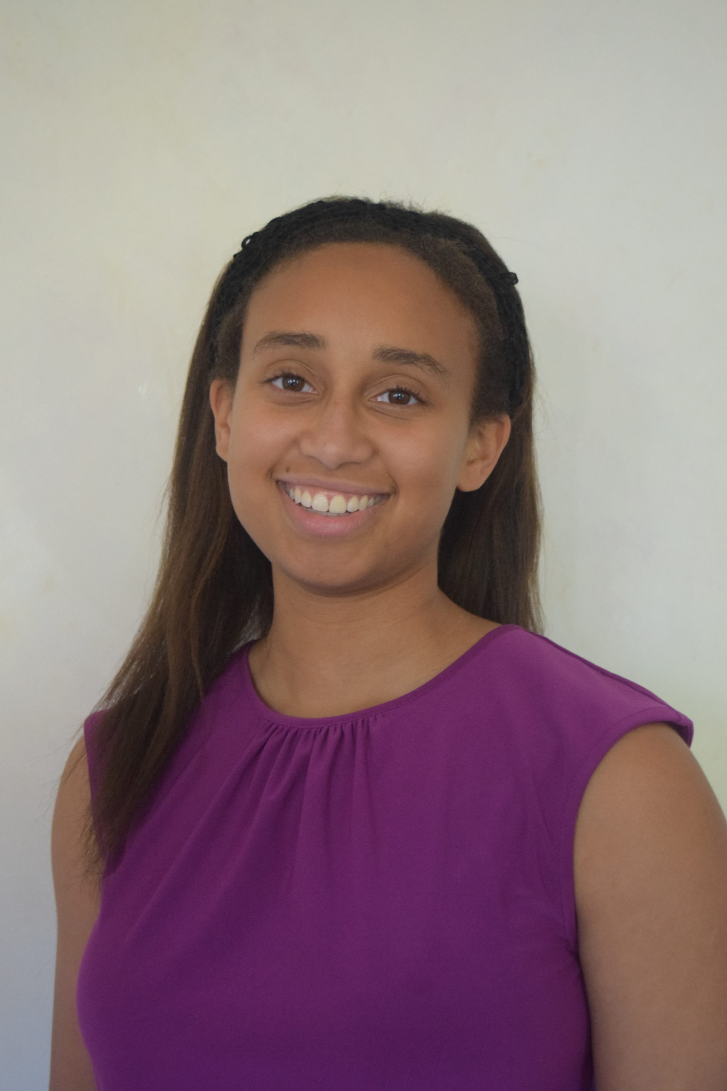
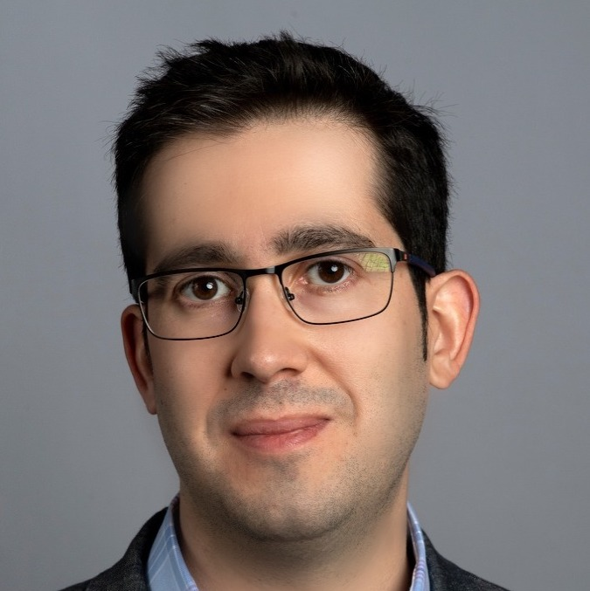
Acknowledgements
Ultrabroadband Nanonetworking Laboratory​
Institute for the Wireless Internet of Things & SMART Center​
Northeastern University​
Josep Jornet:
jmjornet@northeastern.edu
Duschia Bodet: bodet.d@northeastern.edu ​
www.unlab.tech
Josep Jornet
Duschia Bodet
Center of STEM Education
Claire Duggan
Nicolas Fuchs
Franklin Ollivierre III
Katherine Aristizabal Norena

Slide 19
