Slide 1
HIGH POWERED PAPER ROCKETS
Notes:
Why Rockets? What Parts do a Rocket Have?

Slide 2
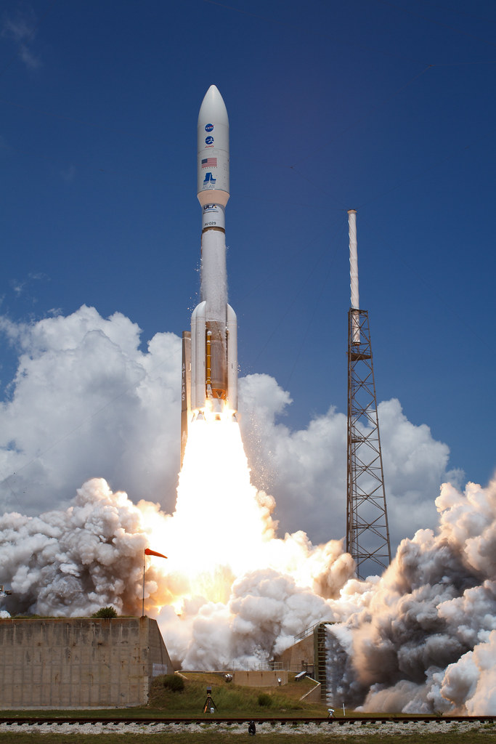
Parts of a Rocket

Slide 3
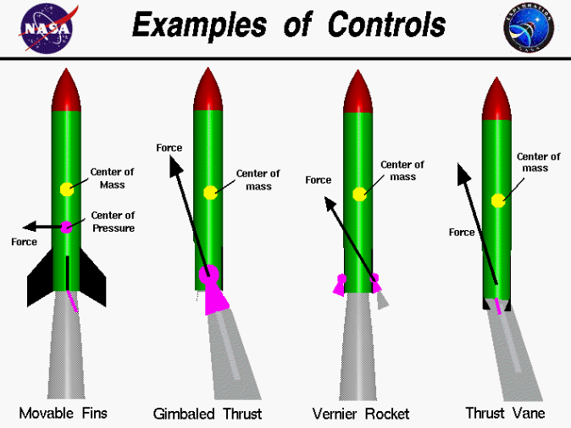
Parts of a Rocket

Slide 4
The Fundamentals of Rockets

Slide 5
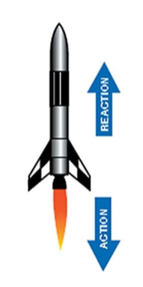
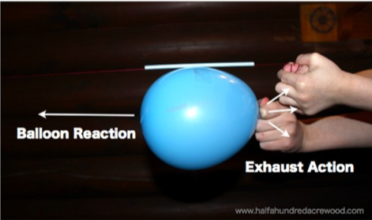
Newton’s 3rd Law

Slide 6
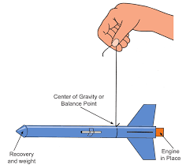
Center of Gravity
The point on an object where weight is evenely dispersed and both sides are balanced.

Slide 7
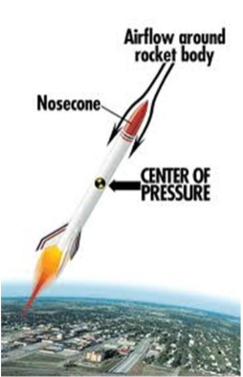
Center of Pressure
Like the center of gravity but for pressure caused by airflow!

Slide 8
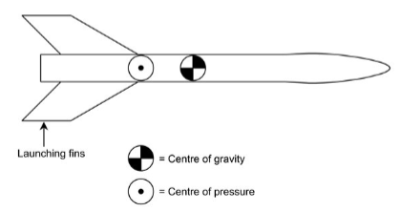
Center of Gravity & Center of Pressure How do they relate?
The farther the center of gravity is from the center of pressure the more stable the rocket

Slide 9
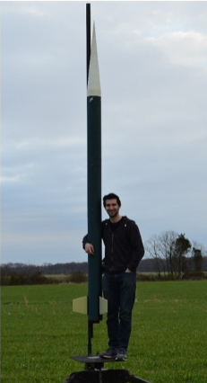
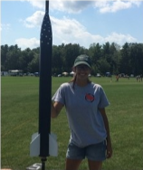
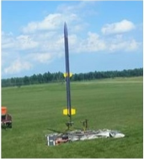
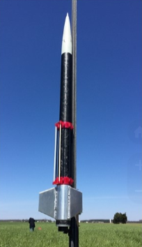
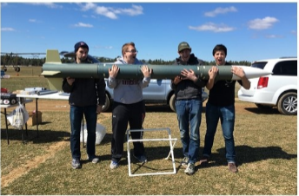
AerospaceNU Rockets

Slide 10
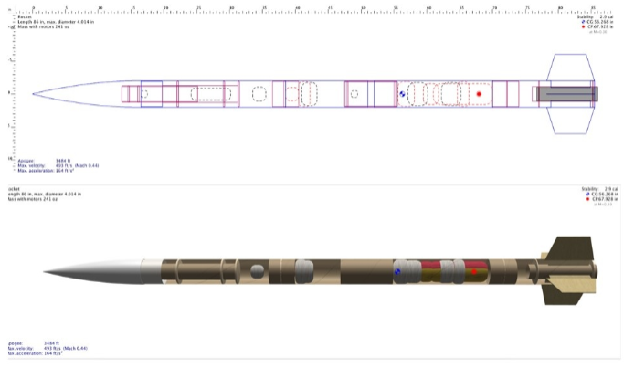
AerospaceNU Rockets

Slide 12
Building Paper Rockets

Slide 13
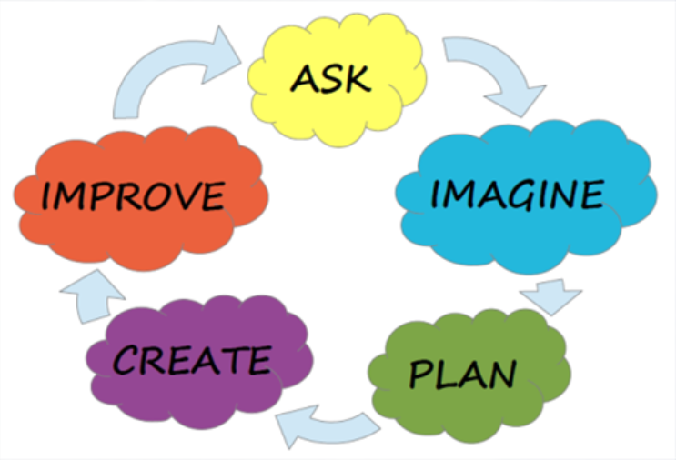

Slide 14
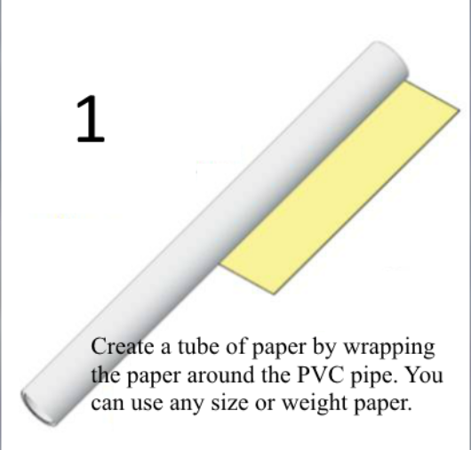
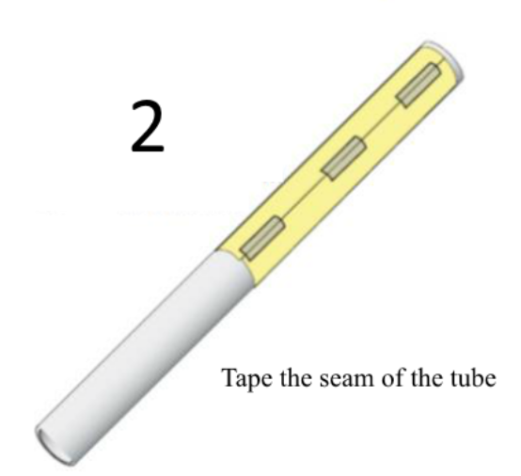
Instructions

Slide 15
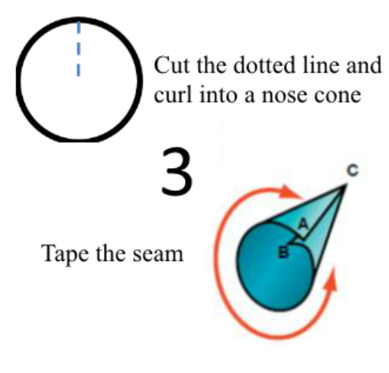
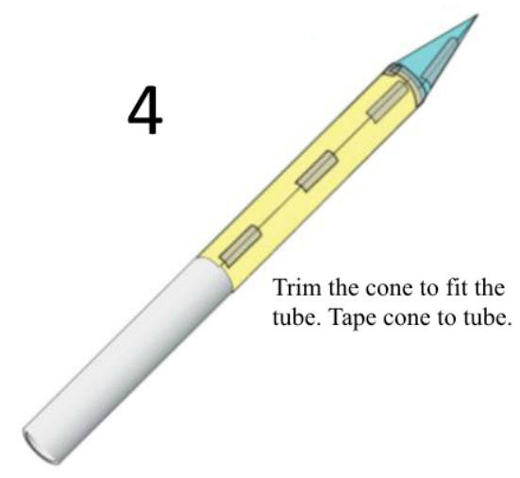
Instructions

Slide 16
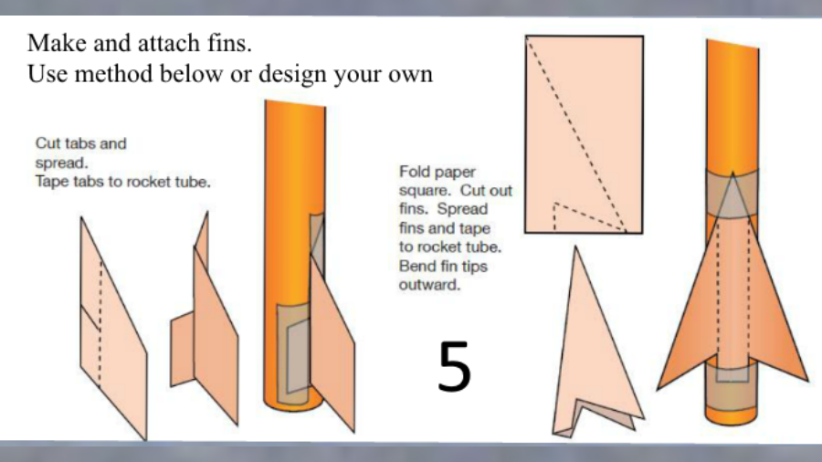
Instructions

Slide 17
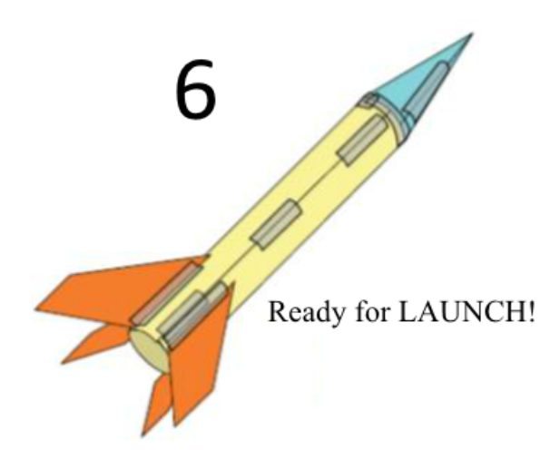
Instructions

Slide 18
Rocket Failure
Russia
July 2013

Slide 19
Falcon 9 Landing August 2016

