Slide 1

HIGH POWERED PAPER ROCKETS
Notes:
Why Rockets?
What Parts do a Rocket Have?

Slide 2
STOMP PAPER ROCKETS
Notes:
Why Rockets?
What Parts do a Rocket Have?

Slide 3
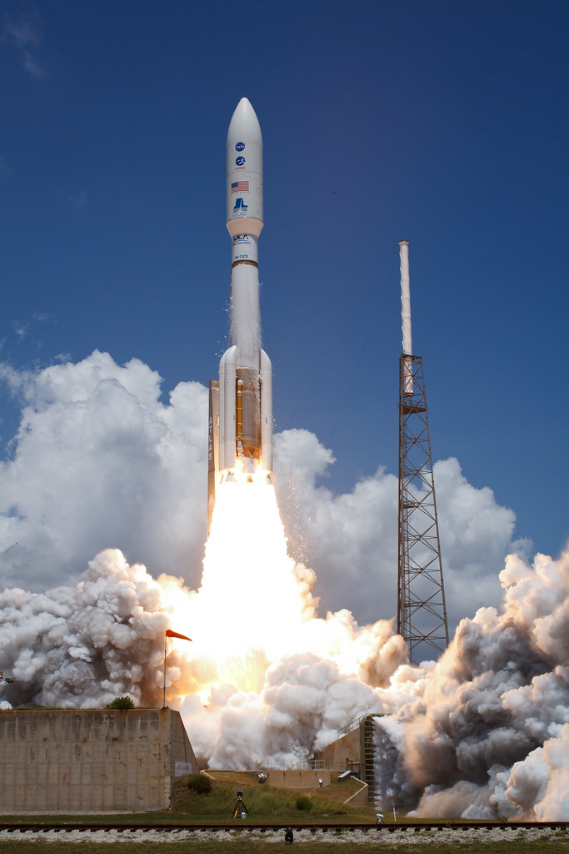
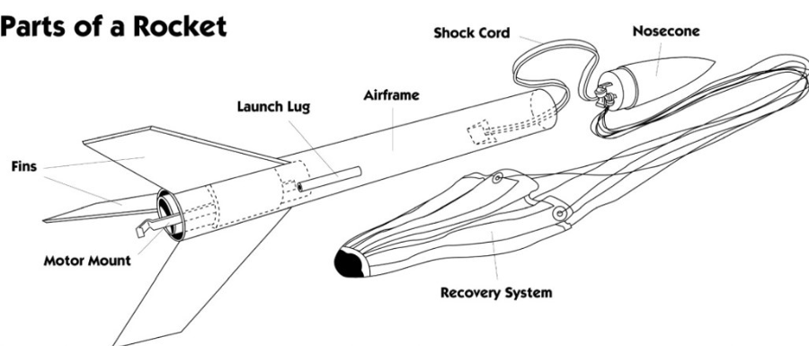
Parts of a Rocket

Slide 4
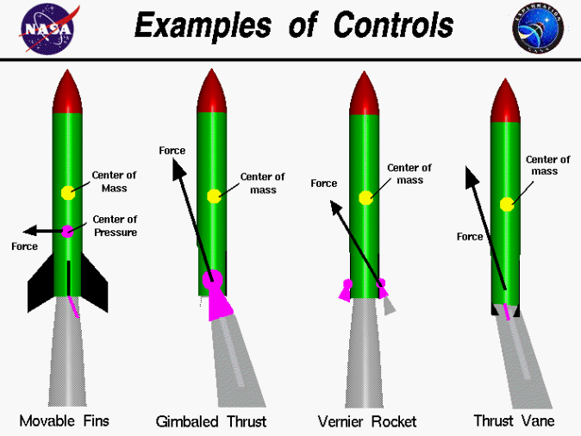
Parts of a Rocket

Slide 5

The Fundamentals of Rockets

Slide 6
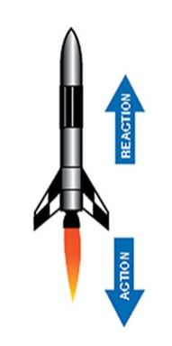
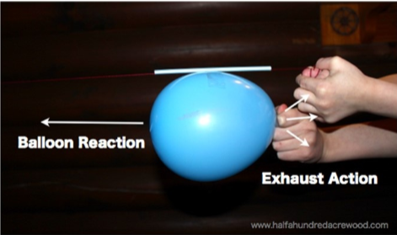
Newton’s 3rd Law

Slide 7

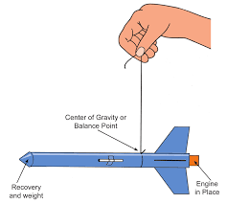
Center of Gravity
The point on an object where weight is evenely dispersed and both sides are balanced.

Slide 8
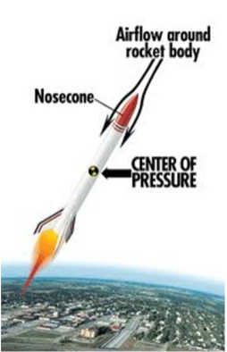
Center of Pressure
Like the center of gravity but for pressure caused by airflow!

Slide 9
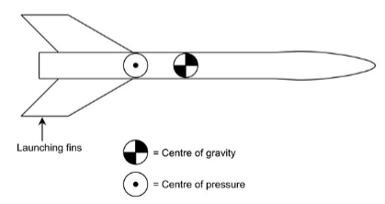
Center of Gravity & Center of Pressure
How do they relate?
The farther the center of gravity is from the center of pressure the more stable the rocket

Slide 10
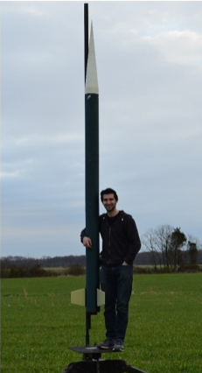
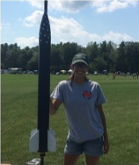
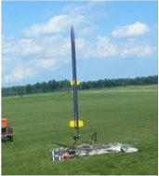
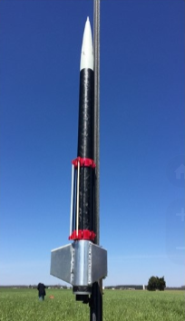
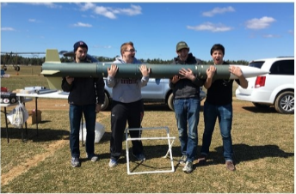
AerospaceNU Rockets

Slide 11
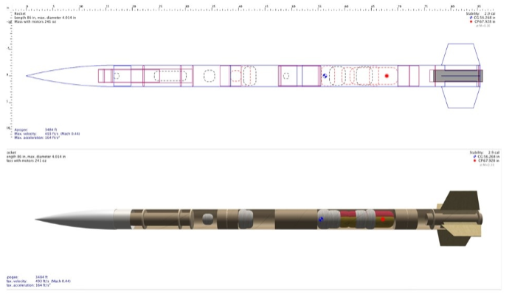
AerospaceNU Rockets

Slide 12
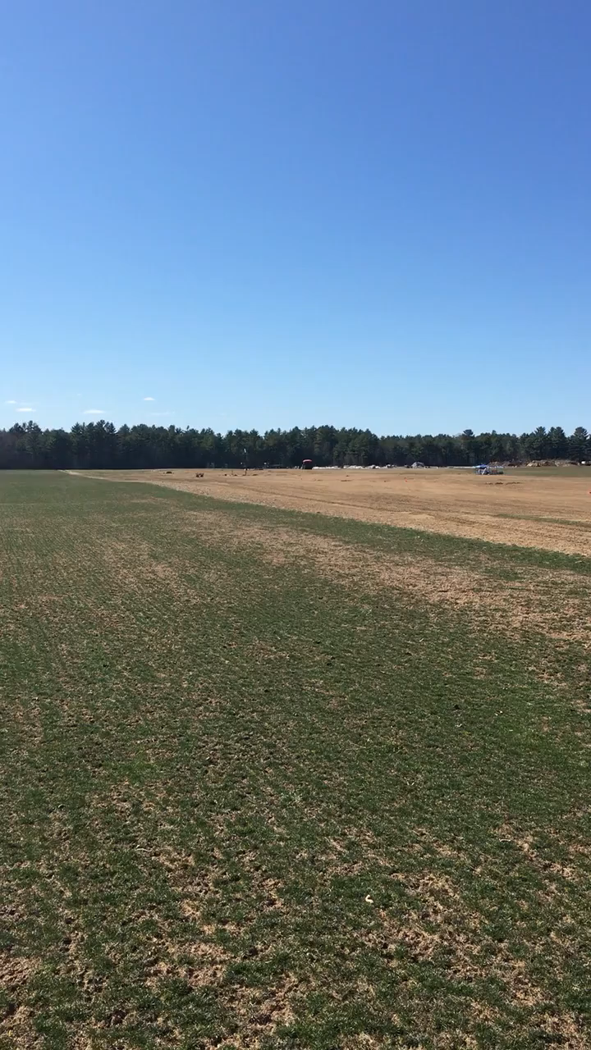

Slide 13
Building Paper Rockets

Slide 14
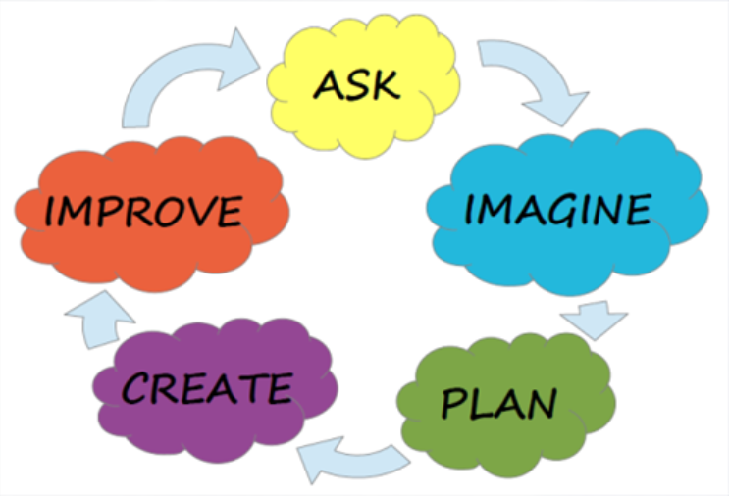

Slide 15
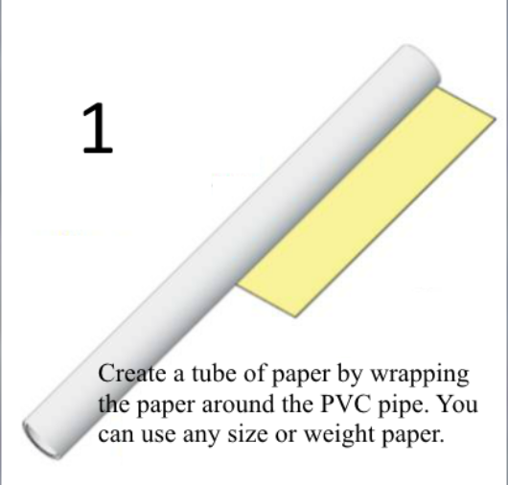
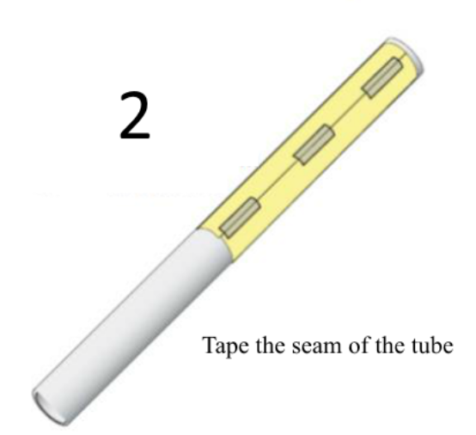
Instructions

Slide 16
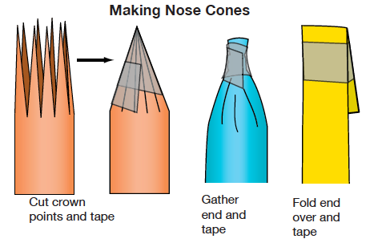
Instructions

Slide 17
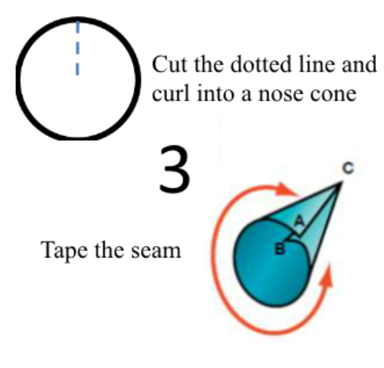
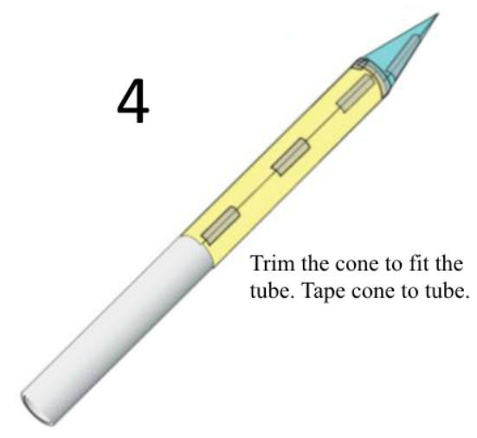
Instructions

Slide 18
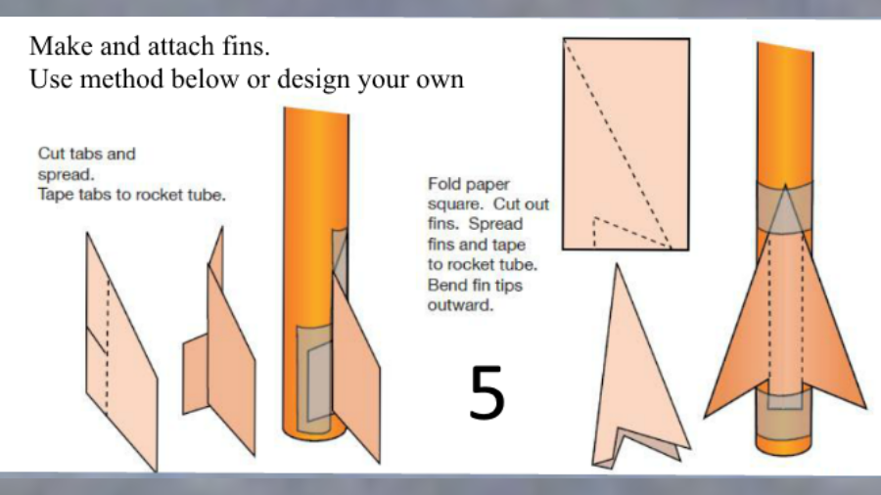
Instructions

Slide 19
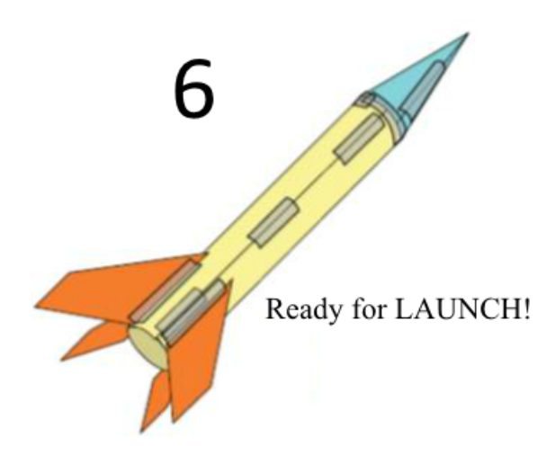
Instructions

Slide 20
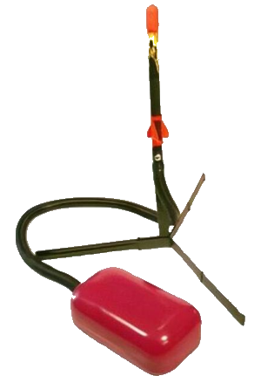
Testing Your Designs
The goal of your design: to fly as FAR as possible
Rockets will be launched by “stomping” onto the container of air, launching the rockets
Rockets will be launched at an angle
Certain parameters of your rockets will be measured so we can compare designs:
  Mass, Length, # of Fins, Launch Angle

Slide 21

Rocket Failure
Russia
July 2013

Slide 22
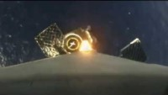
Falcon 9 Landing
August 2016

