Slide 1
Programs, Partnerships & Collaborations
Center for STEM Education
Boston Science and Engineering Fair
Collaborative Events
Engineering Explorations
Broader Impact
College and Post-Graduate Programs
S-POWER
REU
UPLIFT
Community and School Programs
Curley After-School Program
Library After-School Programs
Alumni Afterschool Program
Field Trips
STEM Field Trips/Reverse Field Trips
Pathways to Science/Engineering
Public Events
Building Bridges
Engineering for Everyone Expo
Summer Programs
NUSSP
IFTP
YSP
1
2
3
4
5
6
7
8
9
10
11
12
U
G
P
Demographic Information
Elementary School
Middle School
High School
Undergrad
Grad
Post-Grad /Faculty

Slide 2
Demographics of STEM Programs
Average # of Students Impacted Annually Through All Outreach Efforts: ~2000
Back to Timeline

Slide 3
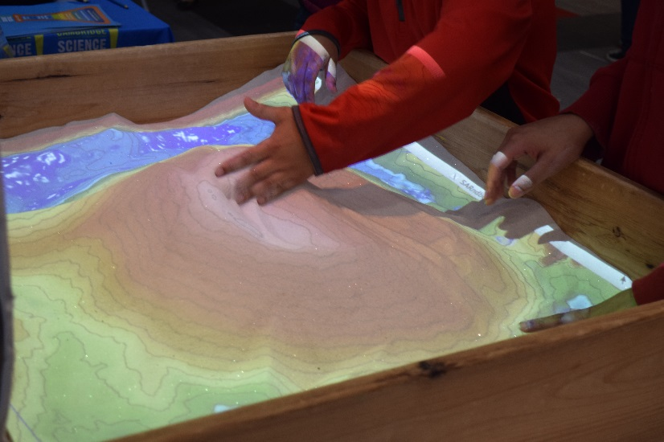
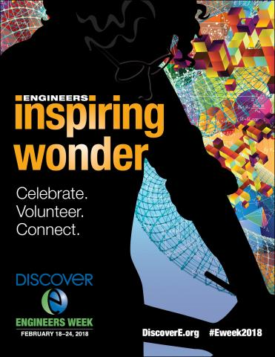
Engineering for Everyone Expo
Program Overview
Students of all ages get the opportunity to learn more about engineering through a variety of activities, experiments, and demonstrations led by student volunteers, clubs and affiliated organizations.
Target Student Population
All ages
Learning Environment
Interactive presentations and activities about engineering principles
Program Results/Highlights
75 Northeastern University student volunteers and 15 student groups participate in the now annual event
Approximately 200 participants
Back to Timeline

Slide 4
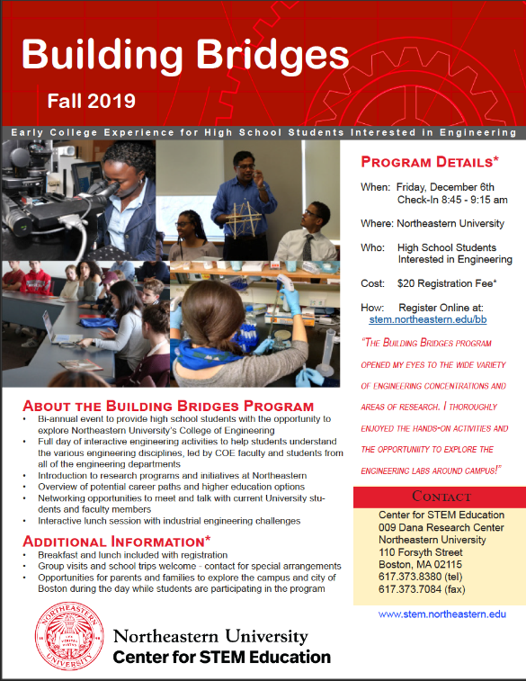
Building Bridges
Program Overview
Building Bridges is a bi-annual event at which high school students explore the College of Engineering and meet with university faculty members and students through interactive engineering activities led by the different departments. A “College 101” panel is also provided to allow students to learn more about college life.
Target Student Population
High school students with a strong interest in majoring in engineering.
Learning Environment
Interactive, lecture-based classroom activities
Program Results/Highlights
Approximately 300 students annually from 12+ states and 100+ schools
Knowledge of engineering increased by 29% and interest in engineering increased by 18%
91% of participants indicated interest in applying to Northeastern
Back to Timeline

Slide 5
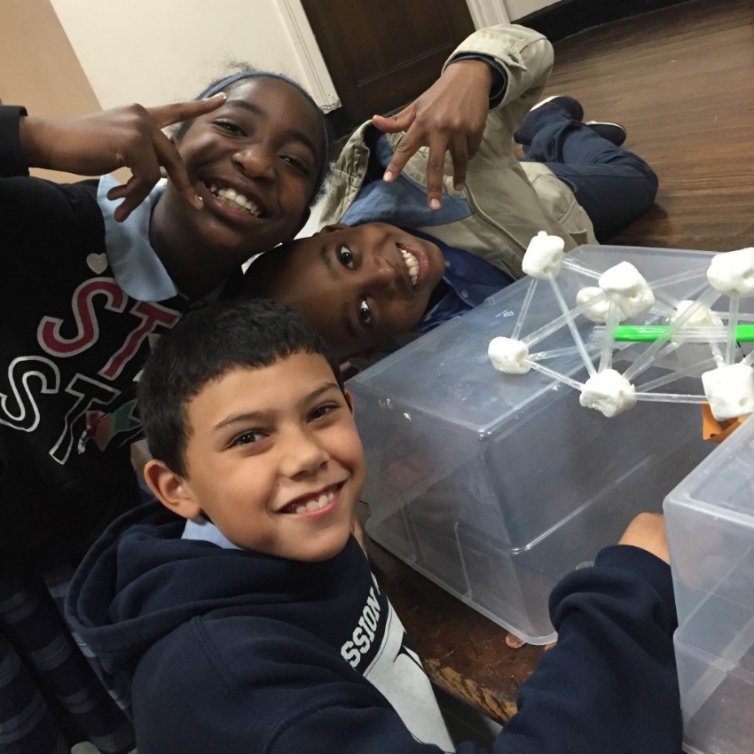
Library After-School Program
Program Overview
An eight-week after-school program at various Boston Public Libraries designed to introduce elementary students to engineering and the design process. Weekly, hands-on design/construction activities are led by STEMOut, University Scholars and/or Center for STEM staff members.
Target Student Population
1st grade through 5th
Learning Environment
Hands-on activities in a library
Program Results/Highlights
Approximately 35 elementary students attend this program annually. Currently offered in Jamaica Plan, prior programs offered at the Parker Hill Library branch on Mission Hill.
Back to Timeline

Slide 6
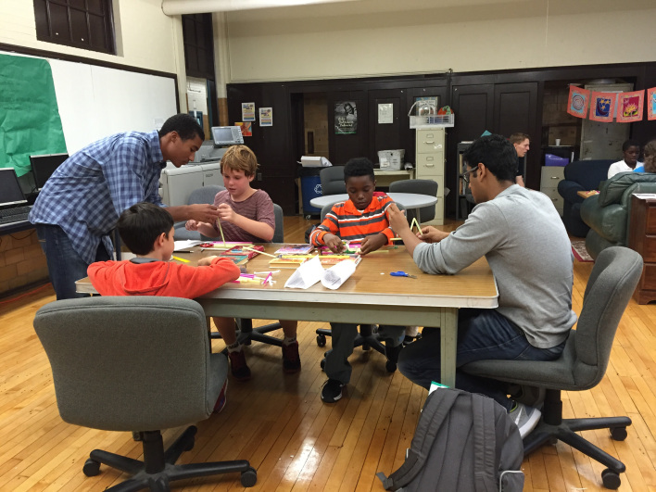
Curley After-School Program by STEMventures
Program Overview
Established and offered by The Center for STEM Education now led by students from the University Scholars Program
Target Student Population
Elementary and middle school students
Learning Environment
Curley K-8 School classrooms
Program Results/Highlights
Approximately 15 students each semester participate in this program.
Back to Timeline

Slide 7
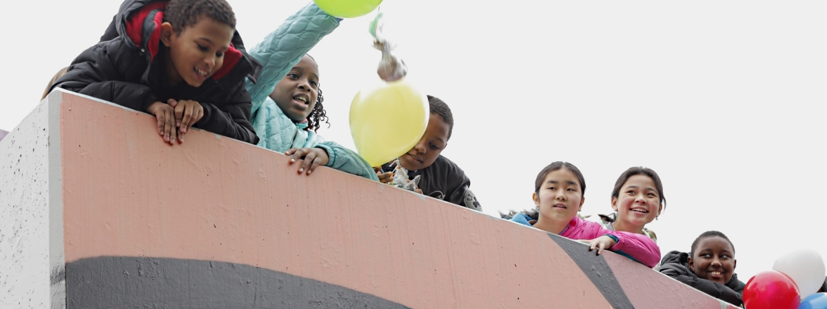
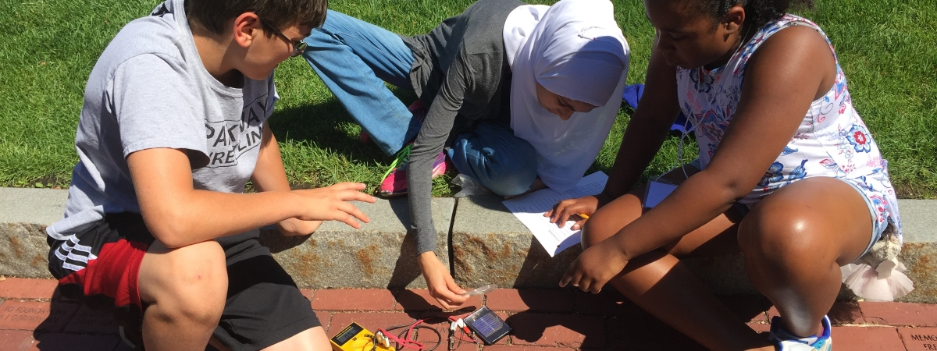
STEM Field Trips/Reverse Field Trips
Program Overview
This program gives students an introduction to STEM through hands-on activities taught by Northeastern students and faculty. Students can attend either a traditional field trip and spend the day at Northeastern or participate in a reverse field trip where Northeastern students visit the classroom.
Target Student Population
4th grade through 8th
Learning Environment
Hands-on classroom environment and/or laboratory
Program Results/Highlights
Approximately 1,500 students reached through 18 -20 STEM field trips annually
Field trips are supported by 75+ NU student volunteers (99% STEM majors)
Average rating of the field trips by teachers in 2019 was 9.43/10 and 100% indicated that they would participate again or recommend it to a colleague.
The average rating by student participants was 9.56/10.
More feedback from students and teachers can be found here.
Impact
Program Impact Summary
Back to Timeline

Slide 8
K12 Student and Teacher Feedback
Teacher Feedback
“Most had never visited a college before and told me after they expected it to be boring – but instead they were excited and loved it! Two students who struggle in normal classroom activities told me this is how they like to learn.”
“My kids loved getting to learn on a college campus and are excited about their futures.”
Student Feedback
“My favorite part was learning more about science and technology. I also loved learning about different ways you can solve new problems…”
“I think the challenges and contests mixed friendly challenge and the topic that we learned during the day in a fun way to deepen our knowledge about that topic.”
Back to Field Trips
Back to Timeline

Slide 9
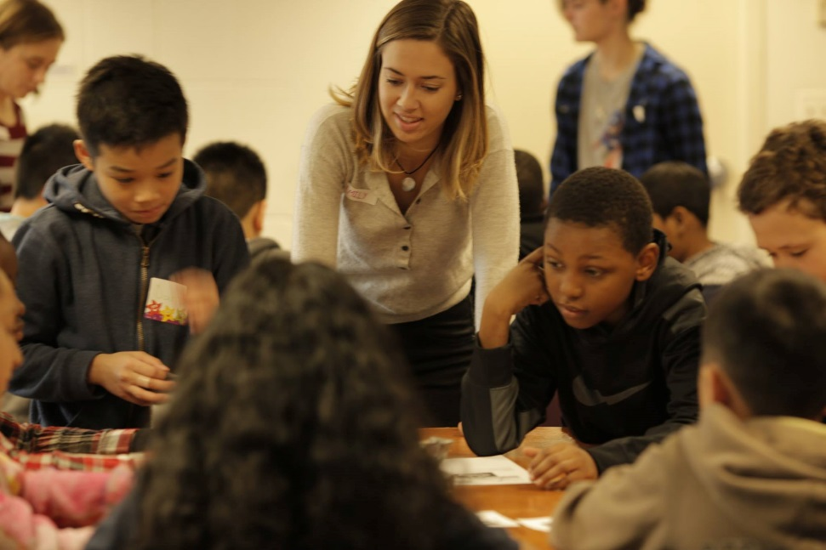
Northeastern University Summer STEM Program
Program Overview
This two week academic day program emphasizes increasing students’ mathematics/science skills, introducing them to college life, and stimulating their interest in science and engineering as a potential career path.
Target Student Population
6th grade through 8th
Learning Environment
Classroom lessons and activities
Program Results/Highlights
Over 500 participants to date
95.8% of participants would recommend the program to a friend
91% of parents said the program was a valuable experience and would recommend to other families
Impact
Program Impact Summary
Back to Timeline

Slide 10
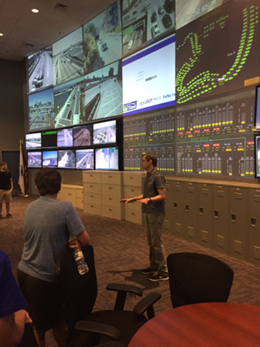
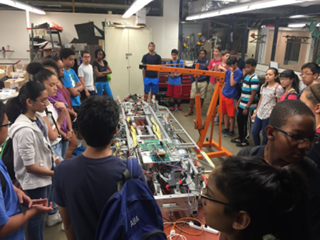
Imagining the Future of Transportation Program
Program Overview
The Imagining the Future of Transportation Program (IFTP) is a free, two-week, project based engineering experience focused on transportation.
Provide Valuable Experiences that Stimulate Students’ Interest in Engineering, with Specific Regard to Transportation Engineering, as a Potential Career Path
Inspire Intrigue in STEM Fields by Engaging Students in Practical Experiences and Content Knowledge of Science, Technology, Engineering, and Mathematics
Train 9th and 10th Grade Students in the Procedures of Professional Presentations
Introduce 9th and 10th Grade Students to College Life and Facilitate Interaction with University Students, Staff, and Faculty
Provide Mentoring and Support for Participants and their Families Beyond the Summer Experience and Establish Long-Lasting Relationships with STEM-Focused Students
Target Student Population
30 rising 9th and 10th students
Program Results/Highlights
The overall rating for this program in 2017 was 4.63/5.
100% of the students said they would recommend this program to their friends.
Back to Timeline

Slide 11
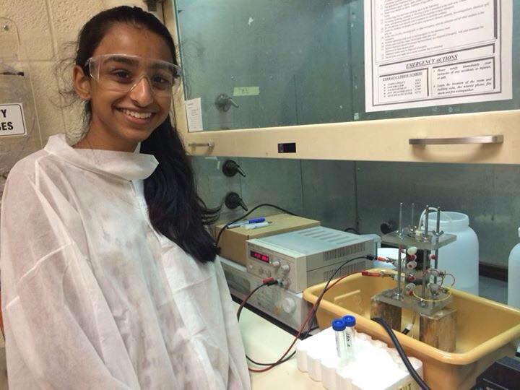
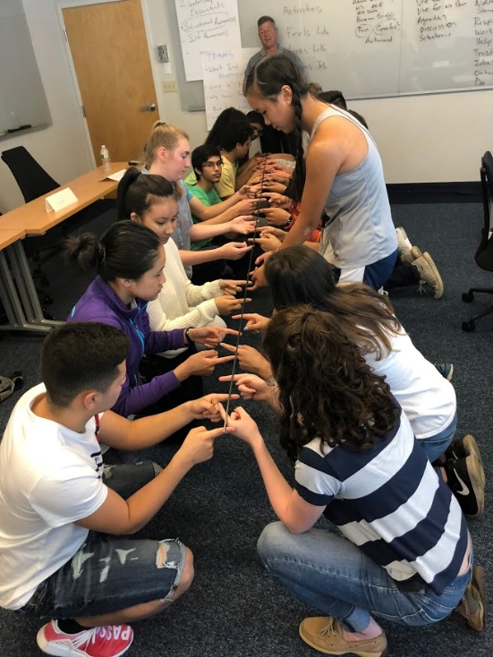
Young Scholar’s Program
Program Overview
Established in 1989, this six week research and college exploration experience allows students to engage in college-level research as well as explore potential career options and be introduced to college life through weekly seminars, workshops and supporting field trips.
Target Student Population
High school sophomores/juniors
Learning Environment
Hands-on research in Northeastern labs and classroom seminars
Program Results/Highlights
29.5% increase in participants’ understanding of research techniques (2018)
92.3% of participating students indicated their intent to apply to Northeastern (2018)
53 Faculty from across the University have supported the YSP to date
Over 500 participants to date
More feedback can be found here.
Impact
Program Impact Summary
Back to Timeline

Slide 12
2018 YSP Participant Feedback
“There is a famous analogy which states: if two people have an apple each and they exchange apples, they each now have one apple; but if two people have an idea each and they exchange ideas, they now have two ideas. I realized the truth behind this analogy from my duration at the Young Scholars Program, which will live with me indefinitely.”
“I learned how to become a better listener, a better leader, and a better team player. These priceless qualities and lessons that I learned from the Young Scholars Program are more than I could have ever expected when I was applying last year. I will take them with me as I continue to grow in the future as a student and as an individual.”
“I gained connections with Northeastern faculty members, graduate students, and the other YSP members. There were definitely some frustrating times in the lab when something didn't produce the results we wanted, but I realized that it's all part of the process of research and that when we did finally get results, it felt amazing.”
Back to YSP
Back to Timeline

Slide 13
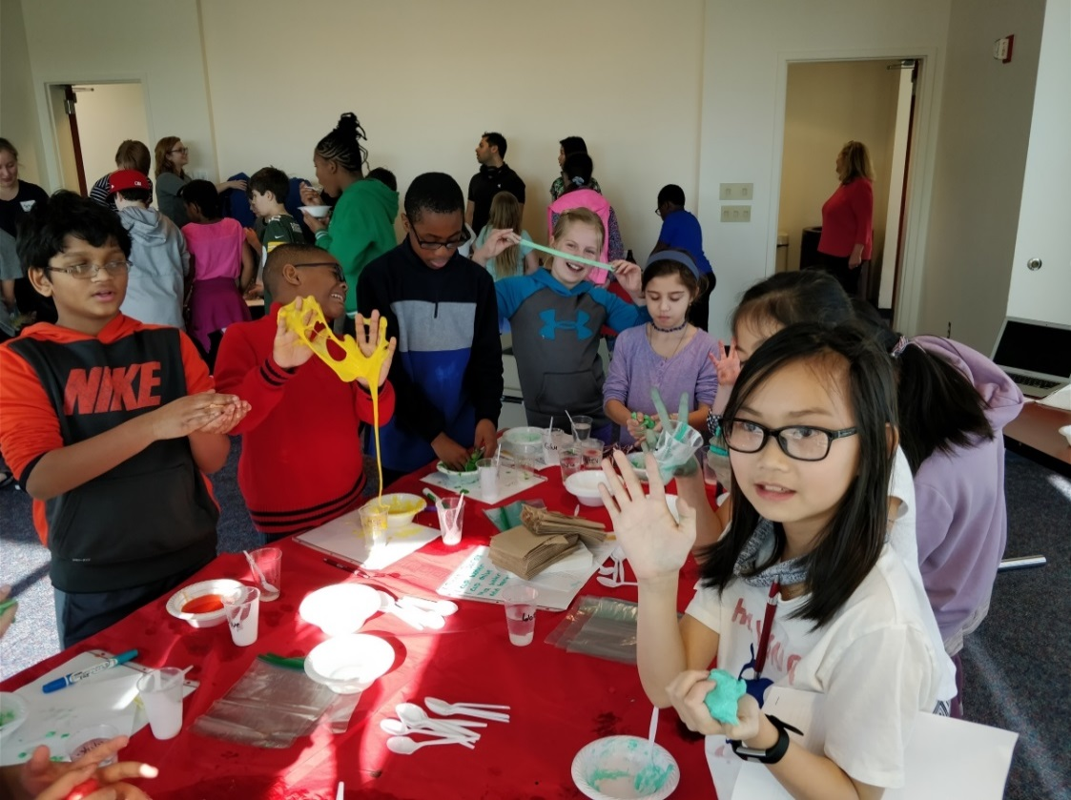
Explorations Week (E-Week)
Program Overview
Explorations Week is a 1-week hands-on engineering program during BPS’s February vacation (which coincided with National Engineers Week). Students explore possible career paths within engineering.
Target Student Population
4th-6th grade students from the Boston area
Program Results/Highlights
In 2018, 25 students participated in the event.
Back to Timeline

Slide 14
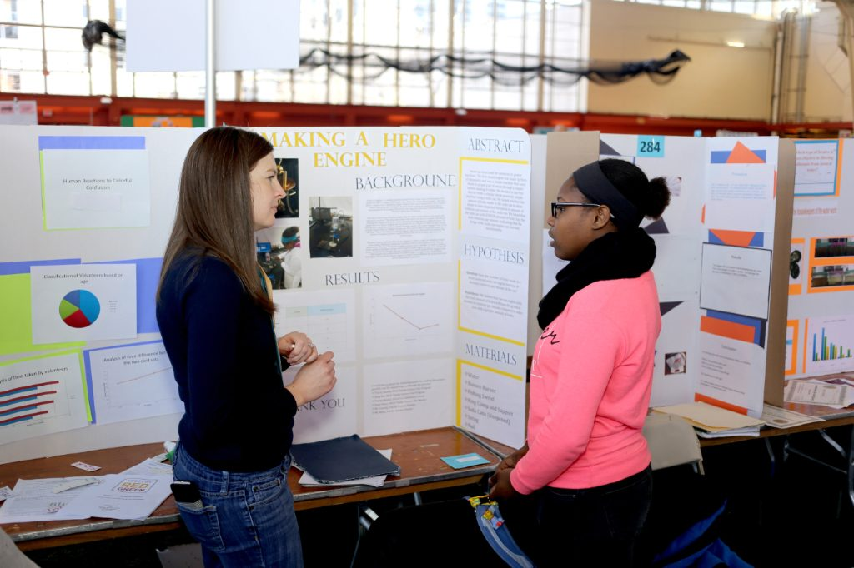
Boston Science and Engineering Fair
Program Overview
The Boston Science and Engineering Fair is a collaboration between the Center for STEM and Boston Public Schools. Approximately 350 students participate annually. The Center for STEM’s coordinates logistics, identifies and recruits judges, offers breakout sessions for program participants, and organizes a STEM EXPO, which allows partner student groups to participate.
Target Student Population
Middle and high school students attending BPS
Program Results/Highlights
Over 350 students participate annaully.
Over 100 judges recruited
~50% drawn from the Northeastern Community
Back to Timeline

Slide 15
Research Experience for Undergraduates
REU-D3 REU Site: REU Research Experiences and Mentoring in Data-Driven Discovery
REU-POWER Research Experience for Undergraduates site to create "Pathways Opening World Energy Resources
Program Impacts
Back to Timeline

Slide 16
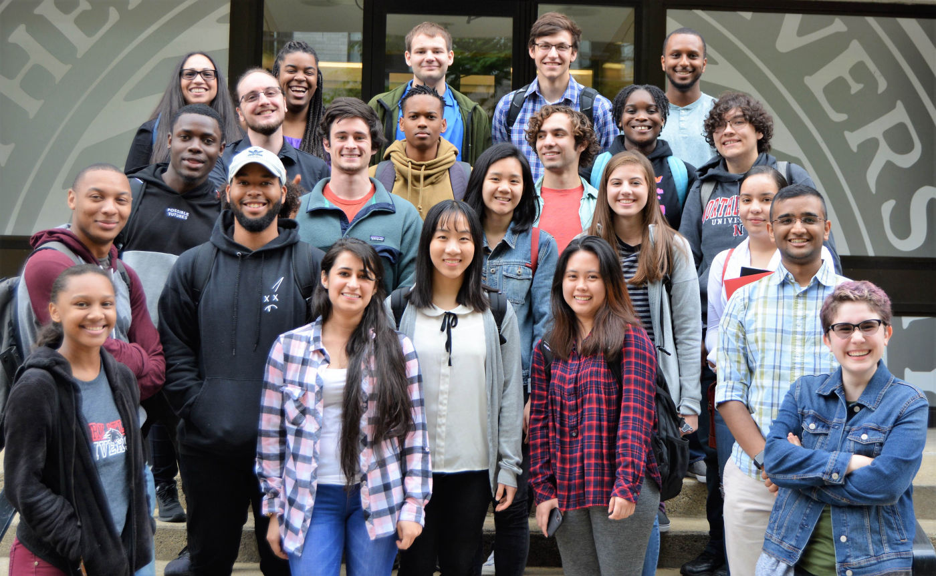
NSF Research Experiences for Undergraduates: Data Driven Discovery (D3)
Program Overview
The REU-D3 is a 10-week summer based research experience in engineering and computer science laboratories. Students focus on topics including computing, data analytics and machine learning.
Target Student Population
10 Rising undergraduate sophomores annually from Northeastern and partner HBCU’s and Community Colleges
Learning Environment
Northeastern COE and CCIS laboratories
http://www.ece.neu.edu/groups/nucar/REU-D3/ NSF#1559894
Back to REU
Back to Timeline

Slide 17
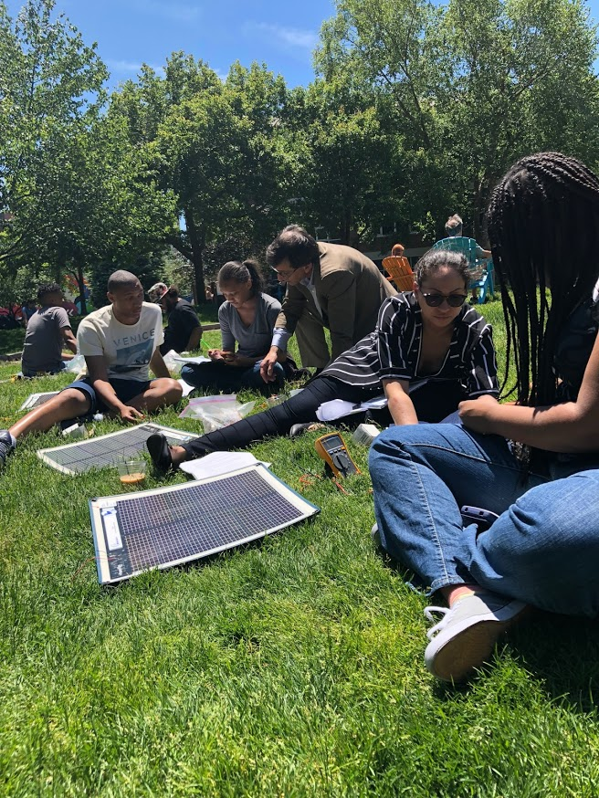
REU-POWER
Program Overview
REU-POWER is a 10-week summer-based engineering research experience for undergraduate students. Students focus on topics pertaining to the National Academy of Engineering (NAE) Grand Energy Challenge, focusing on transcending barriers and overcoming challenges to provide clean energy.
Target Student Population
Rising undergrad sophomores, juniors, and seniors
Learning Environment
Northeastern College of Engineering laboratories
Program Results/Highlights
In 2018, eight rising college sophomores, juniors and seniors participated.
(NSF# 1757650)
Back to REU
Back to Timeline

Slide 18
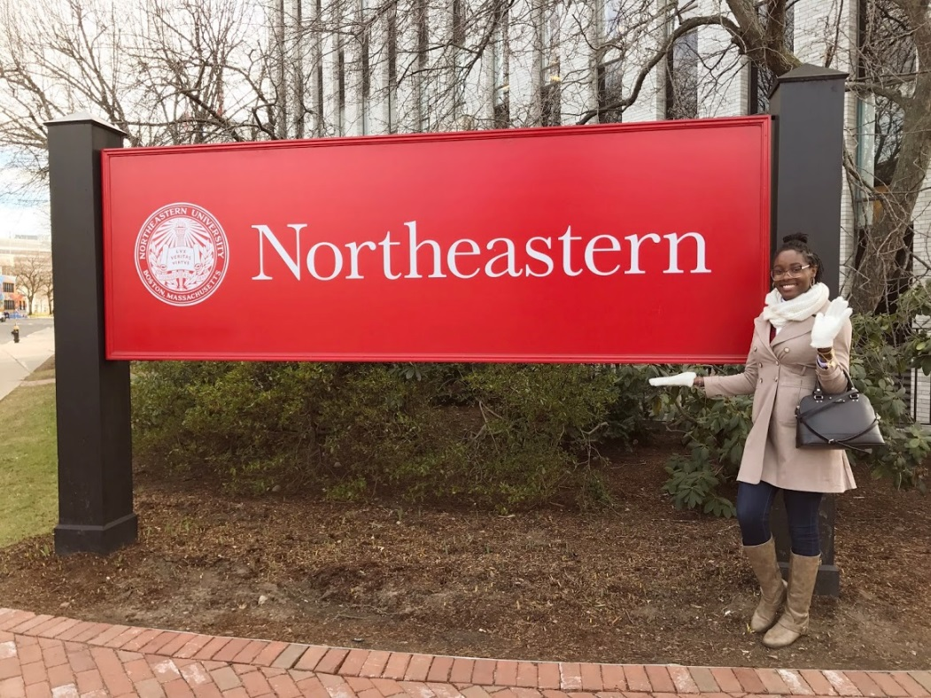
S-POWER
Program Overview
An innovative scholarship and mentorship program developed to help sup­port col­lege transfer stu­dents from under­rep­re­sented back­grounds who are studying and doing research in energy
Target Student Population
Undergraduate/graduate college students
Program Results/Highlights
The program provides scholarships for incoming transfer and/or graduate students from partner institutions including; Clark Atlanta University, Hampton University, MassBay Community College, Middlesex Community College and Northern Essex Community College.
Additional scholarships are awarded to potential transfer students at their host institutions
S-POWER anticipates supporting approximately 160 undergraduate and graduate students over the life of the grant. (NSF 1564653) https://web.northeastern.edu/spower/
Back to Timeline

Slide 19
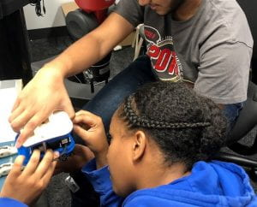
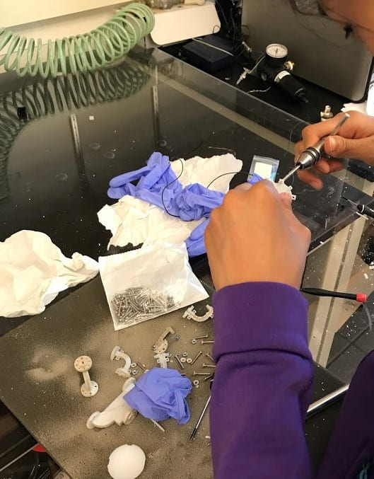
UPLIFT
Program Overview
The UPLIFT program is an academic year research program for incoming freshman that have been selected to participate in research projects across the College of Engineering. Students will engage directly with faculty and graduate student mentors over the course of the semester and produce and present final research presentations.
UPLIFT Students are paired with a CoE Faculty member, participating in research and developing a research project in the fall, then potentially developing a plan for a 4 SH Directed Study course in the Spring, and concluding by applying for a Summer REU.
https://stem.northeastern.edu/programs/ayp/uplift/
Target Student Population
First Year, Undergraduate, Engineering Students at Northeastern
Program Results/Highlights
Program is currently running for the first year, results TBD
35 students and 33 professors participating in the program so far
Back to Timeline

Slide 20
Alumni Afterschool Program
Program Overview
9 weeks of (1/week) virtual meetings with program alumni to continue STEM engagement with the Center after program completion.
Students participate in activities during the meeting and complete challenges during the week.
Overarching Theme: Putting the A (Arts) in STE(A)M
https://stem.northeastern.edu/programs/ayp/aap/
Target Student Population
Alumni of our various programs currently in grades 6-8
Program Results/Highlights
First time running the program, results TBD
Working with affiliated student organization STEMout for program planning and presentation
Currently 14 students participating in the program
Back to Timeline

Slide 21
Pathways to Science and Engineering
Program Overview
Virtual after-school program geared towards high school students interested in STEM. Students will be exploring diverse career pathways through research presentations. Graduate students and faculty members from Northeastern University will be presenting their ongoing research to participants, and participants will have time to ask questions about the presenter’s research and their field of study.
https://stem.northeastern.edu/programs/ayp/pathways/
Target Student Population
Open to Public: any high school students (ideally Juniors)
Program Results/Highlights
First time running the program, results TBD
Attendance has been 80+ students / week
Many graduate students and faculty members have expressed interest in participating in the program
Back to Timeline

Slide 22
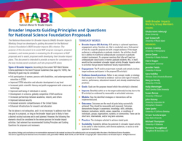
Broader Impacts Support
Program Overview
The Center for STEM Education provides support for faculty to support the development and implementation of their Broader Impact efforts. . This includes help with brainstorming, planning, drafting and facilitating connections with potential partner organizations. Through this program, faculty gain useful support for grant applications and program implementation while the Center staff will strengthen relationships with the faculty of the college.
Target Population
Northeastern faculty
Program Results/Highlights
The Center directly supported 55 faculty members in the development of their Broader Impact efforts (2016-2018).
Of these, 15 have been awarded to date. (Abstracts of BI collaborations https://stem.neu.edu/resources/faculty/broader-impact-support/sample-grants/
Feedback from some of these faculty can be found here.
Back to Timeline

Slide 23
Faculty Feedback
“Very responsive and provided all the support I need. Also engaged me in possible outreach opportunities and activities where I can participate.”
”We have been talking since I arrived at Northeastern. I was able to become quickly engaged in STEM Center programs, namely the YSP program.”
Great support for the grant itself, but also on developing ideas and collaborations in the greater Boston area.”
Back to Broader Impacts
Back to Timeline

