Slide 1
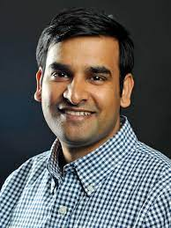
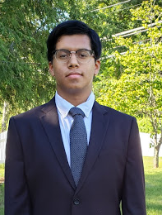
Quantum Computing: What and Why?
Dr. Devesh Tiwari, Assistant Professor of Electrical and Computer Engineering at Northeastern University
Rohan Basu Roy, Ph.D student at Northeastern University
Kirya Caine, rising senior at Belmont High School
Shoumik Kundu, rising senior at Chelmsford High School

Slide 2
Abstract
Quantum computing has the potential to change the way difficult computational problems are dealt with.
However, more widespread knowledge of how it works/its potential is needed.
Project goal: Effectively demonstrate basic quantum computing concepts, discuss potential future challenges and possibilities.
Notes:
Quantum computing is an emerging field with the potential to greatly expand and diversify the computational power accessible to the scientific community. Despite the promise of quantum computing, more widespread and accurate comprehension of its principles and capabilities are necessary in order to gather more consumer interest and outside investment as well as further improve the technology. The goal of this project is to simply and effectively demonstrate basic quantum computing concepts to both increase its relevance among circles that do not directly interact with this technology as well as discuss its potential future challenges and relevant possibilities.
Week 1: Worked on doing some preliminary reading to to attain basic comprehension of quantum principles, cloud computing, and emerging computer science and computational technologies. Narrowed focus of research to Quantum Computing and current state of the field
Week 2: Deepened our understanding of Quantum Computing by reading scientific articles and videos published on the topic. In particular, developed a solid understanding of two basic concepts in the Quantum realm.
Week 3: Developed procedures for demonstrations of these two basic concepts using at-home objects, with the goal of explaining these concepts in simple, easy-to-understand ways. Started research on how feasible quantum computing would be used in the future for different problems that classical computers currently aren’t able to solve.
Week 4: Carried out the demonstrations and recorded data. Created and worked on presentation slides to convey the concepts that we have learned and educate others on them.

Slide 3
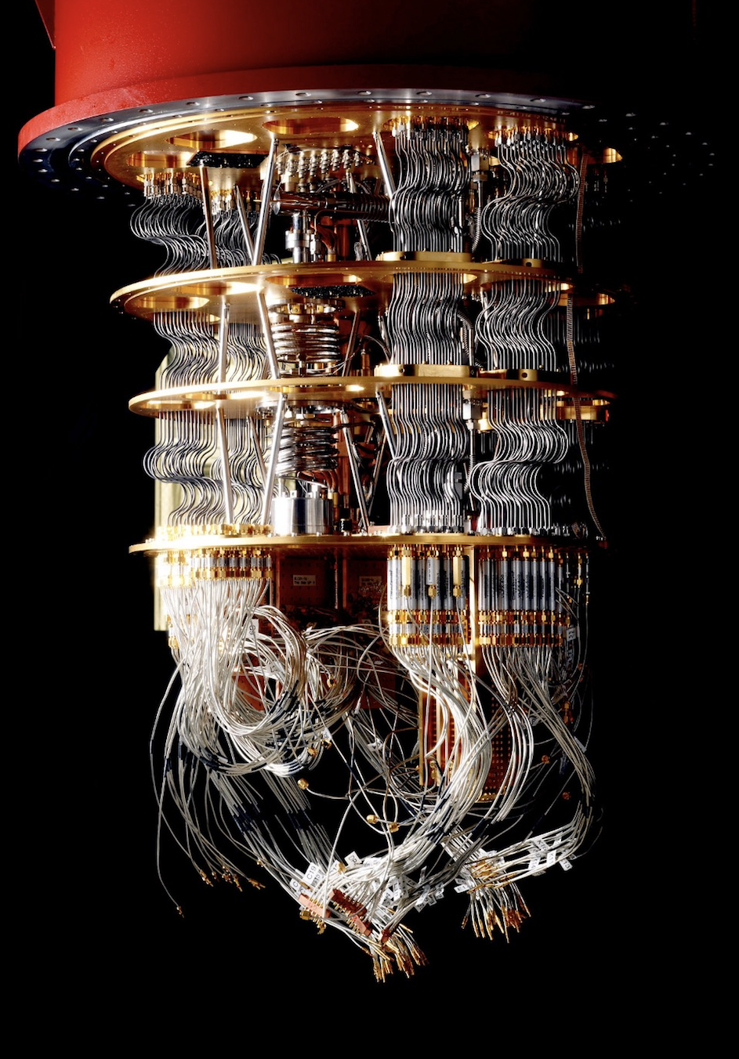
What is Quantum Computing?
A bit in a classical computer acts as a simple 0/1 binary gate. If a classical computer were a mouse in a maze, it would try each path individually.
Quantum bits (qubits) in quantum computers operate differently- they can be in a state between 1 and 0. This allows a “quantum mouse” to run through all paths of a maze at the same time.
A qubit allows the mouse to run two paths at once.
Each additional qubit doubles the amount of paths that the mouse is able to run simultaneously.
Notes:
Picture credit: https://www.wired.co.uk/article/quantum-computing-explained

Slide 4
Principles of Quantum Computing

Slide 5
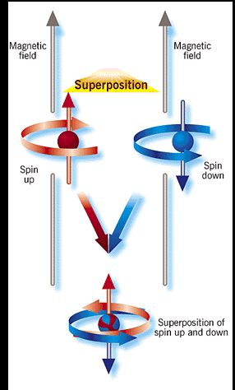
Superposition
Superposition describes a state made up of probabilities of two different outcomes.
Ex. In the presence of a magnetic field, an electron behaves in two possible ways relative to it- “spinning up” or “spinning down”. Until the electron is observed, the electron has a finite probability of being in either state. The electron is not in a single defined state, but rather in a combined state of the two possible outcomes.
Superposition sets qubits/quantum computers apart from bits/classical computers
Notes:
Picture credit: https://www.semanticscholar.org/paper/From-Physicality-to-Mathematicality%2C-to-to-and-Or%2C-Koko%C5%A1ar/8ec19e6cf128e01508746afc0f0506a08283376b/figure/5
Just make sure you mention fact that when a particle is measured, it falls out of superposition and collapses into a definitive state- 1 or 0, spin up or down, heads or tails, etc.

Slide 6
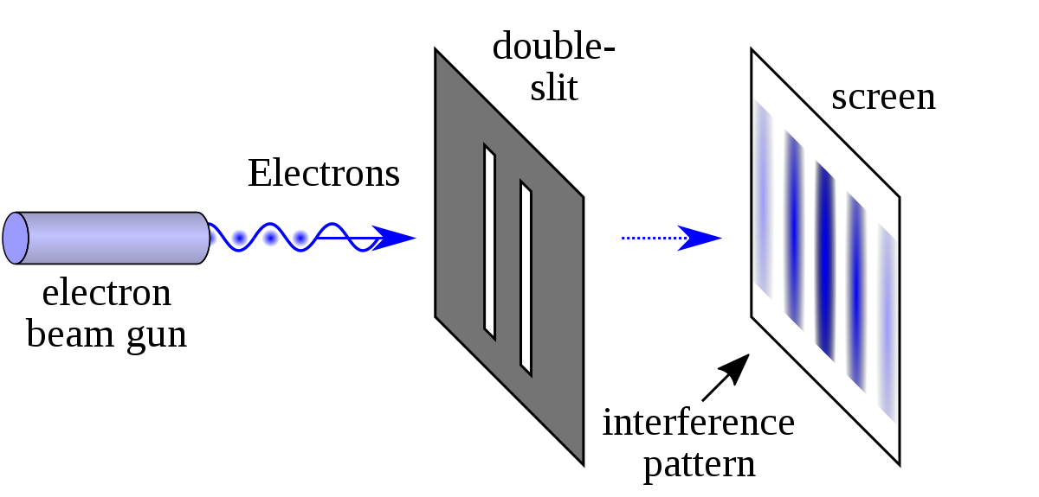
The Double Slit Experiment:
Cornerstone of modern physics and quantum theory
Originally conducted by Thomas Young in 1803 to examine whether light acts as a particle or a wave.
Recreated this experiment at home using a laser pointer and thin wire.
Materials and Procedure for Experiment Recreation
Notes:
Picture credit: https://en.wikipedia.org/wiki/Double-slit_experiment#/media/File:Double-slit.svg
On slide itself, give brief description of history of the double slit experiment- and then link drive doc with materials/procedure

Slide 7
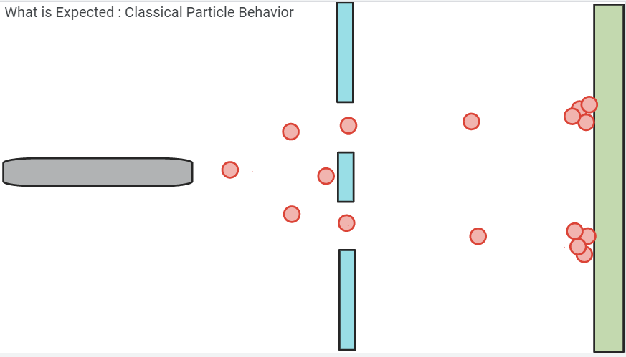
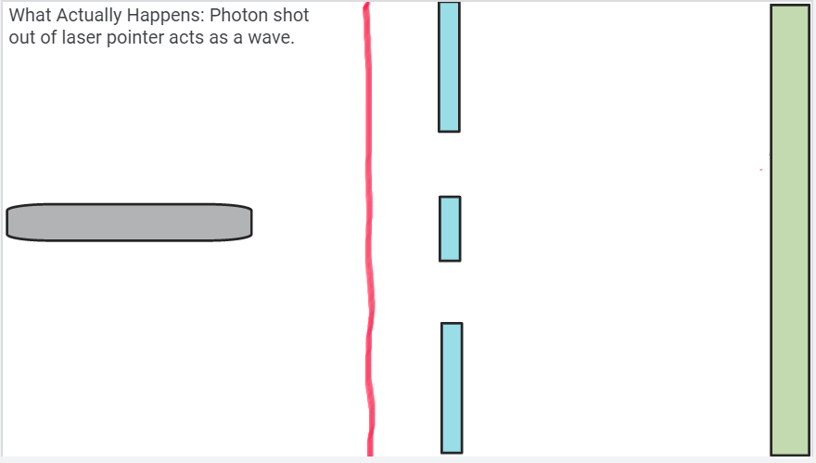
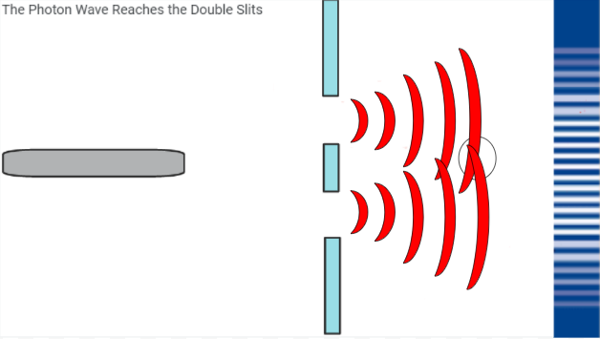
1
2
3
4

Slide 8
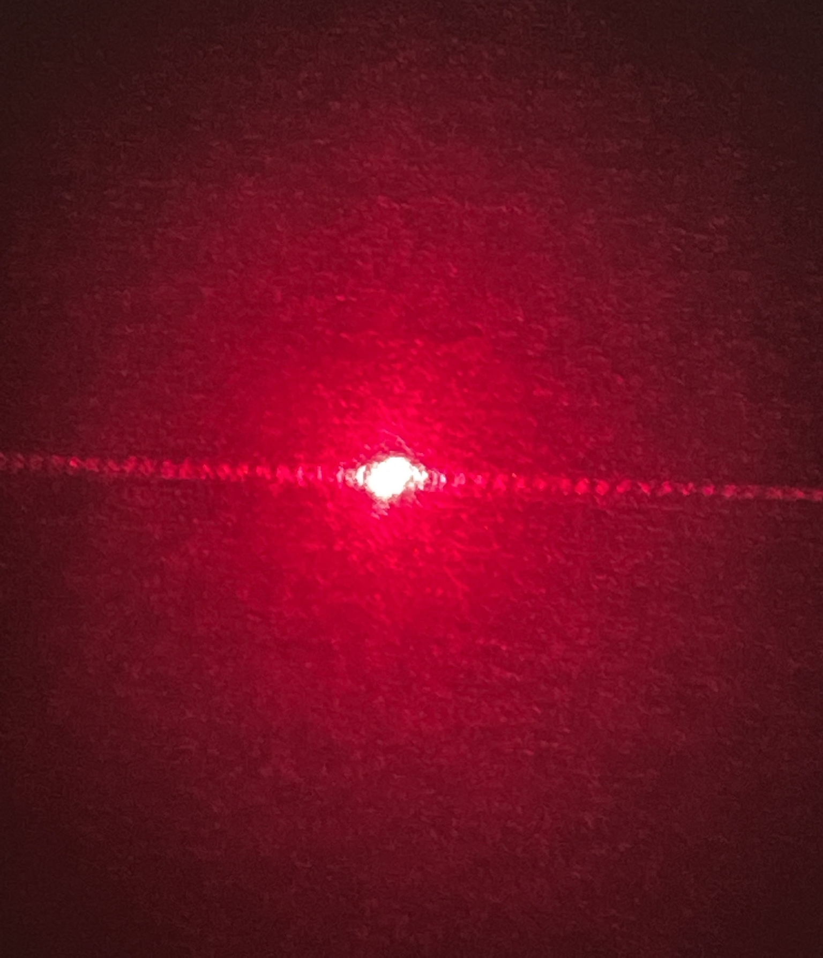
1
3
2
Notes:
Light/White background - without double slit (control)
Dark/red background- with double slit, observe the light pattern that extends out due to interference from the wave-light nature of the photon behavior (due to superposition)

Slide 9
Conclusion:
Due to the interference bands on the wall, we can conclude that the photons acted as waves when going through the double slits.
Not in line with classical particle behavior.
This wave behavior means that the singular photon went through both slits at once.
We can say that the photon was in a superposition state while going through the double slits before collapsing into a single state once it reached the wall.
Qubits and other quantum particles behave in this same way- in superposition until they are observed, or “hit the wall”.
Notes:
If the photons would act like classical particles, which we would expect, we would observe some photons not be able to go through the gates, but some other photons would be able to go past the two barriers and through the double slits. In this case, one photon would randomly bounce around until it chose whether to go through the left slit, or the right slit, and then end up in two distinct piles on the wall, parallel to slits. But, from this experiment, we see that we actually get multiple bands of photons with varying amplitudes all over the wall, even in the middle of the slit paths, which is not what we would expect classically. We see there are gaps where no photons have landed, but also places where a lot of photons have landed. This behavior can be explained if we postulate that the photons acted as a wave when shot out from the laser pointer. But how can 1 particle suddenly turn into a wave? Think about it like this: When a photon is shot out from a laser pointer, it forms a large flat wave, with the wave’s length illustrating the different probabilities of where that particle could be. When the flat wave hits the slits, the photon wave splits into two identical waves. These waves then interfere with each other, before hitting the wall, creating a new wave. The various peaks and troughs on this wave that this interference creates can be seen on the wall, with the larger concentrations of photons that we observe corresponding to the peaks of the new waves, and the gaps corresponding to dips in the new photon wave. These results are very significant, as it shows that the singular photon can then both go through the left slit and the right slit at once, which is contrary to classical thinking, and is the basis of quantum computing and mechanics.

Slide 10
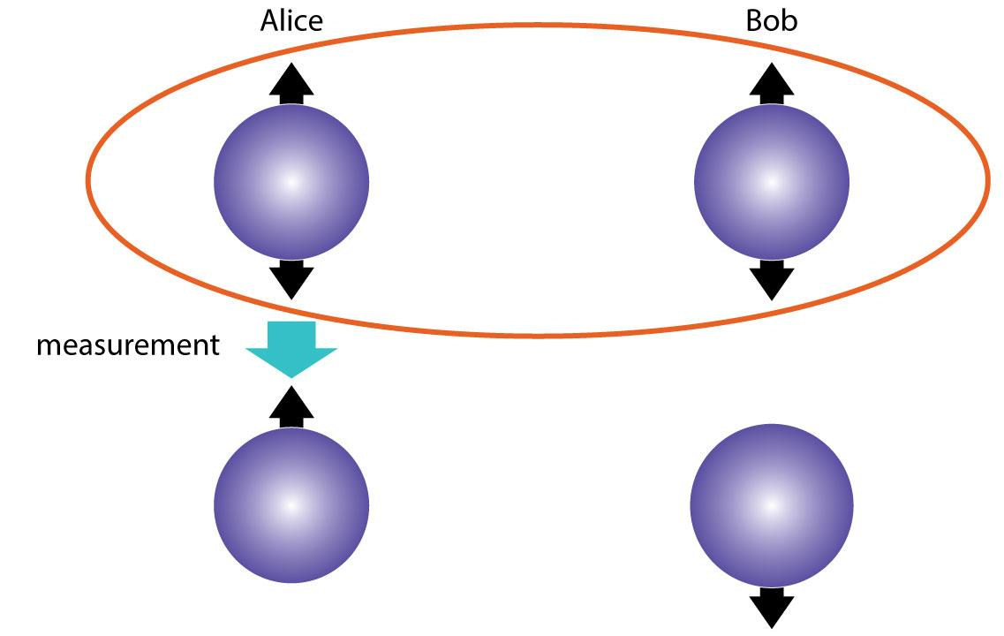
Entanglement
If one particle’s state is measured, causing it to collapse from superposition into a definitive state, then any particles that it is entangled with will collapse into a corresponding state.
Ex. a qubit is measured to have a state of “1”, causing an entangled qubit to also collapse, either into a state of “1” if the two have a direct relationship, or into “0” if the relationship is inverse.
Fig. 1- When photon “A” is measured, it collapses into an “up” spin state, causing photon B to collapse into a “down” spin state.
Notes:
Picture credit: https://www.sciencemag.org/news/2015/08/more-evidence-support-quantum-theory-s-spooky-action-distance
Entanglement is a phenomenon in quantum physics that allows the manipulation of one particle to result the behavior of another particle to be accordingly altered. If you know the state of one quantum particle, then the state of it’s entangled particle, regardless of distance, is also known. One common example of this is entangled photons, which are created by firing a single photon through a crystal to produce a correlated pair. Regardless of spatial proximity, the “spins” of these photons will be linked when measured- in fig. 1, entangled photons exhibit an opposing spin relationship spin relationship.

Slide 11
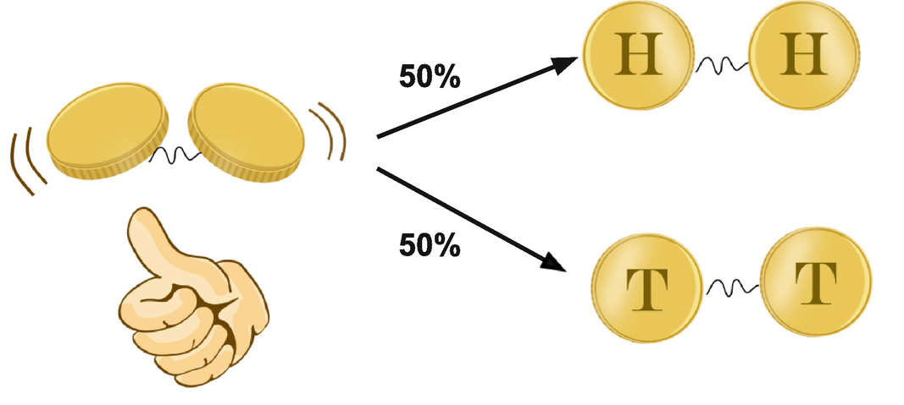
Entanglement
Entangled particles have an intrinsic relationship that causes them to fall into corresponding states faster than light or information can travel.
Entanglement allows more efficient information spread/transfer through simultaneous state changes of qubits and reduced redundant outcomes.
Fig. 2- two entangled coins will always land on the same side, leading to two possible outcomes
Notes:
Picture credit: https://link.springer.com/chapter/10.1007/978-3-030-61601-4_7
The transfer of states between entangled photons is orders of magnitude faster than the speed of light, demonstrating that There is no classical communication between two or more entangled particles at the time of measurement. Rather, there is an intrinsic connection between these qubits that causes their states, when measured, to have a definitive and reliable relationship.
In quantum computing, this means that if the state of 1 qubit is taken out of superposition, one can accurately infer the state of another qubit that is entangled with the original. This property of quantum computers allows them to make certain calculations orders of magnitude faster than classical computers, as it allows more efficient information spread and transfer.

Slide 12
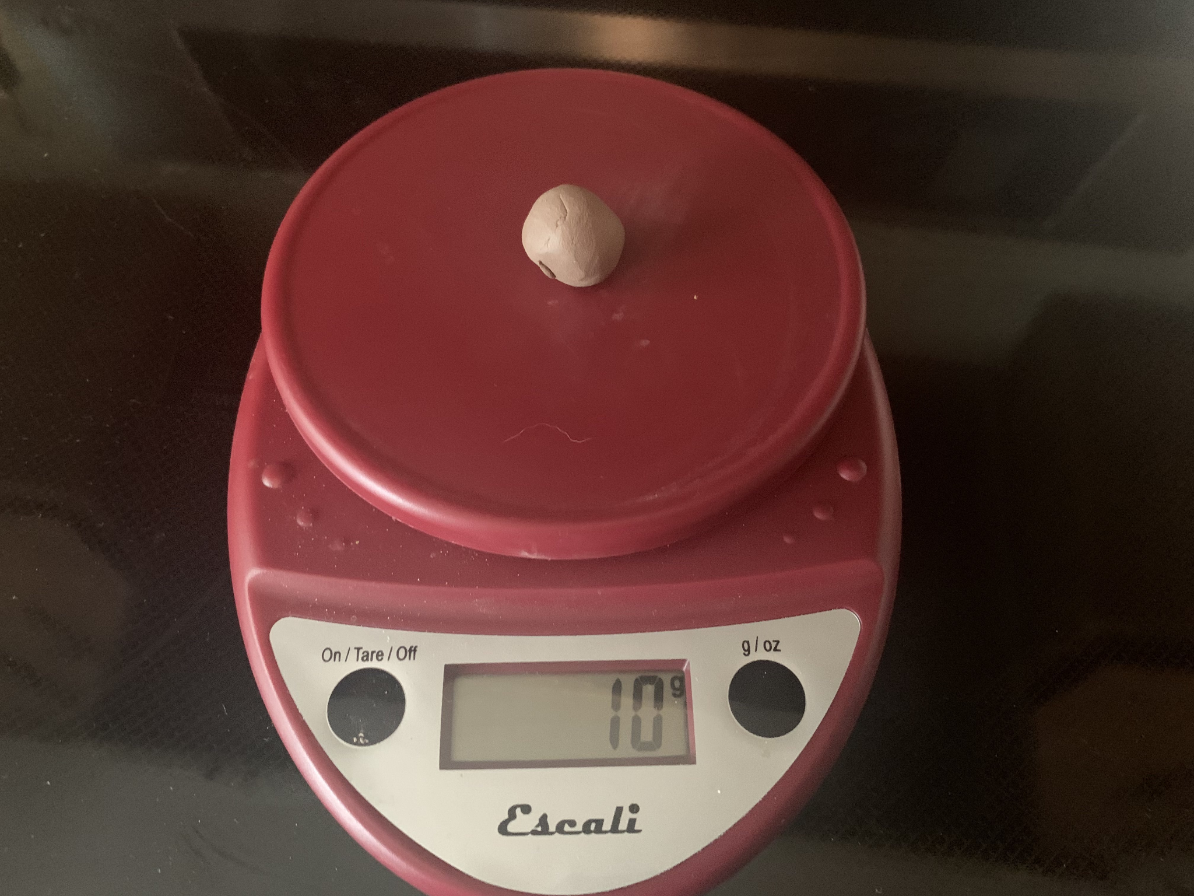
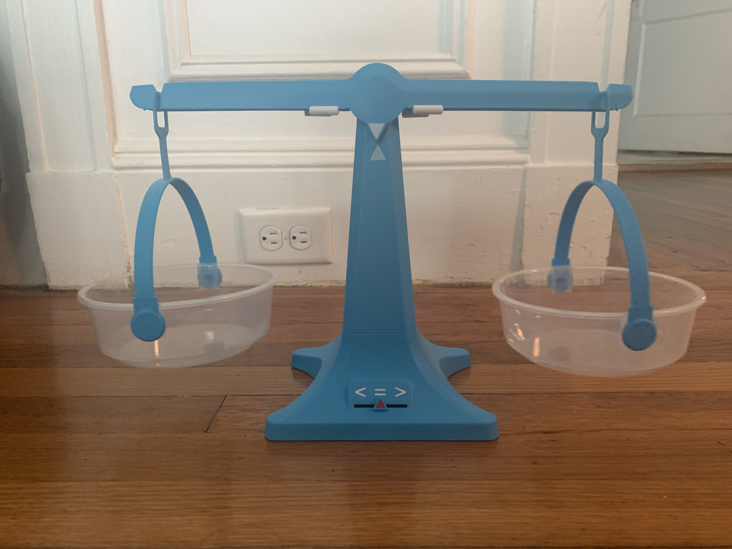
The Double Pan Balance Demonstration:
Materials and Procedure for Experiment Recreation

Slide 13
Trial # | Initial Height L Side of Scale(in) | Initial Height R Side of Scale(in) | Initial Weight R and L (g) | Final Weight L (g) | Final Weight R (g) | Final Height L (in) | Final Height R (in)
1 | 1.75 | 1.75 | 5 | 6 | 5 | 1.5625 | 1.9375
2 | 1.6875 | 1.8125 | 5 | 6 | 5 | 1.625 | 1.875
3 | 1.8125 | 1.6875 | 5 | 6 | 5 | 1.625 | 1.875
4 | 1.75 | 1.75 | 5 | 6 | 5 | 1.5625 | 1.9375
5 | 1.75 | 1.75 | 5 | 6 | 5 | 1.625 | 1.875
Data demonstrates that: 3.5 in. = (height of right pan)+(height of left pan).
Link to full data spreadsheet

Slide 14
1
2
3
Pans begin balanced- in a state of superposition. When the state of one pan is altered (adding weight) and observed (measuring height), this can be thought of as the pan falling out of superposition into a definitive state (lower or higher than at equilibrium)

Slide 15
Quantum Computing in Society

Slide 16
Current Status of Quantum Computing:
Currently, there are only a few quantum computers in the world.
Using cloud computing, a user can request and use certain resources from quantum computers through a virtual terminal.
Quantum computers currently will quickly produce an answer to problems classical computers struggle with, but the solutions they provide aren’t always accurate.
Currently being remedied through ongoing research in the field

Slide 17
Encryption
RSA encryption bases its security on the fact that it is nearly impossible to find the prime factors of a large number.
An encrypted message is “garbled”- locked behind a number with 20+ digits. To decrypt, a “key”-the prime factors of the number- is needed. Finding the key with a classical computer could take years.
Due to superposition and entanglement, quantum computers can run through these calculations and at a much quicker pace.
Has potential pros and cons
Notes:
Photo credit: https://www.iconspng.com/image/13431/encrypted-document-orange

Slide 18
Capacity for Simulation
As the number of electrons in an atom increases, the computing power and time it takes for a classical computer to simulate it increases exponentially.
Poses problems for drug discovery and biomedical industries.
Bohr model of atoms is often used due to this- not as accurate as the electron cloud model.
QCs utilize the very properties that make electrons hard to simulate- they are well-suited to predicting electron position.
Opens possibilities of faster and cheaper research budgets.
Notes:
Picture credit: https://tracingcurves.wordpress.com/2018/01/03/neutrons-bohr-vs-electron-cloud-basic-interactions/
Shows promise that QCs dealing with other problems with uncertain, entangled, or volatile results.

Slide 19
Acknowledgements
Thank you to:
Assistant professor Devesh Tiwari, Ph.D
Ph.D Student Rohan Basu Roy
Director for Programs and Operations at the Northeastern Center for STEM Education, Claire Duggan
Program Implementation coordinator at the Northeastern Center for STEM Education, Nicholas Fuchs
YSP coordinator, Gabriella Gonzalez
YSP coordinator, Franklin Olivierre

Slide 20
Bibliography:
Pautasso, Lorenzo, et al. "The Current State of Quantum Computing: Between Hype
and Revolution." McKinsey Digital, 19 Feb. 2021, www.mckinsey.com/
business-functions/mckinsey-digital/our-insights/tech-forward/
the-current-state-of-quantum-computing-between-hype-and-revolution.
Accessed 28 July 2021.
Quantum Computing as a High School Model. 1 Apr. 2020, arxiv.org/pdf/
1905.00282.pdf. Accessed 28 July 2021.
Tech Adams, performer. How to Make Your Own Double Slit Experiment (Young's) -
Easy At-Home Science. TechLaboratories, 2013. Youtube, Youtube.com.
Accessed 28 July 2021.
Minutephysics, performer. How Quantum Computers Break Encryption | Shor's
Algorithm Explained. Minutephysics, 2019. Youtube, Youtube.com.
Accessed 28 July 2021.
Young Two-Slit Experiment. UOregon, abyss.uoregon.edu/~js/21st_century_science/
lectures/lec13.html.
Accessed 28 July 2021.

