Slide 1
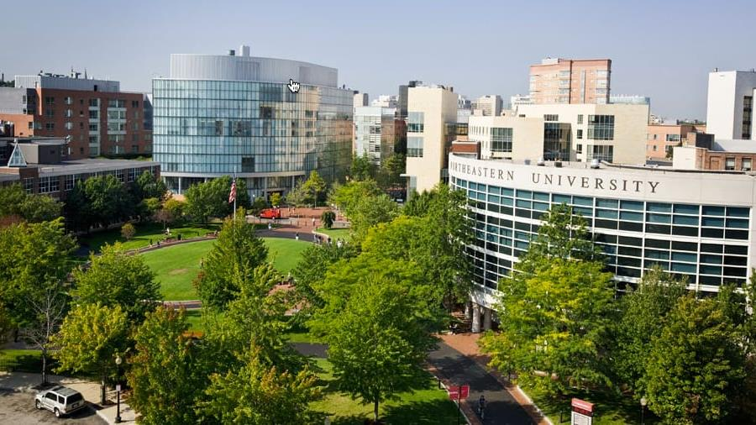
Ron Burton Training Village Virtual Trip to Northeastern
Notes:
Zoom Call: https://us02web.zoom.us/j/2669630254 | Meeting ID: 266 963 0254

Slide 2
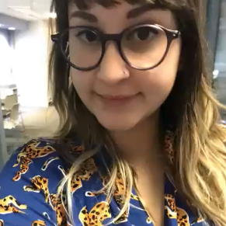
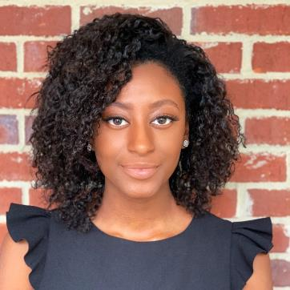
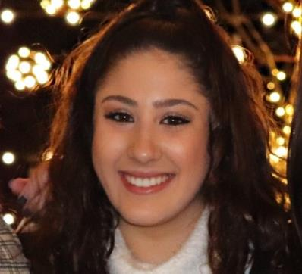
STEM / College 101 Panel
Patricia Rubio Arzola
Behavioral Neuroscience (PhD)
Madisyn Dudley
Electrical/Electronics Engineering
Natasha Zaarour
Behavioral Neuroscience
Tyree Thompson
Bioengineering
Notes:
11:20-11:50 You will be hearing from four Northeastern students and have the opportunity to ask them questions live after their presentations

Slide 3
Notes:
Patricia Rubio Arzola
Behavioral Neuroscience (PhD)

Slide 4
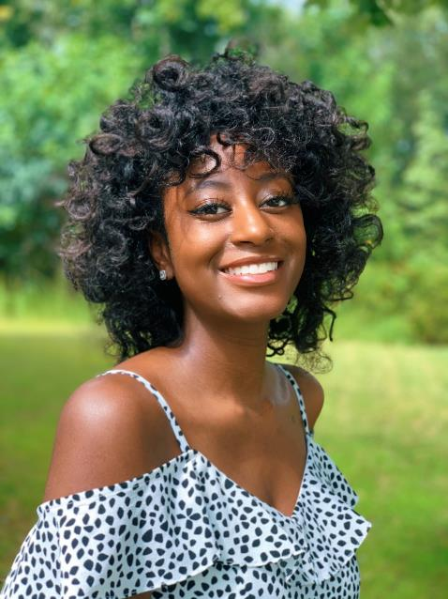
Madisyn Dudley
Year: Senior
Major(s): Electrical Engineering Activities: SEDS (Students for the Exploration and Development of Space) Experiential Learning: Solar Design Engineer Co-op with ClearSky Power, D’Amore-McKim Innovation- Product Design Course Research: Photovoltaic REU with Brad Lehman Next Steps: Apply to a Graduate Program
Notes:
Madisyn Dudley Electrical Engineering (‘21)

Slide 5
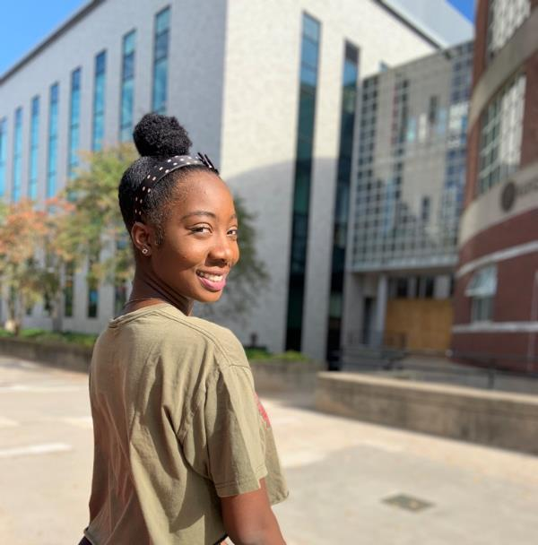
Tyree Thompson
Year: Senior
Major(s): Bioengineering (Cell and Tissue Engineering)
Activities: BESS Black Engineering
Student Society, STEMout Experiential Learning: Advanced Drug Delivery Research (ADDRES) LAB Research: Colon Cancer at UCLA w Dr. Albert
Next Steps: Graduation!
Notes:
Tyree Thompson Bioengineering (‘21)

Slide 6
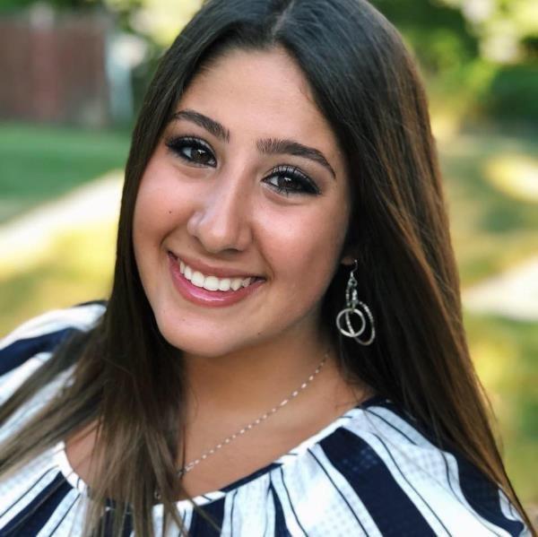
Tasha Zaarour
Year: Sophomore
Major: Behavioral Neuroscience, Pre-med
Minor: Global Health Activities: Global Medical Brigades, Horizons for Homeless Children Volunteer, Tutoring, NEURONs
Next Steps: Apply to Co-ops and Medical School, Become an EMT
Notes:
Tasha Zaarour
Behavioral Neuroscience (‘24)

Slide 7
STEM / College 101 Questions
https://docs.google.com/document/d/1oIjQaBi9c45c6WbBldOp2QKTWRKzqGjLDI882DZDKJw/edit
What is one thing you wish you knew before entering high school?
What is your favorite class in college?
What is your least favorite class in college?
What is your favorite part about college?
How did you know what classes to take in high school?
How did you choose your future career?
Why did you choose Northeastern?
How can I start preparing for high school?
What do students do for fun? Campus activities, clubs, events, etc? How’s the food in college?
How are the dorms?
What is the best way to meet people or make new friends?
How do you balance schoolwork and home responsibilities?
What is your favorite thing to do in Boston?
What is a major in college?
What jobs can you do with your major?
Is there a lot more homework in high school?
What was your transition like between middle and high school?
Is high school a lot bigger?
What was your favorite part about high school?
Notes:
11:20-11:50 https://docs.google.com/document/d/1oIjQaBi9c45c6WbBldOp2QKTWRKzqGjLDI882DZDKJw/edit?usp=sharing

