Slide 1
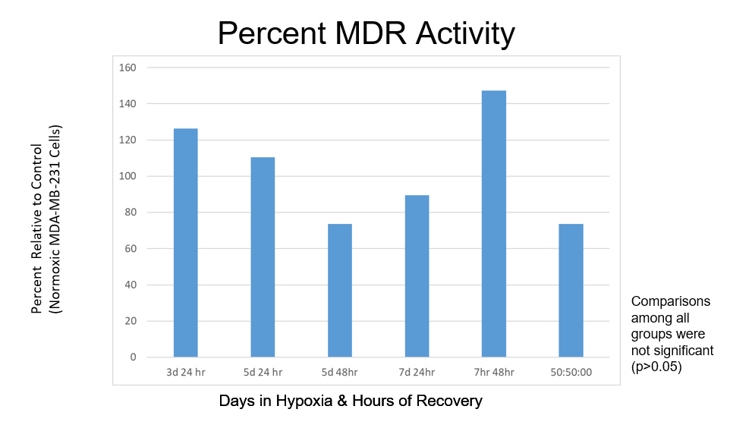
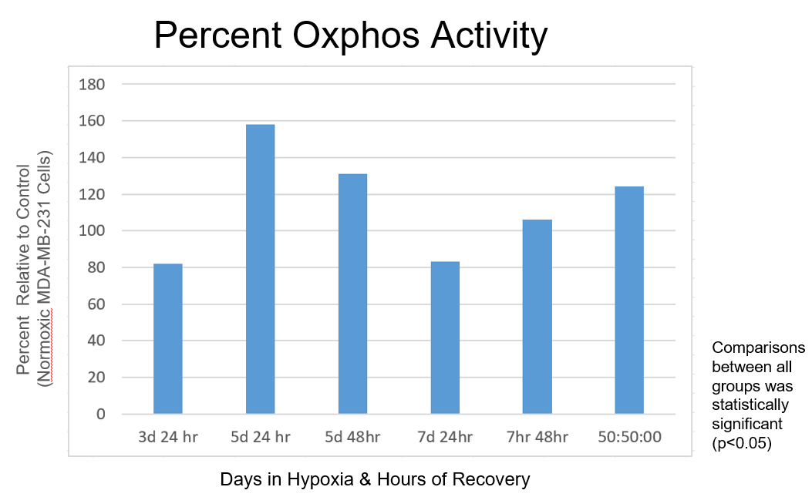
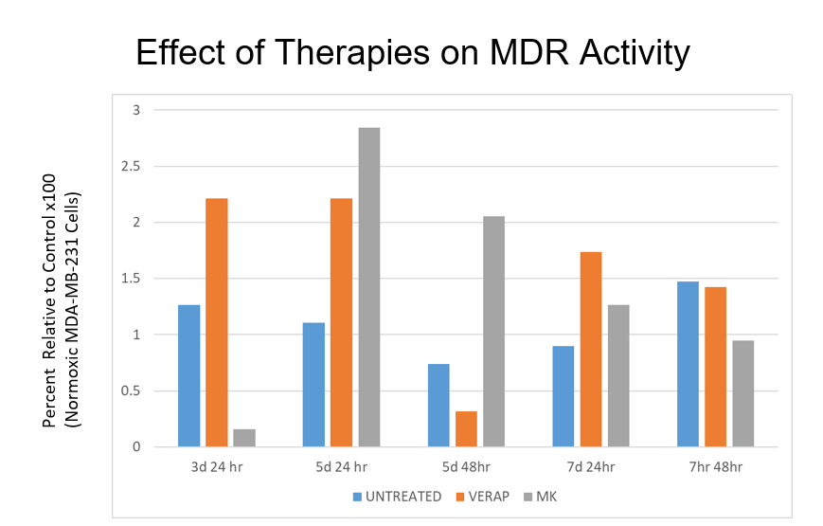
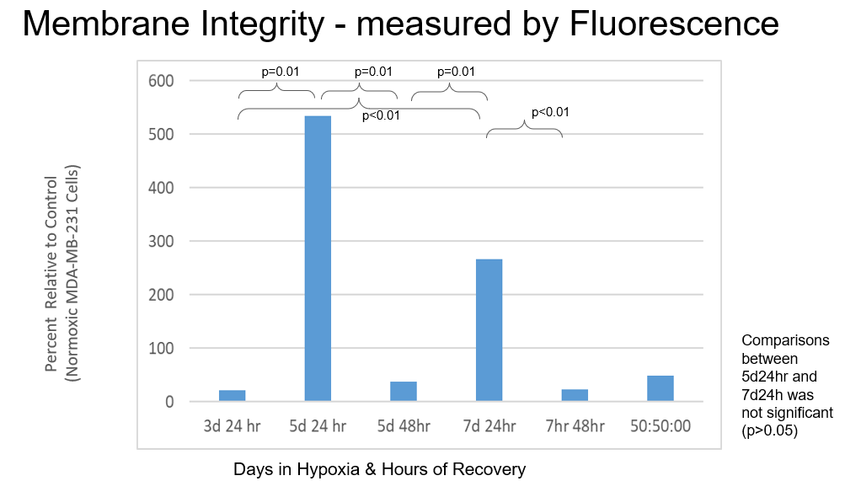
Using Hypoxia as a Model for Multidrug Resistance
Bouvé College of Health Science Department of Pharmaceutical Sciences
Sarper Paker, YSP Student, Newton North High School, Murtaza Khalil, YSP Student, Stoughton High School
Hongyu Li¹, Aditya Banga¹, Raquel Sevilla¹, Lara Milane, PhD¹, Mansoor Amiji, PhD¹,
¹Pharmaceutical Sciences, Northeastern University
Abstract
Experimental Methods
Conclusion and Future Steps
The purpose of this lab investigation was to characterize the implications of the application of hypoxic preconditioning to create cellular models of multidrug resistance in cancer cells. A secondary purpose of this investigation was to determine the stability of the model as cancer cells return to normoxic conditions. Mito Tox Glo assay and Vybrant/Calcein Assay were used to determine implications of hypoxic preconditioning and return to normoxia.Key points of discussion in this paper include the impact of both hypoxic and normoxic conditions on the creation of multidrug resistance in cancer cells.
Firstly, prior to experimentation, cell line MDA-MB-231 was cultivated in hypoxic preconditioning according to intervals known to induce multidrug resistance from prior research. Cells were passaged and split into flasks according to hypoxic treatment and return intervals to normoxic conditioning. Cell were assigned three categories of hypoxic treatment: 3, 5, and 7 days. Cells were also assigned the interval of time to return to normoxic conditioning: 24 hours, 48 hours. After cells were cultivated in hypoxic preconditioning and returned to normoxic conditioning, cell membrane integrity, MDR activity, and oxidative phosphorylation (OXPHOS) activity was measured. OXPHOS was measured using a Mito Tox Glo assay. Cells grown in normoxic conditioning with HEK cell protein will serve as a negative control to ensure that hypoxia is causing a shift in HIF transcription factor and MDR1 protein expression.
MDR1 and MRP1 substrates will be used as positive controls in the MDR activity assay to produce expected results that will serve as a baseline of comparison, and an MDR1 inhibitor (verapamil) will be used as the negative control to ensure treatments have caused the increased activity seen in the plasma membrane.
-Oxidative phosphorylation decreased after 3 and 7 days of hypoxia
-MDR1 activity increased after 3 & 5 days of hypoxia but it didn’t reach statistical significance due to small sample size
-MDR activity after treatment with Verapamil increased after 3, 5 and 7 days of hypoxia & 24 hours of recovery
-MDR activity after treatment with MK increased after 5 and 7 days of hypoxia
-Oxphos decreased after 3 and 7 days of hypoxia has decreased.
-After 48 hours the oxphas has increased after being in the normal concentration of oxygen
-Membrane integrity is impaired on Day 3 due to being in transition
It improves after 5 and 7 days of hypoxia
-When oxygen concentration was normalized for more 48 hours, integrity of cell membrane is impaired again for being in transition state
Background
Results
Cancer is a unique illness in that its sole intention is to survive and thrive. To do so, cancer cells have numerous mechanisms that allow them to continue reproduction and proliferation. These mechanisms include evading tumor suppressor pathways and accelerate cell growth and division.
Multidrug resistance is one of the many mechanisms cancer cells utilize to survive. Multidrug resistance(MDR) most directly relates to the ability for cancer cells to resist treatment in the pursuit of survival. Multidrug resistance is the primary cause of unresponsiveness to cancer treatment. For metastatic cancers, approximately 90% of patients are unresponsive to therapy because of MDR. Hypoxia is an environmental condition that induces MDR in cancer cells through expression of transcription factors and expression of various proteins.
References
Milane L, Ganesh S, Shah S, Duan ZF, Amiji M. J Control Release. 2011 Oct 30;155(2):237-47.
M. Hüttemann, I. Lee, L. Samavati, H. Yu, J.W. Doan; Biochimica et Biophysica Acta (BBA) - Molecular Cell Research, 1773 (2007), pp. 1701-1720,
Milane L, Dolare S, Jahan T, Amiji M. Nanomedicine. 2021 Oct;37:102422.
Rueff J, Rodrigues AS. Cancer Drug Resistance: A Brief Overview from a Genetic Viewpoint. Methods Mol Biol. 2016;1395:1-18.
Milane L, Ganesh S, Shah S, Duan ZF, Amiji M. J Control Release. 2011 Oct 30;155(2):237-47.
Acknowledgements
Young Scholar Programs
Claire Duggan, Program Director
Nicholas Fuchs, Program Implementation Coordinator
Franklin Ollivierre and Katherine Norena, YSP Coordinators

