Slide 1
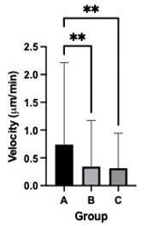
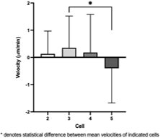
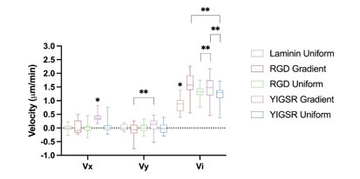
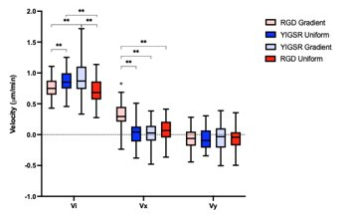
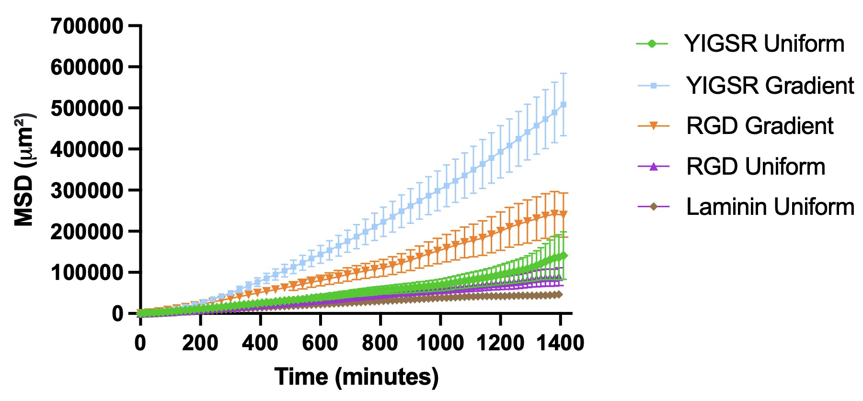
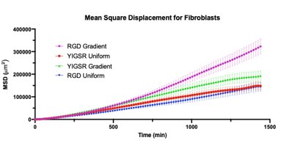
Schwann Cell Migration Enhanced by Laminin-Derived Peptides
Stefan Nguyen, YSP Student, Boston Latin School​
Claire Stipp, YSP Student, Arlington High School​
Yang Hu, Chemical Engineering department, Northeastern University​
Professor Rebecca Willits, Chemical Engineering department, Northeastern University​
Abstract
Experimental Methods
Conclusion and Future Steps
Motivation: ​
Peripheral Nervous System injuries are common and costly. Current treatments include taking a graft, and full return of motor and sensory functioning in the damaged area is not guaranteed. ​Enhancing Schwann cell migration to the injury site could​ Speed up nerve regeneration​ and prevent lasting effects, such as the scarring caused by fibroblasts.
Our Goal: ​
Understand cell migration behavior ​
Analyze original data for different research purposes​
Make scientific graphs of the data​
Results: YIGSR peptide gradients directed the most SC migration with a strong bias to the concentration profile, and the overall speed of SC migration increased with the steepness of the peptide concentration profile. YIGSR gradients had little influence on fibroblast migration, whereas RGD gradients proved effective. ​​
Data Analysis:
Excel was used for data analysis​
Used previously gathered data​
Velocity was calculated for cells ​
First focused on a single peptide, later compared multiple peptides​
Instantaneous Velocity: ​
Average mean square displacement (MSD) was calculated between time intervals​
Graphical Analysis:
Prism was used to create graphs and analysis of the graphs​
Two-way ANOVA is used to determine statistical difference ​
Post hoc tests were conducted to see which specific peptides were different (Tukey's)
YIGSR gradient yielded the most haptotatic response from Schwann cells​
Fibroblast cells had random migration on YIGSR gradient
Fibroblast cells had directional migration on RGD gradient
In the future, these peptides can be tested for in vivo nerve regeneration on implanted scaffolds
References
Background
Results
Motta, Cecilia M.M., et al. "Enhancing Schwann Cell Migration Using Concentration Gradients of Laminin Derived Peptides." Biomaterials, vol. 218, October 2019. doi:10.1016/j.biomaterials.2019.119335. ​
Jessen, Kristján R. et al., “Schwann Cells: Development and Role in Nerve Repair.” Cold Spring Harbor Perspectives in Biology, vol. 7(7), May 2015. doi:10.1101/cshperspect.a020487​
Boerboom, Angélique. “Figure 1. Diagram of Schwann Cell Response to Nerve Injury.” Molecular Mechanisms Involved in Schwann Cell Plasticity, Frontiers in Molecular Neuroscience, 17 Feb. 2017,
Nerves in the peripheral nervous system (PNS) have the ability to regenerate if injured. This is an incredibly important phenomenon, as PNS injuries are very common and costly. Current treatments for nerve damage involve repair using a graft. However, it is not guaranteed full motor and sensory function will return. Another issue regarding nerve recovery is the role of fibroblast cells in nerve repair. When fibroblasts migrate in large numbers to the nerve injury site, they can leave behind scarring and a painful tissue mass. This project explored the role of Schwann cells in nerve regeneration, with hopes that in vitro experiments could lead to new treatments that result in faster, more effective recovery.
Schwann cells are the primary glial cell of peripheral neurons. When a nerve is crushed or cut, Schwann cells migrate to the injury site and change into repair Schwann cells that help to increase the proinflammatory immune response, clean up the remains of the distal stump, and guide axonal growth. Schwann cells migrate to the injured nerve by interacting with adhesive sites in the extracellular matrix, such as the protein laminin. In this project, various peptides derived from laminin were tested and compared for their effects on Schwann cell and fibroblast migration.
(A) (B)
(A) (B)
Figure 3: Velocity in X graphs of Schwann cells with YIGSR gradient (A) and YIGSR uniform (B)
Figure 4: Velocity of SC (A) and fibroblast cells (B) with multiple peptides
(Boerboom).
Acknowledgements
Department of Chemical Engineering​
Professor Rebecca Willits, Professor and Chairperson​
Yang Hu, Ph.D. Student
Center for STEM Education​
Claire Duggan, Director of Programs and Operations​
Franklin Ollivierre III & Gabriella Gonzalez, YSP Coordinators​
Nicolas Fuchs, Project Implementation Coordinator​
Mary Howley. Administrative Officer
Figure 5: Average MSD of SC (A) and fibroblast cells (B) with multiple peptides
(A) (B)
Young Scholars Program at Northeastern University Claire Duggan, Program Director
This work was supported by the National Science Foundation Grant #1603832
Notes:
‹#›
Change to relevant logos of sponsor, also include grant # if there is one.

