Slide 1

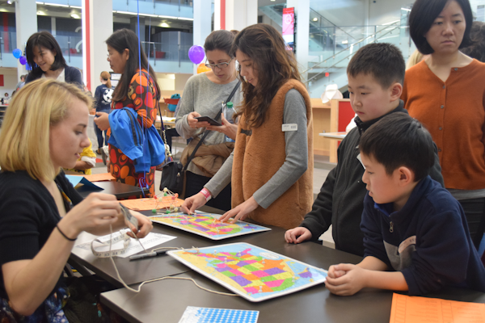
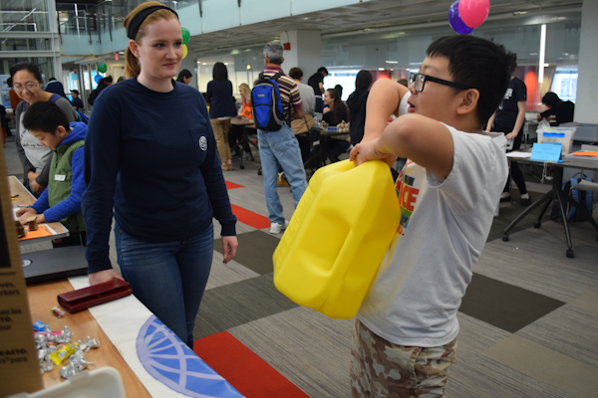
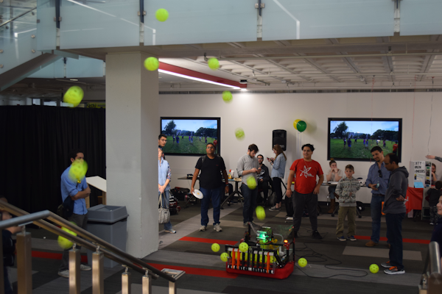
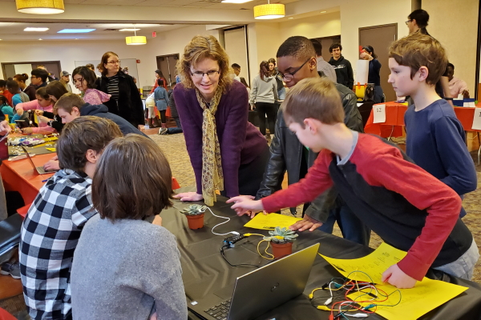
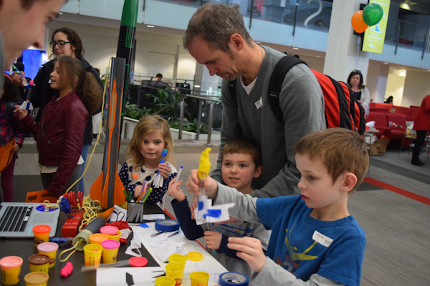
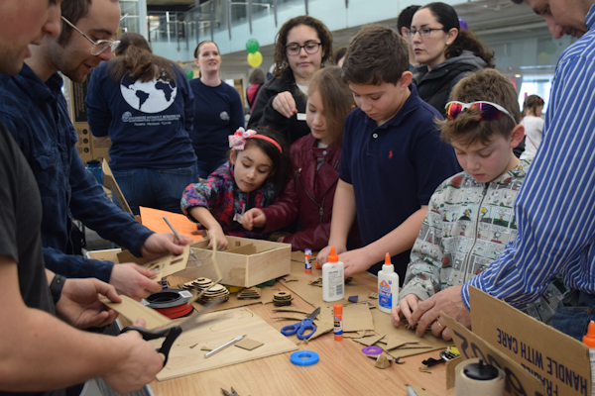
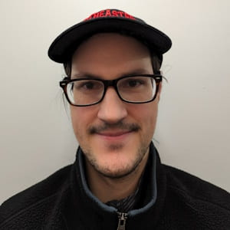
STEM Outreach: NEU Student Organizations
Nicolas Fuchs
Program Manager | x3382 Center for STEM Education n.fuchs@northeastern.edu

Slide 2

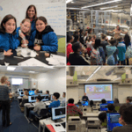
Why are universities engaged in outreach?
National crisis in STEM
Rising Above the Gathering Storm (2007) -> proposed action for federal efforts to improve U.S. competitiveness
Obama 2008 -> Science and Innovation Plan
Federal Agencies respond to the challenge
Expansion of Broader Impact requirements on research grants -> outreach becomes a required part of all NSF grants
Dedicated grant efforts to increase STEM interest, engagement, persistence and success
Math Science Partnerships
ITEST (Innovative Technology Experiences for Students and Teachers) – K-12 tech-based learning programs
NSF Research Experiences for Undergraduates (REU) and Teachers (RET) – summer research programs

Slide 3
Community Outreach - Why?
Benefit to community, benefit to you as students, benefit to faculty and the university
You and your fellow club/organization members have an idea for a great event to host on campus and/or in the community. The first step in event planning includes brainstorming together and writing everything down.
What type of program/event?
Intended audience?
One time offering and/or series?
Age level?
Contacts? Where / when? (as space is limited on campus)

Slide 4
Motivation
What motivates your organization to engage in community outreach?
It’s part of our mission
It’s a good thing to do
I am able to/I am good at it
It makes me feel good
To support youth and the community
What prevents you from engaging?
We don’t have the time
We don’t have the capacity
I don’t have the money/there’s no room in my budget for this
I don’t know what to do
I don’t know how to do it/how to do it well

Slide 5
Working with Minors (Risk Services) Compliance
If you are hosting or sponsoring a program involving minors:
Register the program with the Office of Risk Services
Notification at least 4 weeks before advance, paperwork must be complete 2 weeks in advance
Complete training on recognizing and reporting child abuse and neglect (Mandatory Reporter 51A)
good for 3 years, takes 30m-1h to complete | https://51a.middlesexcac.org/
Undergo a Criminal Background Check if you are proposing to teach, coach, supervise, mentor or otherwise have direct, potentially unsupervised contact with minors in the program
good for 3 years, may take 1-3 months to process
Northeastern processes these at cost ($25 each) – you will not be charged, but only run CORIs on students who you know will be engaged in outreach
Secure Consent to Participate forms from the parents/guardians of the participating minors.
can be collected virtually – but must be collected in advance. Example from 2024 E-Week Program
https://risk-services.sites.northeastern.edu/programs-involving-minors/

Slide 6
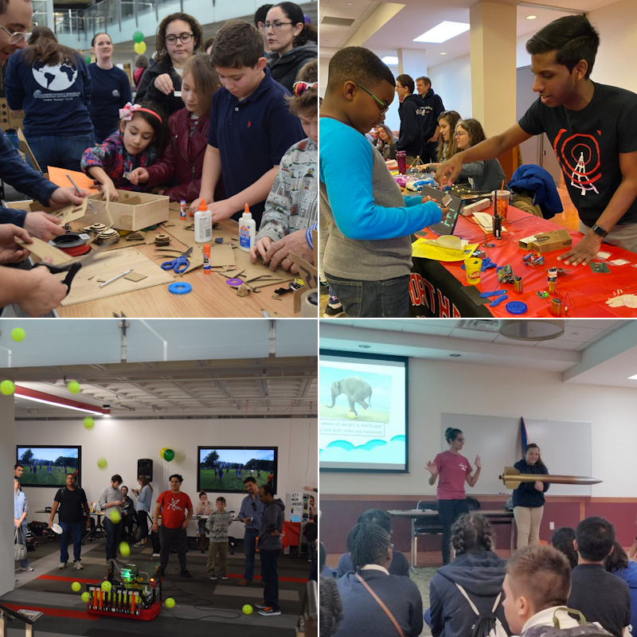
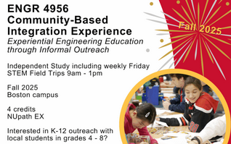
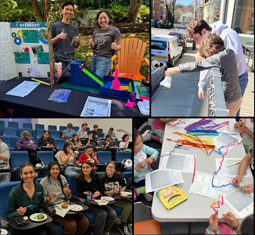
Engaging in Outreach – Collaboration w/ CfSE
The Center for STEM Education can help your organization engage in outreach in a plethora of ways: 1. Helps your organization run its own outreach events 2. Your organization engages in CfSE-led outreach events 3. ENGR 4956 – ELO class focused on outreach 4. Collaboration with STEMout

Slide 7
Engaging in Outreach – Collaboration w/ CfSE
1. The Center helps your organization run its own events. We can help with:
identification of partner schools, teachers, or other groups looking for outreach
curriculum content development / refinement
reserving space on campus
advertising for your outreach events (to our affiliated teachers, students, school districts)
recruitment of volunteers to help run your events
training of membership to support your outreach initiatives
help with required paperwork
Northeastern Outreach Database:
https://docs.google.com/spreadsheets/d/1x3qTPKGW21vDAT_AY7wXIg3C8xCboTgiZ2LrKNJVskc/edit?usp=sharing
Collecting:
• club outreach coordinator info • outreach being done by clubs

Slide 8
Engaging in Outreach – Collaboration w/ CfSE
2. Your organization engages in CfSE-led events:
STEM Field Trips: Fridays on-campus
Reverse Field Trips: Tuesdays/Wednesdays at schools around the city
BPS STEM Fair (March 7)
Engineering for Everyone Expo (February 20)

Slide 9
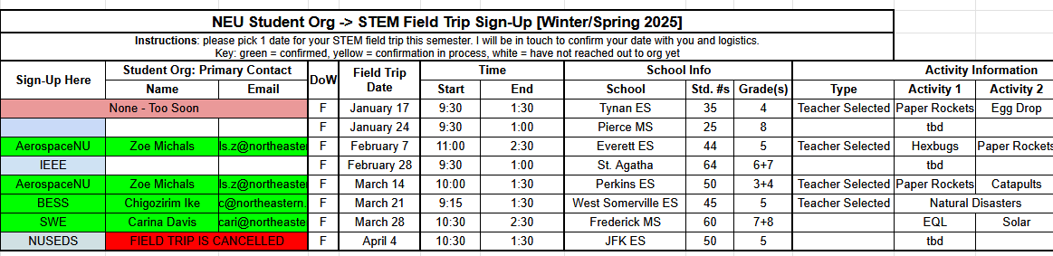
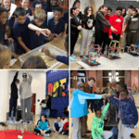
STEM Field Trip Series
Most Fridays during the academic school year (September-April), we invite 30-60 x 4th-8th grade students to campus for a day of hands-on engineering and science activities. These take place on campus (in Curry Student Center and Cabral Center) and typically run 9:30am – 1:30pm. Student organizations can come to these and help run existing activities, or if student groups have come up with their own outreach activity, run that for visiting students. We typically look for 2-5 student org volunteers to help for these days.
To sign up for this, please visit this sign-up sheet and pick 1 date for your STEM field trip this semester (due to large interest, we can only provide 1 date/semester). Write down your org name and info in columns B,C,D and I will be in touch to confirm your date with you and follow-up logistics. If a group has already picked a date, please don’t write over them (document is set to public edit access). Some field trips we have selected our topics already, so some dates may be more fitting for certain student groups (ex: 9/26 or 10/10 are good fits for ASME, 10/17 is good for ASCE, 10/3 or 11/7 are good for IEEE or ReNU. Dates we have not finalized activities for, we are more flexible and can work with new student organizations or org-created activities.

Slide 10
Reverse STEM field trips
These are similar to our STEM Field Trip series, but instead we will be going TO schools, visiting classrooms during the school day. There are 9 dates selected for the academic year. Registration for these events are on the same sign-up sheet as for regular field trips.
October 8 (W) -> BTU Pilot School -> Topic: Environmental Engineering (Pollution & Water Filters) October 28 (Tu) -> Mason Elementary School -> Topic: TBD December 2 (Tu) -> school TBD -> Topic: TBD January 13 (Tu) -> school TBD -> Topic: TBD January 27 (Tu) -> school TBD -> Topic: TBD February 10 (Tu) -> school TBD -> Topic: TBD March 11 (W) -> school TBD -> Topic: TBD March 24 (Tu) -> school TBD -> Topic: TBD April 1 (W) -> school TBD -> Topic: TBD

Slide 11
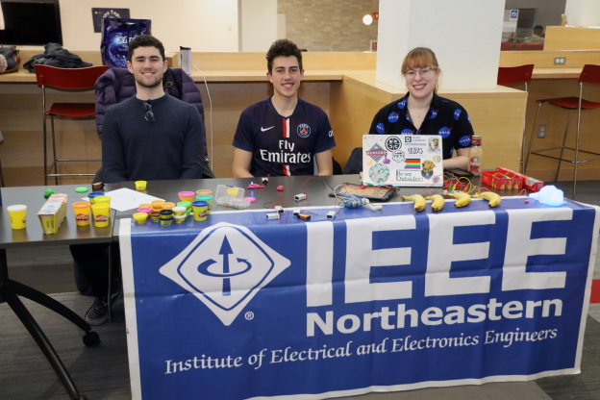
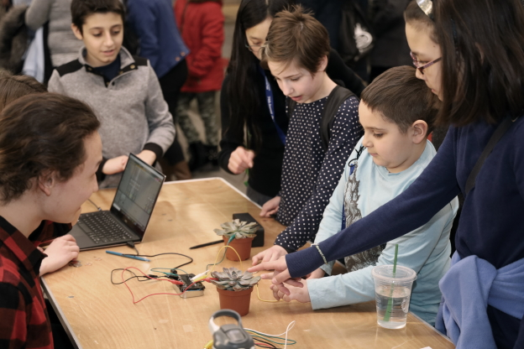
BPS STEM Fair – March 7
Each year, the Boston Public Schools organizes the BPS STEM Fair, in which ~250 middle and high school students showcase their science/engineering fair projects. During this fair, from 12:30-2:30pm, STEM organizations take part in a “STEM Expo”, in which students rotate through to take part in hands-on 5-minute STEM activities. The fair takes place at Reggie Lewis Center, a 10-minute walk from campus. Student orgs typically bring 2-5 volunteers. If you are interested, please register in advance (hard cap of 25 organizations, and this expo is also open to non-NEU organizations): https://www.surveymonkey.com/r/bps-scifair26-expo
Past Participants: AIAA, AIChE, ASCE, IEEE, IGH, SASE, SEDS, NUsound, STEMout, SWE, Wireless Club
Note: this is Saturday during NEU spring break
NUsound
https://stem.northeastern.edu/programs/ayp/fair/expo/

Slide 12
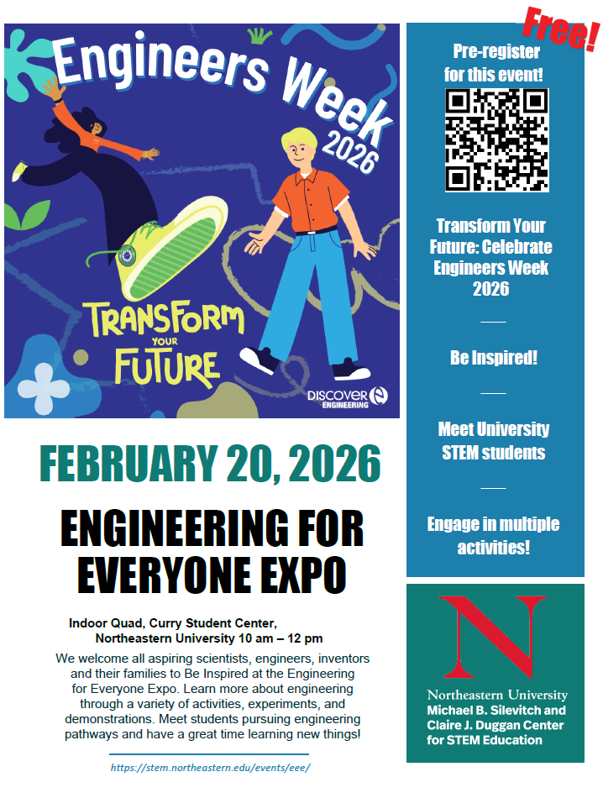
Engineering for Everyone Expo
To celebrate National Engineers Week, we invite the public to participate in hands-on STEM activities hosted exclusively by NEU student groups. Typical attendance is parents and students in grades 1-8, with ~300 attendees We are looking for student orgs interested in participating in this, register here:
https://www.surveymonkey.com/r/EEE2026-ORGREG
Friday, February 20, 2026 Curry Student Center, Indoor Quad 10:00am – 12:00pm
Past Participants: AerospaceNU – Balloon Rockets AIChE – Hot Diggity Dye ASCE – Mechanically Stabilized Earth BESS – Sparkfun Circuits GWISE – Skeletal Hands IEEE – Play-Doh Circuits & Lemon Battery
NU Brain Lab – Build a Brain Hat NUCLEUS – Brain Games NUSEDS – SUITS Designs NUsound: Fruit Instruments SWE – Penny Boats TPEC – Build a Rollercoaster
https://stem.northeastern.edu/events/eee/

Slide 13
Engaging in Outreach – Collaboration w/ CfSE
1. The Center helps your organization run its own events. We can help with:
identification of partner schools, teachers, or other groups looking for outreach
curriculum content development / refinement
reserving space on campus
advertising for your outreach events
training of membership to support your outreach initiatives
help with required paperwork
recruitment of volunteers to help run your events
2. Your organization engages in CfSE-led events:
STEM Field Trips: Fridays on-campus
Reverse Field Trips: Tuesdays/Wednesdays at schools around the city
BPS STEM Fair (March 7)
Engineering for Everyone Expo (February 20)
3. ENGR 4956
4. Collaboration with STEMout

Slide 14
ENGR 4956: Community-Based Integration Experience
This Experiential Learning Opportunity (ELO) course will explore the field of informal STEM education, a field of science and engineering education outside the formal school & classroom environments. This ELO is designed for Northeastern undergraduate and graduate students, especially those in any STEM major or minor. Enrolled students will explore opportunities to learn about science and engineering principles, frameworks relevant to informal STEM education in K-12 outreach programs, experiential learning theories (Kolb, 1984), curriculum frameworks for K-12 science & engineering education (Next Generation Science Standards and state-specific science, engineering, technology and digital literacy standards), STEM lesson development and delivery with a focus on place-based community needs, student learning assessment tools, and program evaluation. Course is 4 credits and is taught by Professor Jennifer Love. (full for Fall 2025, open for Winter 2026)

Slide 15

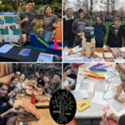
Collaboration with STEMOut
STEMout is an NEU club for students who want to design STEM outreach content or volunteer for outreach efforts in the Boston community (CfSE focuses on on-campus outreach, STEMout focuses on off-campus outreach). STEMout currently has two programs: Curley Afterschool Program (at Curley K-8 School) and Saturday Library Program in Jamaica Plain (Saturdays 11:00-12:30), potentially expanding to more schools/libraries this year. To learn more, consider attending STEMout meetings or email neustemout@gmail.com

