Slide 1
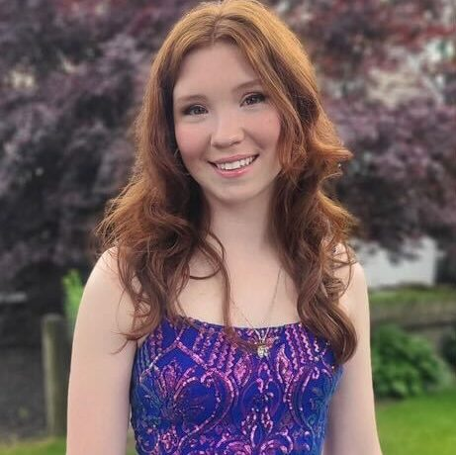
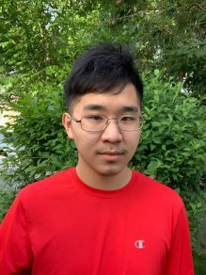
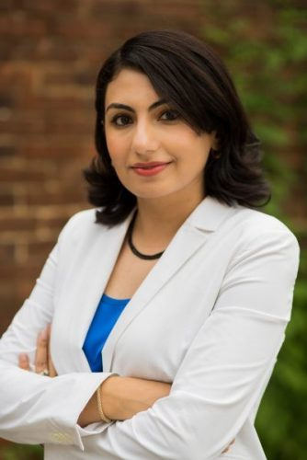
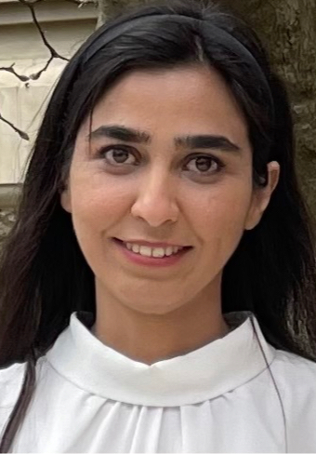
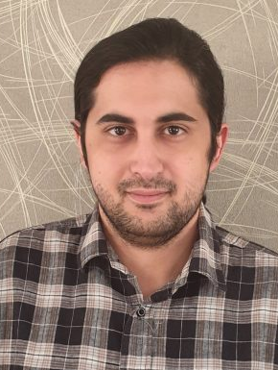
Computer Vision and Its Applications in Infant Health Monitoring
Presenters
Victoria Berry, YSP Student, North Quincy High School
Franklin Chen, YSP Student, North Quincy High School
Advising Team
Professor Sarah Ostadabbas, Electrical and Computer Engineering, Northeastern University
Elaheh Hatami, EAI Post-Doc, Northeastern University
Pooria Daneshvar Kakhaki, PhD Student, Northeastern University
NEU Young Scholars Program 2023 - August 3, 2023

Slide 2
Abstract
Research Objective
This research focuses on developing a monitoring device able to provide developmental screenings and detect motor abnormalities in infants using computer vision and machine learning.
Our Goal
Our goal is to collect and process data for the development of machine learning and computer vision based algorithm used to assess infant health and detect abnormalities in motor function.
Motivation
Delayed screening for neurodevelopmental delays can severely impact children who are at risk and cause them to not receive the proper care and support they need.
Results
Data was extracted from raw footage of infants and was analyzed. The data were formatted so that the machine learning and computer vision algorithms would be able to process it.
NEU Young Scholars Program 2023 - August 3, 2023

Slide 3
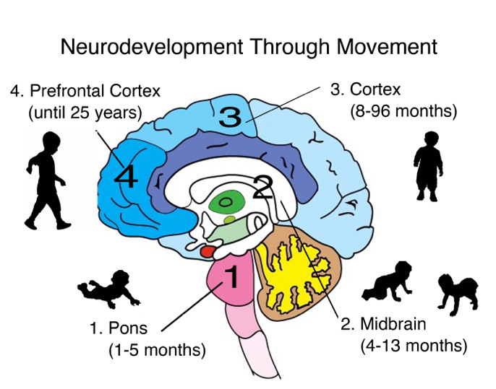
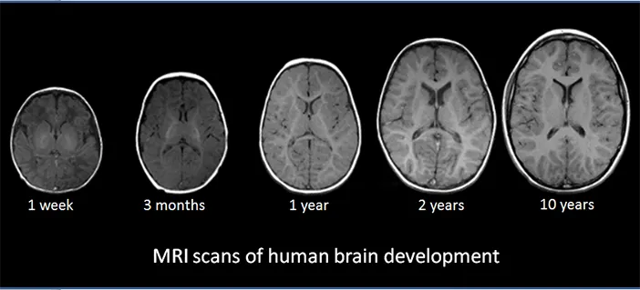
Background: Neurodevelopment
Neurodevelopment refers to the development and organization of the central nervous system and its functions, which also determines the functional abilities of a child later in life.
Major developmental milestones are reached during the first few years of a child's life, such as developing gross motor skills, language abilities, and problem solving skills—all skills that influence each other.
Figure 2: Stages of Brain Region Development
Approximately 7% of children in the US are affected by neurodevelopmental delays, and only about a third of children under the age of five receive recommended developmental screenings.
Figure 1: MRI Scans of Human Brain Growth Throughout Childhood
NEU Young Scholars Program 2023 - August 3, 2023

Slide 4
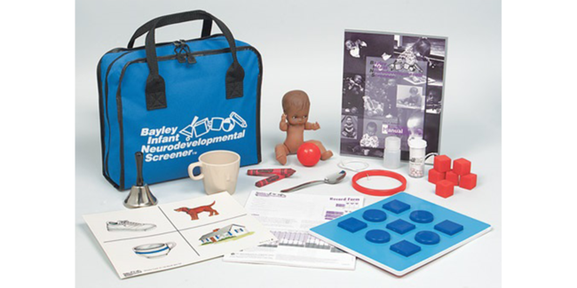
Background: NDDs
NDD Examples
Congenital torticollis
Autism spectrum disorder
Cerebral palsy
Figure 3: Typical Children Social Behavior
Neurodevelopmental delays (NDDs) can occur at any time during the early developmental stage to around five years old and persist their entire life.
Delayed NDD screenings can impact infants and children who are at risk and cause them to not receive proper support in time and have more difficulties in social interactions, academics, and other long-term developments.
Figure 4: Neurodevelopment Screening Kit
NEU Young Scholars Program 2023 - August 3, 2023

Slide 5
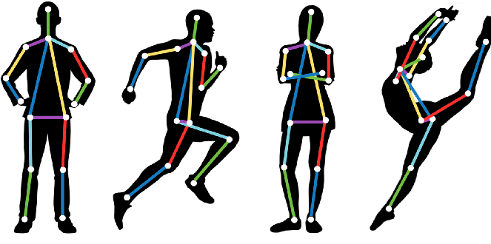
Background: Pose Estimation
Pose estimation is a part of computer vision that focuses on detecting the position and orientation of a person or an object.
This can be done by locating key points on a human, such as hands, elbows, and fingers.
With pose estimation, computer vision machine learning models can more easily annotate, track, and estimate movement patterns for people and objects.
Figure 5: 2-Dimentional Pose Estimation Examples
NEU Young Scholars Program 2023 - August 3, 2023

Slide 6
Workflow Pipeline
Video
Annotate
Clips
Analysis
Images
Pose and Joint Coordinates
NEU Young Scholars Program 2023 - August 3, 2023

Slide 7
Data Collection: Video Data
3–5 second clips extracted from raw home videos displaying infants interacting with their environment.
Motor Functions: Holding, Grabbing, Reaching, etc.
Creates a CNN-LSTM (long short-term memory network)
NEU Young Scholars Program 2023 - August 3, 2023

Slide 8
Data Collection: Video Data (Cont.)
NEU Young Scholars Program 2023 - August 3, 2023

Slide 9
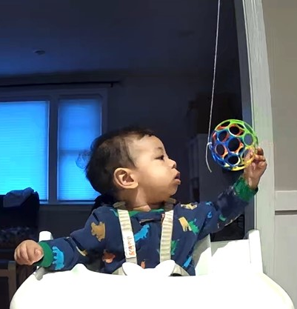
Data Collection: Image Data
Images of infants during peak action were taken and run through MediaPipe Pose, which estimated the joint coordinates and pose onto the images as low-dimensional pose and body landmark representations.
NEU Young Scholars Program 2023 - August 3, 2023

Slide 10
Data Collection: Image Data (Cont.)
NEU Young Scholars Program 2023 - August 3, 2023

Slide 11
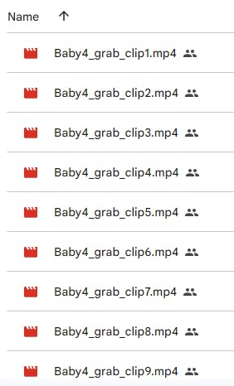
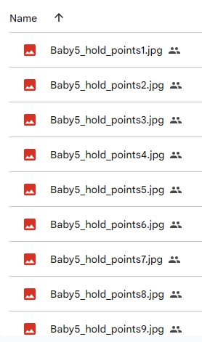
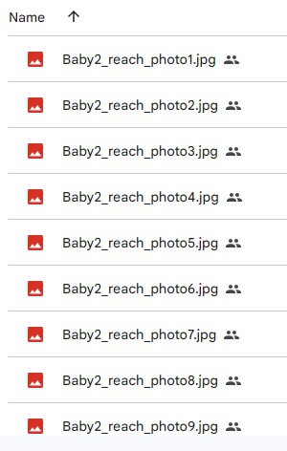
File Naming Conventions
Video clips, images, and other data were organized and labelled using a specific file naming conventions to be readable by the researchers, as well as the machine learning models.
NEU Young Scholars Program 2023 - August 3, 2023

Slide 12
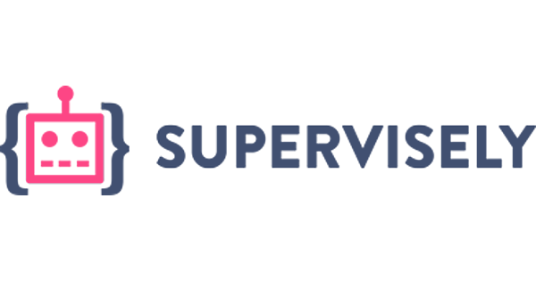
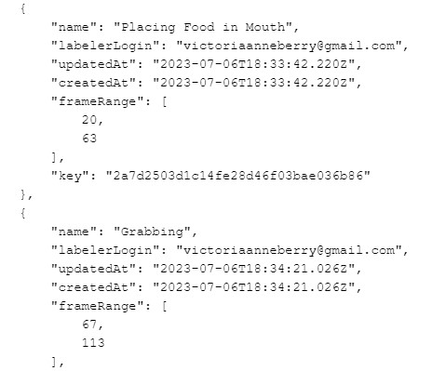
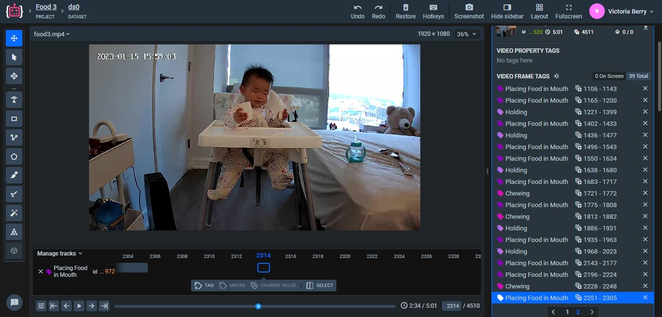
Data Collection: Annotation
Supervisely: A computer vision and machine learning platform that was used to annotate the raw home videos
The specific time frames for the different motor functions displayed were tagged to help the machine learning models understand the data.
NEU Young Scholars Program 2023 - August 3, 2023

Slide 13
Data Tables
Clip Title | Baby | Hand | Ball | Comment
Baby2_reach_clip1 | Infant 2 | Left | Left
Baby2_reach_clip2 | Infant 2 | Left | Left
Baby2_reach_clip3 | Infant 2 | Left | Left
Baby2_reach_clip4 | Infant 2 | Both | Both | Ball was swinging from side to side, baby extended left arm more than right arm
Baby2_reach_clip5 | Infant 2 | Left | Left | Ball was swinging a little and went over baby's head
Baby2_reach_clip6 | Infant 2 | Left | Left | Used left arm at first but raised right arm a little
Baby2_reach_clip7 | Infant 2 | Left | Left | Right arm was out to the side at first
Baby2_reach_clip8 | Infant 2 | Both | Left | Right arm went from being up to being to the side
Baby3_reach_clip1 | Infant 3 | Right | Right
Baby3_reach_clip2 | Infant 3 | Right | Center | Ball was in front of baby's face
Baby3_reach_clip3 | Infant 3 | Right | Center | Ball was in front of baby's face at first, then moved to the left, baby raised left arm
Baby3_reach_clip4 | Infant 3 | Left | Left | Ball was swinging on the left side, baby raised right hand a little
Baby3_reach_clip5 | Infant 3 | Both | Left | Left hand was higher than right hand
Baby3_reach_clip6 | Infant 3 | Both | Left | Ball was swinging a little, left hand higher than right hand
Baby3_reach_clip7 | Infant 3 | Both | Right | Baby was using right hand more, but both arms were up
Baby3_reach_clip8 | Infant 3 | Both | Right | Baby was using right hand more, but both arms were up
Each infant’s movements while performing different actions were examined, such as the hand used when interacting with the ball and the ball’s relative position.
These newly collected data assist researchers and the artificial intelligence to become familiar with infant motor patterns and detect irregular behaviors.
NEU Young Scholars Program 2023 - August 3, 2023

Slide 14
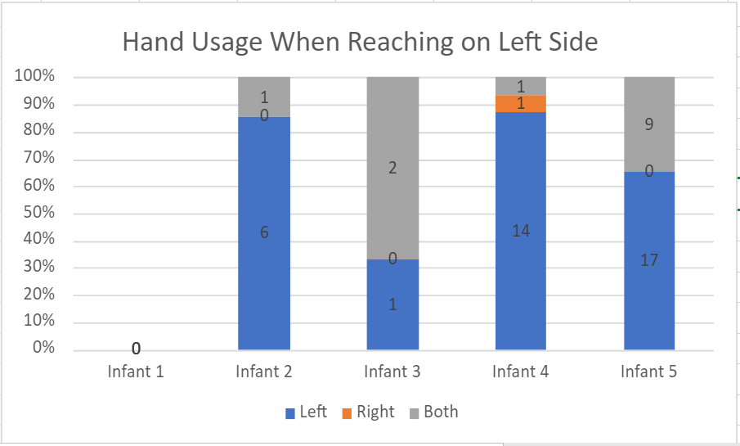
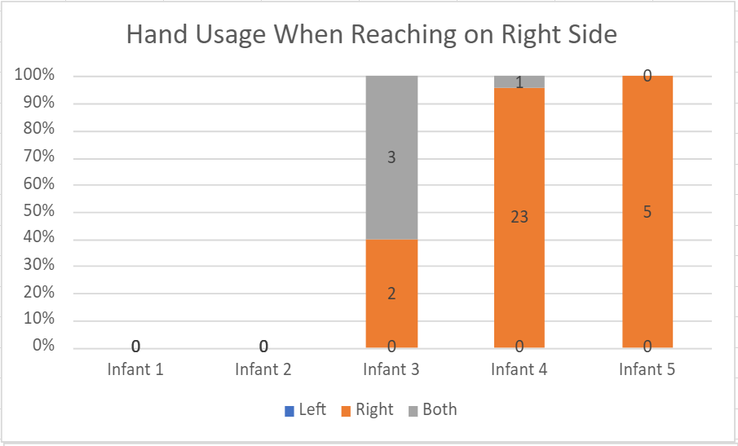
Graphs: Reaching
NEU Young Scholars Program 2023 - August 3, 2023

Slide 15
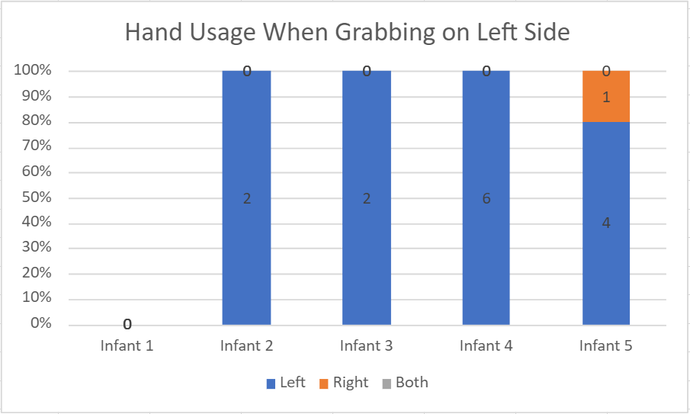
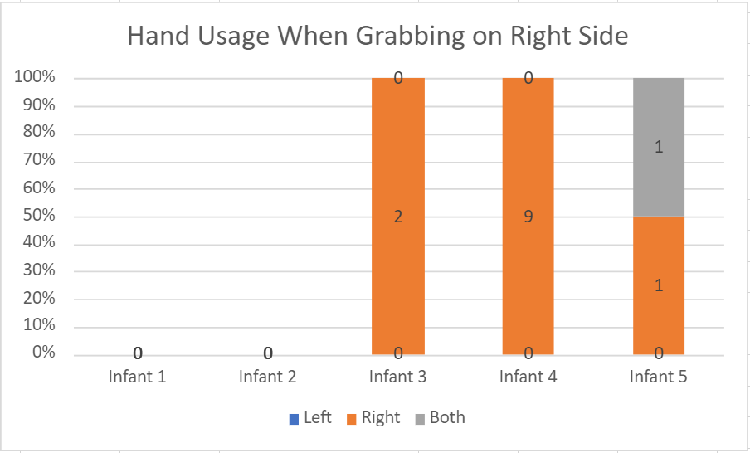
Graphs: Grabbing
NEU Young Scholars Program 2023 - August 3, 2023

Slide 16
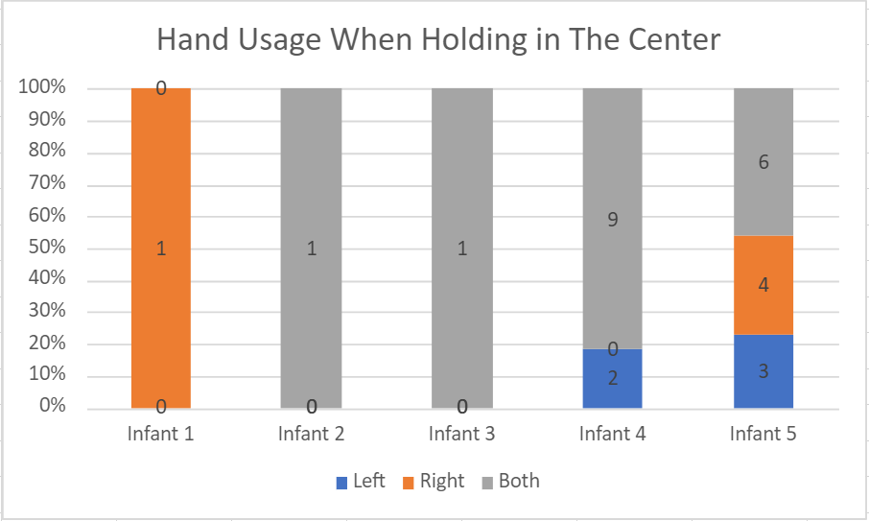
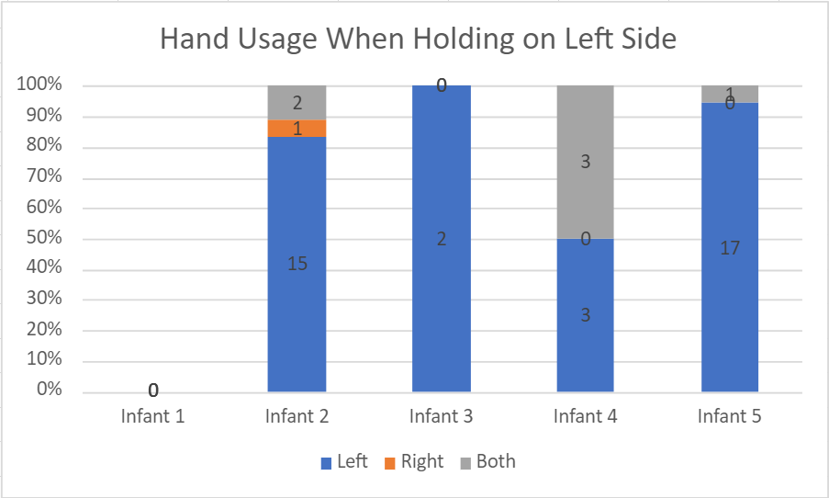
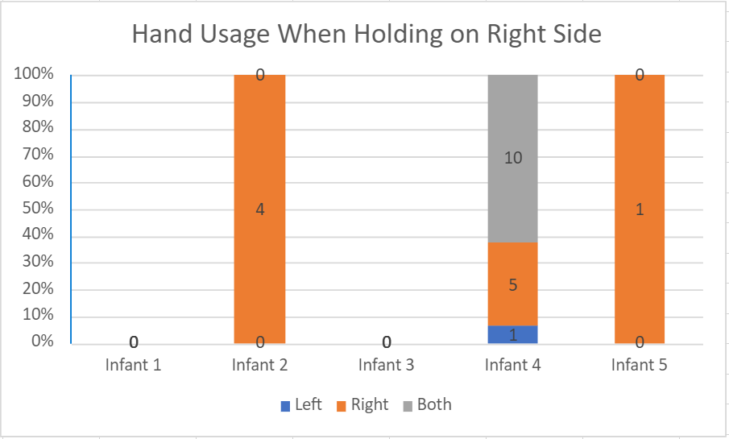
Graphs: Holding
NEU Young Scholars Program 2023 - August 3, 2023

Slide 17
Conclusion and Future Steps
Conclusion
The graphs displayed tendencies of the infants and the percentage of times the infants used each appendage while interacting with the plastic ball. More data, along with further processing and analysis, are required to draw more conclusive results about the infants' health and to develop the monitoring device.
Future Steps
The video clips and other data collected will undergo further processing and be used by researchers to fed to train the machine learning and computer vision algorithms.
Researchers will reach out to more parents to collect raw home footage and data.
In the future, the infants will be checked if they're diagnosed with neurodevelopmental delay and data will be adjusted.
The developed programs will be implemented into the monitoring device.
NEU Young Scholars Program 2023 - August 3, 2023
Notes:
Put the joint pose video as an example of future work here

Slide 18
Resources
1.) United States Environmental Protection Agency. (2019, August). America’s Children and the Environment | Third Edition. United States Environmental Protection Agency. https://www.epa.gov/system/files/documents/2022-04/ace3-neurodevelopmental-updates_0.pdf
2.) Villagomez, A. N., Muñoz, F. M., Peterson, R. L., Colbert, A. M., Gladstone, M., MacDonald, B., Wilson, R., Fairlie, L., Gerner, G. J., Patterson, J., Boghossian, N. S., Burton, V. J., Cortés, M., Katikaneni, L. D., Larson, J. C. G., Angulo, A. S., Joshi, J., Nesin, M., Padula, M. A., … Brighton Collaboration Neurodevelopmental Delay Working Group. (2019, December 10). Neurodevelopmental Delay: Case definition & guidelines for data collection, analysis, and presentation of Immunization Safety Data. Vaccine. https://www.ncbi.nlm.nih.gov/pmc/articles/PMC6899448/
3.) New Oxford Neurodevelopment Consortium. (2017, January 13). Haiku. https://www.ndcn.ox.ac.uk/news/new-oxford-neurodevelopment-consortium
4.) Brain Development - Neuro Clinic. (2021, January 20). Neuro Clinic. https://neuroclinicbarrie.com/neurodevelopment/brain-development/
5.) Ostadabbas, S. (2023). An overview of one of our research at the Augmented Cognition Lab at Northeastern University. YouTube. YouTube. Retrieved July 18, 2023, from https://www.youtube.com/watch?v=_1ZlxC4Q65I
6.) Admin. (2019). Treating Children with Global Developmental Delay. Nurture Pods Pte Ltd. https://www.nurturepods.com/treating-children-with-global-developmental-delay/
7.) Brighton Center for Pediatric Neurodevelopment. (n.d.). What is Neurodevelopment?. Brighton Center for Pediatric Neurodevelopment. https://www.bcpn.org/what-is-neurodevelopment-.html
8.) Bayley Infant Neurodevelopmental Screener. (n.d.). https://www.pearsonassessments.com/store/usassessments/en/Store/Professional-Assessments/Cognition-%26-Neuro/Bayley-Infant-Neurodevelopmental-Screener/p/100000163.html
9.) Papers with Code - Pose Estimation. (n.d.). https://paperswithcode.com/task/pose-estimation
10.) Walia, M. S. (2022). A comprehensive guide on human pose estimation. Analytics Vidhya. https://www.analyticsvidhya.com/blog/2022/01/a-comprehensive-guide-on-human-pose-estimation/
NEU Young Scholars Program 2023 - August 3, 2023

Slide 19
Acknowledgements
Center for STEM Education
Claire Duggan, Executive Director
Jennifer Love, Associate Director
Claire Stipp and Yassine Souabny, YSP Coordinators
Nicolas Fuchs, Program Manager
Mary Howley, Administrative Officer
Augmented Cognition Lab (ACLab)
Professor Sarah Ostadabbas, Electrical and Computer Engineering, Northeastern University
Elaheh Hatami, EAI Post-Doc, Northeastern University
Pooria Daneshvar Kakhaki, PhD Student, Northeastern University
Muskan Kumar, REU Student, Massachusetts Bay Community College
NEU Young Scholars Program 2023 - August 3, 2023

Slide 20
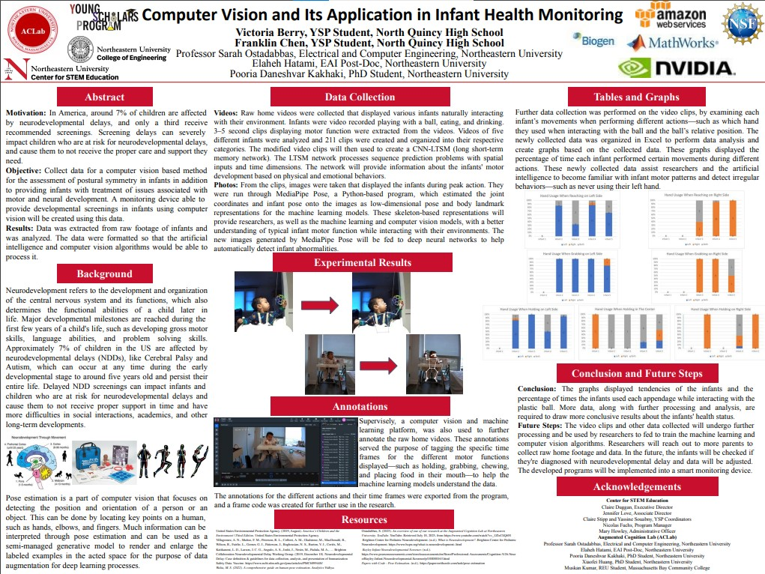
NEU Young Scholars Program 2023 - August 3, 2023

