Slide 1
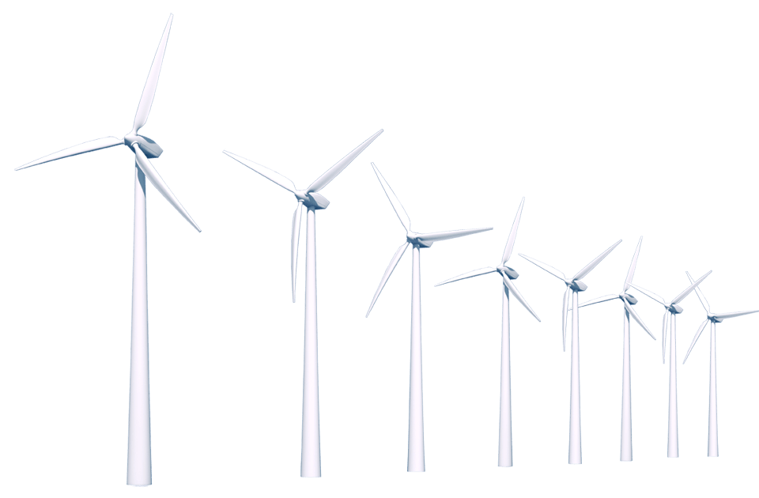
Wind Energy

Slide 2
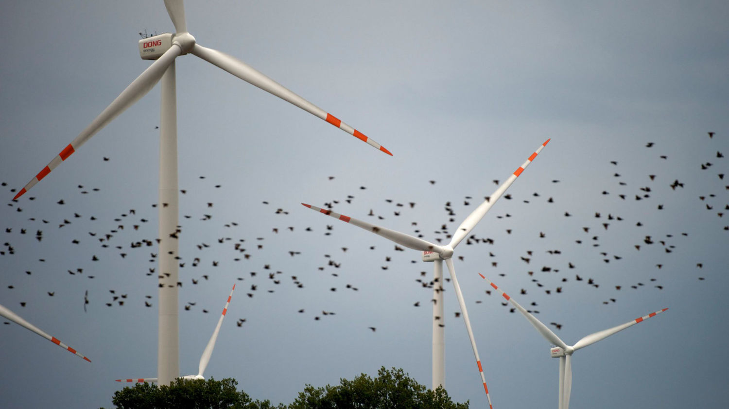
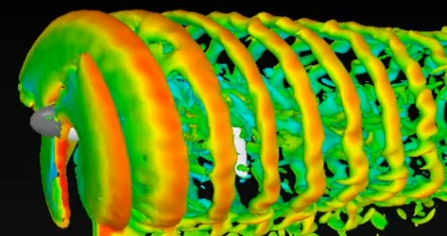
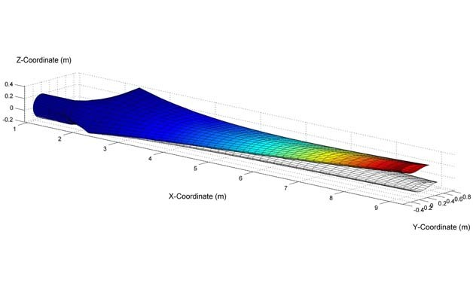
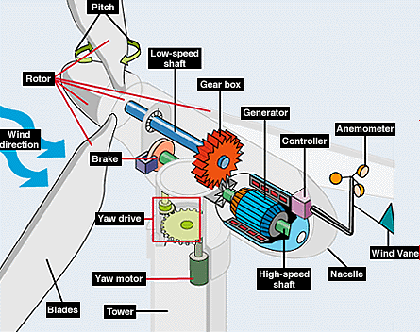
Today we are …
Environmental / Mechanical Engineers
Notes:
Connection between Paper Towers and Wind Turbines -> what goes into building a wind mill?

Slide 3
Review
What do we already know about energy?
What is energy?
Notes:
Who can give us a definition of "ENERGY"?

Slide 4
Think About This:
When we move around, we are using up ENERGY from our bodies.
If we move around too much,
eventually we will run out of energy!

Slide 5
Think About This:
What sources do human (bodies) get energy from?
How do we use this energy?
Food contains stored chemical energy
The body uses this energy to:
• Move (mechanical energy)
• Generate Heat (thermal energy) • Other bodily processes (the things that keep us alive)
Notes:
The oxygen in the air you breath helps the body break down sugar in a process known as cellular respiration. Oxygen is also a critical component in the molecules that make up your body.
Water itself does not provide energy to the body but instead helps keep you hydrated and regulates your body temperature which enables your body to derive energy from the food you eat.

Slide 6
Forms of Energy
There are 4 main FORMS of ENERGY:
electrical
mechanical
(kinetic)
thermal
chemical
power outlets moving cars hot water batteries
There are also other forms: ex: gravitational or sound (14 total known)
Notes:
Energy is divided into different forms or types of energy based on how it is created and/or used. There are 4 main forms of energy/

Slide 7
Sources of Energy
There are a variety of SOURCES of energy!
List as many as you can think of:
Notes:
Wind, Water, Sun, Gasoline, Natural Gas, etc

Slide 8
Today, we will be working with wind turbines!

Slide 9
Wind Turbines
Wind turbines convert what kind of energy to what kind of energy?
Mechanical Energy (energy of moving air)
Electrical Energy
(electrical energy)
→

Slide 10
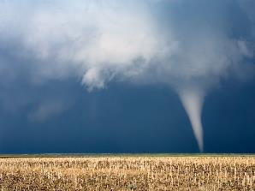
What do we (humans) use wind for?
What else is the wind for?

Slide 11
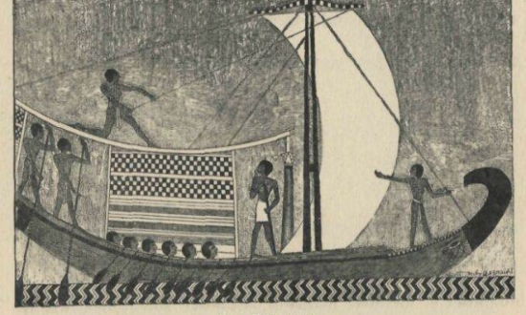
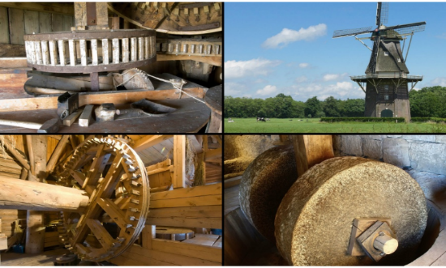
History of Wind Power
Egyptian Sailboats
Agricultural Windmills
First use of wind power: 5000 years ago!
Wind powered ”mills” (“grind”)
Used to crush grains into flour

Slide 12
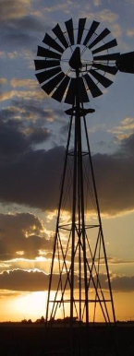
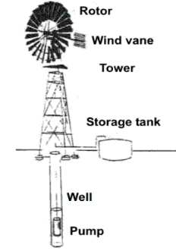
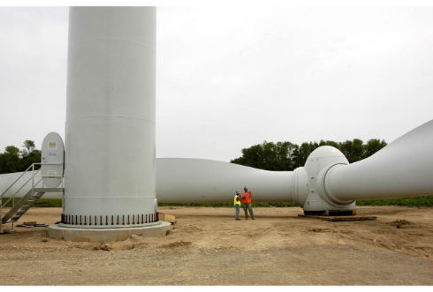
History of Wind Power (Continued)
Windpumps
Modern Wind Turbine
Windmills that move and pump water
Windmills that generate energy

Slide 13
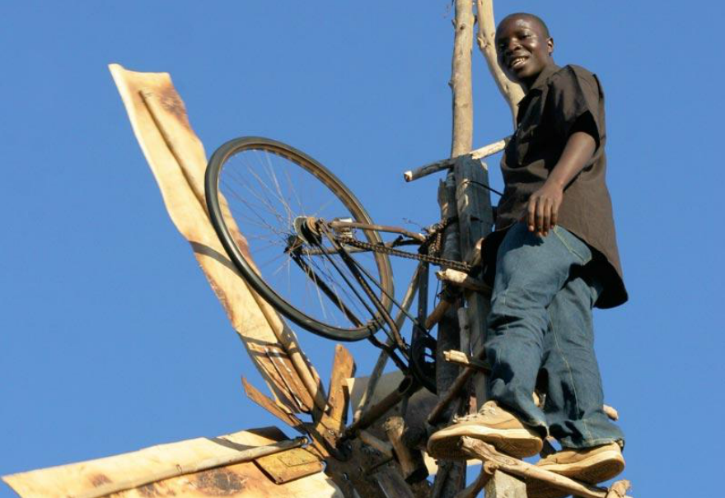
The Boy Who Harnessed the Wind
How I Built a Windmill (4m Video)
William Kamkwamba
How I Harnessed the Wind (6m Video)
In 2014, William received his Bachelor of Arts in Environmental Studies from Dartmouth College.
Besides the windmills, he has also run a biogas digester project in Kasungu, Malawai, which generates gas through cow dung.
In addition, he has helped expand the school in his hometown, with solar panel installations to allow students to study late at night.

Slide 14
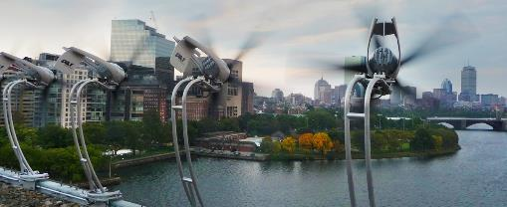
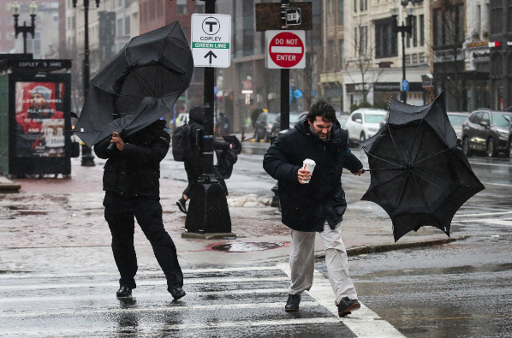
You may have heard Chicago called “the Windy City”. In Chicago, the average wind speed is 10.3mph
Boston is even windier! On average, Boston’s wind speed is 12.4mph

Slide 15
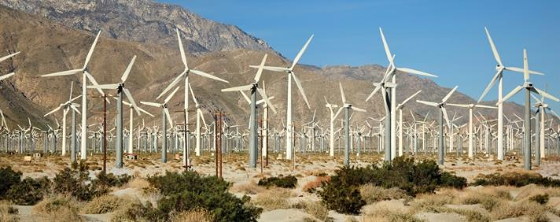
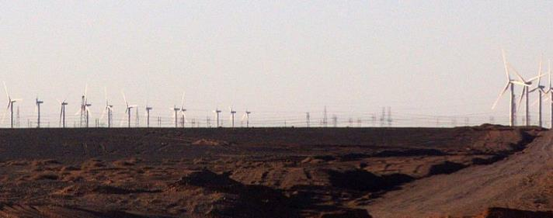
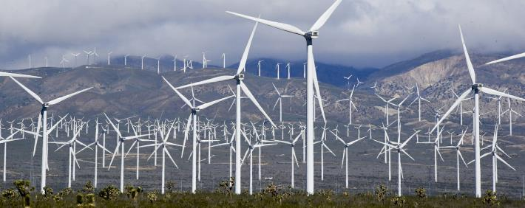
Sense of Scale
Individual wind turbines do not provide much energy by themselves (~1.5 MW each, or ≈ 15 car engines) Commercial wind "farms" therefore are VERY large!
Largest in USA = Alta Wind Energy Center [California] = 600 Wind Turbines
Largest in World = Gansu Wind Farm [China] = 7000 Wind Turbines

Slide 16
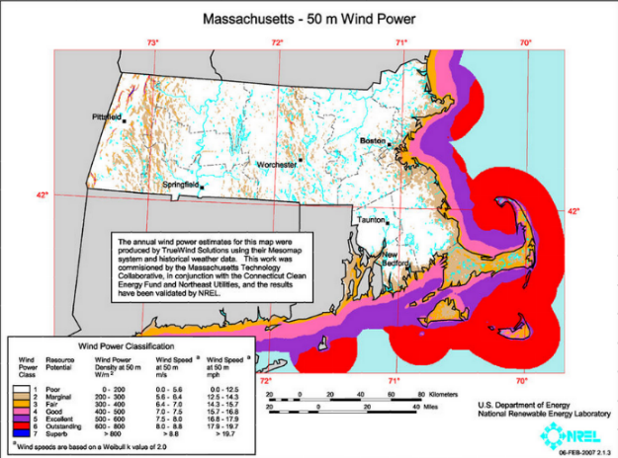
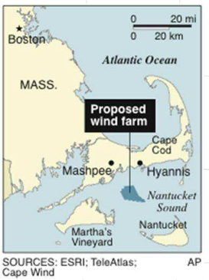
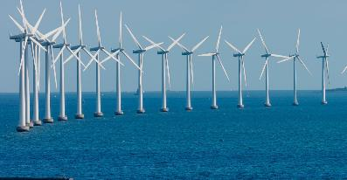
Cape Wind
Cape Wind was a proposed wind farm (130 turbines) off Cape Cod which was approved, but due to various setbacks fell apart in 2017 and is now defunct.

Slide 17
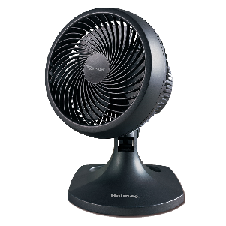
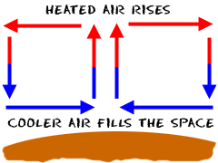
What is Wind?
How is wind formed?
HOT air weighs less than COLD air, so the hot air rises and the cold air sinks!
When the warm air rises, the
cool air moves in to take its place!
Wind is the air in motion! Just as a fan moves air, the Earth has a natural movement of air
in the atmosphere.

Slide 18
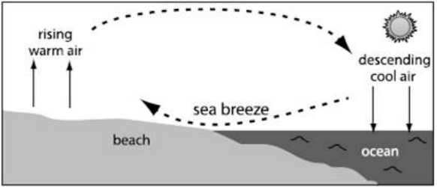
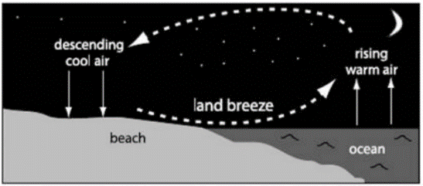
What is Wind?
During the day, LAND (soil on earth's surface) heats up FASTER than the WATER (oceans and lakes).
At night, the ocean stores the heat of the sun and the land cools down faster.

Slide 19
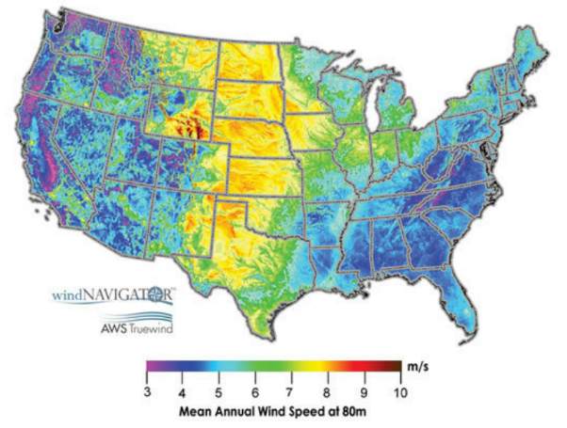
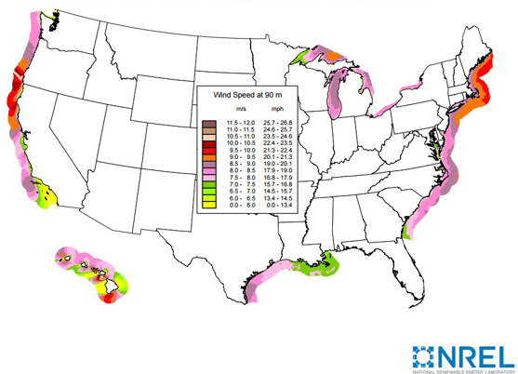
Windiness
Due to a variety of factors (sunlight impact, topography, oceans, cities, etc.), some parts of the country are windier than others.
USA – Annual Average Land Wind Speed at 80m (off the ground)
USA – Annual Average Offshore Wind Speed at 90m (off the ground)

Slide 20
Windy City
You may have heard Chicago called “the Windy City”. In Chicago, the average wind speed is 10.3mph
Boston is even windier! On average, Boston’s wind speed is 12.4mph

Slide 21
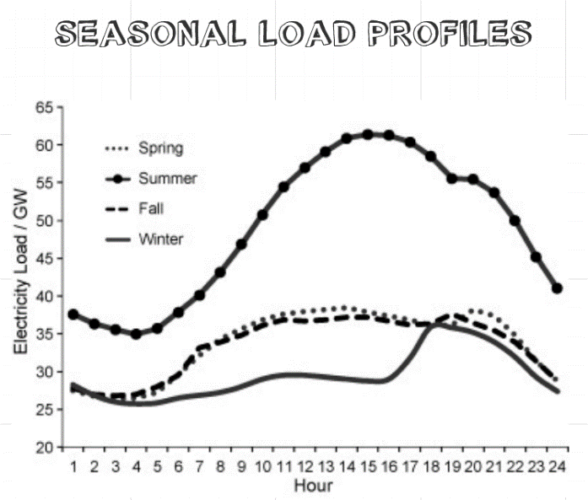
Wind Energy Use

Slide 22
Capturing Wind Energy

Slide 23
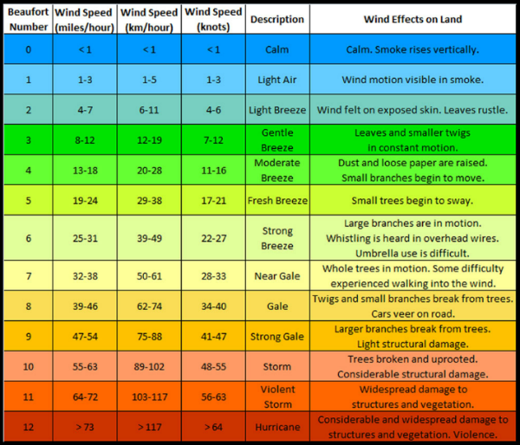
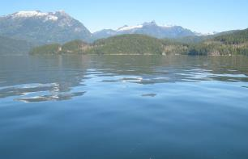
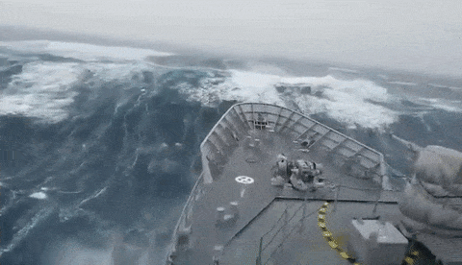
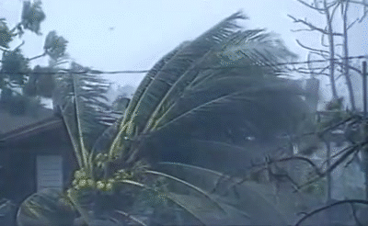
Wind Speed Scale
Beaufort wind force scale This scale relates the wind speed to observed conditions at sea or on land (i.e. what effect the wind is having on things)
Force 0
Force 12

Slide 24
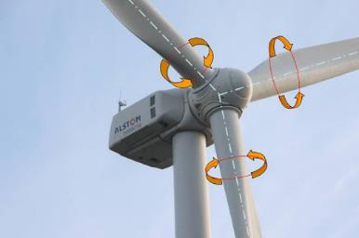
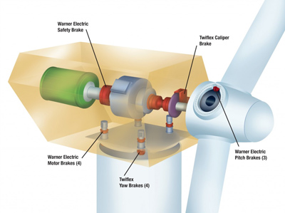
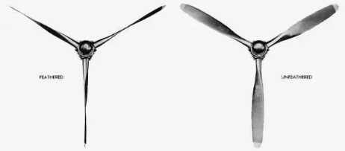
What do Wind Turbines do in High Winds?
Rotate the blades’ pitch into the wind, keeping them from spinning (called “feathering”)
Brakes to slow the rotation of the blades

Slide 25
What do Wind Turbines do in High Winds?
Brakes to slow the rotation of the blades
Rotate the blades into the wind, keeping them from spinning (called “feathering”)
Or if things go wrong…

Slide 26
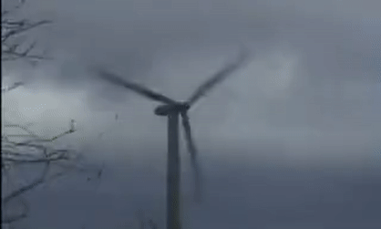
What do Wind Turbines do in High Winds?
Anything above 60 mph is dangerous for wind turbines
Hornslet, Denmark (2008) Wind Turbine collapsed due to brake failure

Slide 27
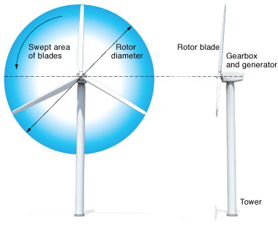
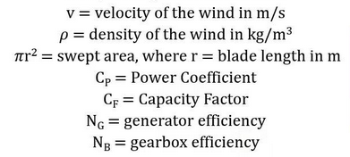
Energy in the Wind
Kinetic Energy = (M = Mass, V = Velocity)
Wind Power = (it’s complicated!)
The length of the blade is very important! With 15mph wind, a wind turbine with blades 1 meter in diameter captures just 48 watts of energy (a typical lightbulb is 60 watts)

Slide 28
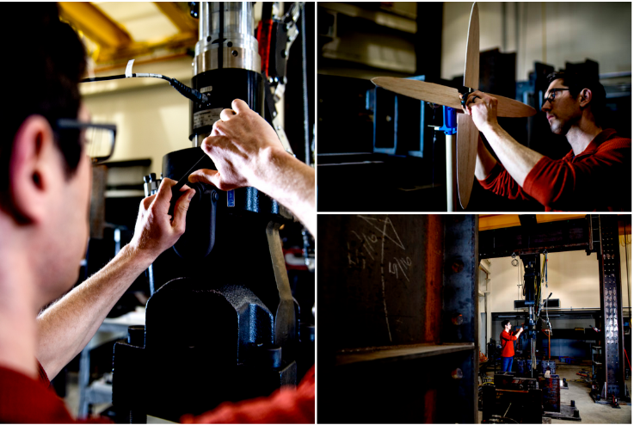
Research at Northeastern
Professor Andrew Myers does research with offshore wind structures. He models and experiments with different wind turbine structures and materials. Recently he has been designing a super light wind turbine that floats on the ocean surface (as opposed to current turbines that are anchored to the seafloor).

Slide 29
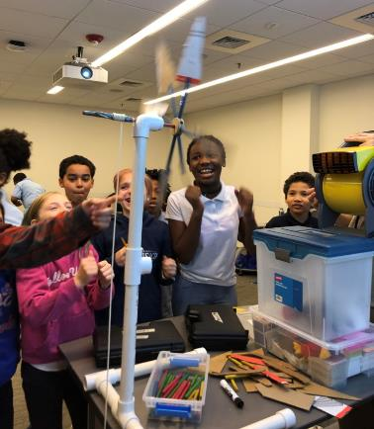
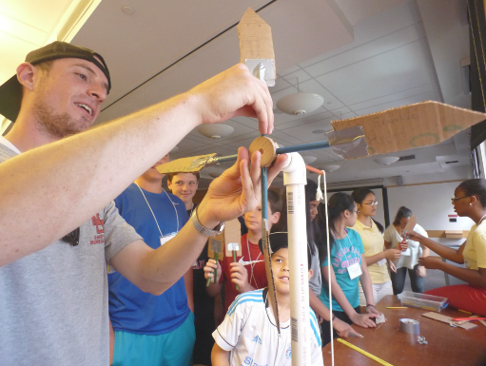
Activity
Today we are going to make our own mini, cardboard wind turbines!

Slide 30
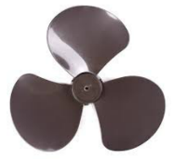
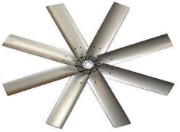
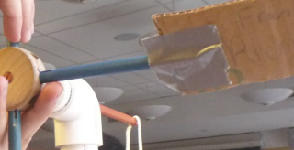
Variables
Five Key Things to Consider:
3. Shape of Blades
1. Number of Blades
• Between 1 and 8 Note: due to the test set-up, odd number of blades cannot be placed symmetrically
2. Size of Blades
• Smaller blades spin faster
• Larger blades have more power, but also more air resistance
4. Radius of Rotor
• Longer arms lift more weight
• Shorter arms spin faster
5. Pitch/Rotation of Blades
Note: blades will be attached to the end of a wooden dowel (the rotor arm), so make sure there is a large enough area for the dowel to attach to

Slide 31
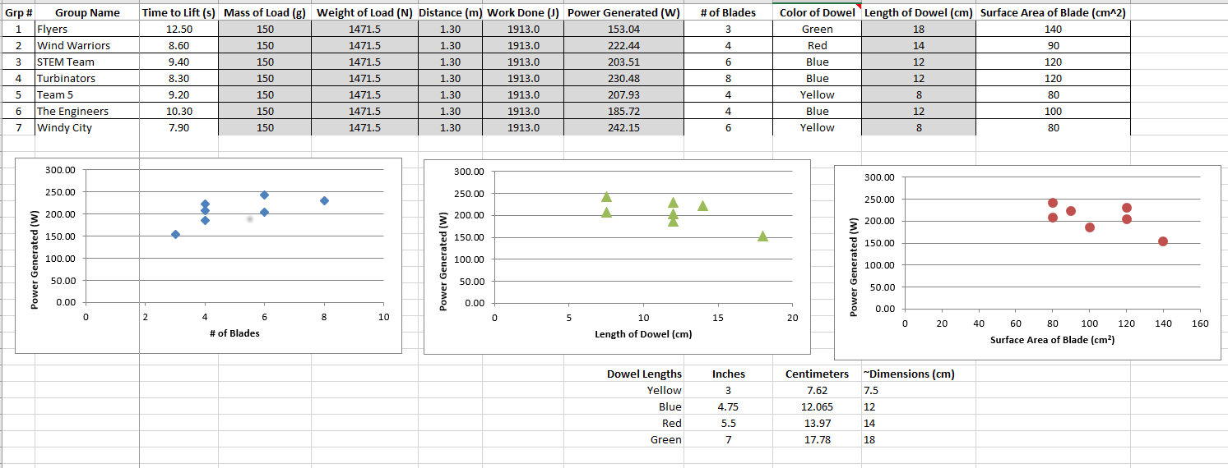
Data Analysis
Spreadsheet
SAMPLE (not real data)

Slide 32
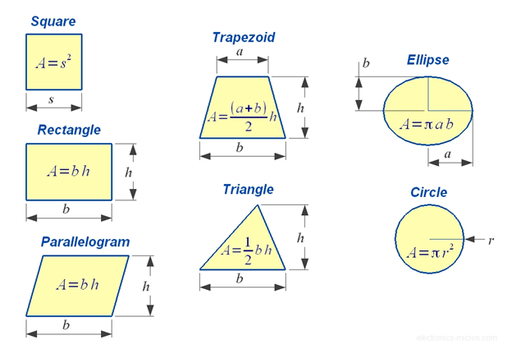
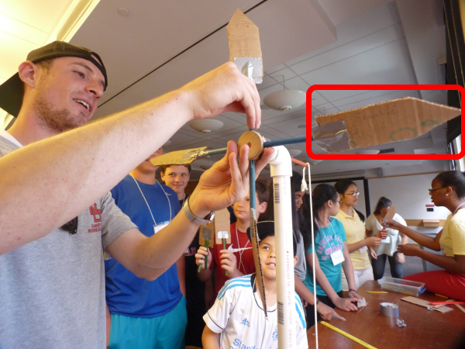
Data Analysis
Blade Surface Area Calculation:
Information we need: - Group Name
Time (s) to Lift - # of Windmill blades - Color of rotor dowel
Surface Area of Windmill Blade
For simplicity, only calculate the front surface of the blade (2D)
This is thus the area of your blade

Slide 33
STEM / College 101 Questions
https://docs.google.com/document/d/1omRfq21CgTunw7rvBLwQfWuJ_CPTd63SKb0q6H9muOg/edit?usp=sharing
What is one thing you wish you knew before entering high school?
What is your favorite class in college?
What is your least favorite class in college?
What is your favorite part about college?
How did you know what classes to take in high school?
How did you choose your future career?
Why did you choose Northeastern?
How can I start preparing for high school?
What do students do for fun? Campus activities, clubs, events, etc? How’s the food in college?
How are the dorms?
What is the best way to meet people or make new friends?
How do you balance schoolwork and home responsibilities?
What is your favorite thing to do in Boston?
What is a major in college?
What jobs can you do with your major?
Is there a lot more homework in high school?
What was your transition like between middle and high school?
Is high school a lot bigger?
What was your favorite part about high school?

Slide 34
Assessment (Exit Ticket)
Please go to Exit Ticket Survey and Complete Students: https://www.surveymonkey.com/r/FT-EXIT-TICKET
Notes:
Thank you very much from the Center for STEM Education at Northeastern. https://www.surveymonkey.com/r/FT-EXIT-TICKET https://www.surveymonkey.com/r/VEXIT2021-T
https://www.surveymonkey.com/r/VEXIT2021-V

