Slide 1
Causal Coupling Inference in Mass Shootings Data
Northeastern University
REU Pathways
Complex Dynamic Systems and Control Laboratory (CDSCL) Lab
Xeon
Student, Computer Science and Mathematics
Acknowledgements
Faculty advisor: Rifat Sipahi
Graduate student: Xu Wang
Research funding agency: NSF
Grant #2150417
Rifat Sipahi
Professor Mechanical and Industrial Engineering at Northeastern University
8/3/2022
Notes:
what I believe

Slide 2
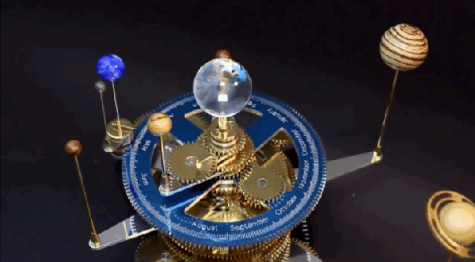
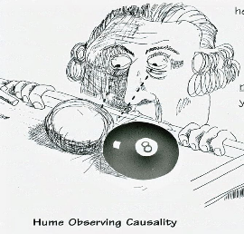
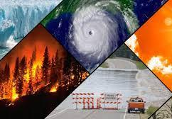
Information Theory to Pinpoint Causal Links from Complex Data
Information Theory to Pinpoint Causal Links from Complex Data
Complex Dynamical Systems: An Introduction
History
Scientific Discoveries
Copernicus, Kepler’s Laws, Galileo, Newton’s Laws
Analogies
“Billiard balls”
“Clockwork universe”
Issues
Temporally: slices of time vs occurring over time
Spatially: localized vs dispersed
Static vs dynamic → systems and networks
Emergence
Climate change
Universe
Life
Consciousness
Societal and psychological behavior
Notes:
Hume: conjunction of time does not entail causation, causation is ”if the first object had not been the second never had existed”, correlation does not entail causation
“The only thing which is constant is change itself.”- Heraclitus Emergence: “the whole is greater than the sum of its parts” (increased level of complexity)

Slide 3
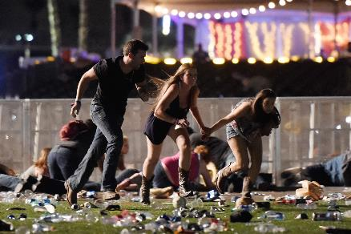
Information Theory to Pinpoint Causal Links from Complex Data
Information Theory to Pinpoint Causal Links from Complex Data
Causal Coupling Inference in Mass Shootings Data (causalities about casualties)
2022 US Mass Shooting Stats by Month
Location | Mass Shootings
Jan | 41
Feb | 43
March | 52
April | 66
May | 67
June | 68
Total | 337
Research goals
determining causal links on real world data regarding mass shootings, firearm acquisition, and media coverage.
Research Hypothesis
Increased firearm acquisition and media output results in more mass shootings
Research Activities
transfer entropy, granger causality, python coding
Larger Research:
Using information theory to pinpoint causal links from complex data
Notes:
do not hear about them, yet so many happened
chaos
joker
Terrorism is also a strategic tool used during conflict. In explaining the aim of the 9/11 attacks, Osama bin Laden noted that for a cost of only $500,000 they inflicted $500 billion worth of damage to the American economy (Zakaria, 2008).
violence is waged with not just our bodies, but with our minds. That is the battlefield.
Sociology: deviance, Émile Durkheim and functionalism, one of the good things about deviant behavior as well is the perpetuation of new norms and behavior
Social psych: anonymity (such as melding into the identity of group) leading to deindividuation and inhibition of self control

Slide 4
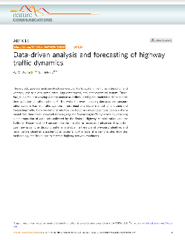
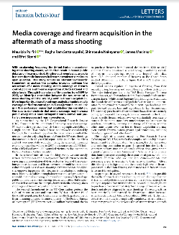
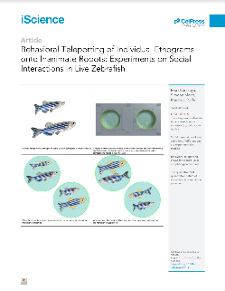
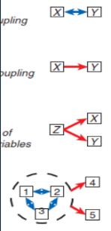
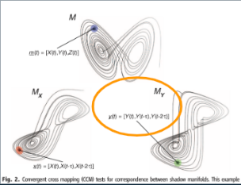
Raman Spectroscopy of Layered MnO2 Materials for Batteries
Information Theory to Pinpoint Causal Links from Complex Data
Causal Coupling Inference in Mass Shootings Data
Introduction
some of the papers discussed
Background literature
NYU Experiments on fish behavior
Robotic surgery time delays
Incremental additions of time delays from reactions times in traffic, phantom jam, and the economic costs of such
Hot topic of firearms and mass shootings
Ideas
types of casualties
heuristical methodology
visualizations
mathematically
scope of applicability
of time series
Complete
Ring
Path
Star
comparing types of casualties in one paper with network topologies in another paper
causal type analogy
Lab area

Slide 5
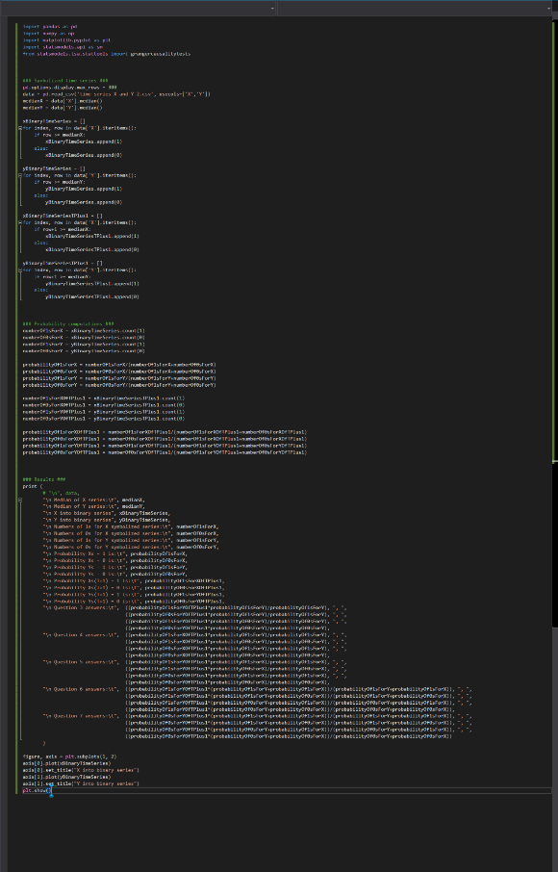
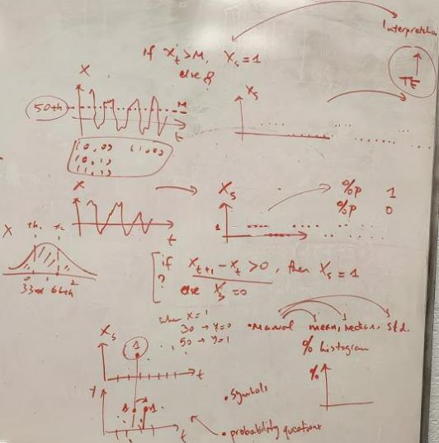
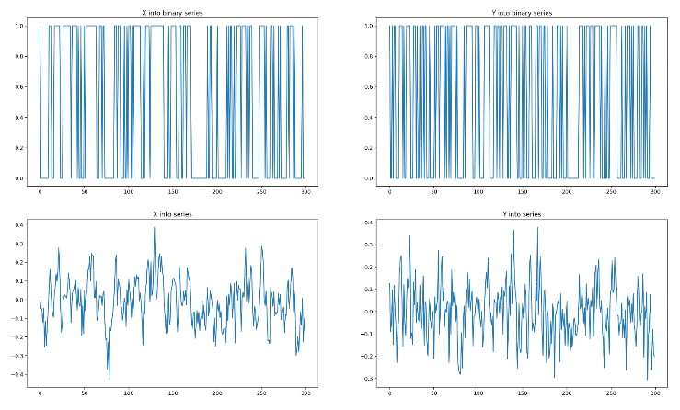
Raman Spectroscopy of Layered MnO2 Materials for Batteries
Information Theory to Pinpoint Causal Links from Complex Data
Causal Coupling Inference in Mass Shootings Data
The Set Up
Created symbolized time series based upon data
Calculated conditional probabilities
Notes:
heh, like a heist
two methods: symbolization based on previous point of increase or decrease, or above or below median
explain the graphs, symbolized from regular and that is why it is so binary
why not 1, 2, and 3? or up to 4? Also, how would that be done? Could be done by doing different percentiles than median, such as 33 and 66 split. However, well, redundancy and a famous paper in the field which is about 60 pages of relentless math, and somehow that it reduces accuracy if you do so that way.

Slide 6
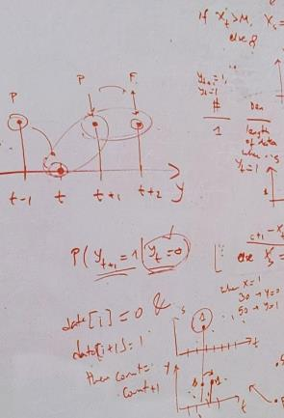
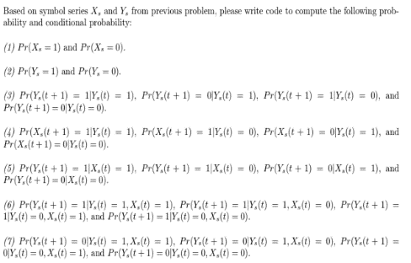
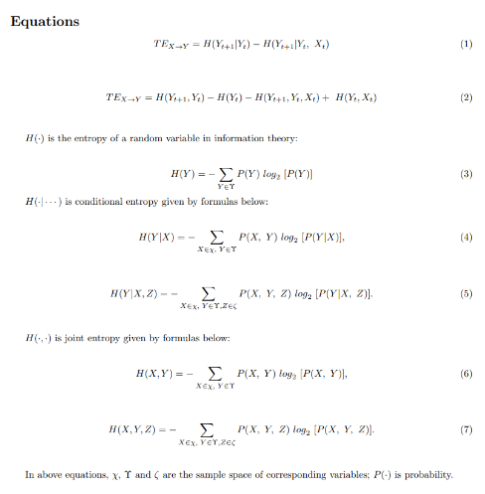
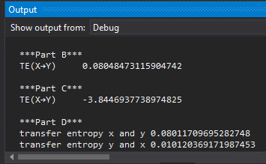
Raman Spectroscopy of Layered MnO2 Materials for Batteries
Information Theory to Pinpoint Causal Links from Complex Data
Causal Coupling Inference in Mass Shootings Data
Causal Coupling Inference in Mass Shootings Data
Finishing up software for data
Created transfer entropy equations in code
meticulous, fixing bugs
Math into code, harder than it looks!
What is “entropy”?
What is “transfer entropy”?
Notes:
permutations of computations done:
1. xt and yt
2. x(t+1) and y(t+1)
3. up/one or down/zero
4. count of each
5. count of each combination
6. probability of each
7. probability of each combination
8. entropy of some of these combinations
8. transfer entropy equation for some of these combinations
9. with the data, there is a triad of x y and z for MS MC and BC therefore have to do all that 2 more times

Slide 7
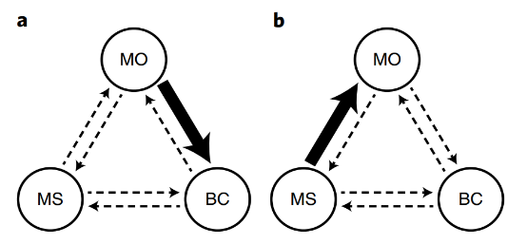
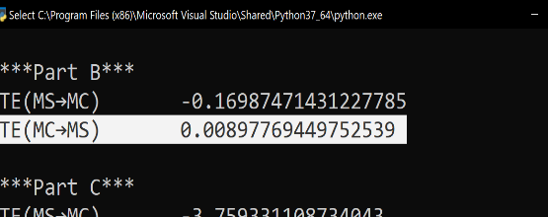
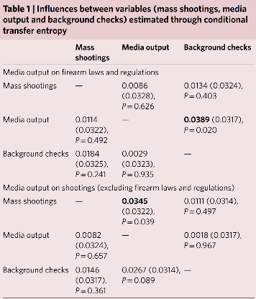
Raman Spectroscopy of Layered MnO2 Materials for Batteries
Information Theory to Pinpoint Causal Links from Complex Data
Causal Coupling Inference in Mass Shootings Data
Causal Coupling Inference in Mass Shootings Data
Final Results: Applied to Data Sets
My code works
Interpretation of data
relative vs absolute
significant transfer entropy from media output to background checks
Notes:
“We identify significant transfer entropy from media output to background checks (0.0389, against the 95% quantile of the null distribution 0.0317 from 50,000 permutations, P=0.020), after controlling for mass shootings. No further significant transfer entropy values are noted in other pairs of variables”
“As discussed by Luca et al.31, there have been, on average, more than 30,000 firearm-related fatalities in the United States per year over the 25-year period from 1989 to 2014, and mass shootings (using a similar definition to Mother Jones) amount to a very small fraction (0.13%) of these firearm-related deaths. However, previous efforts have identified a robust association between mass shootings and firearm acquisition, such that more firearms will be acquired in the aftermath of a mass shooting1”
“the association between mass shootings and background checks loses significance. We find that variations in the number of background checks are not explained by the occurrence of a mass shooting, nor are the occurrences of mass shootings explained by variations in the number of background checks. These results suggest that observations in previous reports on the link between specific mass shooting events and new firearm acquisition might be mediated by media coverage on firearm control policies”

Slide 8
RESEARCH PROJECT TITLE
Information Theory to Pinpoint Causal Links from Complex Data
Causal Coupling Inference in Mass Shootings Data
Conclusion
Contributions
developed code for entire set of equations and concepts
understood transfer entropy (line by line)
replicated results
Further research
conditional entropy
convert hard code into package via user input and parameter passing
apply to other phenomena
personal interests: types of casualties, unnatural causalities
Notes:
oversimplification: I spent an entire summer understanding a single equation, and creating it in code from the ground up. In reality, it is set of equations, innumerous calculations in order to use the equations in the first place, it is an idea itself related to other ideas, and then of course I also applied it to a data set

Slide 9
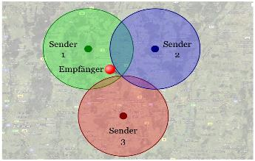
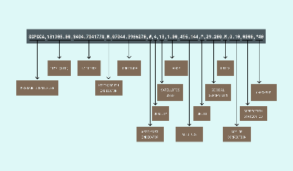
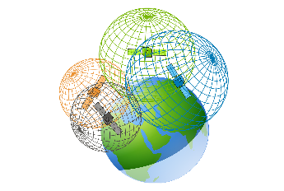
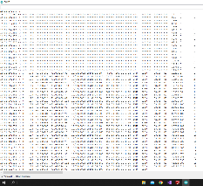
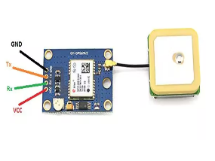
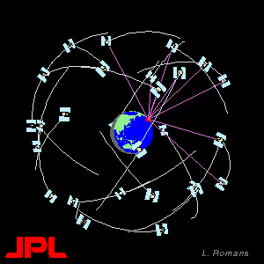
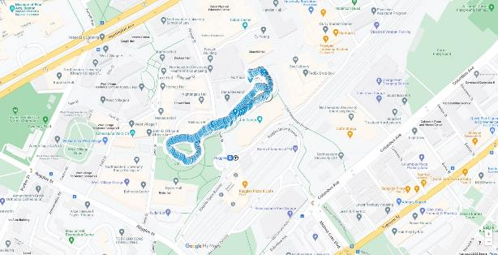
Raman Spectroscopy of Layered MnO2 Materials for Batteries
Information Theory to Pinpoint Causal Links from Complex Data
Summer Workshop: Arduino Project
Smart Tracking
Problem Statistics
$13,808,000,000 in stolen (Hattis and FBI 2020).
168,478 lost items in New York subway system, with only 33% reclaimed (Chalabi 2014)
Solution
Design a smart inexpensive, small, customizable system that provides tracking and location information for personal items while constrained to size and accuracy.
Objectives, Functions, Constraints,
Figure 1. One among millions of people looking for a lost item
Trilateralization
NMEA 0183 data standard
Trilateralization
Data Extraction
Schematics for GPS module
Trilateralization
it works!
Notes:
exhibit 1, exhibit 2
trilateralization (distances) vs triangulation (angles)
Issues with constructing local GPS network (tried doing what NASA did with billions of dollars in space, but for a single room by ourselves. Oh the folly of youth.)
Most gps modules only interface with the present global network (coding within hardware)
Would need to take care of transmitting “satellites” as well
Would need three transmitters
Would need to encode complex computations for the localized network
Further iterations
GPS module with antenna
much faster and more reliable signal locking
Internal power source in order to be portable
(currently relying on power from laptop)
Wireless data transmitter
(currently relying on USB wire to transmit data)
Create an enclosure for protection and aesthetics
Creating systems which utilize location data to conduct other actions
(example, locking and unlocking a door automatically based on proximity)
Upload csv file to google drive desktop drive, which saves to and auto updates a google My Maps

Slide 10
RESEARCH PROJECT TITLE
Information Theory to Pinpoint Causal Links from Complex Data
Causal Coupling Inference in Mass Shootings Data
Works Cited
Alderisio, F., Fiore, G., Salesse, R. N., Bardy, B. G., & Bernardo, M. D. (2017). Interaction patterns and individual
dynamics shape the way we move in synchrony. Scientific reports, 7(1), 1-10.
Chalabi, Mona. “The Most Common Items Lost on New York City's Transit System.” FiveThirtyEight, FiveThirtyEight, 29
July 2014, https://fivethirtyeight.com/features/mta-new-york-lost-and-found-subway-most-common/.
Hattis, Shana Hertz, and FBI. Crime in the United States 2020. Bernan Press, 2020.
Porfiri, M., Sattanapalle, R. R., Nakayama, S., Macinko, J., & Sipahi, R. (2019). Media coverage and firearm acquisition in
the aftermath of a mass shooting. Nature human behaviour, 3(9), 913-921.
Sugihara, G., May, R., Ye, H., Hsieh, C. H., Deyle, E., Fogarty, M., & Munch, S. (2012). Detecting causality in complex
ecosystems. science, 338(6106), 496-500.

Slide 11
Thank you

