Slide 1


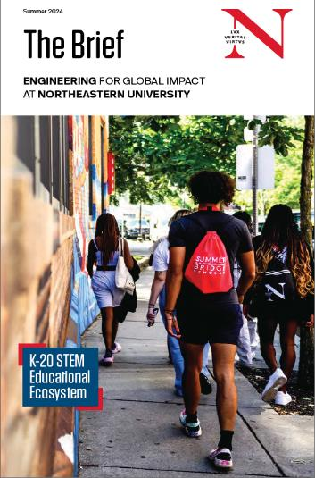
Young Scholars Program
Northeastern University
Research Experience for High School students
Final Presentations – July 30, 2026
Notes:
Claire

Slide 2
Schedule
9:00-9:15: | Welcome & Introduction | Claire Duggan & Richard Harris
9:15-9:25: | Zara Atti & Maya Vovk | Prof. Calina Copos | (COS: Biology) | PRESENTATION LINK
9:25-9:35: | Lena Lee & Adil Tigli | Prof. Juliet Davidow | (COS: Psychology) | PRESENTATION LINK
9:35-9:45: | Teju Kalluri & Katherine Sola | Prof. Ambika Bajpayee | (COE: BioE) | PRESENTATION LINK
9:45-9:55: | Nymisha Goli & Henry Mai | Prof. Francis Loth | (COE: MIE/BioE) | PRESENTATION LINK
9:55-10:05: | Jiko Chatterjee & Srishti Kar | Prof. Moneesh Upmanyu | (COE: MIE) | PRESENTATION LINK
10:05-10:15: | Nyasa Luharuka & Arin Shinde | Prof. Sarah Ostadabbas | (COE: ECE) | PRESENTATION LINK
10:15-10:25: | Ilyas Mohamed & Alina Shi | Prof. Zhi Tan | (Khoury: CS) | Flash Drive, or 1 & 2
10:25-10:35: | Angela Wang & Chris Xu | Prof. Marvin Onabajo | (COE: ECE) | PRESENTATION LINK
10:35-10:45: | Arihant Rangoli & Matt Sokoloff | Prof. Francesco Restuccia | (COE: ECE) | PRESENTATION LINK
10:45-11:00: | Intermission
11:00-11:10: | Farah Can & Dhruvi Upmanyu | Prof. Peter Schindler | (COE: MIE) | PRESENTATION LINK
11:10-11:20: | Anjali Misra & Kunal Shanbhag | Prof. Rouzbeh Amini | (COE: MIE) | PRESENTATION LINK
11:20-11:30: | Chelsea Bateman & Spencer Seidel | Prof. Akram Alshawabkeh | (COE: CEE) | PRESENTATION LINK
11:30-11:40: | Phoebe Corcell & Marcus Klingler | Prof. Adam Caparco | (COE: ChemE) | PRESENTATION LINK
11:40-11:50: | Alex Braga & Tarun Kannan | Prof. Joshua Gallaway | (COE: ChemE) | PRESENTATION LINK
11:50-12:00: | Emme Turner & Fennell Wisseh | Prof. Maijia Liao | (COS: Physics) | PRESENTATION LINK
12:00-12:10: | Adam Aoua & Karuna Tarafdar | Prof. Jacqueline McCleary | (COS: Physics) | PRESENTATION LINK
Notes:
9:15-10:05: Kenny
10:15-11:10: Frances
11:10-12:10: Ahmed

Slide 3

Final Remarks
https://docs.google.com/presentation/d/1tIaqs-oMyzD90oEQVbrsxm01aqzNY5zh21n0d-MDSUs/edit?usp=sharing

Slide 4
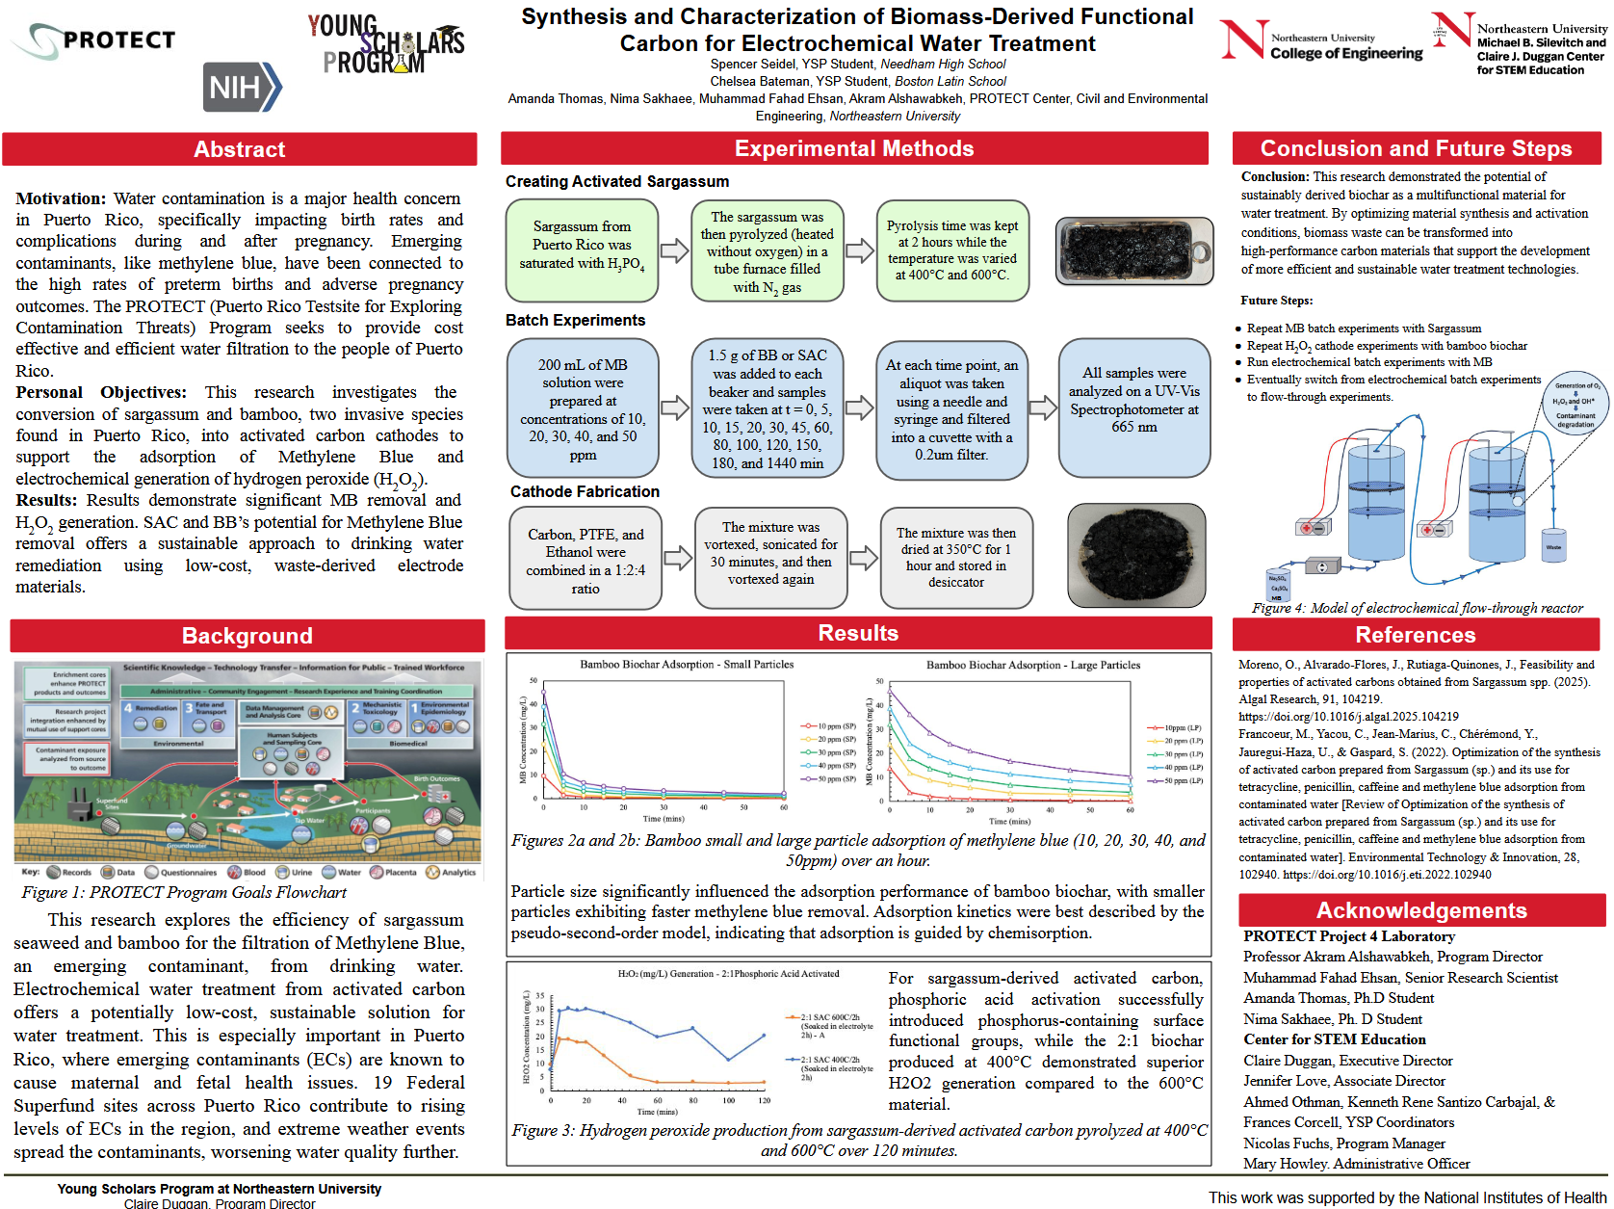
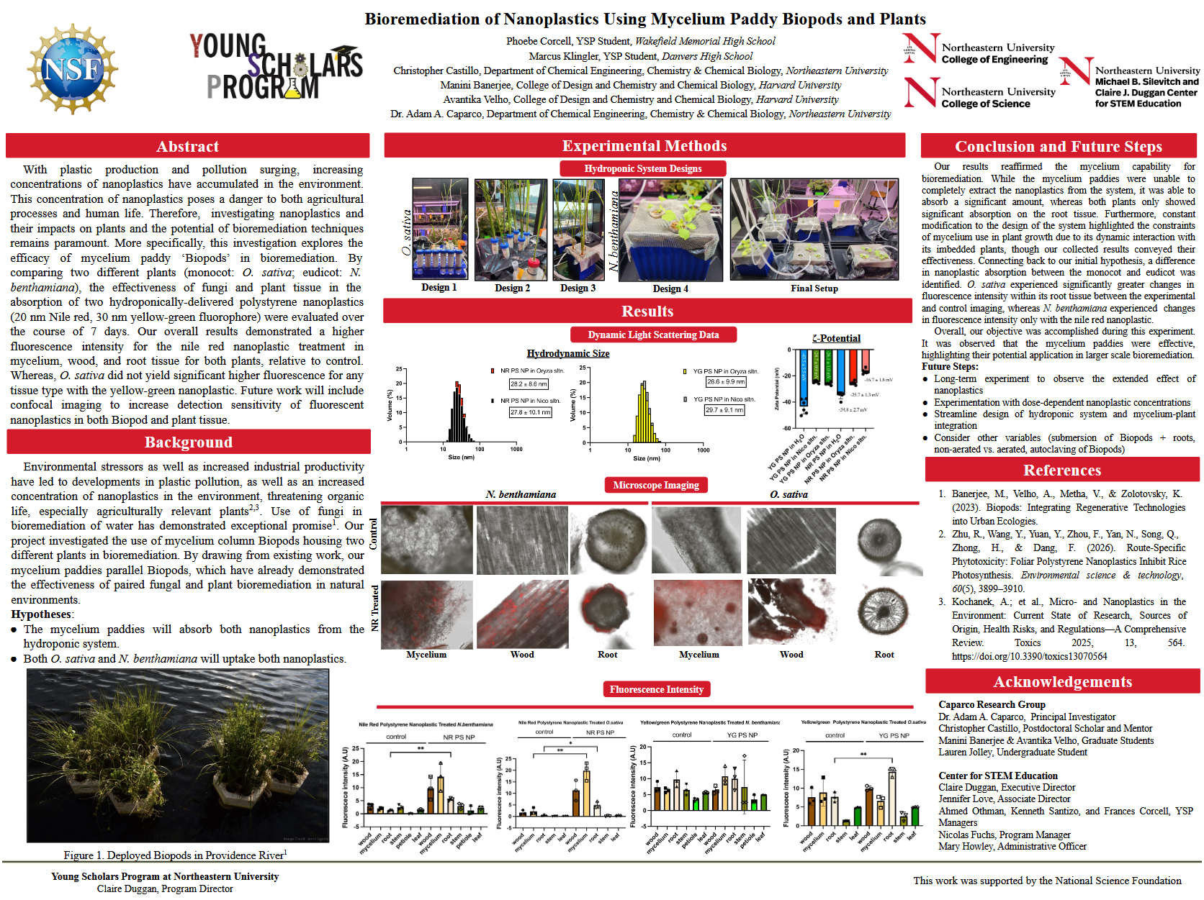
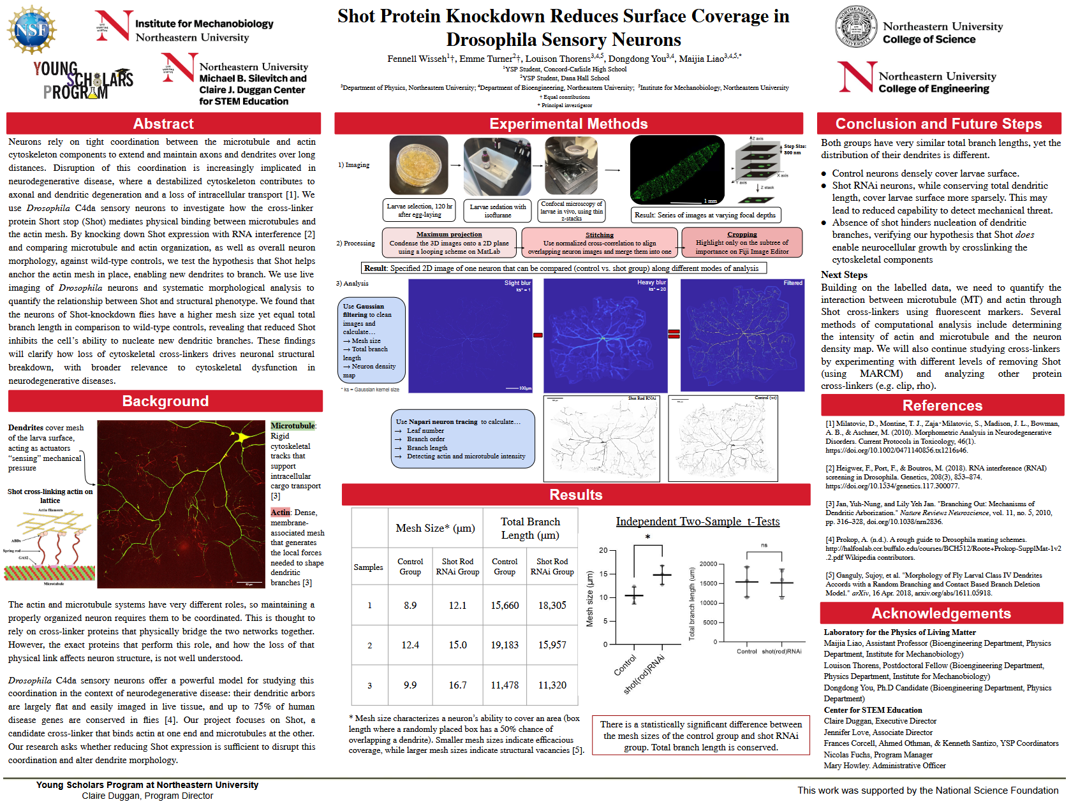
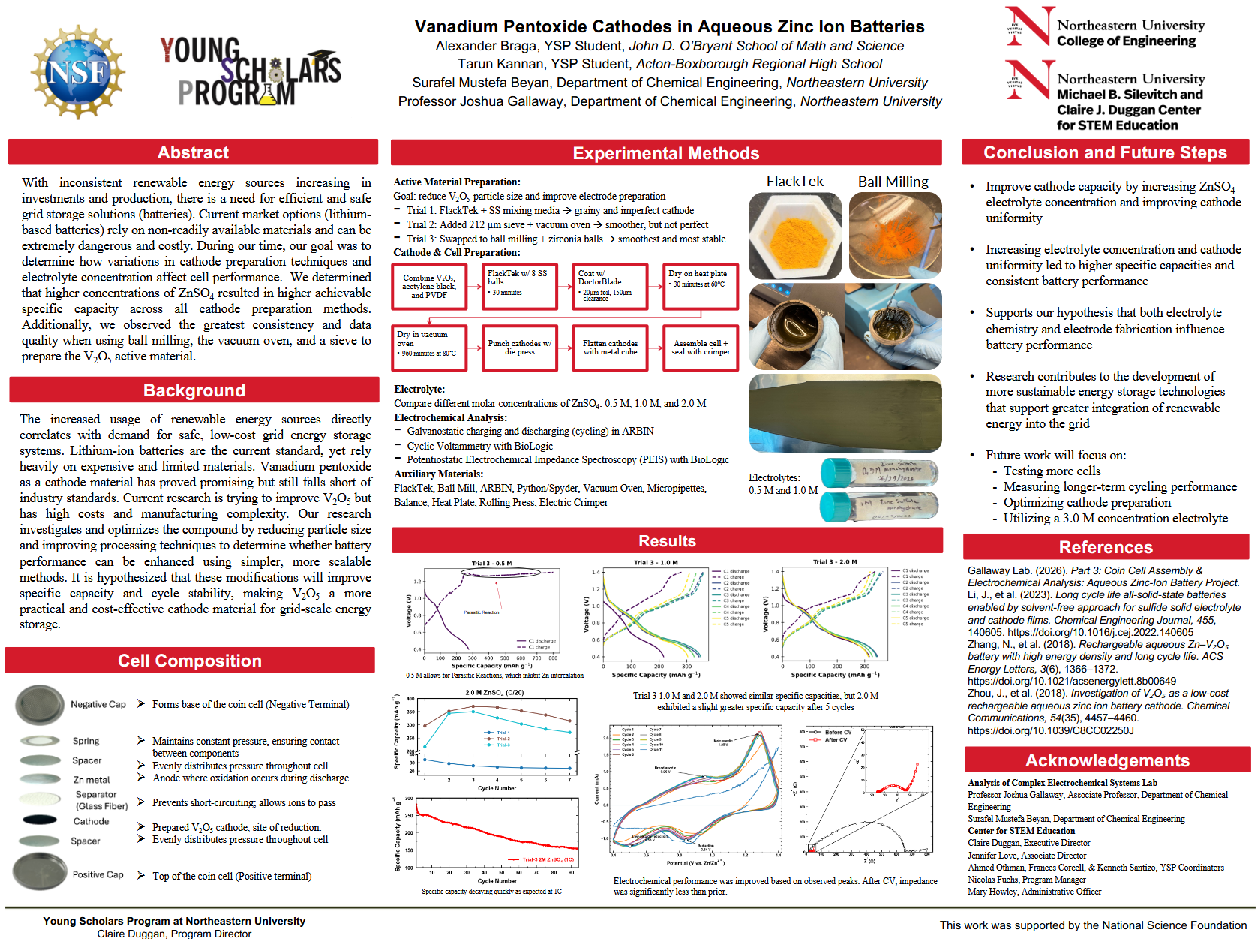
Poster Session
12:30-1:30
https://stem.northeastern.edu/summer/ysp/ysp2026/

