Slide 1





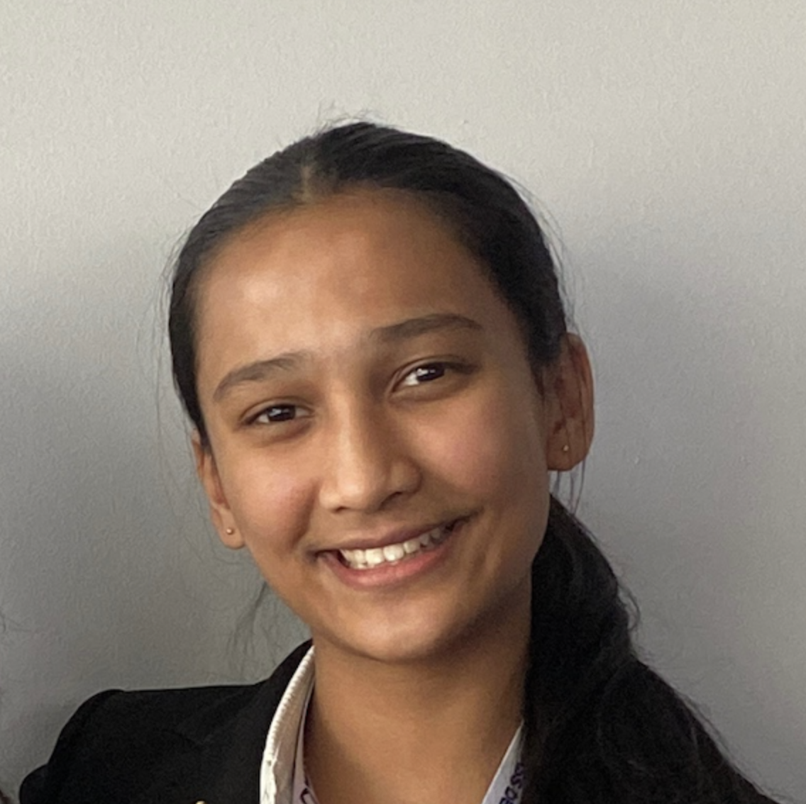


Creating Dark Matter Mass Maps using Stratospheric Balloon Observations
Adam Aoua, YSP Student, Belmont High School
Karuna Tarafdar, YSP Student, Newton South High School
Sayan Saha, Physics, Northeastern University​
Prof. Jacqueline McCleary, Physics, Northeastern University​
Notes:
Karuna

Slide 2

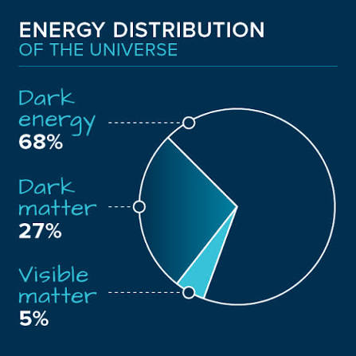
Dark Matter
Only 5% of the universe is baryonic (visible) matter → can emit, absorb, and reflect EM waves
Dark matter doesn’t emit, absorb, or reflect EM waves
How do we know Dark Matter exists?
Gravity from Baryonic matter isn’t enough to hold galaxies together
Creating Dark Matter Mass Maps using Stratospheric Balloon Observations
Adam Aoua and Karuna Tarafdar - NEU Young Scholars Program 2026 - June 22 - July 30 1
Notes:
Adam

Slide 3
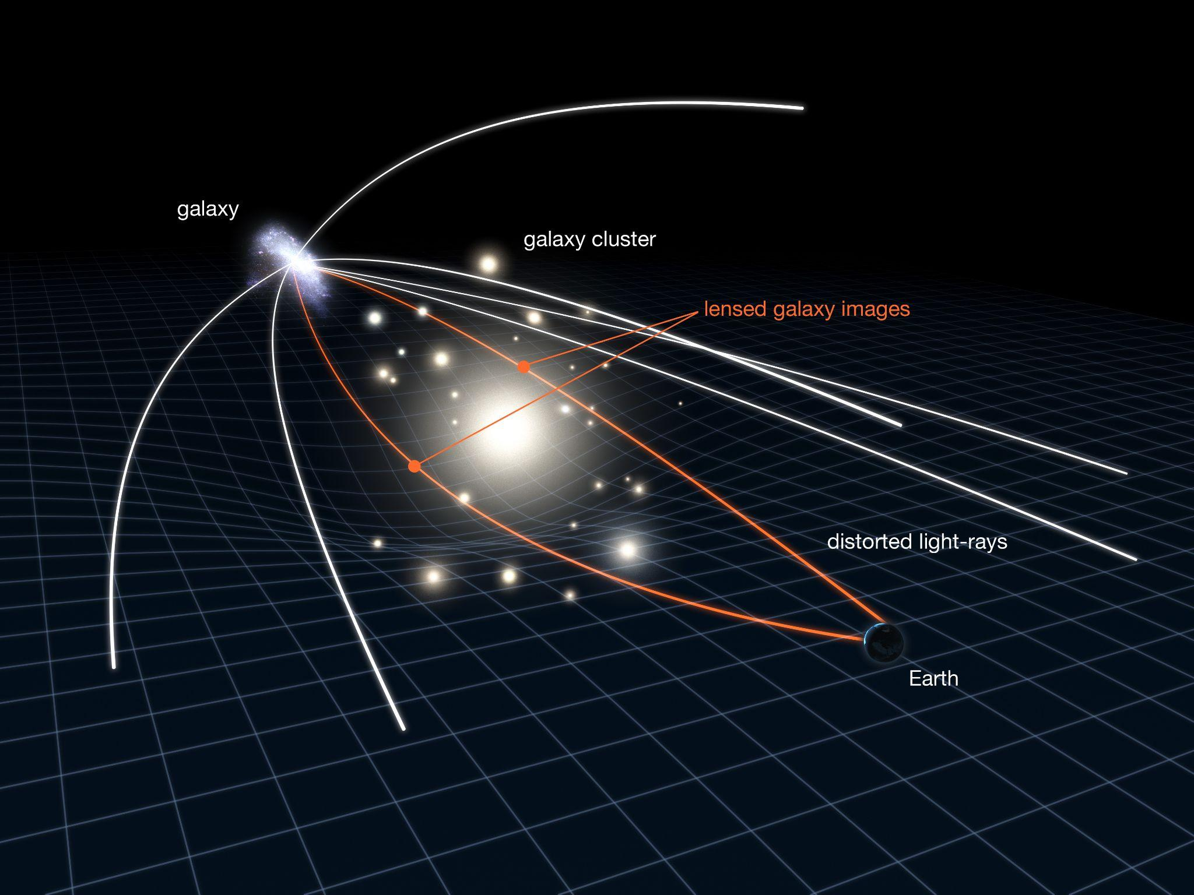
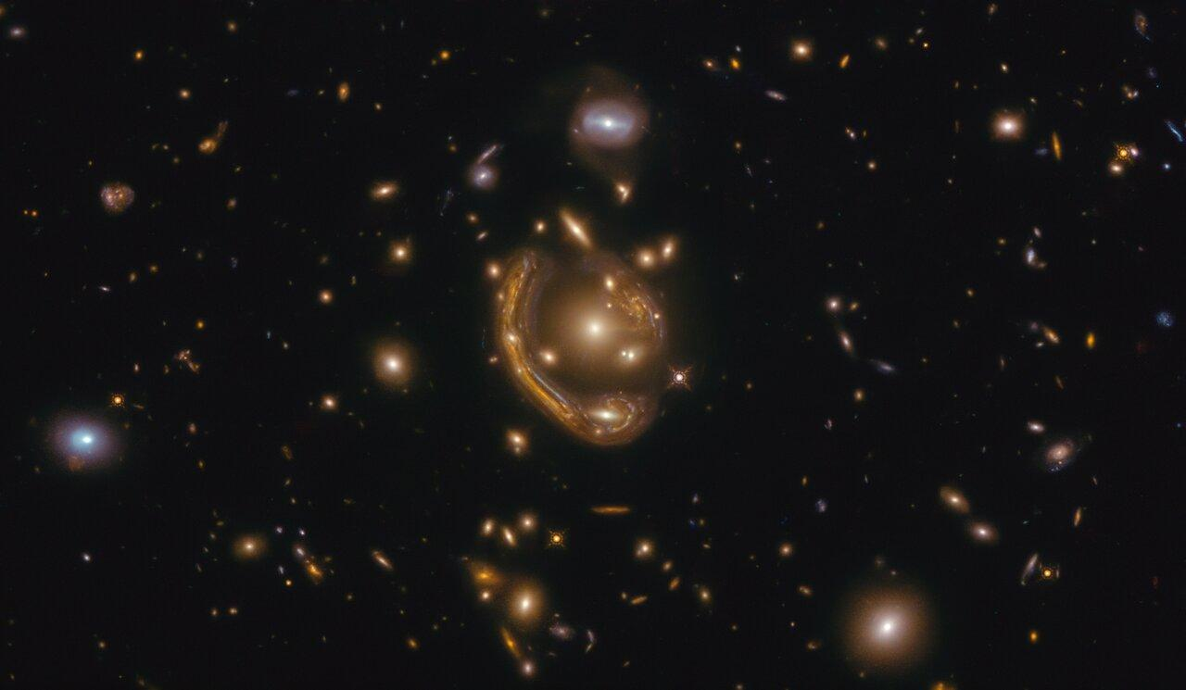
Gravitational Lensing
Weak Gravitational lensing → The bending of light around mass
  Allows us to detect dark matter
  Distorts background galaxies
Image of weak gravitational lensing taken by the Hubble Space Telescope
Diagram of weak gravitational lensing, from NASA, ESA & L. Calçada
Creating Dark Matter Mass Maps using Stratospheric Balloon Observations
Adam Aoua and Karuna Tarafdar - NEU Young Scholars Program 2026 - June 22 - July 30 2
Notes:
Karuna

Slide 4
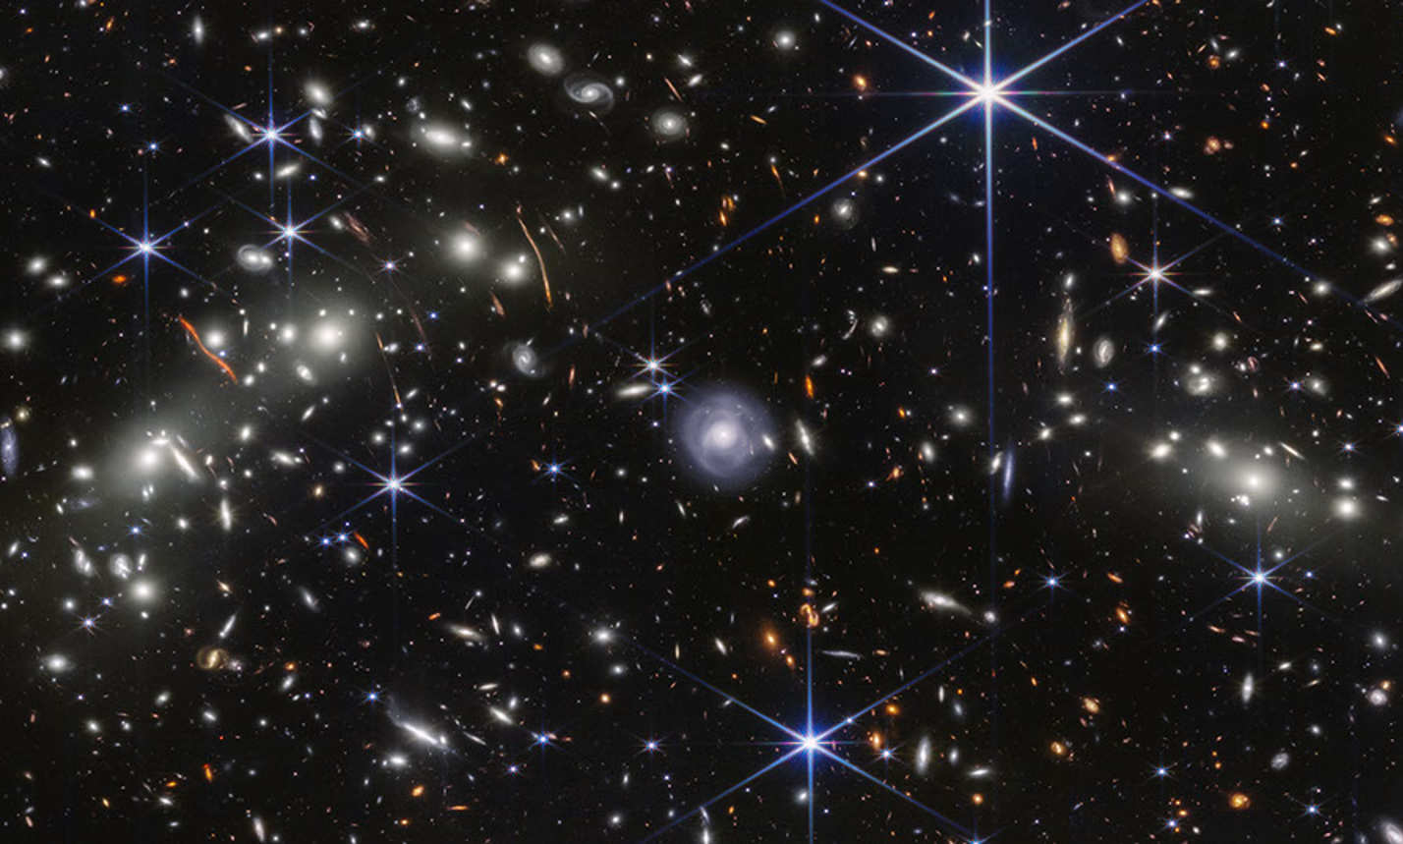
Galaxy Clusters
Galaxy clusters are made of:
  Galaxies bound together by gravity
  Hot gas (emits X-rays)
  Dark matter
80 - 90% of matter is dark matter
Only galaxies gravitationally lens
NASA Webb ‘Pierce's’ Bullet Cluster
Creating Dark Matter Mass Maps using Stratospheric Balloon Observations
Adam Aoua and Karuna Tarafdar - NEU Young Scholars Program 2026 - June 22 - July 30 3
Notes:
What a gala

Slide 5
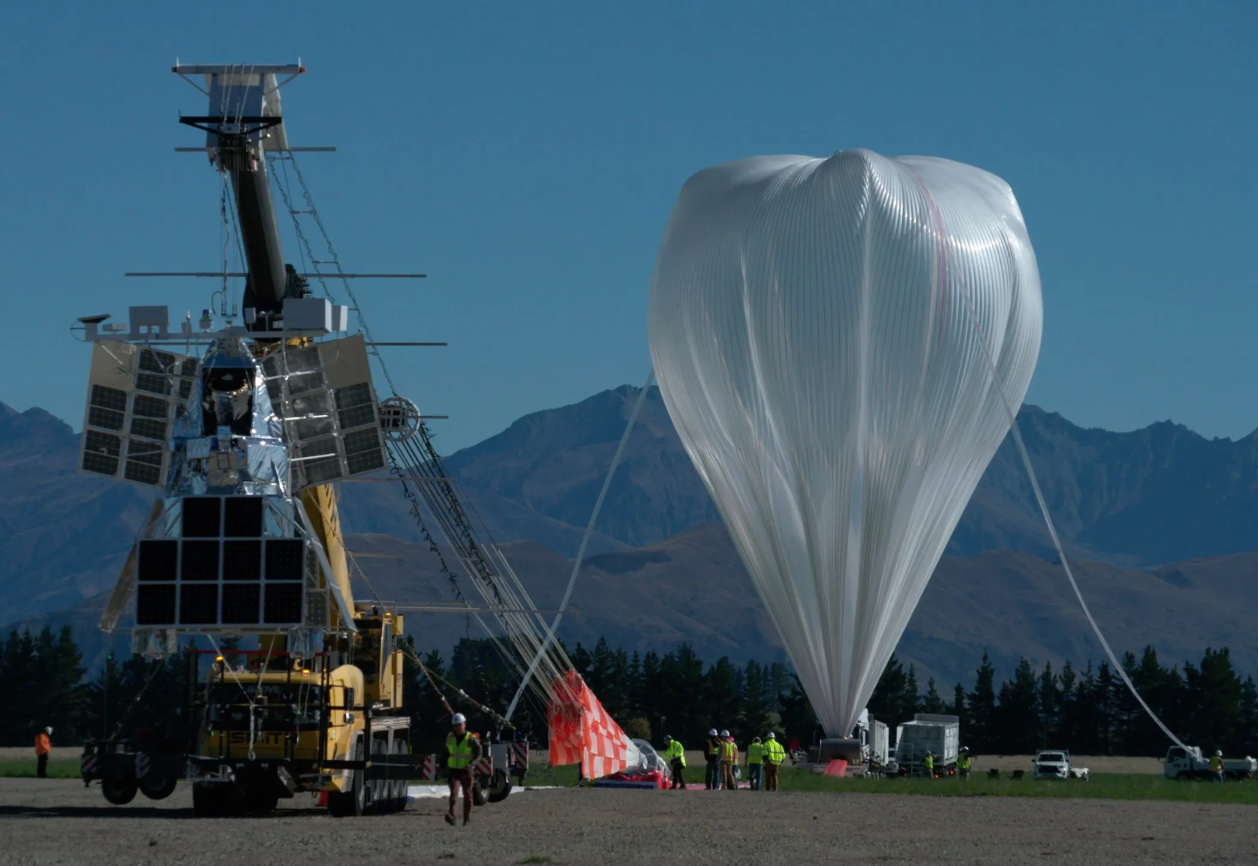
SuperBIT
Super-pressure Balloon-borne Imaging Telescope (SuperBIT):
  A balloon-borne telescope in the stratosphere
  Imaging is comparable to space based telescope at a much cheaper cost
  We use galaxy cluster images taken from the SuperBIT
SuperBIT as it’s being prepared to launch from New Zealand in 2023 taken by Bill Rodman (NASA)
Creating Dark Matter Mass Maps using Stratospheric Balloon Observations
Adam Aoua and Karuna Tarafdar - NEU Young Scholars Program 2026 - June 22 - July 30 4
Notes:
Karuna

Slide 6
Research Goals
Research goals:
Understanding the distribution of dark matter in galaxy clusters by analyzing data from SuperBIT
Maximize signal to noise ratio to increase certainty of dark matter detection
Creating Dark Matter Mass Maps using Stratospheric Balloon Observations
Adam Aoua and Karuna Tarafdar - NEU Young Scholars Program 2026 - June 22 - July 30 5
Notes:
Adam

Slide 7
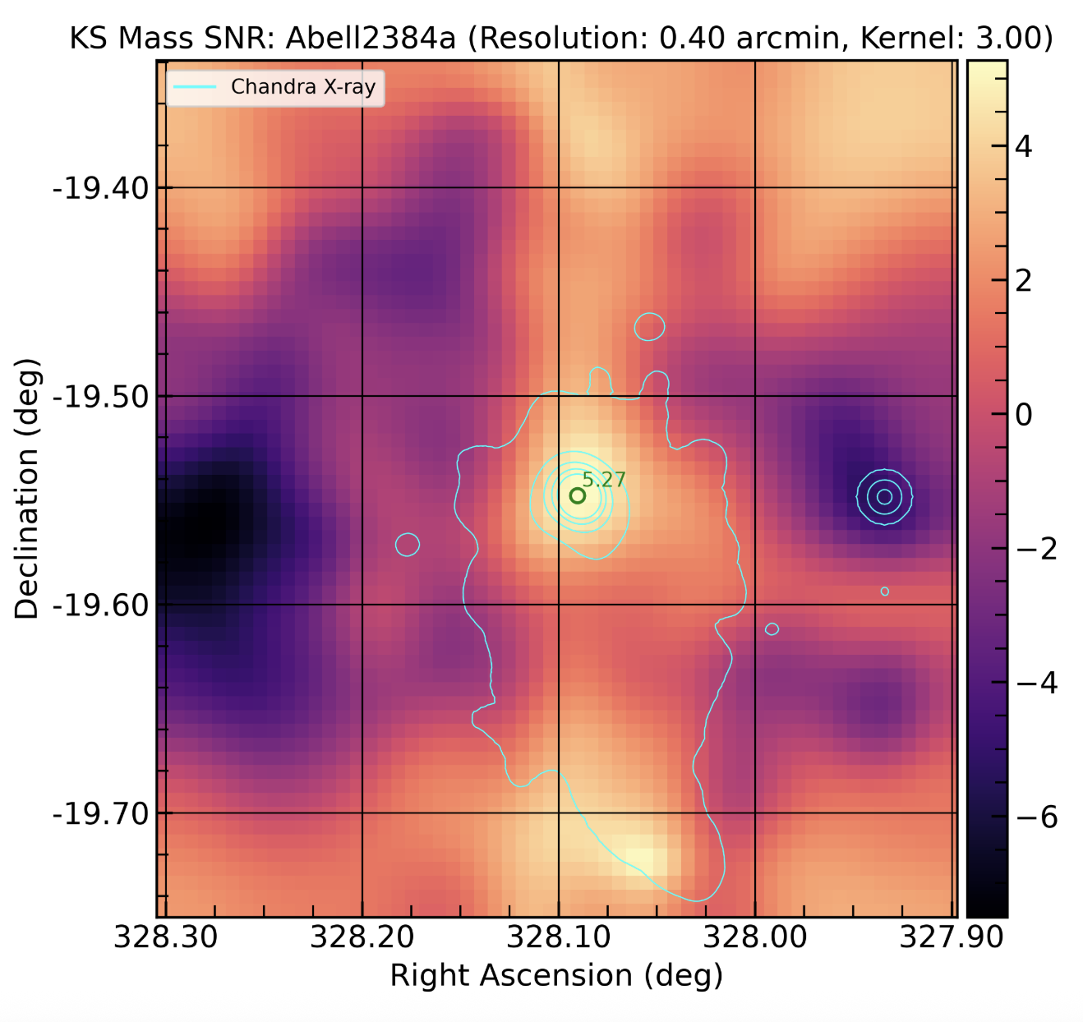
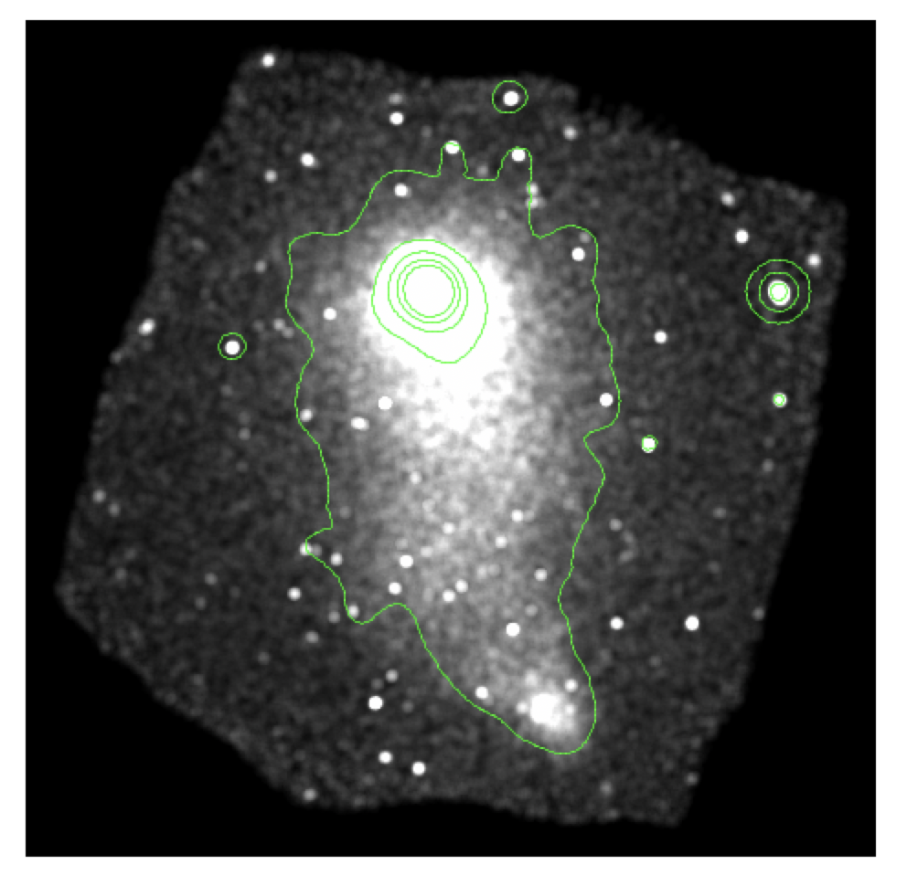
Creating Signal to Noise Ratio Plots & X-ray Contours
SNR Plots:
Signal → Bending of light around dark matter during gravitational lensing
Noise → Random distortions in galaxies
Bright orange spots → where dark matter is more likely to be
X-ray Contours:
Baryonic matter emits X-rays
Contours similar to topographic map
Compare positions of dark matter and baryonic matter
X-ray overlay on SNR plots of Abell 2384a
X-ray contours of Abell 2384a in DS9
Creating Dark Matter Mass Maps using Stratospheric Balloon Observations
Adam Aoua and Karuna Tarafdar - NEU Young Scholars Program 2026 - June 22 - July 30 6
Notes:
Adam

Slide 8
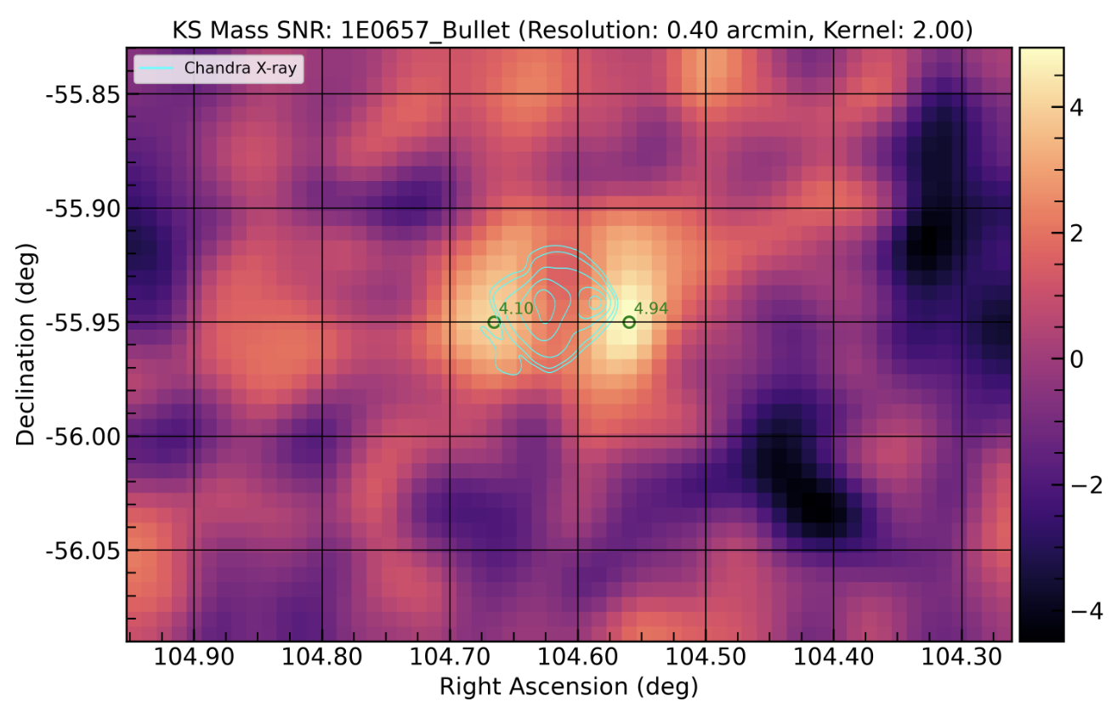
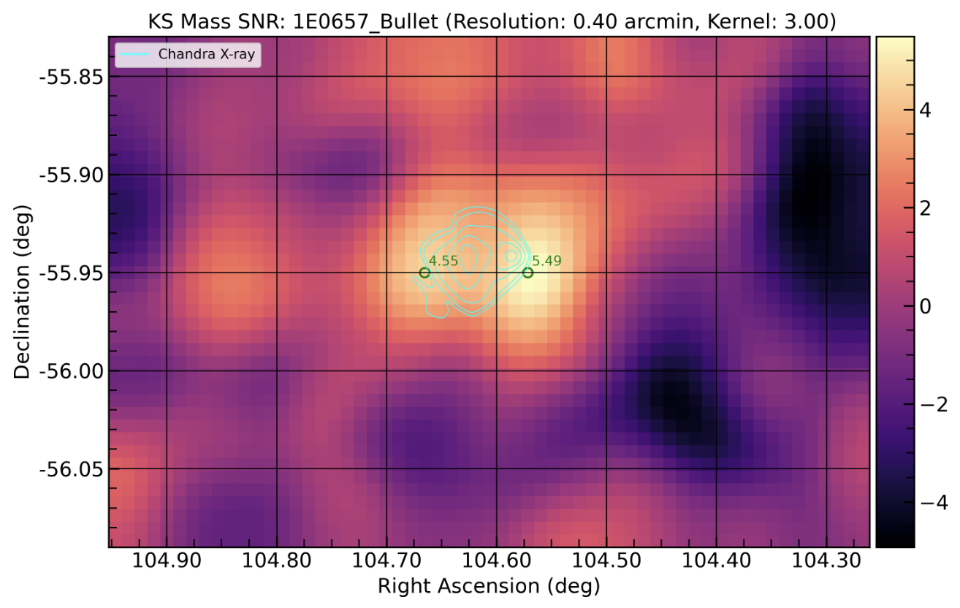
Manually Maximizing Signal to Noise Ratio Plots
Our Goal: To maximize the SNR values at peaks (bright spots), which increases the certainty of dark matter detection
Manually Tuned Variables:
Min_sn → minimum signal to noise ratio for individual galaxies
Resolution → pixel size
Gaussian_kernel → smoothing of image
Creating Dark Matter Mass Maps using Stratospheric Balloon Observations
Adam Aoua and Karuna Tarafdar - NEU Young Scholars Program 2026 - June 22 - July 30 7
Notes:
Karuna

Slide 9
Automating the Tuning Process
Created an automated process using python
  Runs through a range of values for one variable
  Updates the config file that generates the SNR plots
  Scans the image for peak SNR values
  Repeats for multiple values of the variable to find the highest SNR peaks
Repeat for multiple variables
Creating Dark Matter Mass Maps using Stratospheric Balloon Observations
Adam Aoua and Karuna Tarafdar - NEU Young Scholars Program 2026 - June 22 - July 30 8
Notes:
Karuna

Slide 10
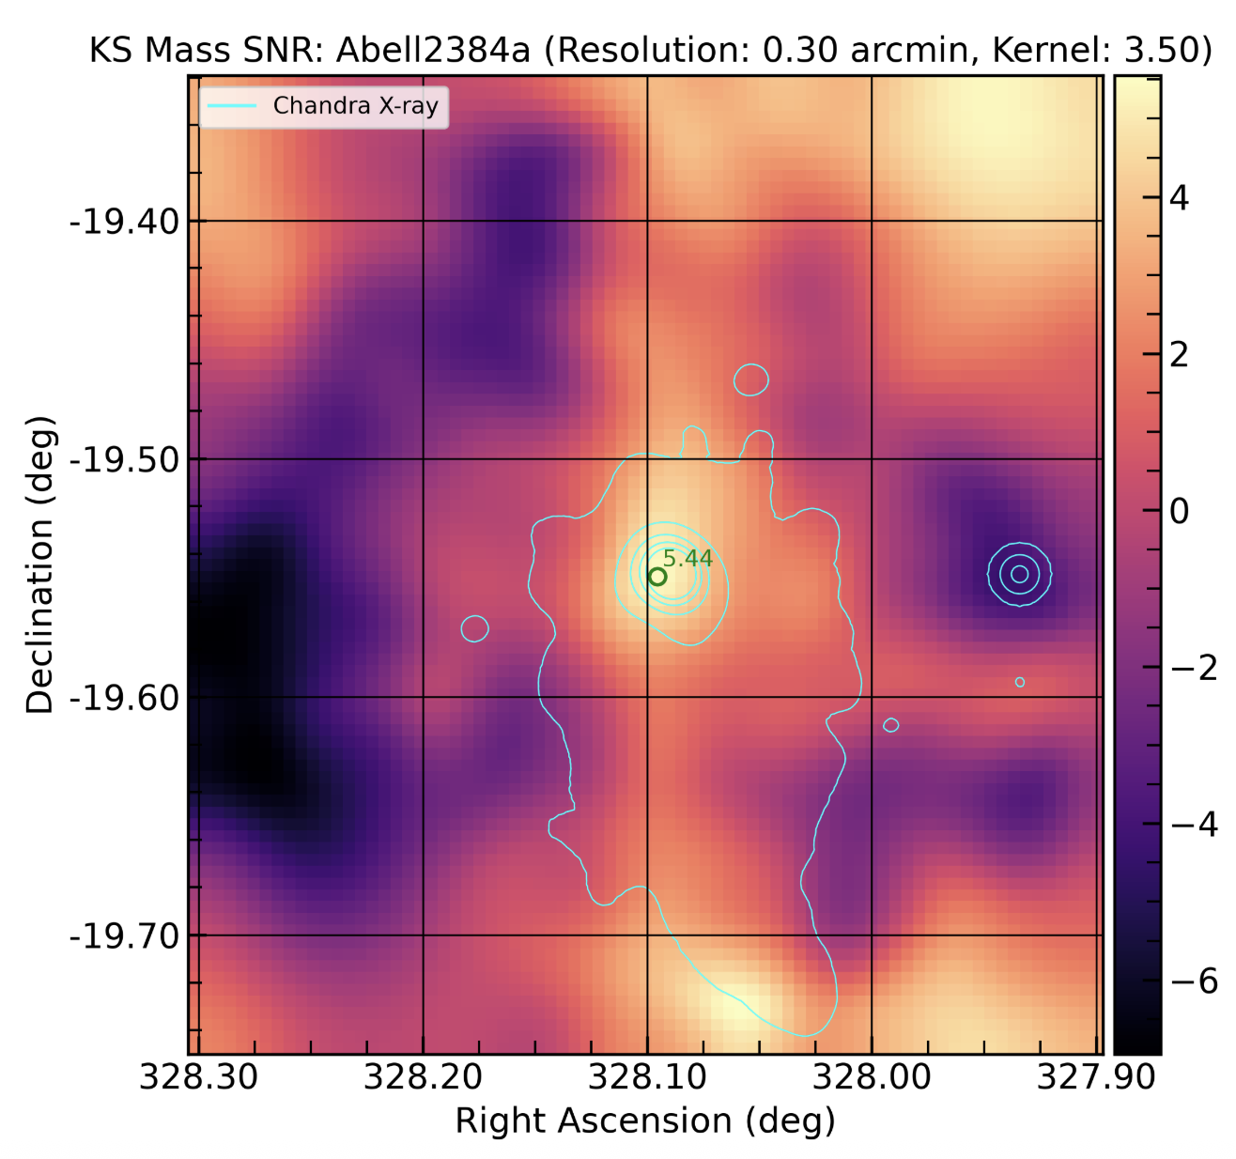
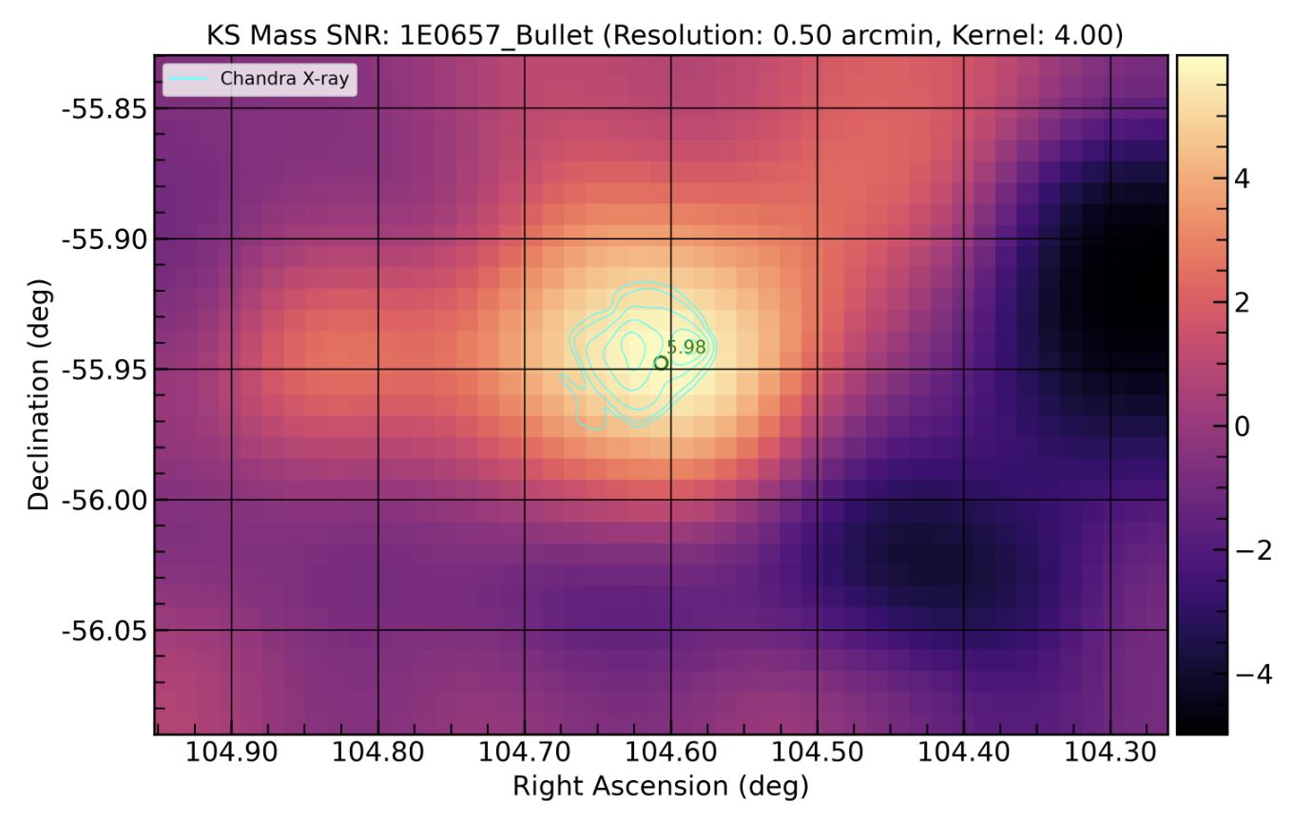
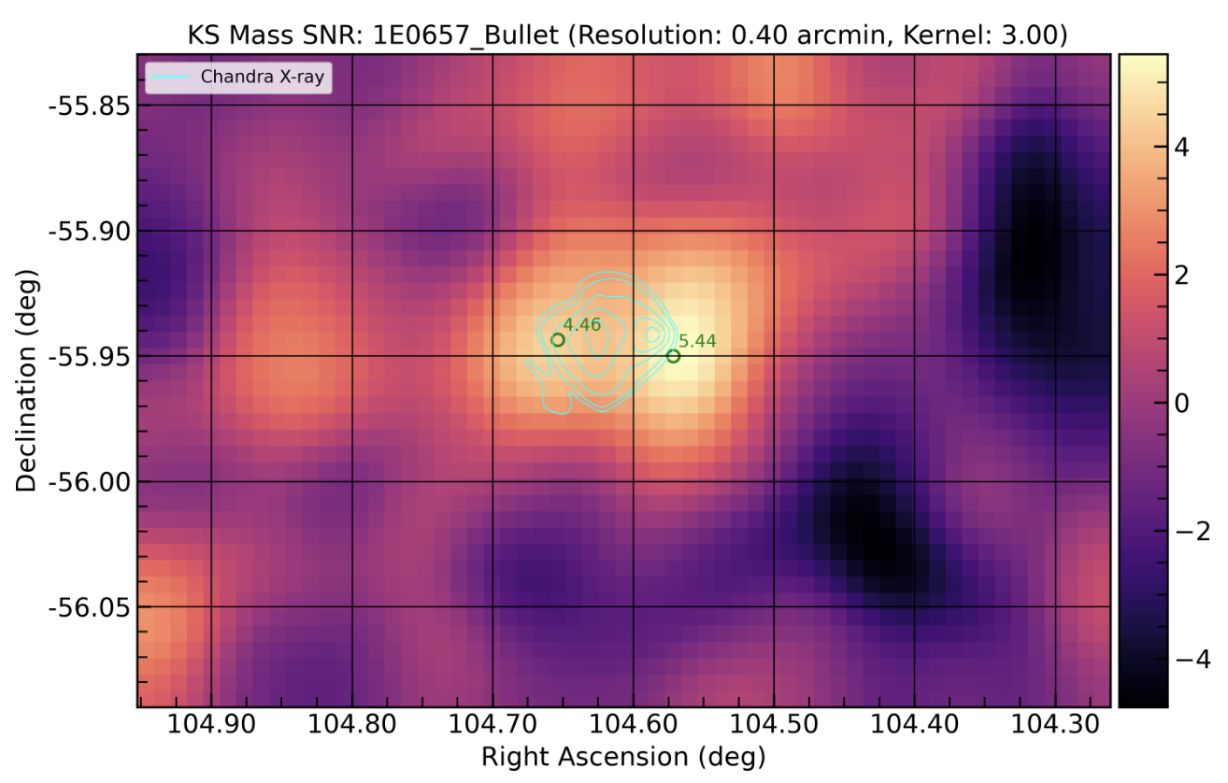
Refining the Automation
Radius
Oversmoothing
1E0657_Bullet has two merging clusters
Over smooth
To fix create a maximum for resolution and gaussian_kernel
Edges of SNR plots have very few galaxies, generating a high SNR
Focus on center cluster
Only allow code to look within certain radius from the center
Creating Dark Matter Mass Maps using Stratospheric Balloon Observations
Adam Aoua and Karuna Tarafdar - NEU Young Scholars Program 2026 - June 22 - July 30 9
Notes:
Adam

Slide 11
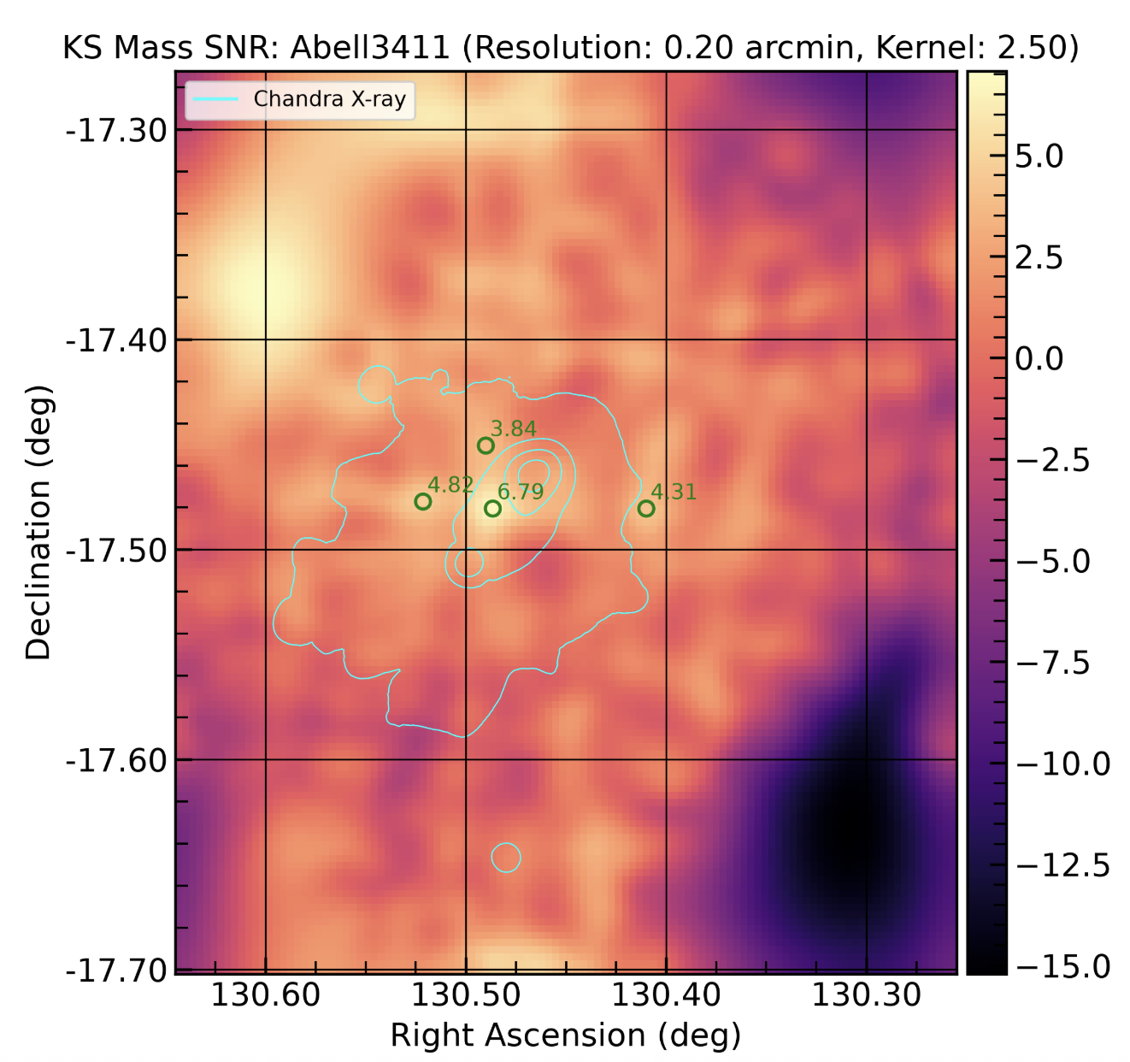
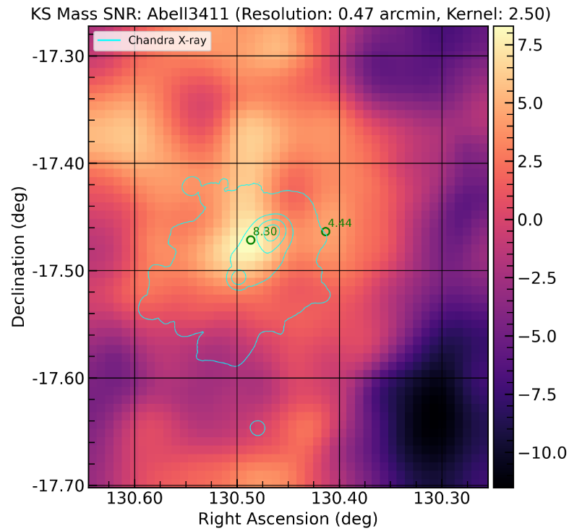
Results
6.79 → 8.30
Created a tool to maximize SNR peaks which can be used in future work.
Works toward the goal of mapping dark matter in the universe.
Creating Dark Matter Mass Maps using Stratospheric Balloon Observations
Adam Aoua and Karuna Tarafdar - NEU Young Scholars Program 2026 - June 22 - July 30 10
Notes:
Karuna

Slide 12
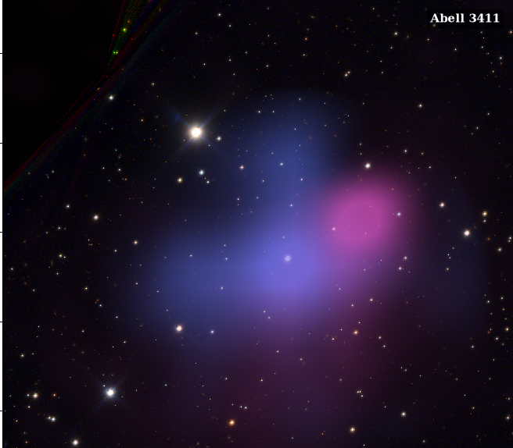

Results: Overlaying Dark Matter on RGB Images
Background RGB image of Galaxy Clusters:
Created RGB images using SuperBIT’s filters
Layered X-ray (baryonic matter) and kappa (dark matter from SNR plots)
Creating Dark Matter Mass Maps using Stratospheric Balloon Observations
Adam Aoua and Karuna Tarafdar - NEU Young Scholars Program 2026 - June 22 - July 30 11
Notes:
Adam

Slide 13
Future Steps
Fine tuning our optimization function to make it as accurate and efficient as possible
Implement the code for all clusters in high performance computers
Implement the function into the main SuperBIT lensing pipeline
Creating Dark Matter Mass Maps using Stratospheric Balloon Observations
Adam Aoua and Karuna Tarafdar - NEU Young Scholars Program 2026 - June 22 - July 30 12
Notes:
Karuna

Slide 14
References
Balzer, A. (2026, April 16). Weak Lensing. NASA. Retrieved July 23, 2026, from https://science.nasa.gov/mission/roman-space-telescope/weak-lensing/
Díaz-Sánchez, A. (2025, Aug 17). “Molten Ring” Galaxy. NASA. Retrieved July 23, 2026, from https://science.nasa.gov/asset/hubble/molten-ring-galaxy/
Stoltz, J. (2026, Jul 15). Dark Matter. NASA. Retrieved July 23, 2026, from https://science.nasa.gov/dark-matter/
University of Toronto. (2017, May 10). Welcome to SuperBIT. UToronto. Retrieved July 23, 2026, from https://sites.physics.utoronto.ca/bit
Creating Dark Matter Mass Maps using Stratospheric Balloon Observations
Adam Aoua and Karuna Tarafdar - NEU Young Scholars Program 2026 - June 22 - July 30 13

Slide 15

Acknowledgments
Northeastern Cosmology Group
Jacqueline McCleary, Assistant Professor of Physics
Sayan Saha, Postdoctoral Research Associate
Center for STEM Education​
Claire Duggan, Executive Director
Ahmed Othman, Kenneth Carbajal, & Frances Corcell, YSP Coordinators​
Nicolas Fuchs, Program Manager
Mary Howley, Administrative Officer
Creating Dark Matter Mass Maps using Stratospheric Balloon Observations
Adam Aoua and Karuna Tarafdar - NEU Young Scholars Program 2026 - June 22 - July 30 14

Slide 16
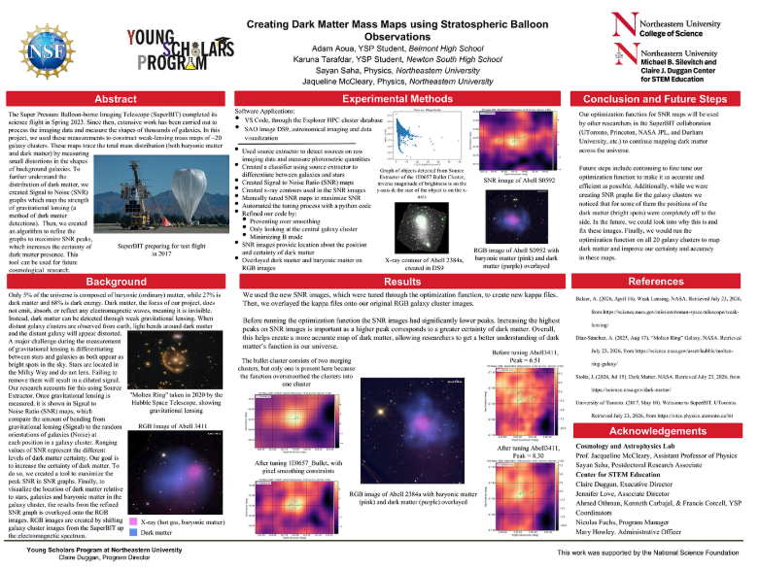
Poster
Creating Dark Matter Mass Maps using Stratospheric Balloon Observations
Adam Aoua and Karuna Tarafdar - NEU Young Scholars Program 2026 - June 22 - July 30 15

Slide 17
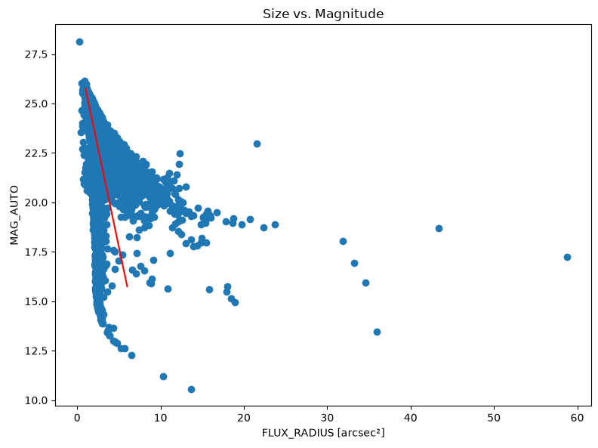
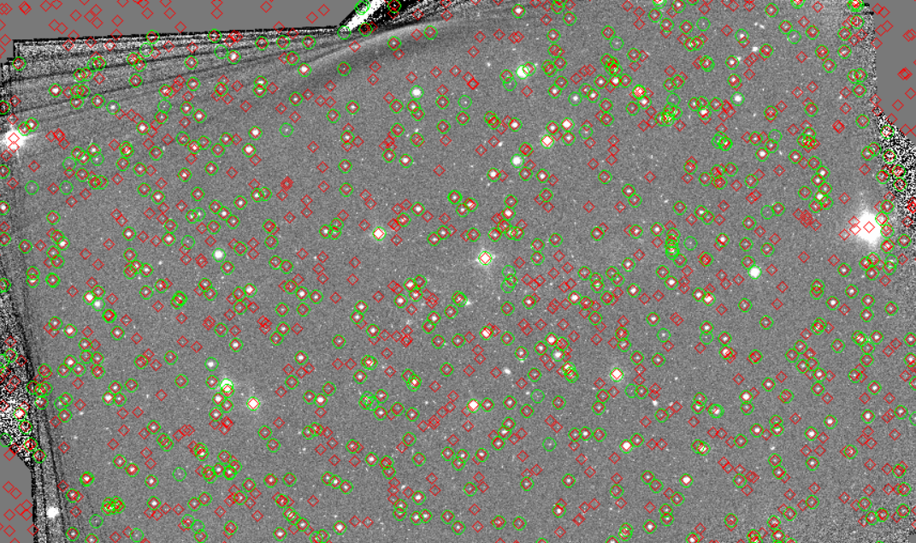
Understand How Galaxy Cluster Images Are Created: Source Extractor
Source Extractor:
Scans astronomical image to identify bright spots (star, galaxies…)
Measures properties → size, brightness, shape…
Our goal → differentiate between stars and galaxies
Using Source Extractor:
Compared mag_auto (inverse of brightness) to flux_radius (size)
2 distinct paths
Used the European Space Agency’s Gaia to confirm
  Visually using DS9
  Through code → ~88% accuracy (correctly predicting a star)
Gaia stars
Prediction with SE
Image of 1E0657_Bullet cluster from DS9
Creating Dark Matter Mass Maps using Stratospheric Balloon Observations
Adam Aoua and Karuna Tarafdar - NEU Young Scholars Program 2026 - June 22 - July 30 7
Notes:
Adam

