Slide 1


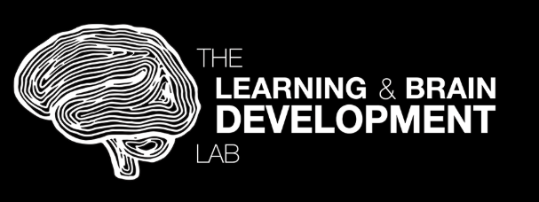


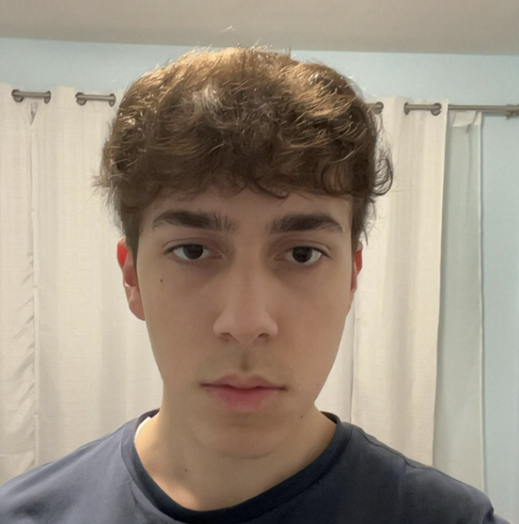







Assessing Quality Control of MRI-based Measurements of Iron in Subcortical Structures for Adolescent Learning
Adil Tigli
YSP Student
Pioneer Charter School of Science II
Lena Lee
YSP Student
Lexington High School
Ava Moore
Lab Manager
Learning & Brain Development Lab
Caitlyn Jaryszak
Lab Technician
Learning & Brain Development Lab
Brianna Aubrey
PhD Student
Northeastern University
Erica Niemiec Skelton
PhD Student
Northeastern University
Zoe Kross
PhD Student
Northeastern University
Dr. Juliet Y. Davidow
Associate Professor
Northeastern University
Assessing Quality Control of MRI-based Measurements of Iron in Subcortical Structures for Adolescent Learning
Northeastern University Young Scholars Program (YSP) | June 22, 2026 - July 30, 2026
Notes:
Adil

Slide 2
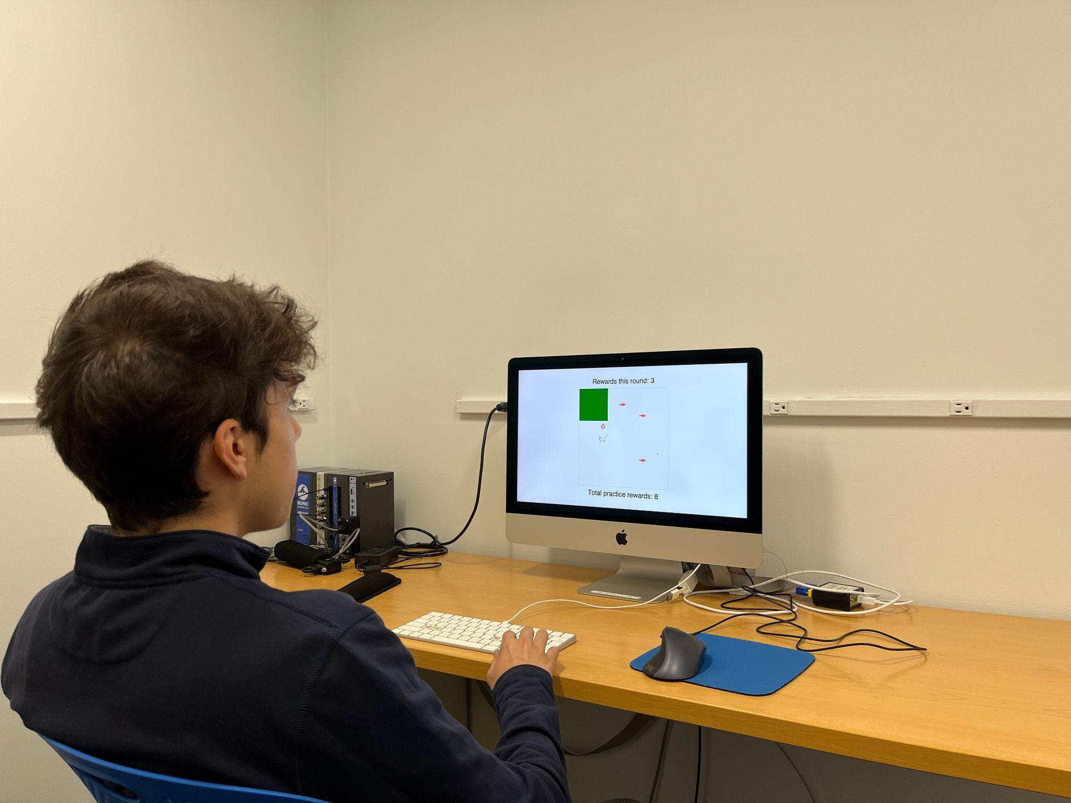
Learning and Brain Development Lab: Mission
Central Aims
Methods
Exploring adolescent learning and development from a computational neuroscience lens
Looking at ways that changes in the adolescent brain can be positive
What factors are connected to learning and behavior?
  Peers, rewards, and hormones
MRI + fMRI scans
Learning, memory, and decision-making games to investigate behavior
Computational modeling
Explore the cognitive and neural mechanisms underlying behavior
Figure 1: Adil piloting a computer game study
Assessing Quality Control of MRI-based Measurements of Iron in Subcortical Structures for Adolescent Learning
Northeastern University Young Scholars Program (YSP) | June 22, 2026 - July 30, 2026
Notes:
https://lbdlpsych.sites.northeastern.edu/research/
Our lab, the Learning and Brain Development Lab, is a psychology lab at Northeastern that is interested in studying how adolescents learn and develop from a computational neuroscience perspective.
Adolescence is a time of great change that we are all familiar with, and yet research on neurocognitive development is still pretty limited. And although adolescence may get a bad rap from the image of the rebellious teenager and risky behaviors, our lab looks at the ways that changes in the brain during this time can actually be positive and enhance processes like learning.
Some of the research being conducted includes the effect of peer influence, rewards, and hormones on adolescent behavior
Using MRI data from participant studies involving learning, memory, and decision-making tasks like computer games, [here’s Adil piloting one of them] our lab aims to explore the cognitive and neural mechanisms underlying behavior, some of which we will discuss more in our presentation today

Slide 3
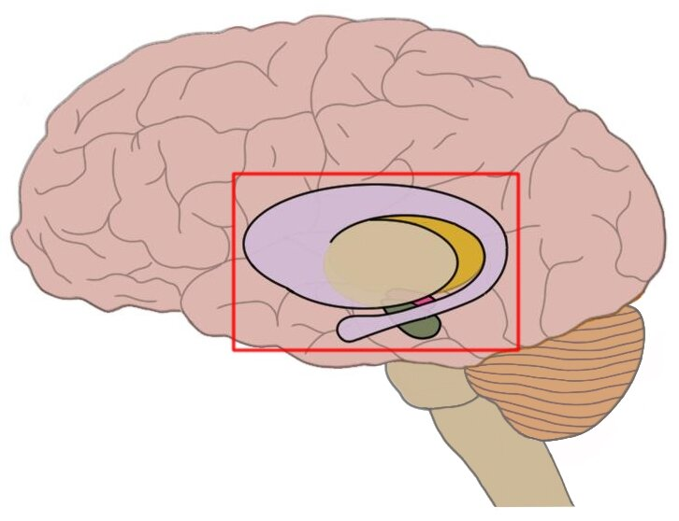
Adolescence and The Brain
Adolescence: phase of life between childhood and adulthood
  Typically defined as ~12 - 20 years old
  More independence in changing environments
    Parents/caregivers → peers
Basal ganglia: group of structures in the center of the brain:
  Motivation, learning, and reward-seeking behavior
  Dynamic changes in tissue iron levels and dopamine signaling
  Behavioral changes: risk-taking, sensitivity, and cognitive control (i.e. emotional regulation, working towards goals)
Figure 2: Basal ganglia
(Boyes et al., 2022), (Parr et al., 2022), (Larsen et al., 2020)
Assessing Quality Control of MRI-based Measurements of Iron in Subcortical Structures for Adolescent Learning
Northeastern University Young Scholars Program (YSP) | June 22, 2026 - July 30, 2026
Notes:
Lena
So, what is adolescence? Adolescence is the phase between childhood and adulthood, typically defined as being between the ages of 12-20, where adolescents must learn to navigate more independence in changing environments, such as transitioning away from parents and caregivers towards other peers, or going to college and living independently, for example
A region of the brain that our lab is particularly interested in studying is the basal ganglia, a group of structures in the center of the brain responsible for motivation, learning, and reward-seeking behavior and it’s known to undergo changes in tissue iron levels and dopamine signalling
This leads to some of the behavioral changes typically associated with adolescents, such as increased risk taking, heightened sensitivity, and cognitive control, which includes emotional regulation and working towards goals
https://neuroscientificallychallenged.com/glossary/basal-ganglia - source for visual
https://pubmed.ncbi.nlm.nih.gov/34762929/ - wellbeing
https://www.sciencedirect.com/science/article/pii/S1878929322000445#sec0130 - changes
https://www.nature.com/articles/s41467-020-14693-3 on the LBDL research page

Slide 4
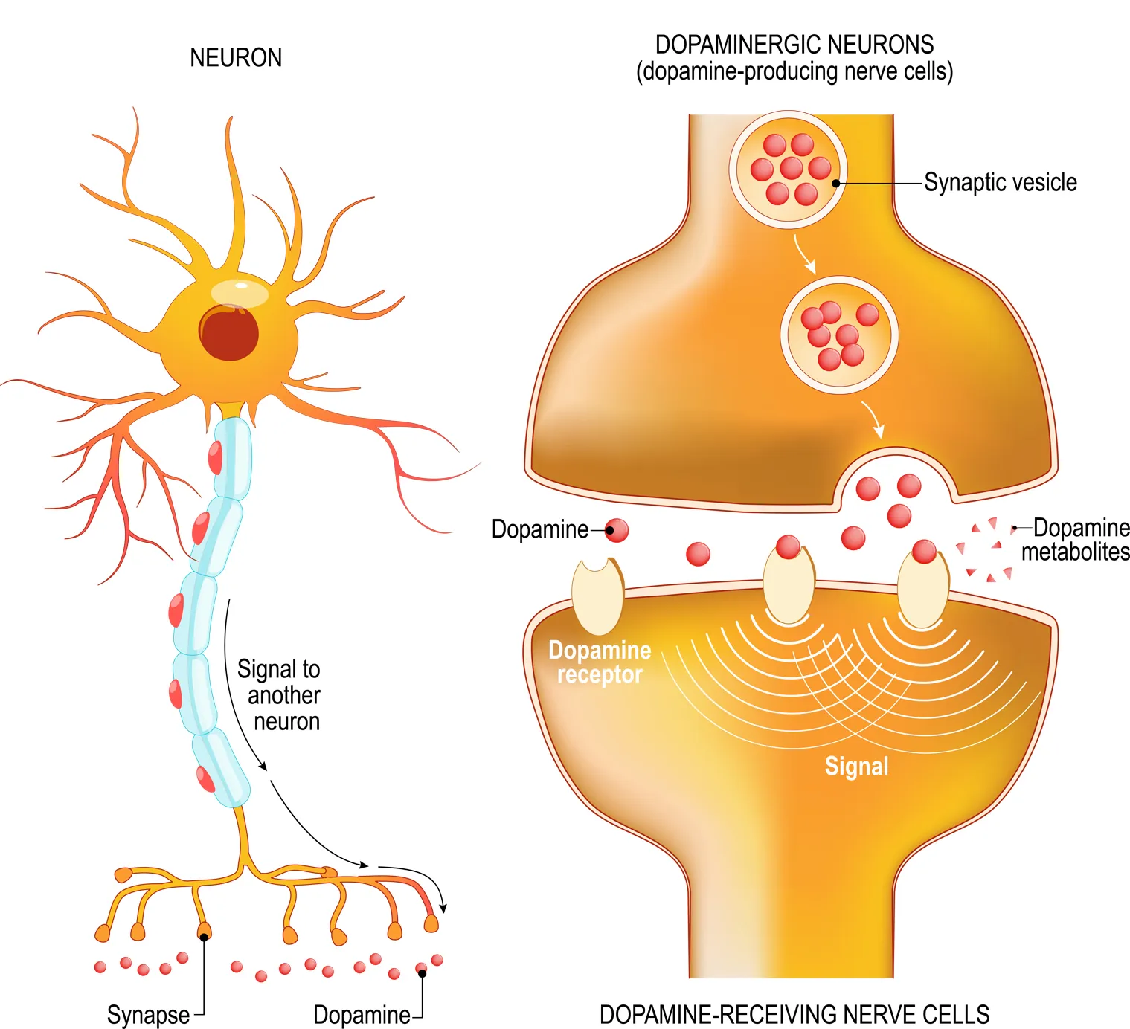
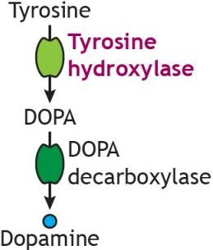
Dopamine and Iron
Dopamine: key neurotransmitter
  Responsible for reward-based behavior, motor control, and learning
Iron serves as a vital co-factor for the enzyme tyrosine hydroxylase → catalyst needed to commence dopamine synthesis
  Dopamine synthesis is linked to motivation, learning, and cognitive processing
  Iron concentration can be used as an indirect proxy for past dopamine activity
Iron is most abundant in the basal ganglia
  Regions of interest (ROI): Putamen, Caudate, Accumbens, and Pallidum
    Assists in reward processing and change during adolescence
Figure 3: Dopamine neurotransmission
Figure 4: Simplified dopamine synthesis pathway
(Bromberg-Martin et al., 2011 )
Assessing Quality Control of MRI-based Measurements of Iron in Subcortical Structures for Adolescent Learning
Northeastern University Young Scholars Program (YSP) | June 22, 2026 - July 30, 2026
Notes:
adil

Slide 5
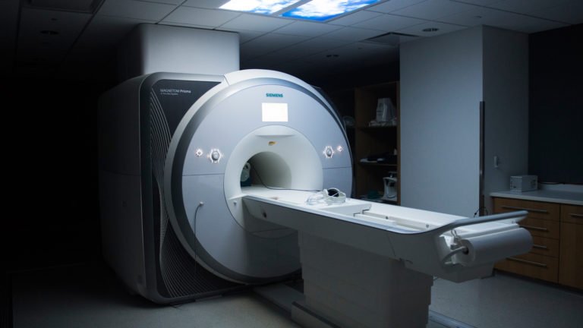
Magnetic Resonance Imaging (MRI)
MRI: non-invasive method to image the brain
  Safe for use in children and adolescents
  Radio waves and magnetism
    No harmful radiation or radioactive tracers
Analyzing MRI sequences → tissue iron concentrations in the brain → past dopamine activity
Our dataset: MRI scans from 131 subjects from ages 7-24 years, including 55,000+ image slices
Figure 5: Northeastern’s 3T MRI Scanner
(Haacke et al., 2005 )
Assessing Quality Control of MRI-based Measurements of Iron in Subcortical Structures for Adolescent Learning
Northeastern University Young Scholars Program (YSP) | June 22, 2026 - July 30, 2026
Notes:
Lena
Our data came from an MRI machine, and you may have heard of or gotten an MRI scan for common injuries. However, it can also be safely used for brain studies of children and adolescents, as it is a noninvasive method that uses radio waves and strong magnets instead of harmful radiation or radioactive tracers, like other methods
These MRI sequences can tell us the iron concentration levels in the brain, which is what we are using as a proxy for past dopamine activity.
Our dataset currently has MRI data from 131 participants from 7 to 24 years old, so that we can look at patterns both pre and post adolescence, and we have over 55k cross-sectional images of the brains in order to compare and assess for any patterns
-45sec
MRI: measures distribution of gray/white/CSF based on distribution of water
fMRI: brain activity based on oxygenated blood flow
PET: radioactive tracers to observe blood flow

Slide 6
Research Goals
Overall Research Question:
How do levels of tissue iron in the brain, specifically in the basal ganglia, vary across childhood, adolescence, and early adulthood?
Overall Research Question:
Do tissue iron levels in the brain relate to adolescent learning and behavior?
Our Goal:
Document MRI artifacts (image distortions) and decide for possible reprocessing/removal measures to increase the signal to noise ratio in our dataset
& assess iron distributions in the subcortical (deep brain) structures we are interested in for possible further research
Assessing Quality Control of MRI-based Measurements of Iron in Subcortical Structures for Adolescent Learning
Northeastern University Young Scholars Program (YSP) | June 22, 2026 - July 30, 2026
Notes:
Adil

Slide 7
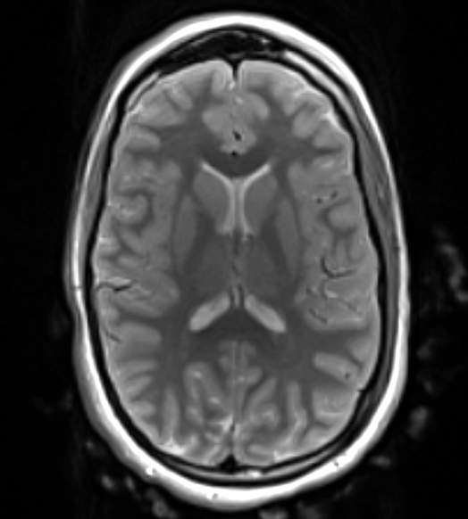
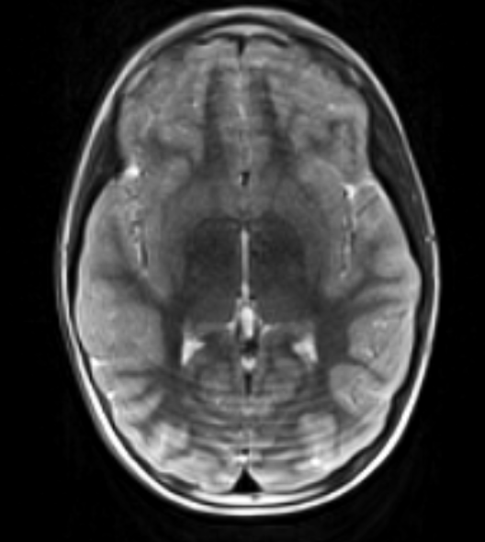
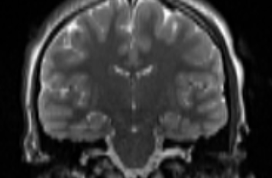
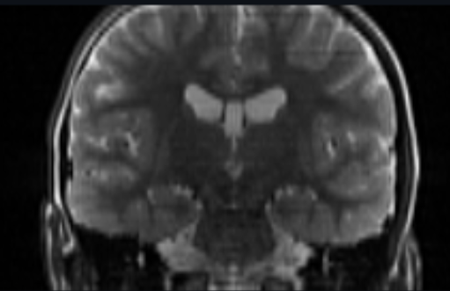
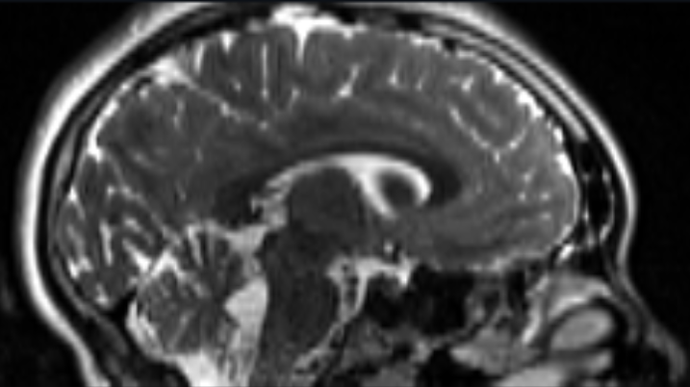
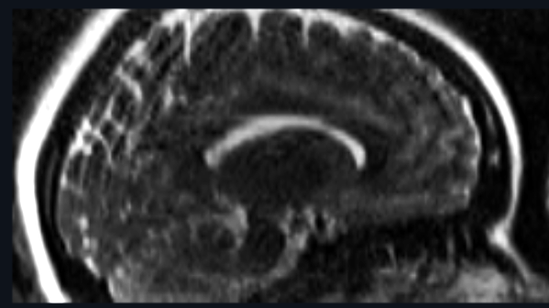
Identifying Artifacts: Ringing
Ringing:
Motion artifact caused by subject motion during MRI scan
Axial view
Our Scale:
1 - Great: No artifacts
2 - Pretty Good: subtle artifacts
3 - Let’s Talk: Moderate artifacts to discuss
4 - Severe: Noticeable deep artifacts
5 - Very Severe: Prominent deep artifacts
Coronal view
Sagittal view
Usable data
Needs removal
Figure 6: Ringing artifacts
Assessing Quality Control of MRI-based Measurements of Iron in Subcortical Structures for Adolescent Learning
Northeastern University Young Scholars Program (YSP) | June 22, 2026 - July 30, 2026
Notes:
Lena:
One of the main artifacts that we found was ringing, and it occurs when the participant moves their head inside the MRI, leading to these patterns around the brain that resemble tree rings [highlighted in red].
If these rings were particularly prominent or reached the center of the brain where the regions of interest were, then we marked it as needing removal. We rated the one on the right as a 4 on our 5 point scale that we used to evaluate the quality of all the scans, and we noticed that children had more instances of ringing, as they tend to have a harder time keeping still
30

Slide 8
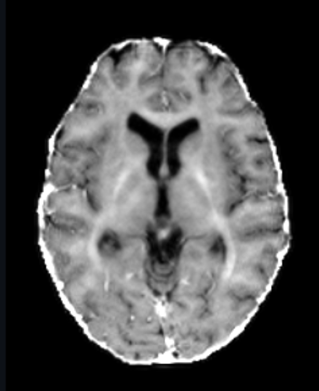
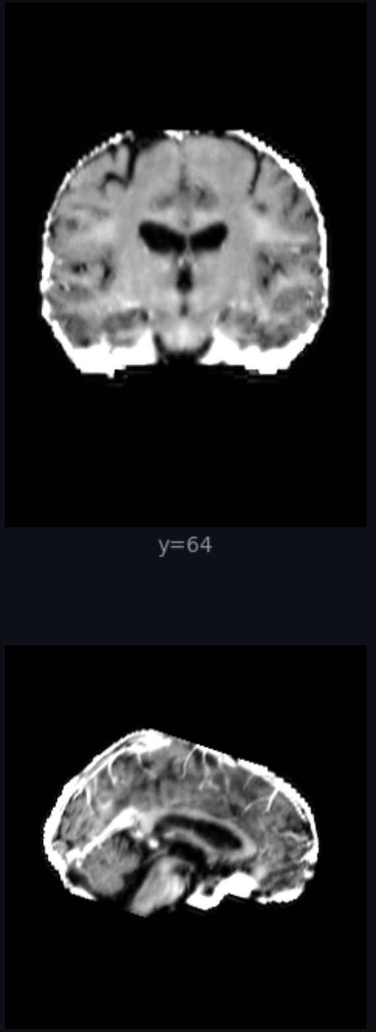
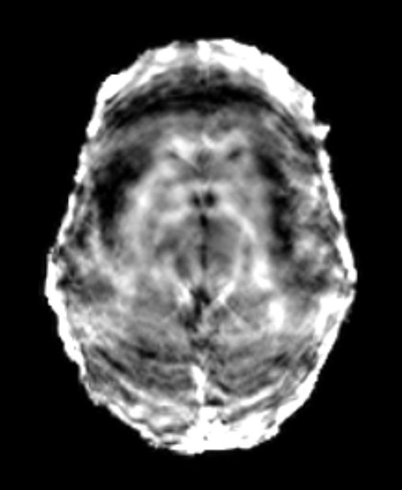
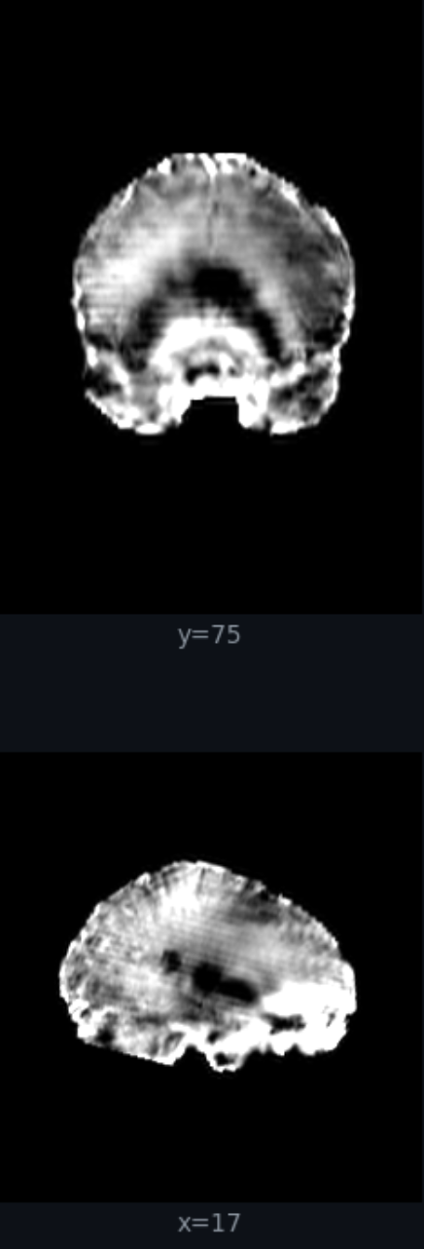
Identifying Artifacts: Shading
Axial view
Coronal view
Sagittal view
Shading:
Scanner artifact from improper image processing
Usable data
Our Scale:
1 - Great: No artifacts
2 - Pretty Good: subtle artifacts
3 - Let’s Talk: Moderate artifacts to discuss
4 - Severe: Noticeable deep artifacts
5 - Very Severe: Prominent deep artifacts
Needs removal
Figure 7: Shading artifacts
Assessing Quality Control of MRI-based Measurements of Iron in Subcortical Structures for Adolescent Learning
Northeastern University Young Scholars Program (YSP) | June 22, 2026 - July 30, 2026
Notes:
adil

Slide 9
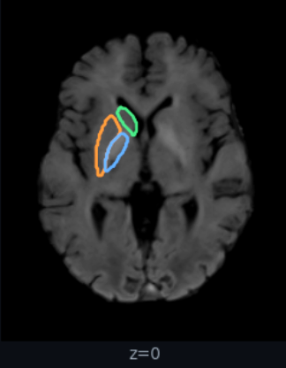
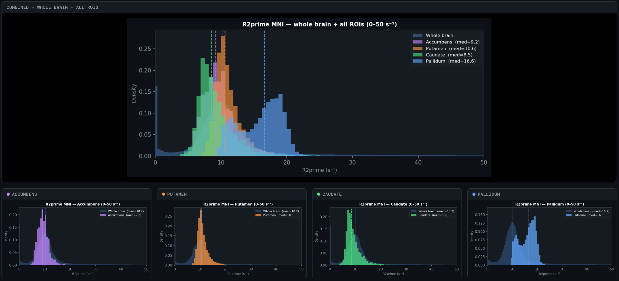
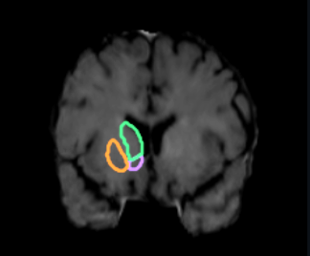
Iron Assessment
Goal:
Assess iron distributions in regions of interest for future studies of iron accumulation in subcortical structures
Putamen
Pallidum
Caudate
Accumbens
Figure 8: Subcortical structure iron distributions
Figure 9: Regions of interest
Assessing Quality Control of MRI-based Measurements of Iron in Subcortical Structures for Adolescent Learning
Northeastern University Young Scholars Program (YSP) | June 22, 2026 - July 30, 2026
Notes:
adil

Slide 10
Summary and Applications
Summary:
Scanned through 40,000+ MRI slices from 96 out of the 131 subjects in the lab’s dataset
Assessed iron distribution for all 96 subjects
Documented 4,230 MRI slices for possible reprocessing/removal
Applications:
The quality controlled MRI scans will be used by future studies in our lab:
  Understanding pro-social risk-taking in adolescents and its relation to dopamine function
  Reinforcement learning → how reward-based learning changes across age groups
Further research on adolescent learning and behavior can inform us more broadly upon:
  Education policies
  Juvenile justice laws
  Mental health vulnerabilities
Assessing Quality Control of MRI-based Measurements of Iron in Subcortical Structures for Adolescent Learning
Northeastern University Young Scholars Program (YSP) | June 22, 2026 - July 30, 2026
Notes:
Lena
Throughout our 6 weeks at the Learning and Brain Development Lab this summer, we assessed over 40k MRI slices from 96 of the 131 subjects in our lab’s dataset, analyzing iron distributions and marking artifacts in around 3k slices to either remove or reprocess that data
Our quality control data will be used for future studies our lab is currently doing: for example,
one of our mentors is studying the relation between dopamine and prosocial risk taking in adolescents, which is when someone takes a personal risk to help somebody else, such as standing up to a bully or protesting for a larger social cause
Our other mentor is studying reinforcement learning and how reward-based learning can vary across age groups
In addition, this research overall can inform us on broader applications of adolescent learning and behavior, such as improving policies in education, changing juvenile justice laws, and better understanding mental health and substance use risks.

Slide 11
Acknowledgements
The Learning and Brain Development Lab
Juliet Davidow, Associate Professor
Brianna Aubrey, Erica Niemiec Skelton, Zoe Kross, PhD Mentors
Ava Moore, Caitlyn Jaryszak, Lab Manager & Technician
Andrea Lopez Abarca, Maria Digilio, Undergraduate Researchers
Sophia Iacobelli, Cad McConnell, Co-Ops
High School Interns:
Vivian, Pete, Mimi, Saisha
Center for STEM Education​
Claire Duggan, Executive Director
Jennifer Love, Associate Director
Ahmed Othman, Kenneth Santizo Carbajal, Frances Corcell, YSP Coordinators​
Nicolas Fuchs, Program Manager
Mary Howley, Administrative Officer
Assessing Quality Control of MRI-based Measurements of Iron in Subcortical Structures for Adolescent Learning
Northeastern University Young Scholars Program (YSP) | June 22, 2026 - July 30, 2026
Notes:
Lena

Slide 12
Work Cited
@neurochallenged. “Basal Ganglia - Definition.” @Neurochallenged, https://neuroscientificallychallenged.com/glossary/basal-ganglia. Accessed 27 July 2026.
Boyes, Amanda, et al. “Basal Ganglia Correlates of Wellbeing in Early Adolescence.” Brain Research, vol. 1774, Jan. 2022, p. 147710, https://doi.org/10.1016/j.brainres.2021.147710.
Bromberg-Martin, Ethan S., et al. “Dopamine in Motivational Control: Rewarding, Aversive, and Alerting.” Neuron, vol. 68, no. 5, Dec. 2010, pp. 815–34, https://doi.org/10.1016/j.neuron.2010.11.022. Accessed 27 July 2026.
Davidow, Juliet Y., et al. “An Upside to Reward Sensitivity: The Hippocampus Supports Enhanced Reinforcement Learning in Adolescence.” Neuron, vol. 92, no. 1, Oct. 2016, pp. 93–99, https://doi.org/10.1016/j.neuron.2016.08.031.
Haacke, E. Mark, et al. “Imaging Iron Stores in the Brain Using Magnetic Resonance Imaging.” Magnetic Resonance Imaging, vol. 23, no. 1, Elsevier BV, Jan. 2005, pp. 1–25, https://doi.org/10.1016/j.mri.2004.10.001. Accessed 27 July 2026.
Larsen, Bart, et al. “Maturation of the Human Striatal Dopamine System Revealed by PET and Quantitative MRI.” Nature Communications, vol. 11, no. 1, Feb. 2020, https://doi.org/10.1038/s41467-020-14693-3.
Parr, Ashley C., et al. “Contributions of Dopamine-Related Basal Ganglia Neurophysiology to the Developmental Effects of Incentives on Inhibitory Control.” Developmental Cognitive Neuroscience, vol. 54, Elsevier, Mar. 2022, p. 101100, https://doi.org/10.1016/j.dcn.2022.101100. Accessed 27 July 2026.
Wilbrecht, Linda, and Juliet Y Davidow. “Goal-Directed Learning in Adolescence: Neurocognitive Development and Contextual Influences.” Nature Reviews Neuroscience, Nature Portfolio, Jan. 2024, https://doi.org/10.1038/s41583-023-00783-w.
Assessing Quality Control of MRI-based Measurements of Iron in Subcortical Structures for Adolescent Learning
Northeastern University Young Scholars Program (YSP) | June 22, 2026 - July 30, 2026

Slide 13
