Slide 1





Alexander Braga
John D. O’Bryant School of Math and Science
Vanadium Pentoxide Cathodes in Aqueous Zinc Ion Batteries
Tarun Kannan
Acton-Boxborough Regional High School
Alexander Braga and Tarun Kannan
July 30, 2026
YSP Final Presentation
Surafel Mustefa Beyan
PhD Student, Chemical Engineering, Northeastern University
Joshua Gallaway
Associate Professor, Chemical Engineering, Northeastern University
Notes:
Alex first (Name and School
Tarun intro, this summer, we in ACES…
Alex→title

Slide 2
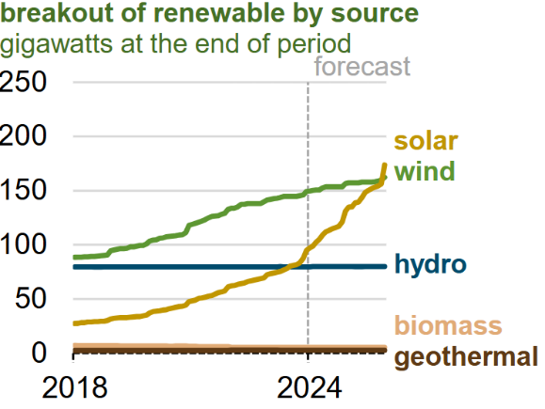
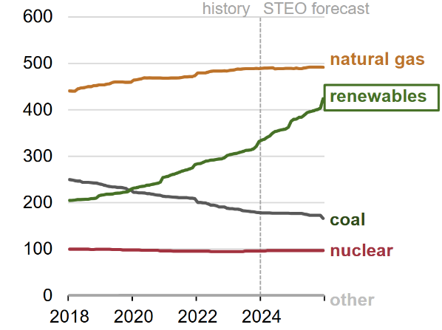
  Background
Capacity addition(GW)
Increasing demand for grid energy storage solutions
Necessary when energy production exceeds demand
Useful at later ours to ease ramping of non-renewables (ex. Fossil fuels)
Capacity addition(GW)
Notes:
alex, renewbale graphs |

Slide 3
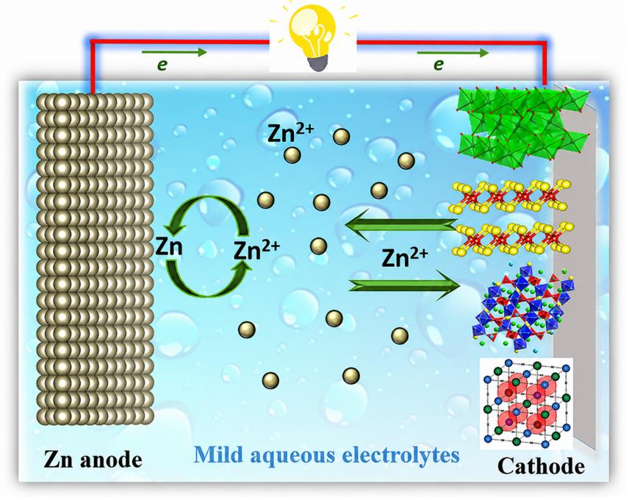
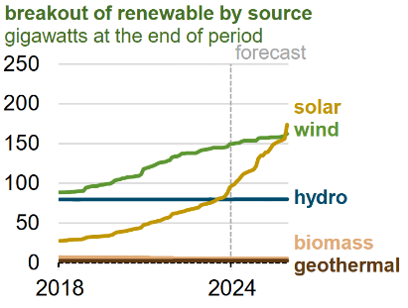
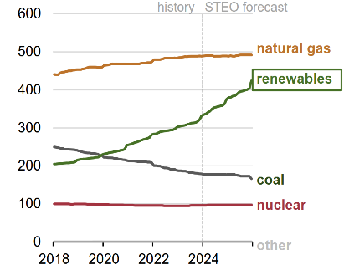
  Background
Li-ion batteries
  Expensive
  Flammable
  Scarce
Zn – V₂O₅
  Cheaper
  Safer
  Abundant
Our battery
  Multiple oxidation states (V⁺⁵ ⇄ V⁺⁴ ⇄ V⁺³)
  Layered structure (intercalation)
Notes:
Tarun (talk abt lithium vs V205)

Slide 4
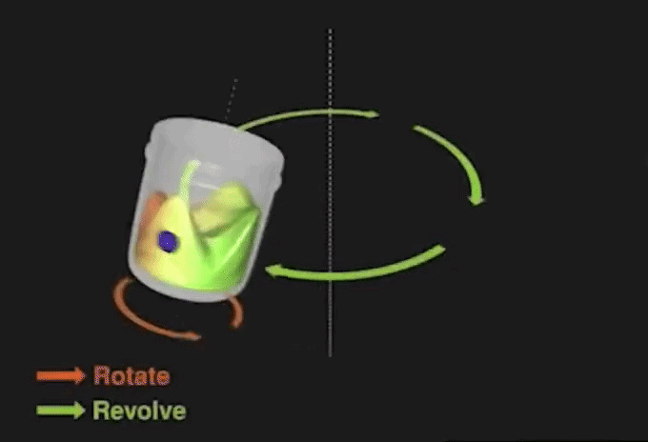
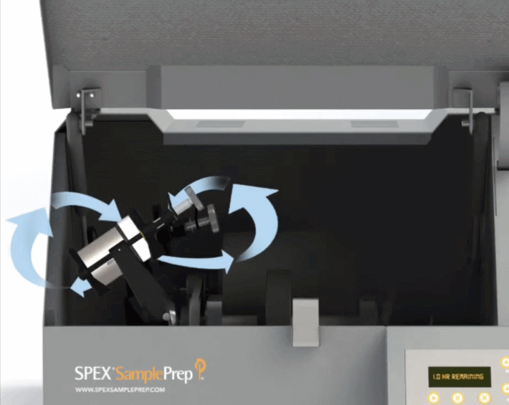
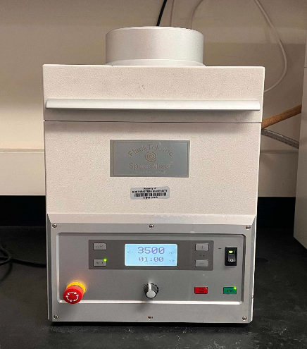
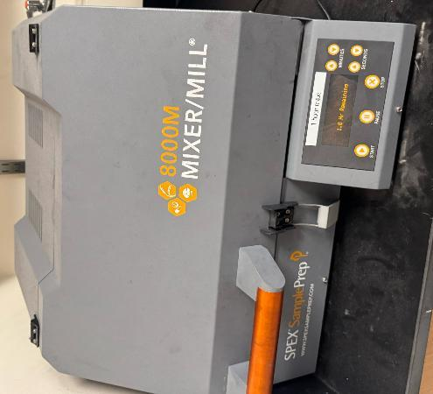
  Experiment Design
Cell batches were created with 0.5 M, 1.0 M, and 2.0 M electrolyte concentrations
Cathode Composition: Active material (V₂O₅), Conductive Carbon (acetylene black), Binder (PVDF)
FlackTek
Ball Mixer/Mill
Trial # | Size Reduction | Slurry Ratio¹: | C-Rate²
1 | FlackTek | 70:20:10 | C/10
2 | FlackTek & Sieve | 70:20:10 | C/10
3 | Ball Milling & Sieve | 70:20:10 | C/20
1. Slurry ratio represents the ratio (by mass) of V₂O_{5,} Acetylene Black and PVDF.
2. C-Rate indicates the ratio of charging rate to the amperage the cell would take to fully charge in 1 hour. (ex. C/20 could take 20 hours to charge, while 2C could take 30 minutes.)
Notes:
Tarun, first bullets (electrolyte concentrations) and (electrolyte composition, what each one does)
Alex( Explain trial 1 and 2 and 3, skip 212 µm

Slide 5
  Hypotheses
HYPOTHESIS:
Greater ZnSO₄ electrolyte concentrations would result in greater achievable specific capacities.
SUPPLEMENTAL HYPOTHESIS:
Cathode fabrication method will influence electrochemical performance.

Slide 6
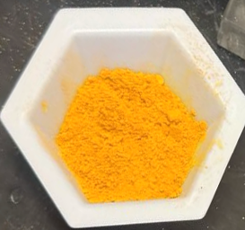
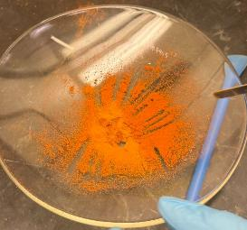
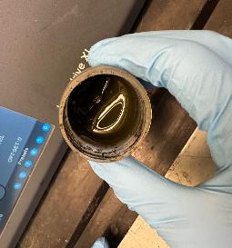
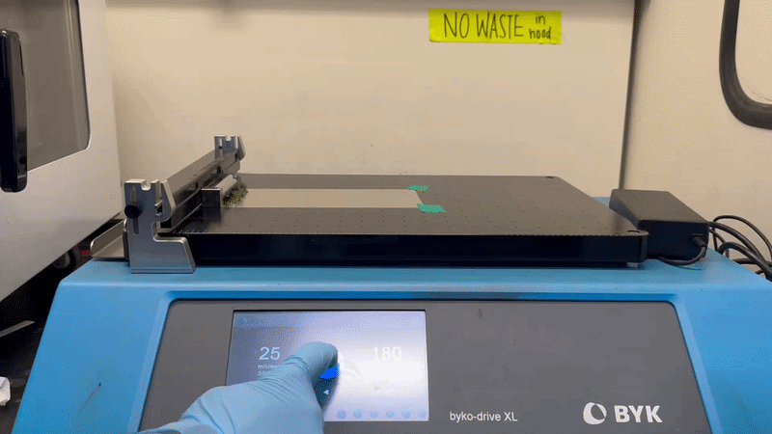
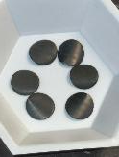
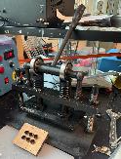
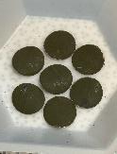
  Cathode Preparation
FlackTek/Ball Milling V₂O₅
  Mix with Acetylene Black + PVDF → creates slurry
  FlackTek mixing
Slurry to Cathode
  DoctorBlade coating
  Heat plate surface drying
  Vacuum drying
Extracting Cathodes
  Die press cathodes
  Flatten cathodes
FlackTek
Ball Milling
Slurry
Notes:
Tarun: milling and slurry to cathode (omit specifics, not temp/times)
Alex, extraction

Slide 7

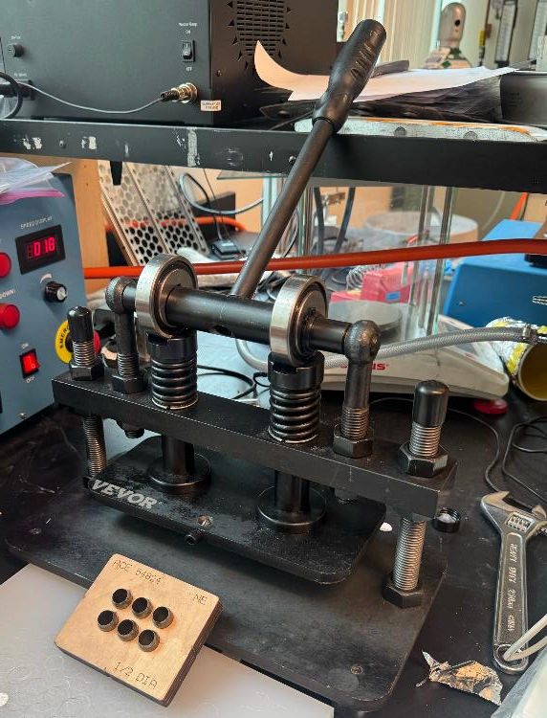
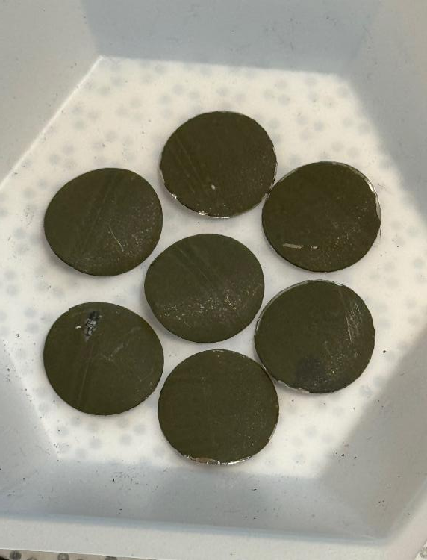
  Cathode Preparation
Good Cathodes
Die Press
Bad Cathodes
Notes:
Alex, quick point out difference between (smooth vs streaky, chips on the edge)

Slide 8
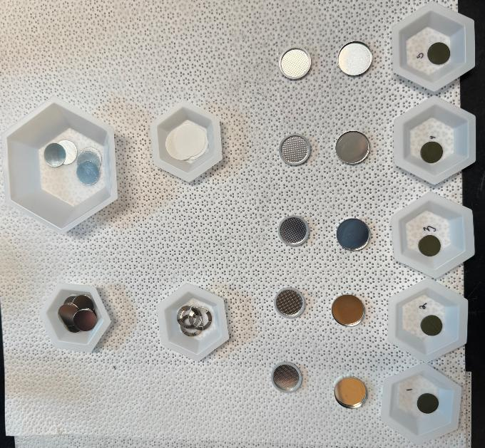
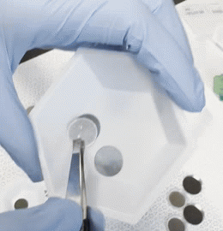
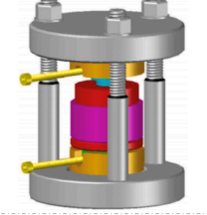
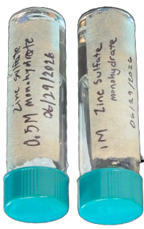
  Coin Cell Assembly
Prepare all materials as shown
Assemble from negative casing to positive
Crimp cells with ≈ 1 ton of force using a Coin Cell Crimper.
Zinc Foil
Spacer
Separator
Spring
Negative casing
Positive casing
V₂O₅ Cathode
ZnSO₄ Electrolyte
Solutions
Notes:
Tarun→the cathodes were done, we needed to build our coin cells. As you can see, there are numerous different components. We assembled each one part by part as shown on the screen, and sealed them off with almost 1 ton of force with our crimper.

Slide 9
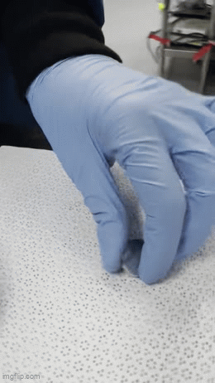
  Coin Cell Assembly
Notes:
Alex: for our coin cells, each component plays an important role. The spring ensure constant pressure inside of the cell, and the two spacers distribute the pressure across the whole area. The Zn foil serves as our anode, and the glass fiber separator holds our aqueous electrolyte allowing for the free movement of ions, while preventing short circuiting. Lastly, our custom dried V2o5 slurry serves as our cathode.

Slide 10
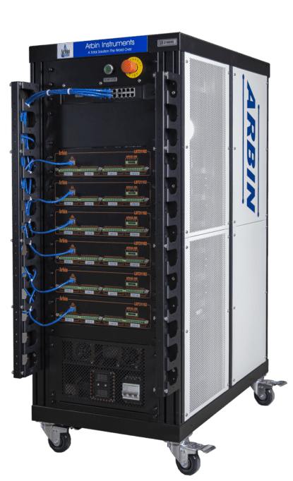
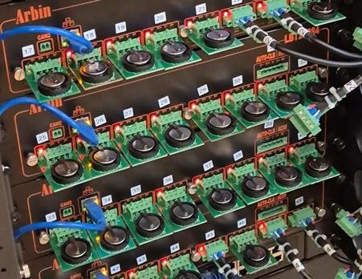
  Testing & Data Collection
ARBIN battery cycler system
  Charged and discharged each battery while recording electrical performance
Measurements Recorded
  Voltage (V)
  Current (A)
  Capacity (mAh)
  Specific Capacity (mAh/g)
Charge/Discharge Conditions
  C/10 (10 hours for 1 charge)
  C/20 (20 hours for 1 charge)
Rest
Discharge
Rest
Charge
Repeat

Slide 11
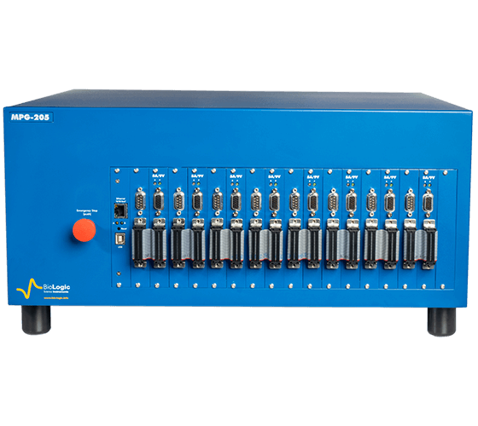
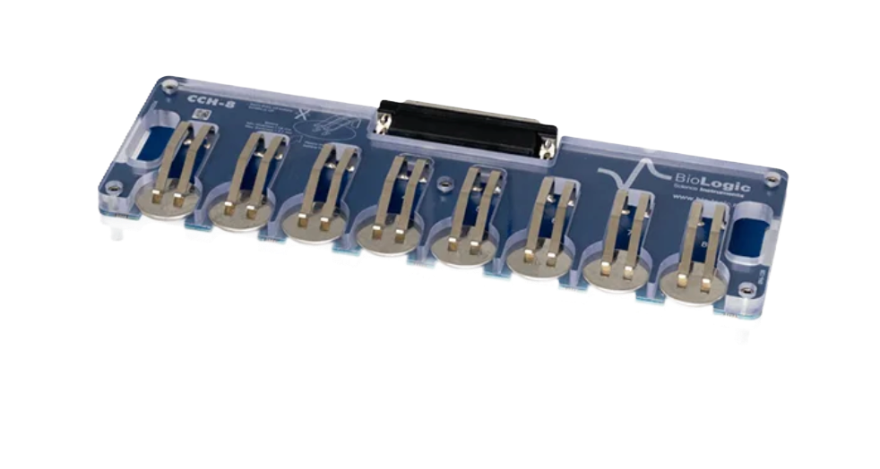
  Analysis
Galvanostatic Cycling
Cyclic Voltammetry – Sweeping Voltage
Potentiostatic Electrochemical Impedance Spectroscopy (PEIS) – Sinusoidal Voltage
Notes:
Cyclic Voltammetry: applies sweeping voltage; shows reversability of material + if any material changes occur
Potentiostatic electrochemical impedance spectroscopy: applies sinusoidal voltage; measuring charge transfer resistance + material impedance

Slide 12
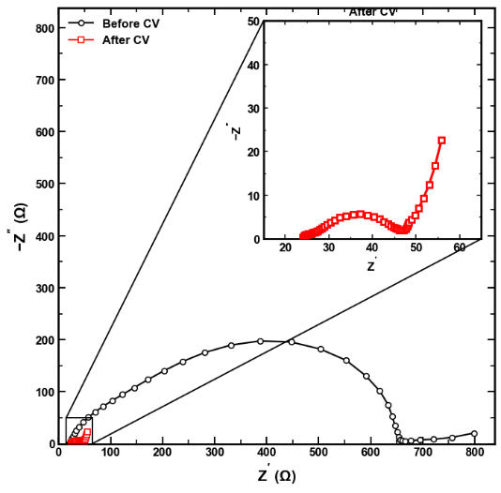
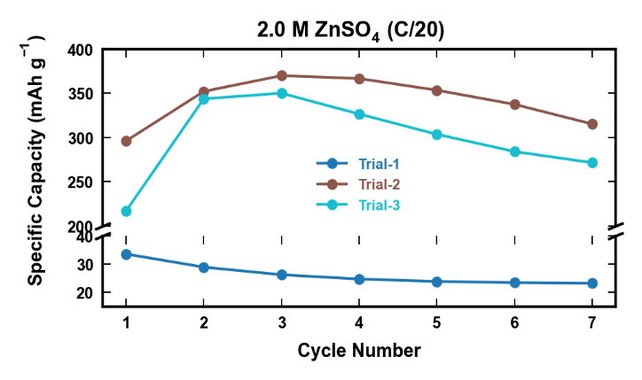
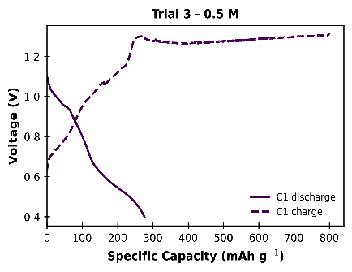


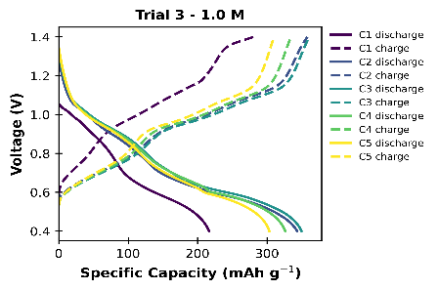
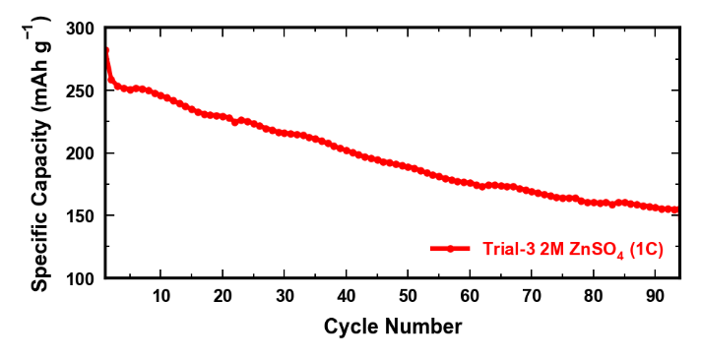
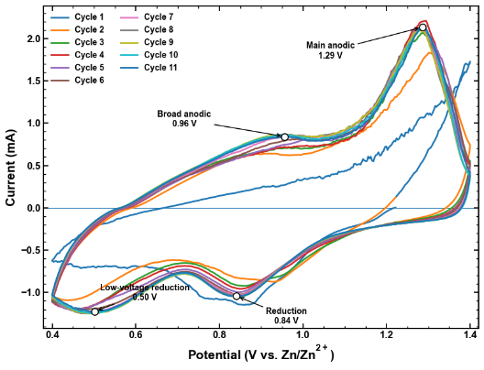
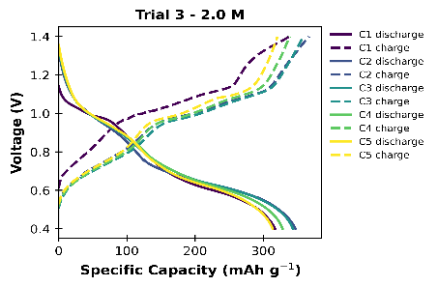
  Results
Figure 1: Significantly less resistance post CV
Figure 3: Specific capacity increases after the first cycle – material changes
Figure 5: Cell failure during 1st cycle
Parasitic Reaction
Figure 6 & 7: Great specific capacity achieved by 2.0 M electrolyte
Figure 4: Specific capacity decreased as expected at 1C
Figure 2: After 2 cycles, material changes and shows consistent cycling
Notes:
CV graph→after the first 2 cycles, with v2o5 intercalates. We can see different chemical reactions occurring at the peaks. Further, this indicates REVERSABILITY
PEIS→here, we can see the impedance decreases significantly after our cyclic voltammetry.

Slide 13
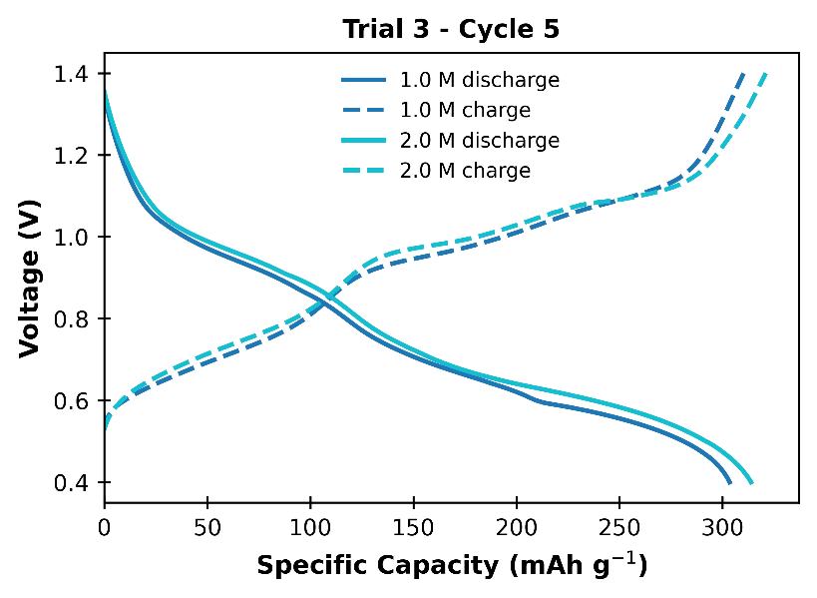
  Discussion and Conclusions
Why did higher ZnSO₄ concentrations improve battery performance?
  Greater charge carriers = higher Zn²⁺ ion flux/concentration near the electrode surface
  Improved cycling stability by reducing water activity
  More Zn²⁺ intercalation
  Reduce side reactions
Why did Ball Milling + sieving + oven produce consistent electrodes?
  Ball Milling → reduced V₂O₅ particle size
  Vacuum Oven Drying → removed moisture
  Sieving → removed agglomerates
Trial 3 - 2.0 M exhibited a slightly greater specific capacity after 5 cycles
Notes:
improved mixing w carbon black and pvdf and more uniform slurry.
more active material distribution
•= more exposed V₂O₅ + more Zn²⁺ access → more energy stored**

Slide 14
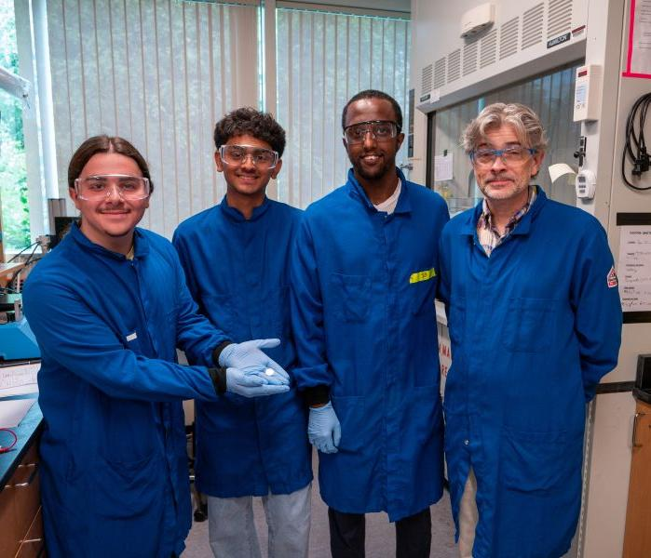
  Future Work
Limitations:
  Small sample size
  Limited testing time
Next Steps:
  Optimize cathode fabrication
  Create and use 3.0 M ZnSO₄ electrolyte
Notes:
Alex: Main takeaway + limitations
Tarun: Next steps

Slide 15
  Acknowledgements
Thank You
Analysis of Complex Electrochemical Systems Lab
Professor Joshua Gallaway, Associate Professor, Department of Chemical Engineering
Surafel Mustefa Beyan, PhD Student, Department of Chemical Engineering
Center for STEM Education​
Claire Duggan, Executive Director
Jennifer Love, Associate Director
Ahmed Othman, Frances Corcell, & Kenneth Santizo, YSP Coordinators​
Nicolas Fuchs, Program Manager
Mary Howley, Administrative Officer
Notes:
TOGETHER, thank tou

Slide 16
  References
U.S. Energy Information Administration, Short-Term Energy Outlook (STEO), January 2024
https://www.youtube.com/watch?v=HCxei0O_kiE
https://www.youtube.com/watch?v=CAnamYWi8HY
https://www.arbin.com/battery-test-equipment/battery-test-product-series/lbt-series.html
https://www.proactiveinvestors.com.au/companies/news/1093006/critical-resources-says-sulphur-free-electrolyte-benchmarks-sulphide-class-solid-state-battery-performance-1093006.html
https://www.biologic.net/
Lio, Y et al. Energies 2023, 16, 7443
Notes:
TOGETHER, thank tou

Slide 17
  POSTER

