Slide 1




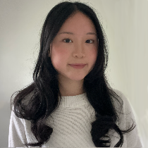
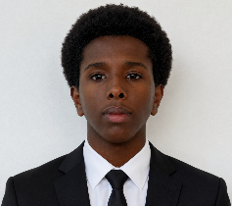

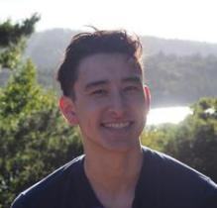

Leveraging Robot Gaze to Signal Membership in Dynamic Group Settings
Alina Shi, YSP Student, Belmont High School
Ilyas Mohamed, YSP Student, Cambridge Rindge and Latin School
Reina Chan - PhD Student
Drake Moore - PhD Candidate
Xiang Zhi Tan – Assistant Professor
Leveraging Robot Gaze to Signal Membership in Dynamic Group Settings
Northeastern Young Scholars Program June 22, 2026 - July 30, 2026
1
Notes:
Rehearse the introduction to our project

Slide 2
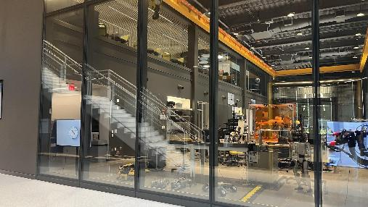

Background
What is the EXP Building?
Northeastern’s EXP building receives groups of visitors who may be unfamiliar with the building and its research.
  No official “welcome system”
Robots may be useful in public spaces because they can provide interactive information rather than static visuals.
How can a robot be integrated into EXP’s entrance?
Leveraging Robot Gaze to Signal Membership in Dynamic Group Settings
Northeastern Young Scholars Program June 22, 2026 - July 30, 2026
Notes:
Ilyas
First describe what EXP is
More engaging when speaking
Constrain to basic ideas

Slide 3

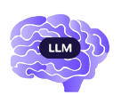
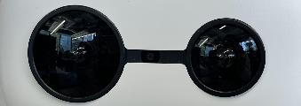


Motivation & Goal
Humans use gaze to signal various things:
Thinking
Focusing on people
Directing attention to objects
People humanize robots, maintaining engagement requires:
Gaze
Dialogue
Body Movement
Use the social robot to explore different ways of interaction and robot behavior with groups using Python, computer vision and language learning models.
How can we utilize robot gaze and speech to increase engagement with dynamic audiences?
Combine
Leveraging Robot Gaze to Signal Membership in Dynamic Group Settings
Northeastern Young Scholars Program June 22, 2026 - July 30, 2026
Notes:
Alina

Slide 4
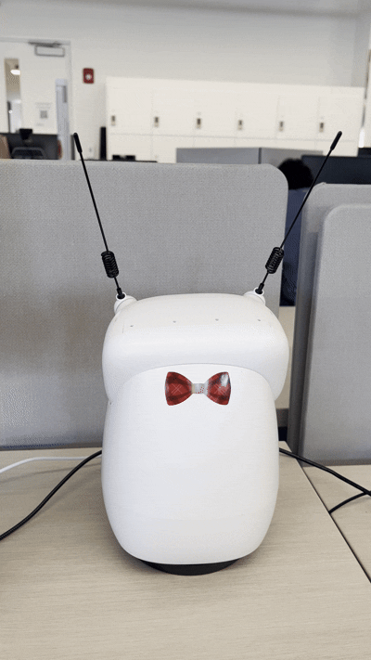
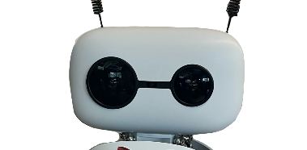
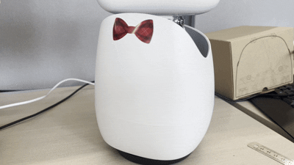
Meet Our Robot: Rocky!
Key features we used:
Camera
Head Movement
Body Yaw
Leveraging Robot Gaze to Signal Membership in Dynamic Group Settings
Northeastern Young Scholars Program June 22, 2026 - July 30, 2026
Notes:
Alina
Head movement Every direction: (Up down left right, roll/tilt, pitch, and yaw/turn

Slide 5
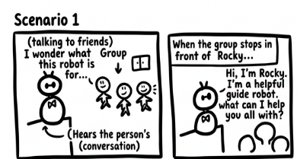
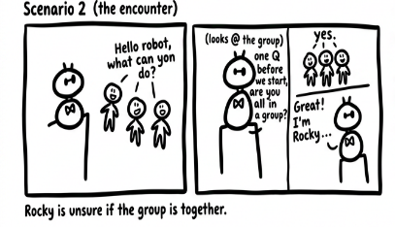
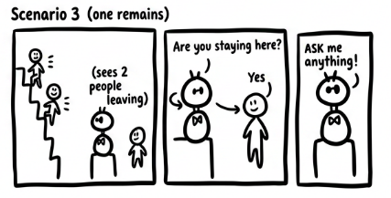
Rocky’s Purpose
We want Rocky to serve as a guide for newcomers at Northeastern.
To accomplish this, Rocky needs two complementing parts:
Gaze/Movement
Speech
Coordinate physical and verbal signals
Leveraging Robot Gaze to Signal Membership in Dynamic Group Settings
Northeastern Young Scholars Program June 22, 2026 - July 30, 2026
Notes:
Alina
Introduce storyboard: Different movements for each interaction + dialogue. Different scenarios of different situations that may happen

Slide 6
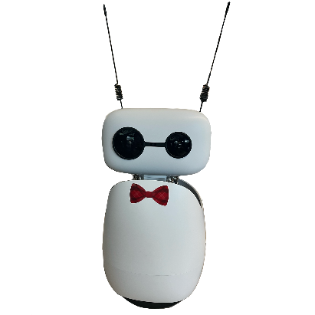

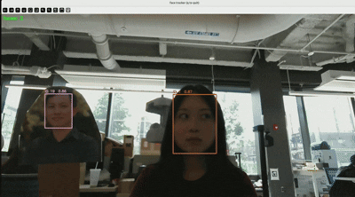
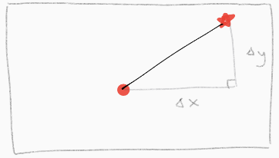
Experimental Methods - Face Tracking
Ultralytics Face Tracker - YOLO Model
Assigns each face with a unique ID number
Bounding box, confidence level
Consistency allows for switching between detected faces
Calculating yaw/pitch angle from change in displacement
Translates the change in head position to the robot’s angular motion
Leveraging Robot Gaze to Signal Membership in Dynamic Group Settings
Northeastern Young Scholars Program June 22, 2026 - July 30, 2026
Notes:
Alina
Ultralytics:in order to keep “eye contact” with people through gaze, we used this face tracker to identify faces
WIth this, Rocky could identify faces, but in order to actually show how its gaze follows a person, the change in position of a person has to translate into the change in Rocky’s head and body angular movement
Because Rocky’s view of a person is 2D, and his movement is angular, we had to use a formula to convert the change in position of a face to the amount Rocky should turn its head/body

Slide 7
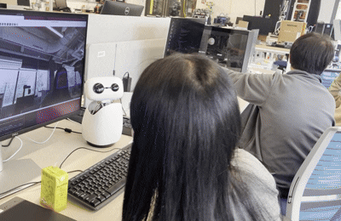
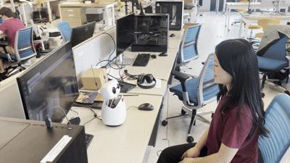
Experimental Methods - Movement Adjustments
PI controller
Used to stabilize and smoothen robot movement
Error = difference between a target value and measured value
Proportional: immediate, Integral: accumulated - combines the two error correction methods
Before PI Control:
Jittery
From sudden changes in frame
After PI Control:
Much smoother Movement
Leveraging Robot Gaze to Signal Membership in Dynamic Group Settings
Northeastern Young Scholars Program June 22, 2026 - July 30, 2026
Notes:
Alina
Implemented PI control
This is how the robot was beforehand, its movement is jerky because of pixel noise and sudden frame changes
Replace image

Slide 8
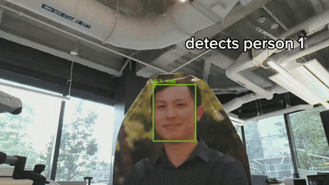
Working Gaze System: Demo
Note:
Newcomer acknowledgement
Uniting “groups”
Recognizing individuals in a group
Leveraging Robot Gaze to Signal Membership in Dynamic Group Settings
Northeastern Young Scholars Program June 22, 2026 - July 30, 2026
Notes:
Ilyas

Slide 9



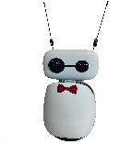


2 ) Rocky Responds
1 ) User asks a question
Rocky speaks the response, then listens for the next question
4 ) Rocky listens
3) LLM generates response
Leveraging Robot Gaze to Signal Membership in Dynamic Group Settings
Northeastern Young Scholars Program June 22, 2026 - July 30, 2026
Notes:
Ilyas

