Slide 1
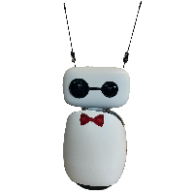
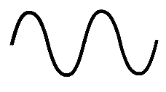

Speech input
Recognizer adjusts for background noise
Visitor speaks to Rocky
Program records the audio
Leveraging Robot Gaze to Signal Membership in Dynamic Group Settings
Northeastern Young Scholars Program June 22, 2026 - July 30, 2026
Notes:
Ilyas
Add reachy, long Audio strip noise background, remove noise background, clip a section for time

Slide 2

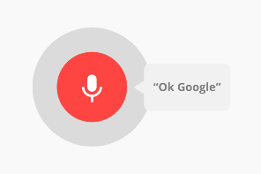

Speech-to-Text
If speech is unclear, the program handles the error
Recorded audio is sent to Google Speech Recognition
Speech is converted into text
Leveraging Robot Gaze to Signal Membership in Dynamic Group Settings
Northeastern Young Scholars Program June 22, 2026 - July 30, 2026
Notes:
Signpost
Ilyas
Make format more consistent

Slide 3

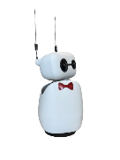




Large Language Model
System prompts define the robot’s role and restrict what it should discuss.
Recognized text is sent to a Gemma LLM through Northeastern’s PARCS LLM gateway.
I am here to help you learn more about northeastern
Who is the greatest athlete of all time
The LLM generates a response based on the user’s question and conversation context
LLM
Conversation history preserved so later responses can use previous messages.
Leveraging Robot Gaze to Signal Membership in Dynamic Group Settings
Northeastern Young Scholars Program June 22, 2026 - July 30, 2026
Notes:
Ilyas
Image can be first
Add video
Add animation

Slide 4

Text-to-speech
Speech Manager receives the text and Edge TTS converts the text into audio
mpg123 plays the audio and Rocky speaks to the visitor
Audio is saved as an mp3 file
Leveraging Robot Gaze to Signal Membership in Dynamic Group Settings
Northeastern Young Scholars Program June 22, 2026 - July 30, 2026
Notes:
Ilyas
Signpost
Take out voice part
LLM, edge_tts

Slide 5
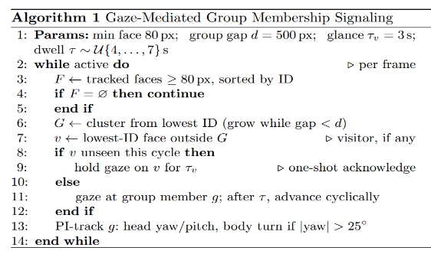

Results
Programmed Rocky to recognize newcomers and invite them to groups
Acknowledge each person in a group setting, making eye contact
Body turns to match head at a certain threshold
Creates an interactive Q&A with visitors
Informs visitors about the EXP building
Combined both: Robot can communicate with speech and movement
Visit Rocky !
Leveraging Robot Gaze to Signal Membership in Dynamic Group Settings
Northeastern Young Scholars Program June 22, 2026 - July 30, 2026
Notes:
Alina
Formalize the robot’s movement
Add more facts about what we did
Add video?

Slide 6
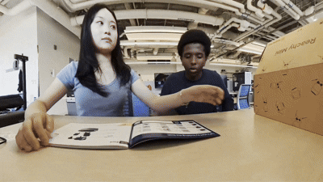
Takeaways
Our first time building and programming a robot that can interact with humans
LLMs can make responses feel more conversational
Custom prompts help shape the robot’s behavior
Consistent face tracking works well by comparing current and past positions
Shifting gaze can be used to unify groups and acknowledge visitors
Social robots involve more than just the mechanics and programming - it also studies different human behaviors
Leveraging Robot Gaze to Signal Membership in Dynamic Group Settings
Northeastern Young Scholars Program June 22, 2026 - July 30, 2026
Notes:
Ilyas
More informal, what’s new

Slide 7
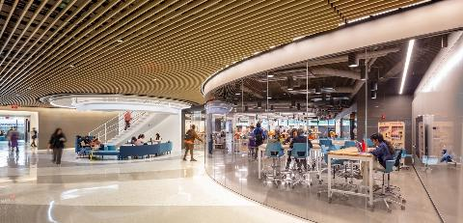
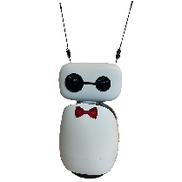


Future Steps
Test the robot in a real-world environments such as the EXP Building
Improve integration between speech and movement
Develop more skills for diverse audiences
  Personalization
Adding facial recognition
  Conversational history of many interactions
Person 1
Person 2
Person 1
How do different gaze patterns influence visitors’ engagement with the conversation?
How can the robot accommodate for multiple groups simultaneously?
Leveraging Robot Gaze to Signal Membership in Dynamic Group Settings
Northeastern Young Scholars Program June 22, 2026 - July 30, 2026
Notes:
Alina

Slide 8
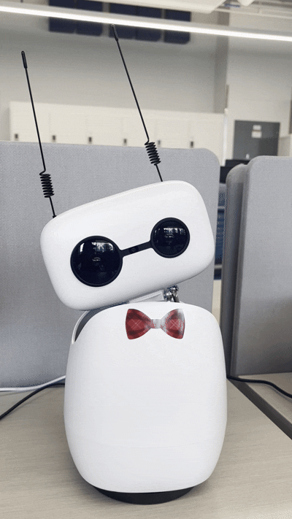
Acknowledgments
People And Robot Collaborative Systems (PARCS) Lab
Xiang Zhi Tan, Assistant Professor of Computer Science
Reina Chan, PhD Student
Drake Moore, PhD Candidate
Center for STEM Education​
Claire Duggan, Executive Director
Jennifer Love, Associate Director
Ahmed Othman, Kenneth Santizo & Frances Corcell, YSP Coordinators​
Nicolas Fuchs, Program Manager
Mary Howley, Administrative Officer
Leveraging Robot Gaze to Signal Membership in Dynamic Group Settings
Northeastern Young Scholars Program June 22, 2026 - July 30, 2026
Notes:
Speakers, parents, peers

Slide 9
