Slide 1











Interference Signal Power Monitoring within Front-End Circuits of Wireless Receivers
Angela Wang, YSP Student, Needham High School
Chenghao Xu, YSP Student, Massachusetts Academy of Math and Science at WPI
Yunfan Gao, Electrical and Computer Engineering, Northeastern University
Minghan Liu, Electrical and Computer Engineering, Northeastern University​
Thomas Gourousis, Electrical and Computer Engineering, Northeastern University
Professor Marvin Onabajo, Electrical and Computer Engineering, Northeastern University​
Notes:
Thomas feedback!
Comparison table → write what input conditions measurements were made in, be clear (e.g. talk about at gif) power level + freq range
Fsl slide, make a stronger point of problem v solution → VERY CLEAR!!!!!
Fsl isn’t in everything
Check citations

Slide 2


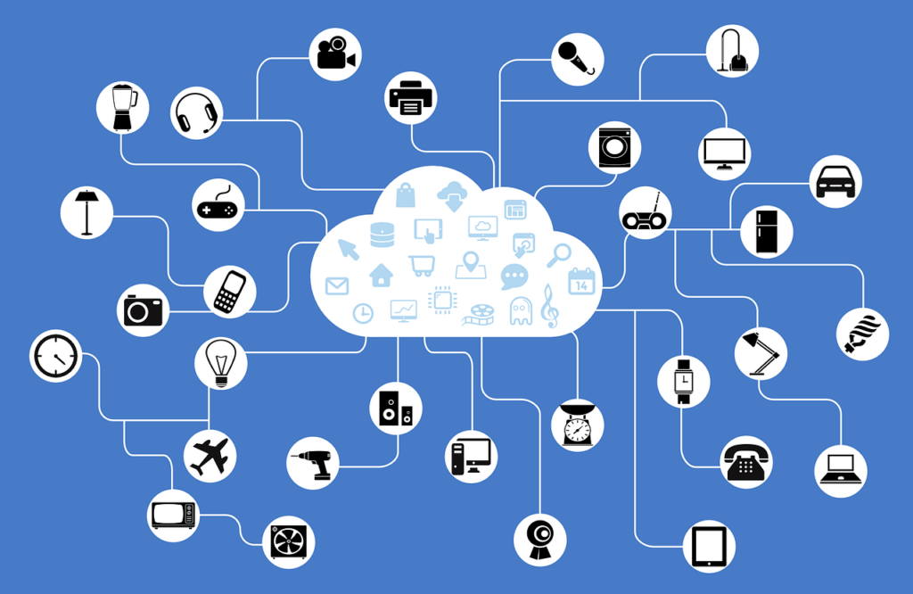
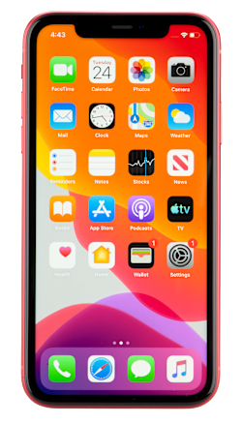

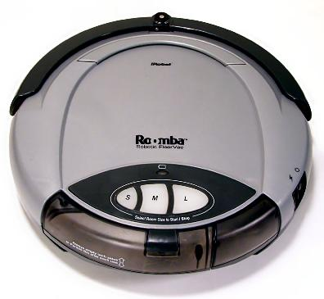



AMSIC Research Lab
What Makes Up the Internet of Things?
Interference Signal Power Monitoring within Front-End Circuits of Wireless Receivers
Slide 02 / 14 - Northeastern University Young Scholars Program 2026 - July 30, 2026

Slide 3
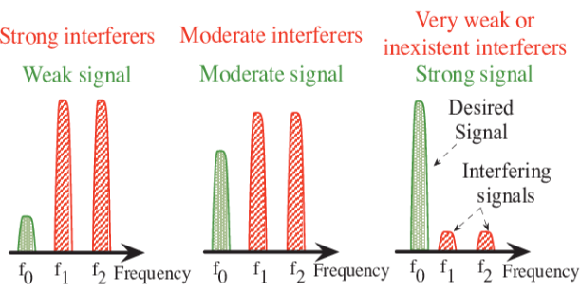
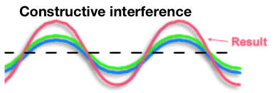

AMSIC Research Lab
Background: Signal Interference
Increased density of overlapping wireless signals
Reliable communication requires signal isolation
Advanced signal filtering and inference mitigation techniques are needed for Radio Frequency (RF) signals
A. Didioui, C. Bernier, L. Q. V. Tran and O. Sentieys, "EnvAdapt: An Energy-Aware Simulation Framework for Power-Scalable Transceivers for Wireless Sensor Networks,“ in Proc. European Wireless Conference, 2014.
Interference Signal Power Monitoring within Front-End Circuits of Wireless Receivers
Slide 03 / 14 - Northeastern University Young Scholars Program 2026 - July 30, 2026
Notes:
https://dbabsorber.com/blogs/blog/radio-frequency-jamming-communication-networks?srsltid=AfmBOoo_7cMB2O3kYd9-MVXvkiuCjfiHsQVxnkYnDZZNA174u4RvynbG
Wi-Fi, cellular networks, GPS, Bluetooth

Slide 4
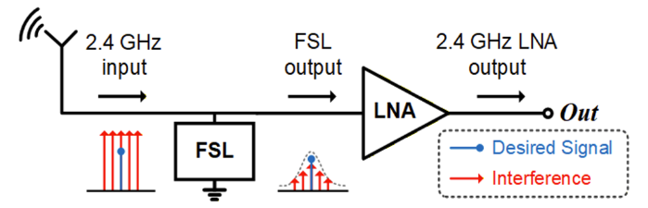
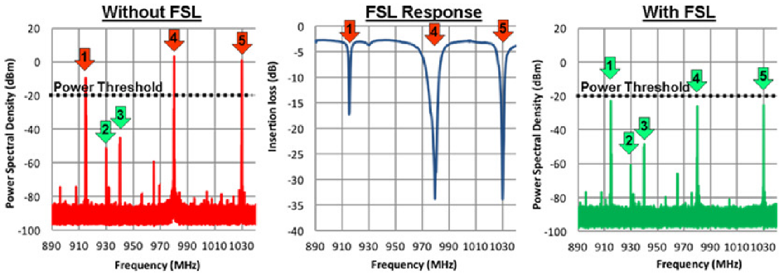
AMSIC Research Lab
Background: FSL-Assisted RF Front-End
RF front-end circuits process wireless signals before digital processing
Growing RF interference degrades receiver sensitivity and signal quality
Frequency Selective Limiter (FSL) tuning maximizes interference rejection and receiver performance
Manual tuning => Automated calibration
Gao et al., Analog Integr. Circuits Signal Process., 2025
Gillette et al., "Ferrite-Based Reflective-Type Frequency Selective Limiters," IMWS-AMP, 2018
Interference Signal Power Monitoring within Front-End Circuits of Wireless Receivers
Slide 04 / 14 - Northeastern University Young Scholars Program 2026 - July 30, 2026
Notes:
RF front-end circuits process wireless signals before digital processing.
Growing RF interference degrades receiver sensitivity and signal quality
FSLs selectively suppress interference while preserving desired signals.
Precise FSL tuning maximizes interference rejection and receiver performance.
Automated calibration replaces manual tuning with faster, more accurate optimization.
MAKE SURE TO TALK ABOUT THE POINT OF THE PROJECT HERE

Slide 5
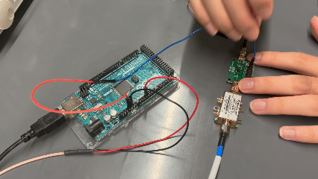
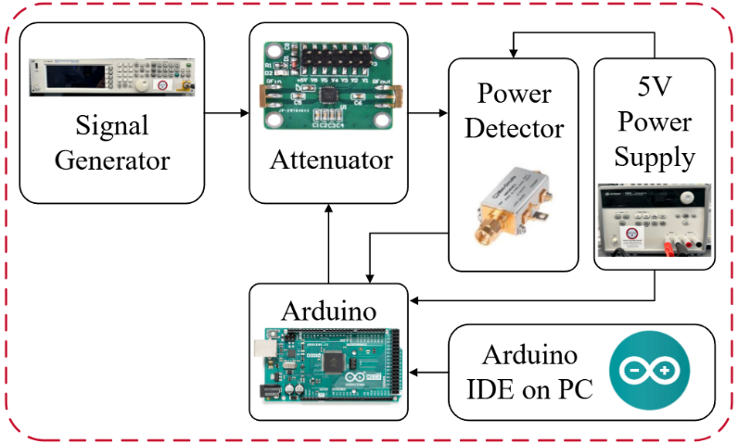
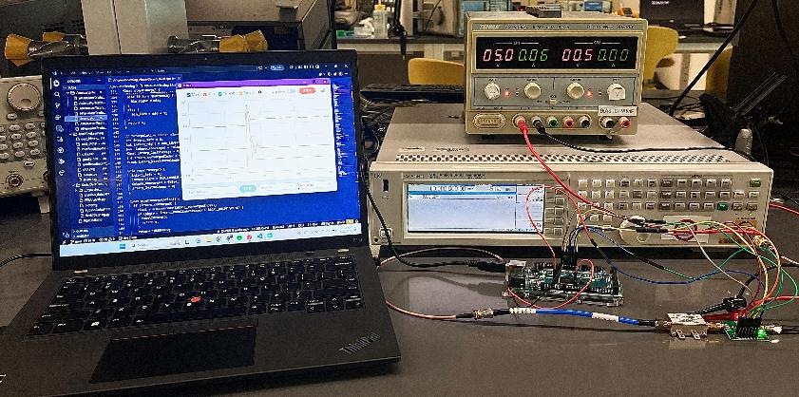
AMSIC Research Lab
Experimental Setup
Arduino IDE
& Code
Power Supply
Function Generator
Attenuator
Arduino
Power Detector
Interference Signal Power Monitoring within Front-End Circuits of Wireless Receivers
Slide 05 / 14 - Northeastern University Young Scholars Program 2026 - July 30, 2026

Slide 6
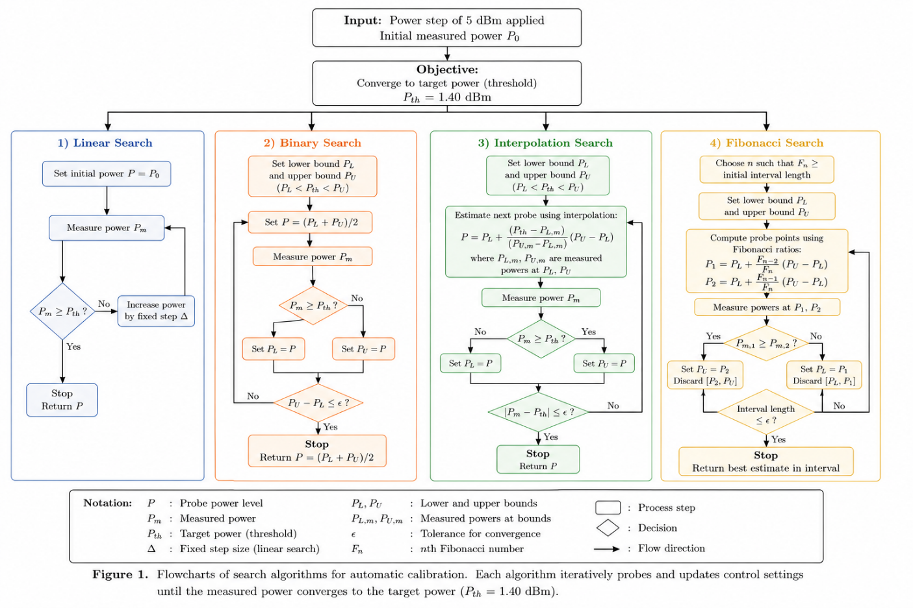
AMSIC Research Lab
Methodology
Interference Signal Power Monitoring within Front-End Circuits of Wireless Receivers
Slide 06 / 14 - Northeastern University Young Scholars Program 2026 - July 30, 2026

Slide 7
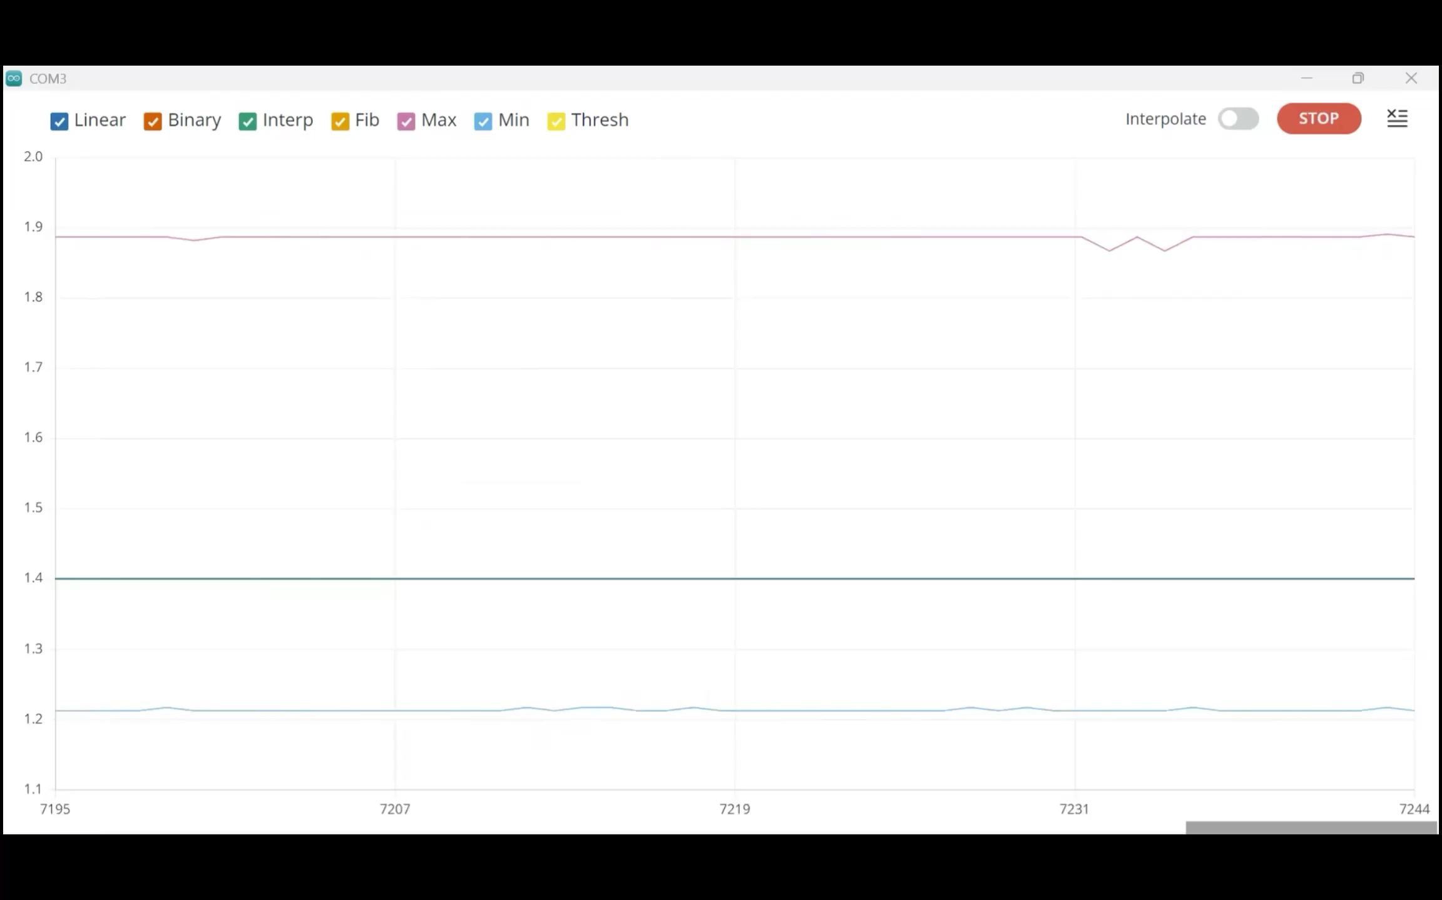
AMSIC Research Lab
Search algorithm responses to input power changes during measurements with the power detector
Interference Signal Power Monitoring within Front-End Circuits of Wireless Receivers
Slide 07 / 14 - Northeastern University Young Scholars Program 2026 - July 30, 2026

Slide 8
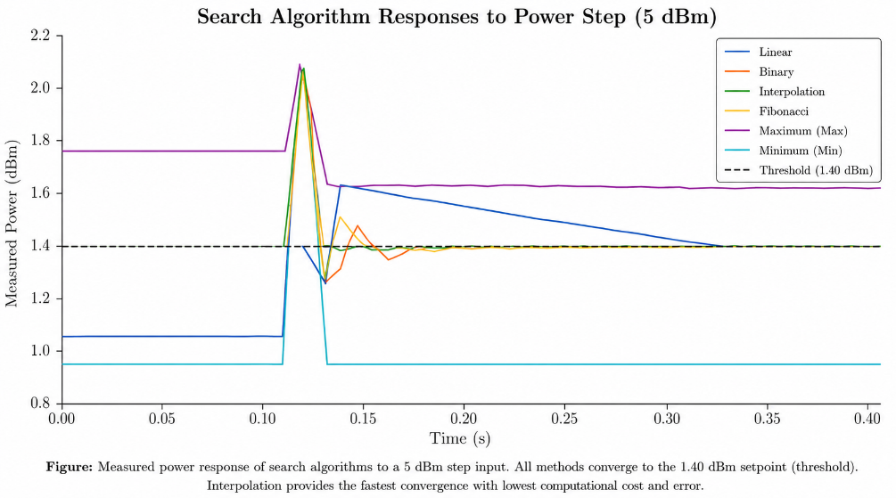
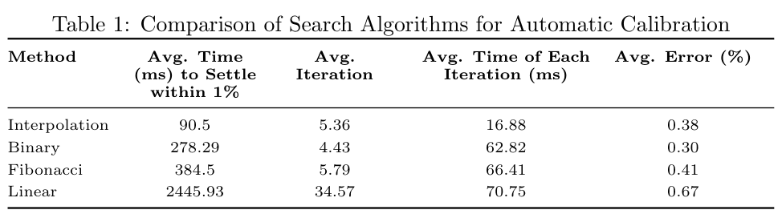
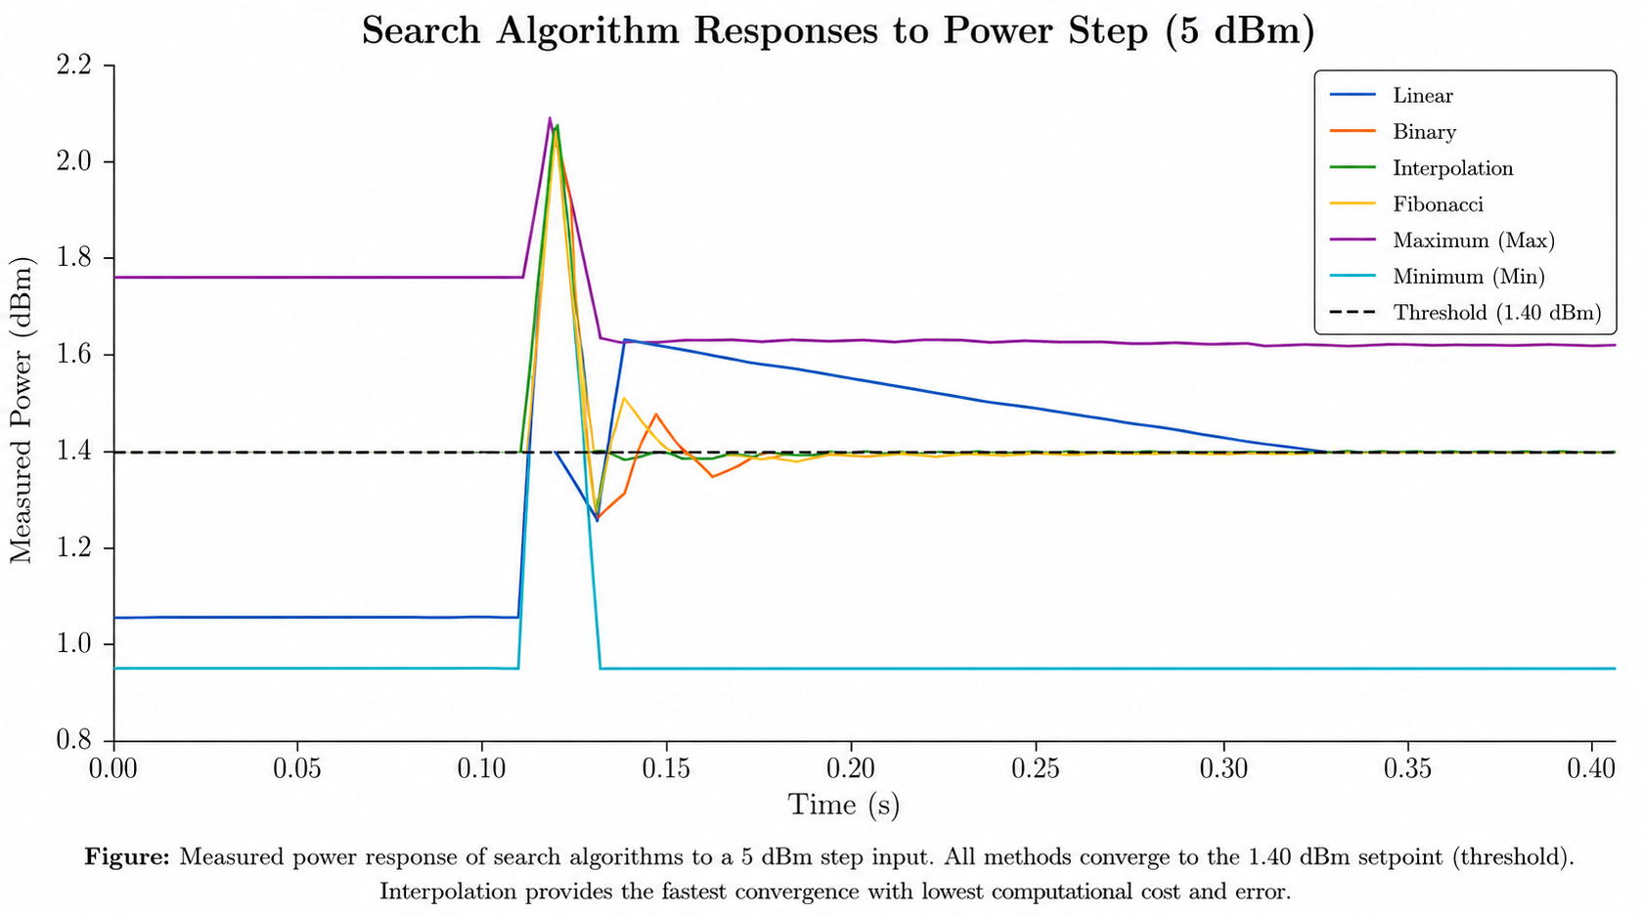
AMSIC Research Lab
Search Algorithm Responses Analysis
BEST OVERALL
Interpolation Search
90.5 ms
Average Settling Time
0.38% Average Error
27x
Faster Than Linear
3.1x
Faster Than Binary
Binary
vs.
Fibonacci
27.6% faster
23.5% fewer iterations
Interference Signal Power Monitoring within Front-End Circuits of Wireless Receivers
Slide 08 / 14 - Northeastern University Young Scholars Program 2026 - July 30, 2026

Slide 9
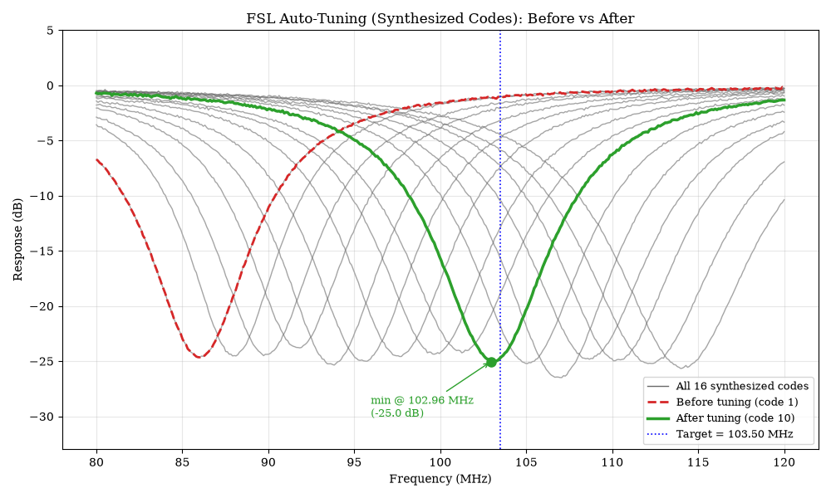
AMSIC Research Lab
FSL Auto-Tuning Model Simulations
Target frequency
Simulation model for FSL calibration algorithm to autonomously tune FSL to a desired operating frequency
16 synthesized FSL response datasets representing successive calibration states
Comparison between the initial response (Code 1, red) and optimized response (Code 10, green)
Demonstrates successful convergence at target threshold 103.5 MHz highlighted in blue
Interference Signal Power Monitoring within Front-End Circuits of Wireless Receivers
Slide 09 / 14 - Northeastern University Young Scholars Program 2026 - July 30, 2026
Notes:
Need to fix

Slide 10
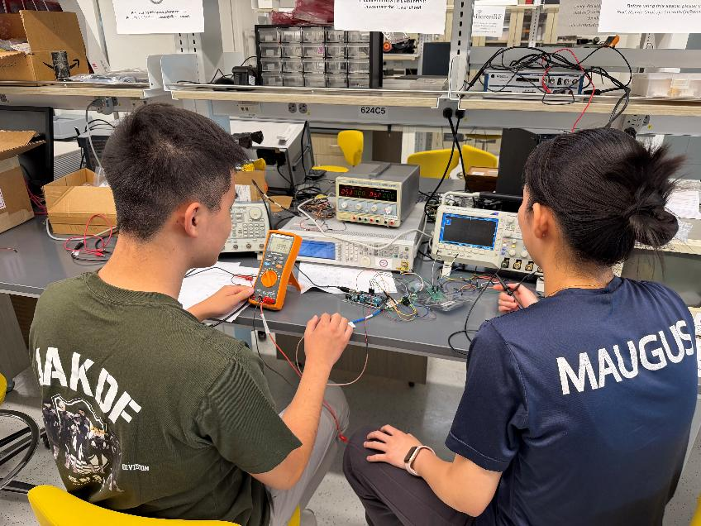
AMSIC Research Lab
Conclusions
Interpolation search provided best balance of convergence speed and calibration accuracy
Demonstrated successful automatic RF power calibration using adaptive search algorithms
Validated consistent calibration performance across multiple search algorithms
Successful validation of automatic FSL tuning feasibility
Interference Signal Power Monitoring within Front-End Circuits of Wireless Receivers
Slide 10 / 14 - Northeastern University Young Scholars Program 2026 - July 30, 2026
Notes:
Need to fix

Slide 11
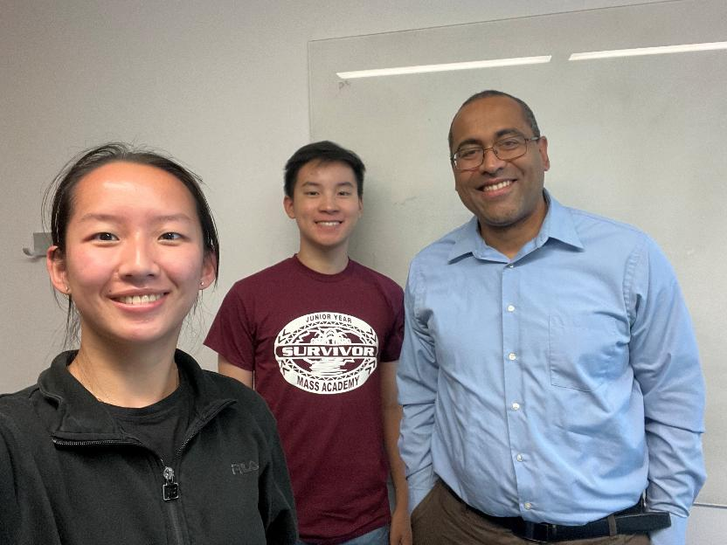
AMSIC Research Lab
Future Work
Evaluate performance across wider range of frequencies and operating conditions
Investigate machine-learning assisted calibration to further enhance speed and robustness
Implement in FSL with automatic tuning capabilities
Interference Signal Power Monitoring within Front-End Circuits of Wireless Receivers
Slide 11 / 14 - Northeastern University Young Scholars Program 2026 - July 30, 2026
Notes:
Need to fix

Slide 12





AMSIC Research Lab
Acknowledgements
Department of Electrical and Computer Engineering
Marvin Onabajo, Professor
Yunfan Gao, PhD Candidate
Minghan Liu, PhD Candidate
Thomas Gourousis, PhD Candidate
Center for STEM Education
Claire Duggan, Executive Director
Jennifer Love, Associate Director
Ahmed Othman, Kenneth Santizo Carbajal, and Frances Corcell, YSP Coordinators​
Nicolas Fuchs, Program Manager
Mary Howley, Administrative Officer
Analog and Mixed-Signal Integrated Circuit (AMSIC) Research Laboratory
This work has been funded by the National Science Foundation (NSF) under award #2229021.
Interference Signal Power Monitoring within Front-End Circuits of Wireless Receivers
Slide 12 / 14 - Northeastern University Young Scholars Program 2026 - July 30, 2026

Slide 13
AMSIC Research Lab
References
[1] Gao, Y., Hussein, H.M., Yan, M., Chen, C., Leeser, M., Cassella, C. and Onabajo, M., 2025. A design and simulation methodology for radio frequency receiver front-ends with frequency selective limiting devices. Analog Integrated Circuits and Signal Processing, 125(2), p.40.
[2] Hussein, H.M., Ibrahim, M.A., Rinaldi, M., Onabajo, M. and Cassella, C., 2021. Reflective parametric frequency selective limiters with sub-dB loss and μWatts power thresholds. IEEE Transactions on Microwave Theory and Techniques, 69(6), pp.2989-3000
[3] John O’Malley, 2011. Schaum's Outline of Basic Circuit. Analysis Revised Second Edition. McGraw-Hill Education.
[4] Razavi, B., 2021. Fundamentals of Microelectronics. John Wiley & Sons.
[5] S. M. Gillette, M. Geiler, J. D. Adam and A. L. Geiler, "Ferrite-Based Reflective-Type Frequency Selective Limiters," in Proc. IEEE MTT-S International Microwave Workshop Series on Advanced Materials and Processes for RF and THz Applications (IMWS-AMP), 2018.
Interference Signal Power Monitoring within Front-End Circuits of Wireless Receivers
Slide 13 /14 - Northeastern University Young Scholars Program 2026 - July 30, 2026
Notes:
Fix formatting

Slide 15
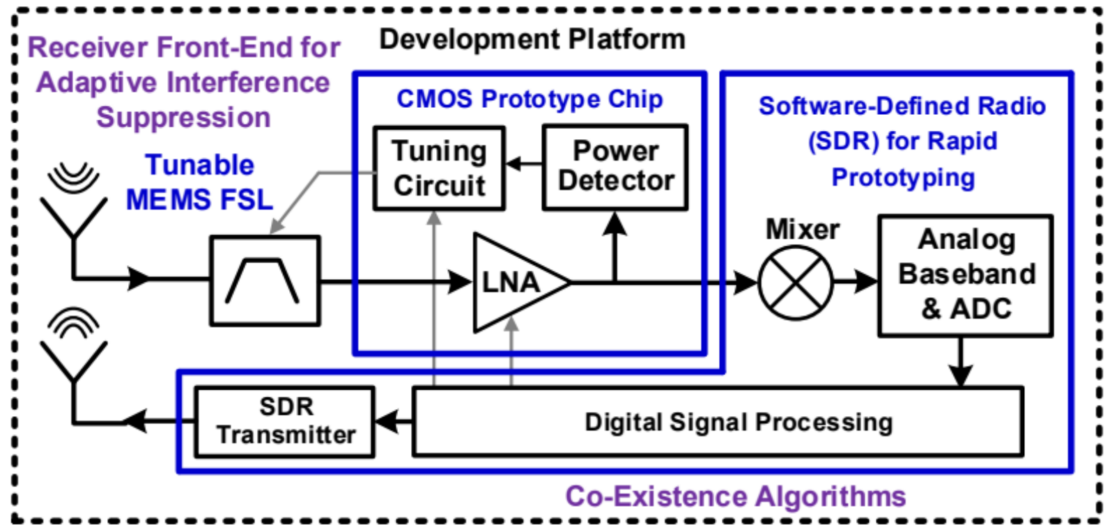
AMSIC Research Lab
Appendix: Project Overview
Interference Signal Power Monitoring within Front-End Circuits of Wireless Receivers
Slide 15 / 14 - Northeastern University Young Scholars Program 2026 - July 30, 2026

Slide 16
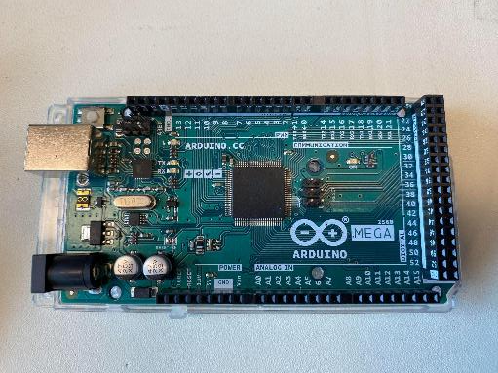
AMSIC Research Lab
Appendix: Microcontrollers
Microcontroller boards
Microcontrollers: small, specialized computers capable of performing specific tasks
Arduino microcontroller: printed circuit board with the hardware necessary to communicate with other devices (pins, oscillator, etc.)
Analog and Digital Signals
Arduino can output digital signals with the ADC
  While analog signals are continuous (they cover infinitely many values in their range), digital signals by themselves are binary (either HIGH (1) or LOW (0))
  The binary code output is used to correct the attenuation level
Arduino Mega 2560
Interference Signal Power Monitoring within Front-End Circuits of Wireless Receivers
Slide 16 / 14 - Northeastern University Young Scholars Program 2026 - July 30, 2026

Slide 17
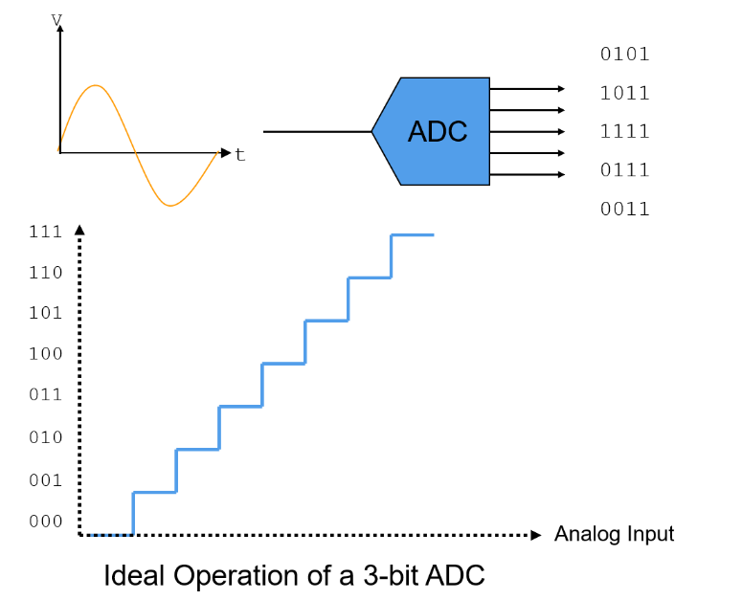
AMSIC Research Lab
Appendix: Analog-to-Digital Converter (ADC)
Arduino’s ADC converts an analog input voltage from 0-2.56 volts into a digital binary sequence (i.e. 000000 - 111111)
Provides 10-bit resolution
  Represents the analog input with 1024 discrete values (0-1023)
Each step in the digital value represents 2.56 / 1023.0 volts
  Approximately 2.5 millivolts
“ADC - Static Parameters.” ADC - Static Parameters - Power’s Wiki, wiki-power.com/ADC-Static_Parameters/#references-acknowledgements. Accessed 17 July 2024.
Interference Signal Power Monitoring within Front-End Circuits of Wireless Receivers
Slide 17 / 14 - Northeastern University Young Scholars Program 2026 - July 30, 2026

Slide 18
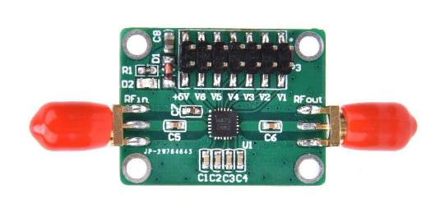
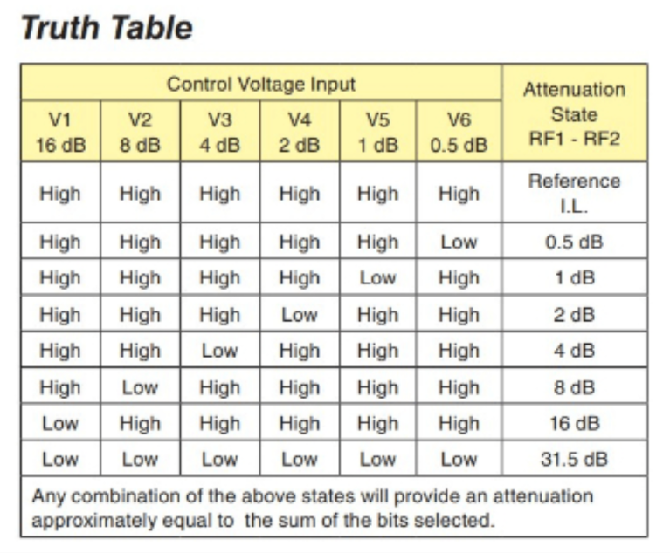
AMSIC Research Lab
Appendix: Digitally Programmable Attenuator
FSL modeled by attenuator
Power level of input interference signal is reduced
Broad frequency range: DC to 3.8 GHz
Attenuation level in dB is programmable via 6-bit digital code
  High (5V) - 1 (binary) - No attenuation from the pin
  Low (0V) - 0 (binary) - Attenuation
  Sum of the pins with a Low input = attenuation level Example; 001010 → 26.5
Interference Signal Power Monitoring within Front-End Circuits of Wireless Receivers
Slide 18 /14 - Northeastern University Young Scholars Program 2026 - July 30, 2026

